Slide 1

GELATO Update 1/26/24
Liam Sherman
Notes:
40+ attendees from Labs (typically 2 per Lab) , ESnet (typically 5-10), and invited vendor technical folks (Bro – Security, Cisco & Aruba – wireless, Amazon – cloud) to provide input on the major topics for the meeting

Slide 2
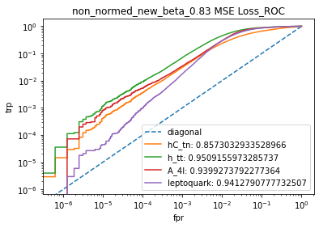
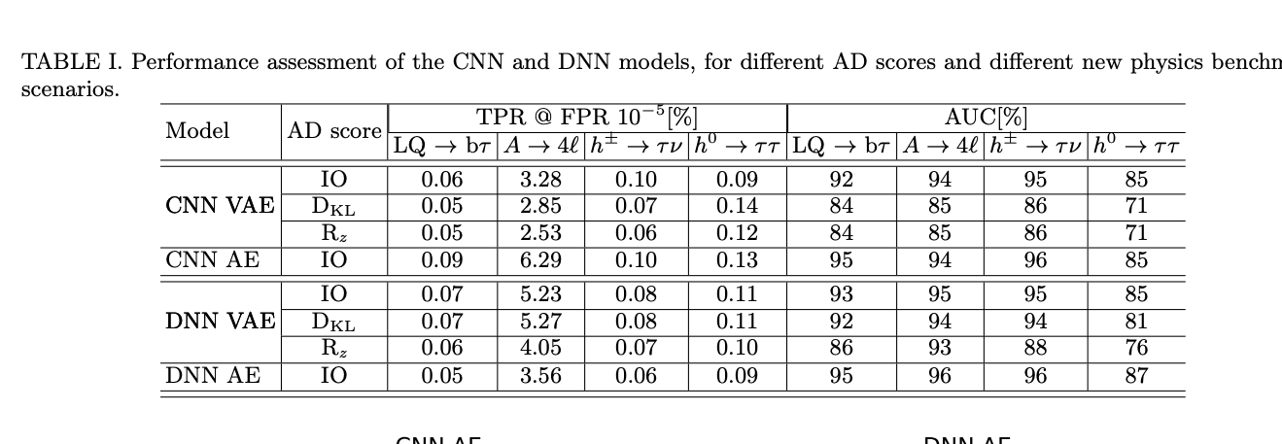
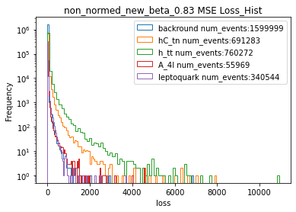
Keras VAE Functional
Model is now trained on unnormalized dataset with only one component of loss used as AD score
VAE now performs in line with 40MHZ paper for MSE loss as AD score
Notes:
Plasma wakefield acceleration has a 10TW laser

Slide 3
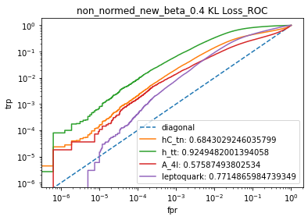

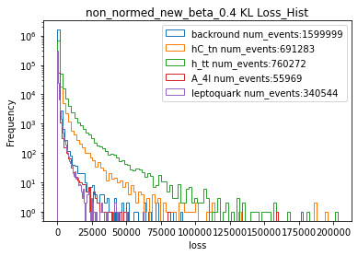

Current Results
Testing with other more useful anomaly scores has shown some issues with the model
The KL AD score results are lower than the 40MHZ paper’s, so that is the avenue of improvement I am going toward
Notes:
Plasma wakefield acceleration has a 10TW laser

Slide 4

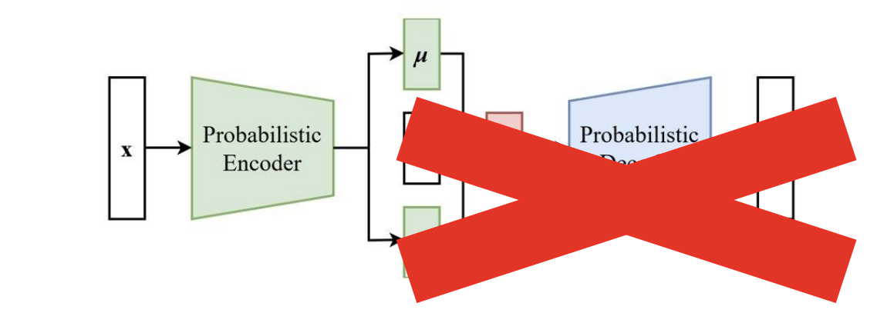

Current Results
I also implemented the ability to test the ‘clipped KL’ AD score that CMS uses
This score was very close to the normal KL score, though this may be an effect of the underlying model issue at the moment
Notes:
Plasma wakefield acceleration has a 10TW laser

