Slide 1

GELATO Update 1/19/24
Liam Sherman
Notes:
40+ attendees from Labs (typically 2 per Lab) , ESnet (typically 5-10), and invited vendor technical folks (Bro – Security, Cisco & Aruba – wireless, Amazon – cloud) to provide input on the major topics for the meeting

Slide 2
Keras VAE Functional
Tested on 40MHZ dataset
Loss function is MSE + beta*KL divergence
Still working out some issues, can’t currently recreate 40MHZ paper results
Notes:
Plasma wakefield acceleration has a 10TW laser

Slide 3
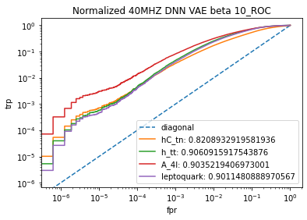
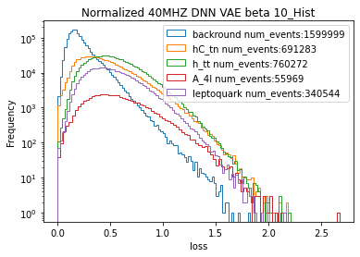
Current Results
Model Structure 57-32-16-(8,8)-16-32-57
Beta = 10
Paper and Max got better results with smaller latent space, so I’m still tinkering
Notes:
Plasma wakefield acceleration has a 10TW laser

