Slide 1
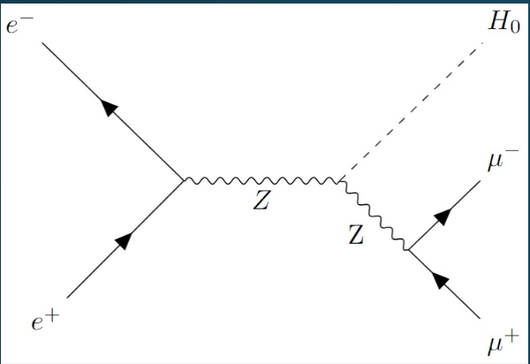
SSI 2024 Project
Resolution at Future Colliders

Slide 2
The Problem: Part 1

Slide 3
The Problem: Part 1
Assume an electron-positron collider:
How can one measure the Higgs boson mass from the ZH process without the Higgs decay products?
What resolution on the Z decay products (muons/electrons) is needed to match the uncertainty on the Higgs mass generated by the beam energy uncertainty?

Slide 4
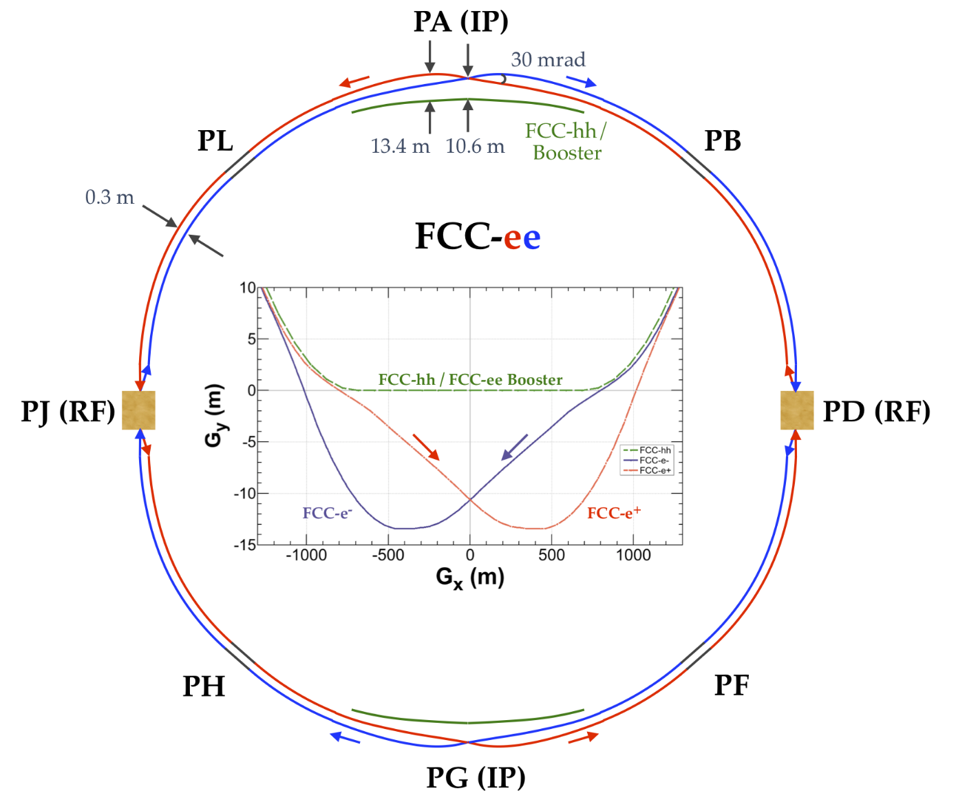
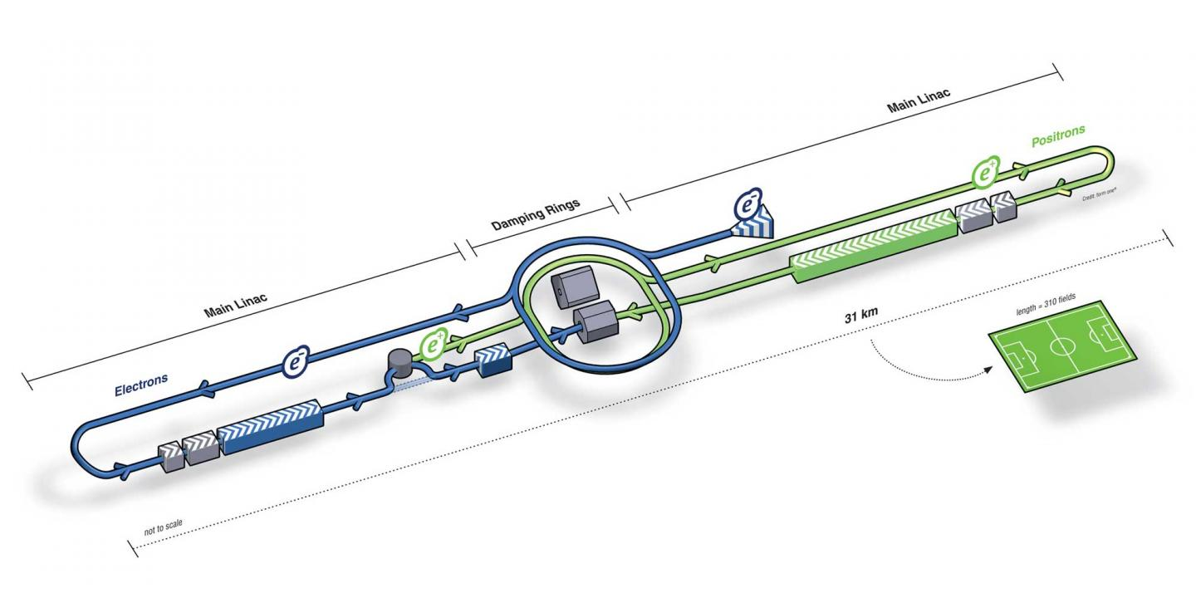
FCCee and ILC
Future Circular Collider (electron-positron)
International Linear Collider (electron-positron)

Slide 5
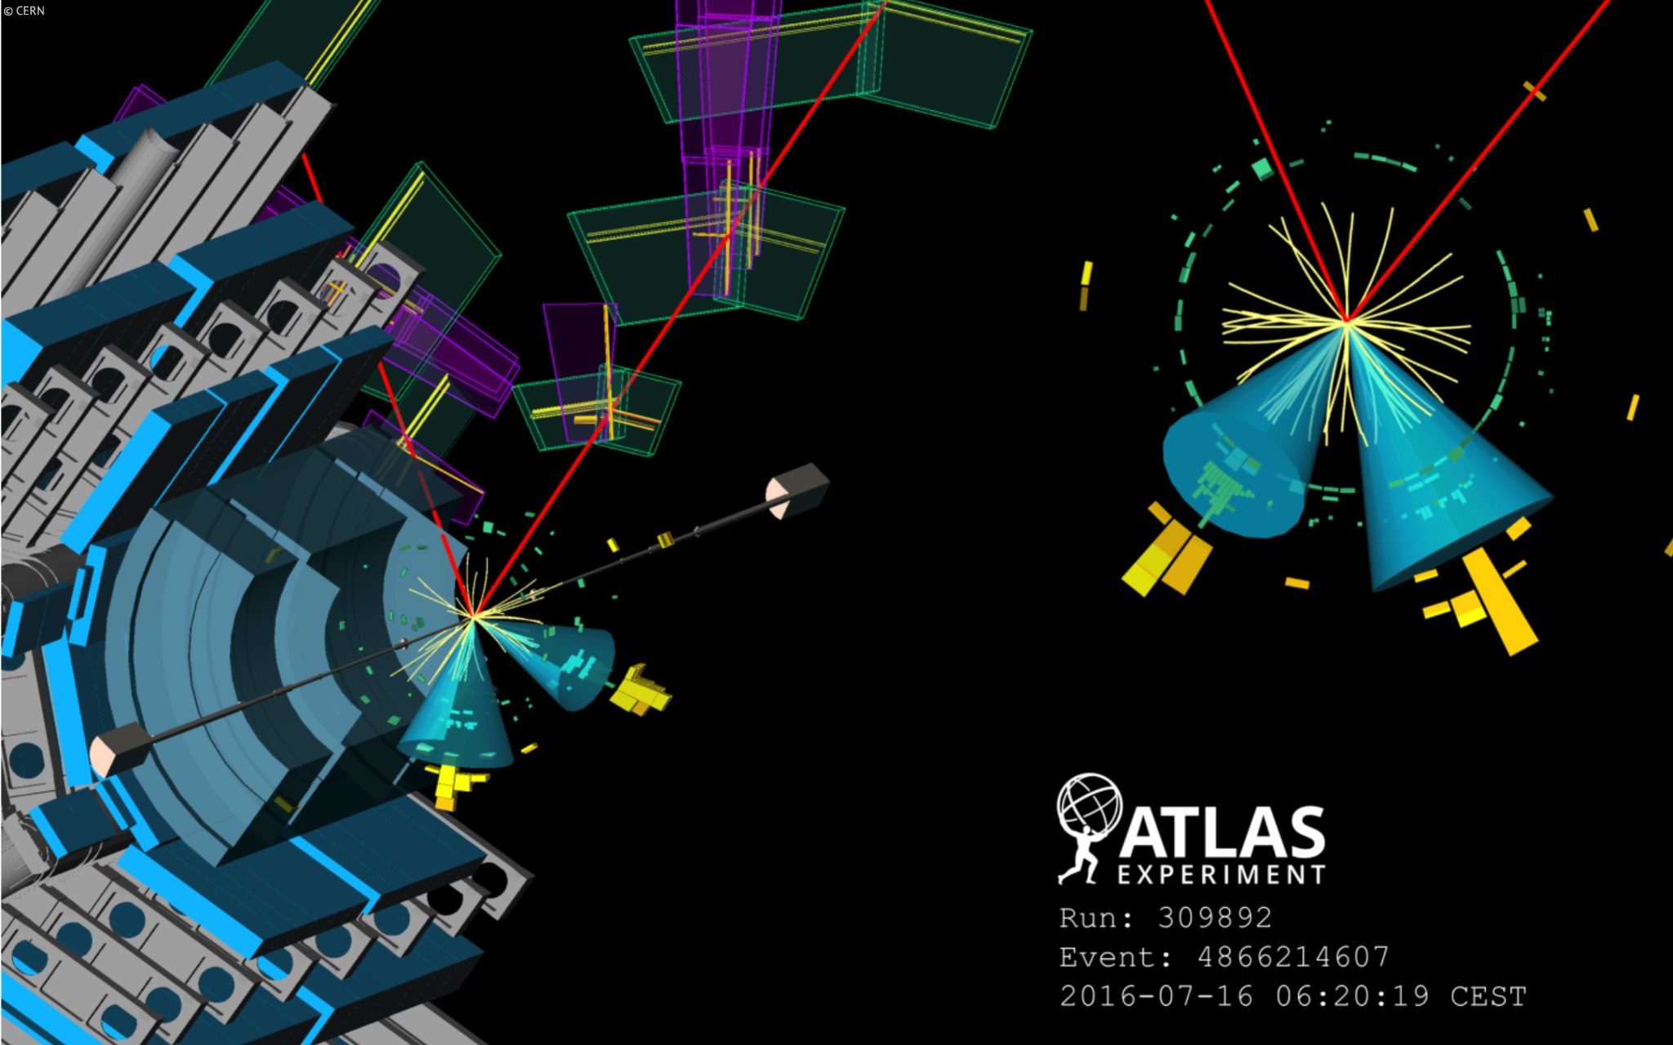
Part 1: Higgs Recoil Reconstruction
Key motivation: understanding recoil reconstruction of Higgs is useful to overcome the challenging hadronic decay channel
Figure: ATLAS display for candidate
event.

Slide 6
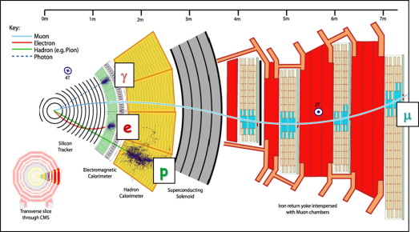
Motivating Detector Resolution
Physics Goals Drive Detector Design
Tracking is used to measure momentum
Energy is measured through calorimeters (Electromagnetic & Hadronic)

Slide 7
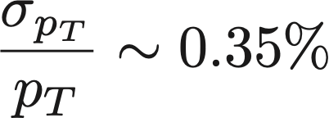
Calculating Momentum Resolution
We want sub-percent precision on Higgs mass
Assume good reconstruction of Higgs and Z, with the following parameters :
Step 5) Error propagation
Then to match beam contribution to uncertainty we need
(FCC CDR)
Matched beam energy contribution

Slide 8
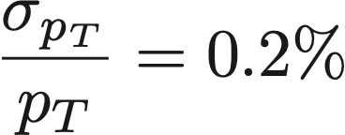
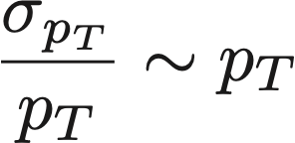
Comparison to FCC-ee design requirements
Now to compare with desired detector specs from the collaboration:
With beam energy spread of FCC wants for
We are within range!
Starting from the Lorentz force law we can also derive high energy behavior that is in agreement with expectations

Slide 9
Toy Monte Carlo Simulation
Previously presented results are from analytical error propagation
Equations are derived with taylor expansion at 1st order
Correlations are not taken into account
Additionally, we generate Toy MC events with this recipe
Sampling √s and Z-mass from Gaussian/Breit-Wigner distribution, respectively
Solve for Z-boson kinematics in laboratory frame
Solve for the kinematics of muon pairs in Z-boson rest frame, then boost them to the lab frame
Finally, smear the momentum of muons with a gaussian distribution
Then we measure the mass by fit to the mass distribution
Notes:
BES: beam energy spread

Slide 10
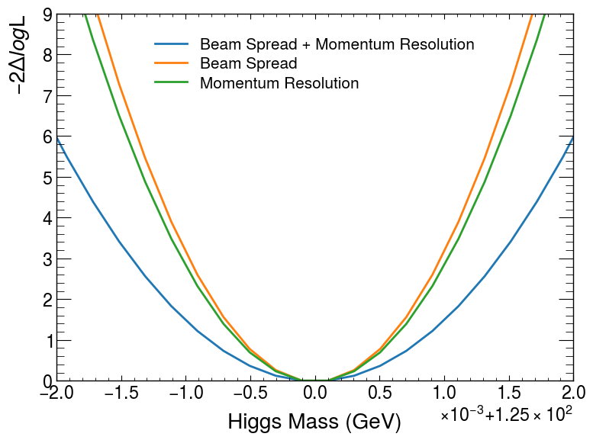
Mass measurement
Finally, we measure the Higgs mass with a maximum likelihood fit
Use Gaussian distribution as the Probability Density Function
Calculate the likelihood for observed data, and minimize the negative log likelihood (NLL)
Assume E_{CM}=250 GeV, and integrated lumi to be 5 ab⁻¹
~0.5% muon momentum resolution, and ~0.2% beam energy spread
Orange curve and green curve give similar limits at 1σ, (or say CL=68%)
Therefore, given this beam energy spread of 0.2%, a muon momentum resolution about 0.5% would have similar impact to the mass measurement
This supports our result from error propagation with analytical derivation
2σ
1σ
Notes:
For detailed introduction to this see https://cds.cern.ch/record/2285058/files/ATL-PHYS-SLIDE-2017-797.pdf

Slide 11
The Problem: Part 2

Slide 12
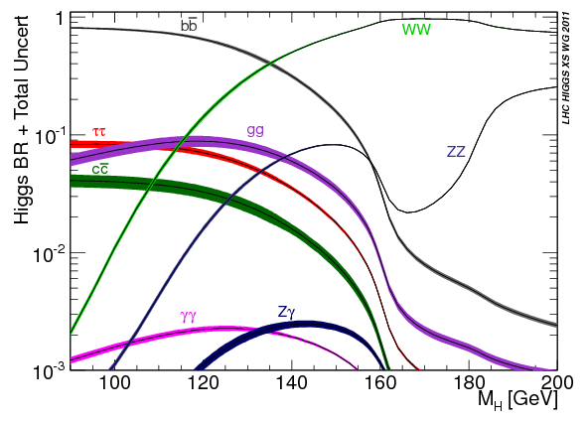
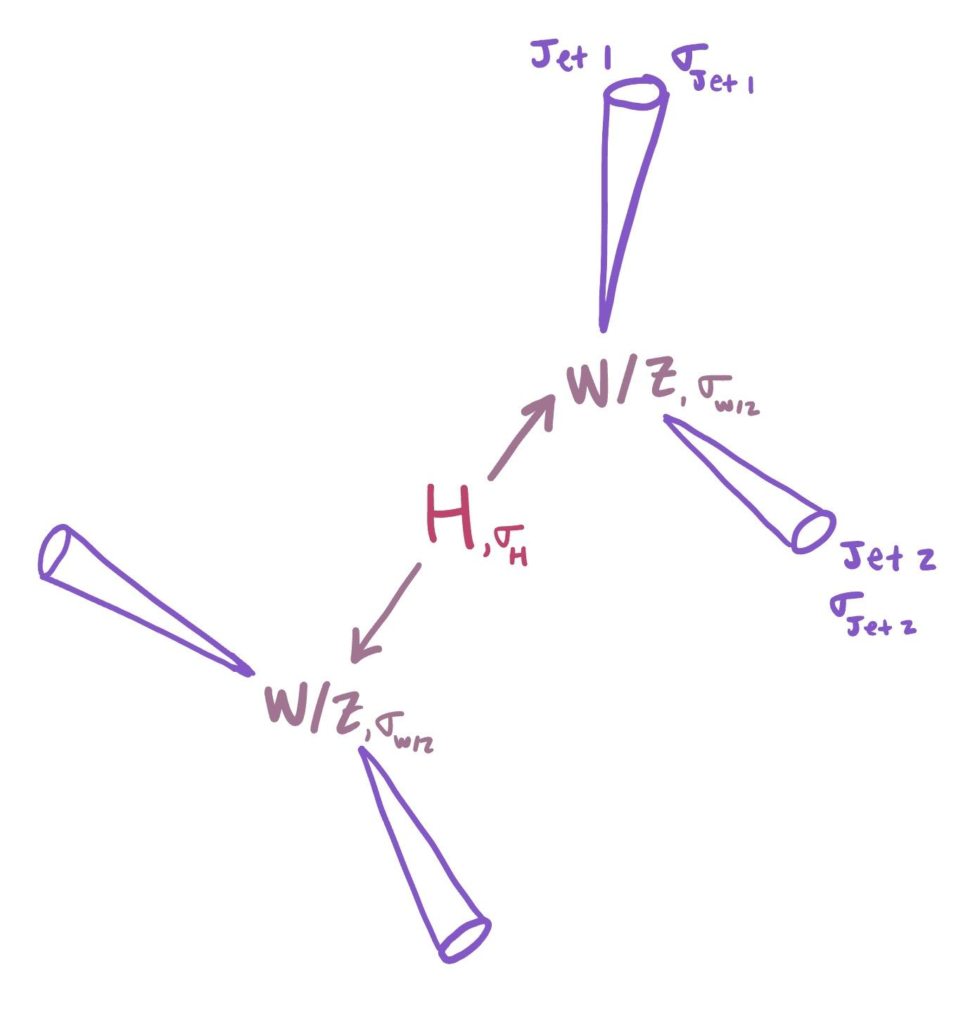
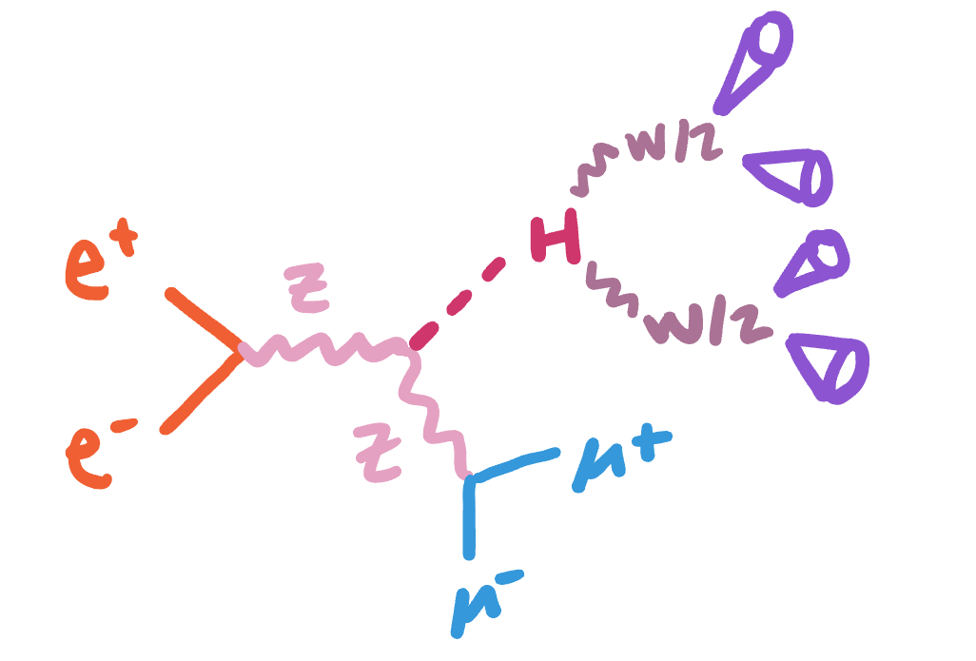
The Problem: Part 2
The Standard Model branching ratio of the Higgs boson to WW* is ~20% and the branching ratio to ZZ* is approximately an order of magnitude smaller. Consider the hadronic decays of the weak bosons (“jets”).
Events with hadronic jets can be messy…

Slide 13
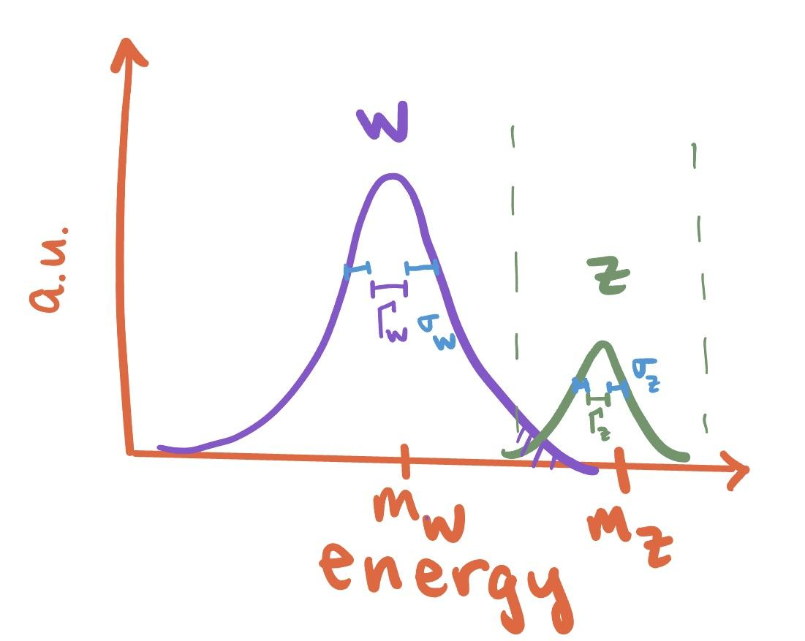
Assuming a mass window of +/- 3 sigma around the Z and ignoring all other backgrounds, what jet energy resolution is required to achieve a signal to background ratio of ten based solely on event counting? And for a ratio of 100, 1000 and 10000?

Slide 14
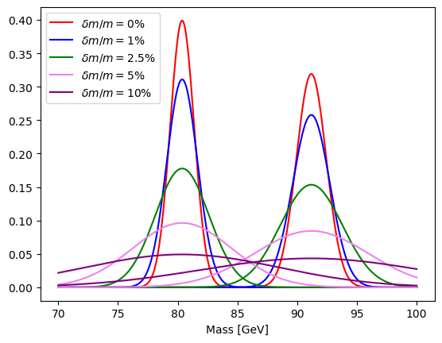
Resolution on the W and Z Boson

Slide 15
Signal and Background
Estimate contamination with Gaussian approximation
*approximated the Breit-Wigner Distributions as Gaussians
Difference in natural widths: Γ_{Z} ~2.5 Gev , Γ_{W} ~2 Gev

Slide 16
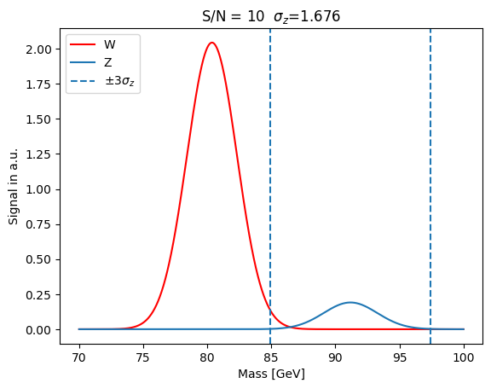
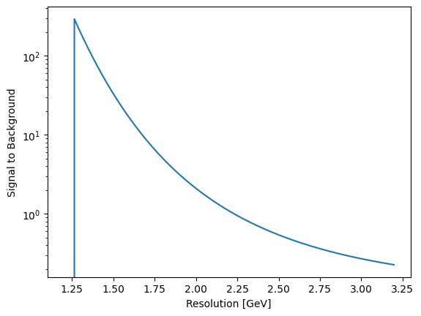
Jet Energy Resolution
Start with the resolution needed on W and Z
W and Z resolution
Resolution limit at the natural width of Z
Assumes 𝜎_{W, resolution} = 𝜎_{Z, resolution}

Slide 17
Translating W and Z resolution to jet energy resolution
Apply conservation of 4-momentum
Assume:
Energy of the jet >> mass of the jet
Error Propagation for the simplest case
The 2 jets have equal energy and therefore equal resolution

Slide 18
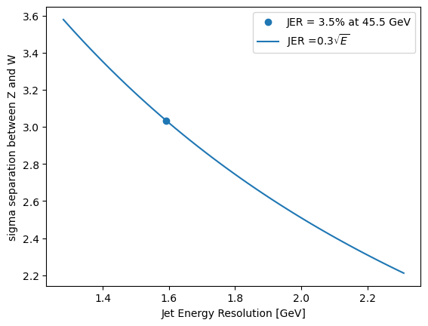
For 𝛿m/m=5% or S/N~10, jet energy resolution needed is ~3.5% for 2 jets with equal momentum (45 GeV) or ~ 25%/√E
Translates to ~3 𝜎 separation between Z and W

Slide 19
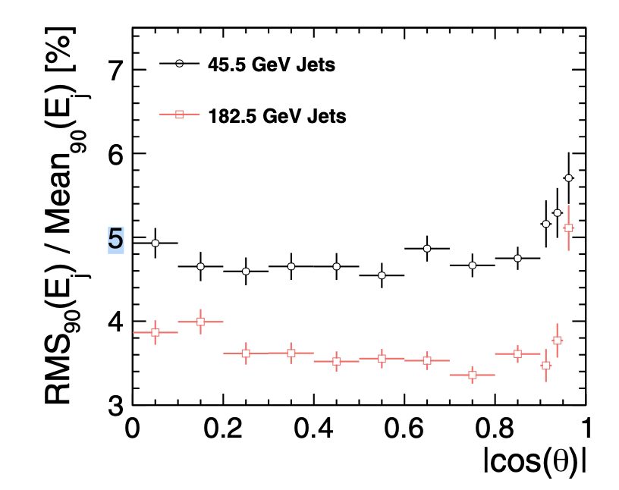
FCCee jet energy resolution quoted at ~5% at 45 GeV
Quoted as 30-40%/ √E (https://indico.cern.ch/event/1077114/attachments/2318206/3994245/DeFilippis_IDEA.pdf)
For S/N=10 jet energy resolution needed is ~3.5% for 45 GeV jets or ~ 25%/√E
Our solution is in agreement with FCC design requirements
Future Circular Collider Conceptual Design Report Volume 2

Slide 20
For H→WW* or H→ZZ*, what jet energy resolution is needed to distinguish the W and Z for a certain signal to background?
W/Z Resolution
W/Z → Jet Resolution
Compare to FCCee
Conservation of 4 momentum, error propagation
W and Z resolution
Resolution limit at the natural width of Z
Future Circular Collider Conceptual Design Report Volume 2
For S/N=10 jet energy resolution needed is ~3.5% for 2 jets with equal momentum (45 GeV)
Translates to ~3 𝜎 separation between Z and W

Slide 21
Backup slides

Slide 22
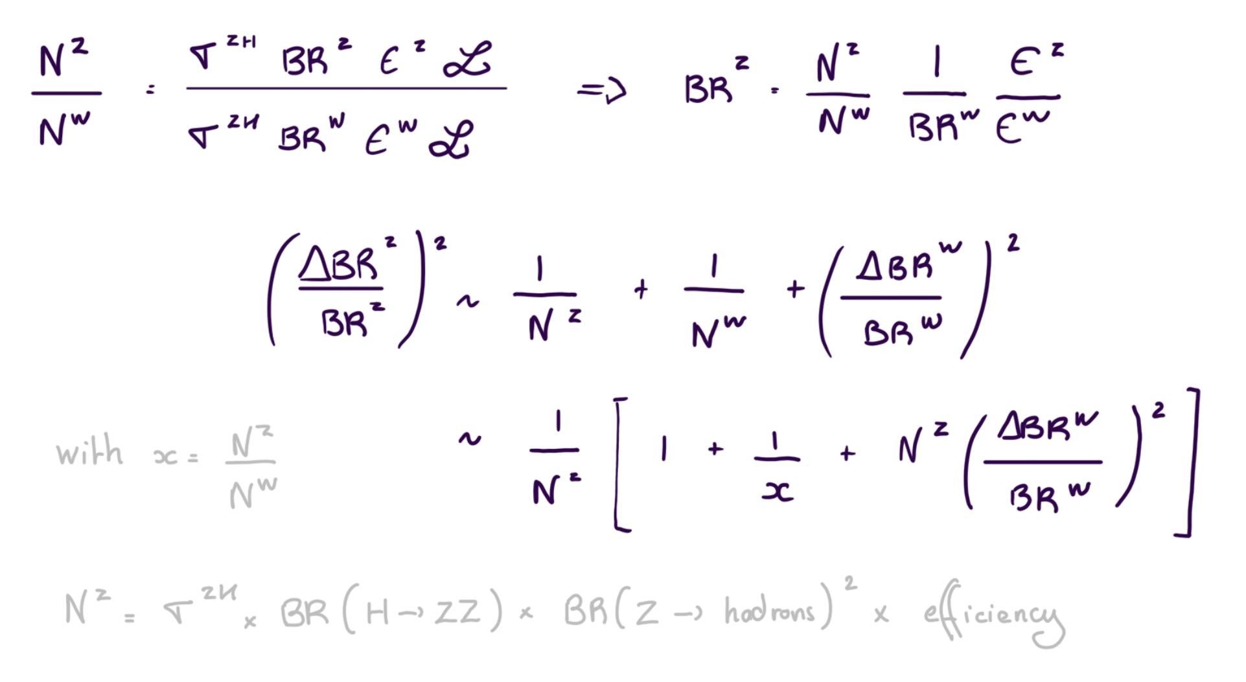
Statistical uncertainty of ZZ* branching ratio

Slide 23
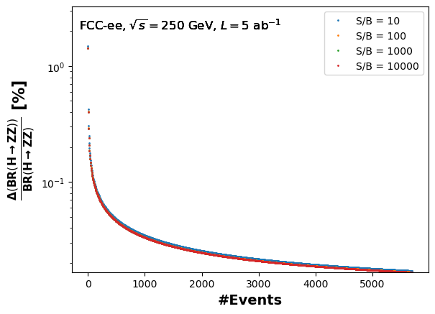
Statistical uncertainty of ZZ* branching ratio

Slide 24
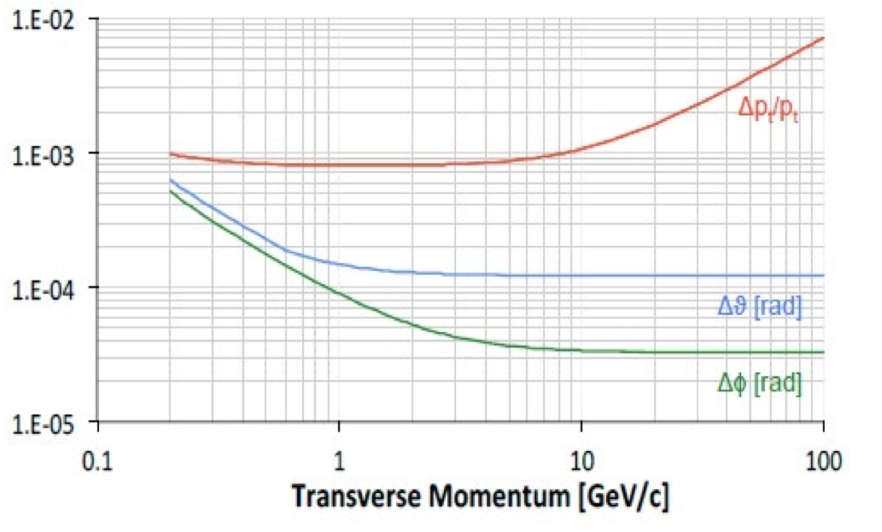
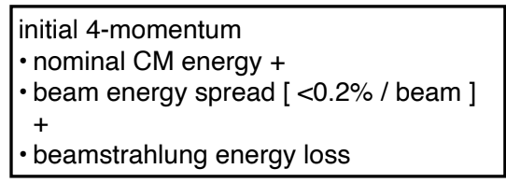
Confirmation of Results/Referenced values
Momentum res. result agrees with the IDEA Detector Resolution Slide 21
Errors on the sagitta as the curve becomes a straight line
*Notes from FCC slides

Slide 25
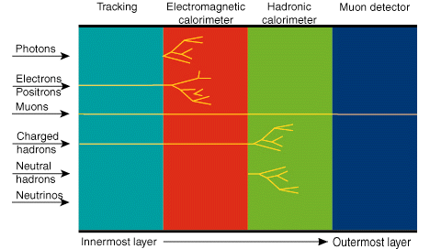
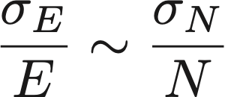
Jet Energy Resolution
Get the energy by counting charged particles, and only accounting for statistical error
*Assumes Poisson statistics

Slide 26
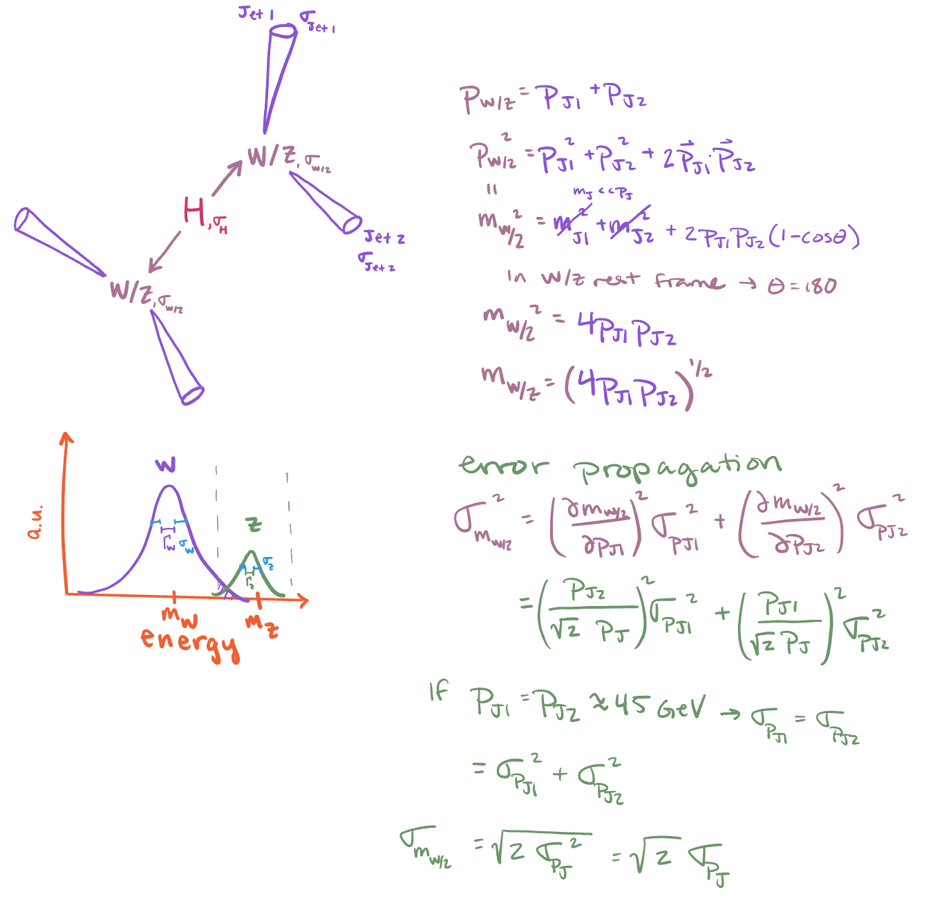
Derivations

Slide 27
Derivations
Error propagation:
Follow the prescription:

Slide 28
And what is the statistical uncertainty on the ZZ* branching ratio in each case?

Slide 29
Statistical uncertainty of ZZ* branching ratio
With FCC-ee, we can measure the absolute Branching Ratio
Therefore we need to count ee→ZH and (ee→ZH, H→ZZ*) events
Uncertainty of Branching Ratio depends their uncertainties
Specifically, for hadronic decay channels
We’ll consider H→WW process as the only background
We can estimate signal and background yield and calculate uncertainty

Slide 30
Statistical uncertainty of ZZ* branching ratio
Hadronic H→ZZ* signal yield is given by
With integrated Lumi to be 5 ab⁻¹
We expect 1 million Higgs produced in ZH mode
2.6% of the Higgs decay to ZZ* [Source: CERN Yellow Report]
70% of the on-shell Z decay hadronically [Source: PDG]
Therefore we expect 18k signal events
As for H→WW* background
We can estimate this background with Monte Carlo, whereas its normalization is constrained by an auxiliary measurement
e.g. an analysis dedicated to measure hadronic H→WW*
Therefore, given this S/B ratio, if there is an auxiliary measurement for this background, the uncertainty contribution from H→WW* is negligible
Notes:
Yellow report https://twiki.cern.ch/twiki/bin/view/LHCPhysics/CERNYellowReportPageBR

Slide 31
Statistical uncertainty of ZZ* branching ratio
N_{Data} ~ Poisson Distribution, therefore σ(N_{Data})² = N_{Data}
Ignore background modelling uncertainties, then
Finally we have
With 18k H→ZZ* hadronic signal events and 1 million ZH events

Slide 32
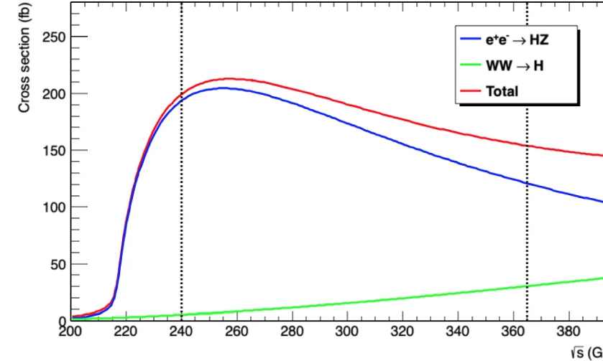
Cross-section and yield of Higgs boson
E_{CM}= 250 GeV, cross section of ZH production: 200 fb
Assume Integrated Luminosity to be 5 ab⁻¹
About 1 million Higgs boson from ZH mode
Eur. Phys. J. Plus 137, 23 (2022)

