Slide 1
FACET-II Long-term planning meeting:
E-320
Alexander Knetsch
01/10/24

Slide 2
High-level response
What are the high-level scientific goals of this experiment?
Measure non-linear Compton scattering
Measure shift in Compton as function of a₀
Measure qualitative change from discrete edges to continuum.
What will be the first high impact result/publication?
Measurement of dressed electronic mass
Transition from perturbative to non-perturbative
Lower impact publications:
Characterization of synchronization method with YAG
Laser wire measurements
What do we need to do to get from here to there?
Improve electron diagnostics
Increase a0

Slide 3
Status as of E-320 retreat in May 2023
Electron beam:
same beam parameters as Summer 2022, but smaller is better.
Laser:
2 um FWHM, 50 fs fwhm, target: a0 ~ 4
Get the goose trigger going
Open window between compressor and picnic basket. Perform RGA measurements
Get the EOS working for E320
Electron Spectrometer:
EDC is not necessary at the moment.
Beam-based alignment the spectrometer quads
Special quad settings for better E320 imaging
Improve LFOV with for better light collection
Test ePIX
Simulations:
Build a model for compton scattering to understand what to expect under ideal circumstances on the spectrometer

Slide 4
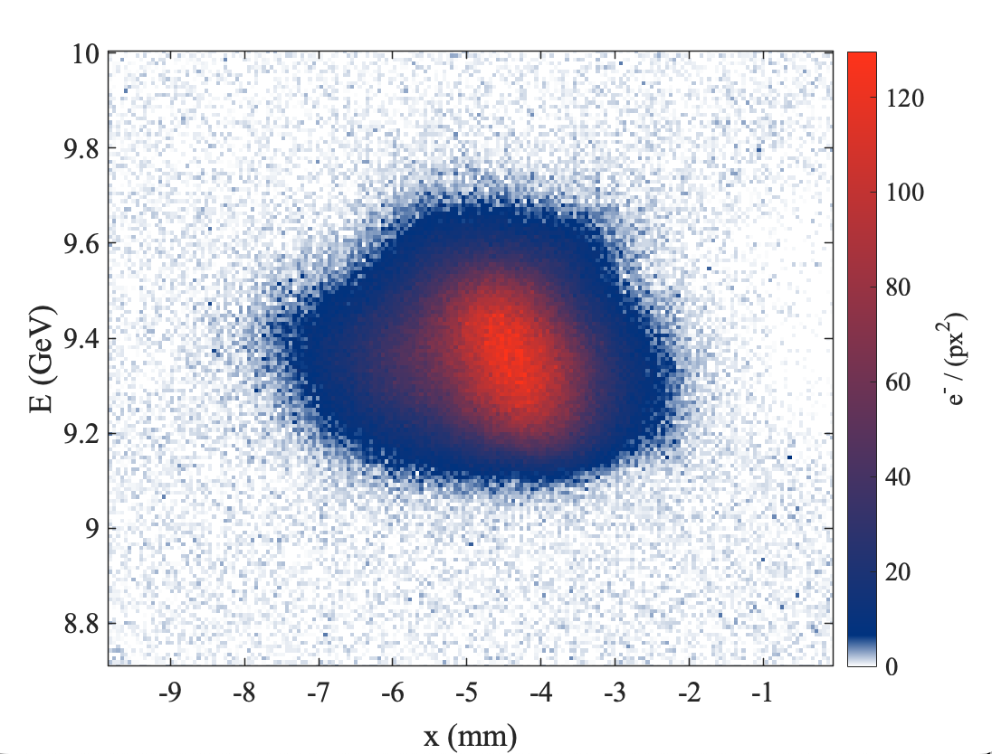
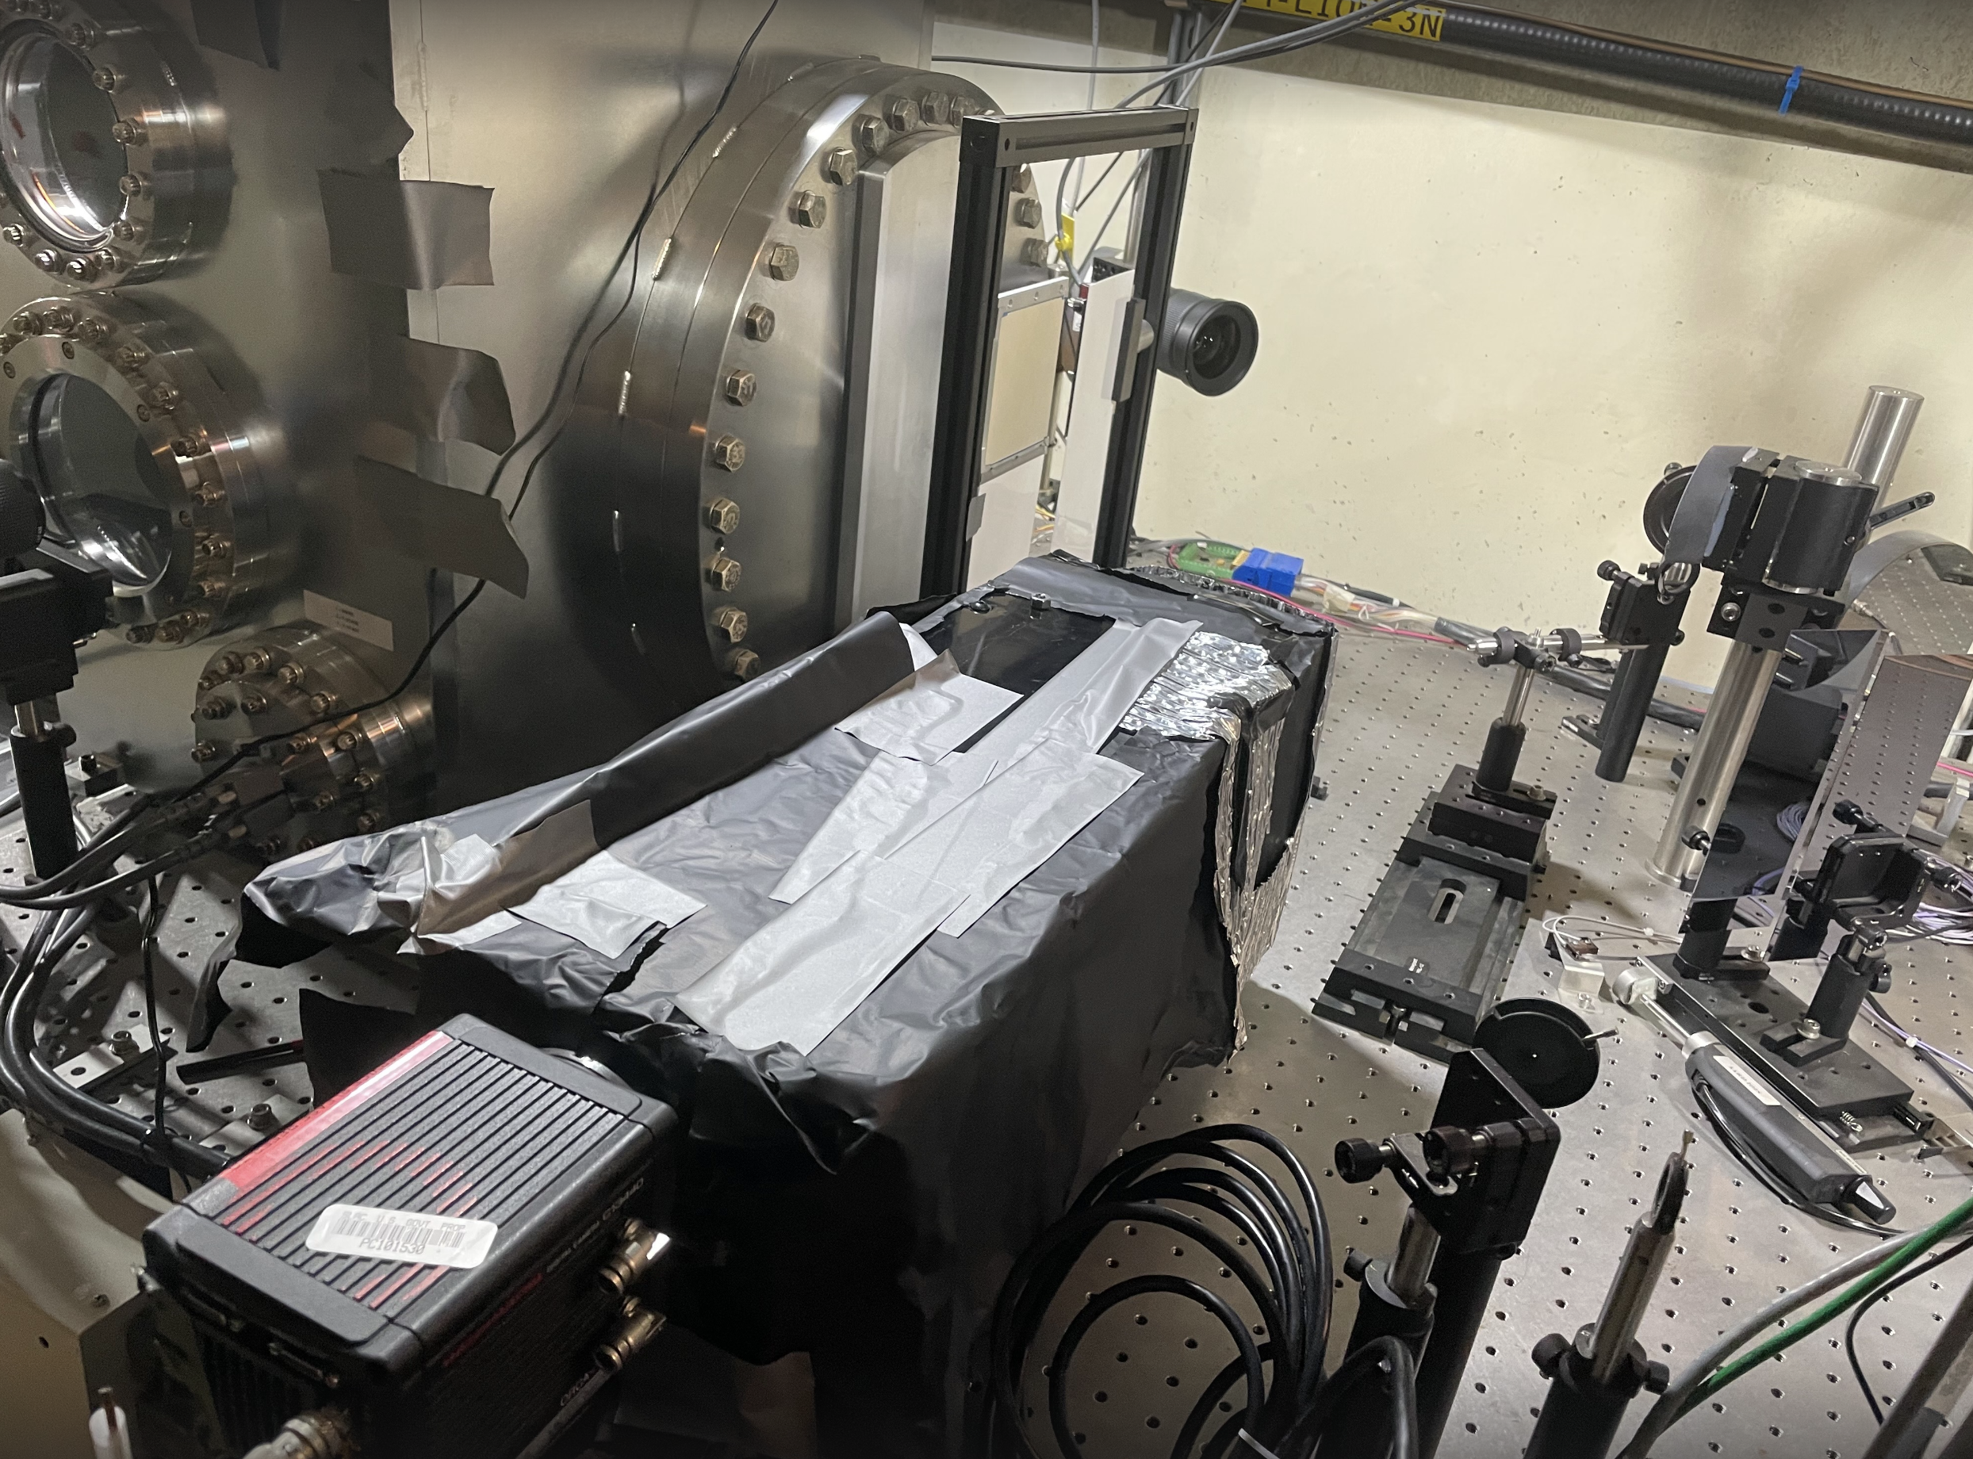
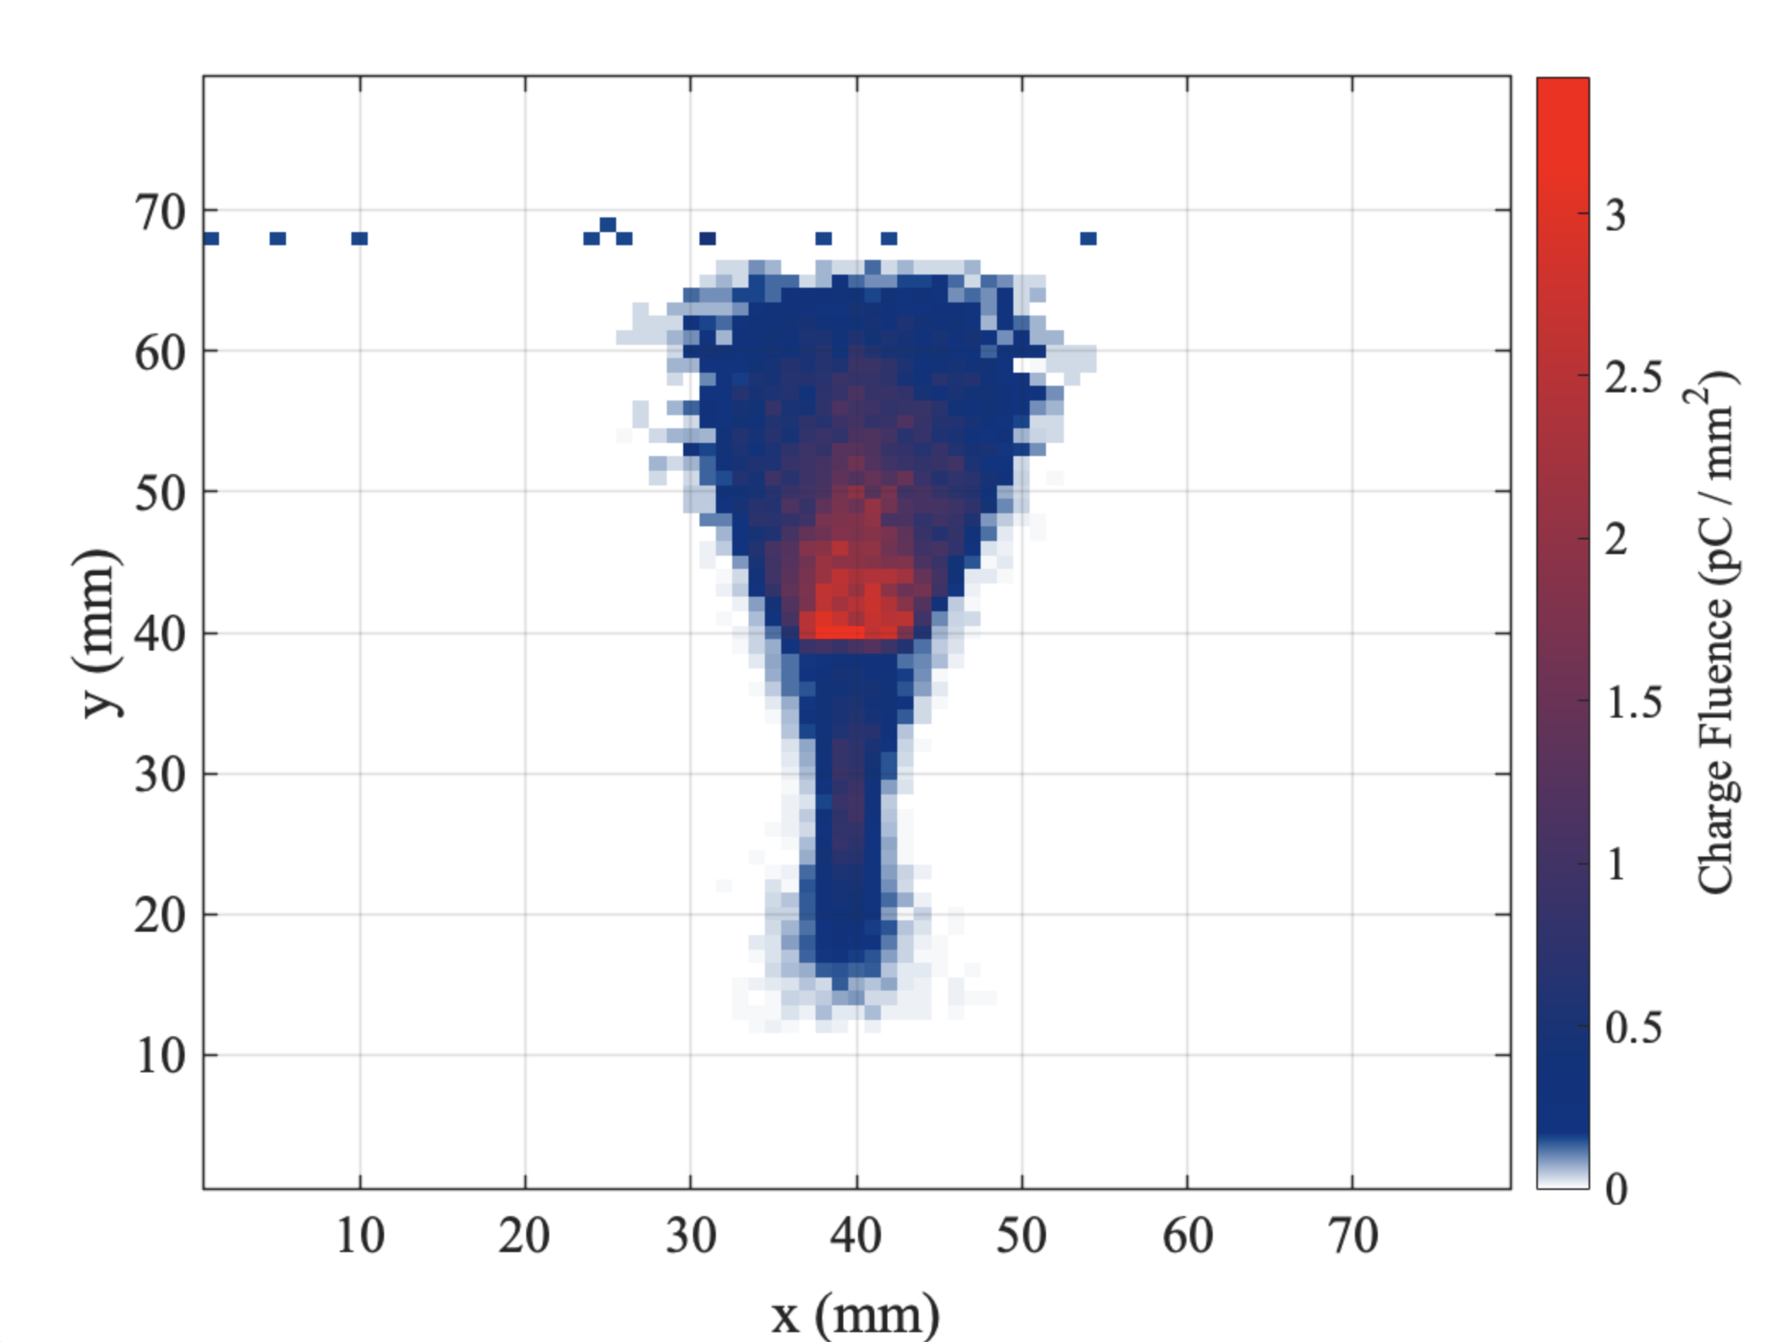
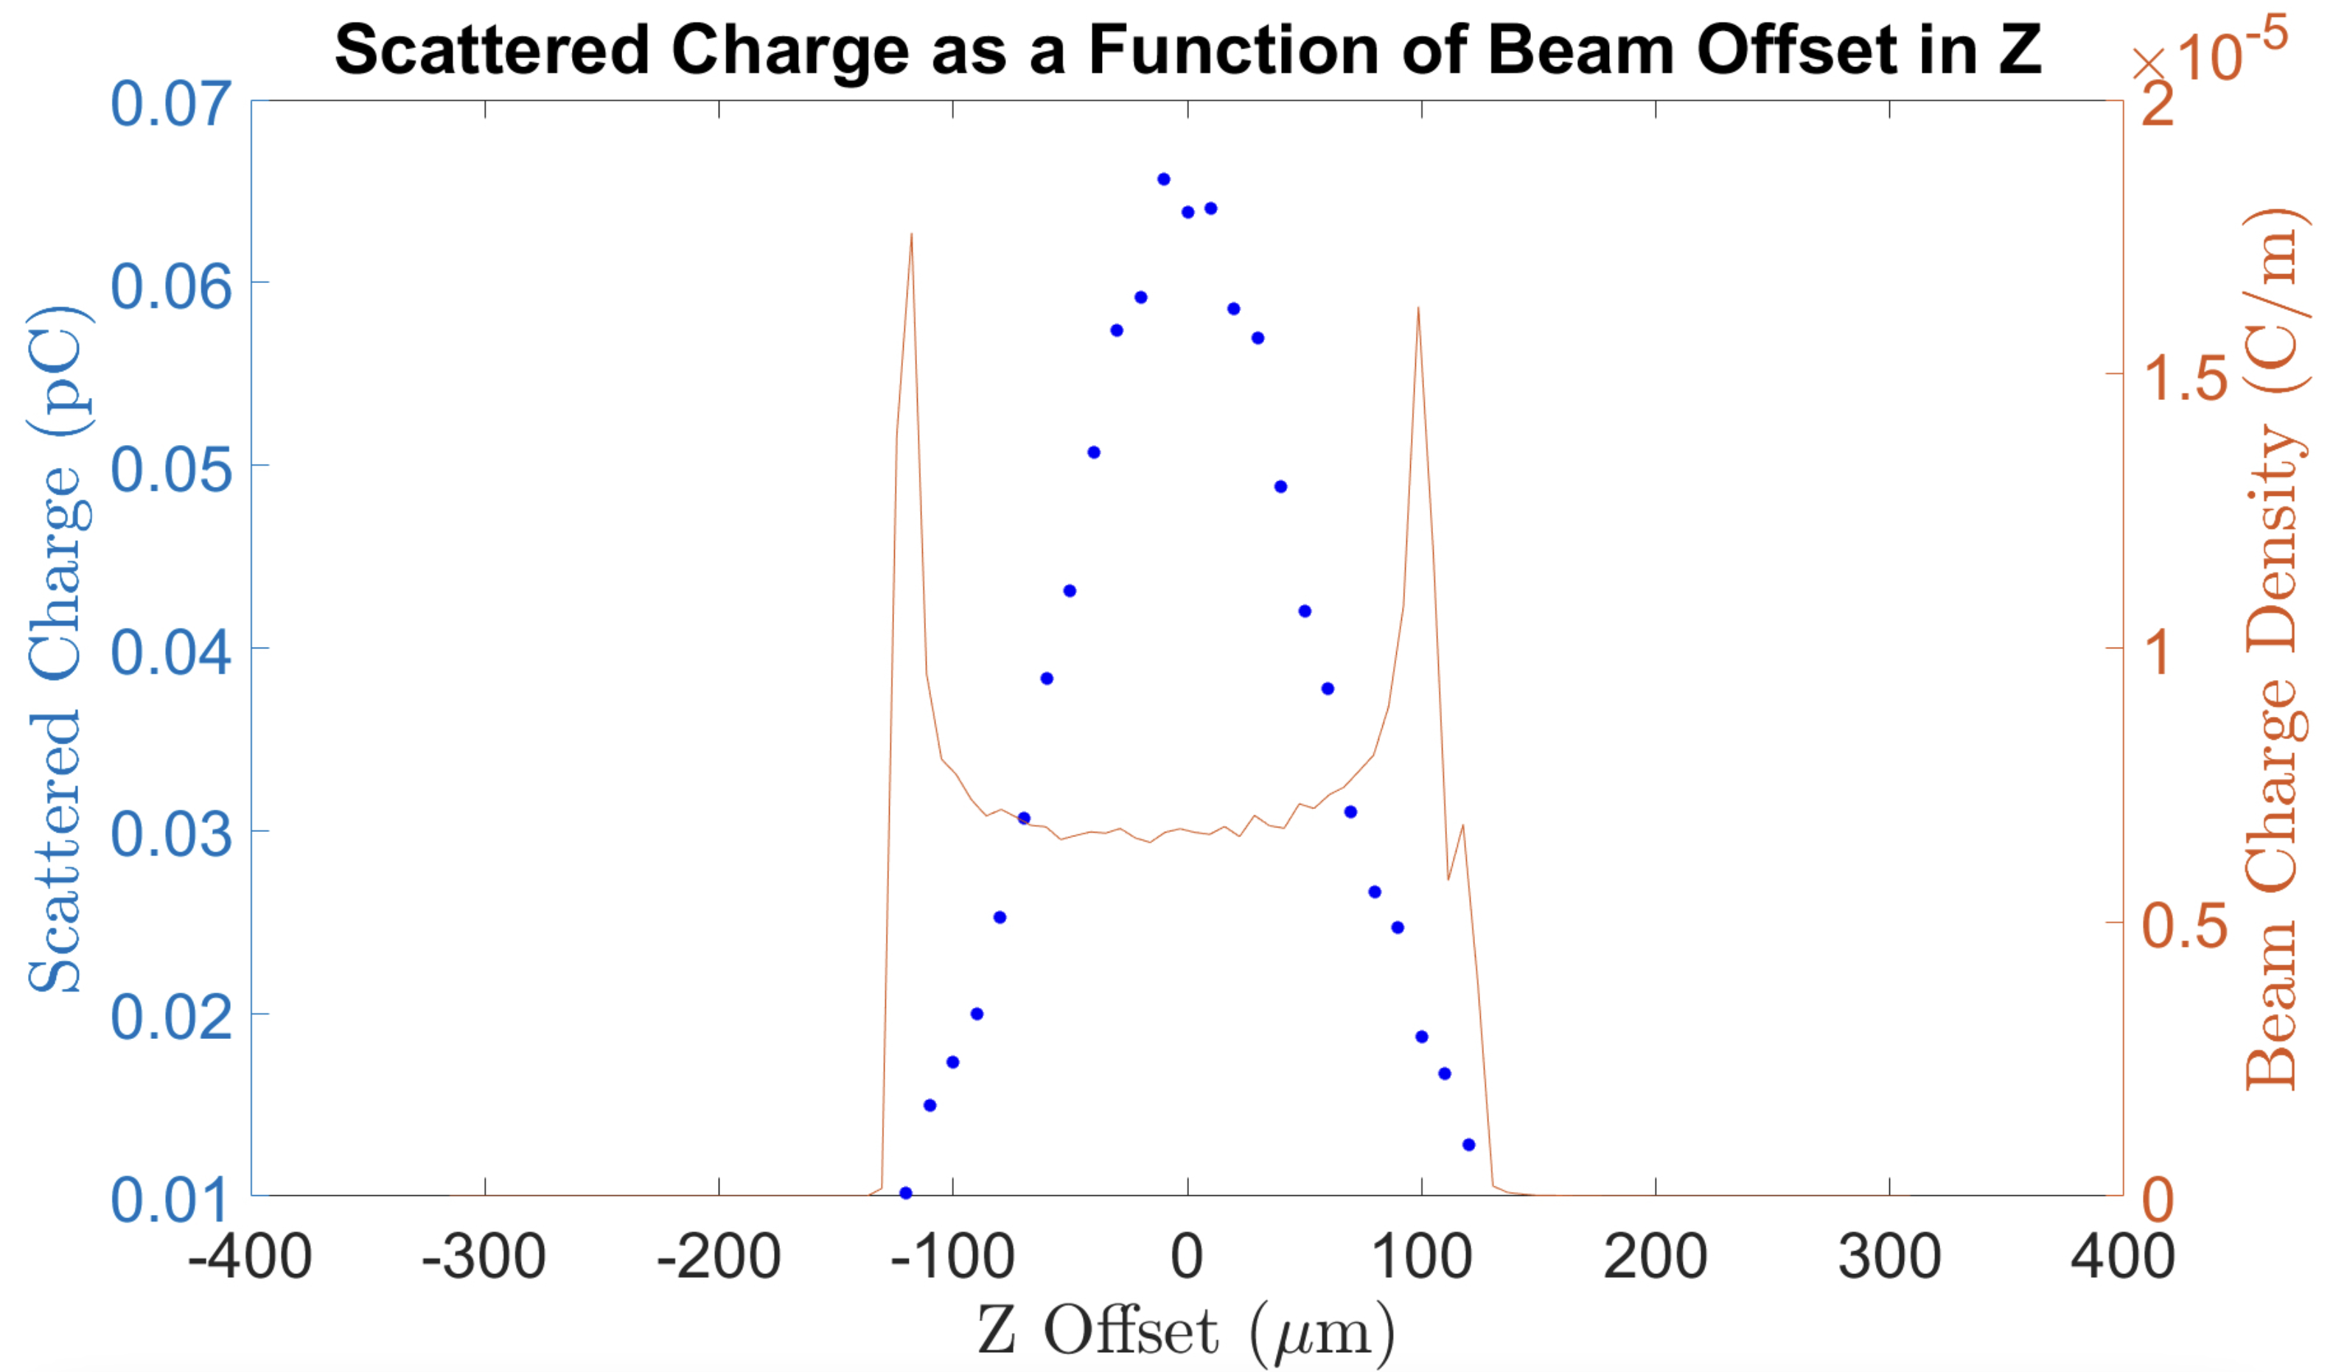
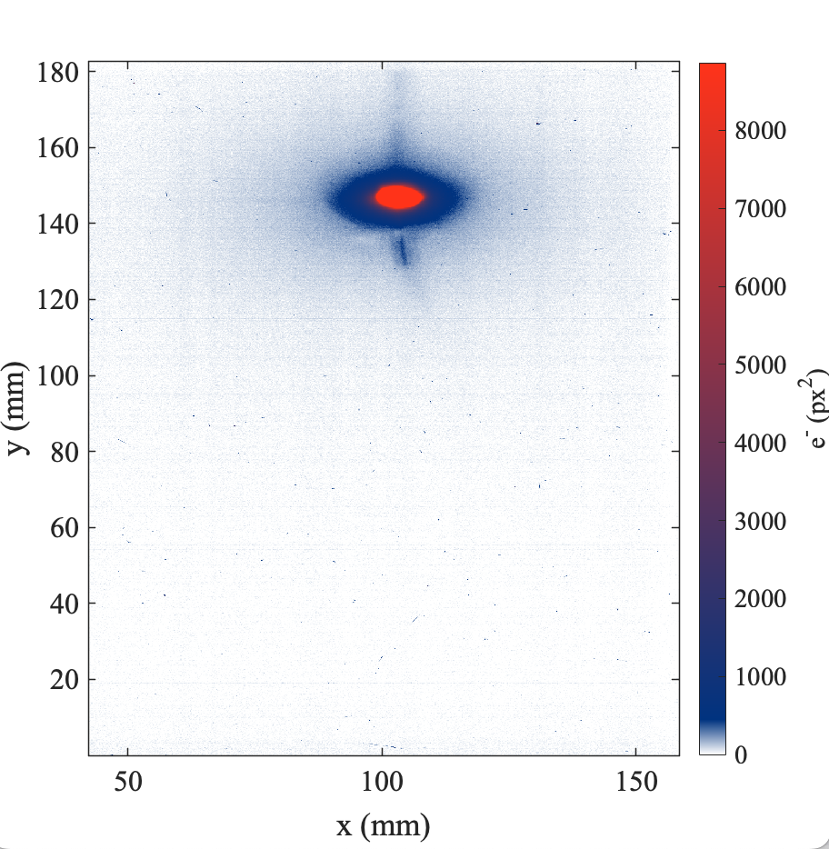
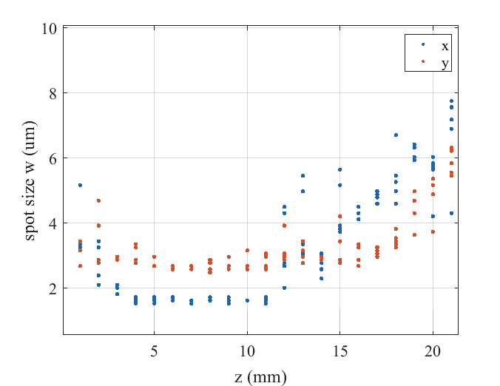
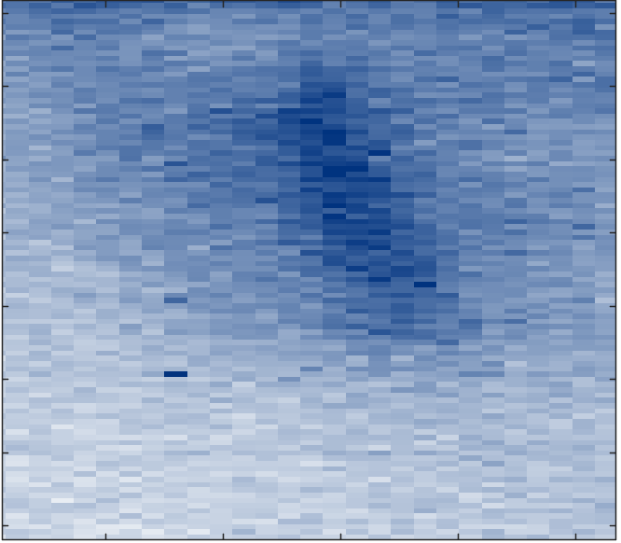
Progress in 2023
Progress from previous year (2022)
Improvement on laser wavefront
New low background LFOV diagnostic
RGA measurements done.
Start-2-end modeling developed
EOS works again and can be timed in with E320
Goose trigger en route
Specialized E-320 imaging optics calculated
Gamma-ray profile, Cherenkov detector, PDC tracker
~30 fC signal on low-background LFOV
Linear Compton scattering observed with pencil beam
Small laser spot size
Scattering simulation implemented in Lucretia

Slide 5
Encountered issues and mitigation strategies
Out of 3 beamtimes only 1 led to observed scattering !
Issues encountered last year (2023)
YAG damage
Spatial drifts in electron beam in IP
Resources/plans to address issues
Strategies to avoid YAG damage:
Use long pencil beam and beam off waist initially
Use YAG only in periphery of beam
Develop plasma-glow like synchronization
Use different references for coarse timing e.g. EOS or gas jet
Strategies to reduce drift risk:
Dispersion monitoring with BPMs
x,y drift measurement with BPMs or DTOTR similar to E332
Beam request:
First priority: Stability and repeatability
Second priority: High charge density in IP
Two configurations under discussion: Pencil beam, compressed beam

