Slide 1
E332 and E336
Progress and long-term planning
Doug Storey
January 10, 2024

Slide 2
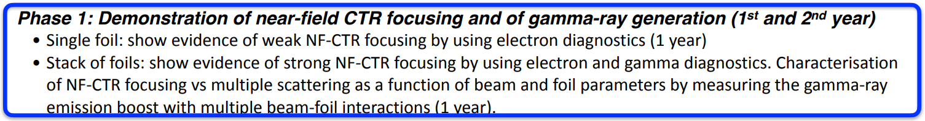
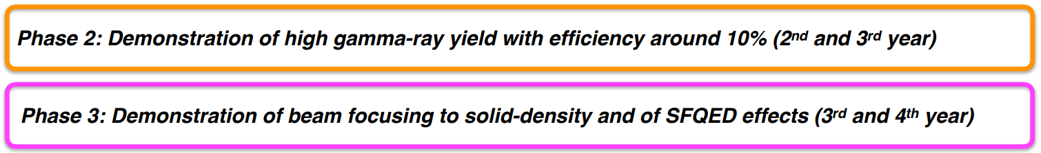
E332 High level scientific goals:
Near Field Coherent Transition Radiation Focusing in Solid targets
Made good progress towards all goals of phase 1 (summary on next slide)
First publication being prepared from data already collected: First demonstration of NF-CTR
What is left to do:
  Focused spot size data should be improved
  We have not yet measured an increase in gamma-ray emission
  E332 will be asking for ~1 shift/month as beam conditions improve
Beam intensity (current and spot size) need to improve significantly to make progress towards these next steps

Slide 3
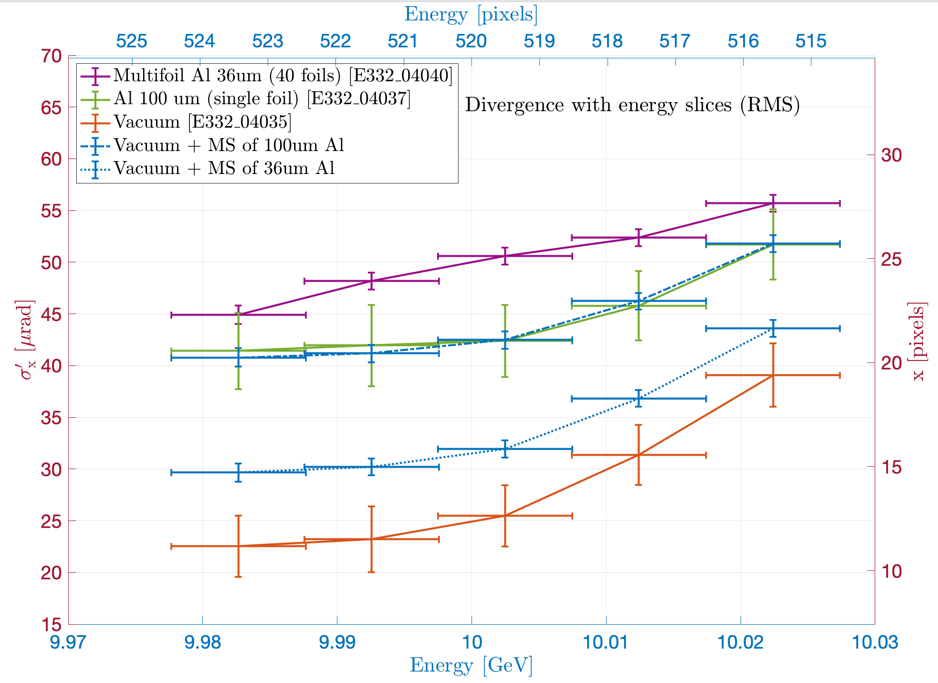
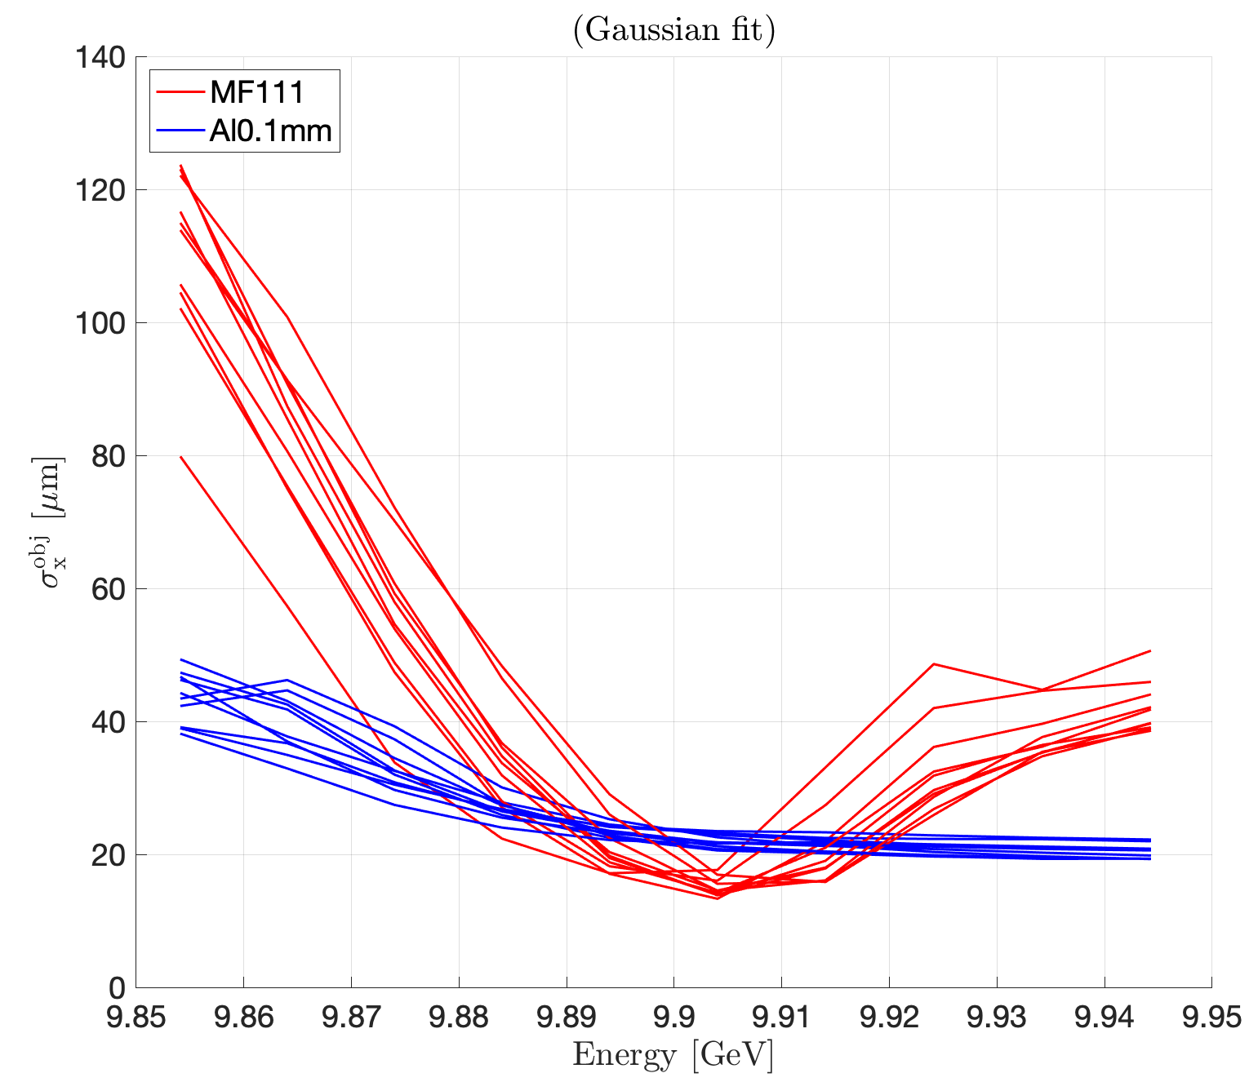
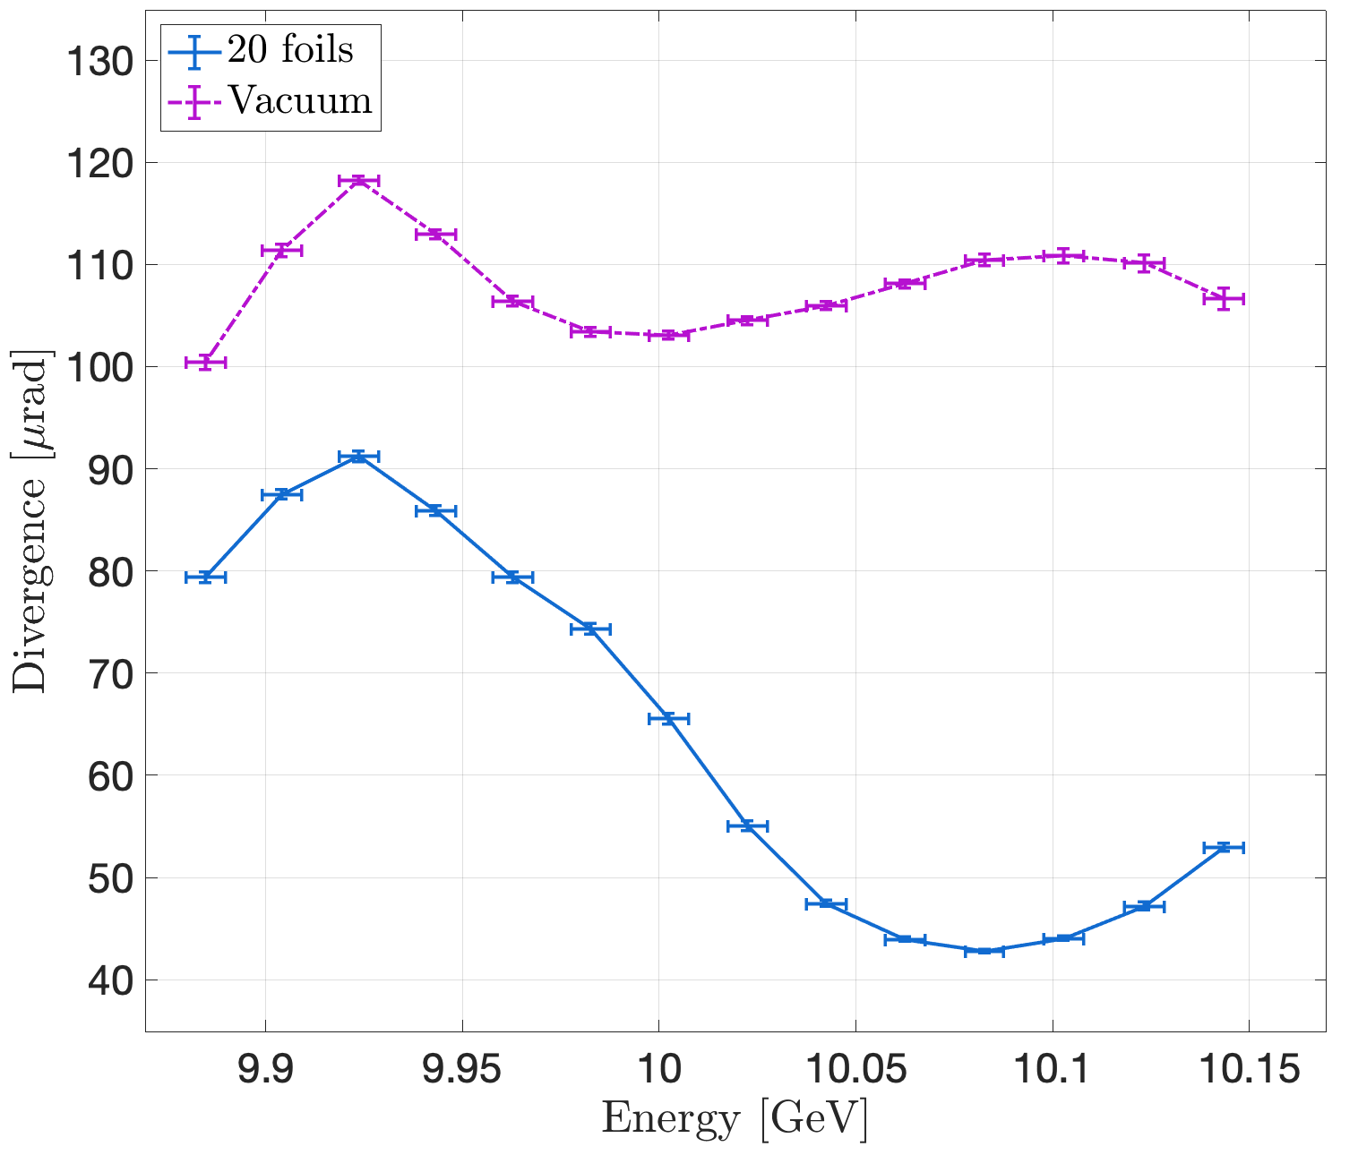
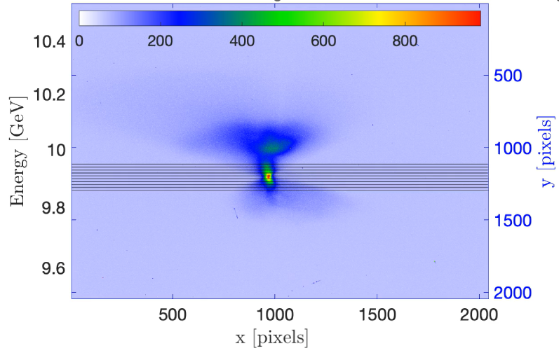




E332 Progress in 2023
Evidence of focusing behaviour of multifoils – Preliminary analysis by Aime Matheron
Divergence increase
Spot size reduction
Multifoil
$σ_{r}$ : beam size
Solid target
Vacuum
111 Multifoil
Multifoil at
beam waist
$$z$$
Solid target at beam waist
$$σ_{vacuum} \sim 19 μm$$
Vacuum
$$σ_{multifoil} \sim 15 μm$$
$σ_{r}$ : beam size
Divergence decrease with offset waist
Multifoil after
beam waist
Vacuum
M12 scan with 111 MF
Multifoil
$$z$$

Slide 4
What worked and didn’t
What worked:
  Multifoil targets and target mover software
  New target mover defender (tested on final shift)
  DTOTR1 - Backwards facing YAG → no COTR on YAG data (not a perfect fix however)
What didn’t work (or could be improved)
  Varying compression – difficult and not repeatable
  Decreasing to <50cm beta is not reliable
  Measuring the reduction in spot size
    limitations from YAG resolution, betatron beam size, dispersion
  Changing the FF changes transverse offset – Final focus BBA and moving magnets?
  Sometimes the DAQ misses PV’s? (i.e. magnet PV’s)
Required for next steps
  Near term (months): improve data, (especially focused beam size measurement) ~1 shift/month
    Improved beam properties (spot size, bunch length, minimize dispersion) will improve data and the NF-CTR interaction
  Mid term (possibly by end of this year?): higher current and smaller spot size and/or plasma lens for progress towards efficient γ-ray source
    Aiming for order 5 µm spot sizes, >50 kA peak current
  Long term: with >100 kA + plasma lens → Laserless SFQED

Slide 5
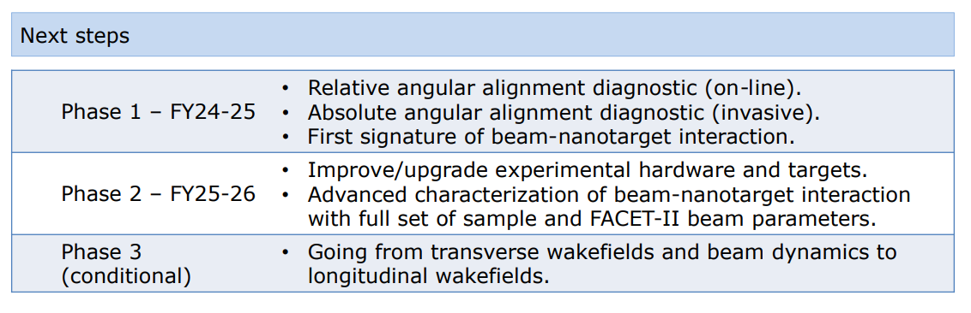
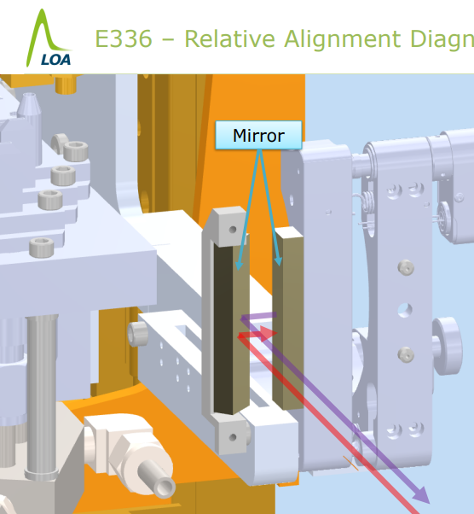
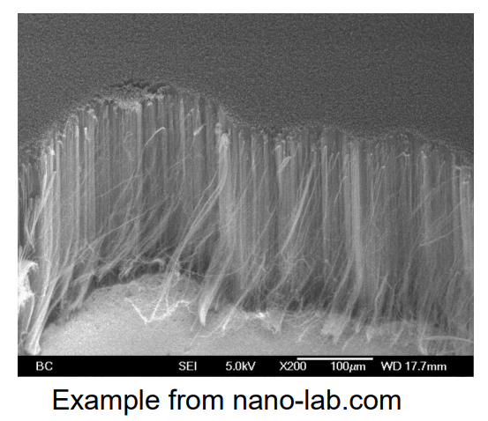
E336
Beam Interaction with Nanotube Materials
Stated goals from science meeting:
  1.5 yr: - Distinguishable interaction with nanotarget and amorphous targets
  3 yr: - Parametric studies with various target and beam parameters
No beam time was requested in 2023
Main observables:
  Beam deflection for tilted targets
  Growth of transverse momentum spread
Two pressing issues to be resolved:
    Installation of mirror for alignment feedback
    Carbon Nano Tube sample
Beam requirements to make progress:
  Highest bunch density and smallest emittance
    i.e. 50 kA and 5 mm mrad works
    20 kA and 20 mm mrad does not

Slide 7
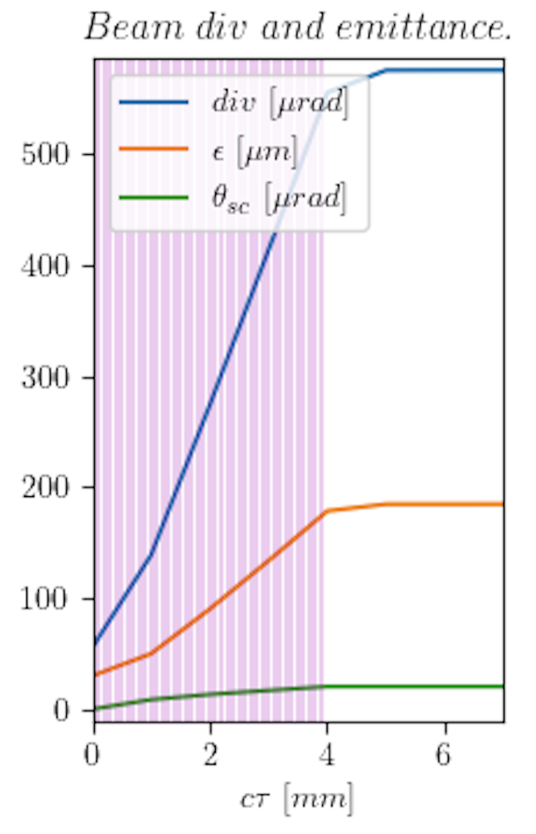
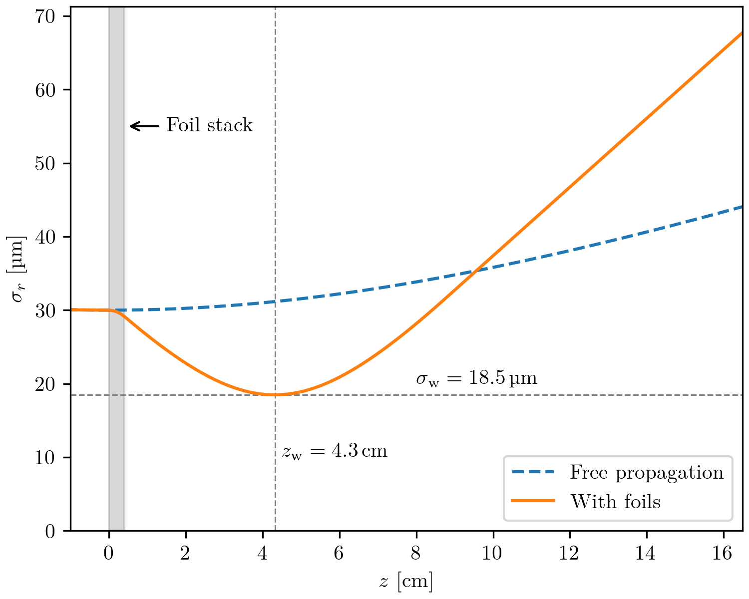


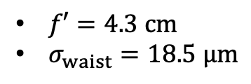
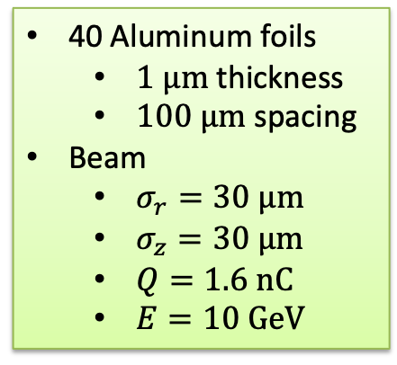
E332 experiment and beam focusing at SLAC
40 foils
40 Aluminum foils
  $1 μm$ thickness
  $100 μm$ spacing
Beam
  $σ_{r}=30 μm$
  $σ_{z}=30 μm$
  $Q=1.6 nC$
  $E=10 GeV$
Big change of divergence :
$σ_{r}^{′}$ going from 60 $μ$rad to 600 $μ$rad
Simulation of the beam in the foil stack
The foil stack is acting like a lens :
$f′=4.3 cm$
$σ_{waist}=18.5 μm$
16

