Slide 1
FACET-II Long-term planning meeting:
E-305
Alexander Knetsch
10/01/24

Slide 2
High-level responses
What are the high-level scientific goals of this experiment?
Demonstrate spatial-temporal growth of relativistic streaming instability
The same with e⁺ e⁻ pair beams
Gamma ray more important as diagnostic than as gamma-ray source
What will be the first high impact result or publication?
Demonstration growth of relativistic streaming instability
Characterization spatial-temporal growth of relativistic streaming instability

Slide 3
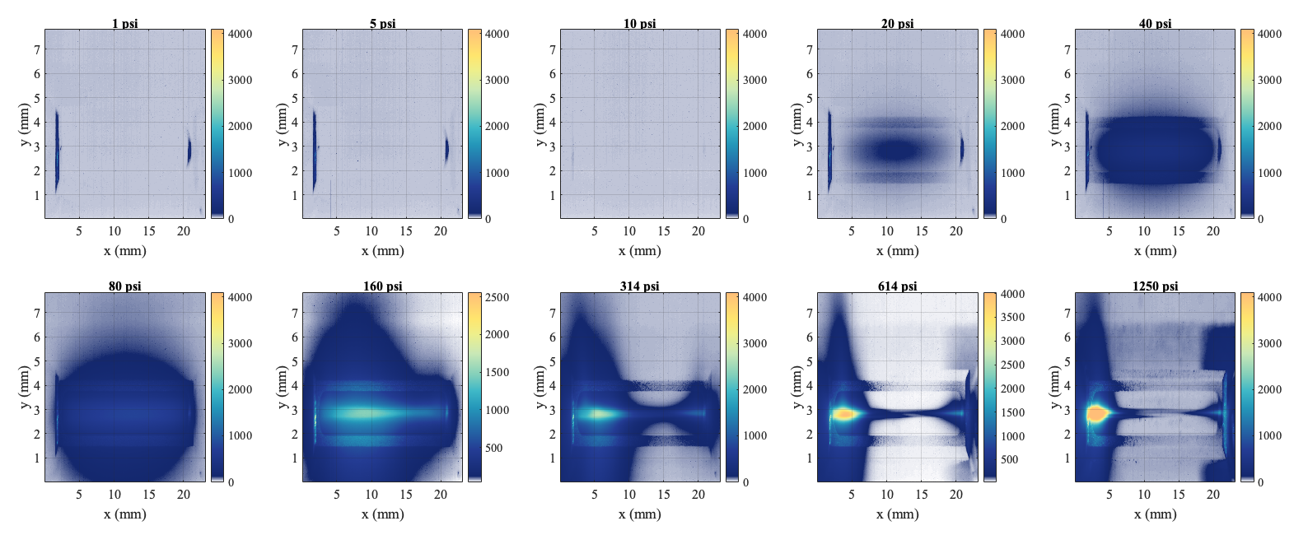
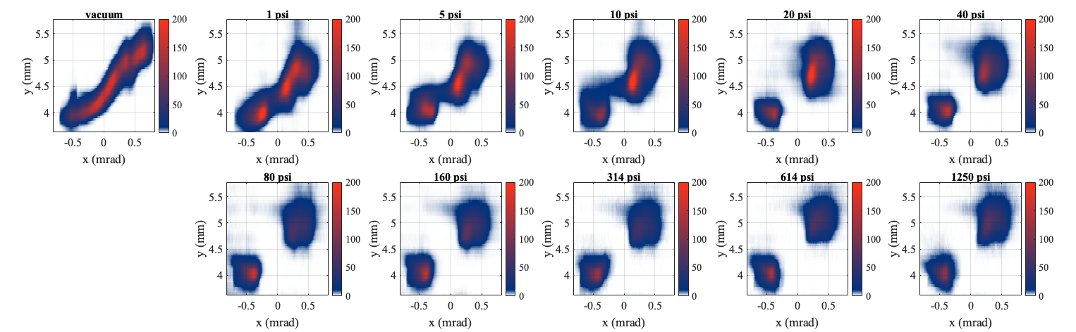
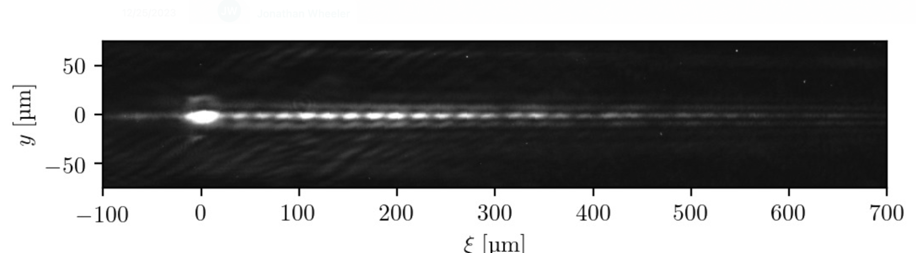
Progress and issues
Progress
No beamtime
E332 used DTOTR and imaging spectrometer to give information on dispersion at IP
Studies at LOA, successfully testing Darkfield shadowgraphy
Visit by Aimé, Viktoriia and Sebastien from LOA
Issues:
Inhomogeneous laser ionization at high pressures
Beam transversally larger than plasma at IP
Beam in IP had E-x’ or E-x correlation
Competition is arising:
AWAKE is studying instabilities in proton beams
HiRadmat makes pair beams
Top view
DTOTR (high M₁₂)
Dark-field shadowgraphy of LWFA
Courtesy Max Gilljohann

Slide 4
Resources and plans to address issues
Scan of compressor gratings can vary spatial-temporal coupling and mitigate ionization defocusing
Get permission to run E305 without window between compressor and Picnic basket
Repeat previous scans with improved beam conditions

Slide 5
How do we get to the high-impact results ?
Probe laser:
Dark field shadowgraphy at 800 nm
Motorization of mask
400 nm dark-field shadowgraphy likely would need spatial filter in the probe
General e-beam related
Sector 20 Pyro
Improved beams (smaller than plasma)
Use beams with understood approximately linear chip
Pair beams have 3 pathways:
  Full positron capability, requires sailboat chicane
  Thick converter, no sailboat chicane
  Multi-foil gamma-ray converter as bethe-heitler pair beam source

Slide 6
Backup

Slide 7
E305 post summer meeting
12.09.2022
A. Knetsch

Slide 8
Progress throughout the summer
17.06.22
  E-beam and axilens ionization trace observed with LR shadowgraphy
12.07.22
  Alignment on front-view and beam-based
  Data taken at different pressures: 100 psi, 500 psi and 1500 psi
15.07.22
  He gas instead of H2. Axilens focus can ionize He
  Pressure scan from 10 to 1200 psig
24.07.22
  High-resolution shadowgraphy
  Axilens longitudinal scan
  Laser-to-ebeam raster scan for beam-based alignment (plasma appears to be 50 um wide)
  Occasionally e-beam ionization
27.07.22
  Plasma trace from e-beam H2 ionization consistent and visible in high-res shadowgraphy at p=1000 psig
02.08.22
  Axilens raster scans for different DM settings
20.08.22
  New 2 cm gas jet installed
  Pressure scan from 1 psi to 1200 psi including object plane scans

Slide 9
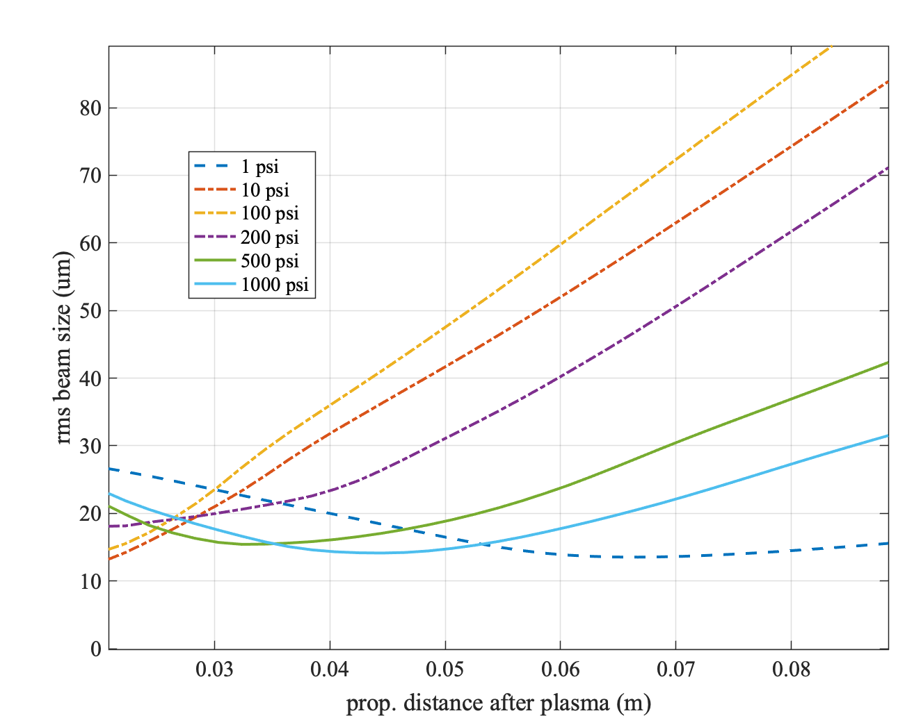
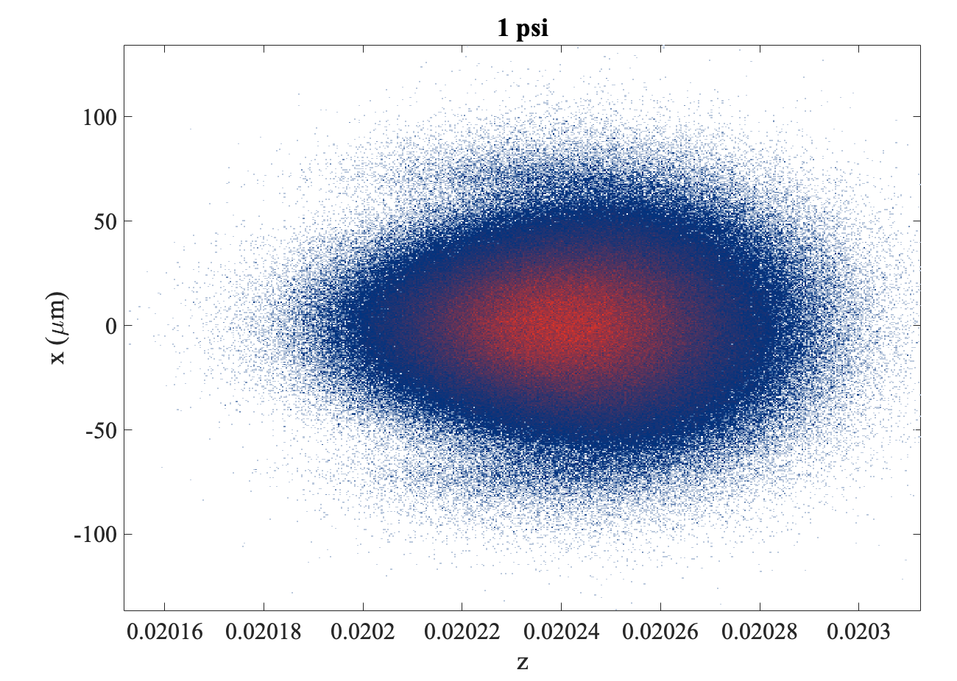
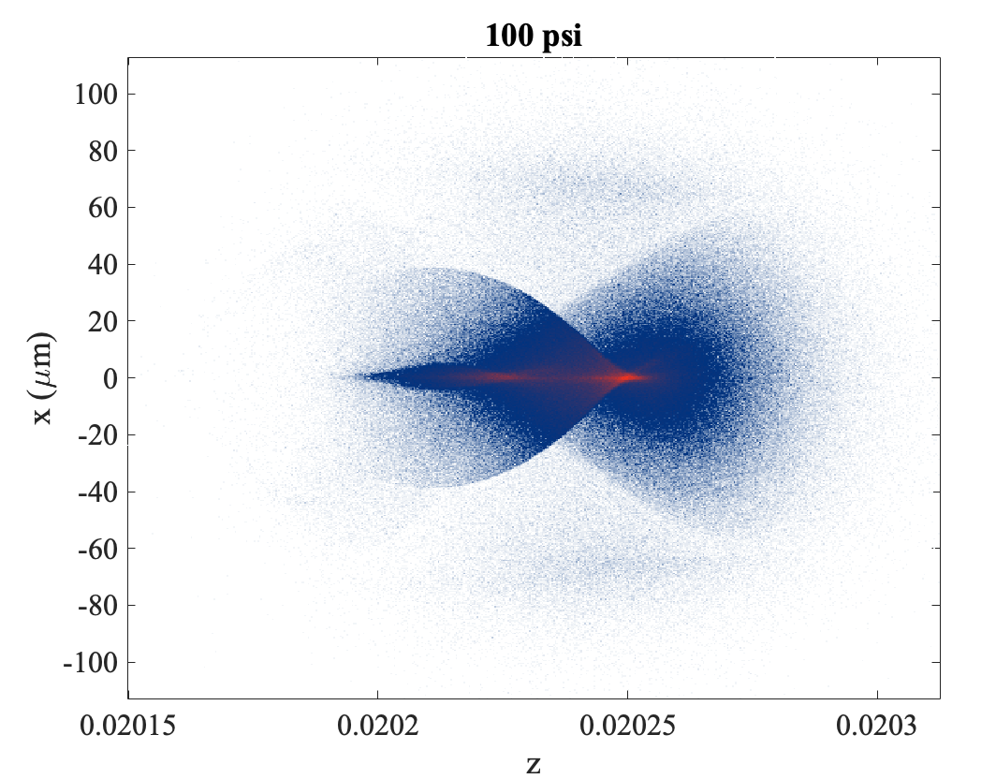
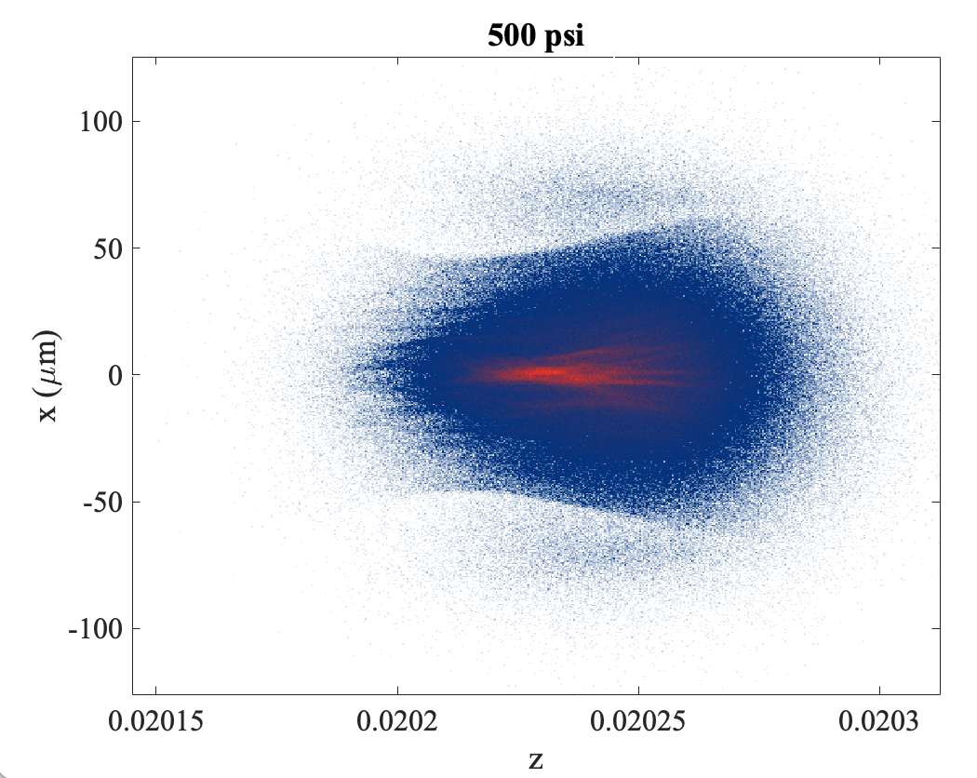
Shifts were inspired by these goals:
Commission of setup
  Alignment, synchronization, etc.
Observe evidence of a filamentation regime
  Gamma diagnostics
  Electron spectrometer
  Shadowgraphy
  Plasma glow
PWFA
PWFA-Filamentation transition
Plasma lensing

Slide 10
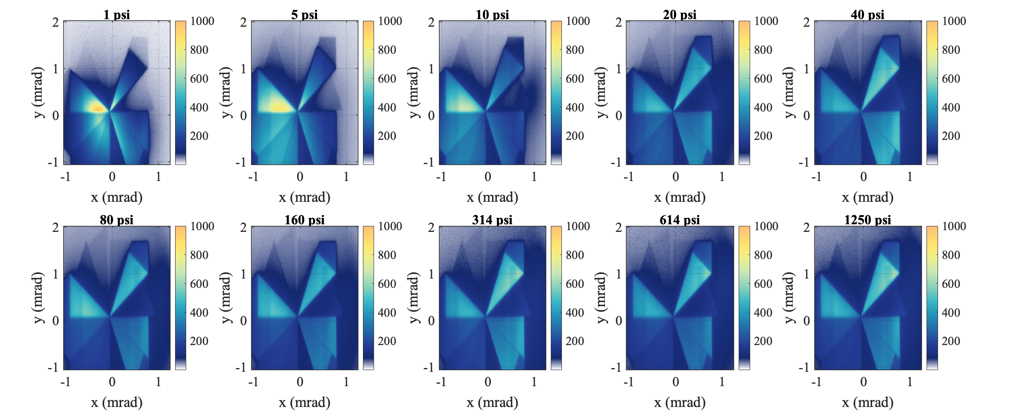
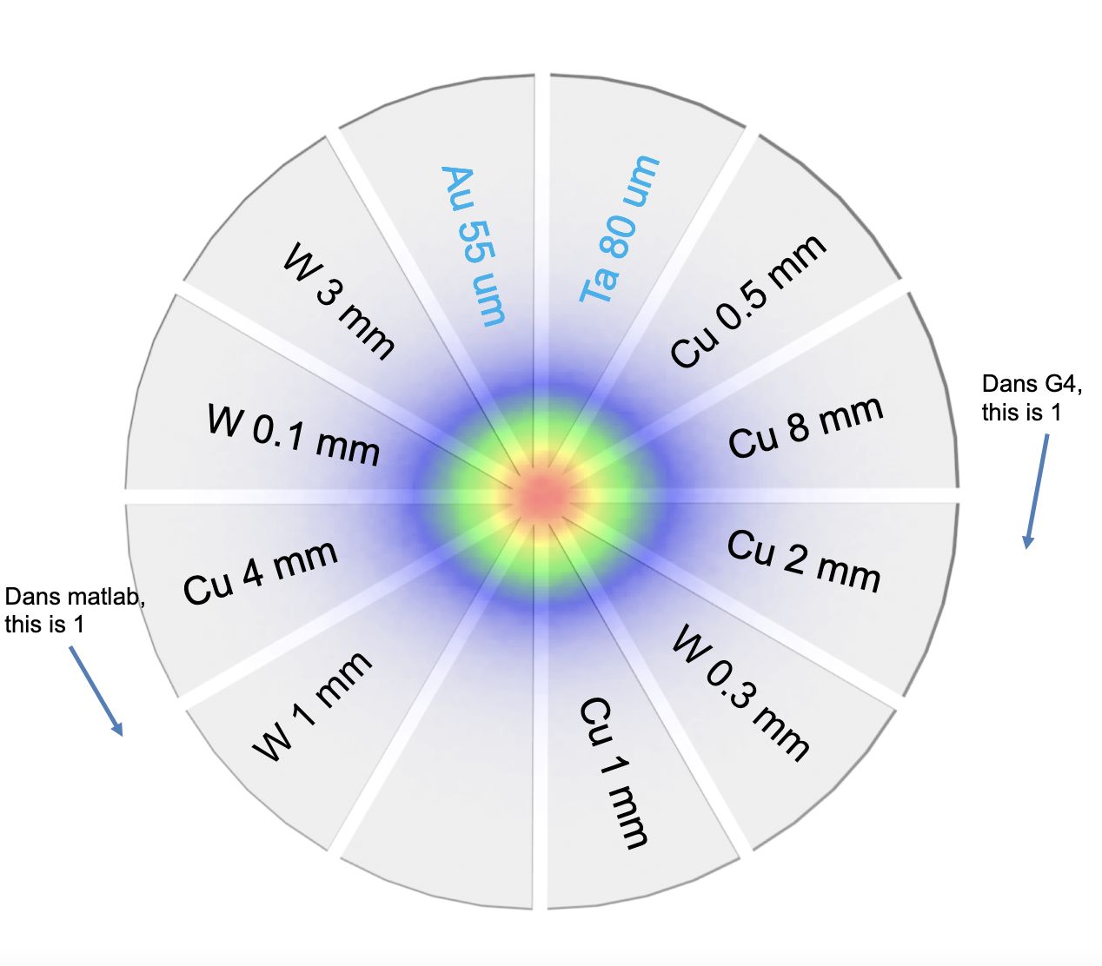
Averaged images measured on Gamma 2

Slide 11
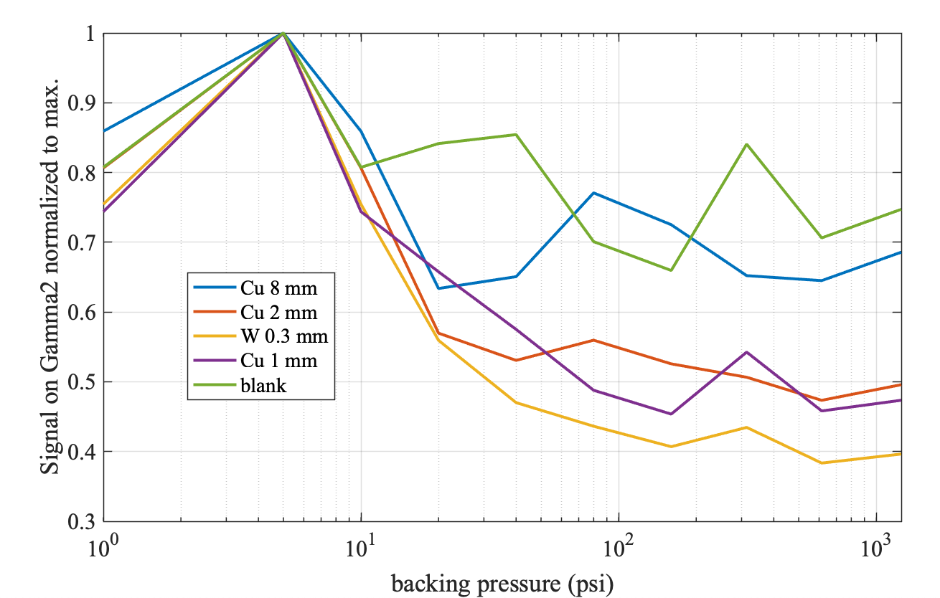
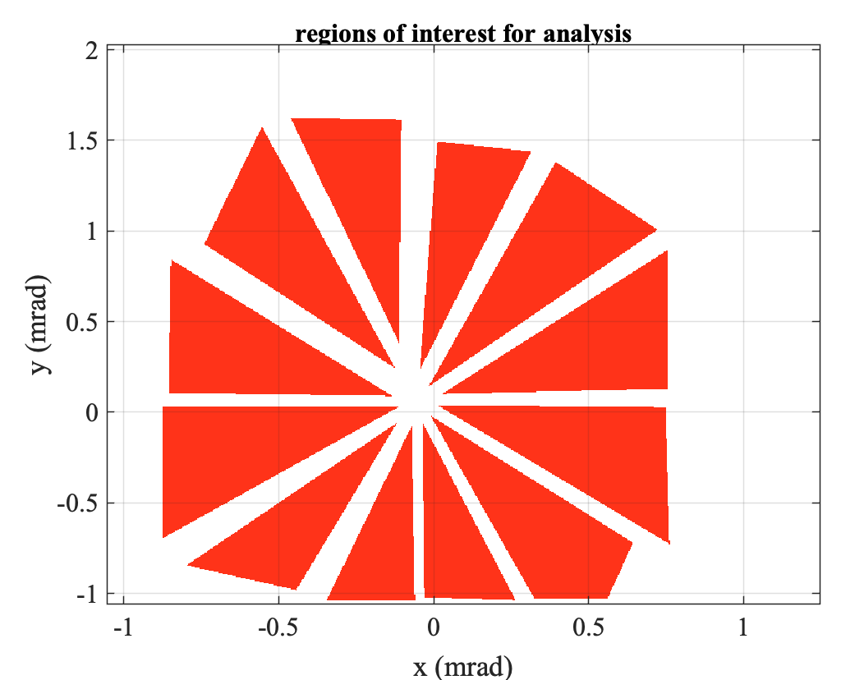
All plots with a maximum at 5 psi

Slide 12
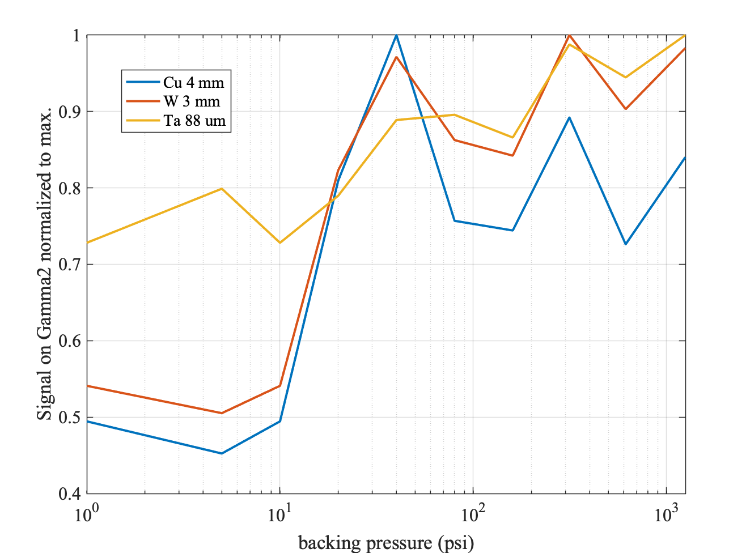
Plots with a maximum at p>5 psi
Maxima can be found
might be prone to pointing variation

Slide 13
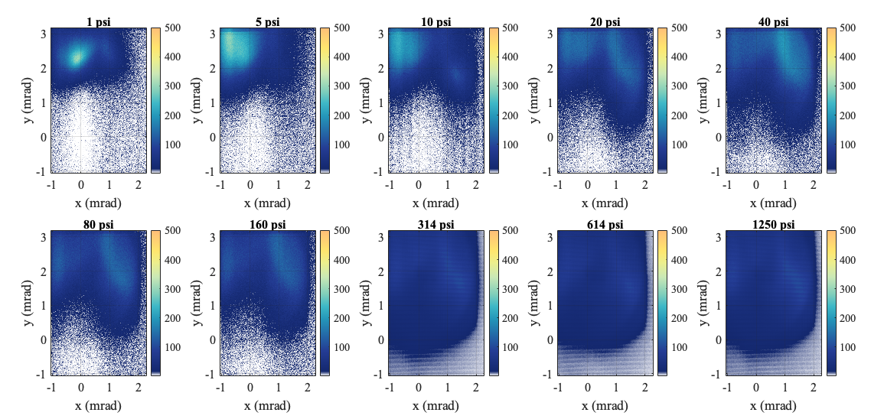
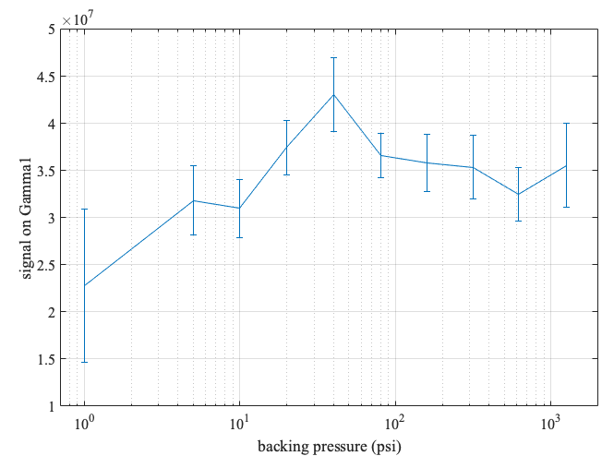
Average Signal on Gamma
For p>300 psi CsI was used, result corrected by sensitivity
Maximum at 40 psi, beyond reduced signal

Slide 14
Plasma glow
Axilens might not have ionized well at p>140 psi
Could be a consequence of decaying gratings or ionization defocusing
Needs investigation

Slide 15
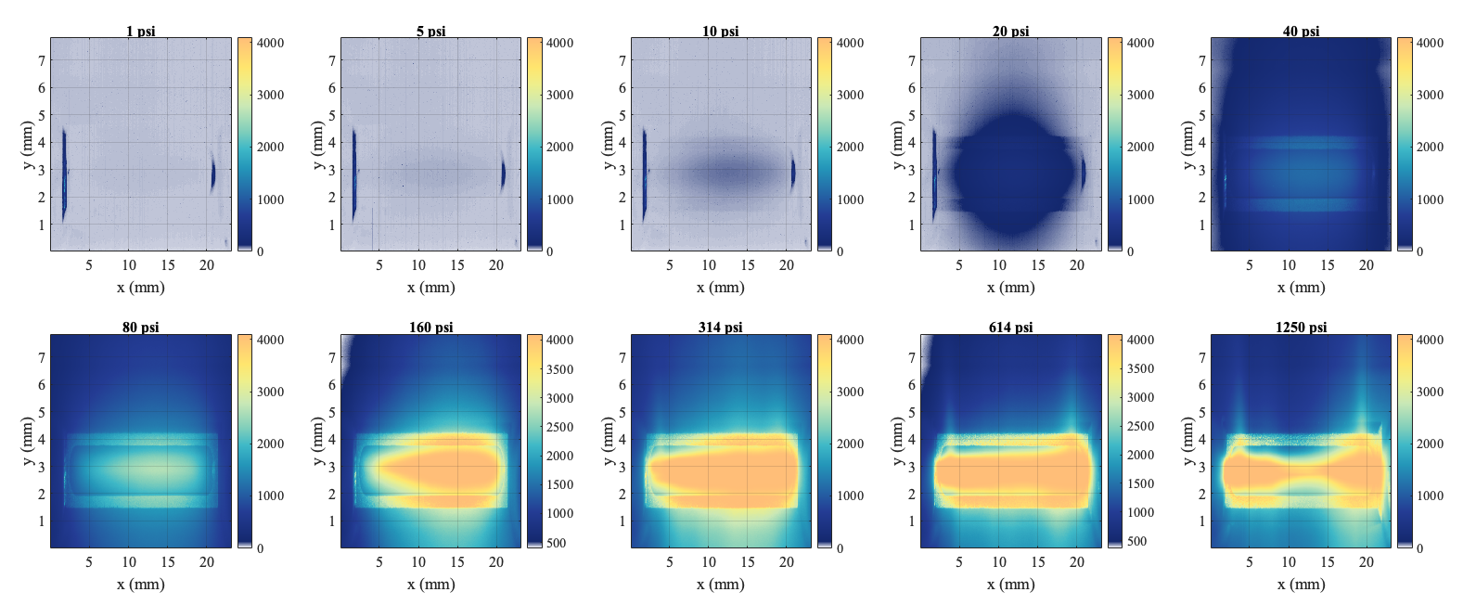
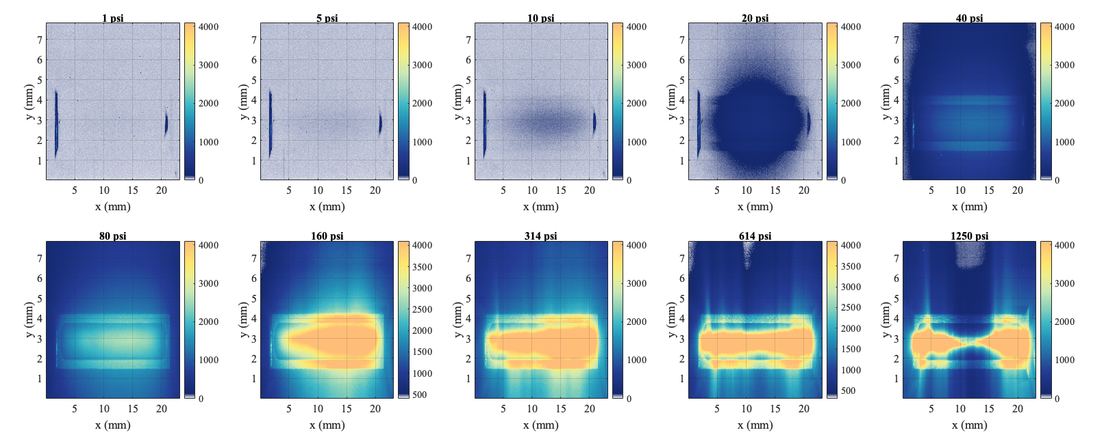
Interaction with e-beam
Mean images
Random (‘typical’) single shot
Enhanced plasma glow visible for sub-atmospheric pressures
Camera saturated for p>80 psi
Possible Solution:
  Flipper with ND

Slide 16
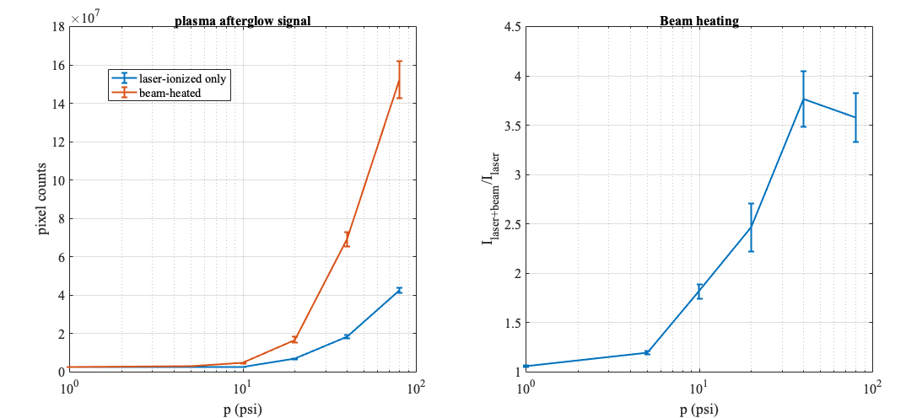
Analysis up to 80 psi

Slide 17
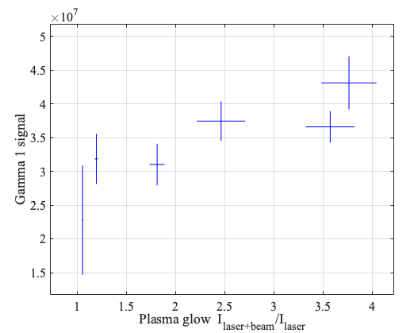
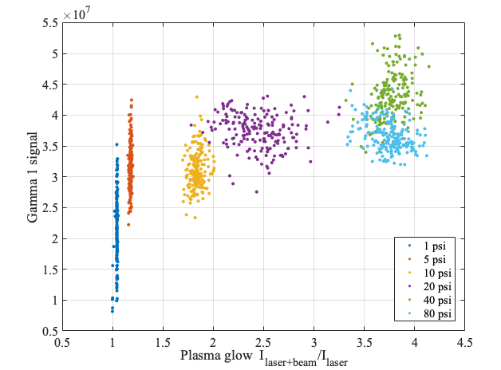
Corellation plasma glow enhancement to Gamma1

Slide 18
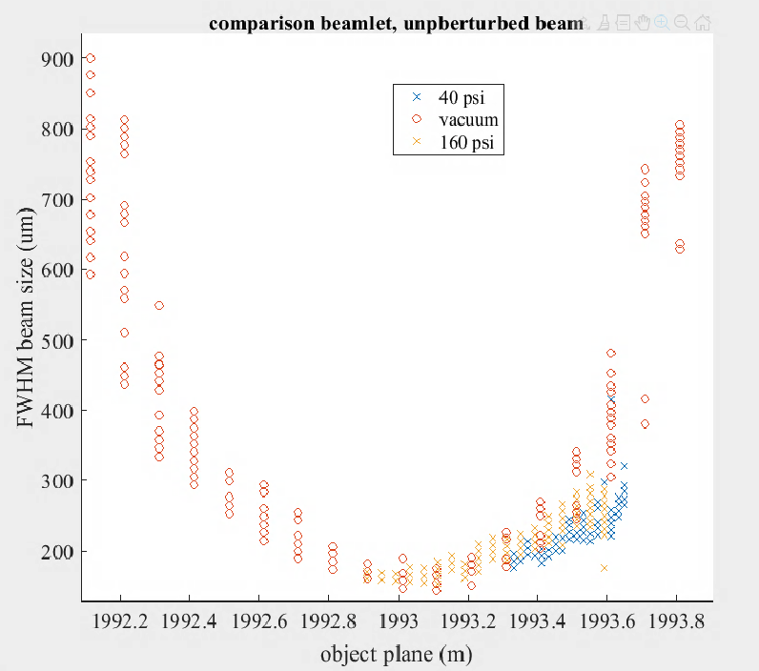
Espec results
Beamlets are seemingly unperturbed
--> Hypothesis: Beam wider than plasma
We shouldn’t see a spatial feature from the waist in the divergence. Except if there is a correlation.
2 options:
  x-x’ correlation (waist not on plasma)
  x-energy correlation (dispersion)

Slide 19
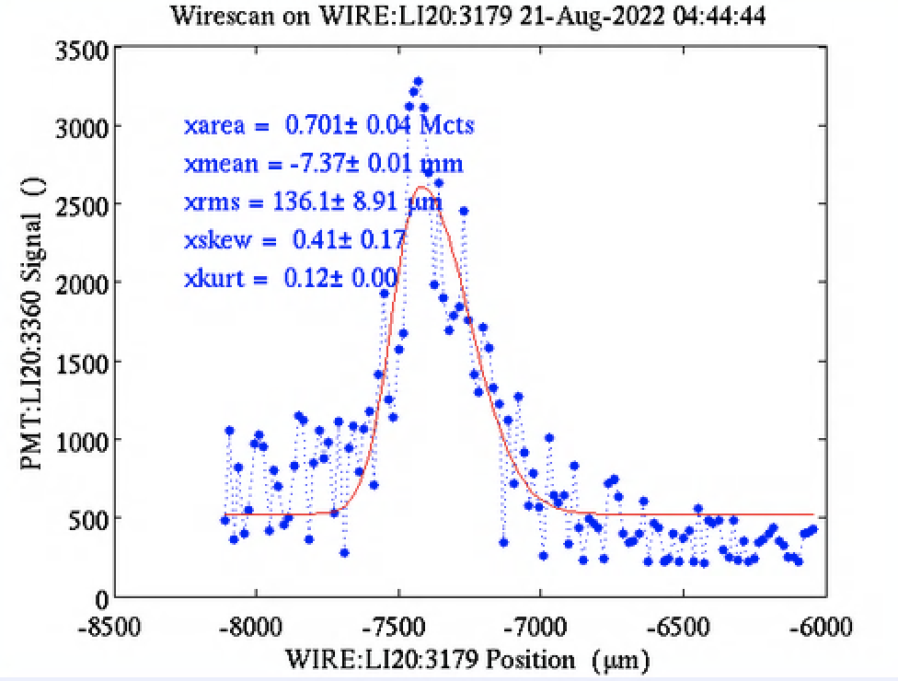
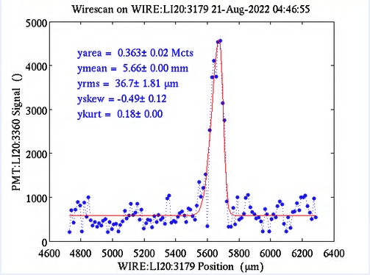
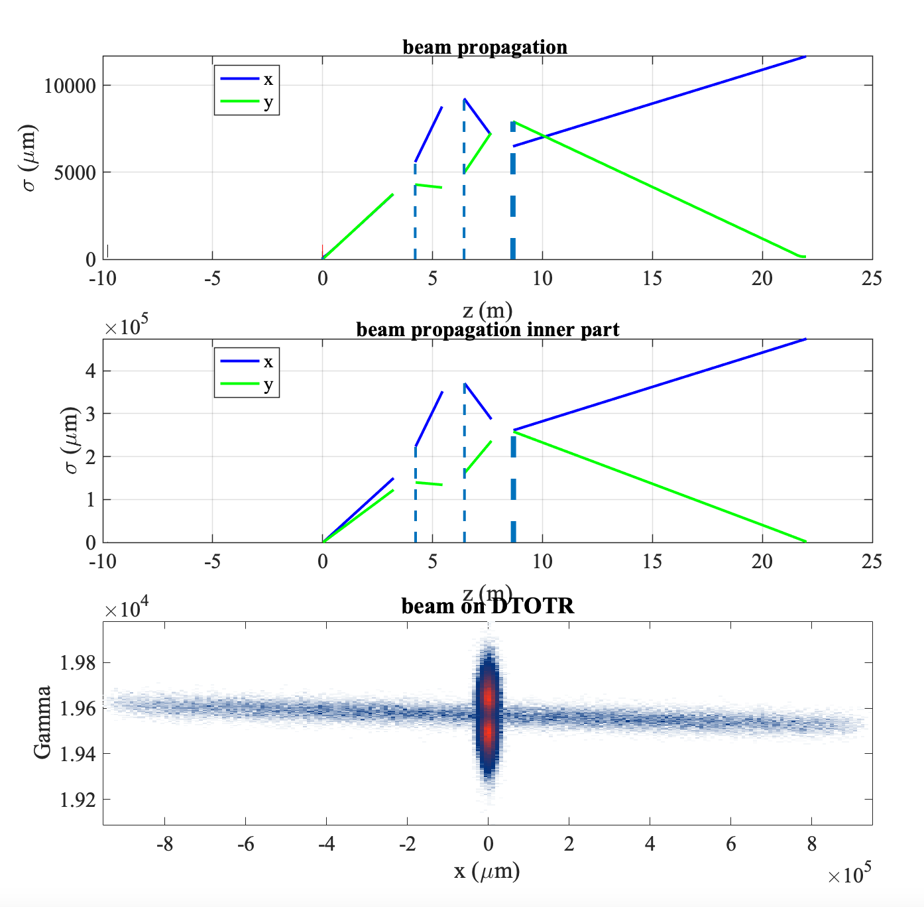
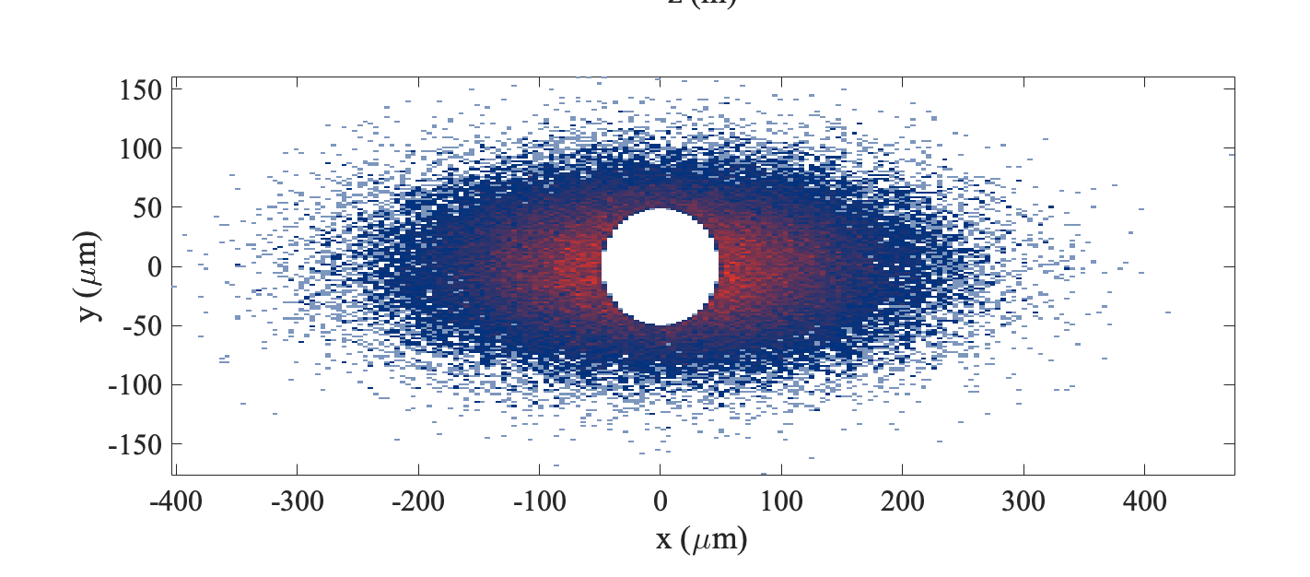
A possible explanation from modeling
x—x’ correlation: Waist needs to be off by a beta function to induce a theta-x relation and even then, the beam is too wide. Chromatic focusing remains to be checked.
Dispersion (energy-x correlation): A hole can be produced in the signal, could be the reason.

Slide 20
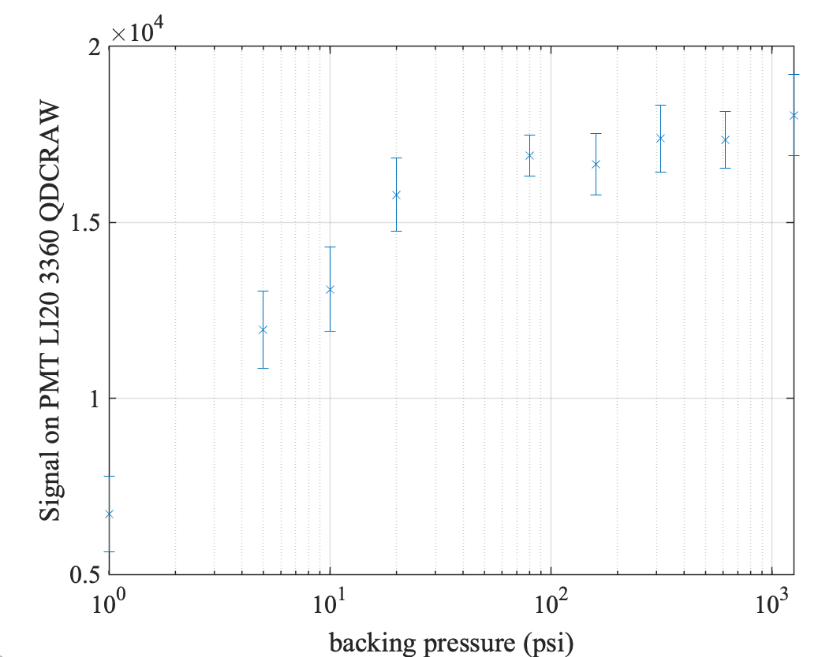
A possible explanation from modeling: Losses
Higher pressures lead to more radiation possibly from lost interacted part

Slide 21
How can we improve ? Discussion points
Gamma spectrometer
  Seems fine / could add Gamma3
Shadowgraphy
  See Henrik’s talk / 400 nm to discuss next meeting ?
Plasma glow
  Appears to be useful for the detection of filamentation.
  Improve light collection for p< 10 psi, add filters p>160 psi
Beam-orbit:
  Improve centering of orbit on beam pipe (flat orbit though IP, is it the same as flat through BPMs ?)
  Reduce dispersion
  More studies on smaller betas and chromatic focusing (See Aimé’s talk in 2 weeks)
Spectrometer:
  Re-iterate divergence-dependent transmission
  Higher resolution on DTOTR2
Axilens ionization:
  Need to ensure full ionization

Slide 22
Thank you for your attention

Slide 23
Slide Dump

Slide 24
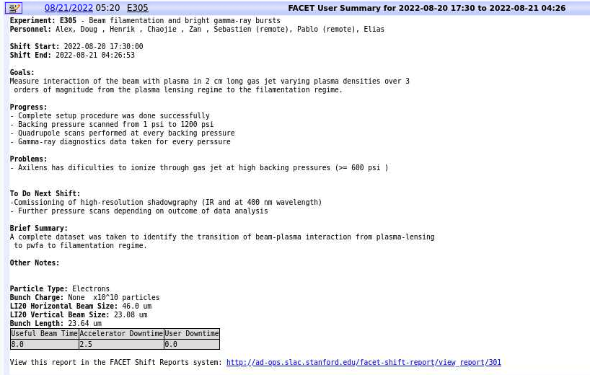
2022-08-20

Slide 25
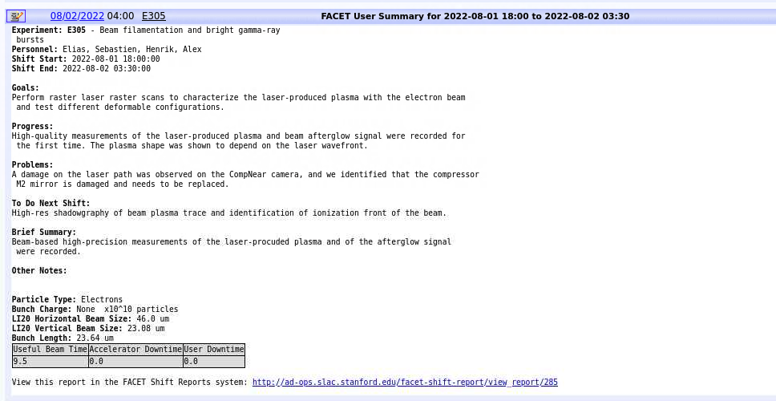

Slide 26
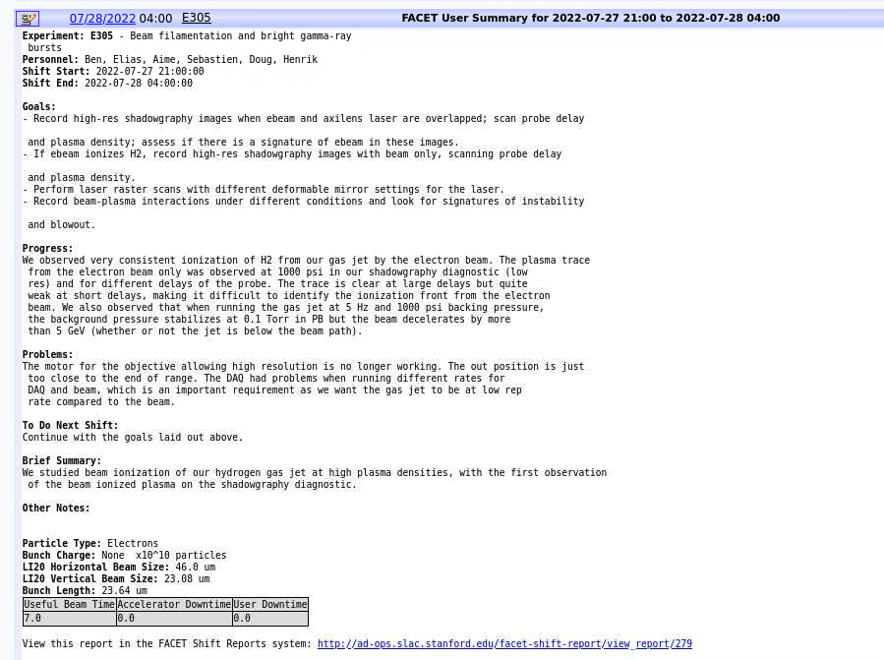

Slide 27
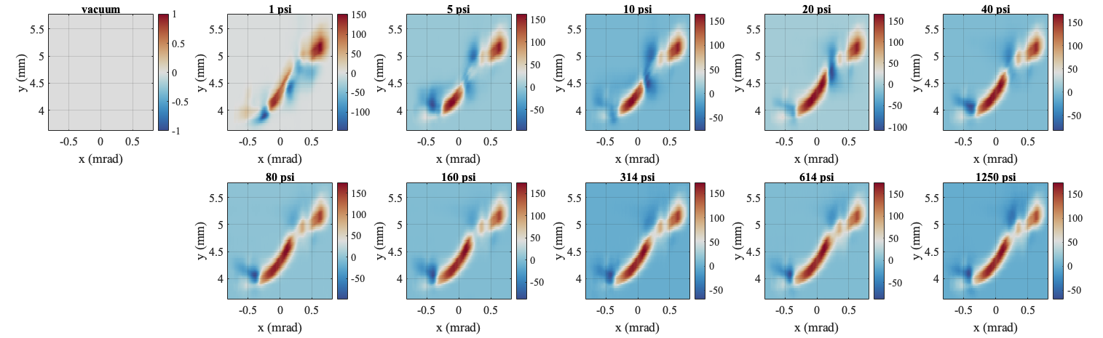
Subtracted image

Slide 28
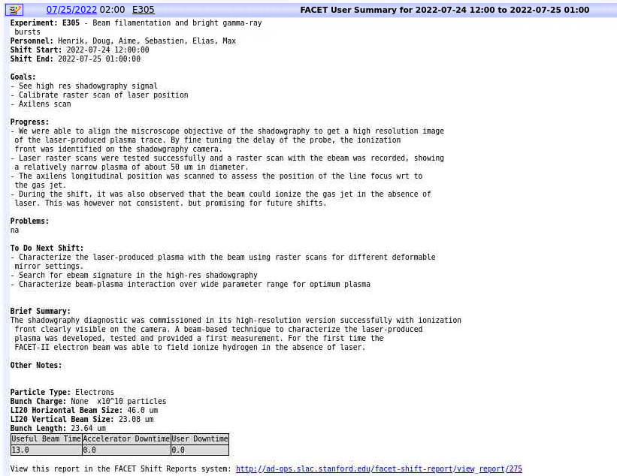

Slide 29
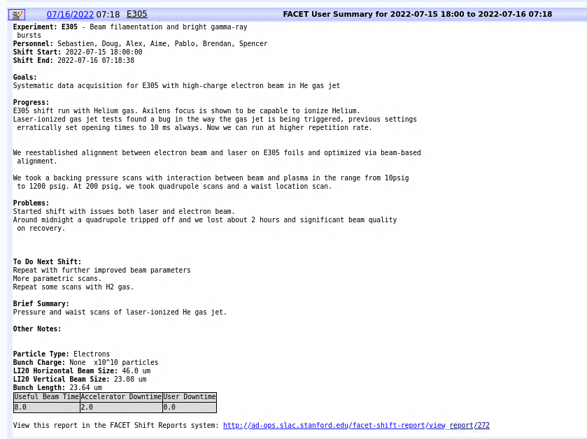

Slide 30
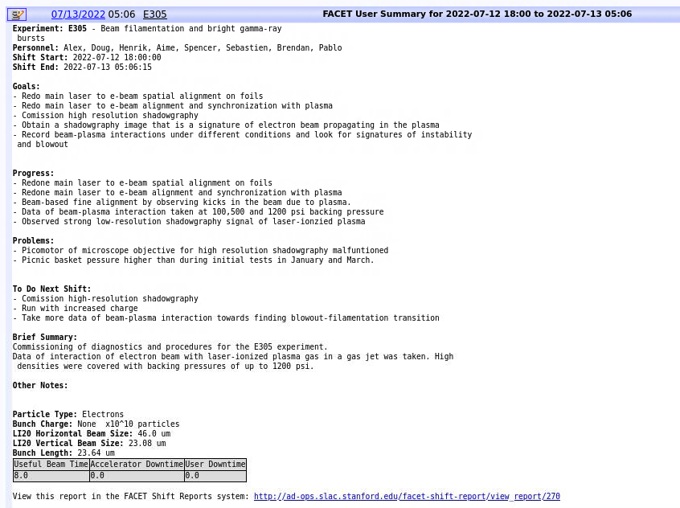

Slide 31
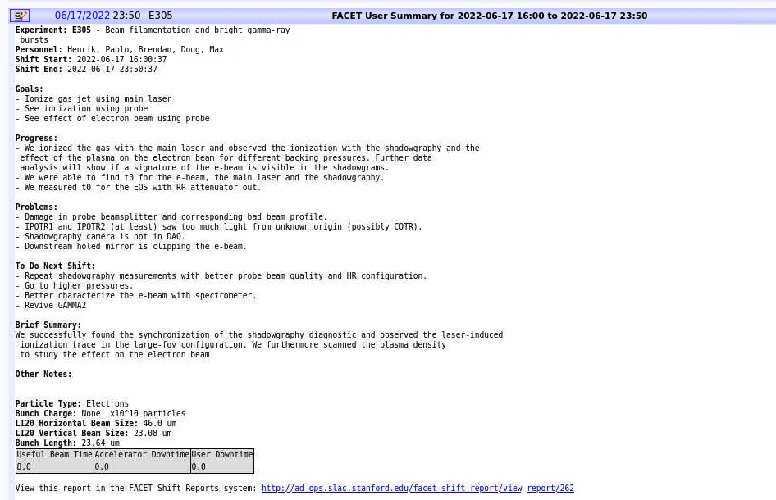

Slide 32
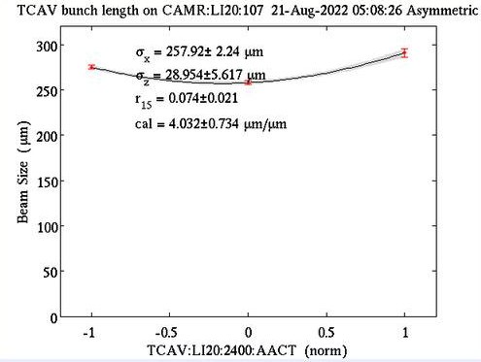
Post-beamtime

Slide 33
Alignment and synchronization
Frontview
Raster
Plasma glow

