Slide 1
E300
Progress and long-term planning
Doug Storey
January 10, 2024

Slide 2
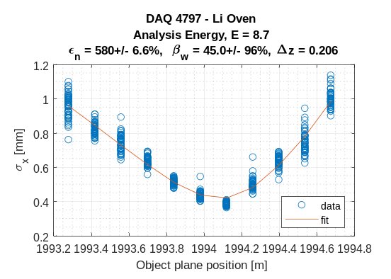
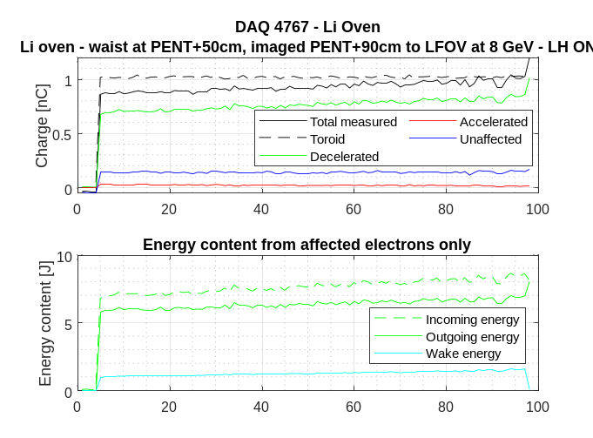
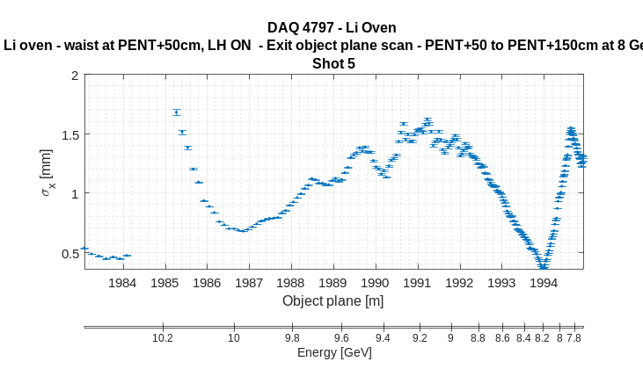
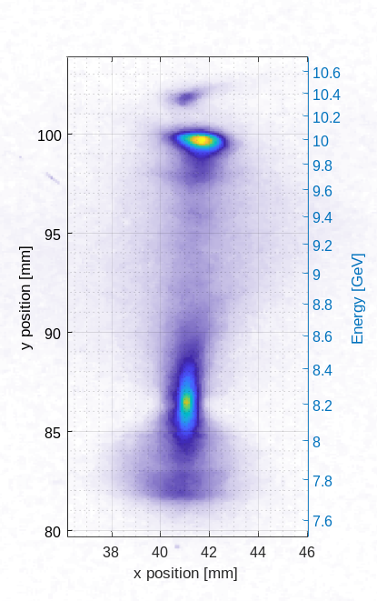
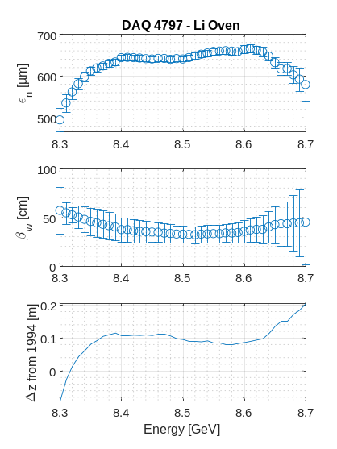
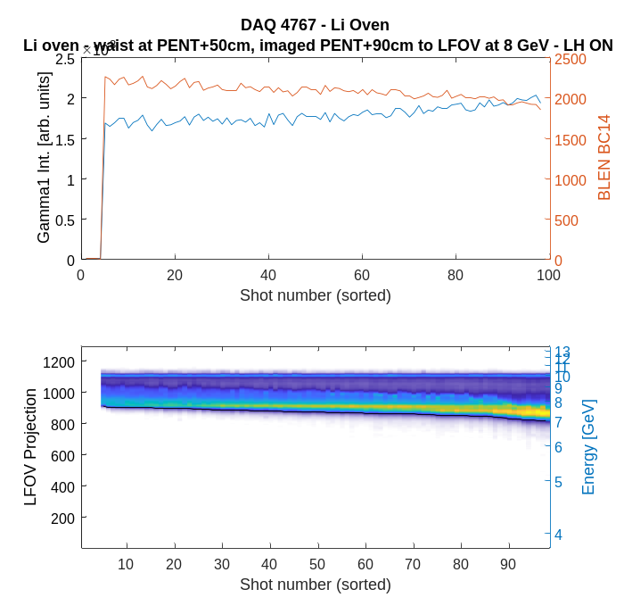
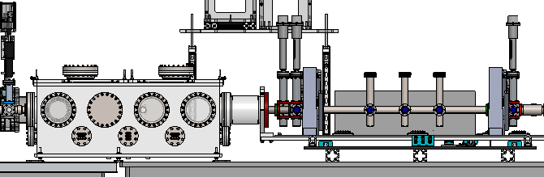
E300 progress in 2023
DPS stability studies and EPS modifications
Dry run of Li oven with DPS – operation for >24 hours with no beam
Some general diagnostics work towards XTCAV, energy spectra, emittance measurements (few shifts)
Beam ionized plasma interaction with H2 gas at various pressures (1 shift)
Beam ionized Li plasma (1 science shift, but several days operation with beam)
Locating plasma exit
Single and multishot beam properties
---- PENT
z = 1994
---- PENT +0.5m
z = 1994.5
---- PENT +1.0m
z = 1995
~10-20% energy transfer

Slide 3
What worked or didn’t
What worked well:
  DPS!!!
    Only one pump faulted in 2023!! And it was a turbopump.
    Can run H2 up to 5 Torr, He up to 10 Torr with present setup
    Samara’s upgrades to gas injection system work great
    # of trained people is increasing
  DAQ – overall quite reliable this year
What didn’t work, or could be improved:
  Some improvements planned for DPS – i.e. Epics control
  Laser heater (but we still love you) – didn’t see a correlation to things like beam-ionization
  Gamma2 motors – Got stuck
  Lots of screen damage – DTOTR YAG, LFOV. Also, DTOTR1 OTR is not shiny enough
  XTCAV:
    Kick is still lower than it should be
    Phase stability is poor, but phase readback is good.
  S20 bunch length monitor – It just doesn’t seem to work
  Beam stability – Studies relying on beam ionization were hard to set up for
  Phase/compression scans – Scanning BC14 setpoint is slow and not very robust
  Alignment of FF and Spec quads – large orbit changes when scanning quads

Slide 4
Goals for this year
What are the high level scientific goals of this experiment?
  Efficient drive to wake energy transfer (>80%)
  Efficient energy extraction by witness (~40% overall) with energy doubling
  Optimize matching conditions to minimize energy spread
  Emittance preservation
Goals for 2024:
  Optimize single bunch drive-to-wake energy transfer efficiency
  Start shooting 2 bunches into plasmas
What do we need to do to get from here to there?
  More time with single bunch
    Vary plasma density, incoming beam parameters (bunch length)
    Aim for >80% energy transfer efficiency
    Reduce non-participating charge
  Diagnostics improvements: emittance, LPS,
    XTCAV, S20 BLEN,
  Beam/Linac improvements
  Development of 2 bunch capability
    Recover the same beam-to-wake energy transfer efficiency as with single bunch, measure some acceleration
  Simulation campaign

Slide 5
Goals from last year
Scientific Goal | Task Item 1 | Item 1 Status | Task Item 2 | Item 2 Status | Task Item 3 | Item 3 Status | Task Item 4 | Item 4 Status | Task Item 5 | Item 5 Status
Robust emittance, EOS, TCAV diagnostics | Highly tuned beam to S20, with sig_r ~20um, sig_z~10um, Ipk ~ 15kA | Multi-scientist high-effort | Develop emittance diagnostics with high quality beam, no plasma | Multi-scientist high-effort | Reliable TCAV performance | Multi-scientist high-effort | Regain EOS capabilities | Readily achievable | Correllate EOS, TCAV, and S20 BL monitor | Multi-scientist high-effort
Demonstrate energy depletion of the drive beam | Demonstrate Li oven with beam | 1 scientist high-effort | H2 and He spike ionization studies (LH, collimators) | Multi-scientist high-effort | High-quality axicon focus - demo laser preionization | 1 scientist high-effort | > 80% energy transfer from the beam to the wake with < 5% unaffected charge | Multi-scientist high-effort | Excercise betatron diagnostics (GAMMA1/2/3) | Readily achievable
Accelerate the witness beam to high energy | Electron drive-witness pair | Multi-scientist high-effort | >30% energy transfer to witness while energy doubling | Multi-scientist high-effort
Emittance preservation | BBA-ed FFS quads for high res measurements | Multi-scientist high-effort | Remove Be windows and replace with straws | New infrastructure req. | Optimize beam matching/loading conditions | Multi-scientist high-effort
Done
Needs work
Needs work
Needs work
Done
Needs work
Needs work
What we did in 2023

