Slide 1
Distributed coupling linacs modes of Operation
Sami Tantawi
Notes:
Highlight RF sources

Slide 2
Outline
Introduction
Pi Mode Structure
Pros and cons
3$\frac{π}{4}$ structure
Comparisons

Slide 3
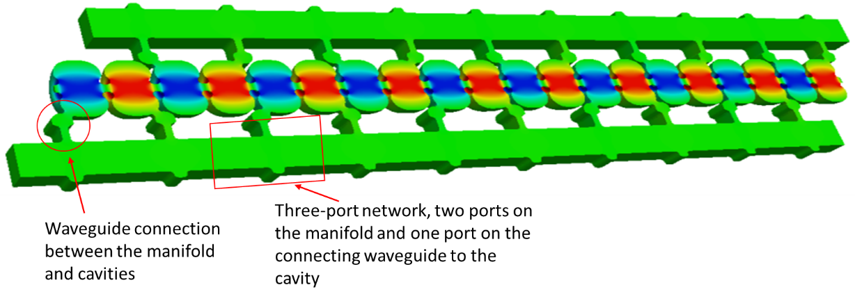
$$π−mode structure$$
Inspired by the need to optimize cavity shape.
The new cavity shapes had very small coupling between the cells.
For the distributed coupling linac topology the choices of the phase advance are discrete.
The initial implementation was done at the $π$-mode which requires two manifolds and guided wavelength within the manifold, $λ_{g}=2 λ_{0},$ the free space wavelength.

Slide 4
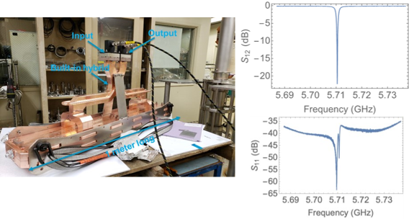
Difficulties with the $π$-mode distributed coupling linacs
the structure is essentially a standing-wave accelerator structure that produces a reflection during the filling time that interacts with the RF source (typically a klystron or a klystron followed by a pulse compressor).
To eliminate the adverse effect of this reflection, a rather sophisticated low-level RF system is needed. Alternatively, two sections of the structure need to be fed together with an RF hybrid to direct the reflected power to a load. This later solution requires an extra $λ/4$ space between the two structures.

Slide 5
Difficulties with the $π$-mode distributed coupling linacs
The distribution manifold connects to the cavities through long waveguides.
The length of this waveguide has to be chosen carefully so that an incorrect operation in one of the cavities, e.g., a detuned cavity due to construction or a breakdown event, does not result in destroying the uniformity of the power feed to the other cavities with excess power to some of them.
Finally, the $π$ -mode of operation does not result in the optimal phase advance.

Slide 6
Difficulties with the $π$-mode distributed coupling linacs
The distribution manifold connects to the cavities through long waveguides.
The length of this waveguide has to be chosen carefully so that an incorrect operation in one of the cavities, e.g., a detuned cavity due to construction or a breakdown event, does not result in destroying the uniformity of the power feed to the other cavities with excess power to some of them.
Finally, the $π$ -mode of operation does not result in the optimal phase advance.

Slide 7
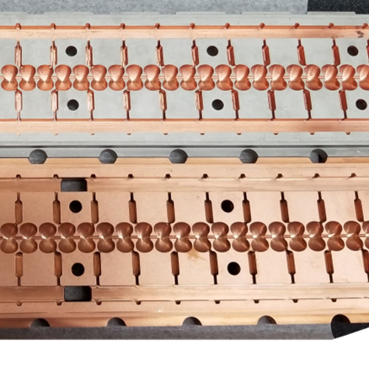
Difficulties Manufacturing technology
The system is manufactured from two blocks of copper which reduces the number of parts and makes the linac construction highly cost effective.
The long waveguides connecting the manifolds increase the lateral size of the linac
The diffusion bonding of the two blocks becomes more difficult
The straightness of the linac is a very serious problem as the fixtures supporting the linac during the diffusion bonding becomes larger.

Slide 8
Possible modes of operation
The shunt impedance for the train of the pill box cavities $\sim \frac{2−2Cos[θ]}{θ^{2}+θ X_{0,1}}$; where $θ$is the phase advace and $X_{0,1}$ is the first zero of the Bessel function of the first kind and zeroth order, $J_{0}(X_{0,1})≡0$.
This proportionality function of the shunt impedance reaches a broad maximum around $θ=103°$ phase advance, and then drops monotonically all the way to $180°$.
For the distributed coupling linac topology the choices of the phase advance is discrete.
The initial implementation was done at the $π$-mode which requires two manifolds and guided wavelength within the manifold, $λ_{g}=2 λ_{0}$
The next logical choice is a phase advance of $\frac{2π}{3}$ which requires 3 manifolds and requires $λ_{g}=λ_{0}$, a condition that can only be achieved with a coaxial line or a corrugated waveguide; both options are awkward.
The next possible choice, which we believe to be optimal for this topology is the $3π/4$ phase advance. It requires 4 manifolds with $λ_{g}=\frac{3}{2}λ_{0}$; easly achievable with a smooth rectangular wave guide.

Slide 9
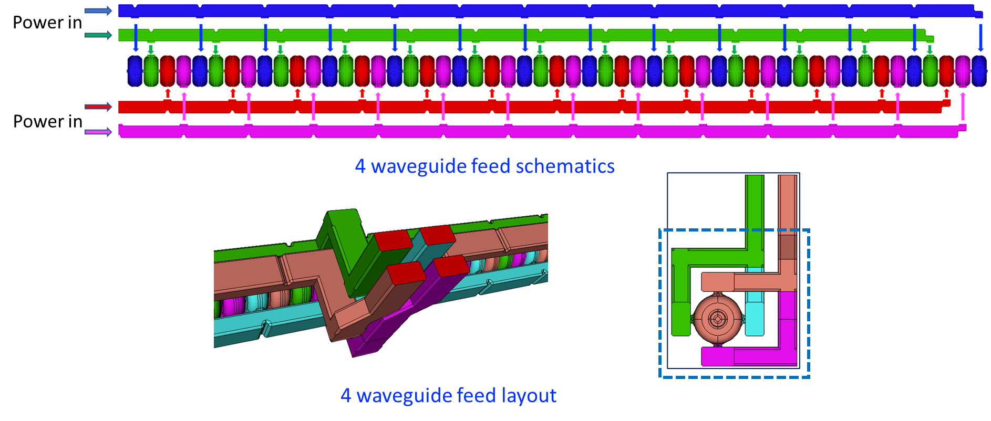
135 degree phase advanced distributed coupling structure
If one includes the period as an optimization parameter then the optimal structure with the minimal surfac magnetic field, and consequently the highest shunt impedance occurs at ~$132°$ phase advance; a natural choice is$a 135°$ phase advance.
Every 4th cavity has a $π$phase shift, hence 4 manifolds are needed to feed the structure.
Every two manifolds need to be fed with a $\frac{π}{2}$ phase shift; naturally fed by a hybrid that isolates the forward signal from the reflected signal.
Shumail, Li, Tantawi

Slide 10
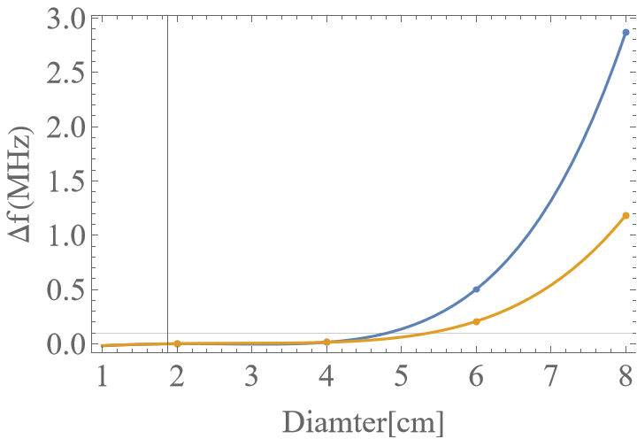
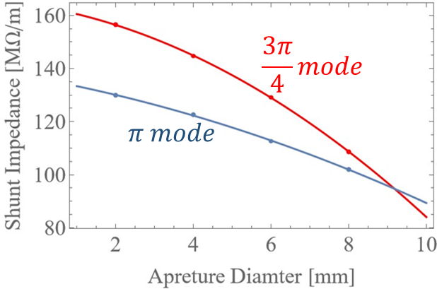
Comparison between the $π$-mode and the 3𝜋/4-mode between
With increasing aperture, the $π−mode$ becomes $increasingly difficult to realize$
Notes:
Merge these and provide comparison with PIC

