Slide 1
Bunch compression for the ultra-compact x-ray free-electron laser
River Robles (riverr@stanford.edu)
Stanford University and SLAC
C³ Workshop
February 13th, 2023

Slide 2
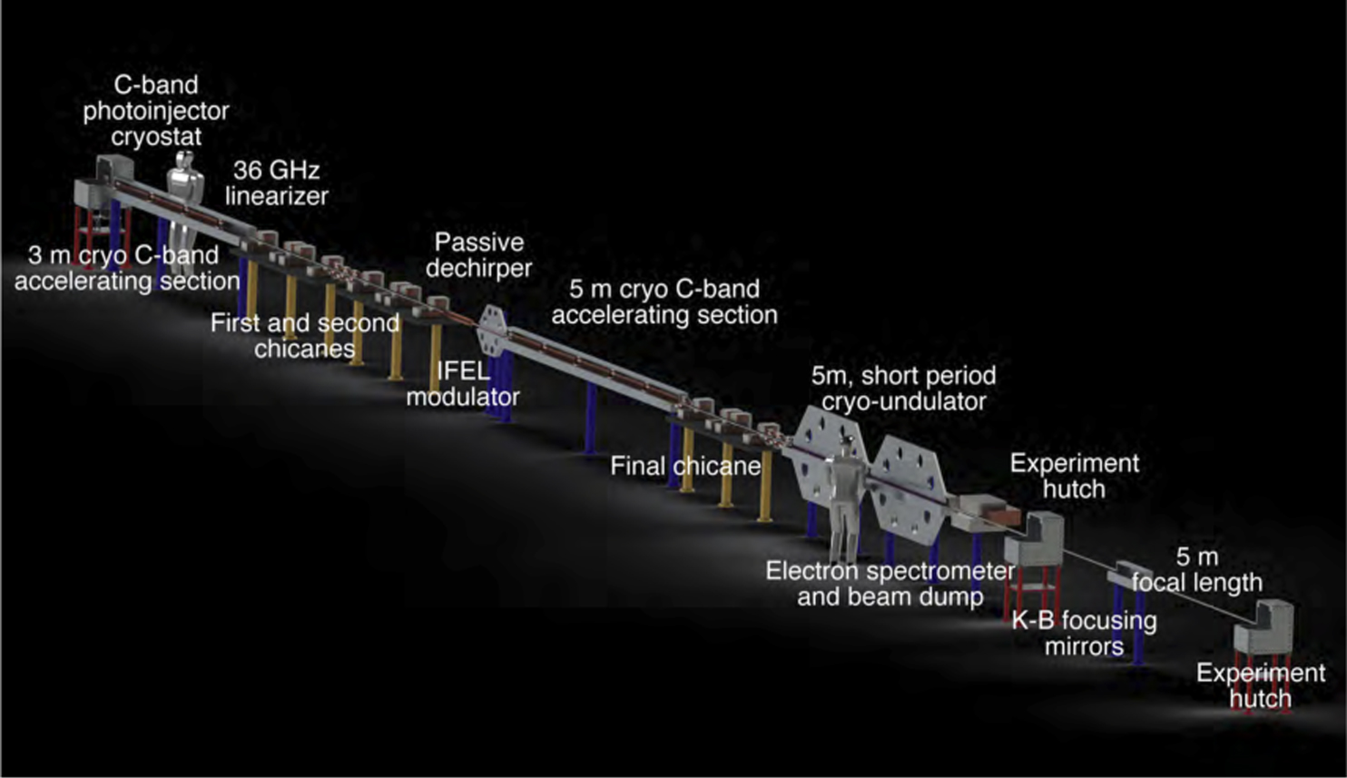
The Ultra-Compact X-ray Free-Electron Laser (UCXFEL)
Rosenzweig, J. B., et al. New Journal of Physics 22.9 (2020): 093067.
Undulator:
~70 nm-rad emittance
1 GeV
~0.5 MeV energy spread
4 kA current
Injector:
55 nm-rad emittance
150 MeV
2 keV energy spread
20 A current
100 pC
Enabling features:
Cool copper accelerating structures → high gradient acceleration
Cool copper injector → ultra-high brightness beam
Novel compression layout → preserve brightness

Slide 3
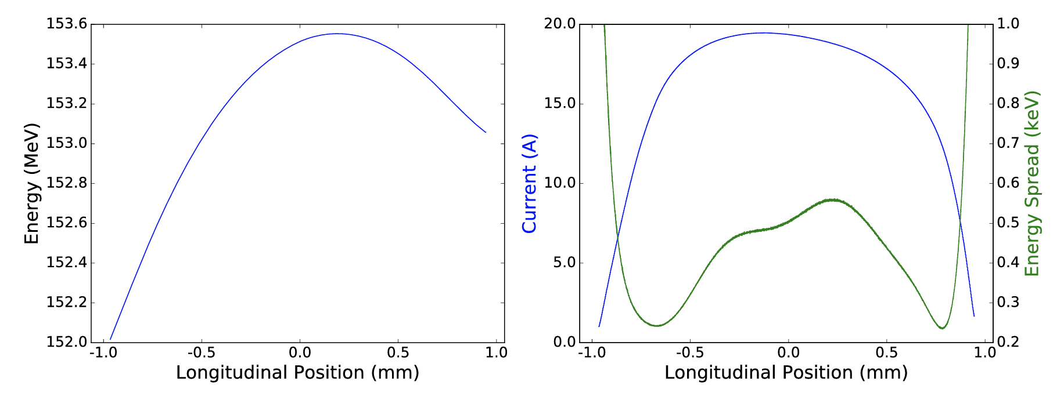
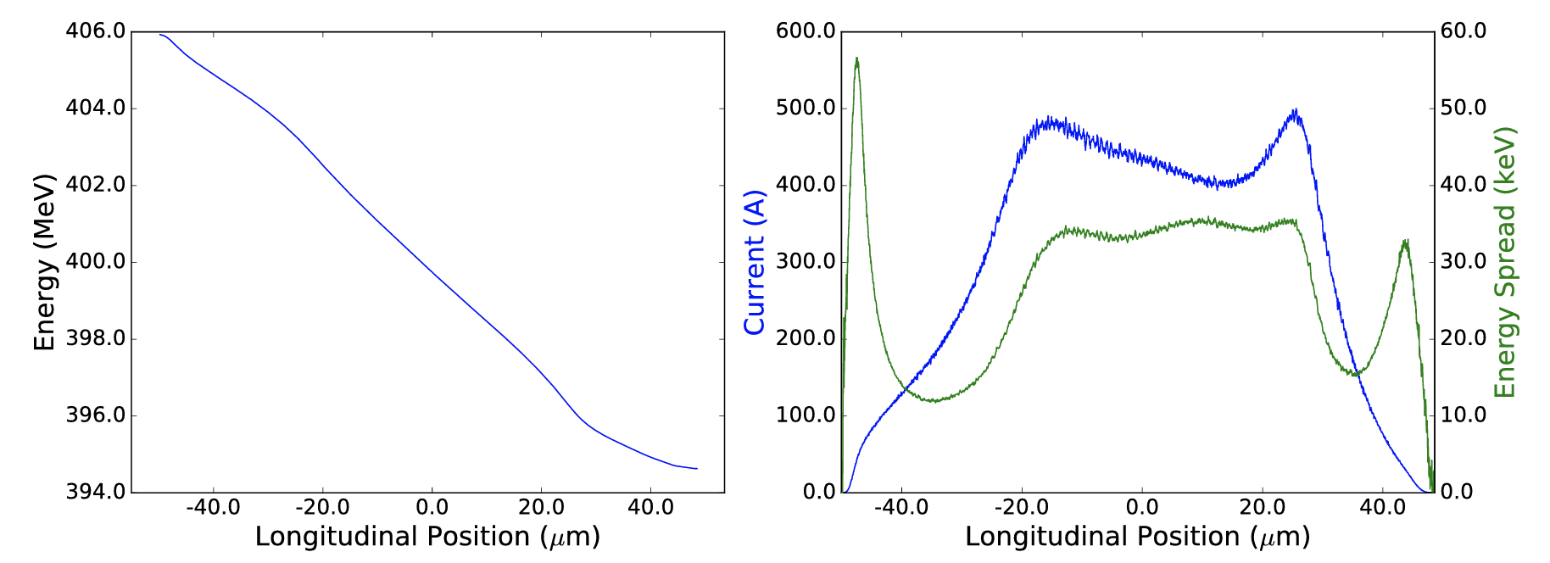
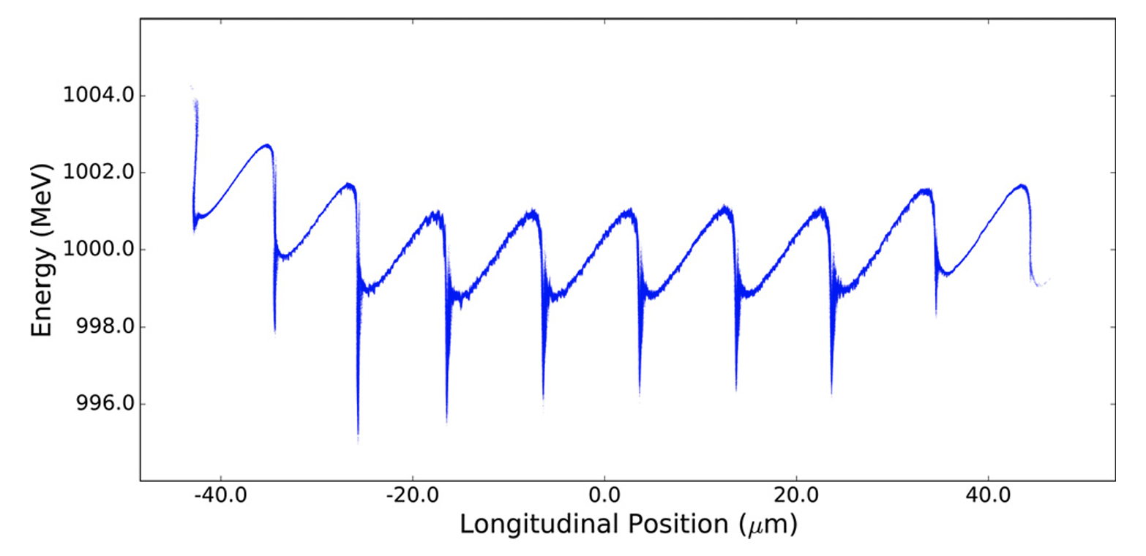
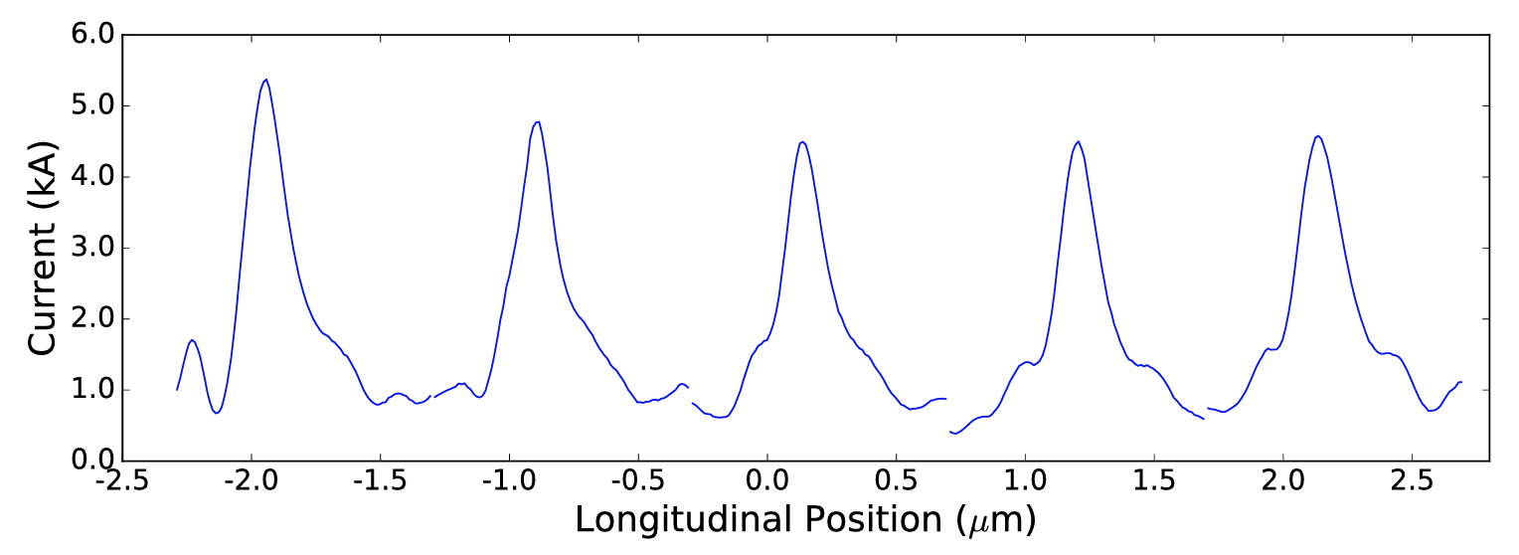
Compression stages in more detail
Rosenzweig, J. B., et al. New Journal of Physics 22.9 (2020): 093067.

Slide 4
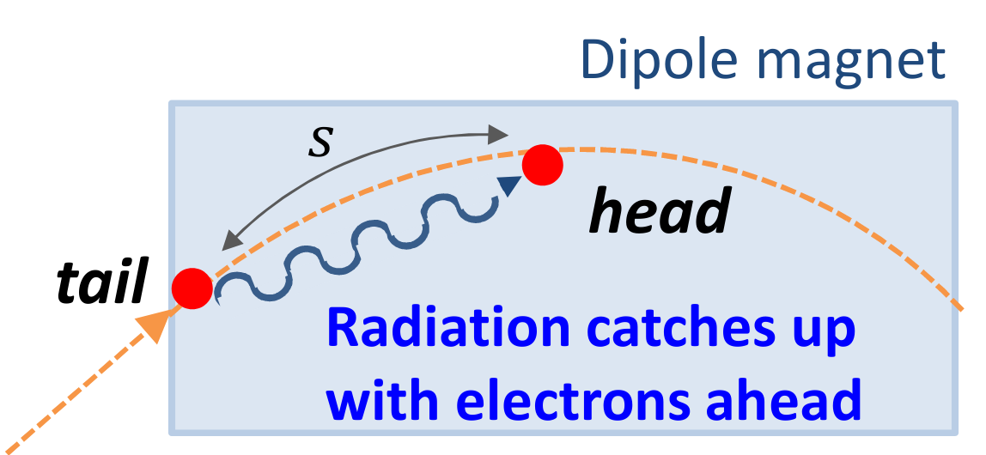
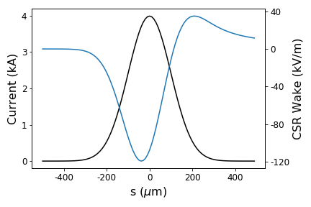
Coherent synchrotron radiation (CSR)
S. Di Mitri, June 2015, USPAS Lecture Notes
Correlated energy kicks in dispersive region → temporal-angular correlations → emittance growth
Projected emittance growth
Slice emittance growth
$$x′$$
$$x′$$
Further compression
$$z$$
$$z$$
Reversible in principle with the right correlated kicks
Practically irreversible

Slide 5
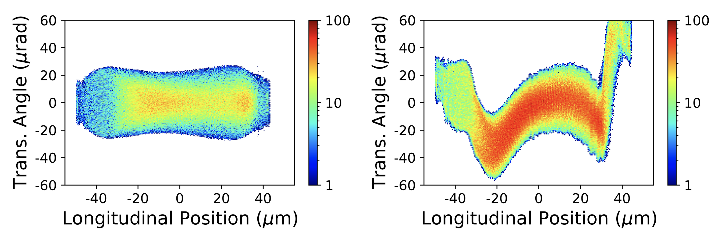
First compressor: zig-zag chicanes
Single chicane (“C-chicane”) design:
112 nm-rad projected emittance
Zig-zag chicane (“S-chicane”) design:
65 nm-rad projected emittance
Jing, Yichao, Yue Hao, and Vladimir N. Litvinenko. PRSTAB 16.6 (2013): 060704.
Robles, River, and James Rosenzweig. Instruments 3.4 (2019): 53.

Slide 6
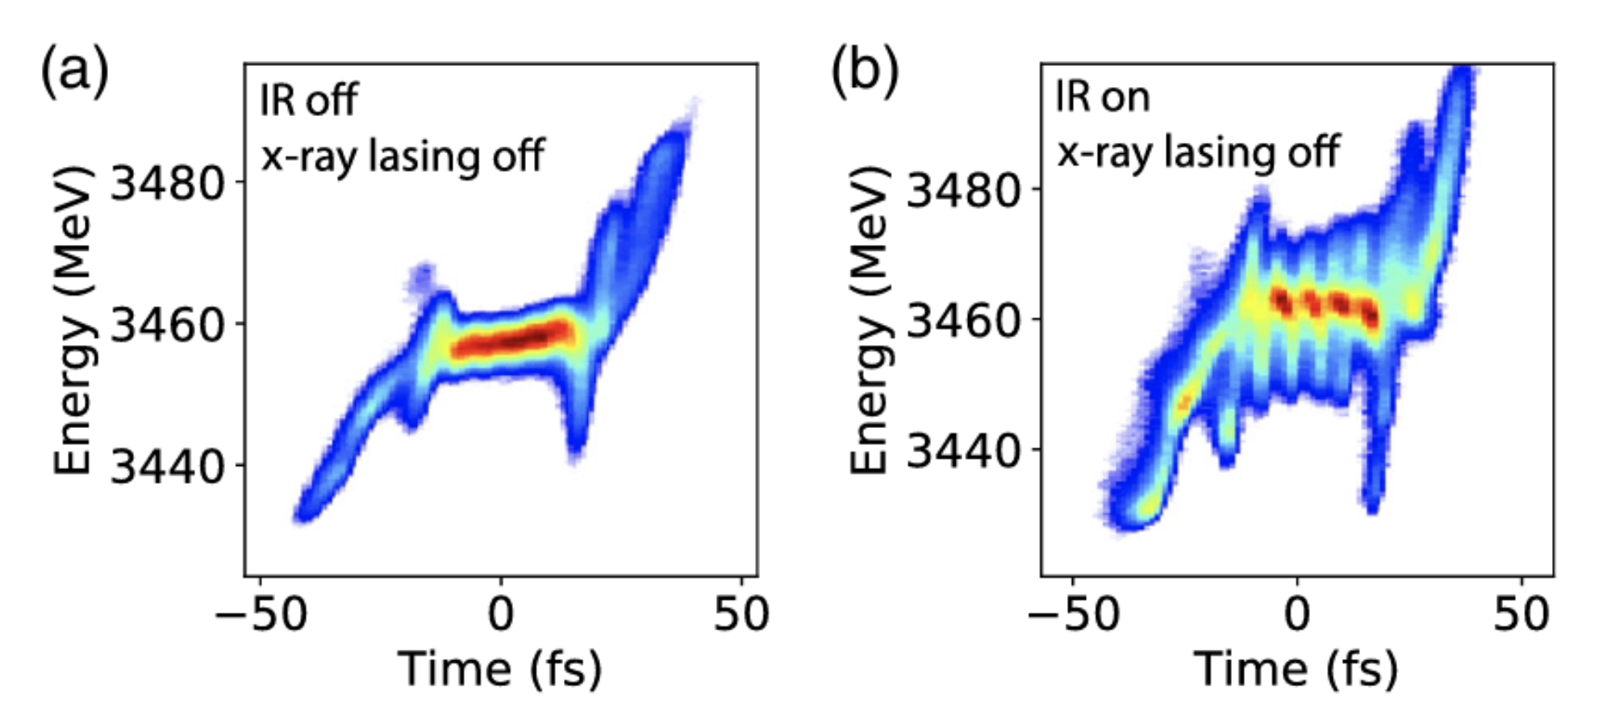
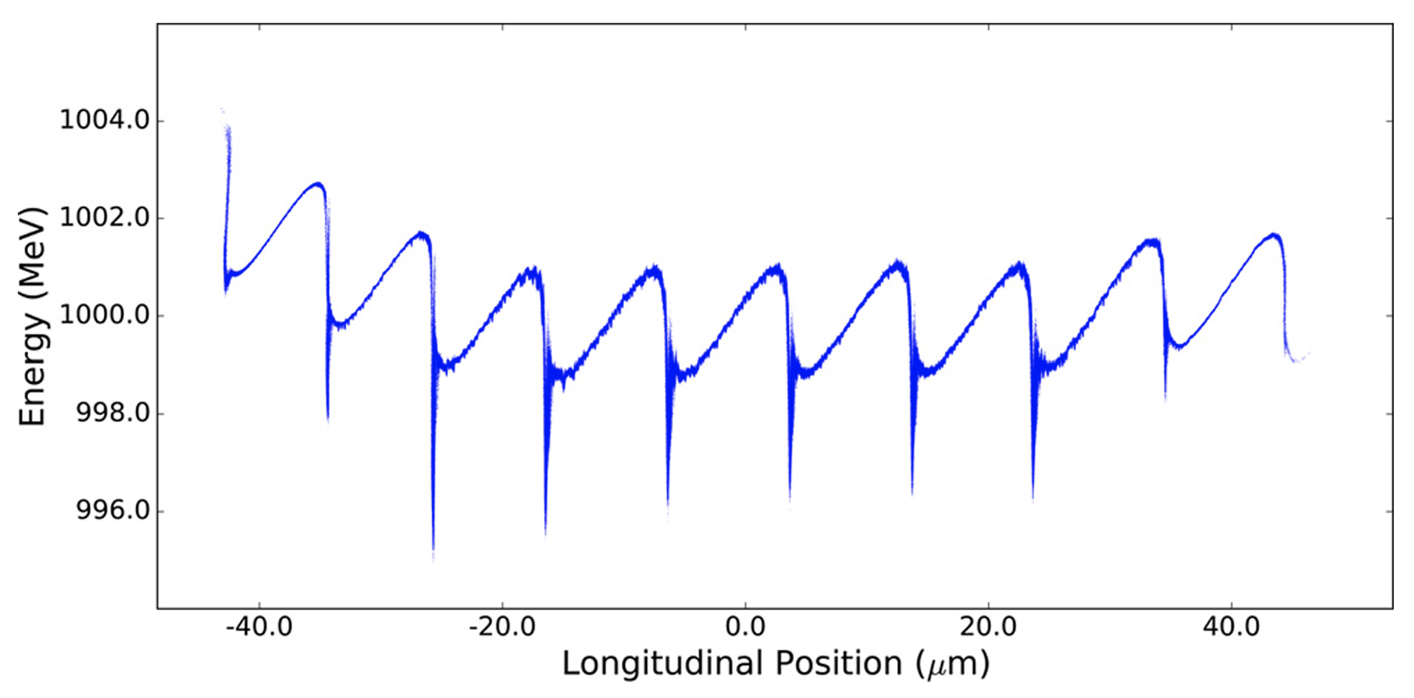
Second compressor: laser-based compression
CSR energy spread:
(a)
(b)
(c)
$$Δγ≃0.22N_{e}r_{e}{\left(\frac{L_{b}θ^{2}}{σ_{z}^{4}}\right)}^{\frac{1}{3}}$$
minimize R₅₆ → maximize chirp
(a)
(b)
(c)
Reproduced from Duris, Joseph P., et al. Physical Review Letters 126.10 (2021): 104802.
Zholents, Alexander A. PRSTAB 8.4 (2005): 040701.

Slide 7
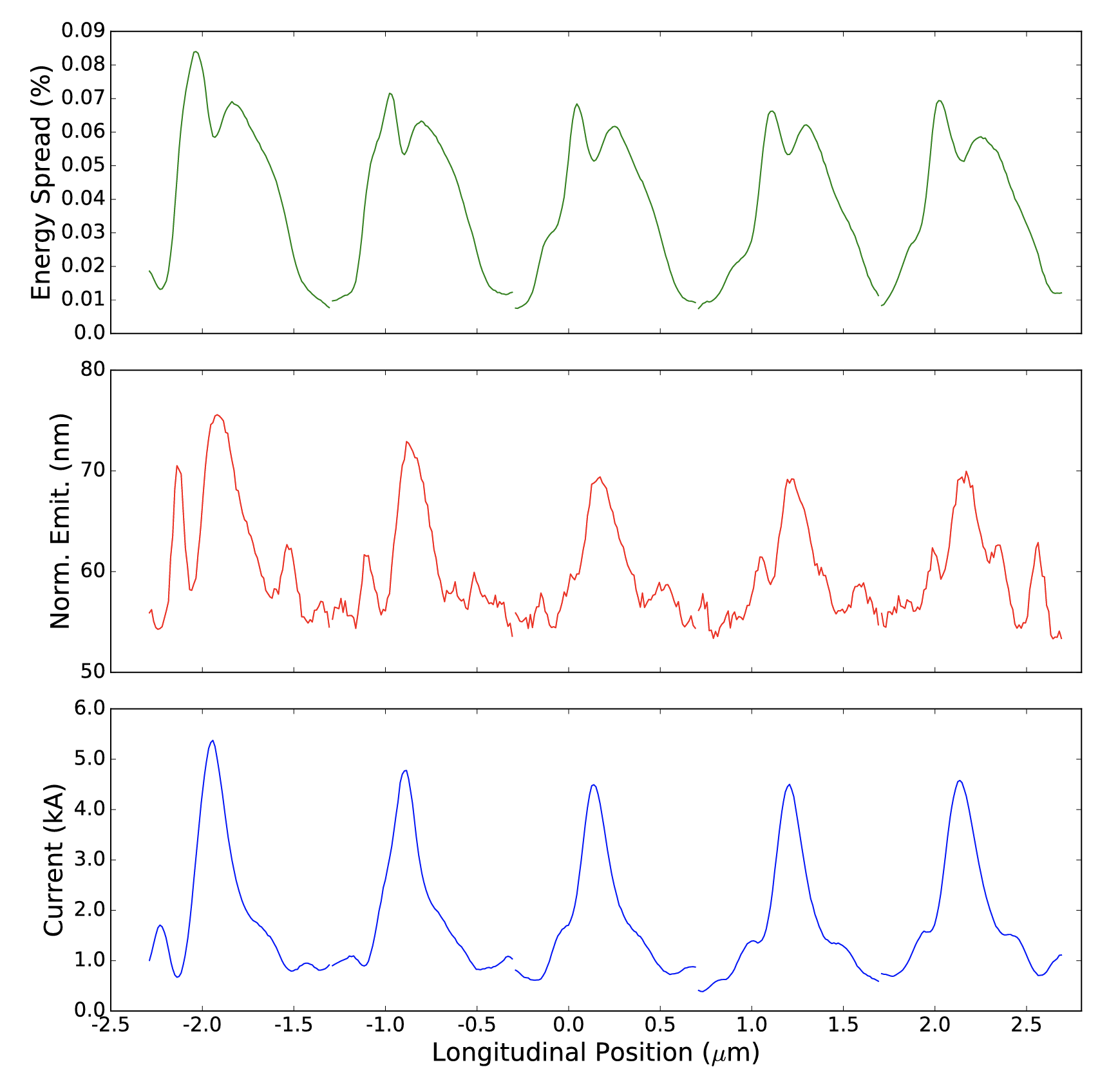
Microbunch features
Rosenzweig, J. B., et al. "New Journal of Physics 22.9 (2020): 093067.

Slide 8
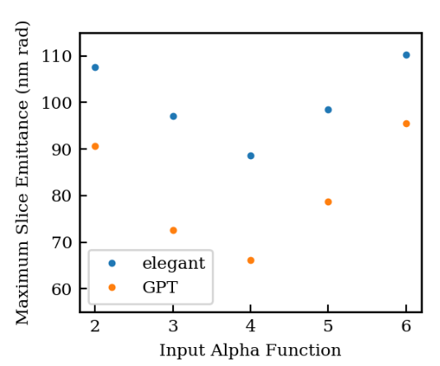
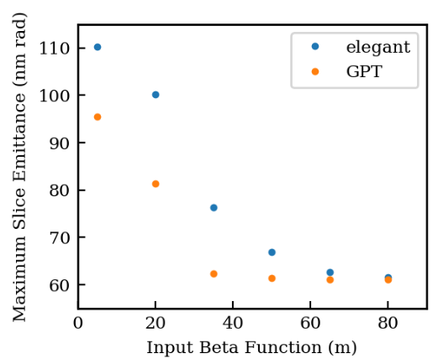
Three-dimensional CSR effects for short bunches
What quantifies the regime?
Derbenev criterion:
$$D=\frac{σ_{r}}{{\left(Rσ_{z}^{2}\right)}^{\frac{1}{3}}}$$
$≥1$ → 3D
$≪1$ → 1D
How does 3D CSR affect the UCXFEL case? – Study with GPT simulations of a single microbunch
Optimal working point for given beta function unchanged:
Better agreement (and smaller emittances) found for larger input beta functions:
Derbenev, Yaroslav S., et al. Microbunch radiative tail-head interaction. No. TESLA-FEL-95-05. SCAN-9511114, 1995.
R. R. Robles, et al. Three-dimensional radiative effects in the compression of ultra-short electron micro-bunches. Proceedings of IPAC 2021 (2021).

Slide 9
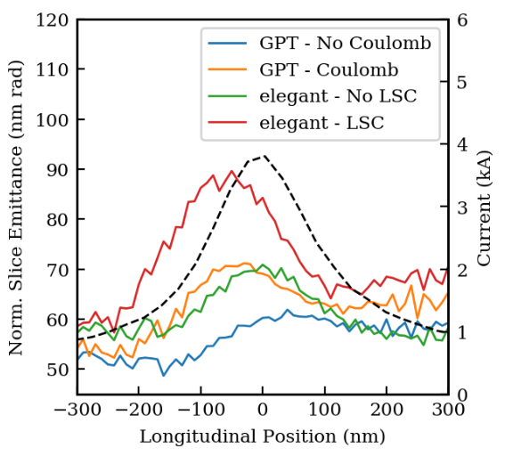
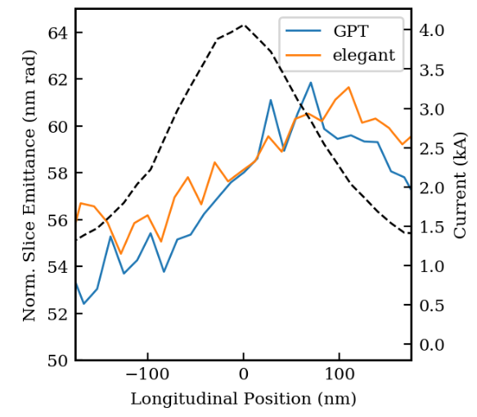
What’s happening?
“Velocity term”
“Radiation term”
10 meter input beta function:
80 meter input beta function:
Brynes, A. D., et al. New Journal of Physics 20.7 (2018): 073035.
R. R. Robles, et al. Three-dimensional radiative effects in the compression of ultra-short electron micro-bunches. Proceedings of IPAC 2021 (2021).

Slide 10
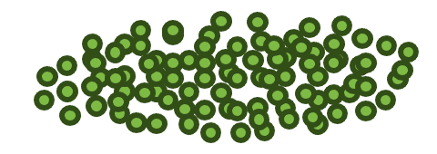
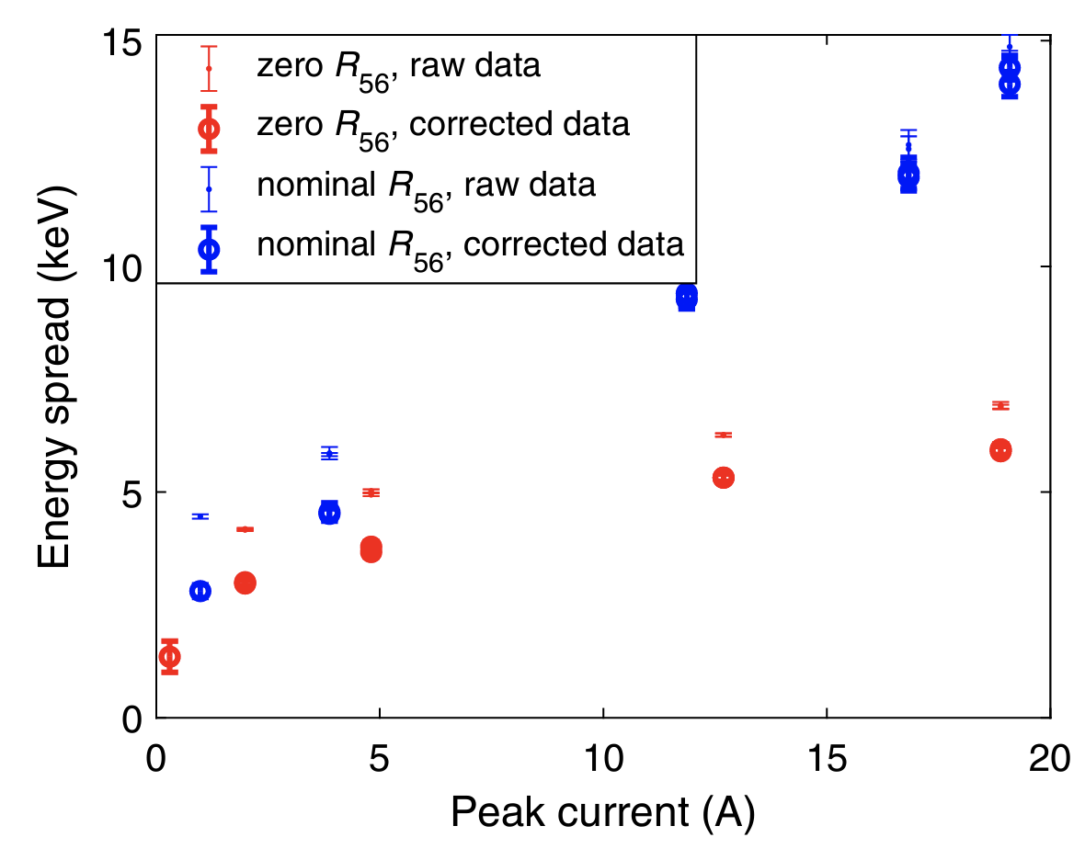
A cautionary tale about energy spread: intrabeam scattering
We only understand bunch compression limits insofar as we understand our energy spread
$$σ_{z,min}=σ_{z,0}\frac{σ_{δ}}{\sqrt{σ_{δ}^{2}+h^{2}σ_{z,0}^{2}}}$$
Smooth, mostly correlated space-charge forces
High-frequency noise → microbunching instability
Stochastic collisions give rise to uncorrelated energy spread growth
Simulations generally < 1 keV from injector
Reproduced from Prat, Eduard, et al. PRAB 25.10 (2022): 104401.
Tomin, Sergey, et al. PRAB 24.6 (2021): 064201.
Qian, Houjun, et al. PRAB 25.8 (2022): 083401.
Prat, Eduard, et al. PRAB 23.9 (2020): 090701.

Slide 11
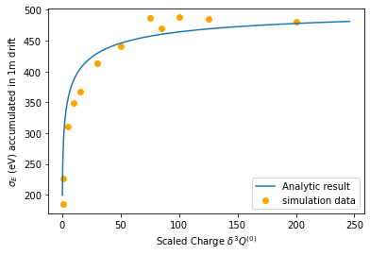
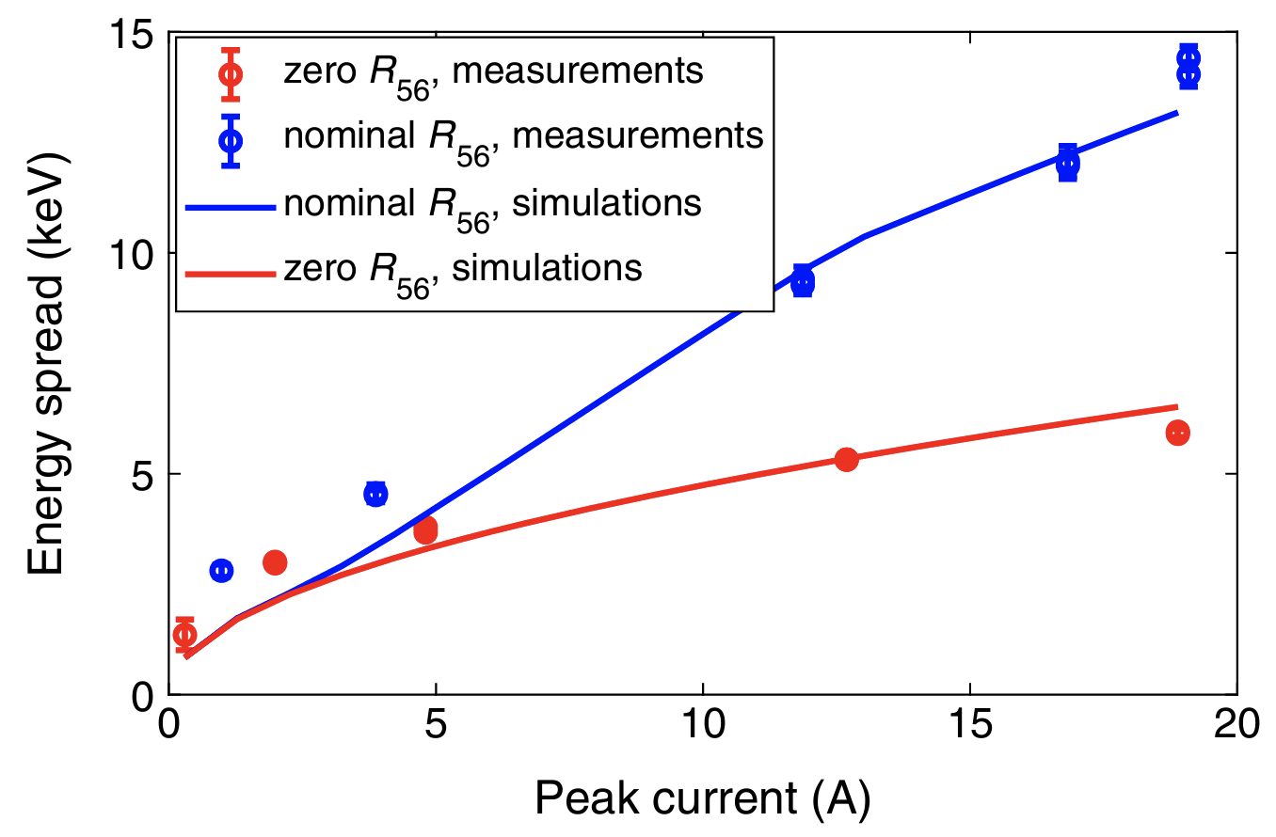
Modeling intrabeam scattering effects
Low energy: scaling arguments
High energy: Piwinski formula
In injector, beam envelope follows:
If we scale this while holding $\frac{Q}{σ_{x}σ_{y}σ_{z}}$ constant, we can put it in a form that is independent of the charge
The following formula is often borrowed from older studies on IBS in rings:
The “coulomb log” is typically ~ 1-20 for relevant beam conditions
Reproduced from Prat, Eduard, et al. PRAB 25.10 (2022): 104401.
E-spread after 1 meter (eV)
Sim. results from Obed Camacho
With 2.4x fudge factor*
Simulated charge (fC)
Robles, River R., et al. PRAB 24.6 (2021): 063401.
A. Piwinski, in Proceedings of the 9th International Conference on High Energy Accelerators, Stanford, CA, USA,1974,p.405.
Huang, Z. SLAC-TN-05-026 (2002).

Slide 12
Conclusions
The UCXFEL has two key challenges that require innovative approaches to CSR mitigation:
Starting from ultra-low emittance beams
Requiring kA compression at relatively low energies
Zig-zag chicanes can cancel correlated CSR kicks, avoiding projected emittance growth
Laser modulation enables large chirps with relatively low energy spreads
3D CSR can be helpful or harmful, but should be quantified. Seems to have the same working points as 1D from a design perspective
Sources of uncorrelated energy spread (IBS, MBI) still poorly understood and require better modeling approaches

Slide 13
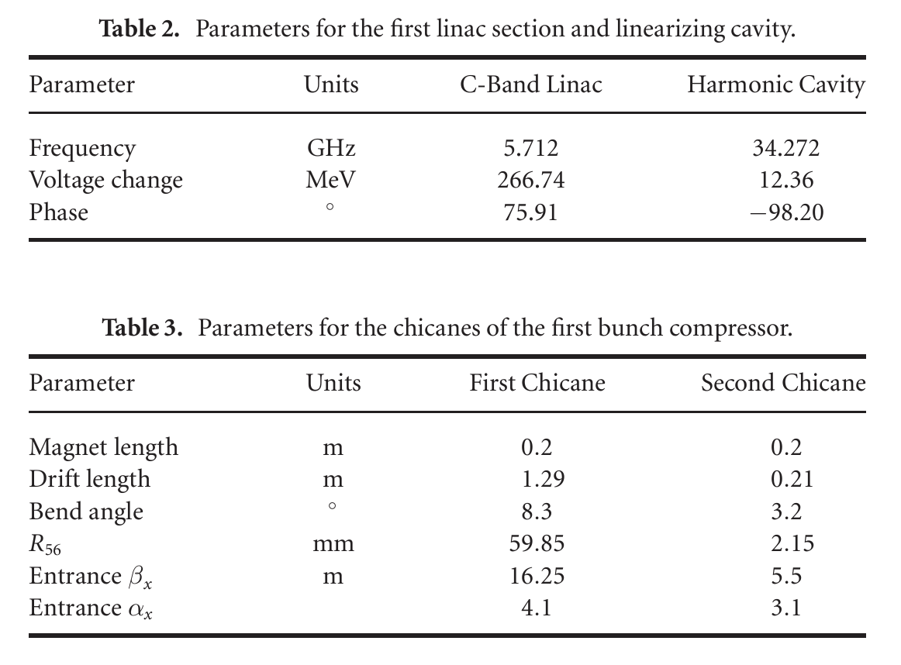
Specific numbers for first compressor

Slide 14
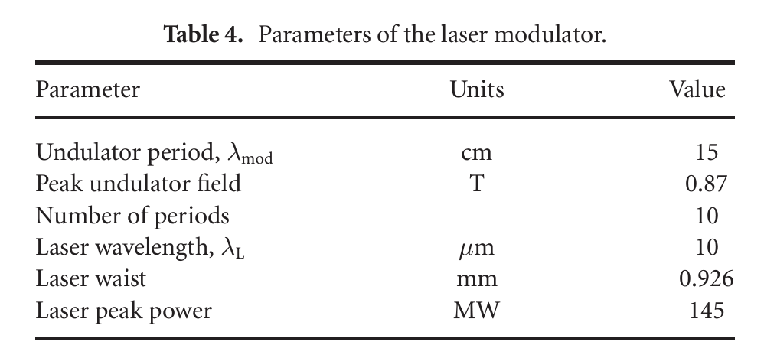
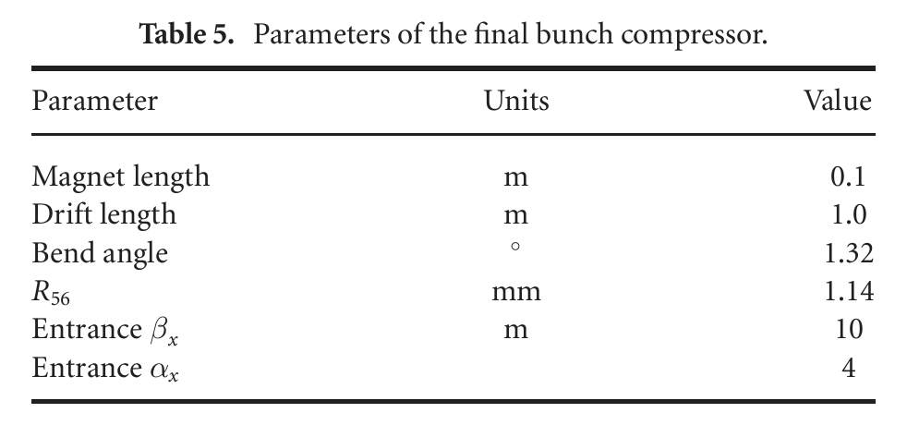
Specific numbers for second compressor

