Slide 1
Updates from Cornell on C3 Activities
Jared Maxson
CLASSE, Cornell University

Slide 2
Cornell: What we do
Cornell’s accelerator group (Faculty: Bazarov, Hoffsteatter, Liepe, Lockyer, Maxson)
  Fundamental Accelerator Research
  Advancing next gen projects
  Advancing our local infrastructure

Slide 3
Cornell: What we do
Cornell’s accelerator group (Faculty: Bazarov, Hoffsteatter, Liepe, Lockyer, Maxson)
  Fundamental Accelerator Research → Max performance of RF cavities
  Advancing next gen projects → Developing the C3 Collider concept
  Advancing our local infrastructure → Deploying cold copper in our local accelerator complex

Slide 4
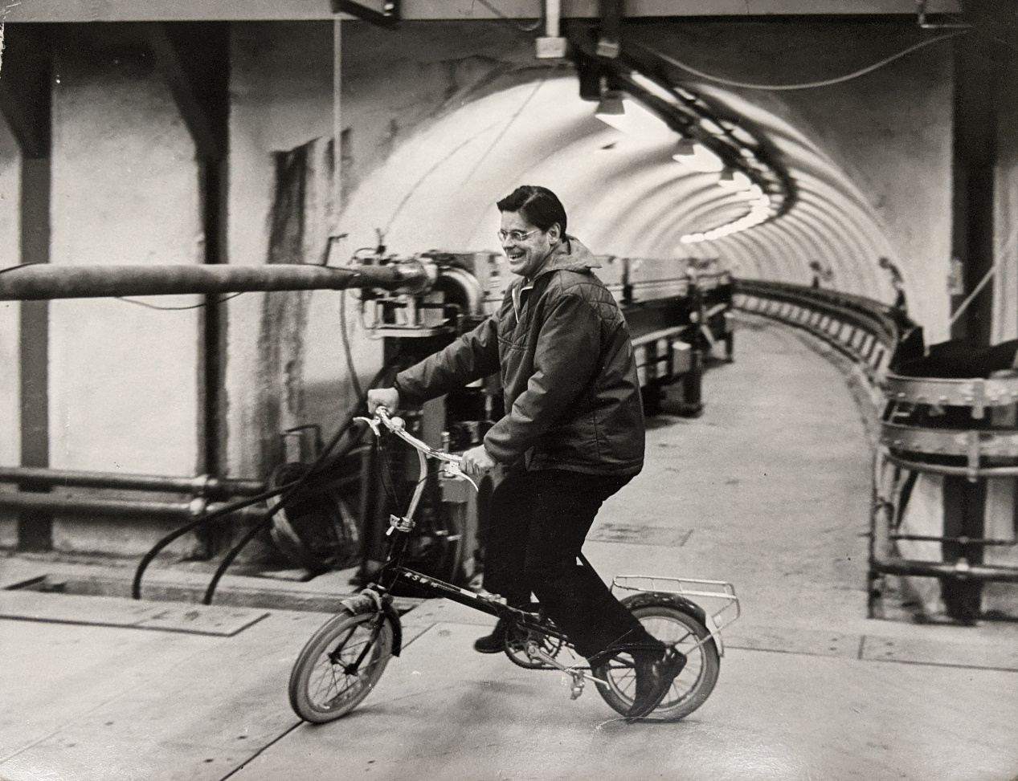
A quick Cornell accelerator overview
History:
1967: 12 GeV Synchrotron
Robert Wilson in the tunnel, 1968

Slide 5
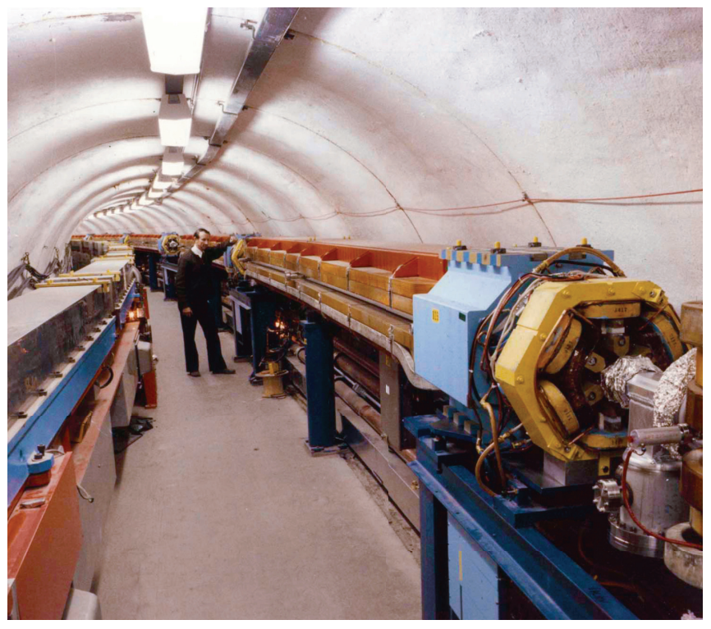
A quick Cornell accelerator overview
History:
1979: Cornell Electron Storage ring, CESR
Electron-positron collisions,
And more than 2 decades of elementary particle physics.
Since inception, CESR has also driven CHESS, running concurrently with the particle physics program.
CHESS is now the primary function of CESR.
Wilsonian synchrotron:
In-vacuum magnets
Remains the booster
for CESR to this day.
Boyce McDaniel with CESR

Slide 6
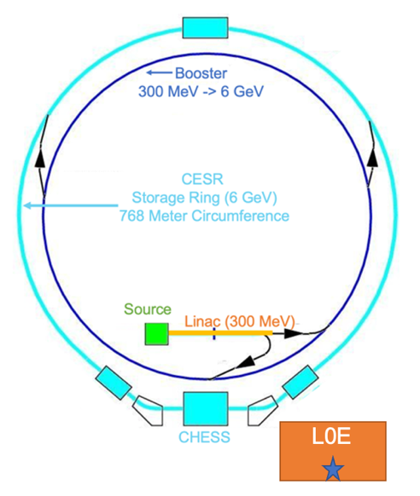
A C3-style upgrade for our linac+booster?
A 6 GeV full energy injection linac could fit in a few places in our facility:

Slide 7
Proposal to NSF: A Cold copper test instrument
We have proposed the Instrument for Cryogenic Accelerator Research and Ultrafast Scattering (ICURUS) at Cornell to NSF
Lots of synergies with LANL/CARIE and UCLA/UCXFEL
Gun to be built by UCLA, employs C3 quarter cryomodule

Slide 8
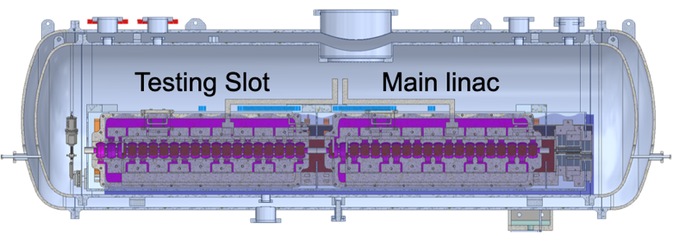
ICARUS Use #1: Accelerator testing
C3 Quarter Cryomodule
  Two seater: One slot for a workhorse cavity, other available for test structures
Lots of things to study:
  Development of cryogenic accelerator diagnostics: alignment, vibrations, …
  Cavity bean-driven wakefield studies (up to 1 nC bunch charge)
  Gradient tests
Experimental hall has radiation shielding and overhead crane.

Slide 9
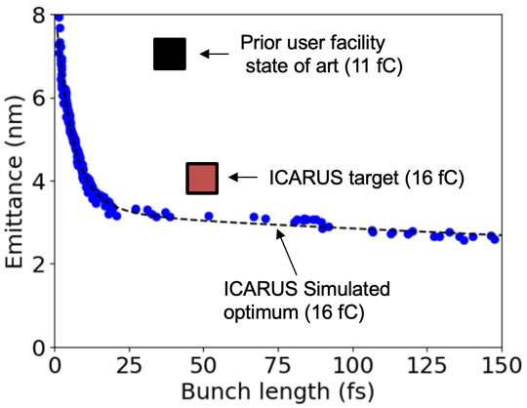
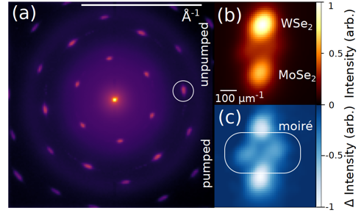

ICARUS Use #2: Next Gen UED
Ultrafast Electron Diffraction (UED)
Gun Only, ~200 MV/m, 7 MeV Beam
High Field/Gun Energy helps brightness
Challenge: diffraction Bragg angles fall as $1/βγ$, and ”zoom” is useful!

Slide 10
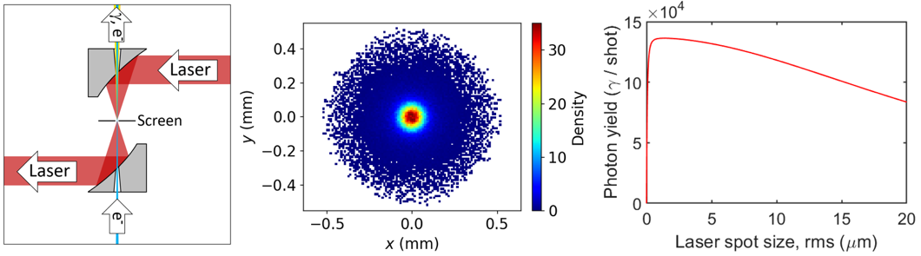
ICARUS Use #3: ICS for Detector testing
Cornell is the home of lots of next-gen x-ray detector development
Large gap in performance between silicon-based detectors (~10 keV) and those for ~100 keV.
Detectors are getting faster and faster—nanosecond framing and below
ICS is a great match for this challenge: short pulses, high energy photons
250 pC in central core
Flux limited only
By existing laser.
x100 feasible with laser upgrade

Slide 11
Now for a new idea for C-band studies at Cornell…

Slide 12
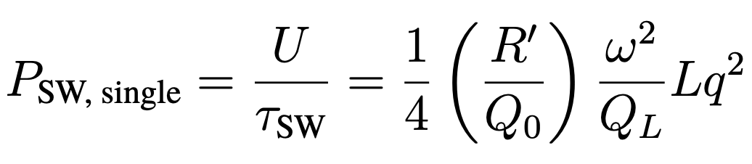
C-band accelerators for W-band power extraction
Cornell (with help from LANL +SLAC) and AFOSR discussing possibility to use C-band for power extraction up to W-band
W-band source options limited at high power: commercial (1 MW cw) and experimental (5 MW pulsed).
For a single, short drive bunch in a standing wave power extraction structure:

Slide 13
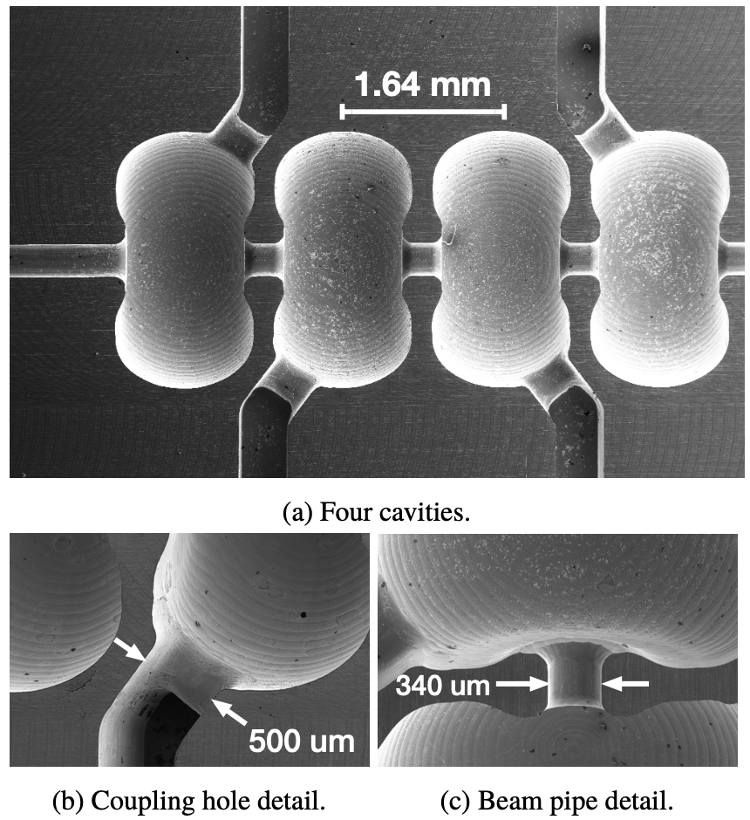
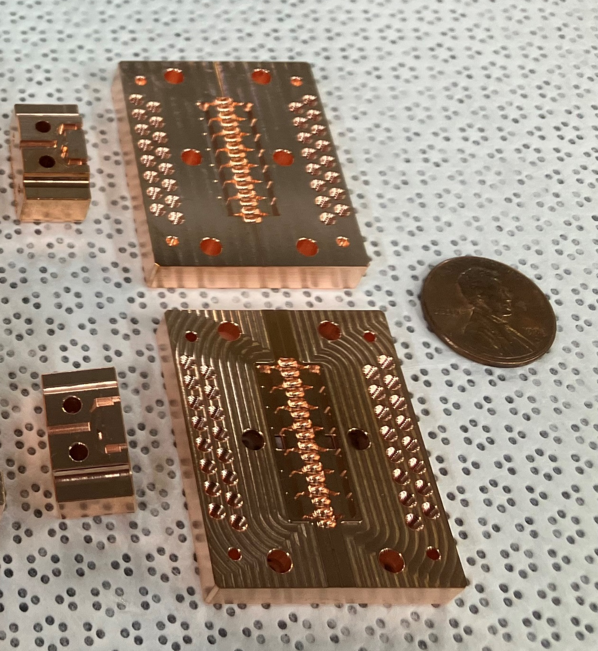
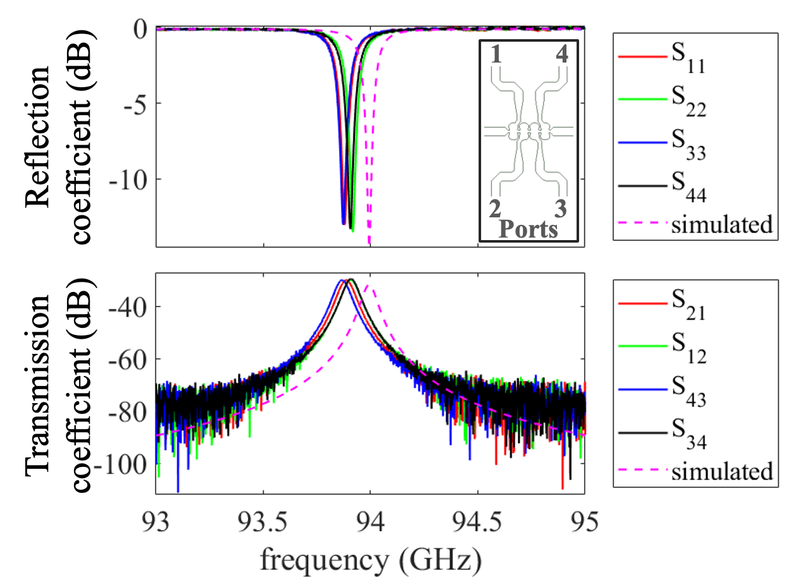
SLAC W-band structures
W-band PETS
E. Snively et al, IPAC 22, AAC22
THPTS063, IPAC2019, Melbourne, Australia

Slide 14
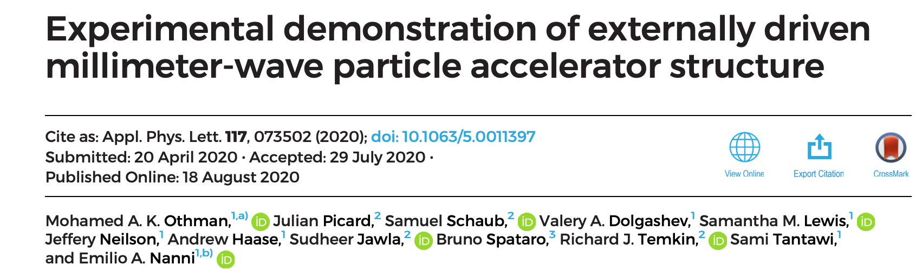
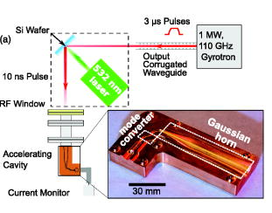
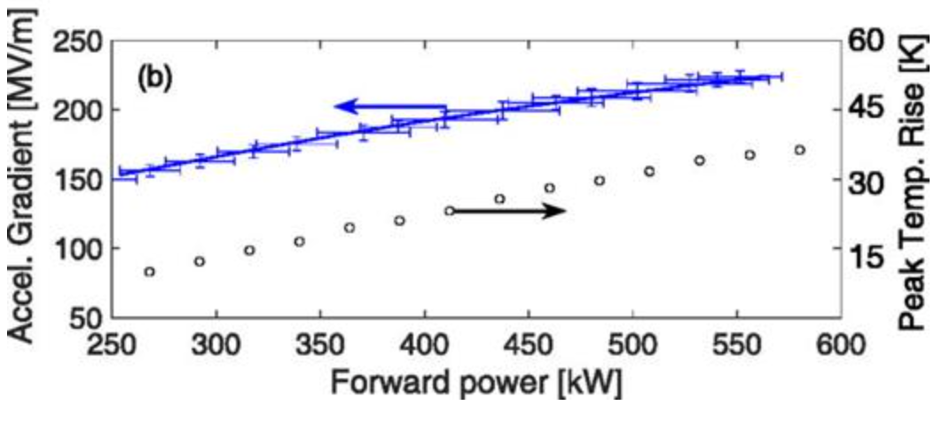
W-Band high power tests
230 MV/m, surface fields above 500 MV/m
Gradient only limited by MW-class output of gyrotron.

Slide 15
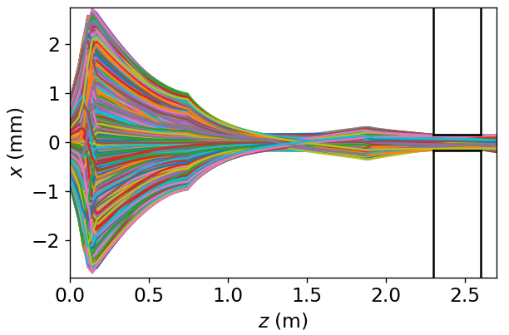
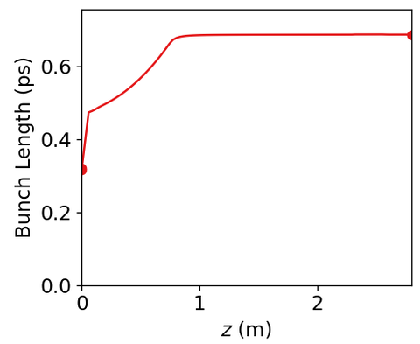


C-band Driver Dynamics
W-band apertures (300 micron) present a brightness problem
A C-band solution for bright, high charge beams using a C-band gun and linac: 500 picocoulomb, 700 fs rms, 70 MeV, $ε_{nx}∼1 μ$m
High Frequency
1 foot long structure
Huge Shunt impedance (440 MOhm/m)
Short bunch compared to period
Depending on details of $Q_{0}, Q_{L}$ we estimate
>10 MW W-band extracted power in a sub-ns pulse.

Slide 16
Summary: Bringing C-band to Cornell
Multiple irons in the fire to bring C-band to Cornell for C3 accelerator development (and related)
  NSF proposal under review
  Possible future partnership with AFOSR
Momentum growing: lab leadership and staff are excited to have cold copper on campus.
We will keep proposing until one lands!

