Slide 1
CFD Sims of High-Power Converter Targets
Silviu Covrig Dusa
Jefferson Lab
25 Oct 2023

Slide 2
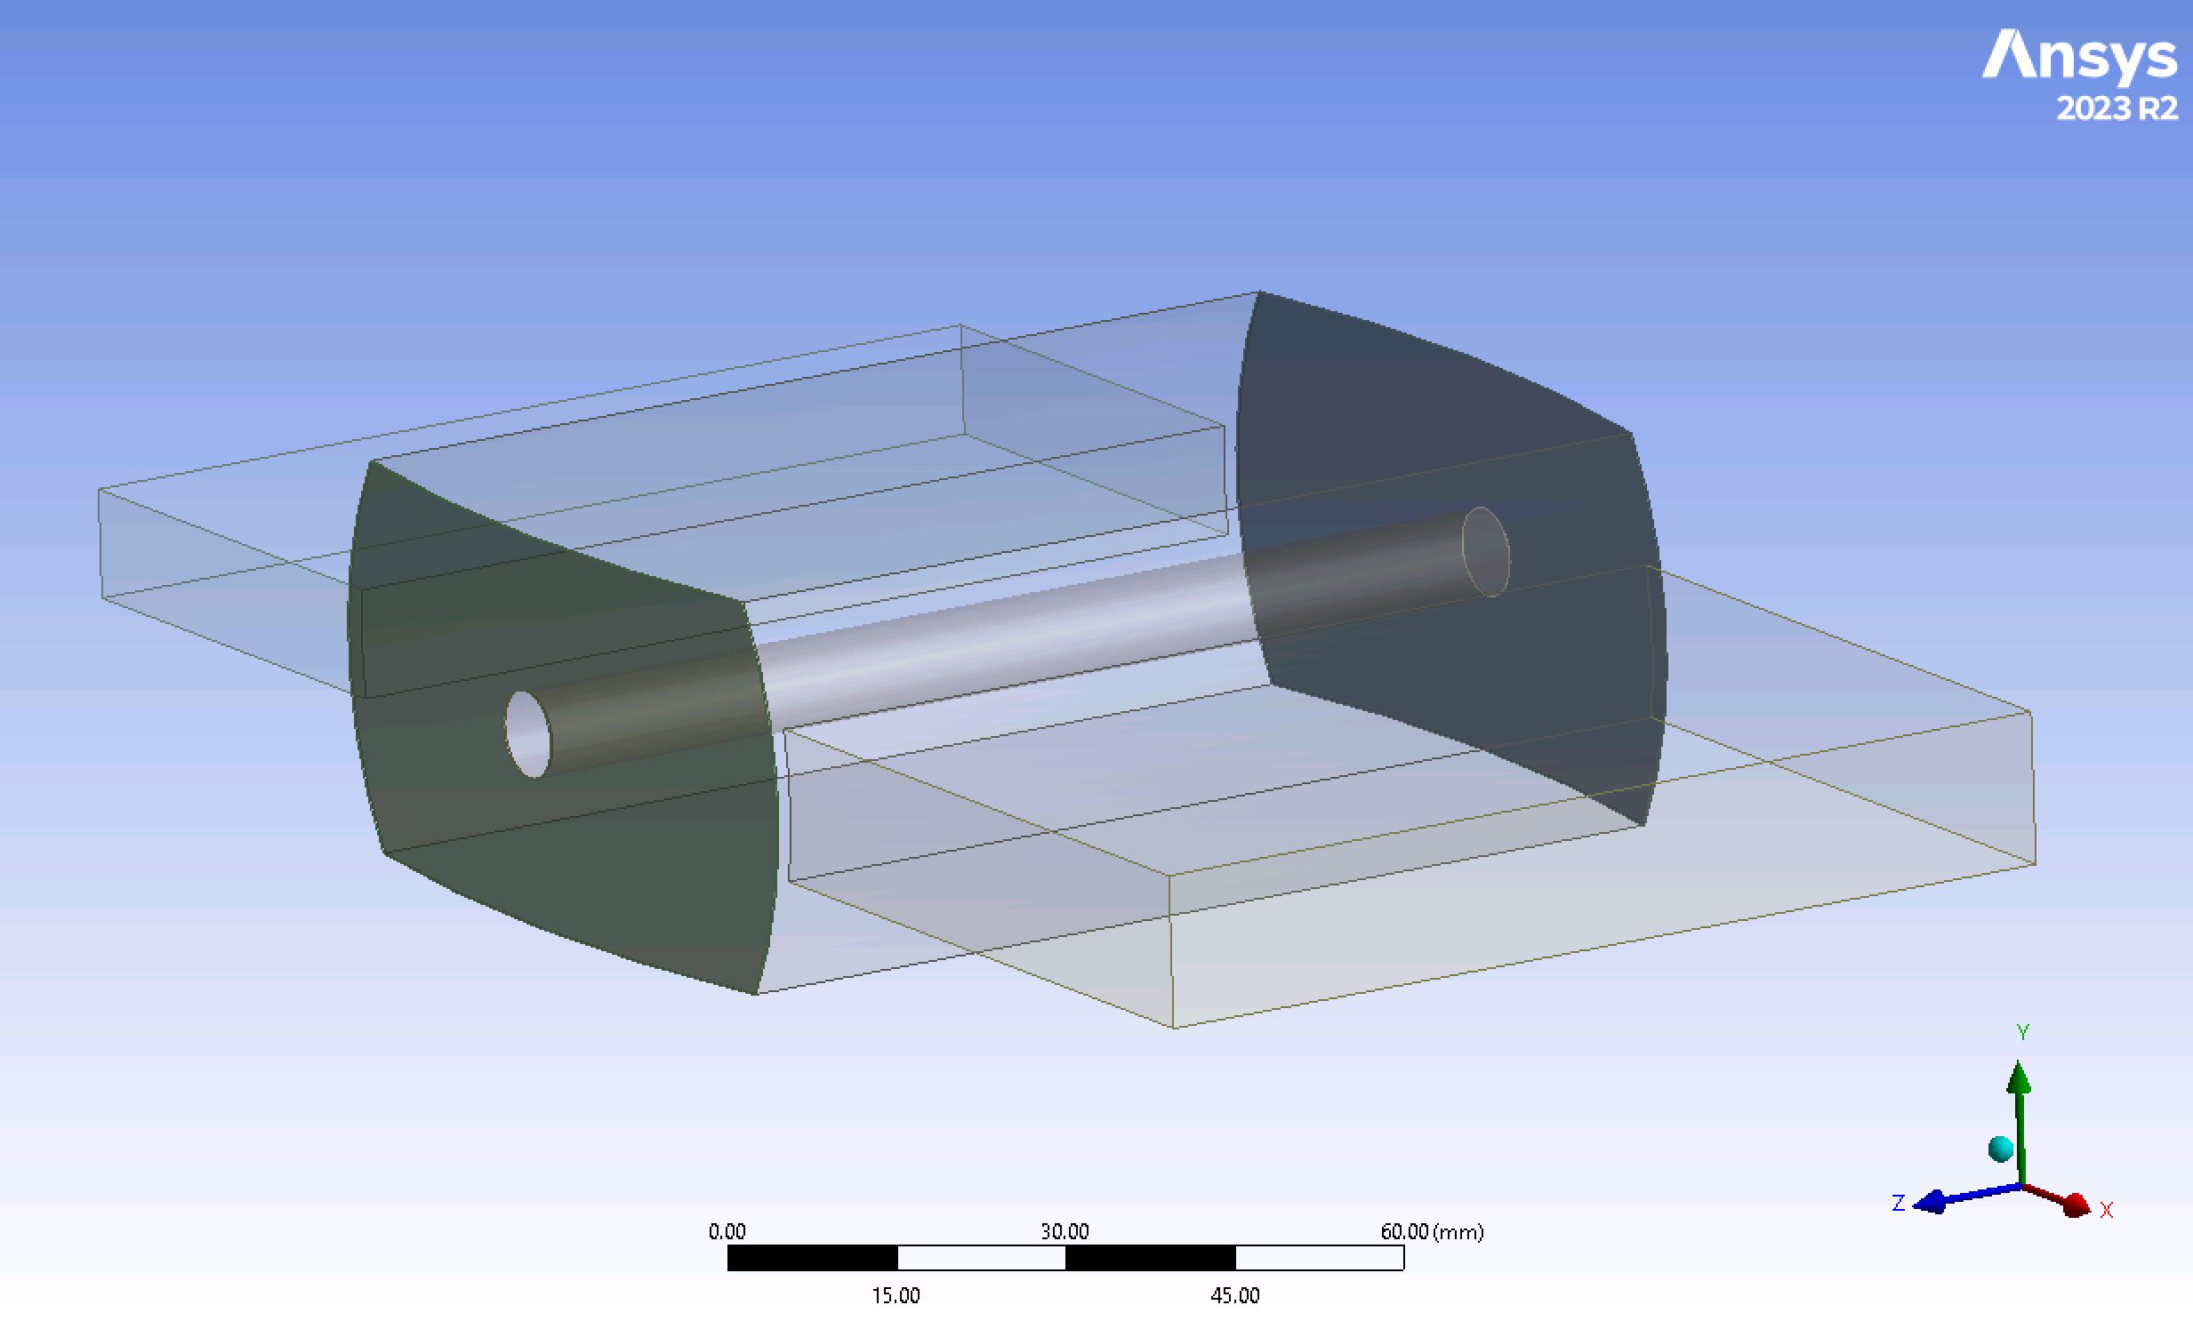
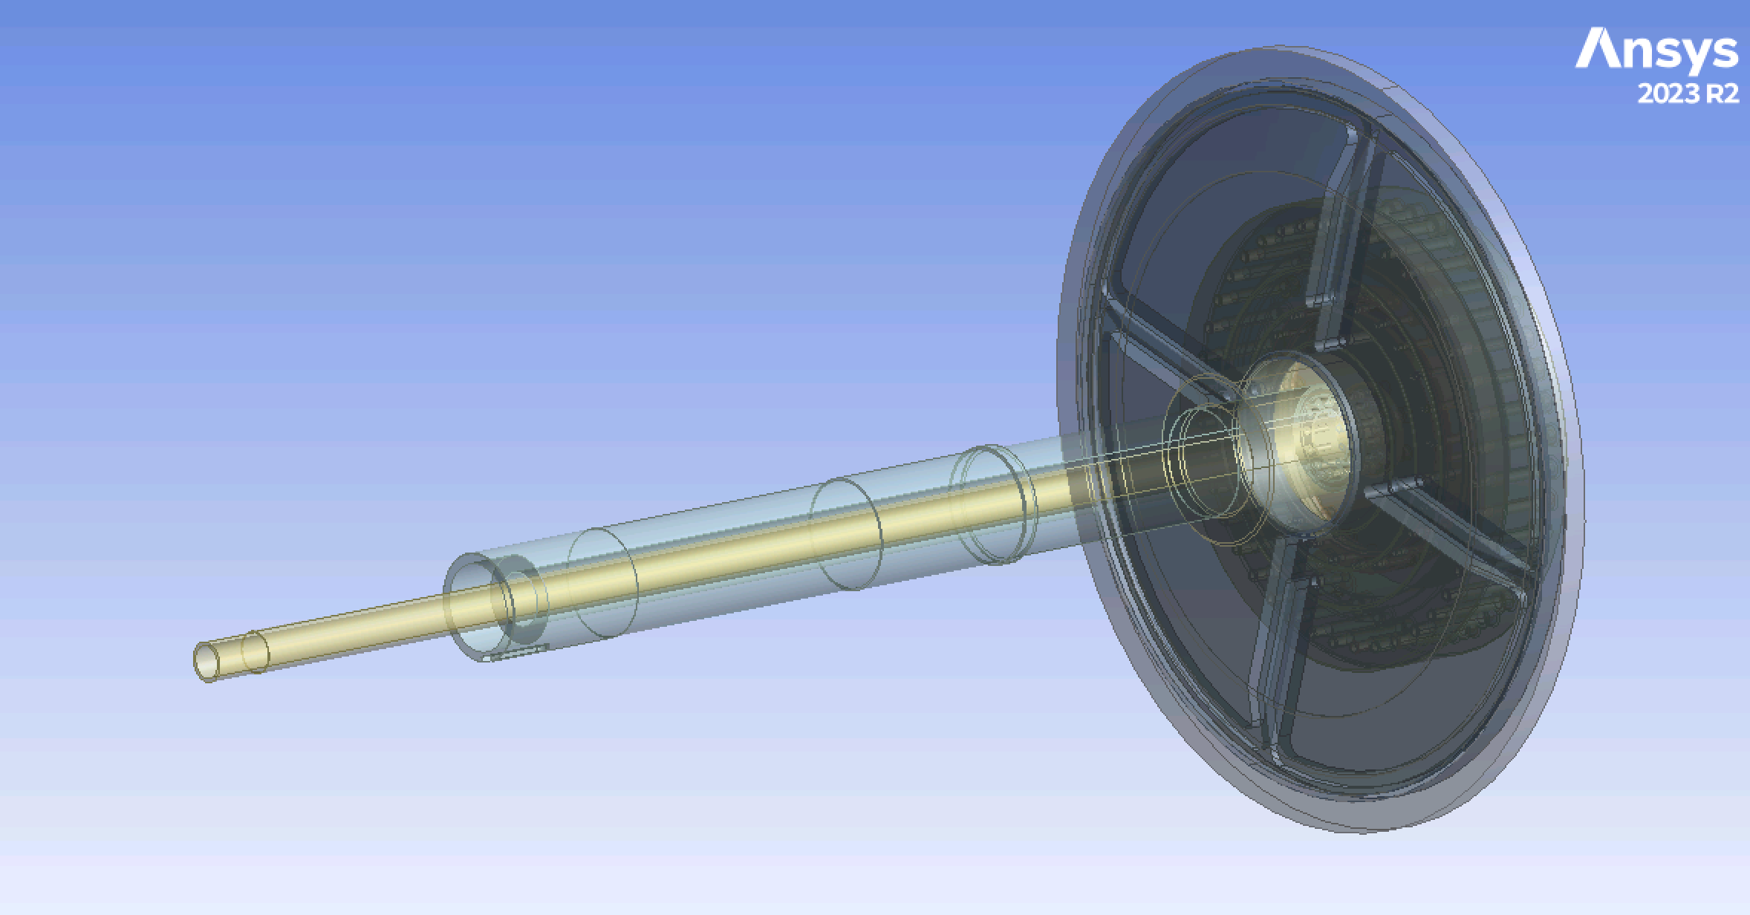
High-Power Converter Targets Considered
SLAC LXe 10-15 cm target, 8 kW (CFD sims started)
SKEKB Rotating W target 17 kW (CFD sims to start soon)

Slide 3
SLAC LXe Target Cell Prototype
Strategy:
  Develop steady-state CFD simulations in an acceptable geometry (done)
  Develop time-dependent CFD simulations that will mimic the ILC beam time-structure and refine the cell geometry to satisfy requirements (working on it)
Step1: considered transverse LXe flow to beam axis cell geometries (3 geometries assessed already) and found a geometry in which the LXe flow is stable
CFD conditions:
  a mixture 2-phase flow was implemented in ANSYS-Fluent v23r1
  LXe was considered at 35 psia, 170 K and 20 kg/s at the cell inlet (at 35 psia Xe saturates at 181.81K and freezes at 161.41 K. Xe properties have been corrected to temperature dependence in the range 160-300 K
  The beam power was considered to be 8 kW and was implemented as a Gaussian profile on the center axis of the cell with a sigma of 1.5 mm and a diameter of 5 mm, otherwise uniform along the beam axis

Slide 4
SLAC Target Cell-3 Geometry
LXe flow inlet
Al beam window, 0.2 mm thick
e- beam direction
Al beam window, 0.2 mm thick
LXe flow outlet
Cylindrical cell geometry, 10-15 cm long

Slide 5
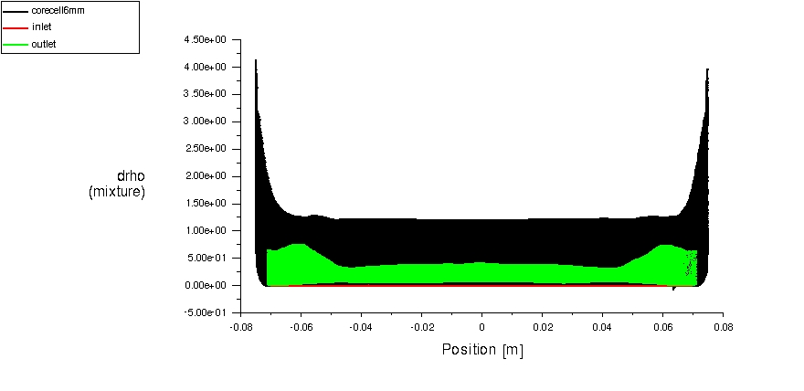
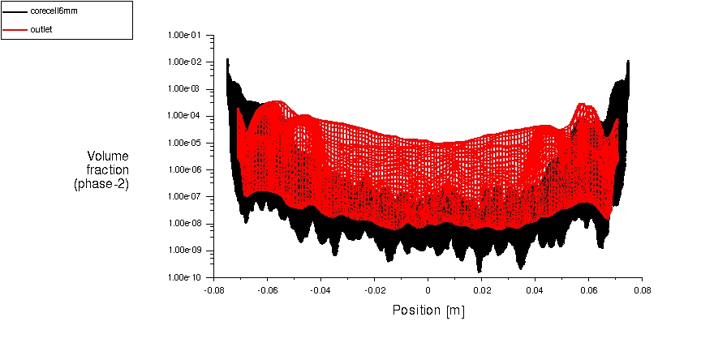
Target Cell-3 (15 cm) CFD Results
GXe volume fraction in the 6 mm diameter core of the cell (black) and at cell outlet (red), along the beam axis. Largest gas fraction, as expected, is near the beam windows.
(%)
Beam axis
LXe density loss average 0.4% in the 6 mm diameter core of the cell for a beam power of 8 kW, maximum density loss in bulk 4 % (if LXe density decreases 2%, it reaches saturation, so there is boiling in the bulk, but negligible)
Beam axis

Slide 6
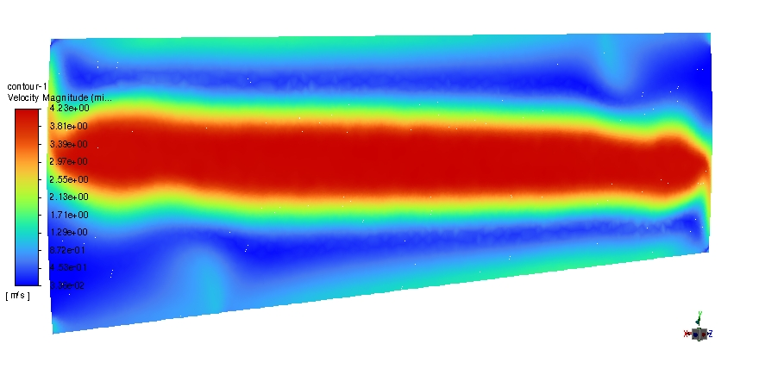
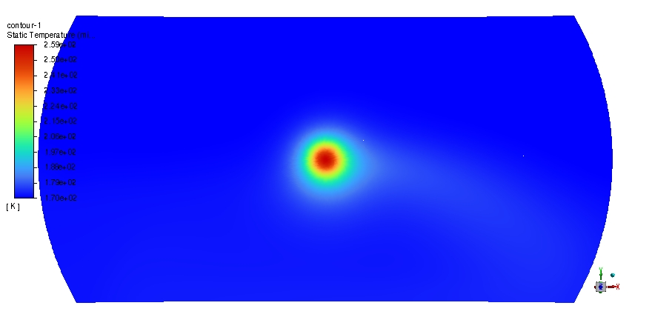
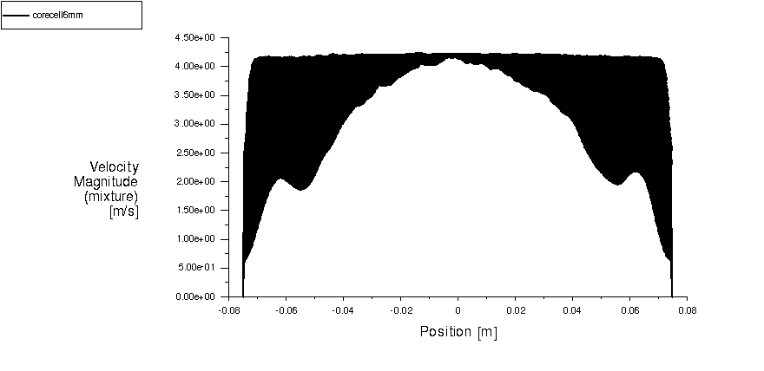
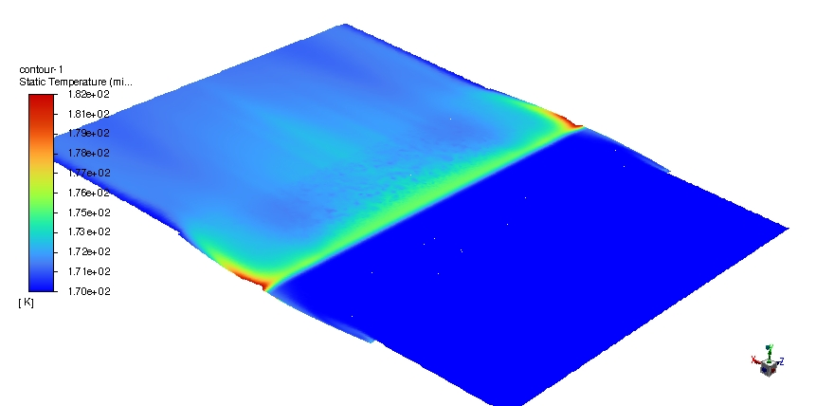
Target Cell-3 (15 cm) CFD Results
LXe flow profile in vertical cross-section
Temperature profile in a beam window, max T < 260 K
LXe flow profile in the 6 mm diameter cell core
LXe temperature profile in horizontal cross-section

Slide 7
Summary
SLAC cell-3 shows promise: stable flow, can take 8 kW beam power in a Gaussian profile
A 10 cm long cell-3 implemented in Fluent, first stage steady-state sims completed, can take 8 kW beam power with drho = 0.97% over the cell core, Gaussian beam profile.
Working on the time-dependent CFD sims for the 10 cm long cell with the beam power deposition profile predicted by SLAC g4 sims (should have results in 2-3 weeks)
  Single beam pulse: assess time relaxation for liquid to equilibrium
  Full-beam structure: assess liquid behavior, mold geometry to minimize LXe density loss
SKEKB target geometry acquired in CAD, will need to schedule a zoom session with Yoshinori’s group to go over the geometry, boundary conditions etc.

