Slide 1
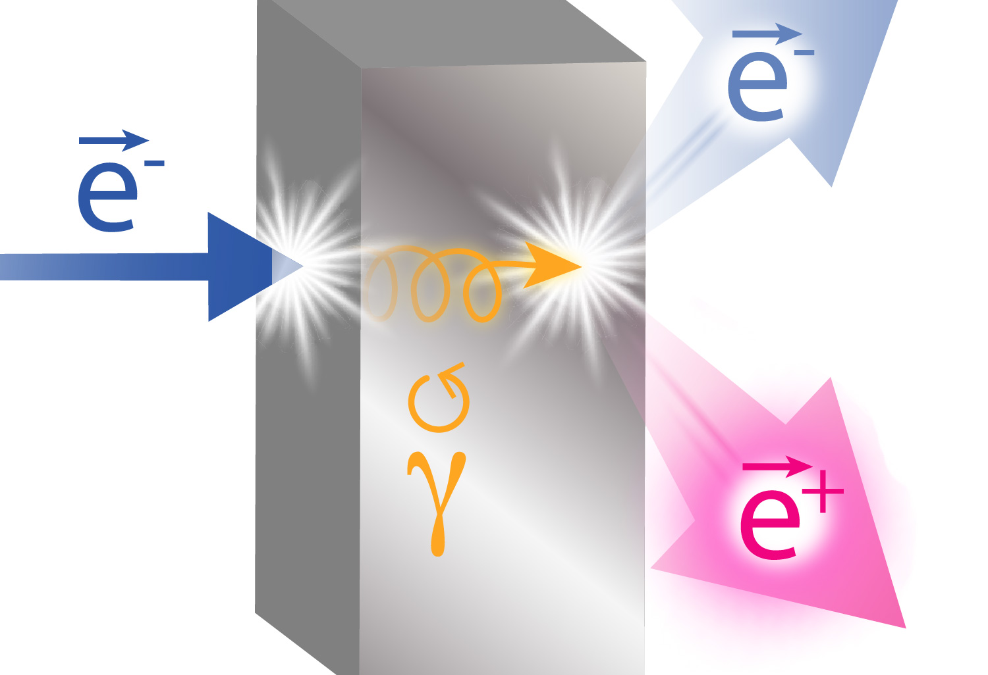
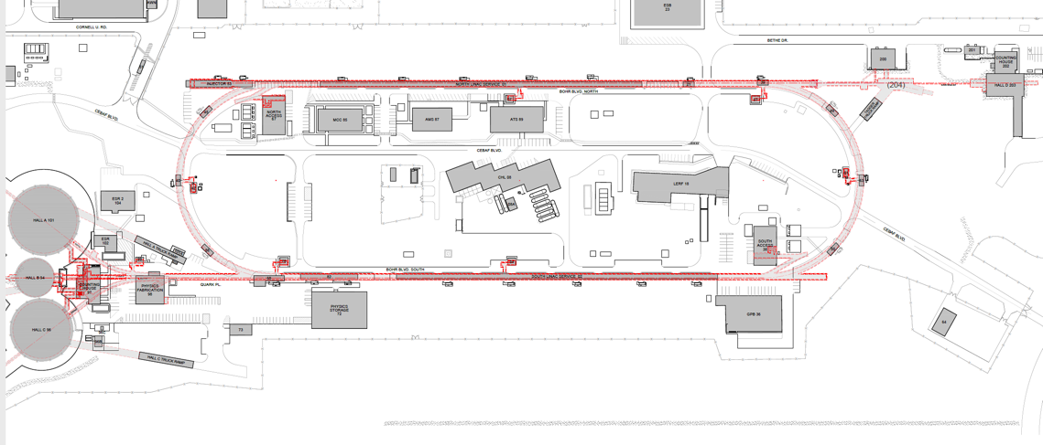
Integration of 120 kW Target into e⁺ Source
CEBAF Polarized
Electron Injector
123 MeV e⁺ Beam
Injected to NL
New e⁺ Injector
at LERF
New Beamline
to CEBAF Tunnel
Andriy Ushakov (Ce⁺BAF WG)
New Transport Line
along SL and West Arc

Slide 2
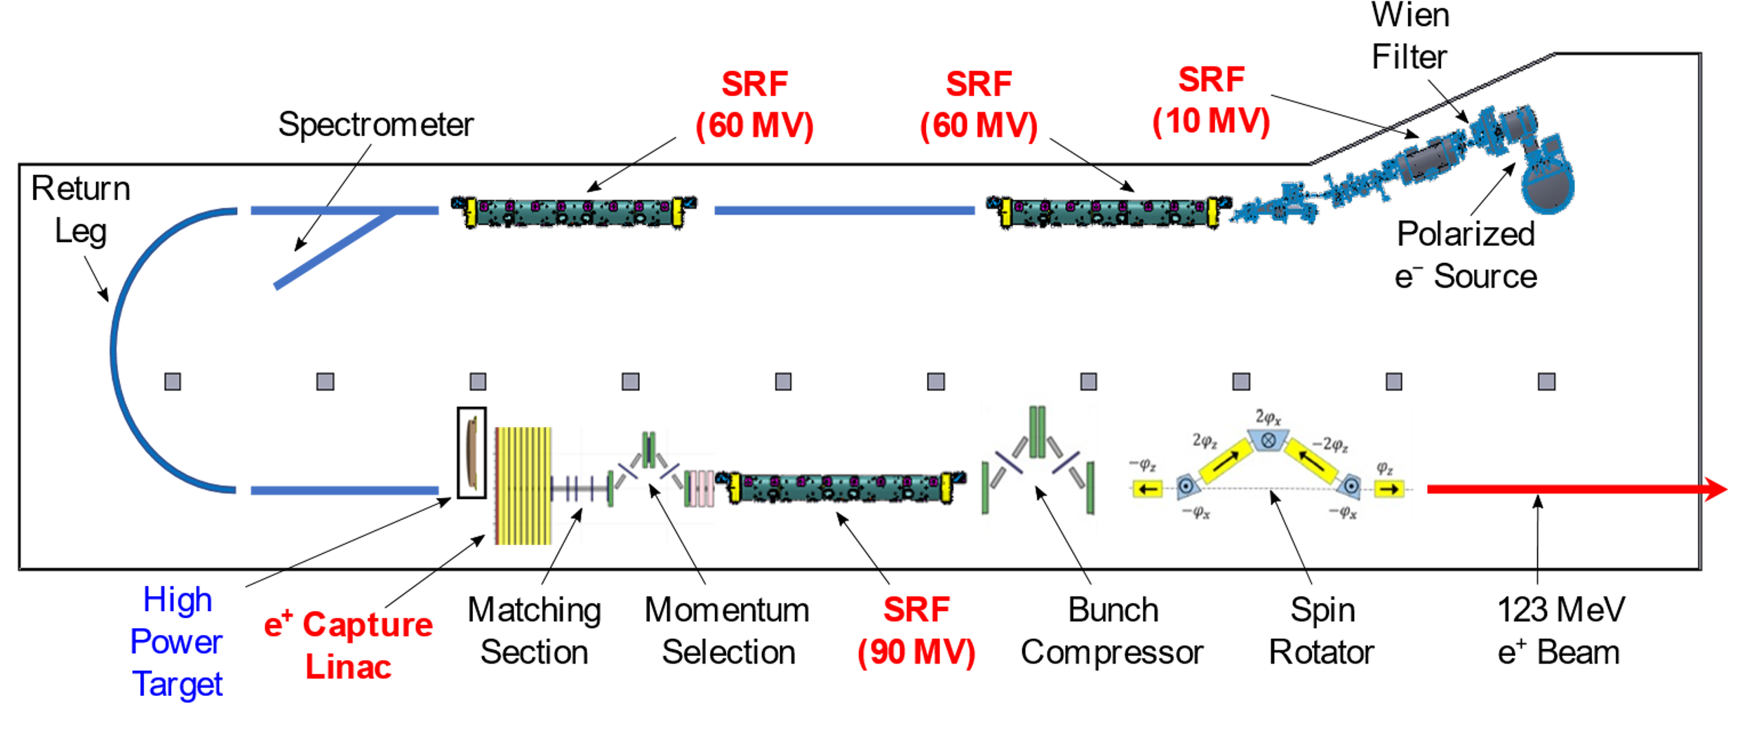
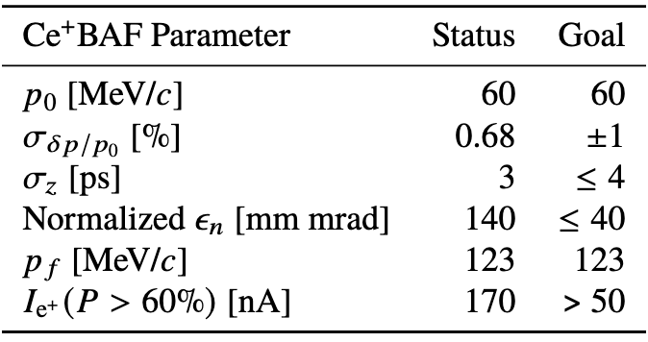
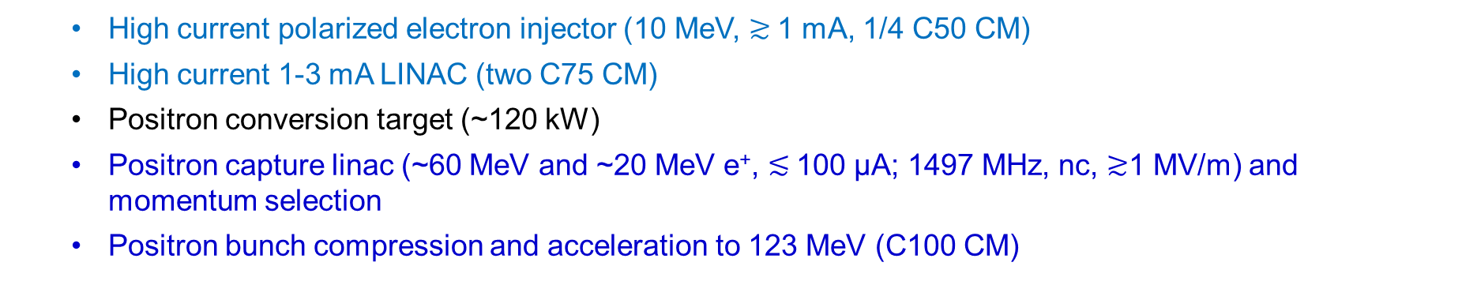
LERF Polarized Positron Injector Concept
  High current polarized electron injector (10 MeV, $≳$1 mA, 1/4 C50 CM)
  High current 1-3 mA LINAC (two C75 CM)
  Positron conversion target (~120 kW)
  Positron capture linac (~60 MeV and ~20 MeV e⁺, $≲$100 µA; 1497 MHz, nc, $≳$1 MV/m) and momentum selection
  Positron bunch compression and acceleration to 123 MeV (C100 CM)

Slide 3
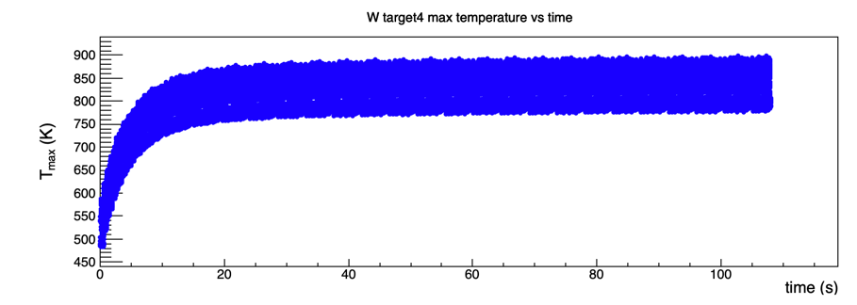
Spinning High Power Target R&D
We expect a 4 mm thick tungsten target with 120 kW of beam power (120 MeV x 1 mA)
~17 kW will be deposited in the target
Target concept is a rotating cooled W disc of with diameter ~35 cm and 2 Hz rot. frequency
Computational fluid dynamics calculations predicts the equilibrium temperature rise will be < 1000 K
We anticipate this will be a major design effort of the project

Slide 4
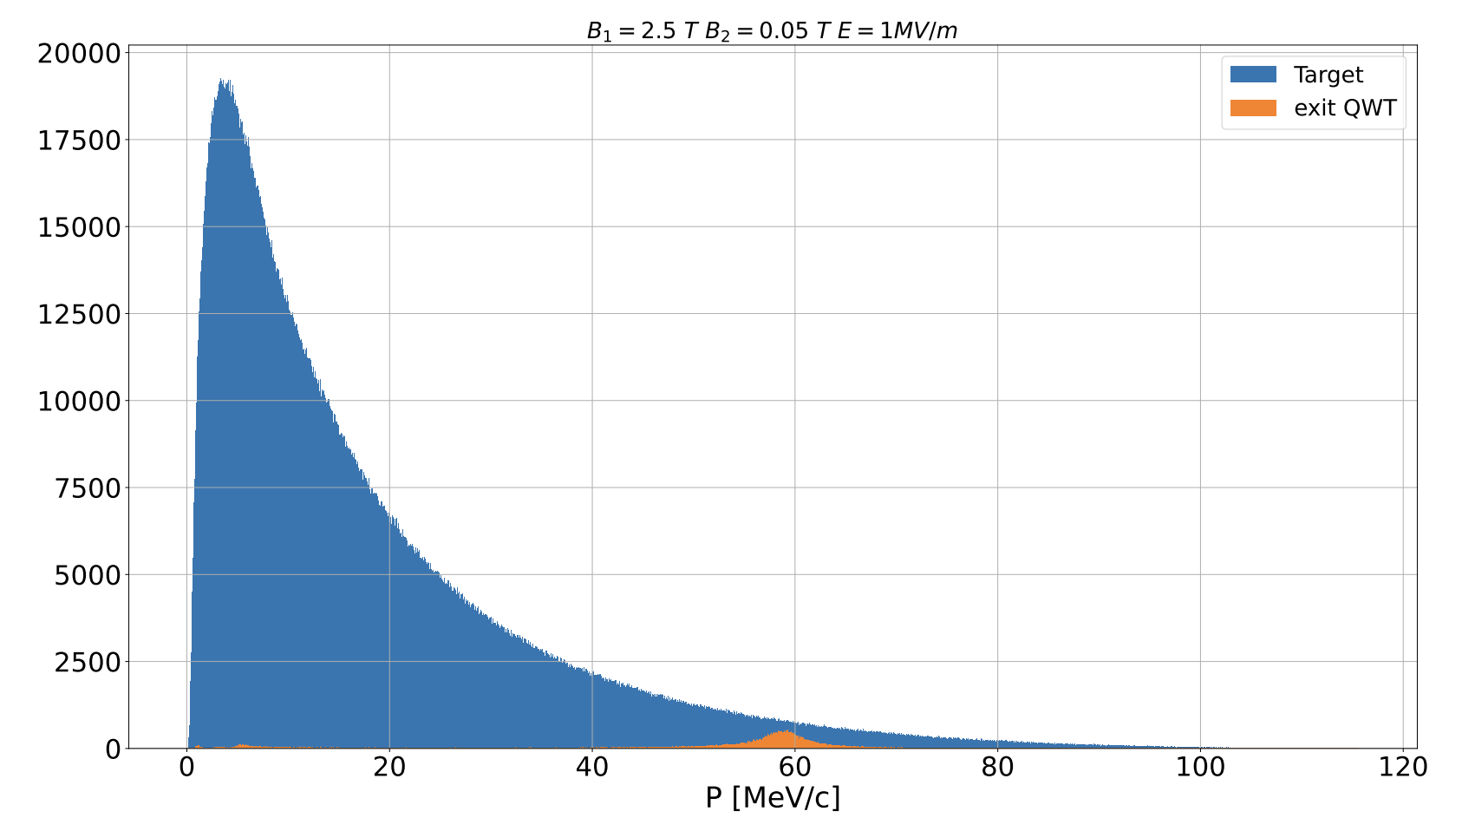
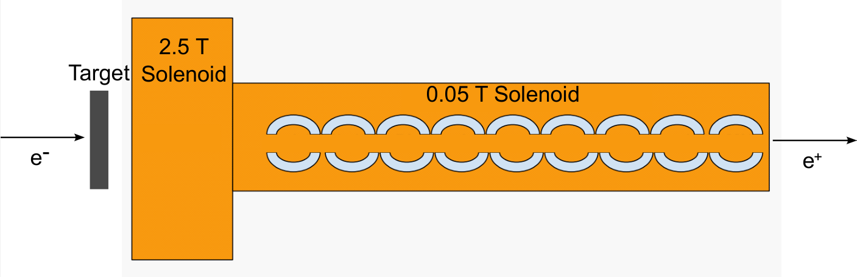
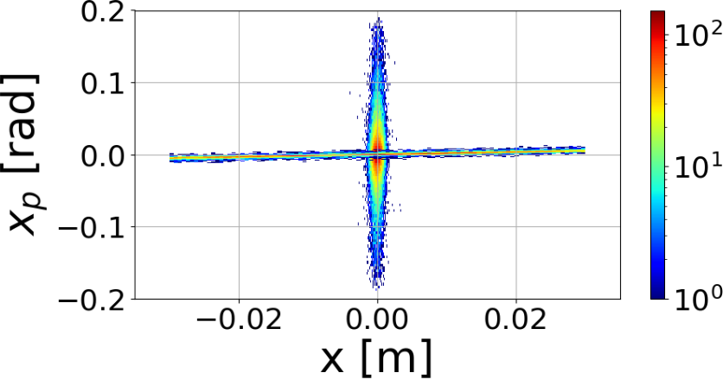
Capture of e⁺ with Energy of ~60 MeV in QWT (Polarized Mode) - S. Habet
QWT consists from 2 solenoids: 1st high-field solenoid with a short length and 2nd low-field solenoid with
a long length around warm RF cavities
QWT
Efficiency of <10⁻⁴ requires a high-current polarized e⁻ drive beam (>1 mA)
N_{e+} [a.u.]
Parameters used for capture of 60 MeV e⁺
Length of 2.5 T solenoid: 25 cm
Length of 0.05 T solenoid: 6 m
1497 MHz cavities
E = 1 MV/m
30 mm aperture of cavities
Target Exit
QWT Exit

Slide 5
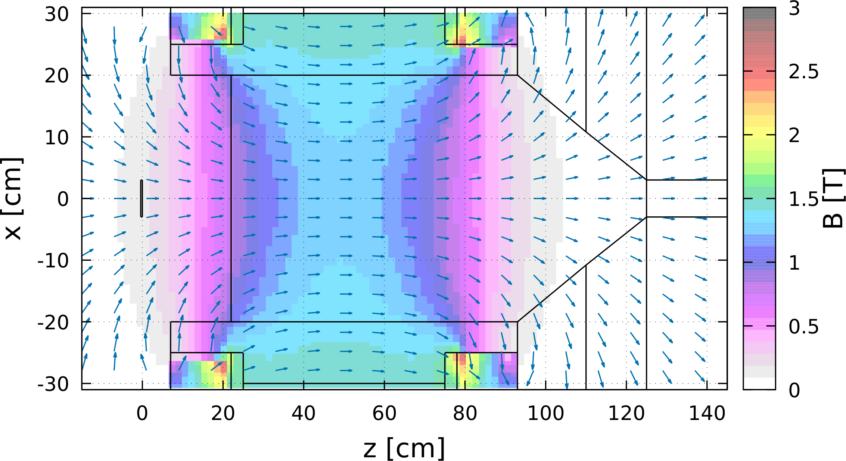
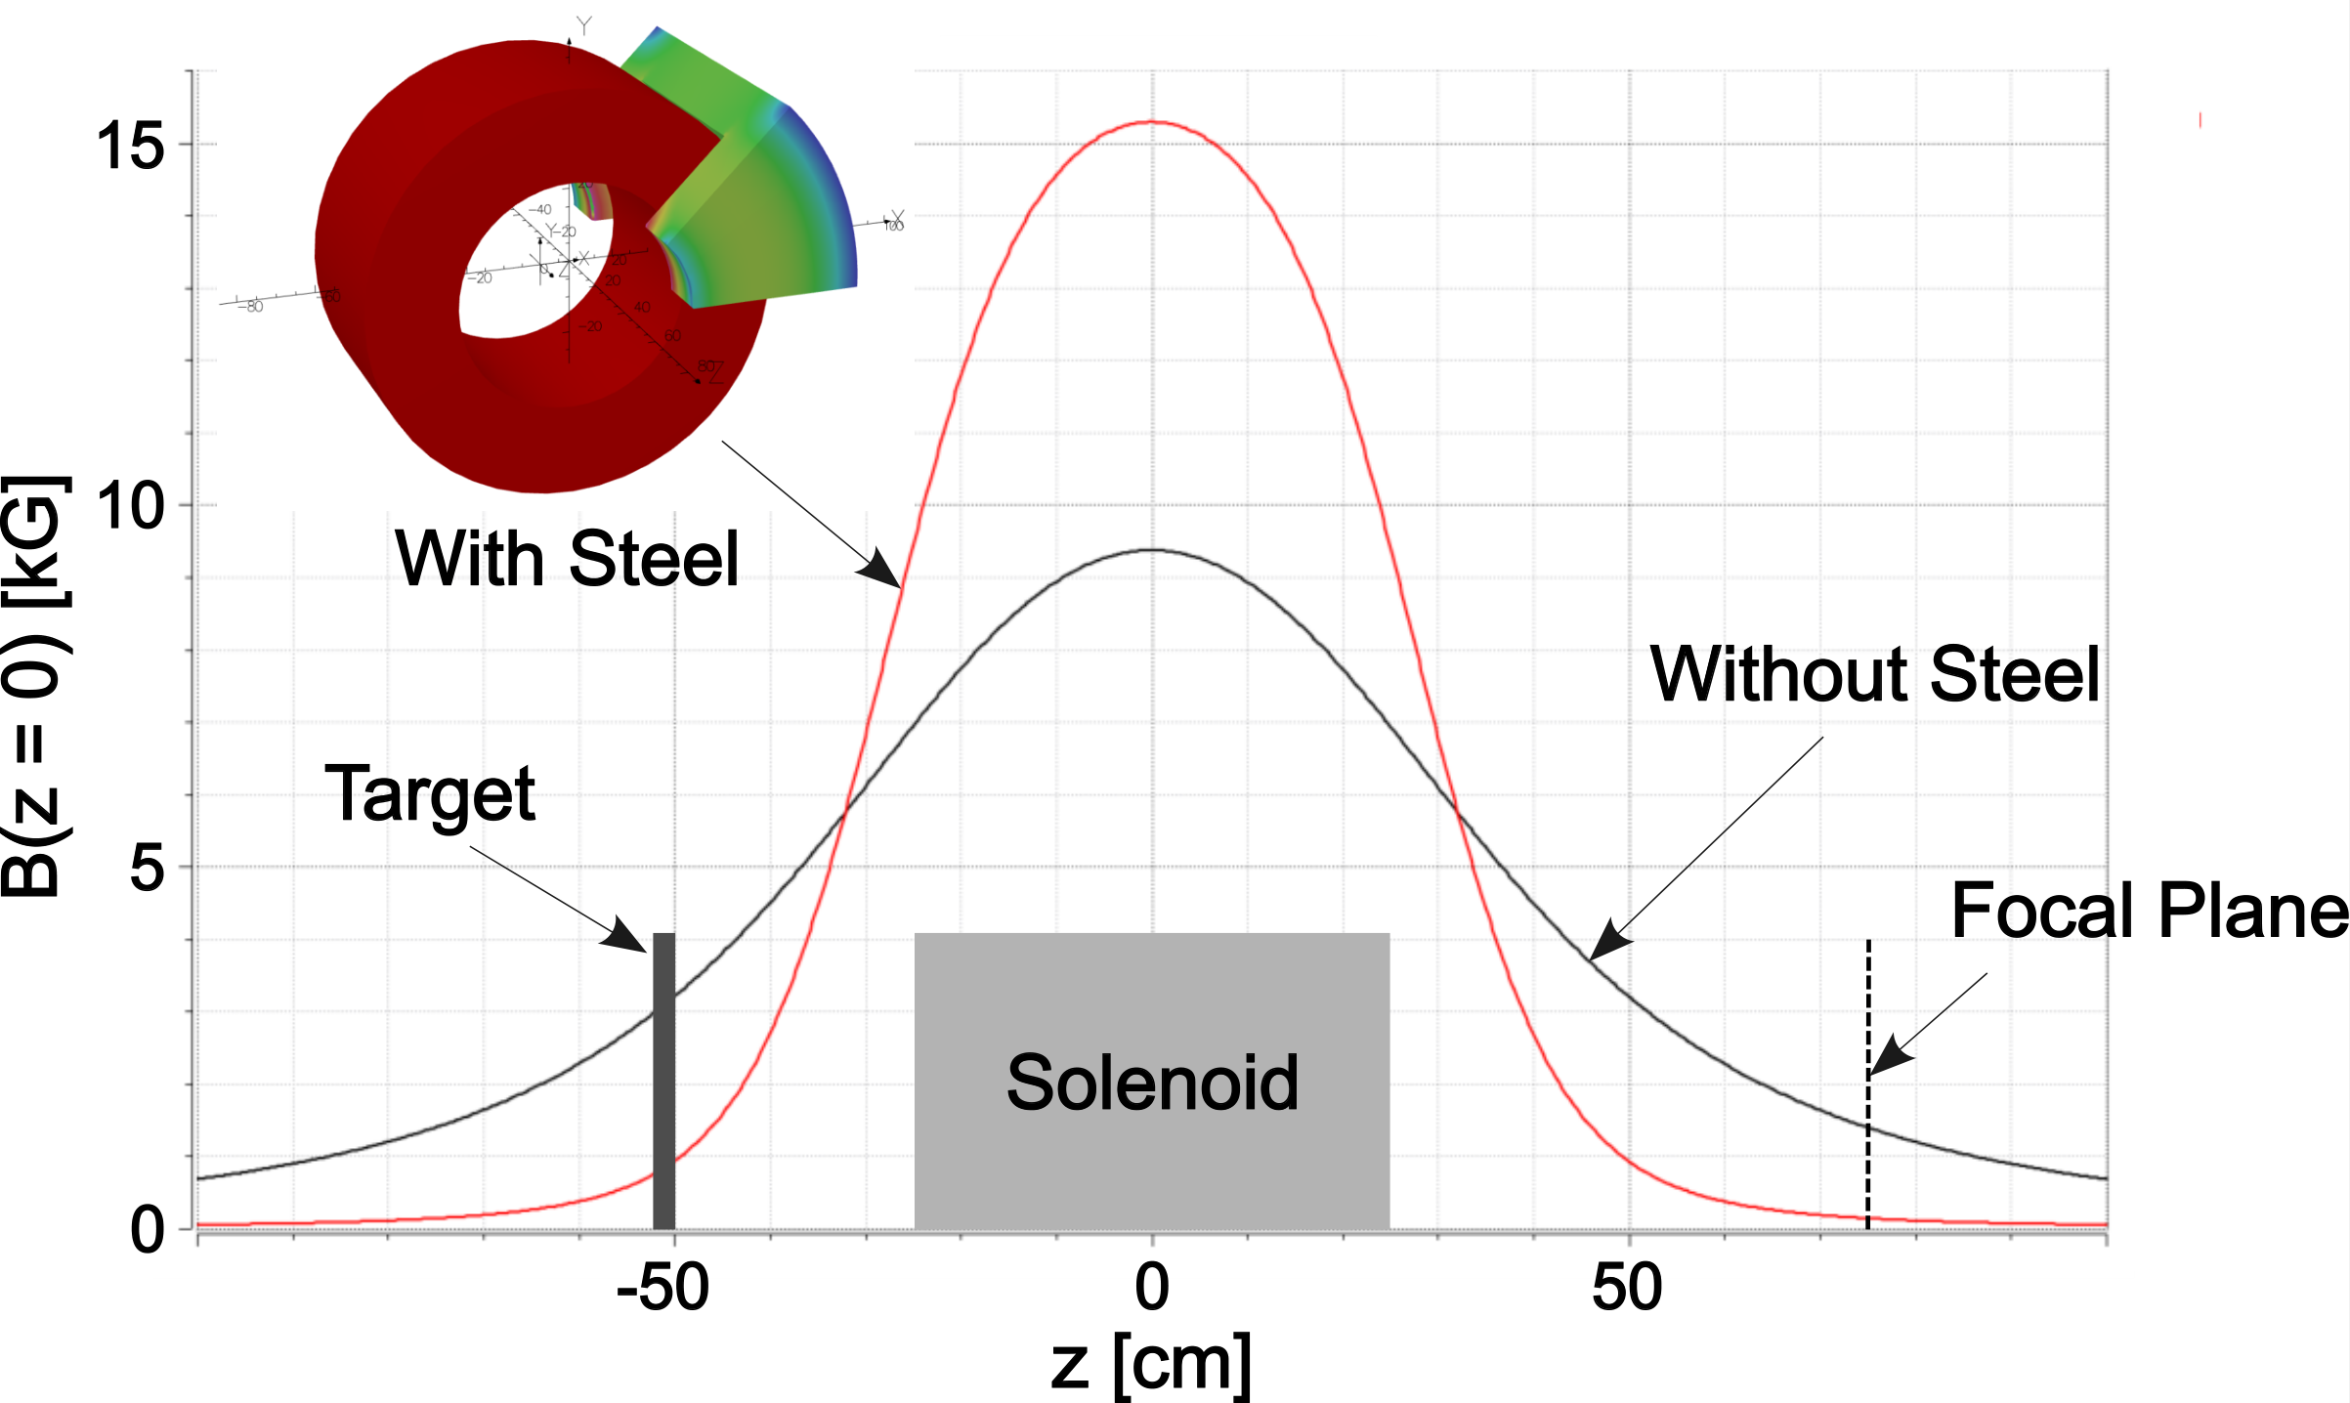
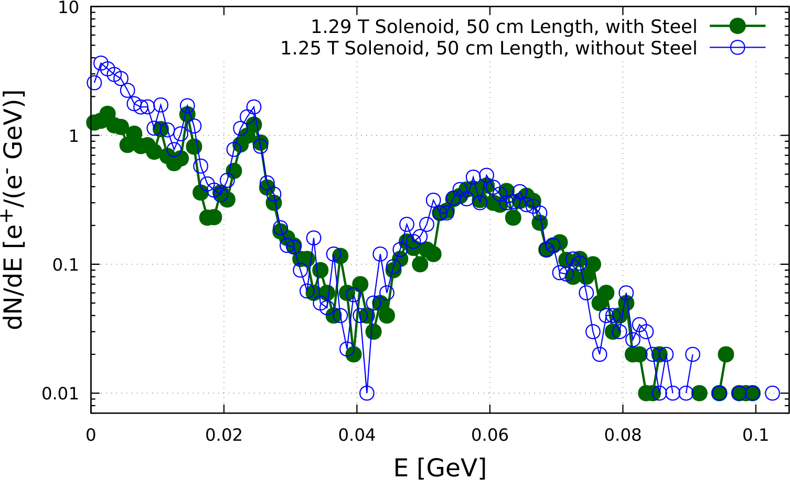
High Field Solenoid
Field Map (imported in FLUKA)
1.29 T Solenoid
Absorbers
Solenoids with and without Steel
(calculated by Jay Benesch)
Target
e⁺

Slide 6
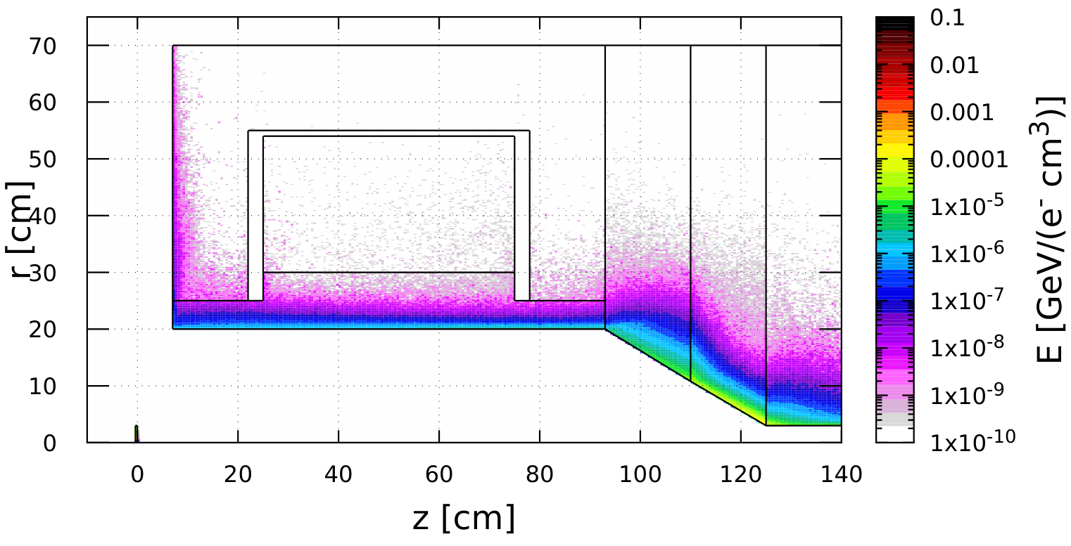
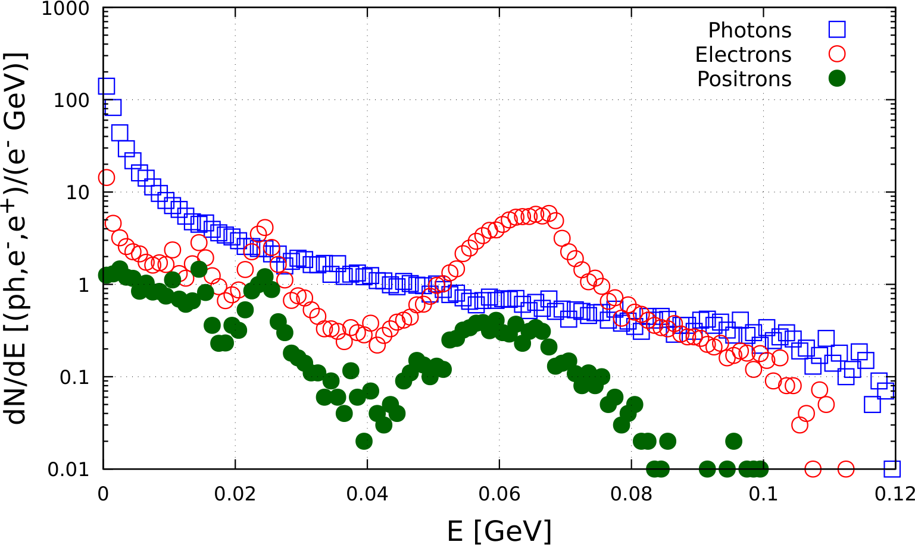
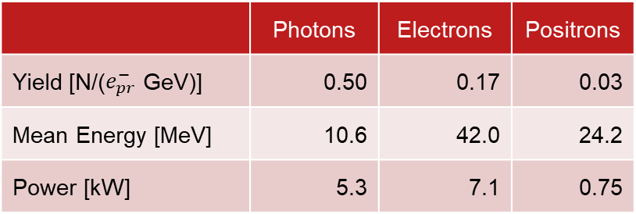
Deposition of Power in Capture Solenoid. Energy Spectra at “End” of Solenoid
Steel
W10Cu
TZM
Cu Cavities
Cu Coils
(B_{max}=1.29 T)
W10Cu
Target
 | Power [kW]
Target | 17.0
Cu Coils and Steel | 0.3
W10Cu Absorber inside Solenoid | 17.2
TZM Absorber | 22.7
W10Cu Absorber (downstream Solenoid) | 31.6
Cu Cavities | 6.5
Total Absorbed Power | 105.8
Power of All Beams at z = 125 cm | 13.1
 | Photons | Electrons | Positrons
Yield [N/($e_{pr}^{−}$ GeV)] | 0.50 | 0.17 | 0.03
Mean Energy [MeV] | 10.6 | 42.0 | 24.2
Power [kW] | 5.3 | 7.1 | 0.75

Slide 7
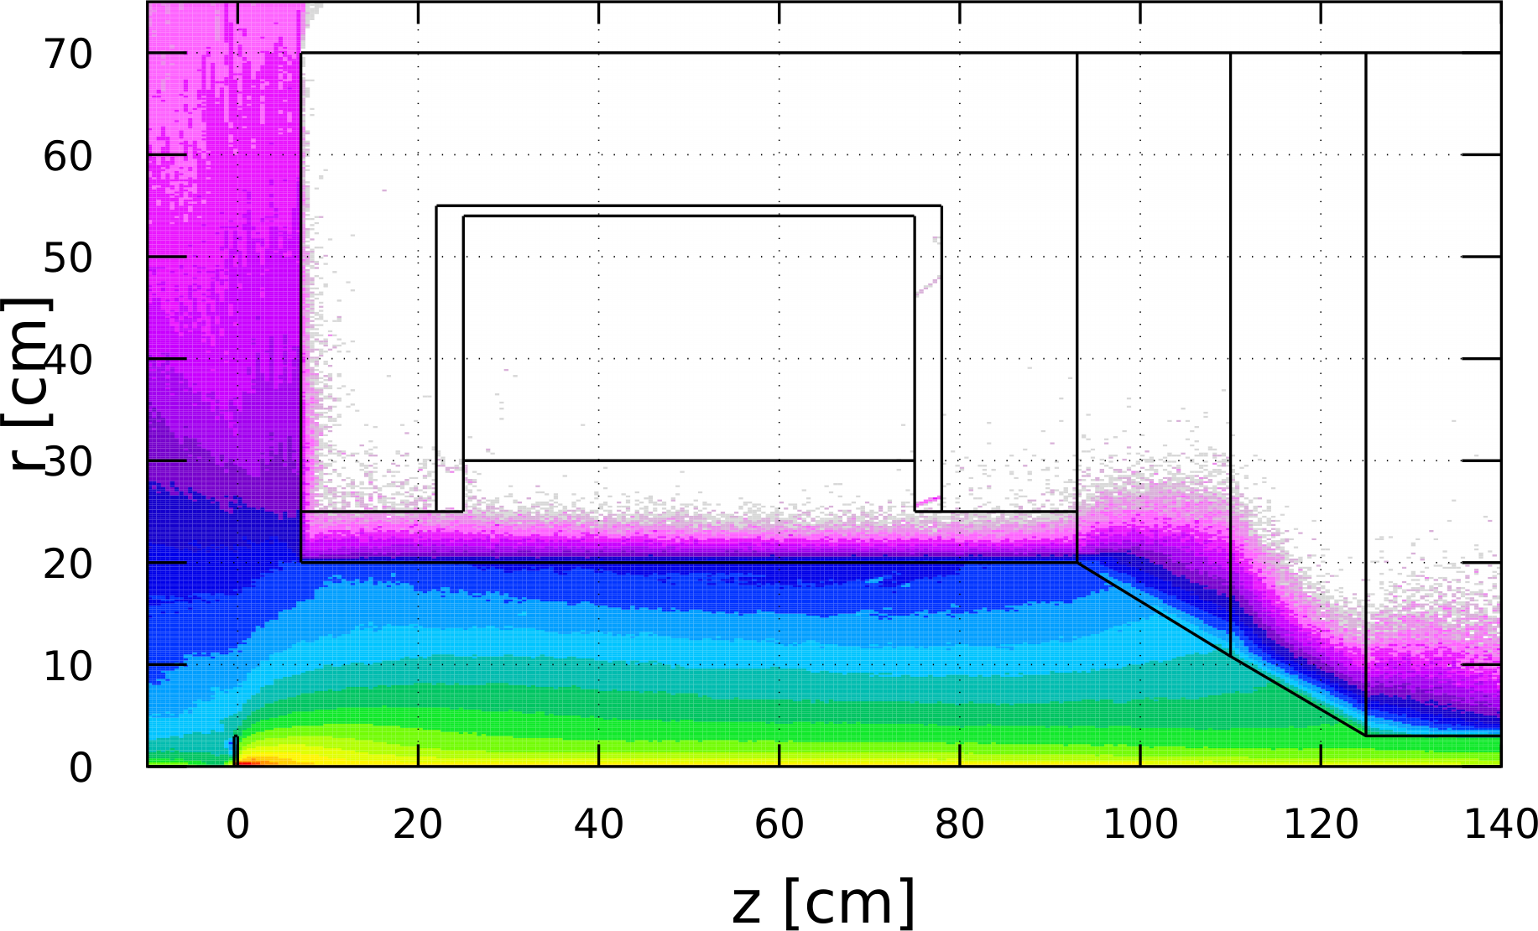
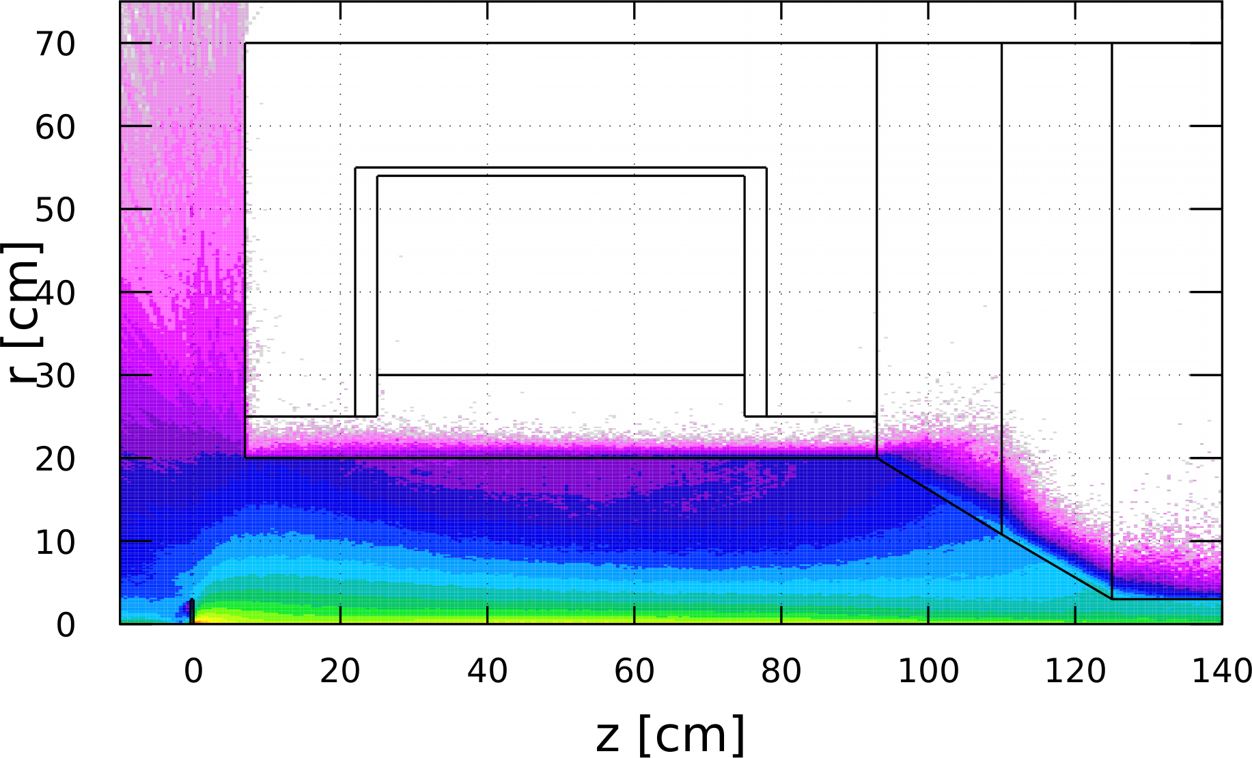
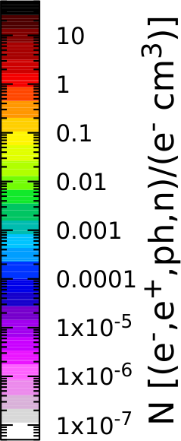
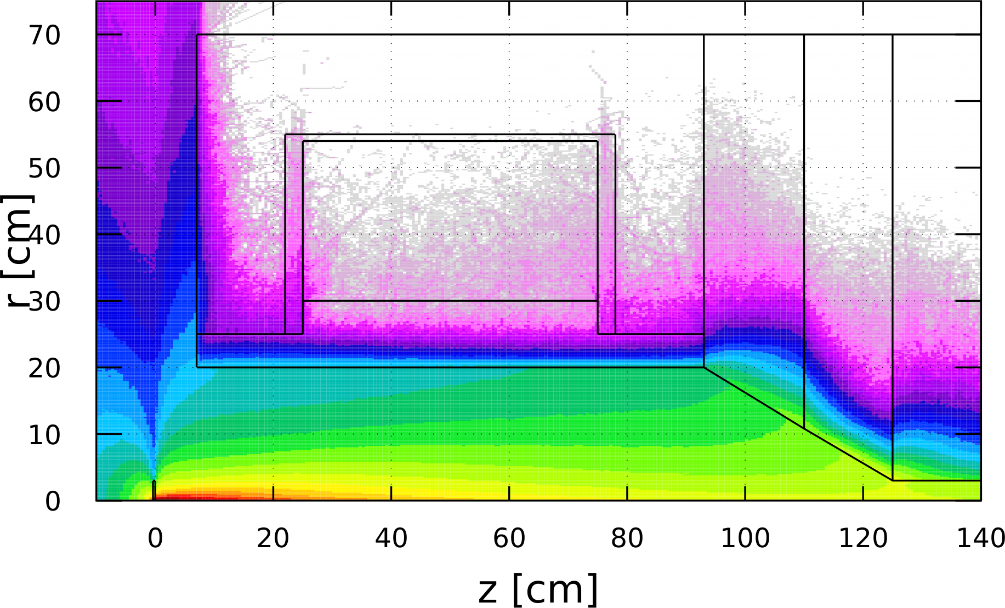
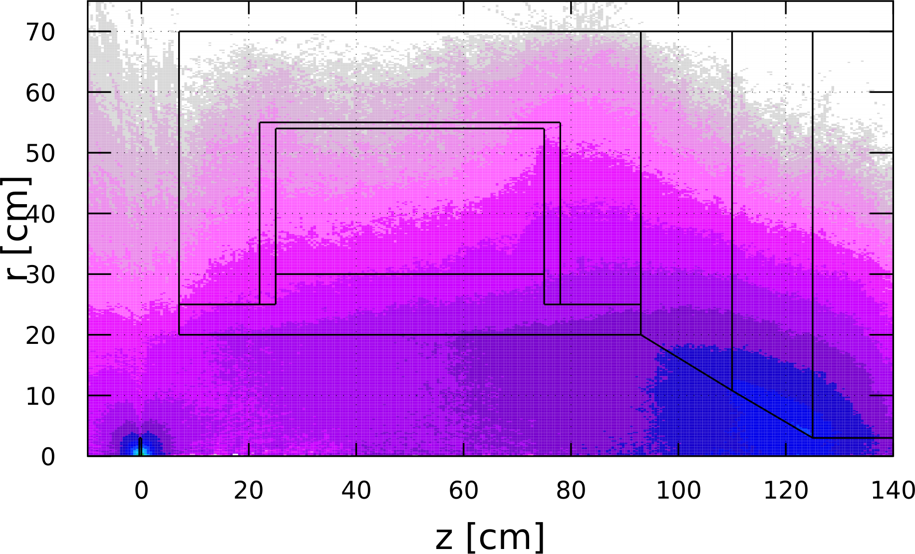
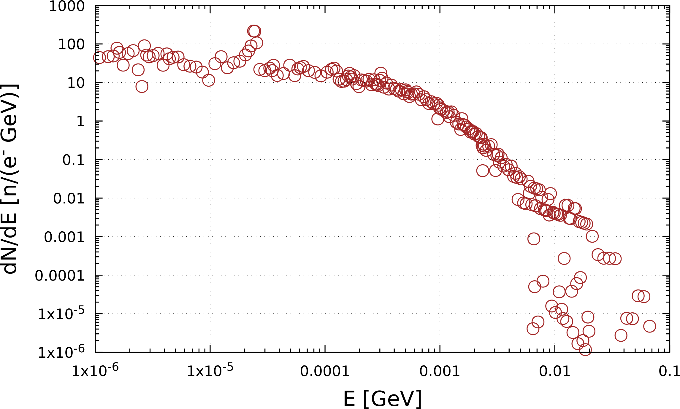

Spatial Distributions of γ, e⁻, e⁺, n. Neutron Energy and Yield
Electrons
Positrons
Photons
Neutrons
Energy Distribution of Neutrons
Neutron Yield:
Y_{n} = $1.0∙{10}^{−2}$ n/$e_{pr}^{−}$

Slide 8
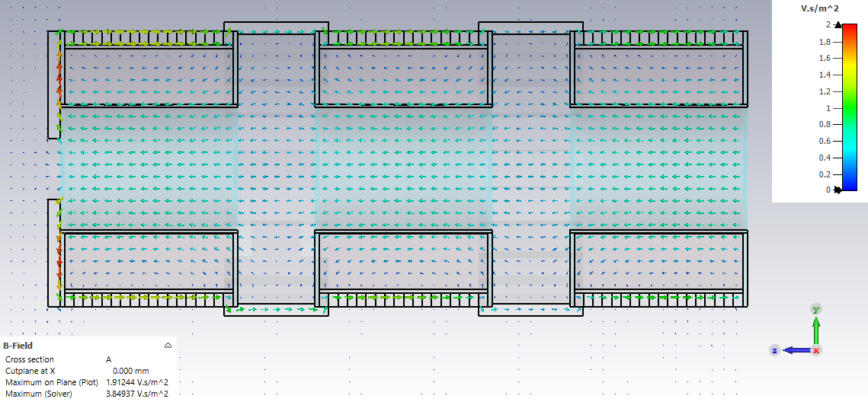
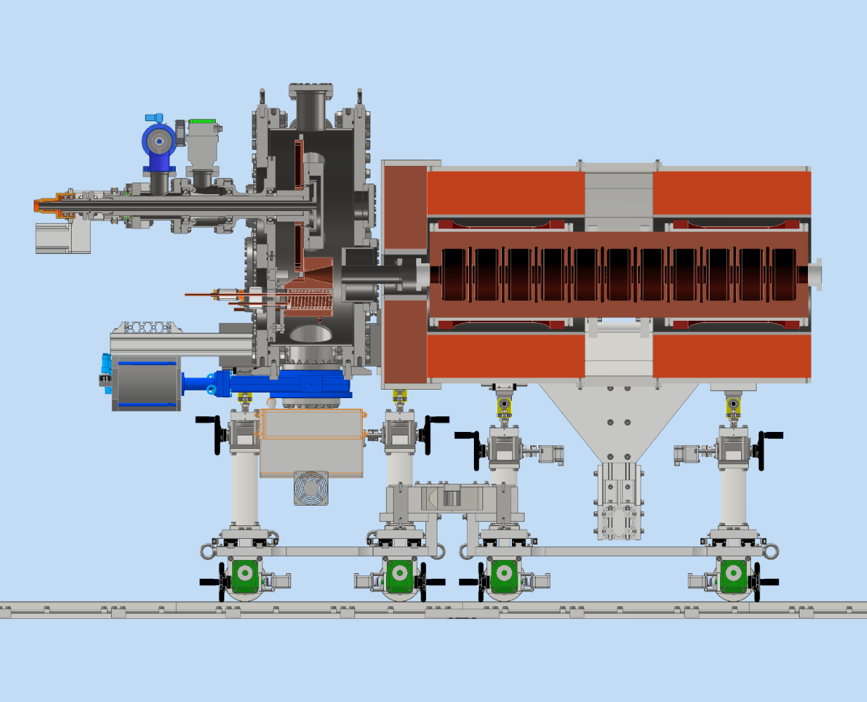
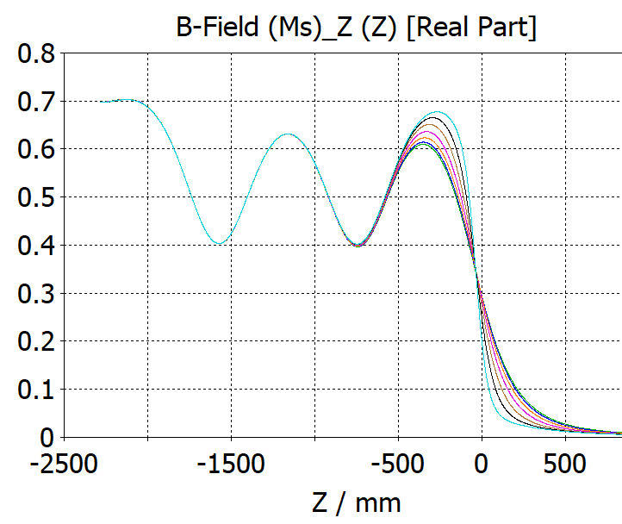
CST Model of KEK/ILC e⁺ Source (Y. Enomoto)
Many thanks to Enomoto-san for providing CST models of all parts of the ILC Positron Source!
Expertise of KEK group in modeling of positron source can help us in development of JLab e⁺ source

Slide 9
Summary and Outlook
Calculations for integration of high power target into positron capture system have been started
For positron focusing downstream target sc and nc solenoids are considered
Solenoid with steel
  Helps to reduce field in target
  Reduces required current and makes magnet cooling much easier
  Removes more low energetic (low polarized) positrons
Beam dynamics and energy deposition calculations in progress

Slide 10
Backup Slides

Slide 11
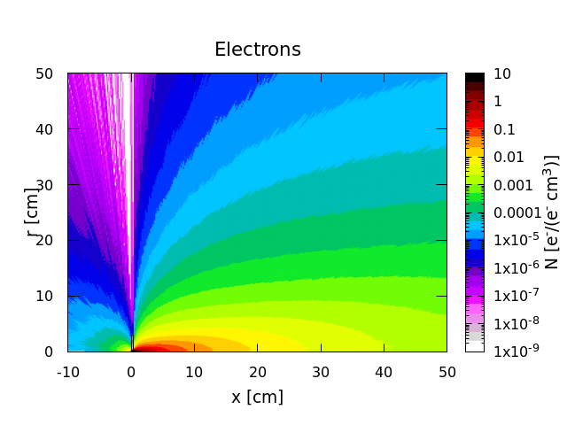
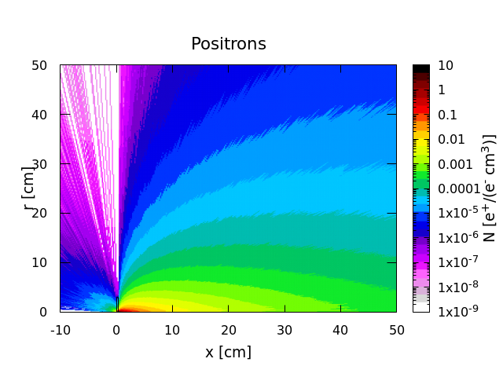
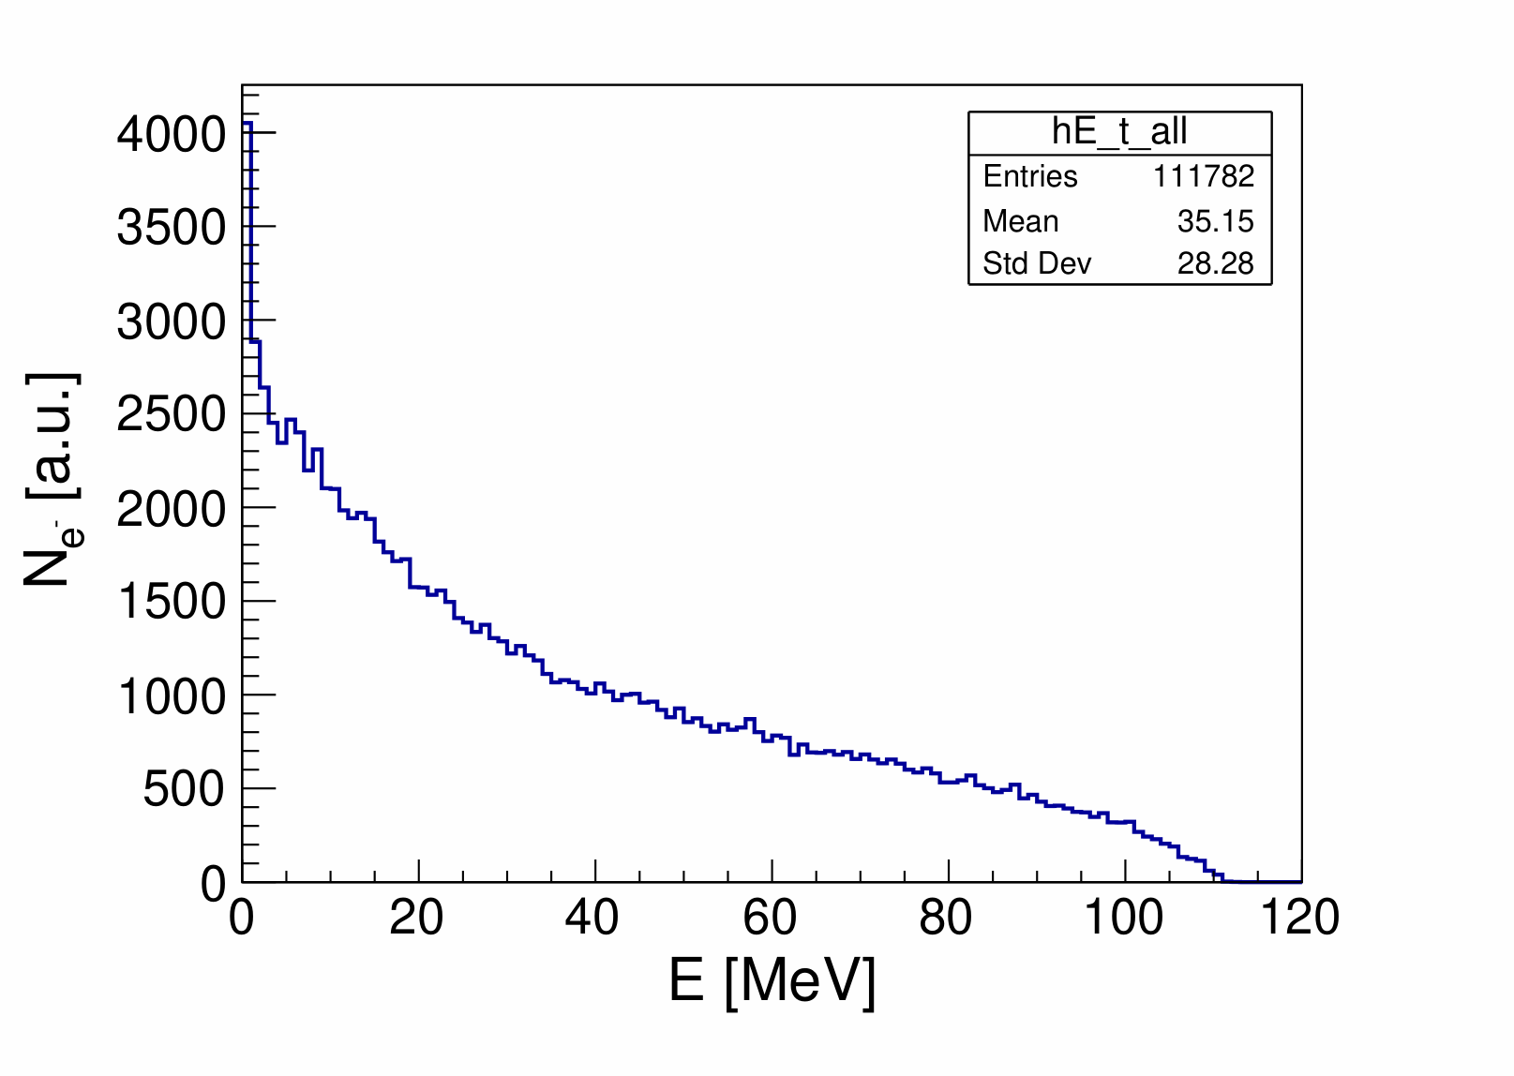
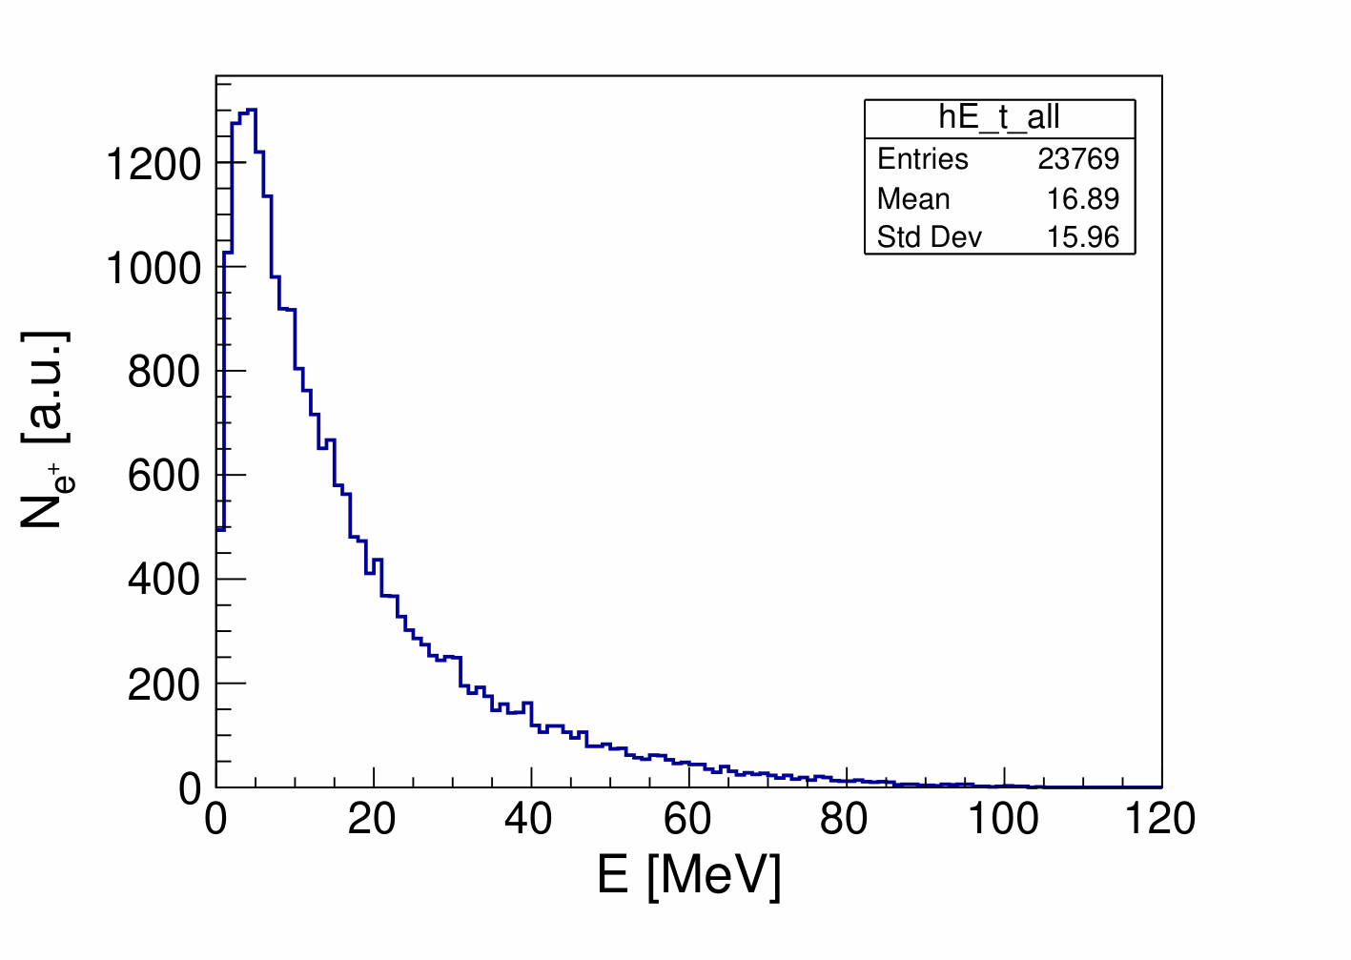
Distributions of Electrons and Positrons at Target (FLUKA/Geant4)
10⁵ primary electrons

Slide 12
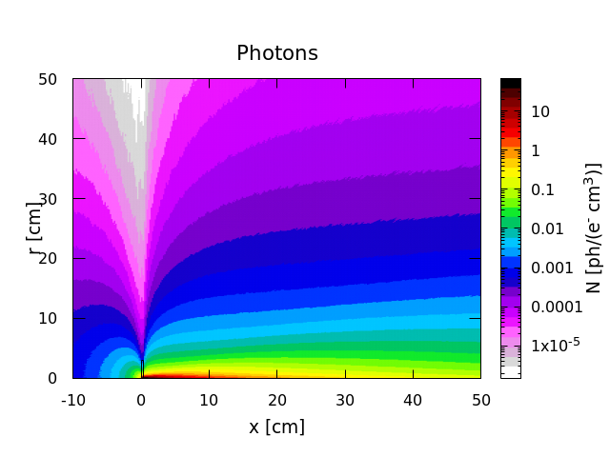
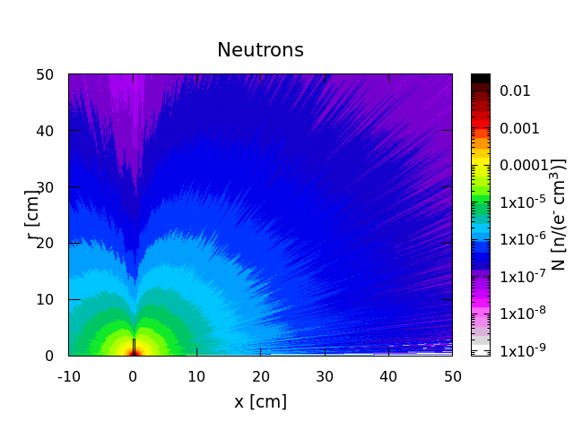
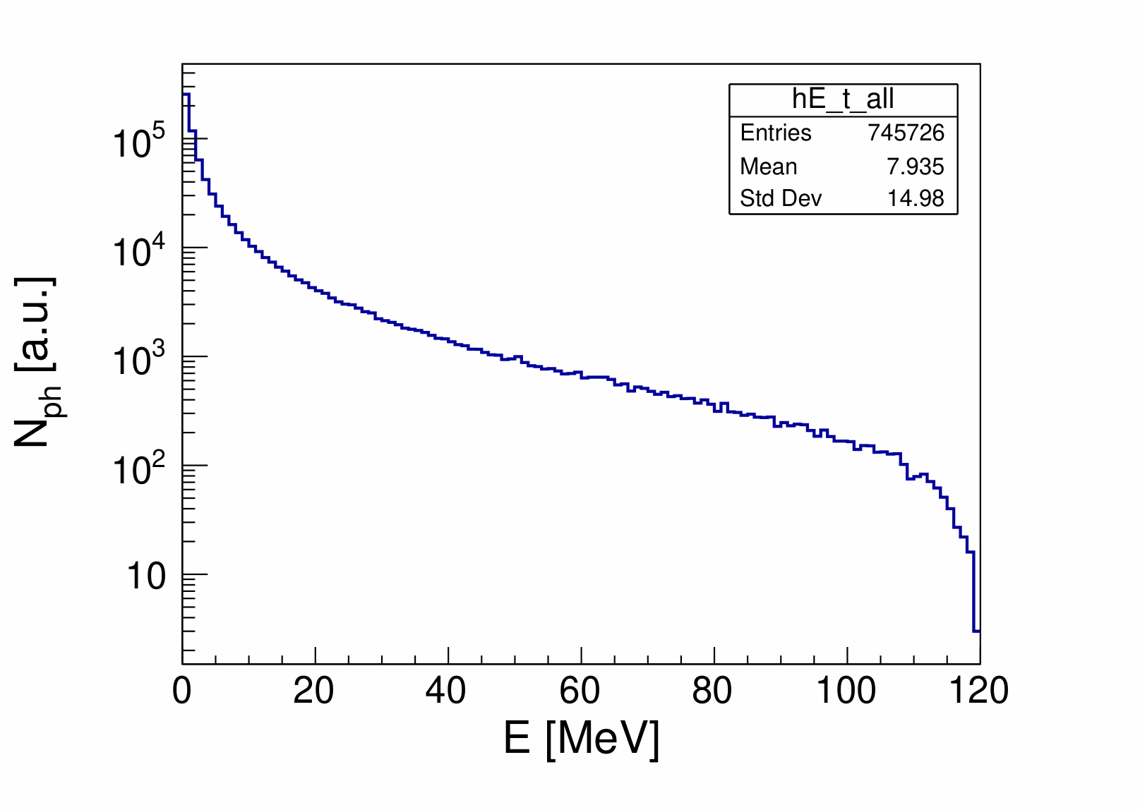
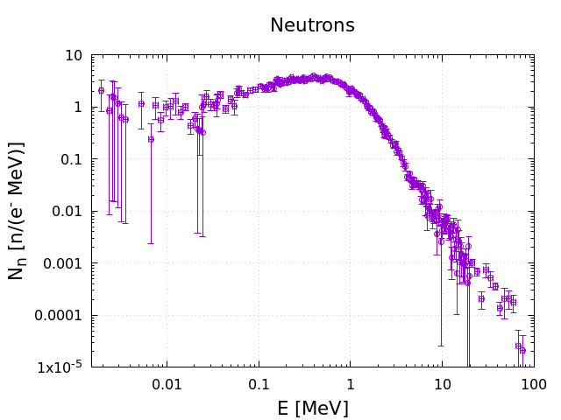
Distributions of Photons and Neutrons (FLUKA/Geant4)
n Yield = 4.7·10⁻³ n/e⁻

Slide 13
Yield, Energy and Power of Particles at 4 mm Tungsten Target (Geant4)
Forward Direction
Photon Yield | 7.5 | ph/e-
Average Energy of Photons | 7.9 | MeV
Average Power of Photons | 59.2 | kW
Electron Yield | 1.12 | e-/e-
Average Energy of Electrons | 35.2 | MeV
Average Power of Electrons | 39.3 | kW
Positron Yield | 0.24 | e+/e-
Average Energy of Positrons | 16.9 | MeV
Average Power of Positrons | 4.0 | kW
Total Power | 102.5 | kW
Backward Direction
Photon Yield | 0.39 | ph/e-
Average Energy of Photons | 1.03 | MeV
Average Power of Photons | 0.40 | kW
Electron Yield | 0.014 | e-/e-
Average Energy of Electrons | 2.18 | MeV
Average Power of Electrons | 0.03 | kW
Positron Yield | 0.001 | e+/e-
Average Energy of Positrons | 4.21 | MeV
Average Power of Positrons | 0.005 | kW
Total Power | 0.44 | kW
Power Deposition in Target | 16.84 | kW

Slide 14
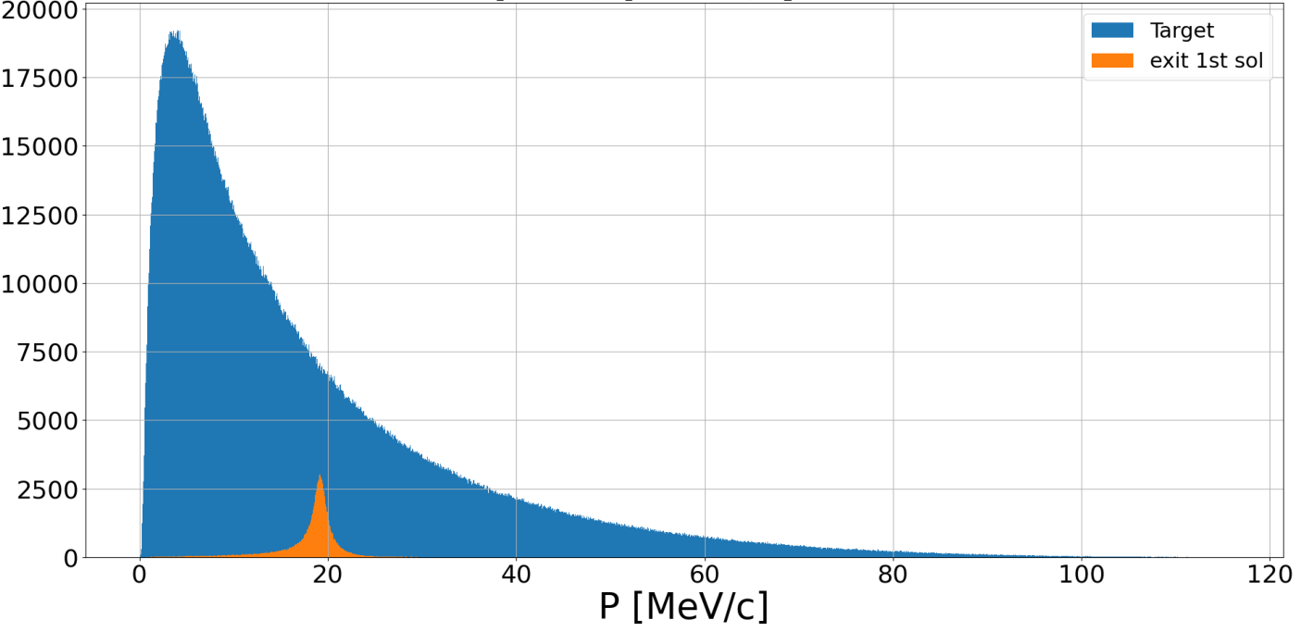

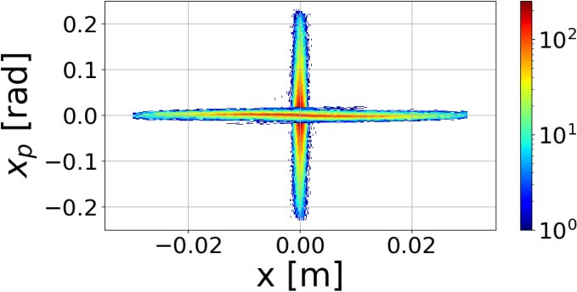
Capture of e⁺ with Energy of ~19 MeV in QWT (Unpolarized Mode) - S. Habet
QWT consists from 2 solenoids: 1st high-field solenoid with a short length and 2nd low-field solenoid with
a long length around warm RF cavities
QWT
N_{e+} [a.u.]
Parameters used for capture of 19 MeV e⁺
Length of 1.3 T solenoid: 25 cm
Length of 0.05 T solenoid: 6 m
1497 MHz cavities
E = 1 MV/m
30 mm aperture of cavities
Target Exit
QWT Exit

Slide 15
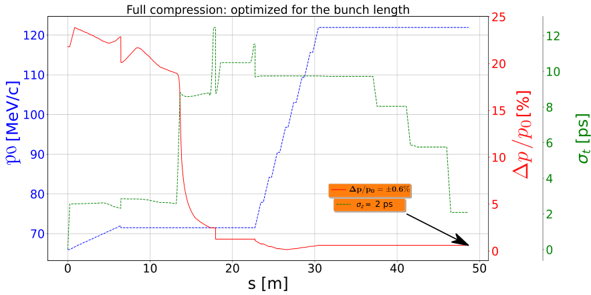
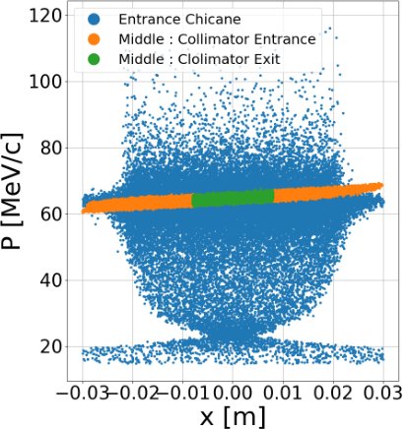
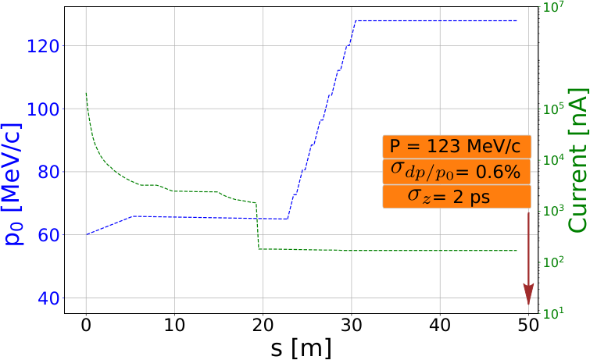
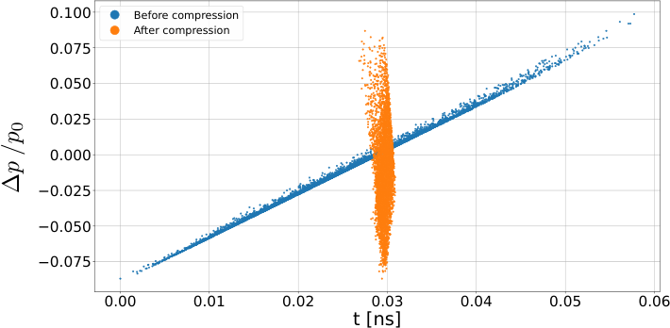
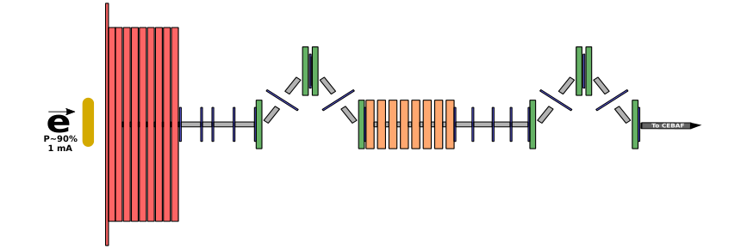
Momentum Collimation and Bunch Length Compression (S. Habet)
Momentum collimation
Long. positron phase space
before and after compression

