Slide 1
RDC 4 Generic & Cross RDC Co Developments in ASICs & Electronics
Kickoff Meeting
Coordinators: A. Dragone, M. Newcomer
October 16, 2023

Slide 2
Agenda for this Meeting
Discussion on RDC4 - ASICs and Electronics roles and coordination with other RD efforts
  ECFA Perspectives - DRD7 initiatives
Planning RDC4 sessions at CPAD: submitted abstracts and today's presentations
  Coordination with other RDC's for Cross topic presentations

Slide 3
ASICs and Electronics RDC4 roles
Foster collaborations for generic “long term” R&D in alignment with PRDs related to ASIC and Electronics
Taking input from synergistic activities (e.g., HEPIC) and creating opportunities for implementations
Ensuring coordination and collaboration between US groups and other International groups
Support the organization of work packages following input from this community
  An example could be a US effort connected as a group with international collaborators on 4D architectures and circuits in 28nm for future colliders
Promote RDC4 work packages and advocate for funding
Foster a cross-institution framework for training new generations of designers with hands-on components in HEP-funded facilities

Slide 4
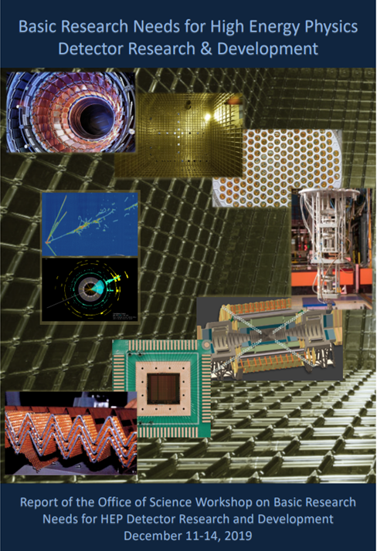
RDC 4: R&D Priorities from the community
A cross-cutting Area with big challenges
 | BRN PRIORITY RESEARCH DIRECTION
CALORIMETRY | PRD 1: Enhance calorimetry energy resolution for precision electroweak mass and missing-energy measurements
 | PRD 2: Advance calorimetry with spatial and timing resolution and radiation hardness to master high-rate environments | RDC9/RDC11/RDC4
 | PRD 3: Develop ultrafast media to improve background rejection in calorimeters and particle identification detectors
NOBLES | PRD 4: Enhance and combine existing modalities to increase signal-to-noise and reconstruction fidelity | RDC1/RDC7/RDC4
 | PRD 5: Develop new modalities for signal detection
 | PRD 6: Improve the understanding of detector microphysics and characterization
PHOTODETECTORS | PRD 7: Extend wavelength range and develop new single-photon counters to enhance photodetector sensitivity
 | PRD 8: Advance high-density spectroscopy and polarimetry to extract all photon properties
 | PRD 9: Adapt photosensors for extreme environments
 | PRD 10: Design new devices and architectures to enable picosecond timing and event separation | RDC2/RDC4
 | PRD 11: Develop new optical coupling paradigms for enhanced or dynamic light collection
QUANTUM | PRD 12: Advance quantum devices to meet and surpass the Standard Quantum Limit
 | PRD 13: Enable the use of quantum ensembles and sensor networks to fundamental physics
 | PRD 14: Advance state of the art in low-threshold quantum calorimeters
 | PRD 15: Advance enabling technologies for quantum sensing | RDC8/RDC4
ASIC | PRD 16: Develop process evaluation and modeling for ASICs in extreme environments | RDC 4
 | PRD 17: Create building blocks for Systems-on-Chip for extreme environments
SOLIDSTATE | PRD 18: Develop high spatial resolution pixel detectors with precise high per-pixel time resolution to resolve individual interactions in high-collision-density environments | RDC3/RDC11/RDC4
 | PRD 19: Adapt new materials and fabrication/integration techniques for particle tracking
 | PRD 20: Realize scalable, irreducible-mass trackers
TDAQ | PRD 21: Achieve on-detector, real-time, continuous data processing and transmission to reach exascale | RDC5/RDC4
 | PRD 22: Develop technologies for autonomous detector systems
 | PRD 23: Develop timing distribution with picosecond synchronization
X-CUT | PRD 24: Manipulate detector media to enhance physics reach
 | PRD 25: Advance material purification and assay methods to increase sensitivity
 | PRD 26: Addressing challenges in scaling technologies
+
Snowmass

Slide 5
Snowmass IF Recommendations

Slide 6
RDC 4 R&D Priorities Translation
Areas of R&D Priorities
Topic Area #1: Circuits and Architectures for 4D Tracking and Calorimetry
  Picosecond Timing Circuits
  Efficient methods for increased granularity
  Monolithic Readouts
  Models and Techniques for extreme radiation
Topic Area #2: Big Data Management
  Energy efficient architectures and circuits
  On-Chip Computing (e.g., eFPGA)
  On-Chip AI/ML
  Fast Interconnections and I/Os
  Advanced Integration (3D, Photonics, Wireless)
Topic Area #3: Cryogenic and Deep Cryogenics
  4K Circuits and Architectures for QIS
  Circuits and Architectures for Noble Liquid Detectors
  Cryogenic Models and Libraries
Topic Area #4: Methodologies, Tools, and Workforce Development
  Design for Verification methodologies
  CAD Tools and Foundries shared joint access
  Common IC blocks, Shared libraries and access model
  Domain knowledge transfer and training

Slide 7
RDC 4 Coordination
Areas of overlap with other RDCs / DRDs / existing collaborations
  HEPIC: Community-organized workgroup providing input from the community on HEP IC design needs and challenges
    RDC4 aims at implementing HEPIC recommendations within IF PRDs
  ECFA DRD7 on Electronics and on-Detector Processing
    RDC4 coordinators will engage with DRD7 coordinators to explore synergies, promote US community efforts, and foster collaboration
  Other US collaborations (US FCC, Linear Collider workgroup, Muon Collider Workgroup)
    RDC4 coordinators will engage with other US collaborations to ensure RDC generic R&D efforts support collaborations in the of readout and ASICs
  US Initiative on Microelectronics
    RDC4 coordinators will highlight potential opportunities to leverage the Microelectronics Initiative synergistically, supporting Microelectronics R&D and HEP core mission
10/16/23
RDC4 Kick Off Meeting October 16, 2023

Slide 8
ECFA Perspectives
The undersigned institutes intend to submit to the DRDC a proposal for a new CERN DRD collaboration to develop future electronic systems and technologies for particle physics.
The collaboration will include developing and demonstrating new hardware, firmware, and software concepts relevant to the requirements of medium- and long-term detector projects.
The collaboration will also facilitate access to expertise, tools, and industry vendors.
The collaboration will bind together the efforts of experts across a range of European and international institutes.
Major electronic systems are now too complex for any single institute to implement alone, often requiring expertise in disparate technologies.
Through the adoption of open development practices and support for sharing IPs, we will increase the efficiency and capability of all participants.
DRD collaborations will be supported by adopting common standards for IP integration and interfaces and through well-supported system and component simulation, design, and verification workflows.

Slide 9
DRD 7 Initial Focus areas
Data density and power efficiency (WG 7.1)
Intelligence on the detector (WG 7.2)
4D and 5D techniques (WG 7.3)
Extreme environments (WG 7.4)
Backend systems and commercial-off-the-shelf components (WG 7.5)
Complex imaging ASICs and technologies (WG 7.6)
The collaboration currently comprises 64 contributing institutes in 15 countries, and we are developing an agreed work plan for an initial three-year R&D phase. The collaborating institutes intend to contribute to 16 projects with an aggregated yearly effort of over 100 FTEs. The collaboration will remain open to new participants and projects and is intended to continue and evolve in the long term.
We will solicit an overview talk from DRD7 at CPAD

Slide 10
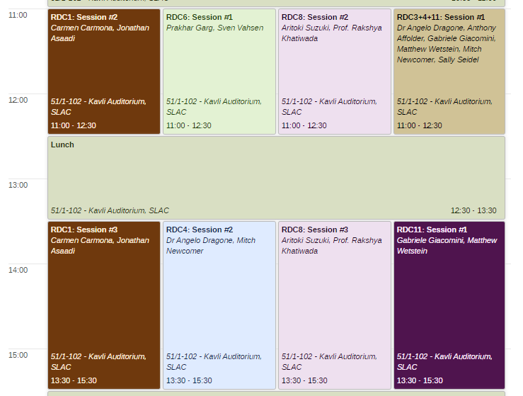
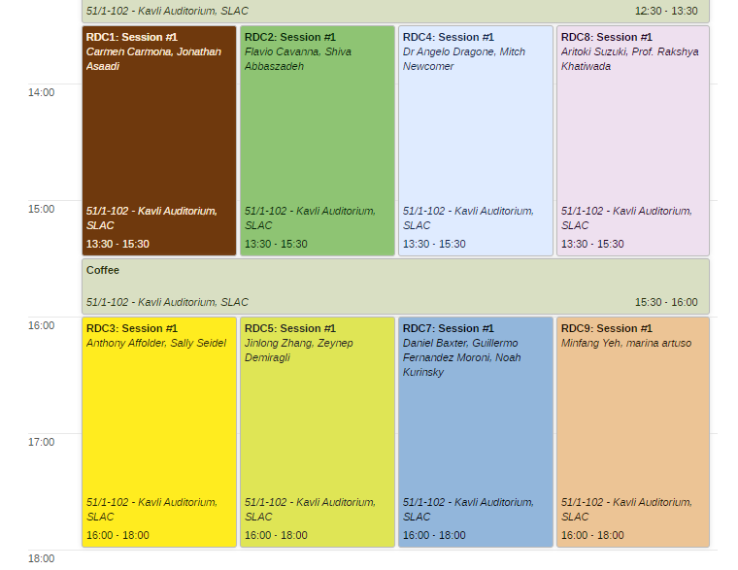
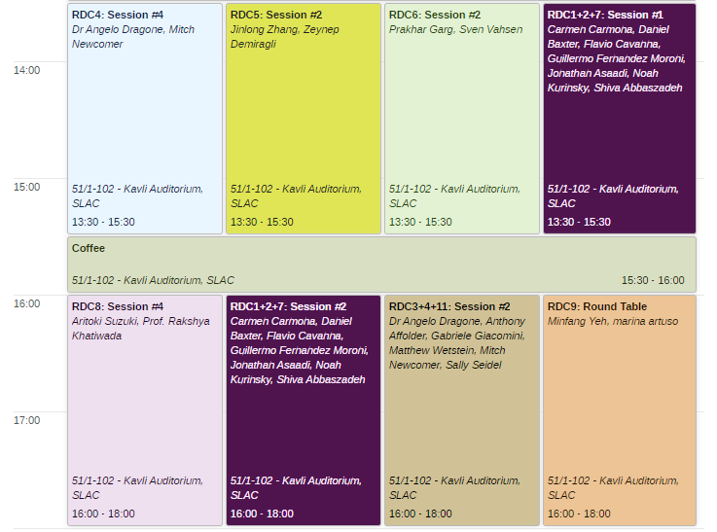
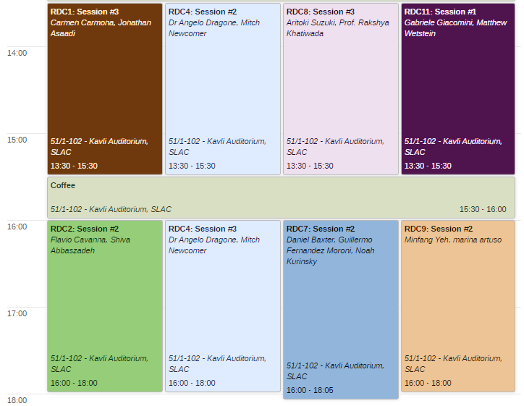
RDC4 CPAD Planning
Four 2hr long parallel sessions
Two joint 1.5hr/2hr long sessions with RDC3 and RDC11
One joint 1.5hr long session with RDC1
Poster sessions

Slide 11
Submitted Abstract (via CPAD – RDC4 call)
Received a total of 57 abstracts
  27 RDC4 specific
  13 shard with RDC3 and RDC11
  4 shared with RDC5
  5 shared with RDC1
  2 shared with RDC10
  3 with RDC2
  2 shared with RDC8

Slide 12
Proposed plan
RDC4 Sessions:
  Circuits blocks and IC architectures for 4D Tracking and Calorimetry (circuit focus)
  Big Data Management
  Cryogenic and Deep Cryogenics
  Methodologies, Tools, Libraries, and Workforce Development
RDC3/RDC4/RDC11 Sessions:
  Circuits blocks and IC architectures for 4D Tracking and Calorimetry (system focus)
  Fast Timing (system focus)
RDC4/others
  Assigned circuit/system focus criteria
Session’s structure:
  Invited talk on broad topic for the session 15+5 min
  6 Talks 12+3 min
  10 min organization of working groups for work packages definition
  Working groups meet during the workshop to prepare an outline for a work package (one pager template) to be given to coordinators by the end of the workshop

Slide 13
Today’s presentations on ideas and suggestions for collaborations:
1 |  | DC-DC conversion using new materials and architectures |  | UPenn Physics, and UPenn SEAS
2 |  | AC-LGAD Readout using SiGe BiCMOS technology |  | UC Santa Cruz, Anadyne INC
3 |  | Waveform readout of fast semiconductor timing detectors |  | UC Santa Cruz, Nalu Scientific
4 |  | Readout circuits on 28nm for 4D tracking at future colliders |  | SLAC
5 |  | 3D Integrated Sensing Solutions project |  | SLAC, FNAL, LLNL
6 |  | Large-area MAPS with ~ns timing |  | SLAC, CERN, UOregon
7 |  | Cryogenic CMOS |  | SLAC
8 |  | eFPGA and Reconfigurable Digital Logic |  | SLAC
9 |  | AI/ML for Future Readout |  | SLAC
10 |  | Beyond Von-Neumann CMOS accelerators |  | SLAC, UCSB
11 |  | SLAC Neural Network Library SNL |  | SLAC
12 |  | RFSoC-based Readout and Characterization Platform Development at SLAC |  | SLAC
13 |  | Overview of FNAL topics for collaboration |  | FNAL
14 |  | Open-source firmware & software libraries |  | SLAC
15 |  | 28nm 4D Pixel detector readout chip aiming at operation at HL-LHC |  | LBNL

