Slide 1
Detector requirements: some challenges for the future present
Luca Pasquini, ESO
D. Milaković, SISSA

Slide 2
Short preamble
Apologies:
  Examples are mostly ‘ESO’, but they are simply more familiar to me ..
    Do not worry, you will have plenty of LSST & other projects in the coming days !
All scientific topics addressed have formidable astrophysical challenges !
  Not discussed here, just the instrumental challenges are presented
  The goal is indeed to produce data that allows to concentrate ONLY on the astrophysics

Slide 3
Precision Precision Precision
Big samples, High precision!
  Big samples lower the statistical uncertainty ..
    Then you hit the systematics!
  In Euclide the variance of the residual shear systematics must be controlled to an accuracy of σ²_{sys} <10⁻⁷
  GAIA has observed billion of stars, with outstanding astrometry, the stellar centroid is measured to ~10⁻³ /pixel, many observations.. systematic effects < 10⁻⁴
AO imager: MICADO @ELT requires astrometry at 3*10⁻² / pixel
Typical pixel for a HighRes spectrograph is 500-1000 ms⁻¹; earth orbit ~10 cms⁻¹

Slide 4
Spectral Fidelity
Spectral Fidelity is our capability to recover the input spectrum removing all instrument (telescope, atmosphere) signatures.
Astronomical literature shows many examples of (relevant) discordant results (e.g. solar composition, variability of fine structure constant..)
  Of course this has to do with the complex nature of the objects
  But also with the non repeatability and fidelity of the spectra
Requirements are similar for Spectral Fidelity, Photometry, Astrometry..

Slide 5
Spectral Fidelity: new frontiers
Two cases addressing fundamental questions:
  Fundamental physics with QSO absorption lines:
    Measuring directly the expansion of the Universe with the Sandage test (ELT science case)
    Variability of fundamental constants (on a solid ground!)
Enormous Legacy and Enabling discovery space
  New solar systems & exoplanet atmospheres by the large exoplanet community
  Accurate abundances and chemical tagging
  Measure of BBN (D), Cosmic background T at different z
  Using spectra from different instruments
Opening a new space dimension

Slide 6
Fidelity and QSO absorption lines
Spectrum of a recently discovered, bright z~4 QSO
(CUBRICS Survey (Cristiani et al. 2023))

Slide 7
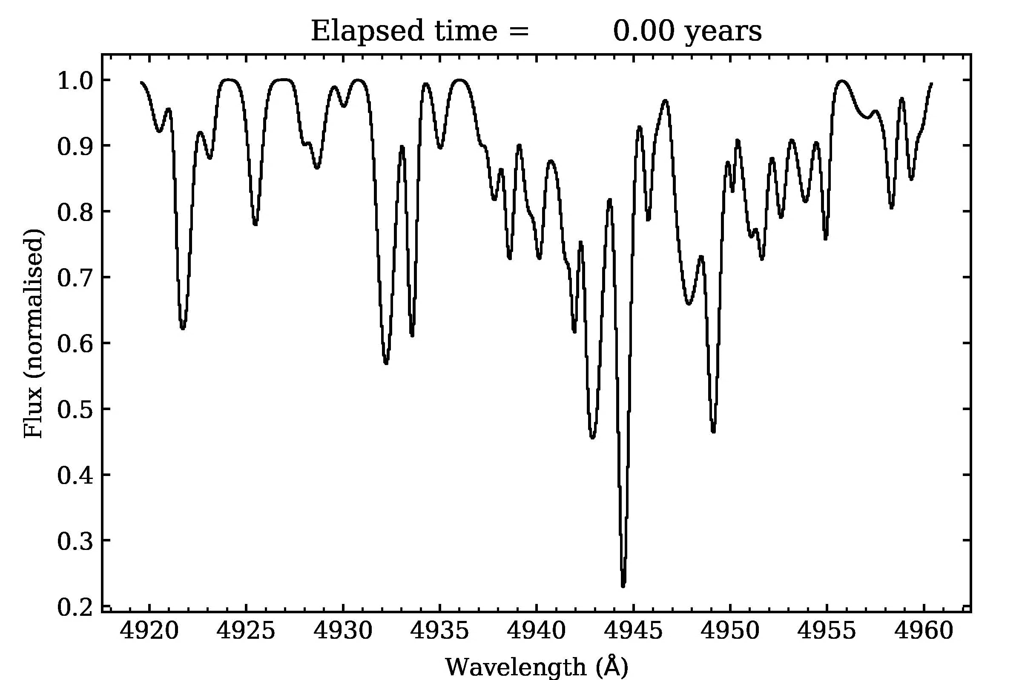
The Sandage test
All existing cosmological tests need assumptions and measure geometry
  The direct measurement has no assumptions and measures dynamics
The experiment is conceptually very simple
  Wait for long enough time and measure the shift of the Ly𝛼 clouds (Sandage 1962, Loeb 1998, Liske et al. 2008)
  dz/dt_{(obs)}(t0) = (1 + z)H₀ − H (z) with H(z) = a’a⁻¹ . In an explicit form :
  𝛥v = c𝛥z/(1+z) = -{[𝛺_{M}(1+z) + 𝛺_{r} + 𝛺_{𝜆}(1+z)⁻²]^{1/2} -1 }H₀𝛥t₀c

Slide 8
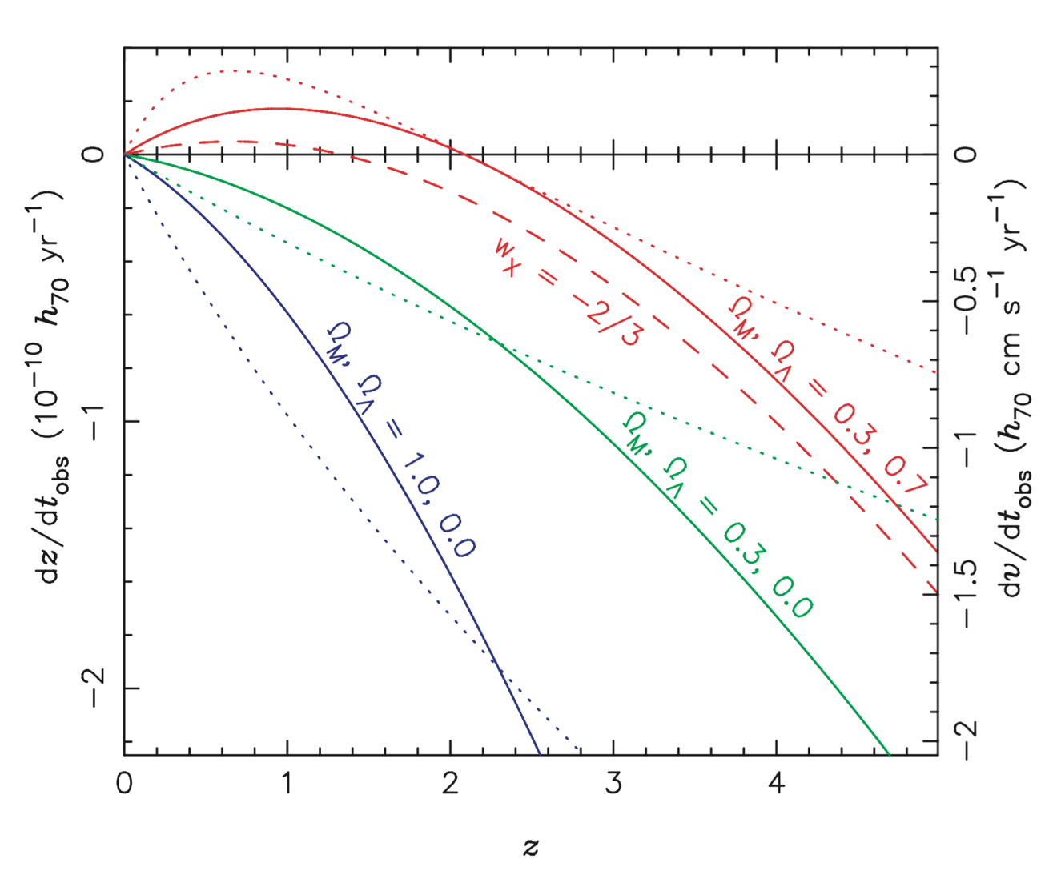
The Sandage test
Expected shift is very small ! (~0.6 cms⁻¹/Yr at z=4)
  Final S/N ~10000
  Thanks to bright southern QSOs the measurement is possible in 20 yrs with ANDES @ ELT and 1500 hours (Marconi et al. 2023, Cristiani et al. 2023)
    Instruments & Detectors need to be calibratable at this precision for decades !
Liske et al.2008
Maeder, private comm.

Slide 9
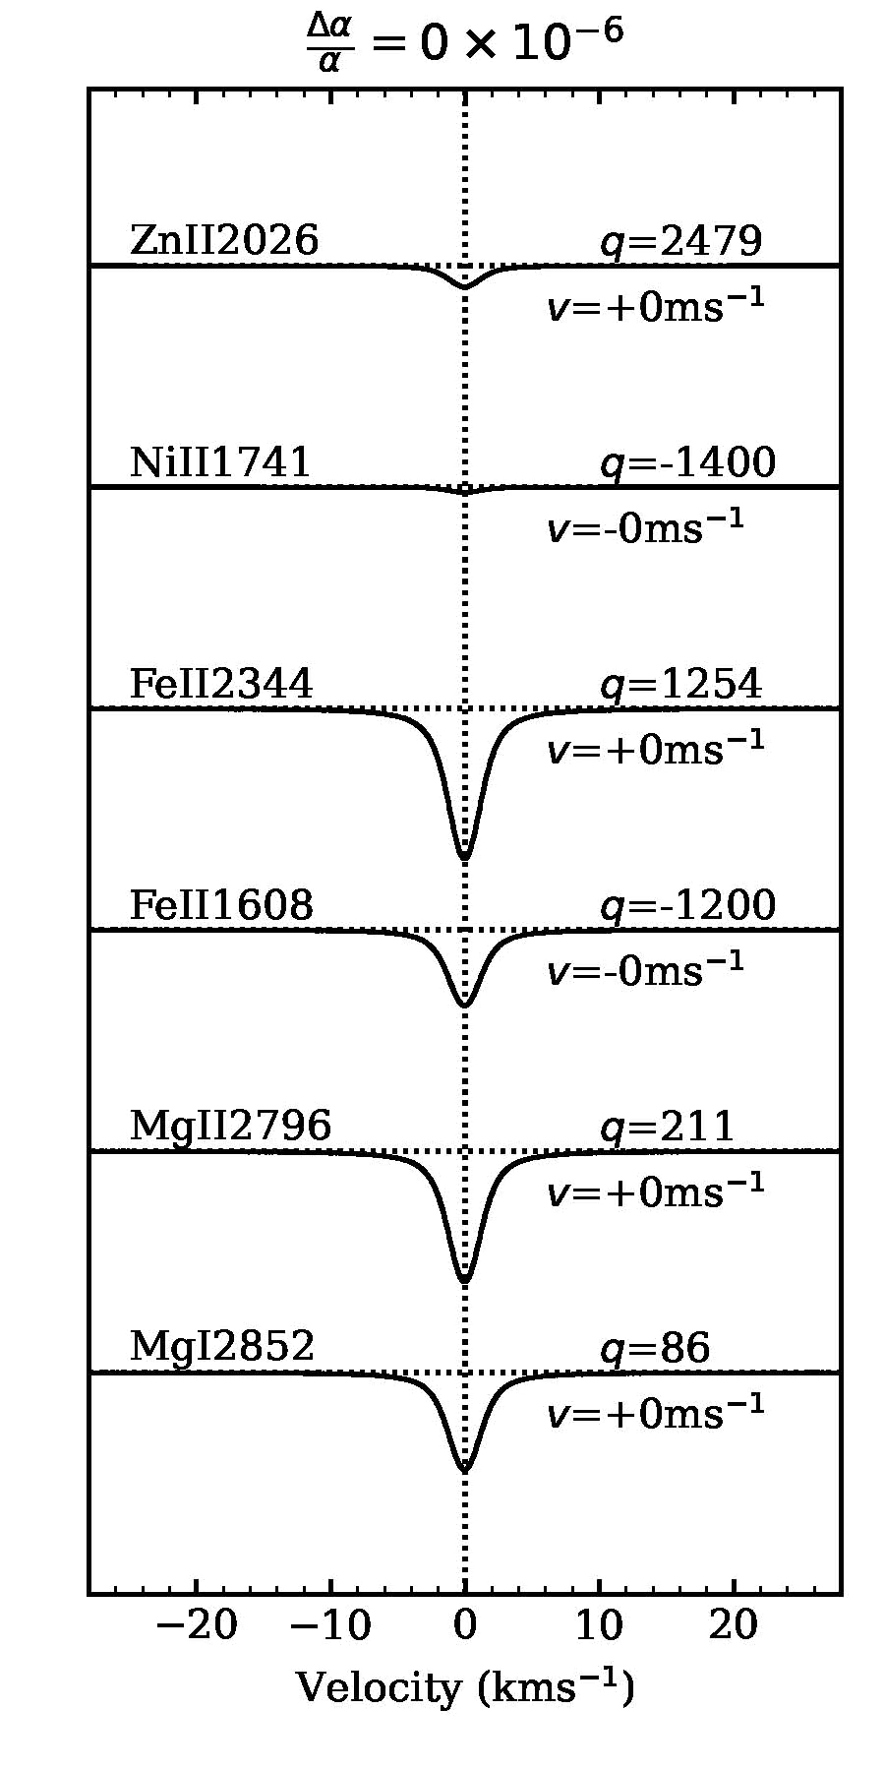
Variability of Fine Structure constant
Characterizes the strength
of the EM force
It has been extensively tested on earth : no
time variability . It can be tested in Astronomy
using metallic lines. A variation of the constant
will produce a shift
In wavelength:
The measurement is also conceptually simple: measure wavelength differences between absorption lines
As reference : 1ppm ~ 15 ms⁻¹

Slide 10
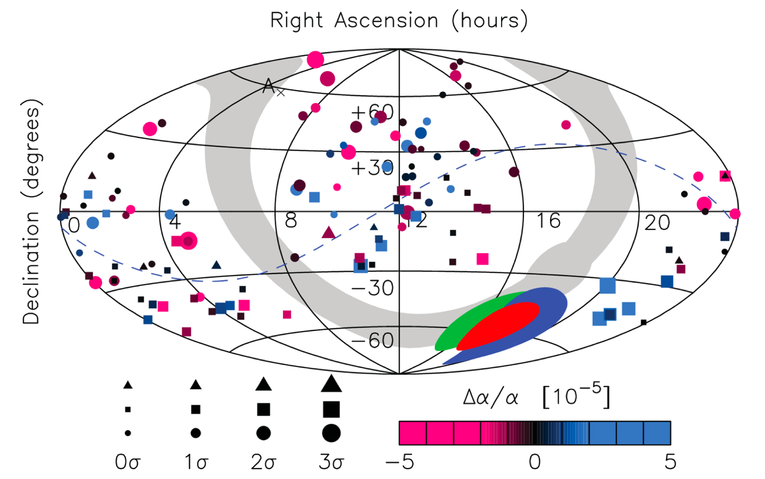
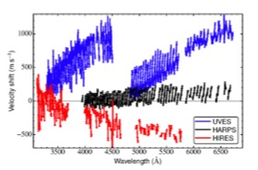
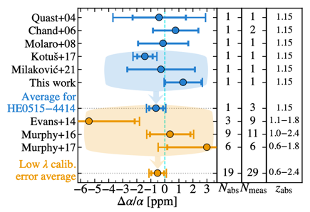
The problem(s)
Claim of dipole in sky (King et al. 2012)
Two main problems
  Experimental: UVES and HIRES suffer of wavelength distortion up to several hundreds ms⁻¹
  The line of sight are complex and the models are not unique
Well calibrated case shows consistent results (no variation at < 1 ppm) (Murphy et al. 2022)
Bring the problem on solid observational grounds!

Slide 11
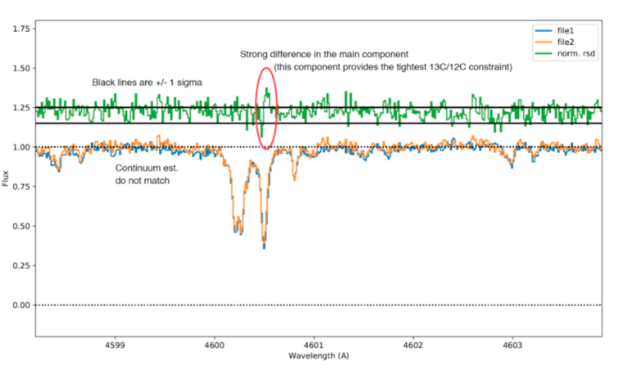
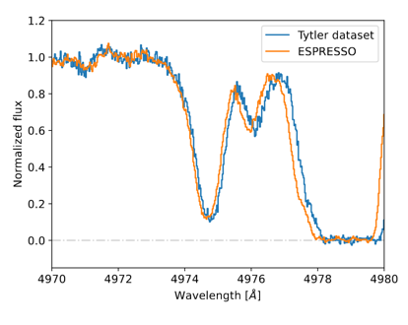
IGM Abundances ..
ESPRESSO spectra of same QSO..
  C12/C13 20 or 90?
  Low level cosmic/hot pixel
BBN: D/H
  Difference between ESPRESSO and HIRES…
  D/H = 2.608 ± 0.10 10⁻⁵ .. Adding HIRES spectra does not improve uncertainty.. Hitting the systematic limits ?
Molaro,Milaković, private communication
Guarneri et al. 2024

Slide 12
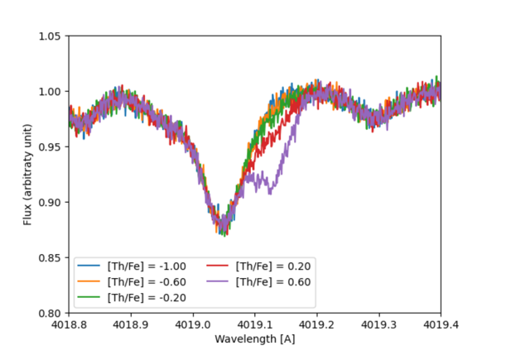
Stars, chemistry
HRMOS is a MOS R~80000 facility proposed for the VLT (Magrini et al. 2023)
  Age of stars through Nucleocosmochronology (Th/U)..
    Blended, tiny line ..
  Chemical tagging requires abundance precision < 0.02 dex ..
Synthetic spectrum of a giant star,
[Fe/H] = -2.5, T_{eff}=4500 K, R=80000
S/N=200

Slide 13
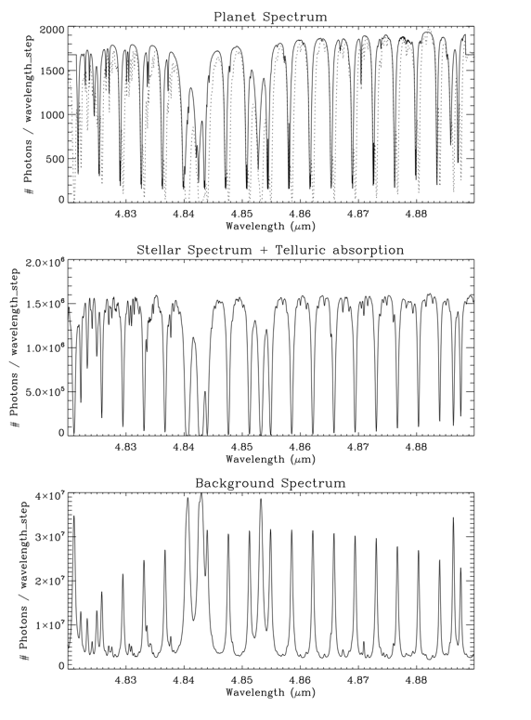
Exoplanets’ atmospheres
Oxygen in amospheres of rocky planets (reflected light) coupling AO and HRS (ANDES, METIS@ELT, Ristretto @ VLT) (Snellen et al. 2015, Palle et al. 2023 Lovis et al. 2017)
  ~10⁻⁷ contrast with stellar flux; n*10³ rejection by XAO
  S/N of a few tens after 1-60 nights observation on a Cen (ELT) or Prox Cen B (VLT)
METIS simulated spectrum
(Snellen et al. 2015)

Slide 14
How to get there?
“Everything Matters” : three Pillars
  Spectrograph (We have them!)
  Calibration : Astrocomb
  Data reduction: PSF reconstruction, Spectro-perfectionism ?

Slide 15
The Spectrograph
New generation spectrographs fulfil the requirements
  Fibre – fed, scrambled PSF independent of input
  Simultaneous calibration
  Vacuum and temperature controlled, super stable
Contrary to imaging, there are not on-sky calibrators

Slide 16
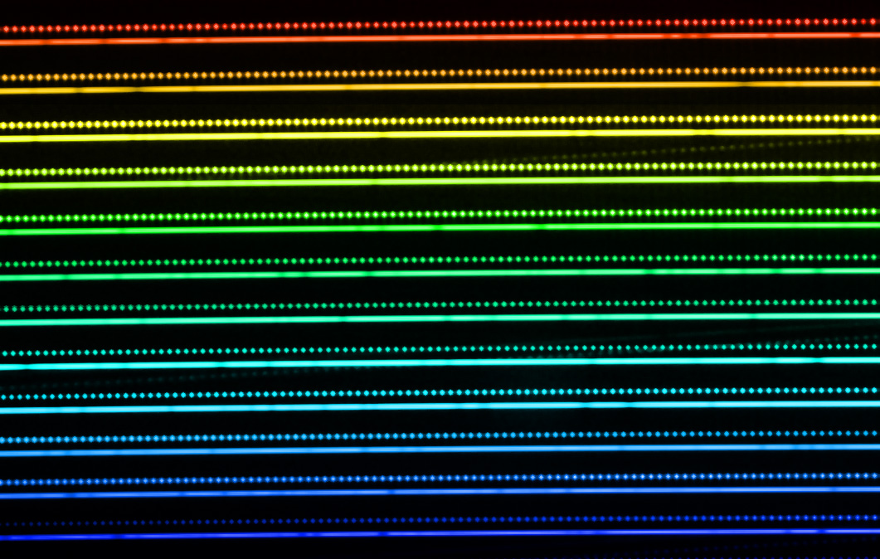
Astrocombs
Astrocombs early recognized as the ideal calibrators (Murphy et al. 2007, Steinmetz et al. 2009)
  Intrinsic accuracy of clocks used
ESO worked with MPQ on prototypes and firsts systems for HARPS and ESPRESSO
  1 cms⁻¹ short term (Wilken et al. 2012)
  Recovered wavelength accuracy to a few ms⁻¹ (Schmidt et al. 2022)
  Consistency between two astrocombs at ~49 cms⁻¹ (Milakovic et al. 2020)

Slide 17
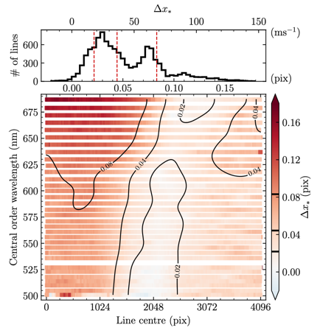
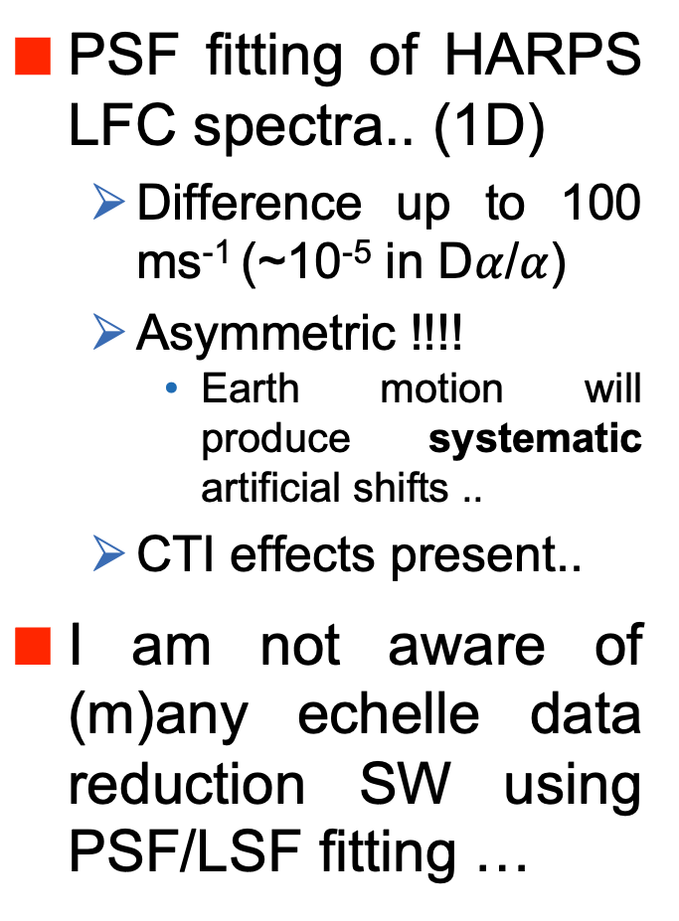
PSF Fitting
PSF fitting of HARPS LFC spectra.. (1D)
  Difference up to 100 ms⁻¹ (~10⁻⁵ in D$α$/$α$)
  Asymmetric !!!!
    Earth motion will produce systematic artificial shifts ..
  CTI effects present..
I am not aware of (m)any echelle data reduction SW using PSF/LSF fitting …
Milakovic & Jethwa 2023

Slide 18
Data reduction
Spectra are extracted:
  Optimal extraction, is great (fast, robust) but has limitations
    It is basically wrong for echelle spectra (assumes perpendicularity to pixels) (see , however, Piskunov et al. 2023)
    It does not use the PSF information
A rigorous forward-modeling treatment is possible (Spectro-perfectionism) (Bolton et al. 2010, 2012)
  P = Af + n and A can be inverted by calibrating the PSF with an astrocomb.
  Main problem : Huge matrices to invert
    Now feasible (faster GPUs, smaller matrix: use only active pixels )
    Adopted by DESI and Minerva (Guy et al. 2023, Cornachione et al. 2019)

Slide 19
Some requirements
A suitable calibration (LFC), able to recover PSF and to characterize each pixel used (in Space ? Pepe et al. 2024)
Data Reduction that makes use of PSF and avoid extraction: my guess is that forward modeling is needed
  Including detector modeling ? (e.g. PyXel https://esa.gitlab.io/pyxel/ )
Requirements as other observations: precise centroids, High Contrast and coadding (low signal) observations
  Detector imperfections (CTI, persistency, binary offsets, cosmics, linearity,PRNU…) measured & characterized also at low signal
  Massive use of AI and statistic criteria: a complete and realistic estimate of the noise (Bias, background, crosstalk, etc..)
Zero RON for exo-planet (transit) spectroscopy and for faint sources
  Fast read out for transit spectroscopy

Slide 20
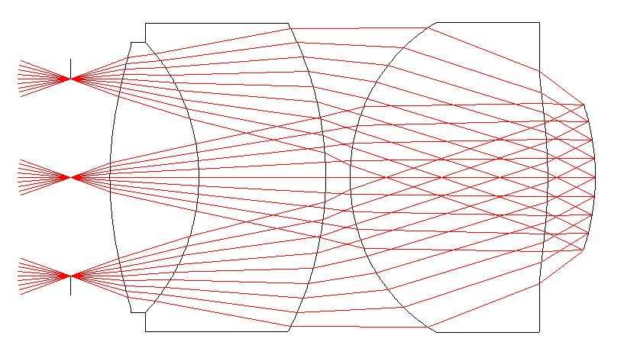
Shopping list beyond precision
Huge focal planes: ELTs, MSE/WST… hundreds of sensors !!
  Curved detectors !!!
  Cheaper !!!!
    High costs inhibits great projects
Huge Calibrations
  Require stability
  Can be performed few/lifetime
97% transmission F/1.1 camera ,
40º FoV (Pasquini et al. 2016)

Slide 21
Thank You
Luca Pasquini: lpasquin@eso.org
Dinko Milaković: dinko@milakovic.net

Slide 22
The ideal calibrator
The requirements

