Slide 1
H4RG analyses for Roman and PFS
Jahmour Givans
ISPA 2024 workshop
Image credit: Teledyne Imaging

Slide 3
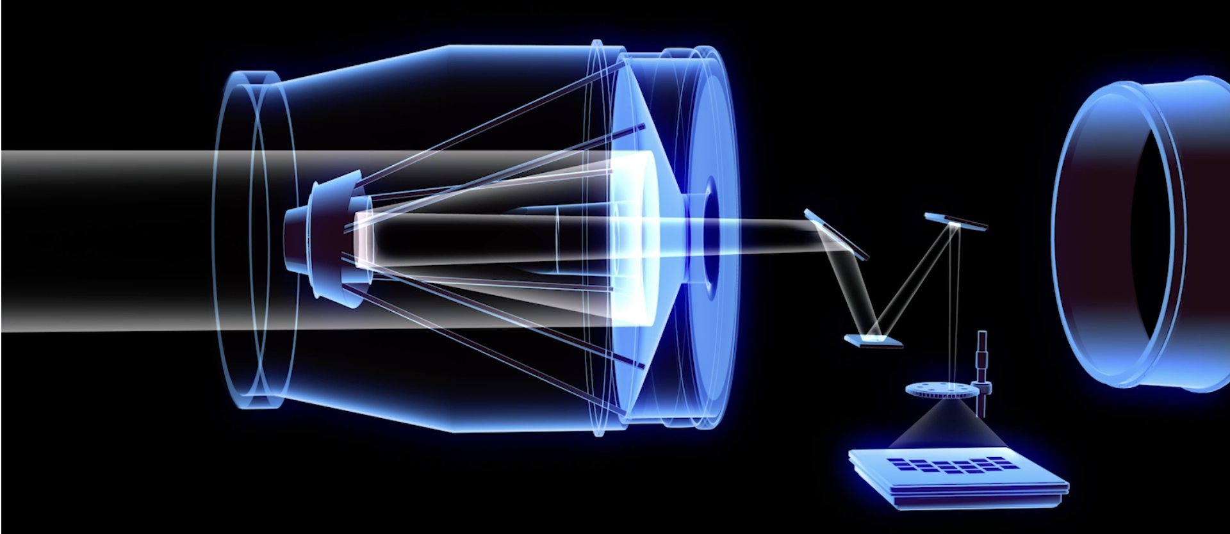
Wide-field instrument specifications
Surveys the sky 1,000 times faster than Hubble!
Imaging and spectroscopy available
0.281 deg^2 field of view
0.11 arcsec/pix, 288 Mpix focal plane
Detector array consisting of 18 H4RG-10s
4096 x 4096 pixels with border of 4 reference pixels per side
32 readout channels, taking 3.04 seconds to read
Bandpass of 0.48-2.3 microns

Slide 4
Roman's Roadmap
Spergel et al. 2015

Slide 5
Gravitational lensing
Percent-level shape/size distortions
Image credit: NASA, ESA, CSA, STScI, A. Galan
Dramatic distortions and multiple images
Correlations used to probe !

Slide 6
Will Roman help resolve a tension?
Early universe
Late universe
Abdalla et al. 2022
(clumpiness)

Slide 7
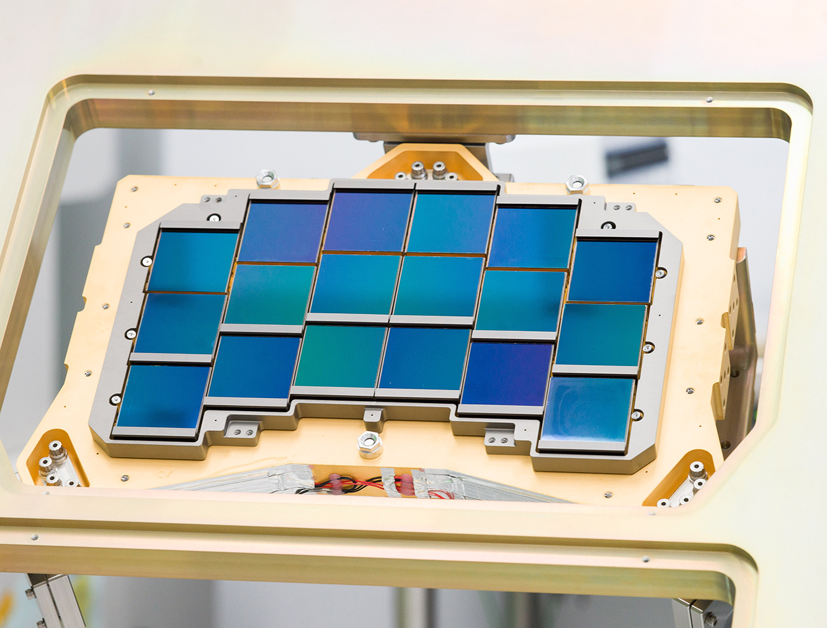
Detectors are the difference!
Most weak lensing surveys use CCDs and operate in the visible spectrum
Roman will use HgCdTe detector arrays with 4096^2 pixels
Access to near-infrared wavelengths
First application to weak lensing, so we need to understand their features!
Mosby et al. 2020

Slide 8
Detector effects
Credit: Jenna Freudenburg

Slide 9
Quantifying the impact
All five effects can throw off our estimated galaxy shapes!
Correlations of signal across the detector used to quantify effects
Use both spatial and temporal correlations to disentangle different effects
Built the first mathematical model to describe correlations including all effects
J. Freudenburg, JG+ 2020 (2003.05978); JG+ 2022 (2110.08155)
Created simulated detector images with relevant physics included
GitHub package: solid-waffle

Slide 10
Performance against simulations
Updated model (BFE+IPC+CNL) resolved lingering 12% bias on BFE parameters from earlier work
Full model recovered input parameters well within a standard deviation!
Quantum yield
Charge diffusion (2x2 matrix elements)

Slide 11
Roman detector maps

Slide 12
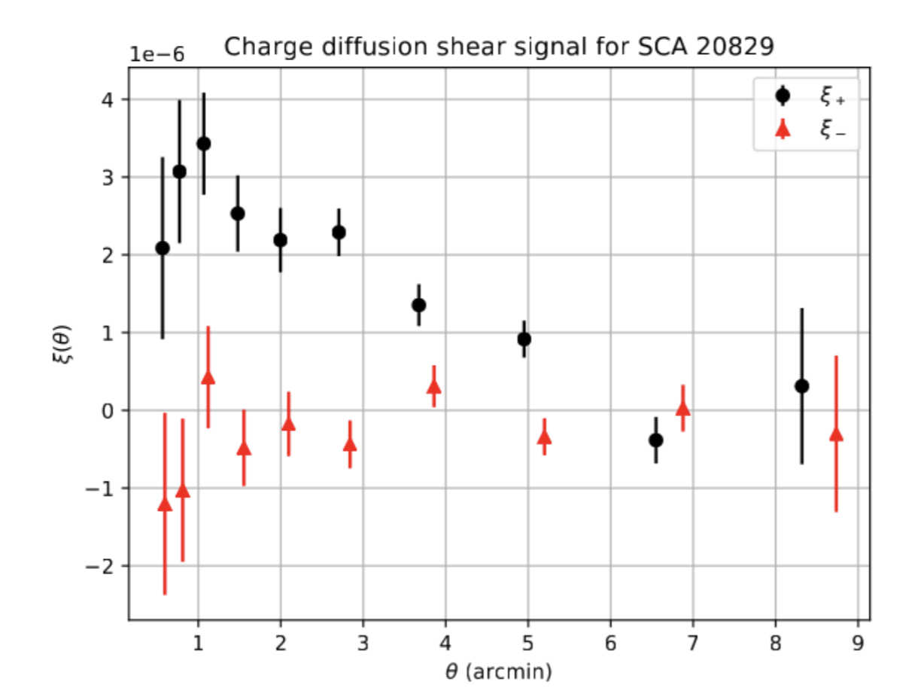
Pioneering analysis: charge diffusion "shear" signal
Black points are an order of magnitude above acceptable limits! Must be corrected for by Roman team.

Slide 13
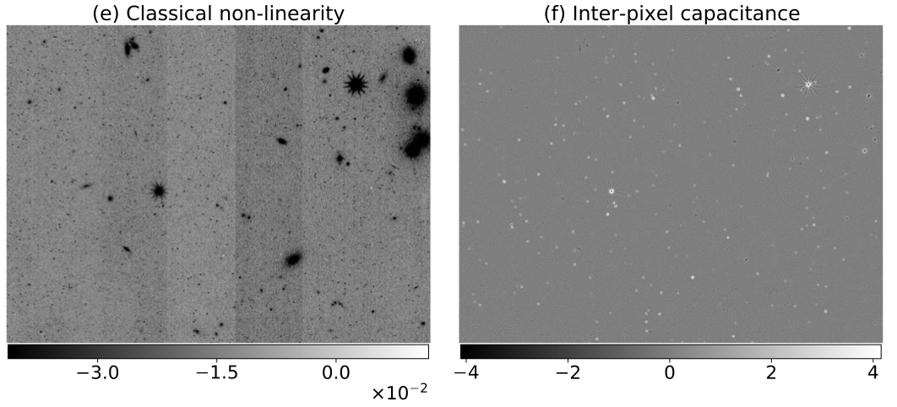
From pixels to pictures
Joint endeavor between Roman and Rubin groups to build a synthetic survey
M. Troxel+ (incl. JG) 2023 (2209.06829)
Incorporated my detector findings in the simulation pipeline
Testing ground for development and validation of joint pixel-level analysis techniques
Important for maximizing science yield from these two surveys
Highest-priority missions outlined in the 2010 Decadal Survey!

Slide 14
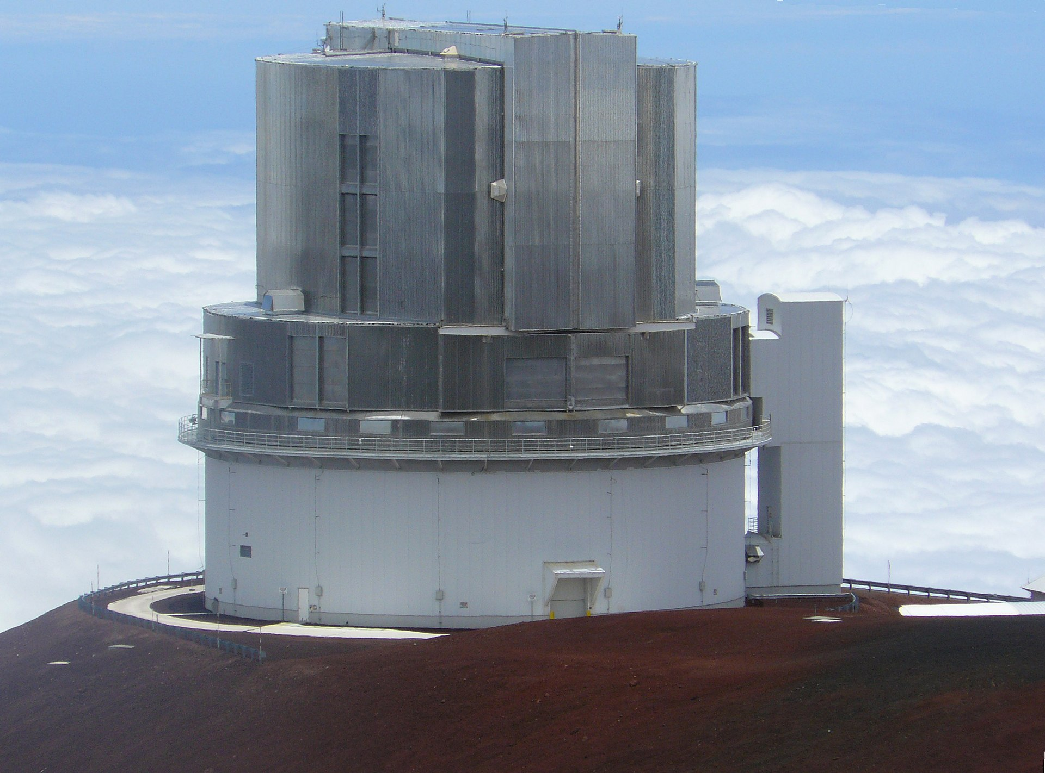
Prime Focus Spectrograph
*Subaru Telescope building shown

Slide 15
Credit: SubaruTelescope.org

Slide 16
PFS science cases

Slide 17
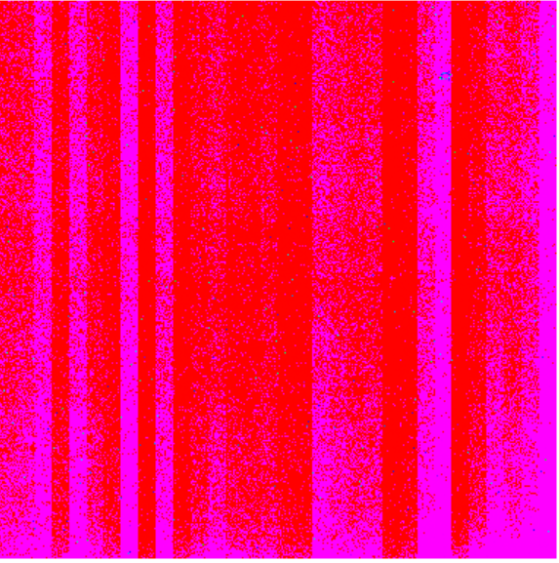
Example dark data
JHU lab data from June 2022
300 frame UTR darks for approximately 24 hours after illumination
IRP1:1 (one interleaved reference pixel read between each data pixel)
Frame times of about 11 seconds
Raw dark frame 100
Raw dark frame 100 - dark frame 1

Slide 18
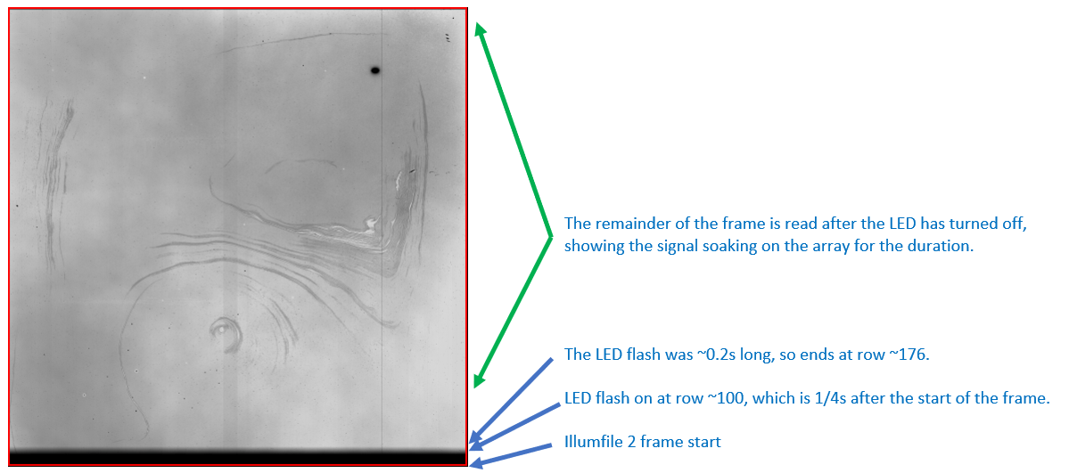
Persistence tests
All persistence runs were carried out and analyzed by Eddie Bergeron
Two-part illumination frame followed by a series of long darks
Charge "soaked" into the detector for one frame time plus time for reset frame to reach a given pixel during the pixel-by-pixel reset
Gain factor for detector is 3.2 electrons/ADU, ASIC preamp gain factor 2.83

Slide 21
Analyzing noise
We are interested in total noise, not disentangling noise sources
Build 3D array of signal in pixels across dark frames
Do this using the difference of two (median subtracted) FITS files
Apply bad pixel mask based on hot pixel analysis
Fit signal across frame number and calculate rms noise
Get best-fit coefficients to describe the noise curve
Noise = sqrt(a/N + b*N)

Slide 22
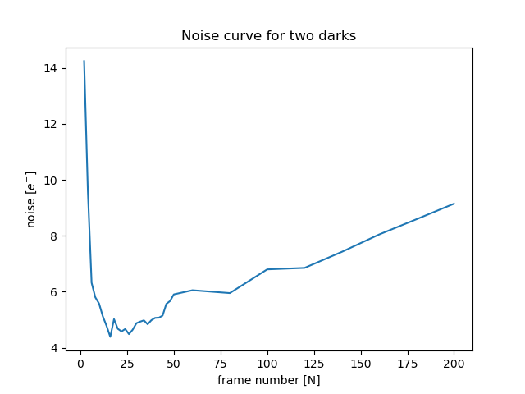
Noise curves (current analysis)
Consistent shape from darks of different FITS files

Slide 23
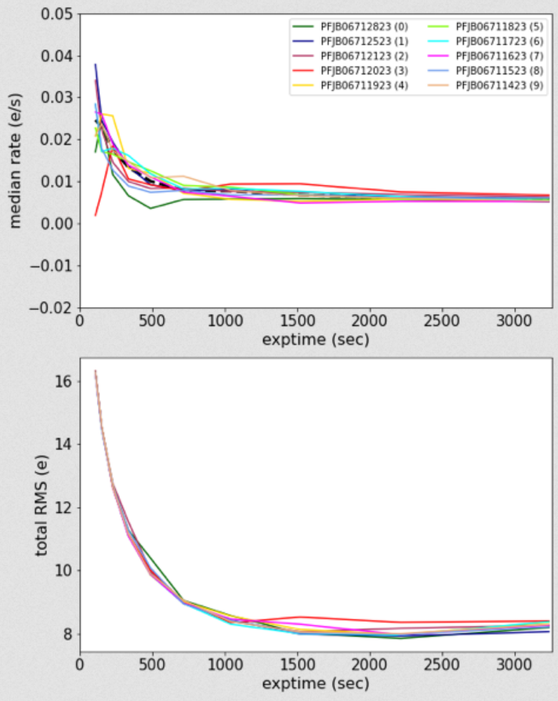
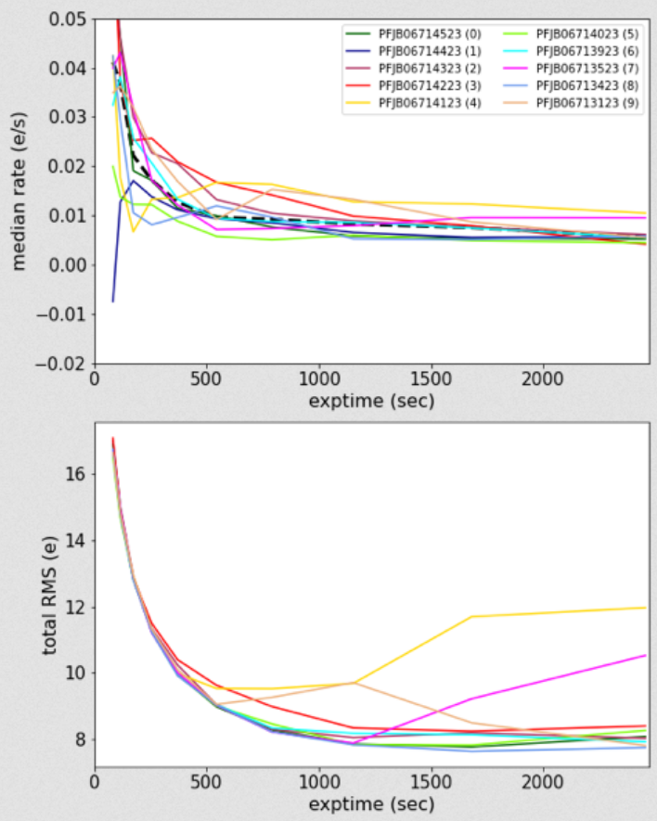
Noise curves (previous analysis)
Initial work in this area carried out by Erin Kado-Fong
IRP1 (left) and IRP2 (right)
Shape is overall discrepant with most recent analysis

Slide 24
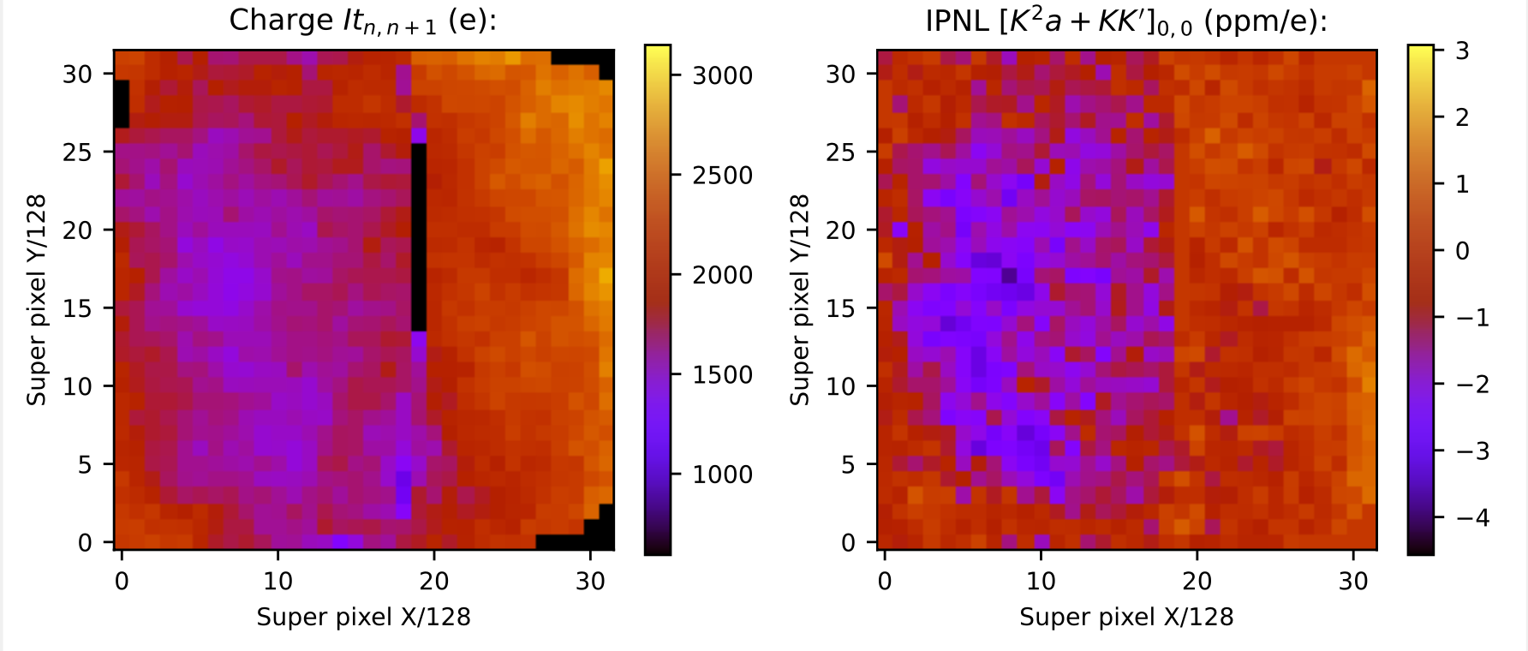
Basic nonlinearity characterization

Slide 25
Going forward
Continued work studying effects of different IRP value choices on noise properties
Thought from this conference: maybe reference pixels aren't the best strategy?
How to translate noise and parameters (BFE, IPC, etc.) to errors on science
Developed/developing for Roman but PFS lags behind
Perhaps Pyxel would be useful?
How will our findings affect the survey strategy?
What can Roman learn from Euclid (and later, SPHEREx) in-flight data?

