Slide 1


STA Skipper and
CCD Development Status
Image Sensors for Precision Astronomy
SLAC
12 March, 2024
Greg Bredthauer, Kasey Boggs, Joe Tufts
greg.bredthauer@sta-inc.net
http://www.sta-inc.net

Slide 2

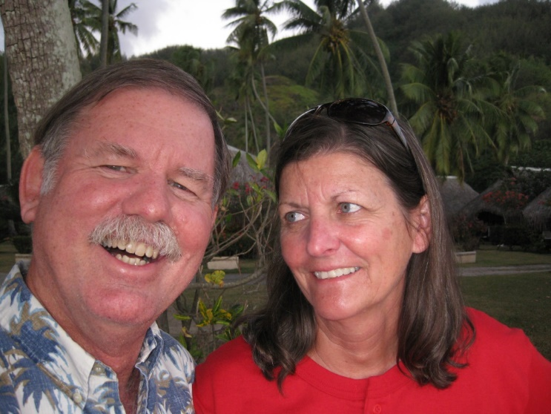
STA
Richard Bredthauer, 1975:
“A 50-bit charge coupled device with AC coupled inputs”
Hubble WFPC2
Mars Pathfinder
Stereo Imager
All Cassini CCDs
STA founded 1999

Slide 3
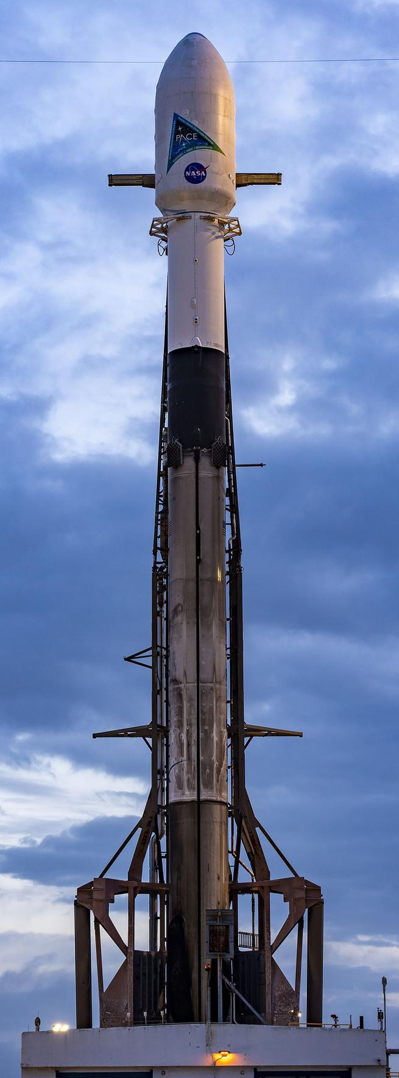
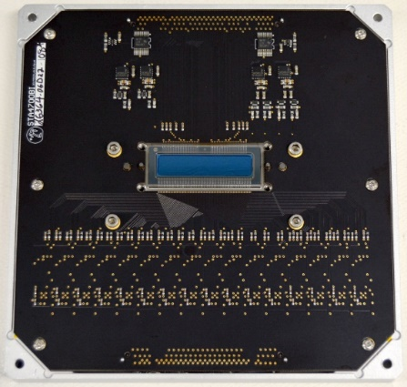
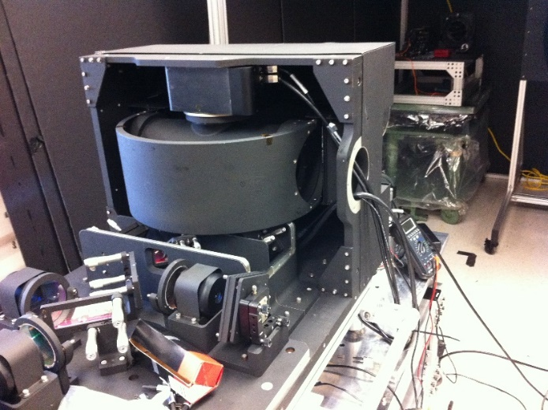
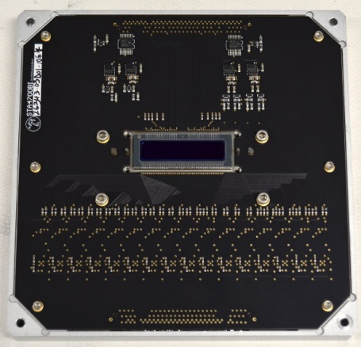
Custom Sensors: PACE OCI UVNIR
Launched February 7, 2024
Ocean monitoring (Plankton, Aerosol,
Cloud ocean Ecosystem;
Ocean Color Instrument)
512 x 128 26um TDI,
16 outputs
Red and Blue tuned AR,
310-610nm, 595-895nm,
custom conversion gains
across sensor
See OCI Flight UVNIR CCD Procurement Specification; Falcon 9 photo from NASA/SpaceX

Slide 4
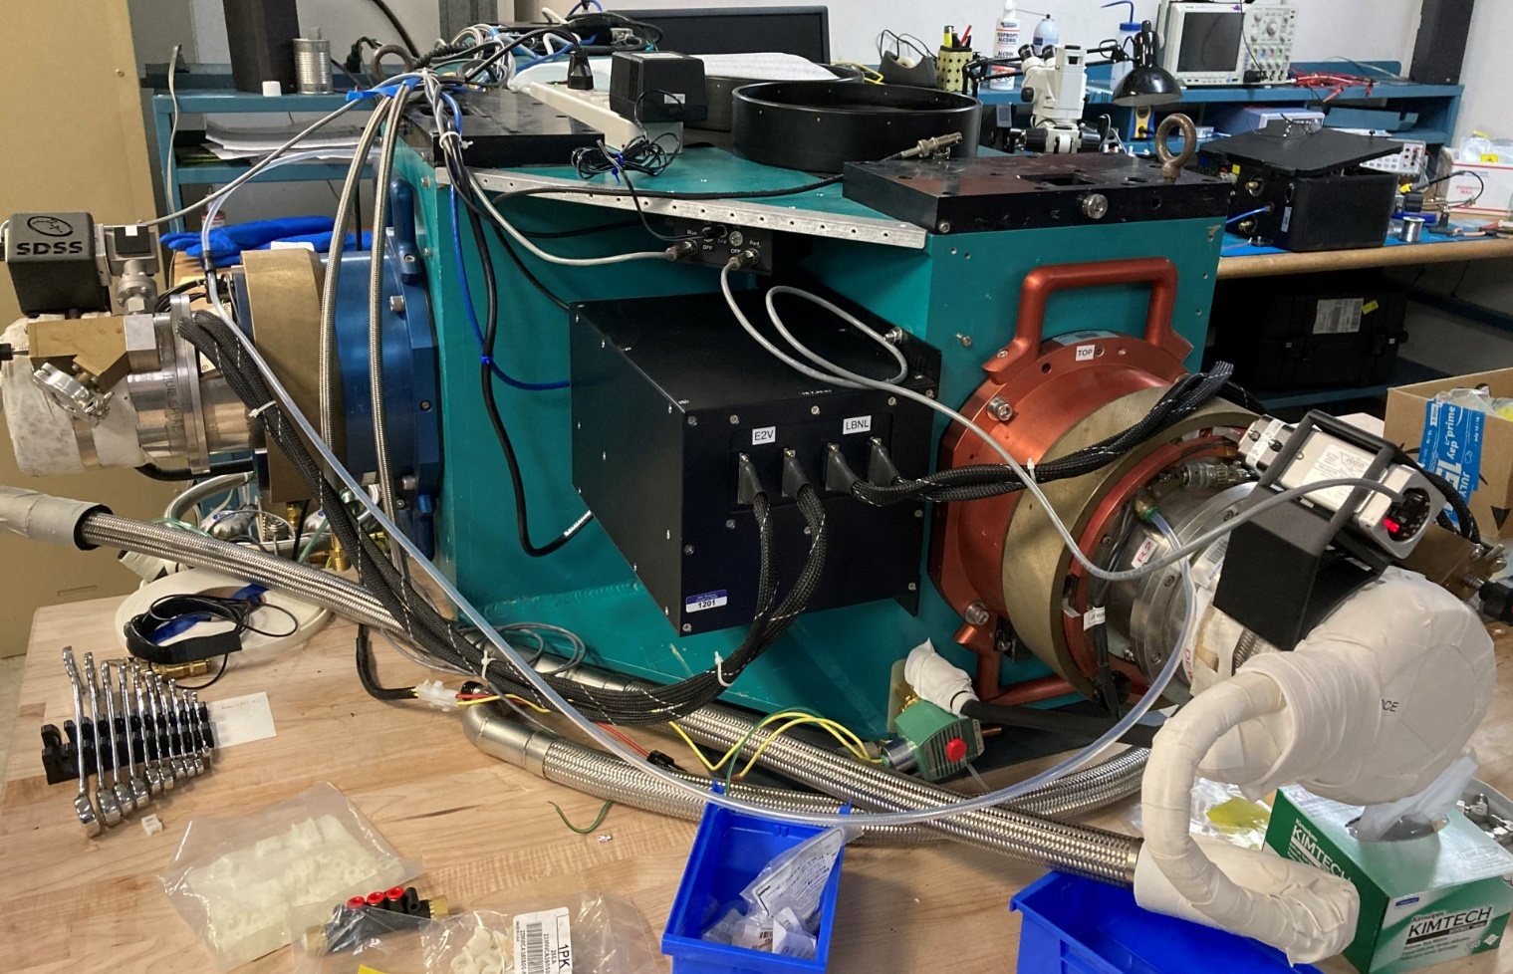
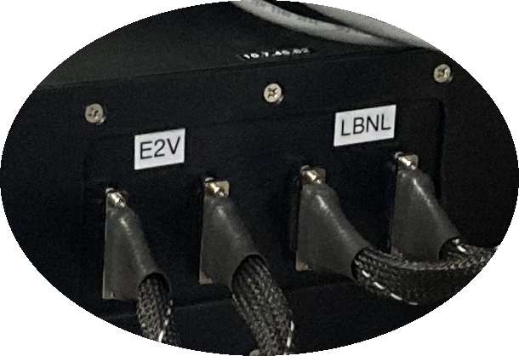
Custom Controllers
HxRG: ADM, 18 channel 18-bit 12.5MHz modules →
72 channels per controller
BOSS spectrograph
upgrade: one Archon
synchronously reading
out an LBNL 3-phase deep
depletion p-channel
4k x 4k CCD and an
e2v 4-phase n-channel
4k x 4k CCD231-84

Slide 5
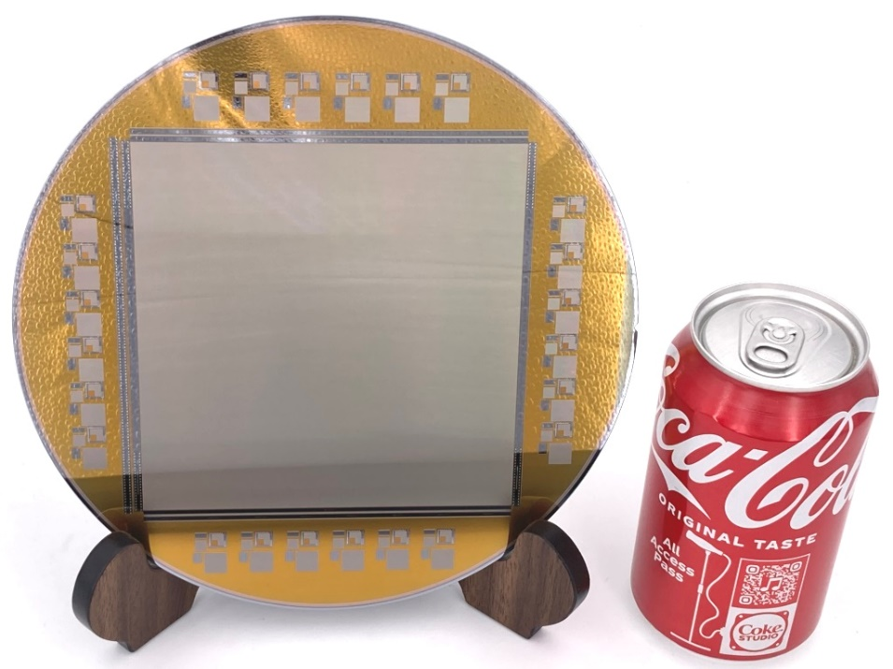
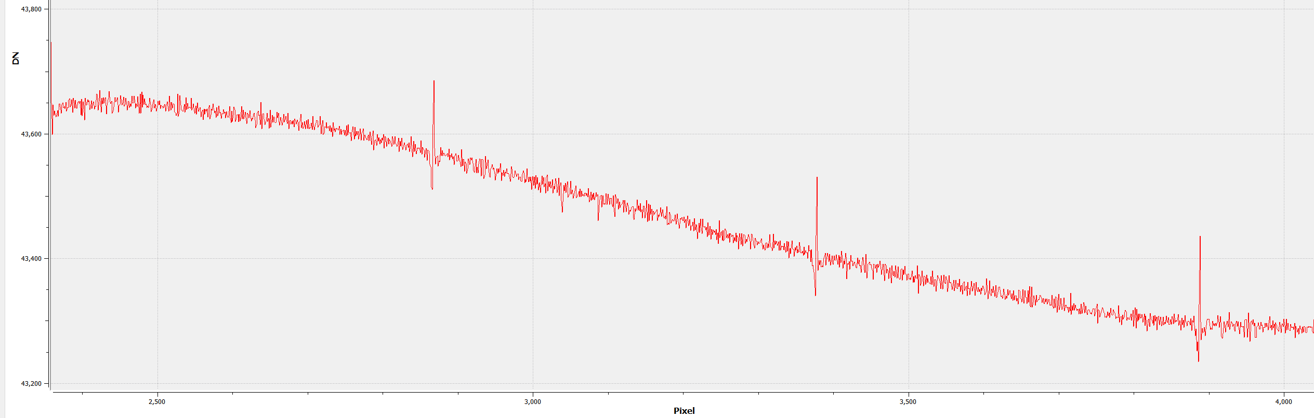
Microchip Foundry
200mm wafers
(150mm at Teledyne DALSA)
5x stepper masks
instead of 1x masks
→ Immediately
attempted an
8k x 8k 15um CCD
Stitching boundaries →
~0.3% feature in PRNU

Slide 6
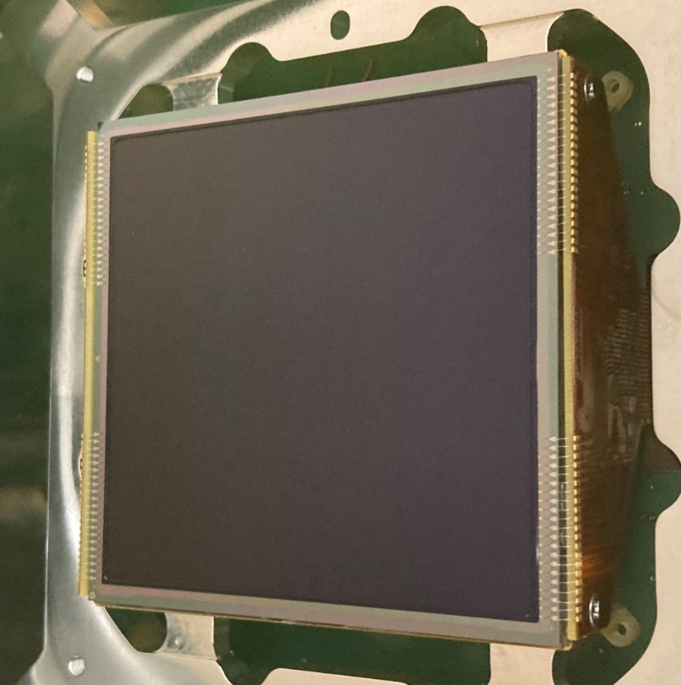
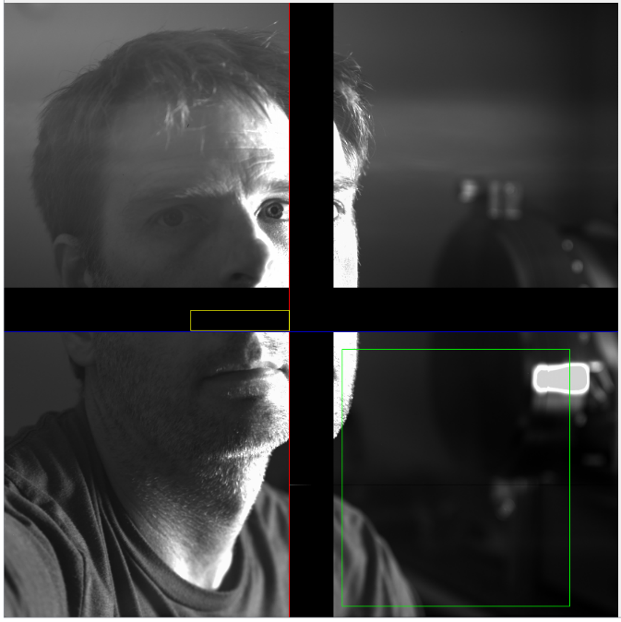
STA5100
First cold testing of BSI STA sensor
from Microchip foundry,
thinning done at ITL
Same format as STA4850,
4 single stage outputs,
4080 x 4080 15um,
1000ohm-cm 30um epi

Slide 7
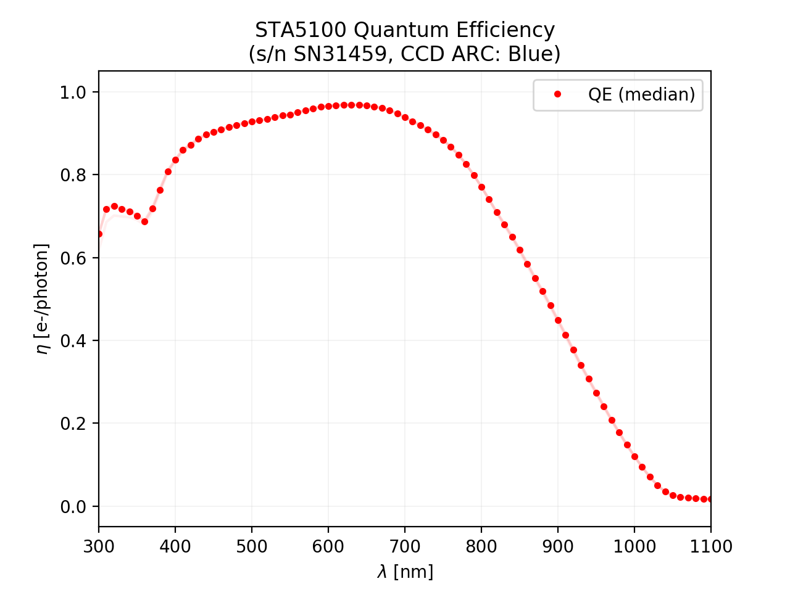
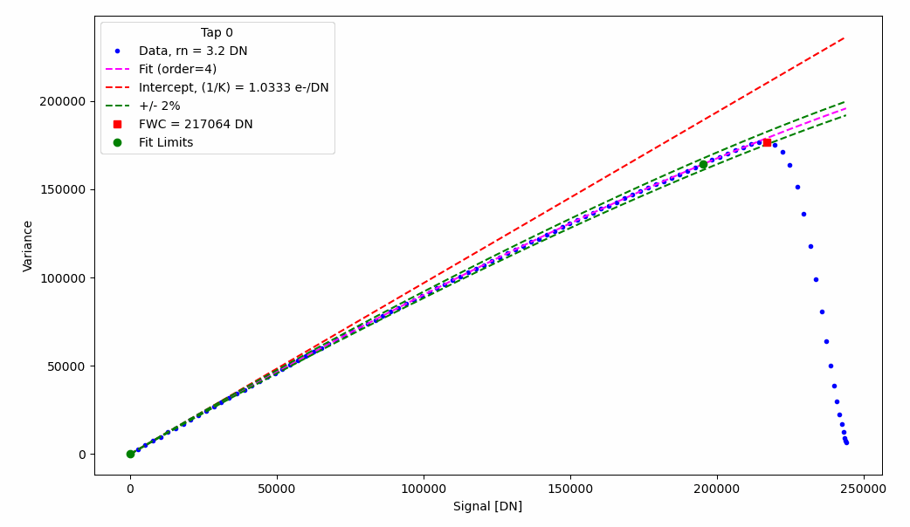
STA5100
4uV/e-, 2.7e- RMS at 100kHz,
4e-/pixel/hour at -100C,
200ke- full well

Slide 8
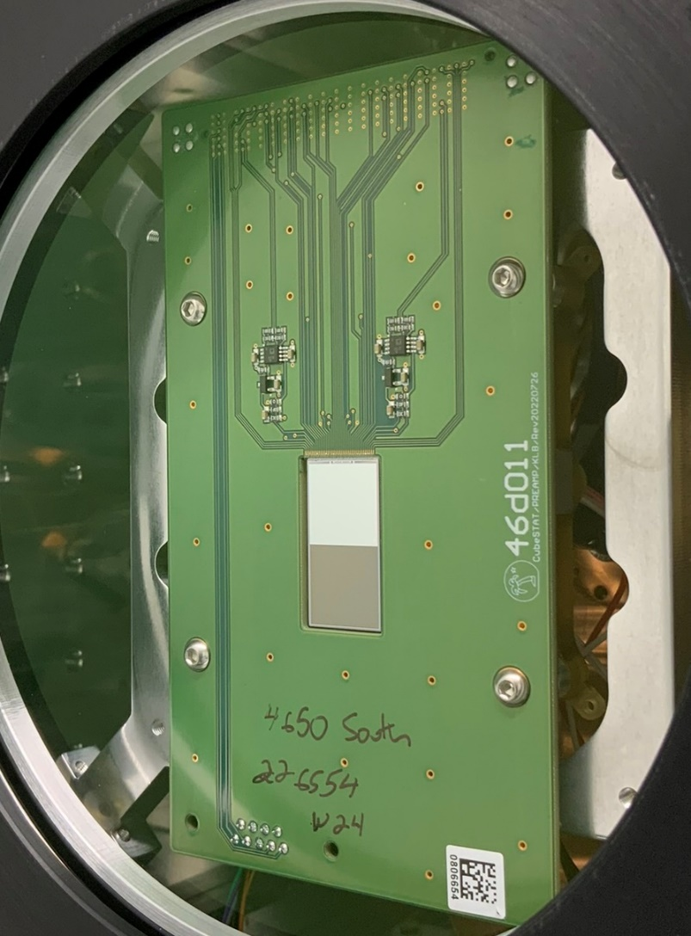
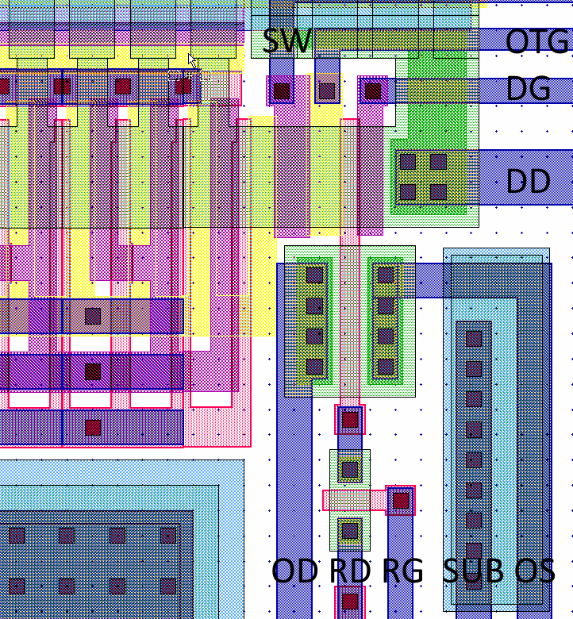
Prototype Skipper Device
1k x 2k frame transfer, 12um pixels
1 standard single stage output,
1 skipper output

Slide 9
Skipper Test Results
Cooled to -100C
Skipper gain 2.5uV/e-
5.5e- single sample noise at 100kHz
5.06e- flat field
0.19e- noise
(2000x sampling)
→ Perfect gain
and linearity,
no PTC needed

Slide 10
LBNL STA5500
Design goal: Blue-sensitive 4k x 4k CCD with < 1e- read noise and a readout time < 60 seconds.
Prototype skipper output modified to reduce capacitance, single sample noise should go from 5.5e- → 4e-
128 outputs total; 32 series skipper outputs per quadrant
4e- / sqrt(32) → ~0.7e- using 100kHz readout
(10us per sample)

Slide 11
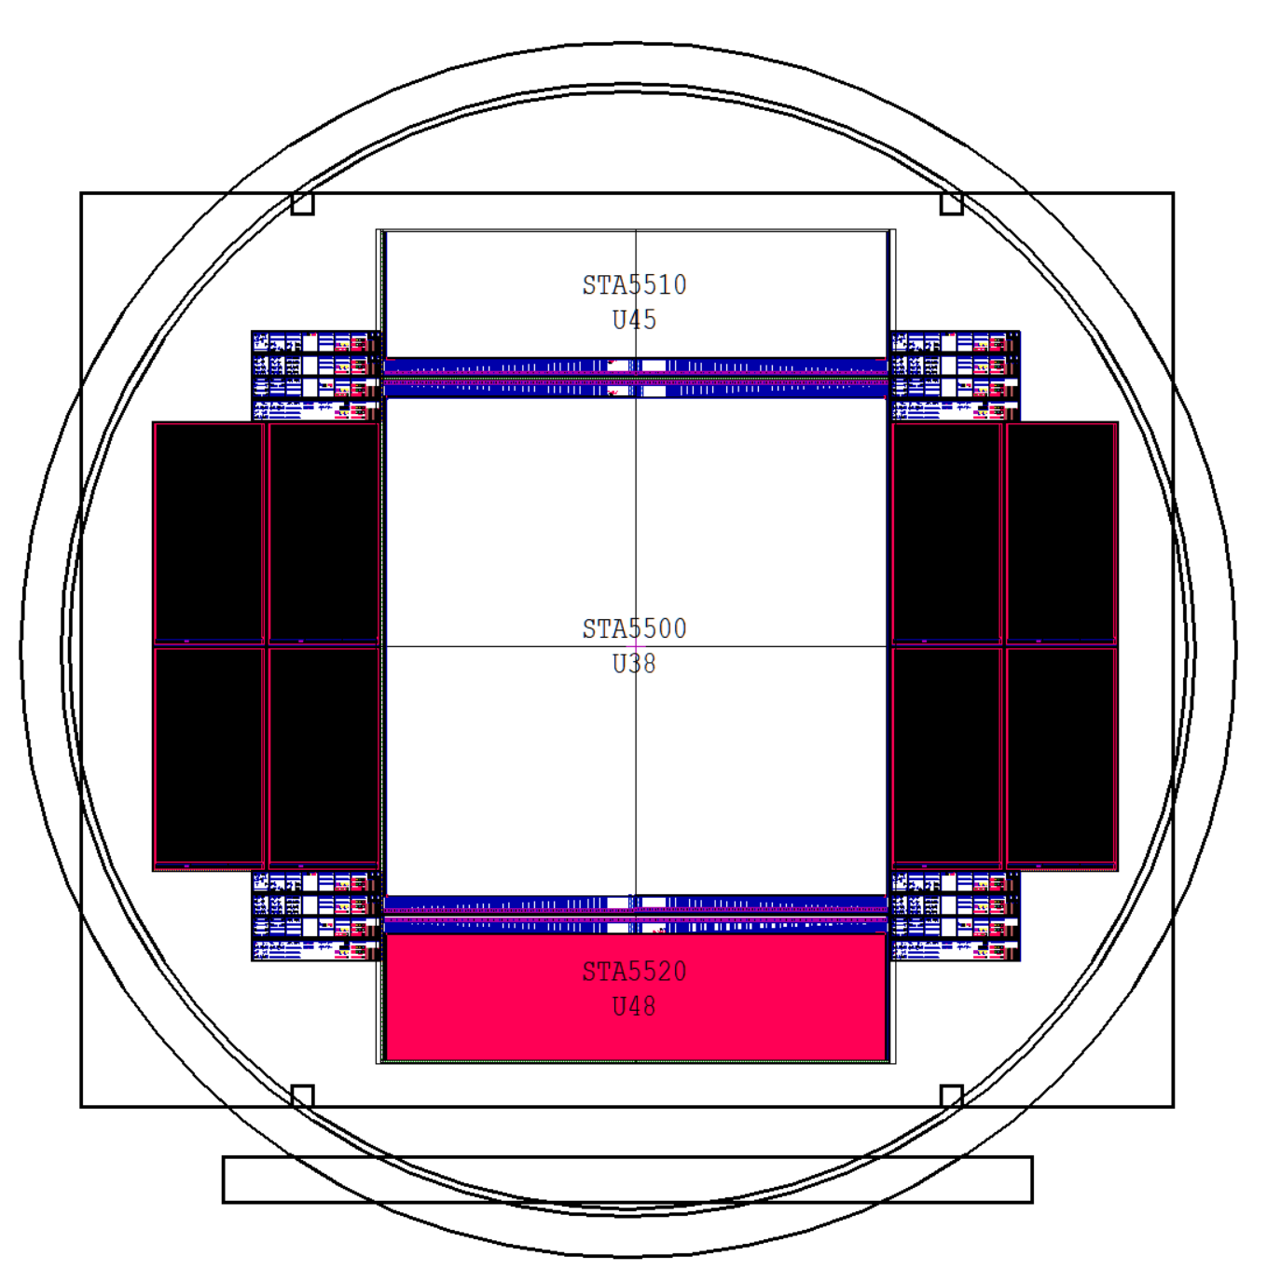
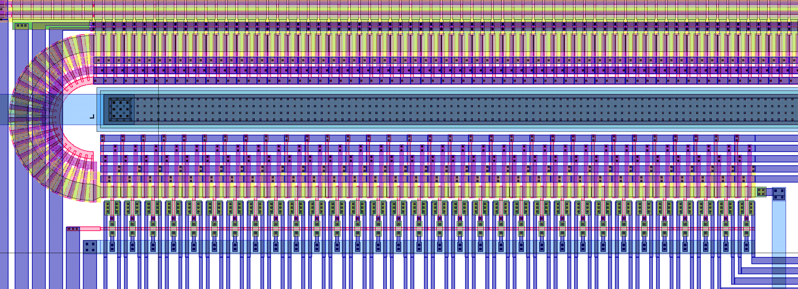
LBNL STA5500

Slide 12
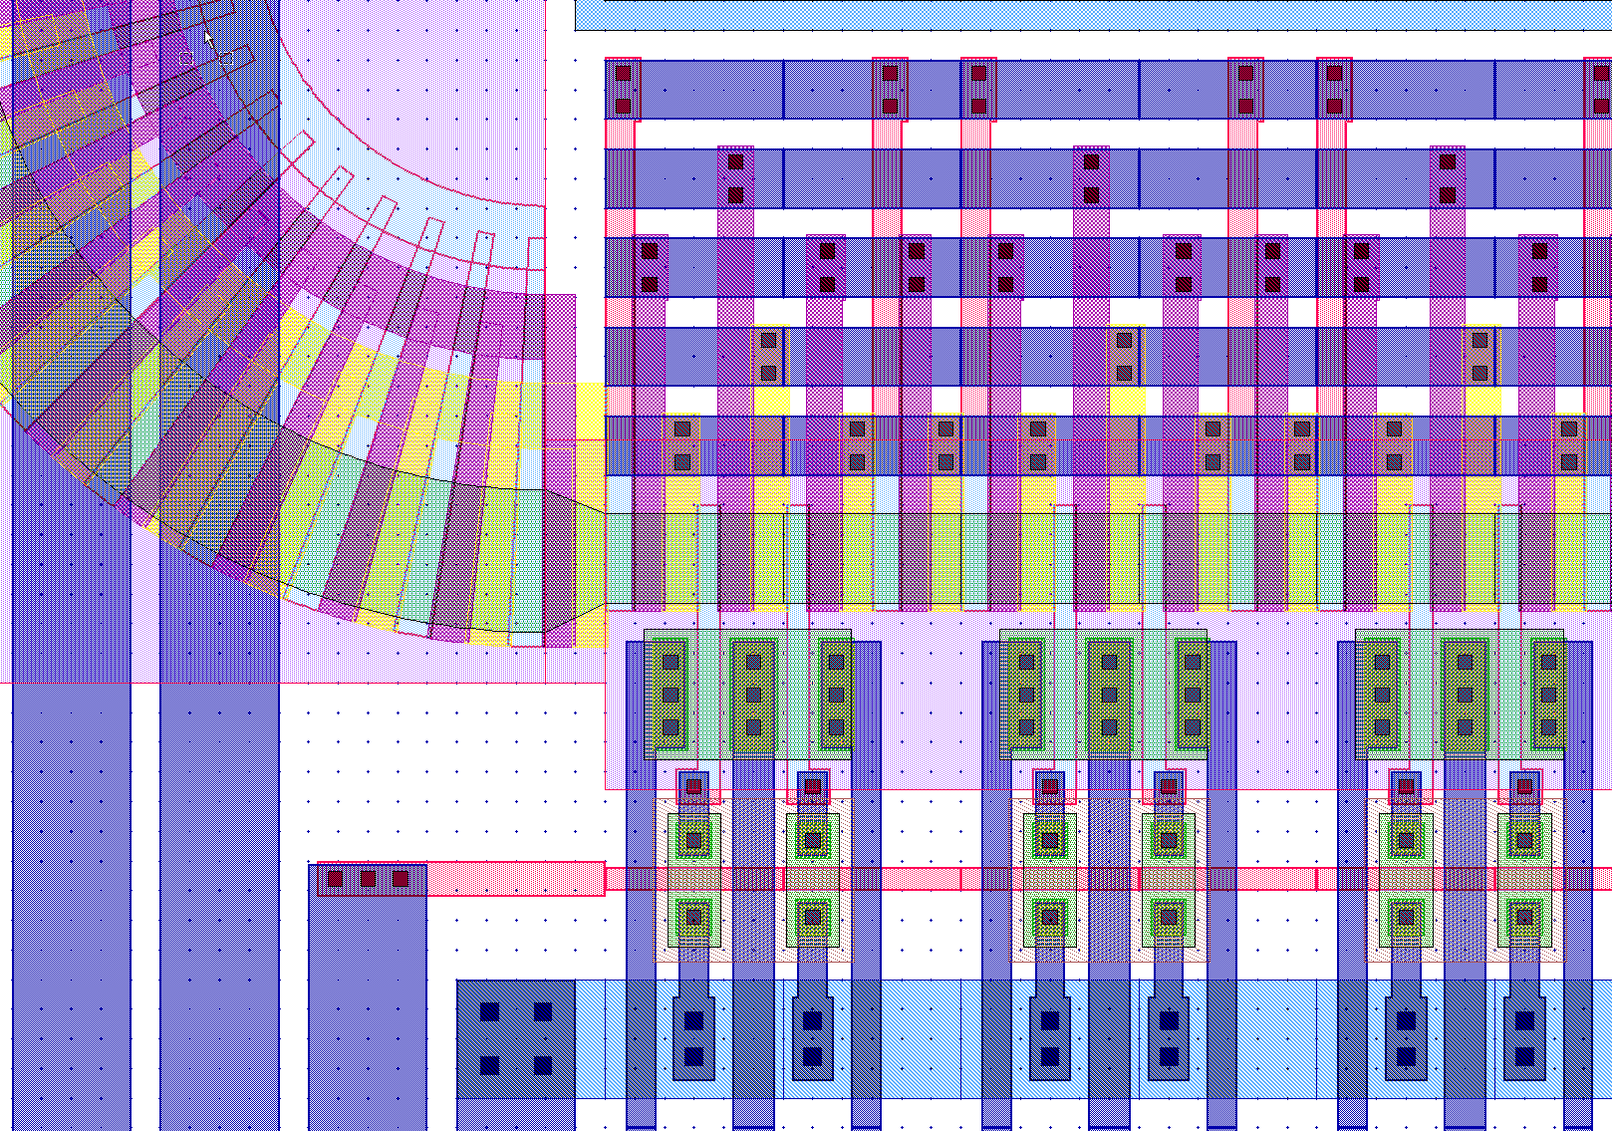
Differential Skippers

Slide 13
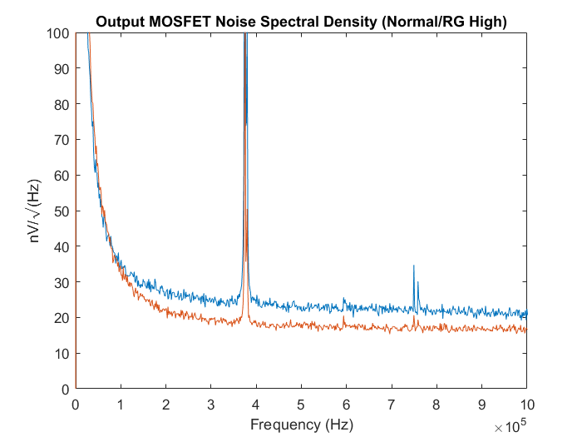
MOSFET Tuning
Want to optimize the output to minimize the read noise, so fewer skipper cycles are needed to get to the noise goal
Experimented with an STA4800
prototype with 16 output design
variants (transistor W/L,
supernotch, buried contacts, etc),
programmable current loads
→ We’re already at the optimal
MOSFET geometry

Slide 14
JFET Design
MIT/LL has reported JFET outputs with ~1e- read noise at 100kHz
Silvaco 3D simulation used to develop a JFET output design
Simulation work supported in part through a collaboration with Prof. Hamden at the University of Arizona

Slide 15
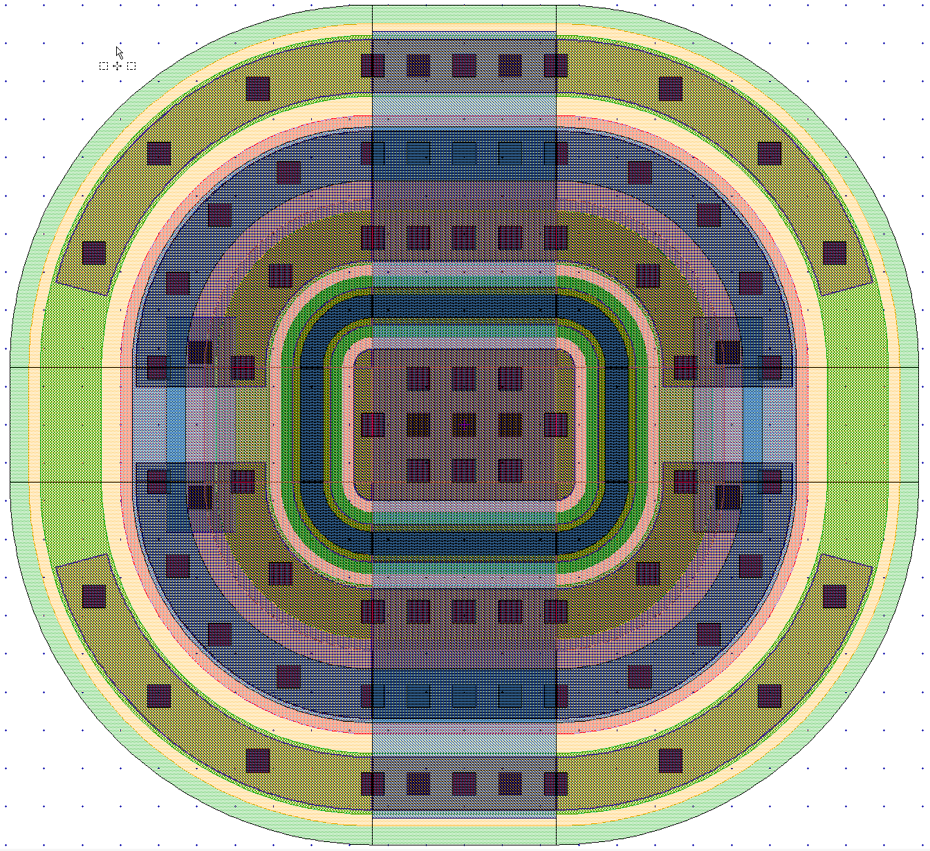
JFET Design
The JFET design shown is predicted to have 0.1fF gate capacitance,
1k output impedance with a 1.8mA drain current, and a source follower gain of 0.9998
Guard
Source
Source
Gate
Drain

Slide 16
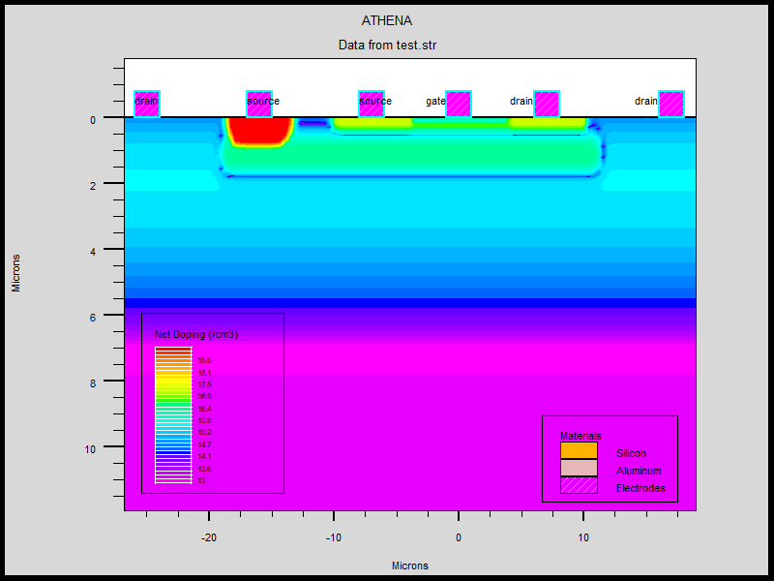
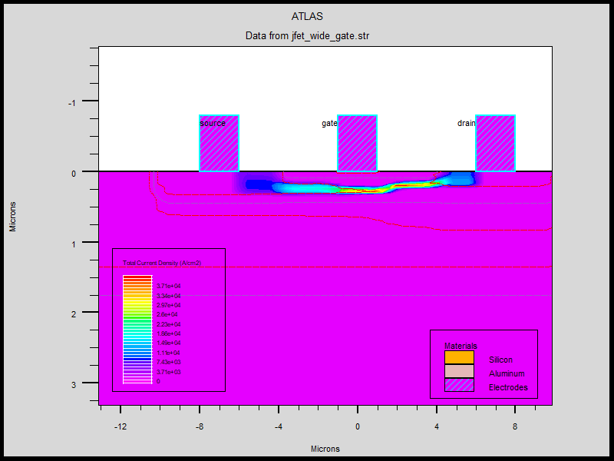
JFET Structure

Slide 17
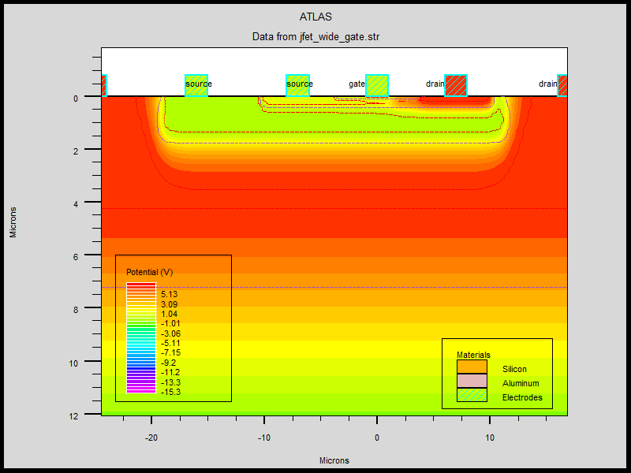
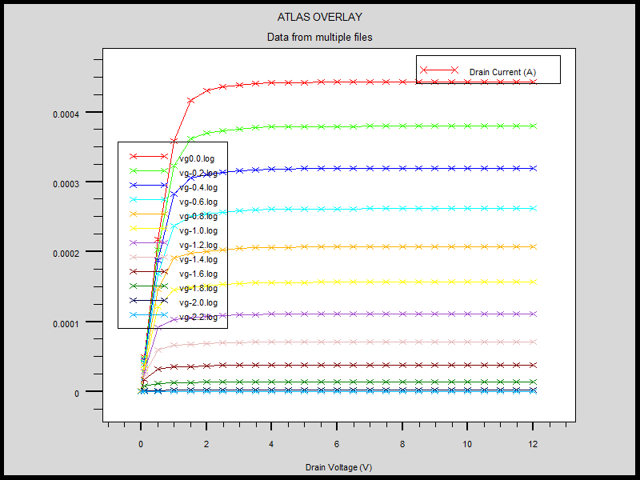
JFET Operation

Slide 18

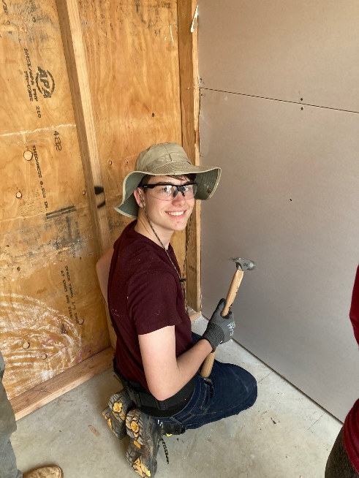

JFET vs MOSFET
Prototype skipper: 20x4 floating gate → 20fF, MOSFET → 15fF
0.7 x q/(20fF + 15fF) = 3.2uV/e- (2.5uV/e- measured)
Skipper with JFET: 12x4 floating gate → 12fF
0.99 x q/(12fF) = 13.2uV/e-
→ Time to build something new,
results later this year

