Slide 1
On the influence of electrostatic barriers that would modify brighter-fatter corrections for PSF estimations Andy Rasmussen & Alex Broughton – ISPA24C41
We use a generic Si drift simulator (https://github.com/arasmssn/bi_ccd_pixpart), operated under cold carrier approximation & validated against all available model-constraining observables to compute pixel boundary response to fixed-pattern & dynamic charge configurations within the pixel. Linked list implementation for E-field source management is appropriate for this problem: 10-20 pixel electrostatic field range & trajectory starting point bisection algorithm tolerance (<10⁻⁵ pixel). (cf. A.Rasmussen 2014 JINST 9 C04027).
This utilizes a non-unique solution to Poisson’s equation within the photosensitive volume (depleted of carriers) and uses superposition of electric field sources that are solutions to Gauss’s law, method of images are used to approximate planes of symmetry (and equipotential surfaces) e.g. the conductive backside window and polysilicon gate structure in these CCDs.
Derived solutions for the time being are specific to one flavor of LSST focal plane sensor model (Teledyne/e2v-CCD250) operated under design conditions (-70V BSS) & integrating clock swing configuration (cf. Guyonnet et al. 2015).
Many, many other datasets exist for the 205 devices/3216 amp channels distributed across sensor models & optimized operating conditions (cf. Y. Utsumi, contrib.42). There’s a lot to learn from a single operating case, single signal level.

Slide 2
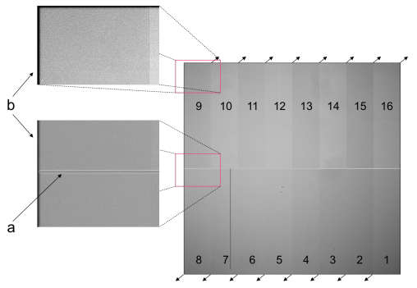
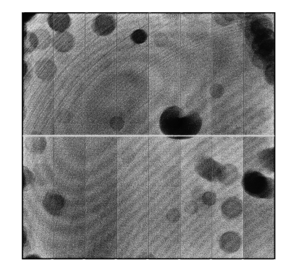
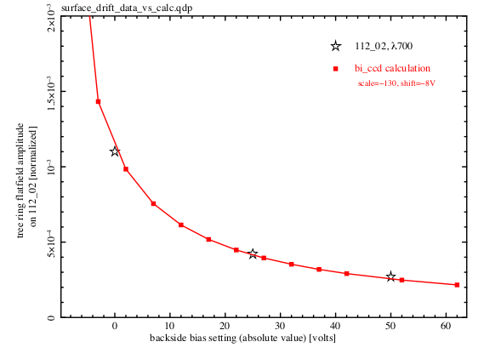
Reconciling observables for carrier drift to validate E-field contributions (figs from R14)
Tree rings
Tree ring amplitude
vs. BSS
x4
Fixed pattern features: area & astrometric shifts
dynamic (tearing) features: area & astrometric shifts
(a): midline bloomstop implant
(b): edge rolloff
Dark border (Divisadero)
Bright finger (isol. cstop w/holes)
4% PV
row height
30% PV
60% PV
col width
col width
4% PV
col width
astrometric
astrometric
astrometric
astrometric

Slide 3
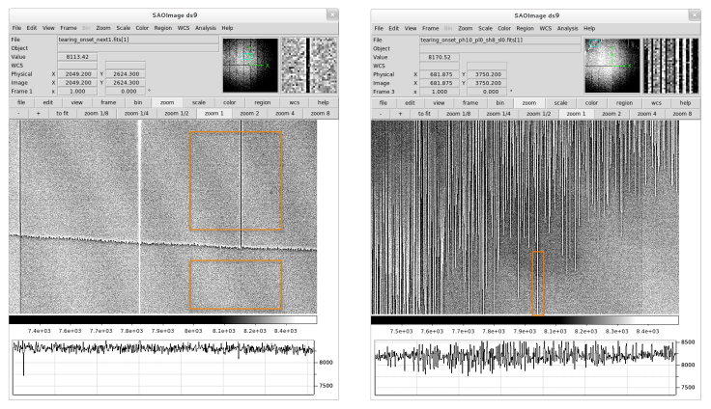
Reconciling observables for carrier drift to validate E-field contributions (figs from R14)
Tree rings
Tree ring amplitude
vs. BSS
x4
Fixed pattern features: area & astrometric shifts
dynamic (tearing) features: area & astrometric shifts
(a): midline bloomstop implant
(b): edge rolloff
Dark border (Divisadero)
Bright finger (isol. cstop w/holes)
4% PV
row height
30% PV
60% PV
col width
col width
4% PV
col width
astrometric
astrometric
astrometric
astrometric

Slide 4
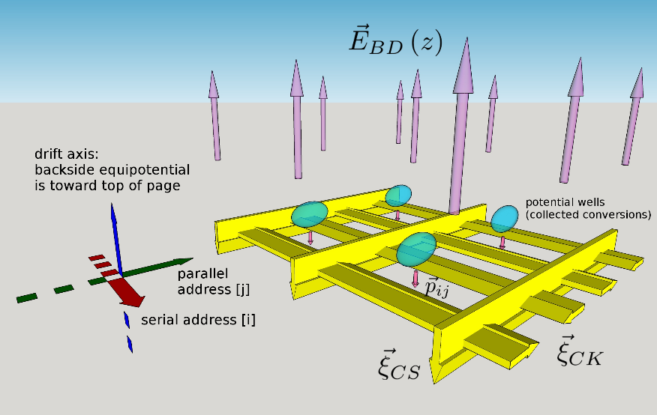
Previous slide demonstrated the intrinsic “fingerprint” E-field basis vectors for this sensor
The implementation of this model is represented as a sketchup cartoon (image charge configurations not shown). cf. A.Rasmussen 2015 JINST 10 C05028.
2x2 pixel region near the channel shown.
Serial addresses vary along the red coordinate.
Polysilicon gates form equipotentials extending along this axis.
Parallel addresses vary along the green coordinate.
Channel stop barriers form (periodic/infinite) p+ negative charge distributions extending along this axis.
Non-unique solution to Poisson equation represented by E_{BD}.
Carriers drift toward the channel (green ovals) from the backside window and partition into pixels. For marginal cases near boundaries, saddle condition is approached. Saddle condition is defined as:

Slide 5
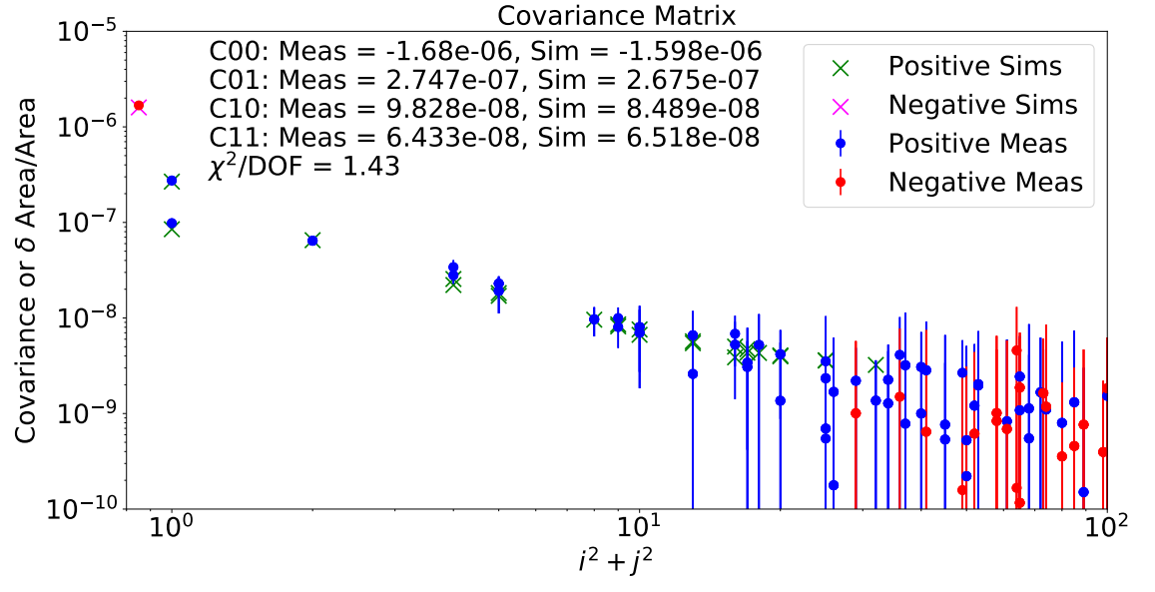
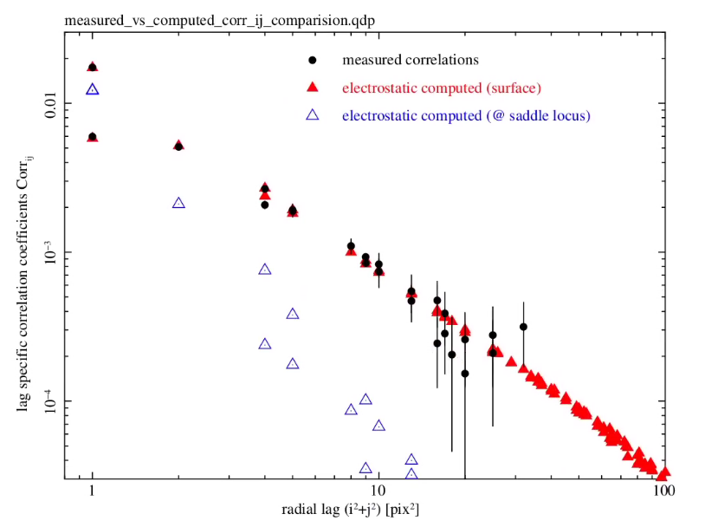
What does this have to do with the brighter-fatter effect?
C.Lage et al. J.Appl.Phys. 130, 164502 (2021)
A.Rasmussen et al. Proc. SPIE 9915 (2016)
C₀₁: within 2.7%
C₁₀: within 15.8%
C₁₁: within 1.3%
Model (Sims) are based on a combination of destructive diagnostic testing and other parameters finalized on in PoissonCCD config file contents
Corr₀₁: within 0.4%
Corr₁₀: within 2.4%
Corr₁₁: within 1.6%
Model (red triangles) are simplex-fit to the data (black dots) to minimize Merit Function. (Free parameters = 3).

Slide 6
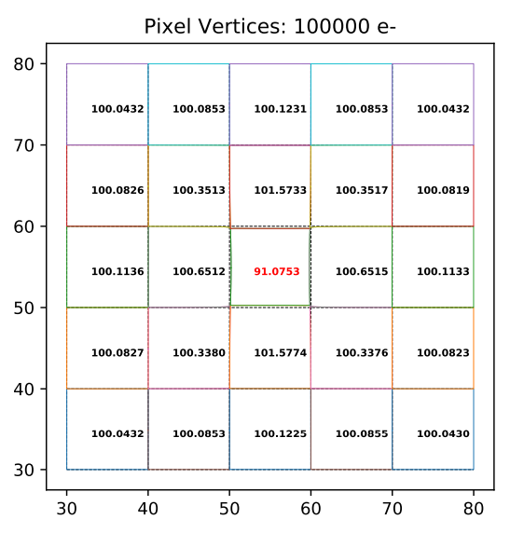
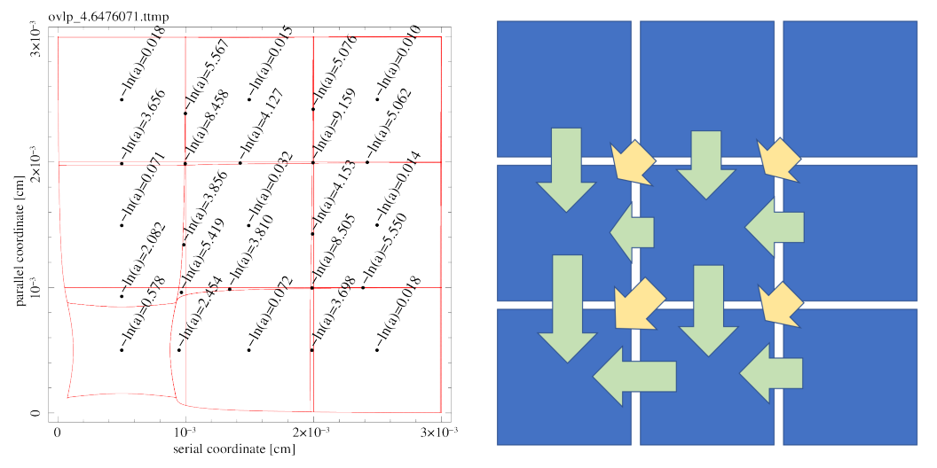
How are the simulations evaluated and compared to observables?
Central pixel containing BFE source signal
BFE lag dependence
ij=01: Δa₀₁/e- ~ +2.7e-7 pix²
ij=10: Δa₁₀/e- ~ +9.5e-8 pix²
ij=11: Δa₁₁/e- ~ +6.5e-8 pix²
C.Lage et al. J.Appl.Phys. 130, 164502 (2021)
A.Rasmussen ISPA (2018)
Pixel boundary formalism (right hand figures) permits analysis of overlaps as corrections
e.g. sparse matrix with 4 indices indicating source & destination pairs:
From: (i,j) To: (i’,j’) and expressed as M_{iji’j’}.
In this extremely distorted case**,
M₀₁₀₀ ~ 2.22 × Δa₀₁
M₁₀₀₀ ~ 5.22 × Δa₁₀
M₁₁₁₀ ~ 1.36 × Δa₁₁
M₁₁₀₁ ~ 1.30 × Δa₁₁
M₁₁₀₀ ~ 0.27 × Δa₁₁ (scales quadratically, but outside scope of Coulton [2018] algorithm.)
NB#0: These area distortions are between x400 larger than what is seen in flat fields! <sqrt(var)> ~ 240e⁻.
NB#1: area distortions (Δa₀₁ etc.) are observable in flat field correlations, while the corrections (M₀₁₀₀ etc.) are not observable. Recovering them was a primary focus of P.Antilogus et al. 2014 JINST 9 C03048, §5.

Slide 7
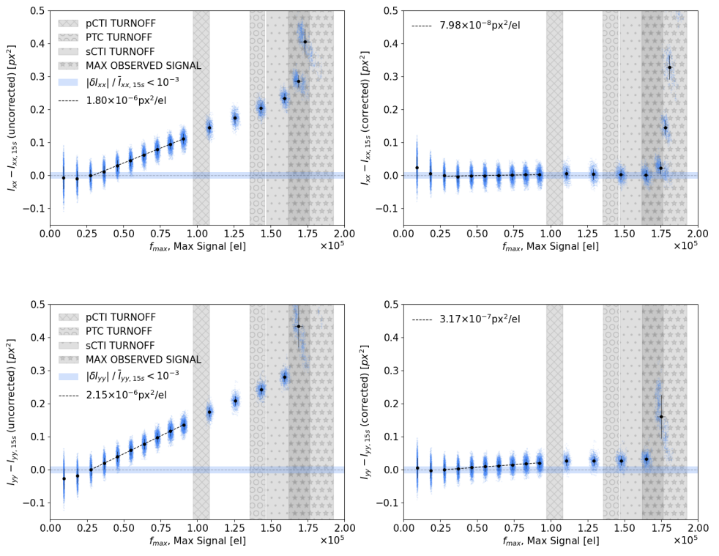
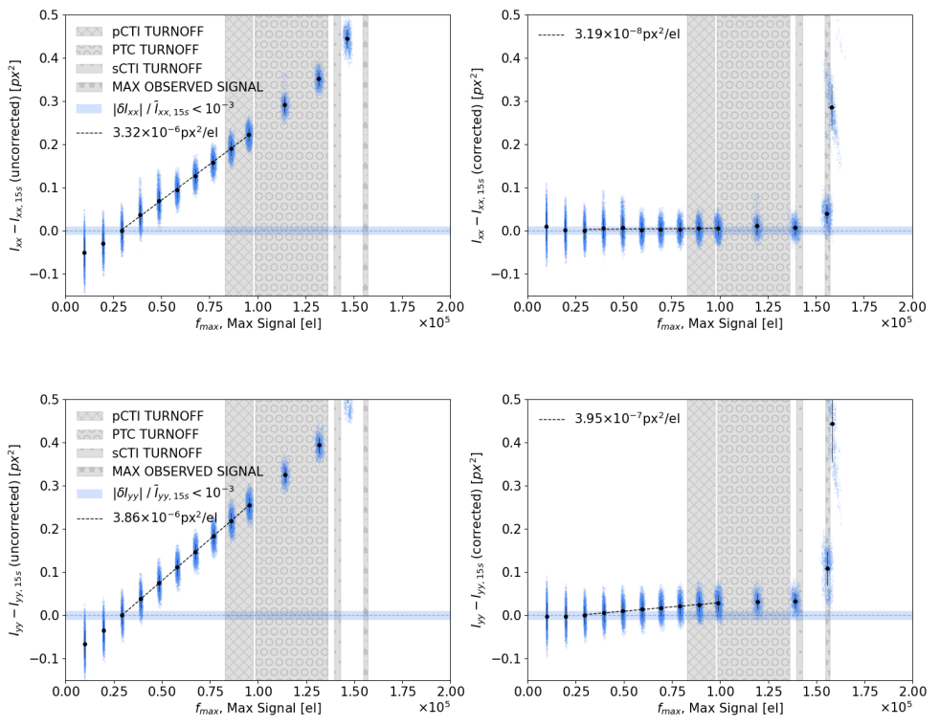
Current, best performance in LSST BFE correction as a part of ISR still shows undesirable artifacts (Broughton et al. 2023)
Sample ITL
Uncorrected spots
Sample ITL
Residuals after C18 correction
Sample e2v
Uncorrected spots
Sample e2v
Residuals after C18 correction
Resid ~ 0.44%
Resid ~ 0.96%
I_{XX} trend
(M₁₀₀₀ issue? )
Resid ~ 14.7%
Resid ~ 10.2%
I_{YY} trend
(M₀₁₀₀ issue?)
Alex’s careful work shows C18 (deterministic, no free parameters) algorithm systematically under-corrects BFE along the parallel direction. Better performance along serial direction might be coincidental. NB: Higher order moment problems may be present.
.. what gives !?

Slide 8
.. And what did other papers, exploring the limits of high fidelity correction have to say?
A selection of statements from recent publications on the state-of-the-art:
Coulton ’18: ... We can see that we meet the requirements for the Final HSC dataset, but that we need to improve our correction by a factor of two or more in order to reach the required levels for LSST.
Lage ’19 (arXiv:1911.09567v1): … We also show, assuming sufficient care is paid to calculating the correction kernel, that the Coulton algorithm does in fact correct 90% or more of the BF effect on measured spots images. … Correcting 90% of the effect should get us down near m = 0.006 To achieve the desired levels of m ≈ 0.001 − 0.003, we need to do a factor of 2-5 times better. … Algorithm improvement will continue as more data becomes available from a larger sample of sensors.
Broughton et al. ’23: (arXiv:2312.03115v1) Our findings also motivate a detailed study on more realistic PSF stars and how measurement errors from BF could ultimately impact cosmology and other science goals. Ultimately, it is important to characterize the sensitivity of cosmological parameters to observables biased with BFEs. Even with state-of-the-art correction techniques, the residual effects could represent a significant component of the systematics error budget for cosmological analyses of LSST observations.

Slide 9
Let’s take the overlap formalism with drift calculation as ground truth and see how Coulton (2018) performs
Recall Δa_{ij} are observable via correlations, M_{iji’j’} are not.
How does the C18 algorithm reproduce M_{iji’j’}?? Test by integrating Δa_{ij} twice to obtain the kernel K according to: via successive over relaxation (SOR). Compare with corresponding elements of M_{iji’j’}.
Use BFE source levels corresponding to the flat field statistical fluctuations (Δa₀₀~5e-4 pix²) instead of source levels near full well. Those have not been observed.
On the following slides, the following are compared:
Measured Δa_{ij} are compared to Δa_{ij} based on the computed kernel (${−∇}^{2}K$).
Measured overlaps M_{iji’j’} are compared to corresponding element of the kernel-based boundary displacement $\vec{ ∇}K$.
$${\left(∇^{2}K+ ∆a\right)}_{ij}=0$$
$${\left(\vec{ ∇}K\right)}_{ij}$$

Slide 10
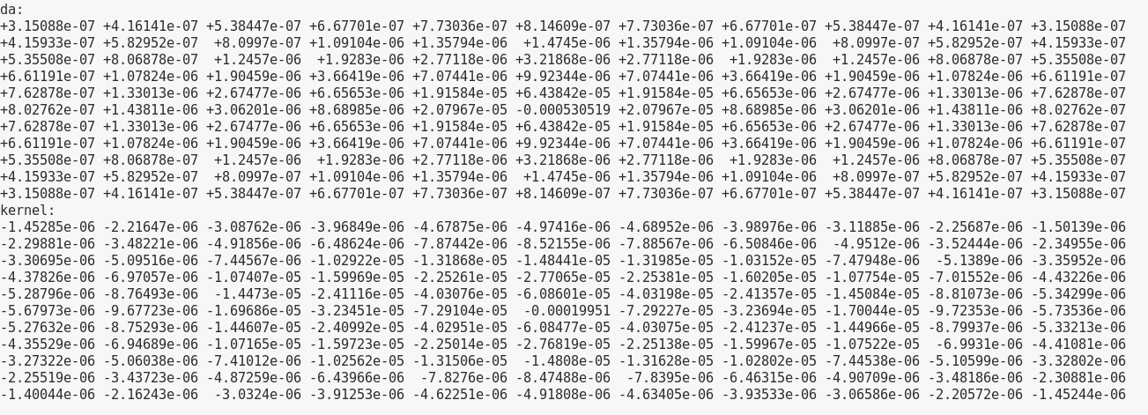
Let’s take the overlap formalism with drift calculation as ground truth and see how Coulton (2018) performs (2)
Subset of calculation results and SOR derived kernel. Calculation extends out to +/- 15 pixels in both axes.
(pix²)
(pix⁴)
Parallel direction →
Serial direction →

Slide 11
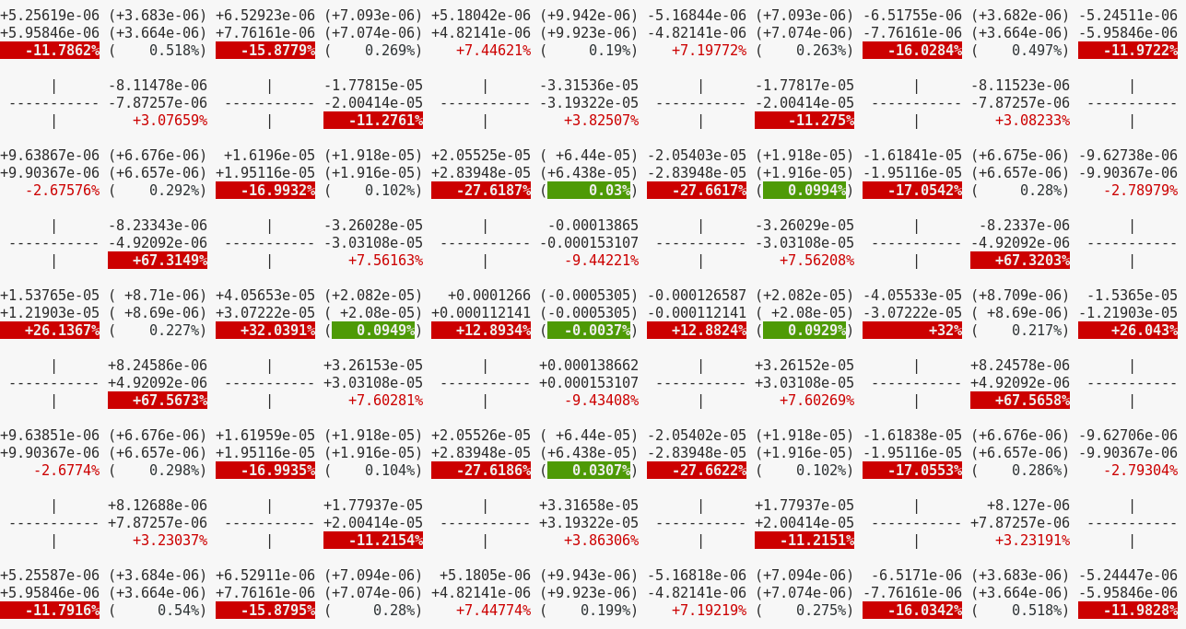
Let’s take the overlap formalism with drift calculation as ground truth and see how Coulton (2018) performs (3)
Pixel area distortions are in orange boxes; overlaps (M_{iji’j’}) are in between. 240 e⁻ source at 00..
Top: kernel derived value
Center:
Truth
Bottom:
rel. dev.
C18 approach undershoots M₀₁₀₀ & overshoots M₁₀₀₀.
Parallel
Direction
→
Serial
Direction
→

Slide 12
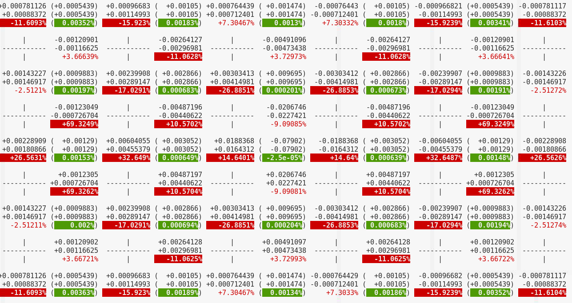
Let’s take the overlap formalism with drift calculation as ground truth and see how Coulton (2018) performs (4)
Similar trend, more pronounced for a ~36ke⁻ BFE source (x148 of source on previous slide)
Top: kernel derived value
Center:
Truth
Bottom:
rel. dev.
C18 approach undershoots M₀₁₀₀ & overshoots M₁₀₀₀.
Parallel
Direction
→
Serial
Direction
→

Slide 13
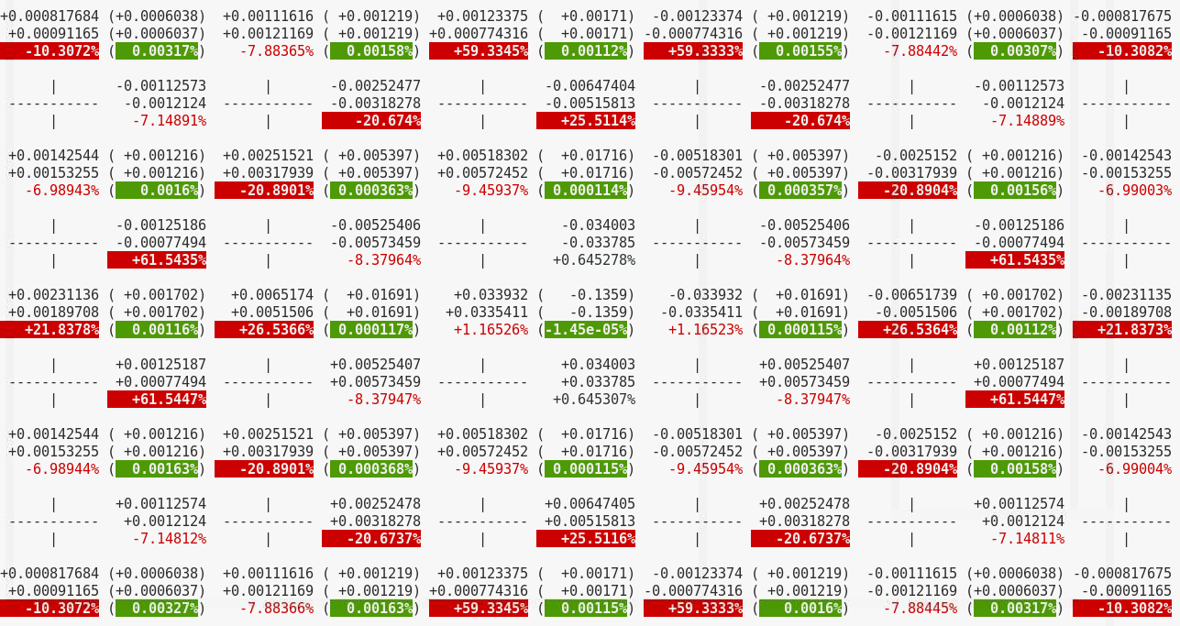
Let’s take the overlap formalism with drift calculation as ground truth and see how Coulton (2018) performs (5)
But cleans up substantially when we artificially dial in x100 weaker barriers
Top: kernel derived value
Center:
Truth
Bottom:
rel. dev.
C18 approach better for M₀₁₀₀ & better for M₁₀₀₀.
Parallel
Direction
→
!!
Serial
Direction
→

Slide 14
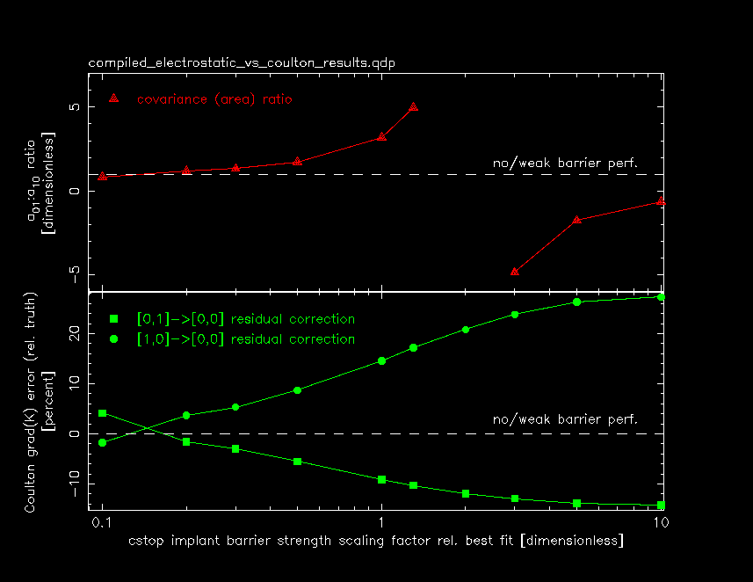
Let’s take the overlap formalism with drift calculation as ground truth and see how Coulton (2018) performs (6)
Fool around further by altering one of the model parameters (channel stop barrier)
Persistent underestimation of M₀₁₀₀ and overcorrection of M₁₀₀₀ using C18 method.
Noted improvement in C18 method when electrostatic barrier strengths are dialed down to 1% level.
Tried scaling one of the parameters to investigate effect on the C18 errors in recovering M₀₁₀₀ etc. and tabulated observables (e.g. Δa₀₁ / Δa₁₀).
Result: C18 works best when either:
Δa₀₁ / Δa₁₀ ~ 1;
barriers are very weak.
We could have asked vendors to provide sensors with Δa₀₁ / Δa₁₀ ~ 1 as a requirement !!

Slide 15
Sources of nonlinearity that cause problems with C18 restriction of fixed K, ranked
Mis-match of gradient-of-derived-scalar-potential $\left(\vec{ ∇}K\right)$ wrt computed boundary shifts tops the short list of mechanisms that would affect mapping of correlation measurements into boundary shifts:
Shape of pixels when barrier strengths are not equal, i.e. C01/C10 ~ 3-5 (correction error +/- 10%);
Attraction & shift of channel potential well toward polysilicon gates as channel fills (correction error +/- 6-7% at 36ke⁻ for N_{d}~5e15 cm⁻³);
Presence of recorded flat field level per pixel when BFE is being characterized in flat pairs: (correction error +/- 4% at 36ke⁻);
Extended distribution of collected conversions (distributed into 3x3 grid) at channel vs. modeled (point-like) spatial distribution (correction error +/- 0.06%). cf. Lage et al. ’21;

Slide 16
Conclusions; how to move forward
We’ve used a first principles-based drift simulator tool, tuned to reproduce various observable signatures/artifacts seen in LSST sensors to compute how charge is partitioned and ultimately recorded. It permits us to evaluate how current baseline correction algorithms (C18) perform and to qualitatively understand their limits.
C18 can’t be tweaked; it features a signal-independent kernel K derived directly from observables and is a scalar quantity. We’ve shown systematic deviations between ground truth pixel boundary shifts and C18 corrections that can partially explain residual BFE terms observed by Broughton et al.
Time to revive old/alternate BFE correction strategies?
Use the sparse “pixel overlap matrix” to correct pixel-by-pixel (a la Astier et al.)
Compute previously proposed book-keeping terms (pixel areas, astrometric shifts, 2nd moments), either for uncorrected data or representing we C18 apparently under- or over-corrects. One option could be for no C18 correction in ISR (but carry these pixel terms based on recorded image esp. for high S/N stars).
Work out a way to incorporate properties of K such that $\vec{∇}×\vec{∇}K ≠0$ (and allow it to be signal dependent while we’re at it, we see this in drift calculations).

Slide 17
Backup slides

Slide 18
How can the overlap matrix M_{iji’j’} elements be used in a ISR process?
Iteratively. Maybe one step is good enough? Similar to other work, e.g. substitute M_{iji’j’} for $\vec{∇}K$ wherever it appears in C18. Otherwise, keep in mind that the M_{iji’j’} overlap matrix elements have more indices because they account for all area displacements between nominal and recorded pixels. 5th index may be introduced to allow overlap coefficients to evolve with signal level:
Evaluate local flux at overlap centroids using recorded image R_{mn}:
1st order displaced signal estimate using local flux S & recorded flux R_{mn}:
1st order estimate for incident flux F:
Refine displaced signal map estimate D evaluated for timeslices:
Iterate incident flux F estimate and while displaced signal D by resolving in time slices. End with convergence condition:

Slide 19
How can the overlap matrix M_{iji’j’} elements be used in a ISR process? (2)
In the previous expressions, these matrices are meant to simplify computation in nested loops over the signal- and time-resolved slices of correction. Basically, they are an amalgamation of Kronecker and Heaviside functions:

Slide 20
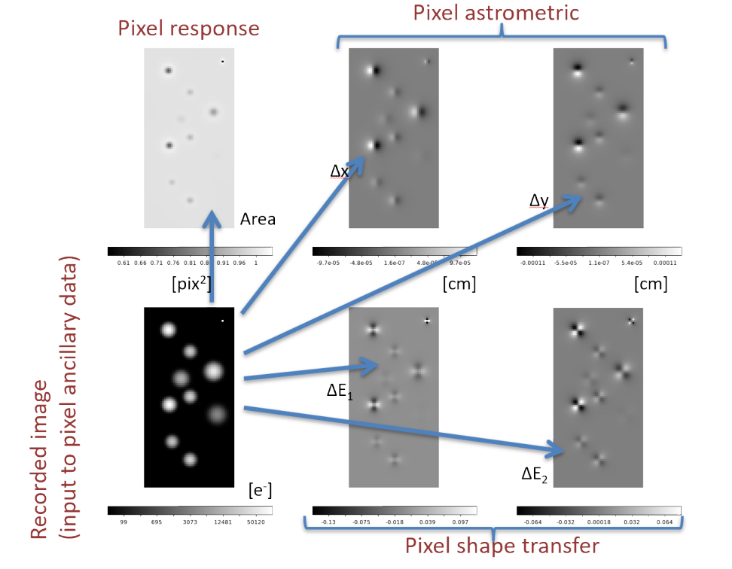
Pixel distortion bookkeeping as an alternate BFE correction strategy appropriate for moments (R18)

