Slide 1
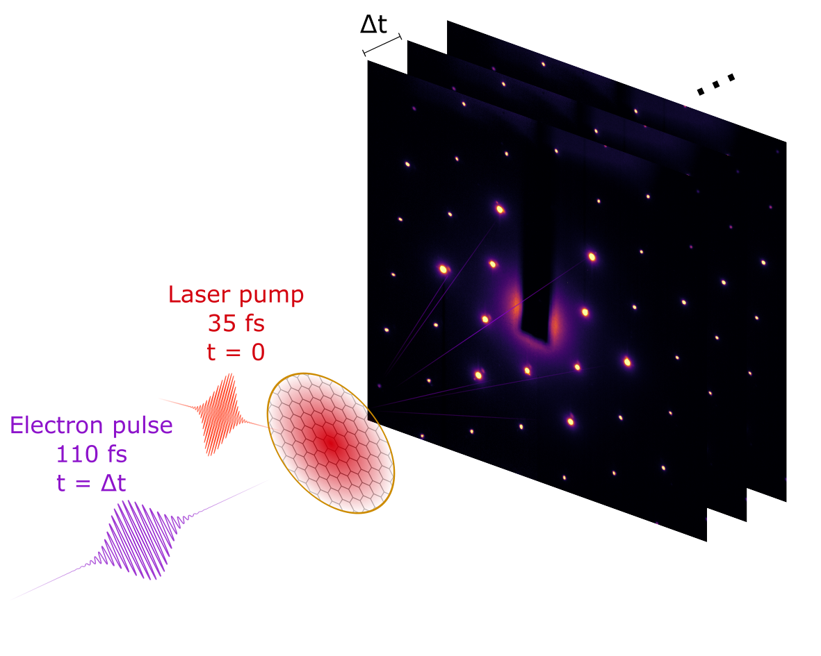
UED Opportunities for Dynamical Imaging of Materials
N. Sirica
Laboratory for Ultrafast Material and Optical Sciences
LA-UR-23-32565
Sessions: MB01 - MB04
11/6/2023

Slide 2
Sy mmet ry B rea ki ng
Spontaneous
Explicit
T > T_{C}
T < T_{C}
B
<M> = 0
<M> ≠ 0
Broken symmetry state is realized only in the presence of an external field
ΔS_{sys} > 0
ΔS_{sys} < 0

Slide 3
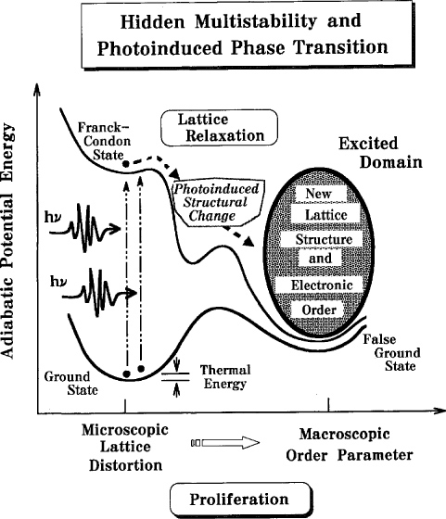


Can Ultrashort Light Pulses be used to Break Symmetry?
Photoinduced Phase Transitions
Or…Stating the Obvious
Photoexcitation alters the energy landscape allowing for the many body system to access thermally inaccessible metastable phases
Light = External Field
Insulators = Electric fields induce polarization ( ex: EFISH)
Metals = Electric fields launch currents
Can be made dynamic with THz!

Slide 4
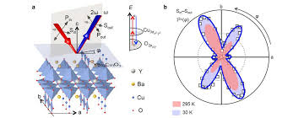
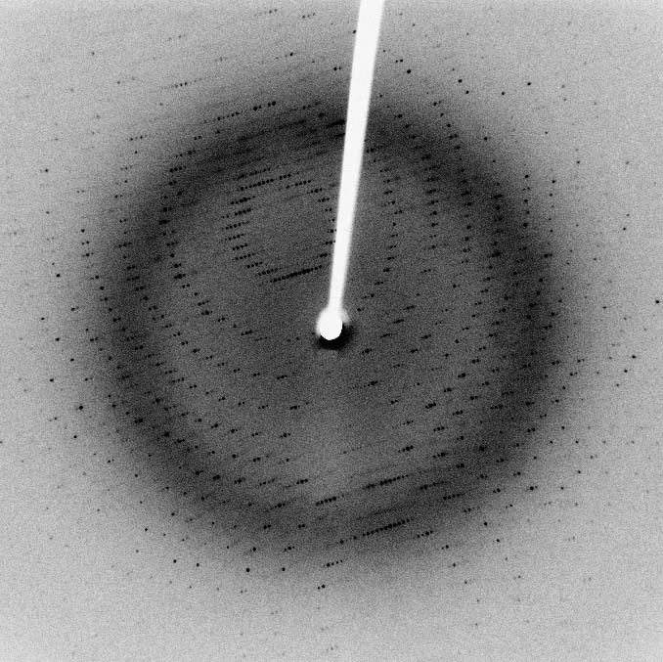

How do we Probe Symmetry?
Conventional probes of symmetry rely on diffractive techniques
Less-Conventional—Nonlinear Optics
X-ray = lattice
Neutron = magnetic
Electron = charge
L. Zhao, et al. Nature Phys. 13, 250 (2017)
$$P_{i}=χ_{ij}E_{j}+χ_{ijk}E_{j}E_{k}+χ_{ijkl}E_{j}E_{k}E_{l}…$$
Resolution of magnetic point group symmetry scales with order of the NLO response
MB03 – Tracking symmetry breaking dynamics via tailored ultrafast probes – Prof. Robert Kaindl (ASU)
Notes:
Add figures showing neutron and LEED

Slide 5
Photocurrent Induced Symmetry Breaking in a Weyl Semimetal
Δt = -5.0 ps
Δt = 0.0 ps
Δt = 1.0 ps
Δt = 5.0 ps
[1,1,0]
[110]
[111]
φ
800 nm
800 nm
400 nm
probe
TaAs (112)
pump
s
p
SHG
[1,1,1]
N. Sirica, P.P. Orth, et al. Nature Mat. 21, 66 (2022)

Slide 6
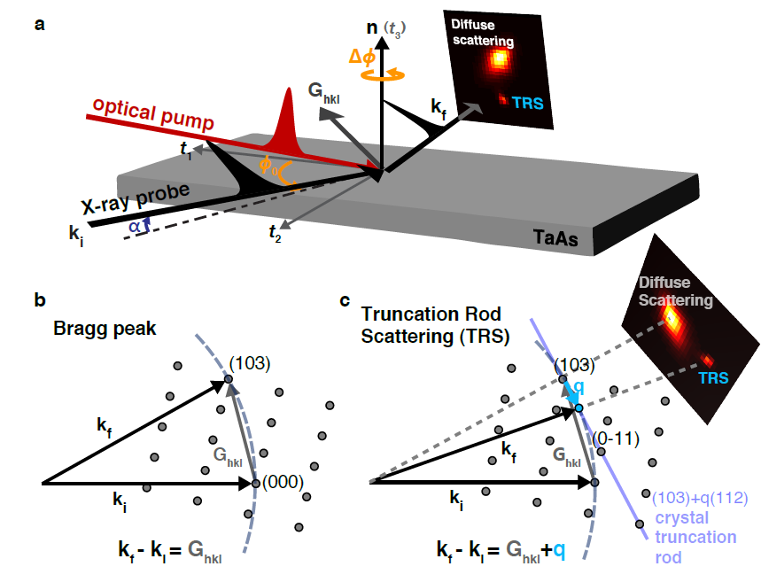
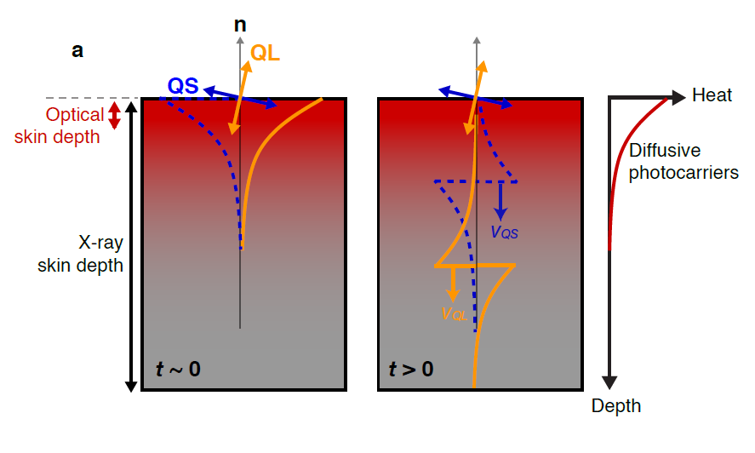
Long Lived Lattice Dynamic Triggered by Ultrafast Photoexcitation
M.-C. Lee, N. Sirica, Phys. Rev. Lett. 128, 155301 (2022)
Oscillations in the (103) Bragg truncation rod = propagating strain wave inducing quasi-longitudinal (112) and quasi-shear (1,1,0) distortions.
Dominant shear strain in ab-plane (eg [1,1,0]) transiently alters Weyl points through breaking mirror symmetry

Slide 7
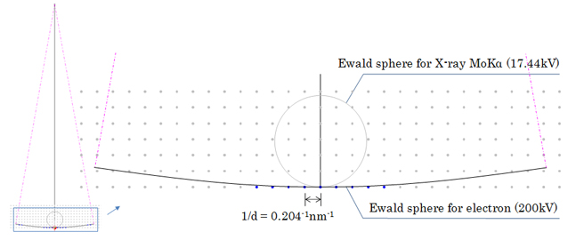
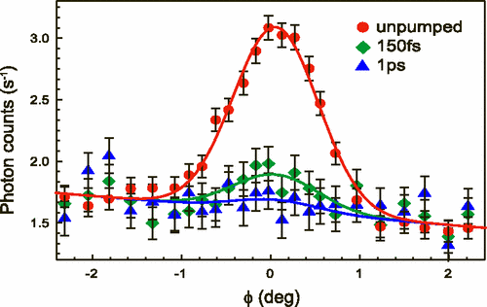
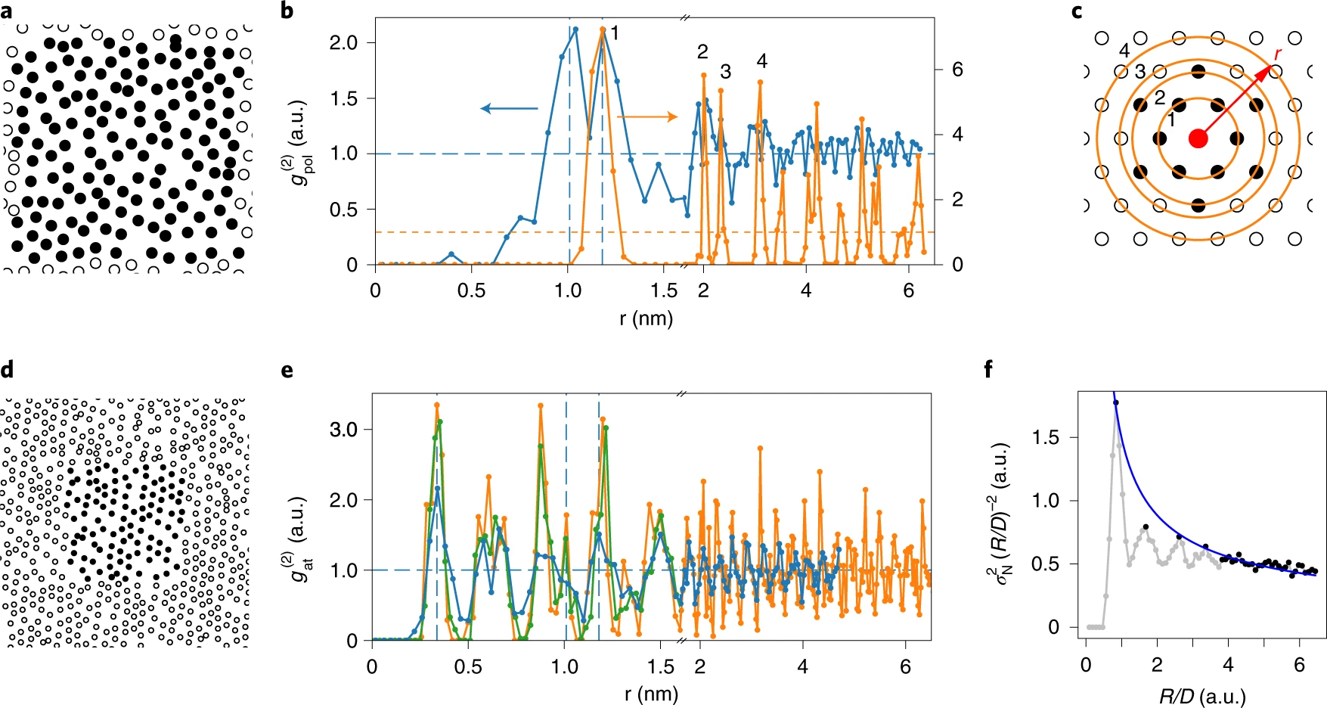
Long-Range Order Short-Range Order
Bragg Diffraction
Pair Distribution Function
Order Parameter
Topological Defect

Slide 8
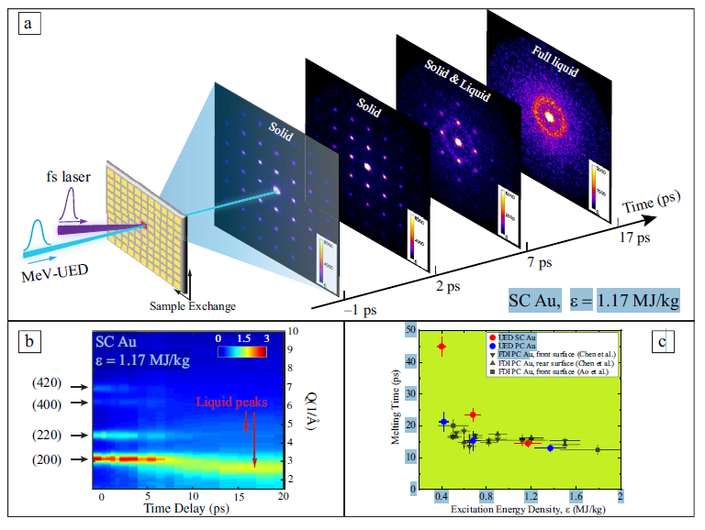
UED: Opportunity to Study Non-crystalline and Non-reproducible Dynamics in (Photoinduced) Phase Transitions
Jamming Transitions
Shock Physics and Warm Dense Matter
Nature Mat. 18, 1078 (2019)
MRS Bulletin 46, 694 (2019)
Ultrabright (> 20 fC)
Ultrafast (< 50 fs)
Deeply sub-Angsrtom (0.003Å)
Direct view into short-range deformations and local structure change in nonreproducible order-disorder transitions
MB01 – Ultrafast electron diffraction studies of materials under extreme condition – Dr. Mianzhen Mo (SLAC)

Slide 9
What to Keep in Mind During the MB Sessions
UED as a Substitute for Ultrafast X-ray Scattering
UED as a Compliment to Ultrafast X-ray Scattering
Strong scattering cross sections – ideal for few scattering centers (gases, monolayers, macromolecules)
Nanofocused beam - potential for in operando microelectronic characterization
Ultrafast Electron Diffuse Scatter – inelastic scattering phonon mode excitation

