Slide 1
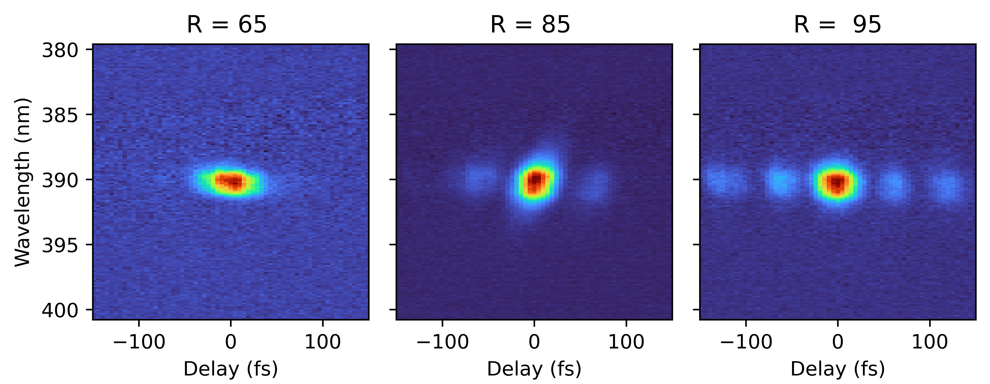
Ultrafast, optical diagnostics of FEL pulses and extending this to electron pulses
Pamela Bowlan, Los Alamos National Lab, pambowlan@lanl.gov
Contributors to our work: William Peters,¹ Travis Jones,^{1,3} Francesca Elverson,¹ Jacob Feltman,¹ Anatoly Efimov,¹ Patrick Skrodzki,¹ Alex Scheincker,¹ Sanghoon Song,² Matthieu Chollet,² Joseph Robinson,² Emanuele Pedersoli,⁴ Riccardo Mincigrucci,⁴ David Gauthier,¹ Ivaylo Nikolov,⁴ Rick Trebino,¹ Miltcho B. Danailov, ⁴ Flavio Capotondi,⁴ Laura Foglia,⁴ Filippo Bencivenga,⁴ Ryan Coffee,^{2,5}
¹Los Alamos National Laboratory, Los Alamos, NM, USA
²Linac Coherent Light Source, SLAC National Accelerator Laboratory, CA, USA
³School of Physics, Georgia Institute of Technology, Atlanta, GA, USA
⁴Elettra-Sincrotrone, Basovizza, Trieste, ITALY
⁵Stanford Pulse Institute, Stanford, CA, USA
LA-UR-23-32590

Slide 2
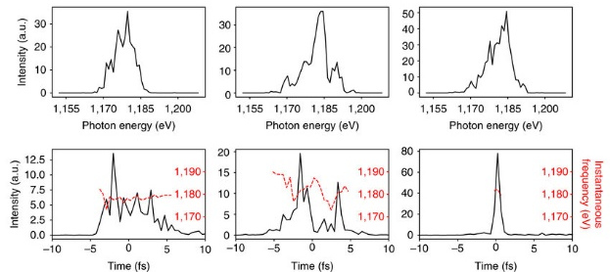
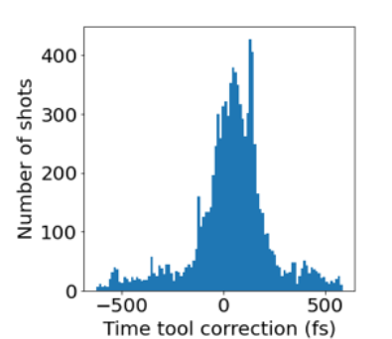
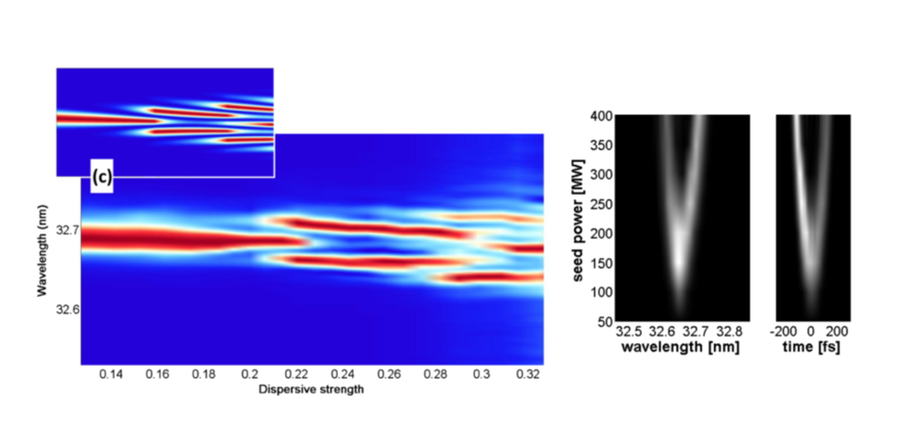
To use femtosecond pulses of any kind, you have to be able to measure them.
FEL X-ray pulse shapes changes shot-to-shot
The arrival time with respect to the optical laser also fluctuates
N. Hartmann et al., Nature Photonics 12, 215–220(2018)
FEL pulse shaping strategies
Optical/XFEL drift (fs)
Measuring the pulses allows for optimizing them, e.g. to generate shaped or attosecond pulses.
G. De Ninno, PRL, (2013), D. Gauthier, PRL (2015) or Marinelli, PRL, (2016)

Slide 3
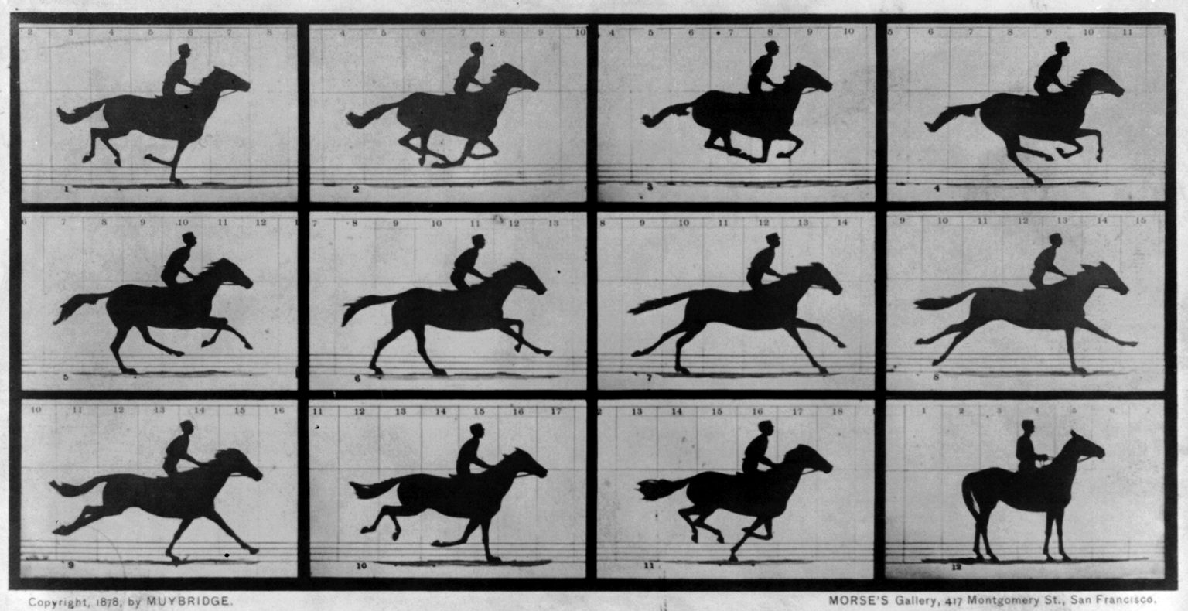
How do you measure the shortest events?
Electronics are typically not sub-ps. The only fast-enough time-gates to measure femto-to-attosecond XFEL or electron pulses are the pulses themselves or optical laser pulses.

Slide 4




The way that we measure optical femtosecond pulses
SHG and other nonlinear optical processes are instantaneous interactions between two or more fields.
$$I\left(t\right)I(t−τ)$$
SHG crystal
Intensity($I$)
$$0$$
$$τ$$
Time (t)
$$P_{i}\left(t\right)=ε_{0}\left(χ_{j}^{(1)}E_{j}\left(t\right)+χ_{ijk}^{(2)}E_{j}\left(t\right)E_{k}\left(t\right)+χ_{ijkl}^{(3)}E_{j}\left(t\right)E_{k}\left(t\right)E_{k}\left(t\right)+…\right)$$
Any fast nonlinear optical process can serve a time gate for measuring ultra short pulses (slower process work also, if the response is known).

Slide 5
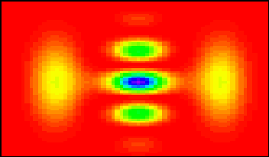


How can you measure x-ray FEL pulses?
Example:
FROG Trace
Pulse to be measured
Frequency-Resolved Optical Gating (FROG)
Pulse $I\left(t\right)$
Frequency
Beam
splitter
$$t$$
Delay
E(t–τ)
Camera
SHG
crystal
Spec-
trometer
E(t)
E_{sig}(t,τ) = E(t) E(t-τ)
Variable delay, τ
FROG uses an instantaneous nonlinear optical effect as a time-gate. Challenge: At high frequencies, the light-matter interaction is dominated by photoionization which is long-lived. The interaction of electrons with mater is similar to that of ionizing radiation.
See: R. Trebino, “Frequency-Resolved Optical Gating: The Measurement of Ultrashort Laser Pulses”, Springer (2000)

Slide 6
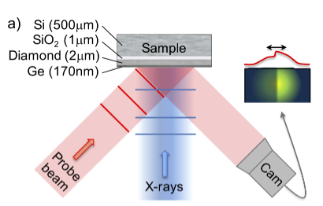
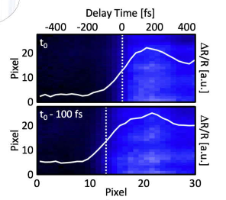
Encoding an X-ray pulse’s arrival time in an optical beam (the time-tool)
Ionizing radiation changes the optical properties. The onset of this change can give laser/XFEL timing information with few-fs time-resolution.
Depending on the material response the pulse shape may also be encoded in this signal.
See: Hartmann et. al., Nat. Photon., 8, (2014), and Droste et al., Opt. Express (2020)

Slide 7
Can we separate out the fast, coherent part of the response and use this a fs-time-gate?
Optical delay-scan
FEL-pulse delay scan
F. Capotondi, et al, J Synchrotron Rad 25, 32-38 (2018)
Past transient grating measurements at FERMI showed a faster, time-resolution limited response when scanning the delay between the grating pulses.

Slide 8
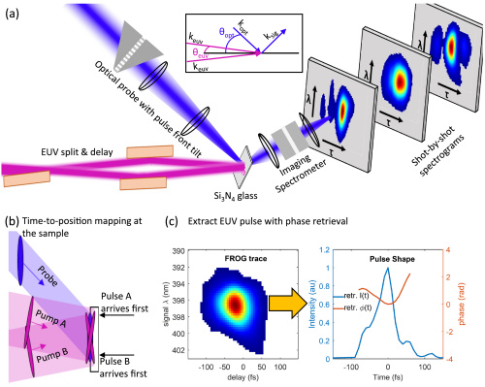
TG FROG in the eXtreme UltraViolet at FERMI
We used the EUV, optical probe TG experiment at DiProI at FERMI with an imaging spectrometer for detection.
W. Peters et al., Optica (2021)
Notes:
DiProI end-station

Slide 9
TG FROG in the eXtreme UltraViolet at FERMI
To measure single-shot spectrograms, we take advantage of the time-smearing between the EUV pulses, and remove it from the probe pulse by with pulse-front-tilt
W. Peters et al., Optica (2021)

Slide 10
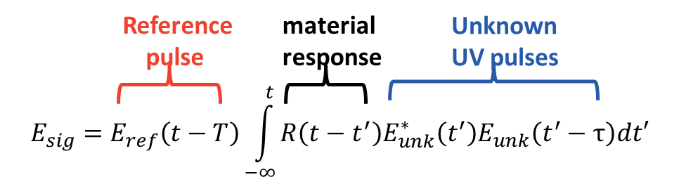
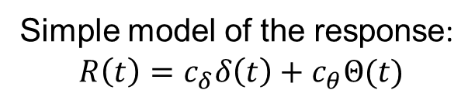
TG FROG in the eXtreme UltraViolet at FERMI
Simple model of the response:
$$R\left(t\right)=c_{δ}δ\left(t\right)+c_{θ}Θ(t)$$
Travis Jones et al., Opt. Express (2021)
In the extreme UV, we found that the phase we encoded in the optical signal so we could retrieve the electric field of single FEL pulses

Slide 11
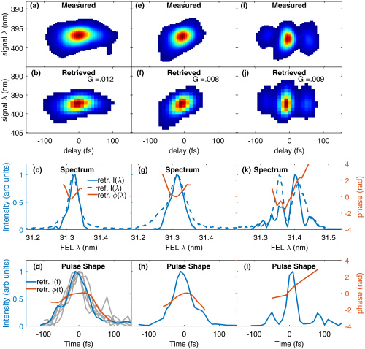
TG FROG in the EUV at FERMI
Standard mode
Chirped seed
Multi-pulse
The spectra are plotted in comparison to independent spectra
measurements.
The grey curves in (d) show the pulse-to-pulse fluctuations.
See: W. Peters et al., Optica (2021).

Slide 12
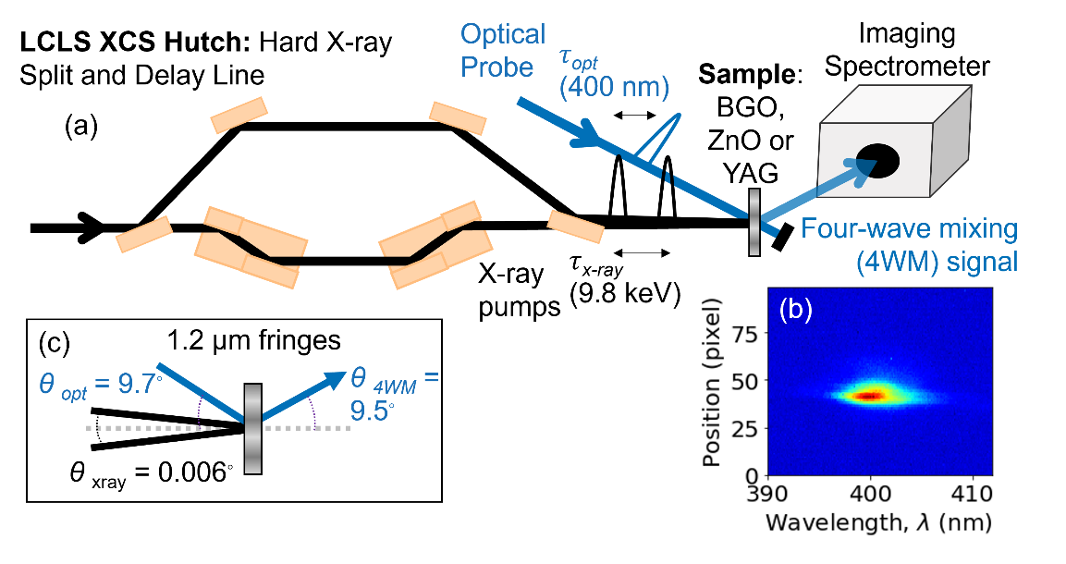
Measuring hard x-ray FEL pulses
Micrometer-scale spatial fringes seen on a YAG screen
For TG, we misaligned the split and delay line at the X-ray Correlation Spectroscopy (XCS) hutch at LCLS so that the x-ray beams crossed.
Another recent x-ray TG experiment but using a grating to interfere the x-ray beams: Rouxel, J.R., Fainozzi, D., Mankowsky, R. et al., Nat. Photonics (2021).

Slide 13
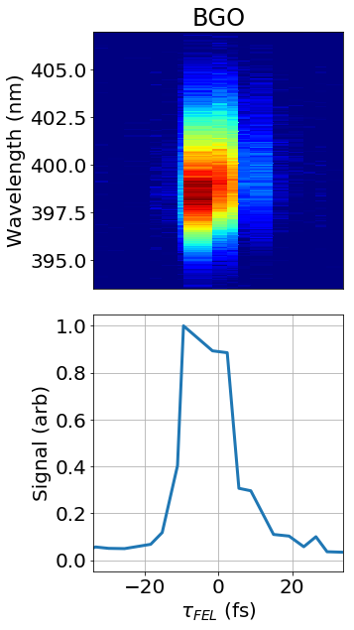
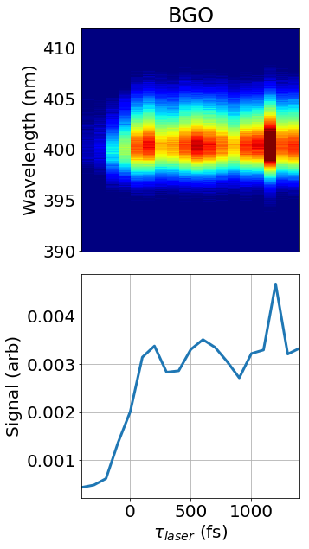
The TG signal versus the x-ray, x-ray delay yields a cross correlation
See Peters et al. Optics Express, (2023)
We could not see any phase information. The left image is the average spectrum of the XFEL pulse. Timing jitter may be obscuring the phase information, or it may just be very weak.

Slide 14
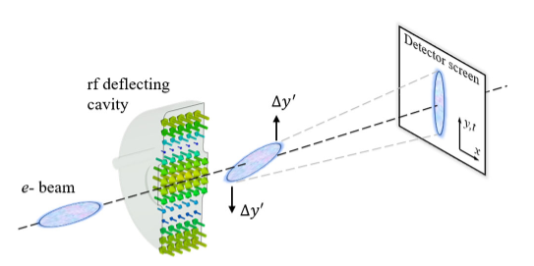
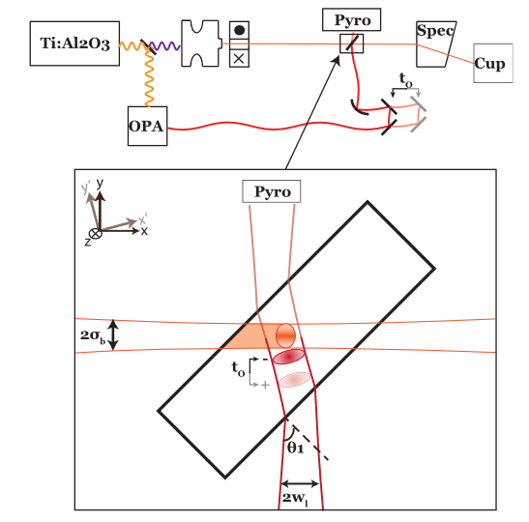
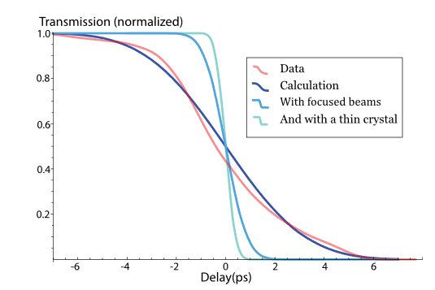
What about measuring femtosecond electron pulse shapes, and timing?
THz or rf streaking for timing and measuring electron pulse shapes
From: Filippetto et all, Rev. Mod. Phys. (2023)
Electron pulse induced changes in the IR transmission of germanium were observed (like the LCLS time tool for electrons).
From: Cesar et. al. APL (2015)
Notes:
Pegasus, is based on EOS
(electro-optic sampling), 19 and, similar to other TOA mea-
surement schemes, has been limited to charges >5 pC. We
note here that a cavity-pickup based sub-pC diagnostic simi-
lar to existing cone shaped pick ups 11 has been recently
proposed. 20

Slide 15
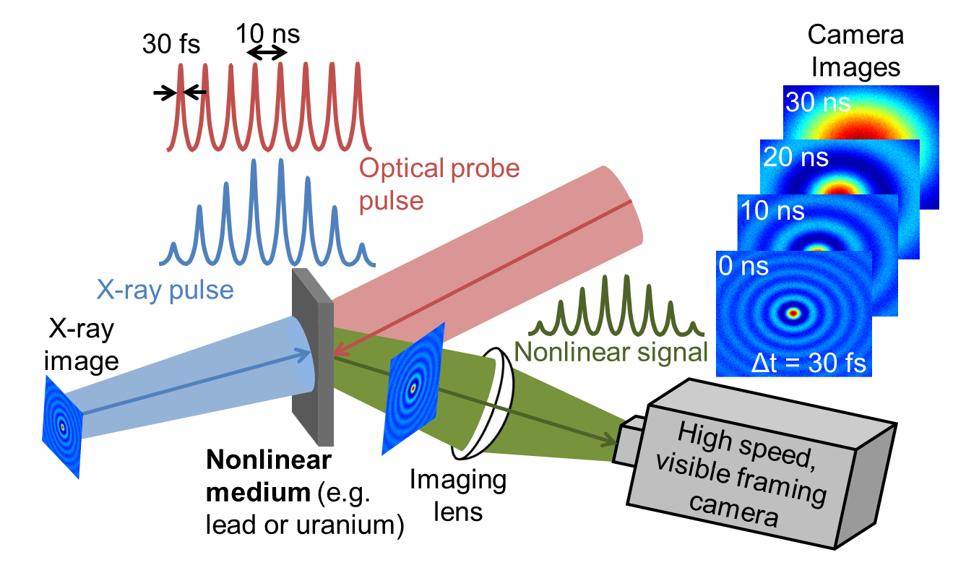
Why use optical encoding for electron pulse measurement?
Materials in Extreme conditions experiments require, single shot high repetition rate diagnostics
Electron pulse train
Nonlinear medium
Having an optical readout gives access to high-speed optical detectors and should be more sensitive with electron pulses.
See Filippetto et al., Rev. Mod. Phys. (2023)

Slide 16
Conclusions: Electron pulse measurement and timing with respect to the optical laser is needed for a UED beamline.
This can be done with THz or RF streaking. Using electron-pulse-induced changes in optical transmission is another promising option due to its simplicity, sensitivity, and the potential to use high speed detectors and cameras
Future work: Measuring shaped pulses, shorter pulses and higher photon energy pulses at the EUV FEL FERMI
Recent shaped pulse FROG measurements at FERMI (EUV FEL)
This work was funded by LDRD grant 20180242ER and 20220074DR

Slide 17
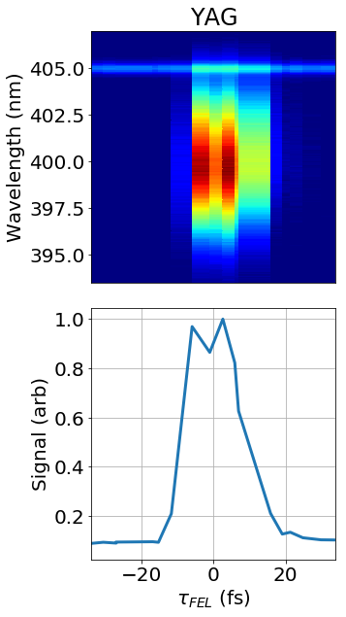
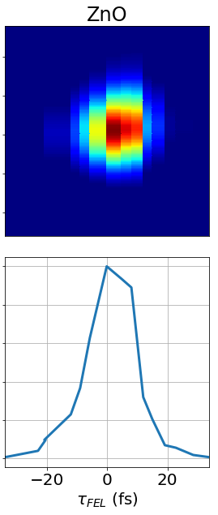
The TG signal versus the x-ray, x-ray delay in other materials
With only 5 µJ of x-ray energy in a 100 x 400 µm spot size, we could easily see a TG signal in BGO, YAG, ZnO and PbWO₄.
The signal in ZnO was largest perhaps because it has an x-ray absorption edge near 10 keV.

Slide 18
The TG signal versus the probe delay
Bismuth germanate (BGO)
Spectro-
meter
τ_{laser}
As in previous work at 7 keV we see the ~2.5 THz oscillations from a phonon excitation.
See: Rouxel, J.R., Fainozzi, D., Mankowsky, R. et al., Nat. Photonics (2021).
Notes:
a 400 μm x 5 μm illuminated area at the sample position with up to 5 μJ per pulse

Slide 19
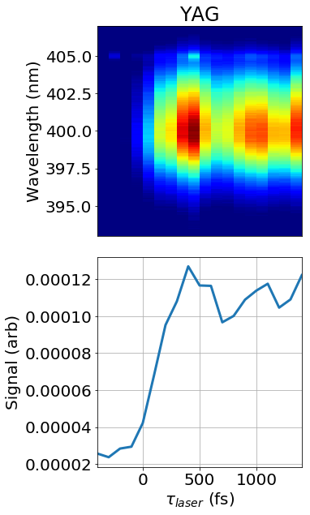
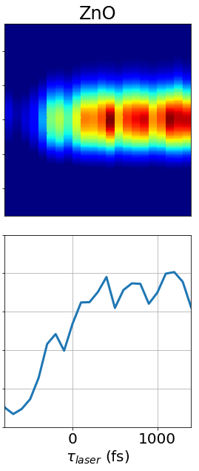
The TG signal versus the laser probe delay in different materials
We see similar 2-3 THz oscillations in YAG and ZnO, both of which also have THz-range phonons.
For phonon frequencies see: Xiaojian Fu, et al., Journal of Electromagnetic Waves and Applications, (2013)
Notes:
Xiaojian Fu, Yunsheng Guo & Ji Zhou (2013) Terahertz optical parameters and lattice vibration-induced resonance of Er³⁺-doped Y₃Al₅O₁₂ crystal, Journal of Electromagnetic Waves and Applications, 27:14, 1792-1799, DOI: 10.1080/09205071.2013.823569 2.4 THz
Polarization??

Slide 20
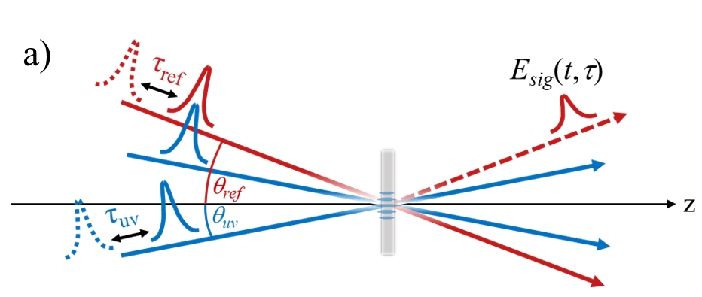
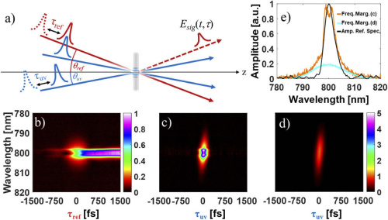
Can we Isolate the fast part of the response? Tests in the UV with transient grating
Transient grating (TG)
Scanning the probe delay
ZnS
See: T. Jones et al., Opt. Express (2021) or F. Capotondi et. al., J. Synchrotron Rad. (2018)
Scanning the grating-pair delay
Instantaneous medium
During pulse overlap, there is coherent four-wave mixing which preserves the phase.
Notes:
Encode the high frequency field in a low frequency signal

Slide 21
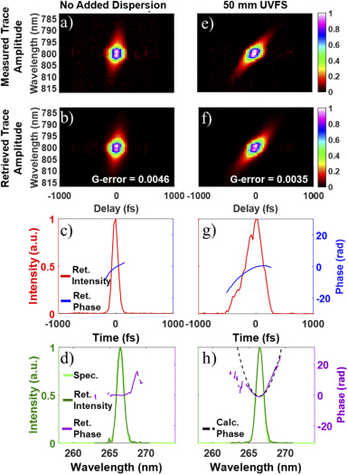
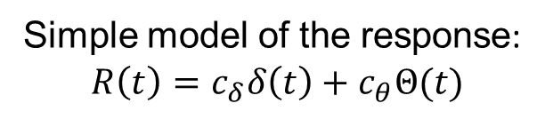
Tests in the UV: Using photoabsorption as a fast time-gate.
Simple model of the response:
$$R\left(t\right)=c_{δ}δ\left(t\right)+c_{θ}Θ(t)$$
With phase retrieval algorithm, the pulse can be extracted.
Travis Jones et al., Opt. Express (2021)

Slide 22
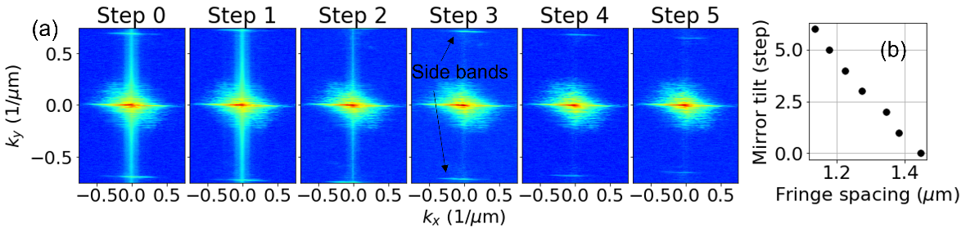
Satisfying phase matching, or the Bragg condition
θ _{opt} = 9.7◦
θ _{xray} = 0.006◦
Phase matching: sinθ_{opt} =
(λ_{opt} / λ_{xray}) sinθ_{xray}
Tuning the split and delay mirrors to set the crossing angle.
Monitoring the interference fringes on a YAG screen, we set the crossing angle to 6.0 millidegree to make 1.2 μm fringes.

