Slide 1



Modern cathode materials for LCLS-II HE
And other applications
John Smedley
Thanks to J. Lewellen, T. Xu, M. Gaowei, J. Maxson, R. Tromp, T. Vecchione, the MSU gun team and the cathode teams at ASU, BNL, Cornell, HZDR, LANL and SLAC

Slide 2
Outline
LCLS-II and LCLS-II-HE
Cathodes – the first frontier of beam quality
  Three Step Model
  Cathode R&D – towards single crystal, low MTE cathodes
    Cesium Antimonide Family
    Cesium Teluride
  Epitaxy!
Requirements for high charge UED

Slide 3
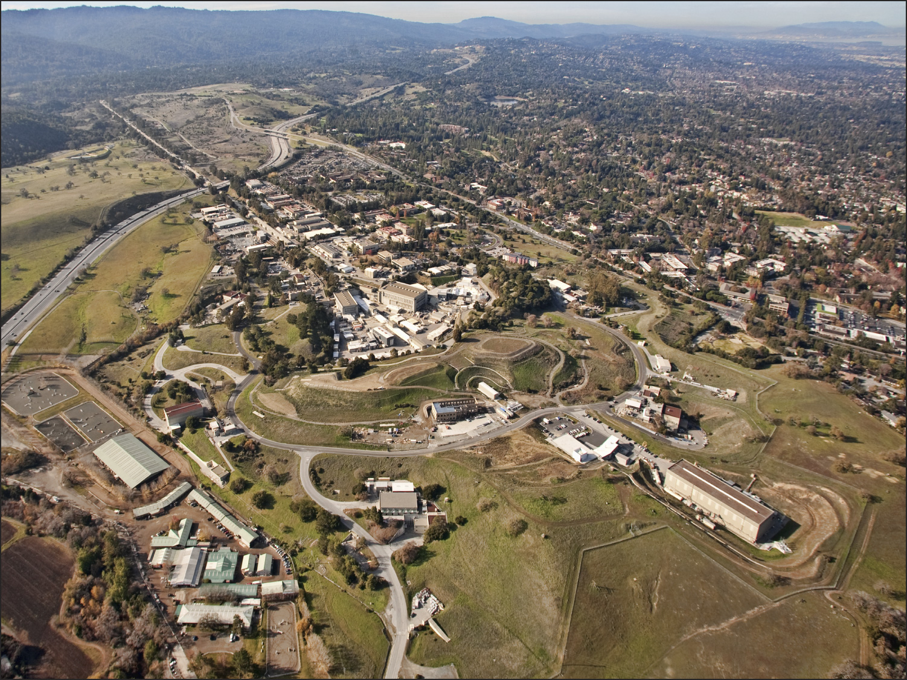






LCLS-II CD-4 Review | September 26-27, 2023
LCLS-II
Injector
Cryoplant
CD-0: 2010
TTO: 2023
13 years
~ 5M hours
~ $1B
LBNL
Undulators
e⁻ gun & associated injector systems
Fermilab
Cryomodule engineering/design
Manufacture 50% of cryomodules: 1.3 GHz
Design and manufacture 2+1 Cryomodules: 3.9 GHz
Design and acquisition of helium distribution
Processing for high Q (FNAL-invented gas doping)
Argonne
Undulator R&D: vertical polarization prototype
Undulator Vacuum Chamber
Assisting in tuning undulators
Also supports FNAL w/ SCRF cleaning facility
Jefferson Lab
Manufacture 50% of cryomodules: 1.3 GHz
Design and acquisition of two 4 kW Cryoplants
Processing for high Q
Cornell
R&D planning, prototype support
processing for high-Q (high Q gas doping)
NC Linac
SC Linac
Spreader
Bypass
Beam Transport
Undulators &
X-Ray Transport
X-Ray Experimental Area
(NEH and FEH)

Slide 4
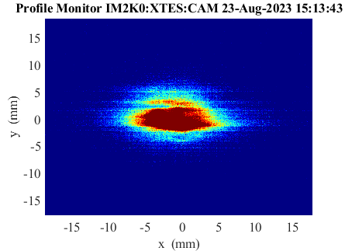
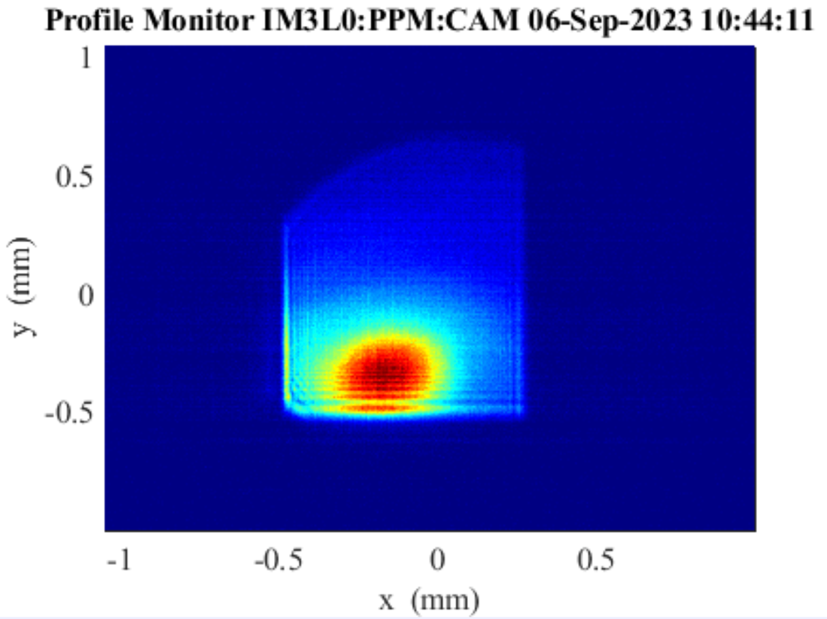
LCLS-II First Light
8/23/23
Soft X-ray Undulator, 450 eV
9/6/23
Hard X-ray Undulator, 1050 eV

Slide 5
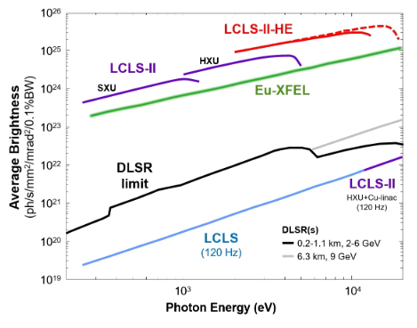
Motivation for the Low Emittance Injector (LEI)
0.1um
Provide lower emittance beams to extend photon energy reach, enabling a broader photon physics program
Less costly than increasing beam energy, which is currently limited by space constraints
Provide redundant electron source
Qualify second injector while current one operates
Once online, could quickly revert to original injector if problems occur
In the interim, a spare LCLS-II gun with modest improvements is being built
0.4um
Electric field on cathode 30 MV/m is required to achieve 0.1 um emittance.
Notes:
A broader Photon Physics Program requires higher energy light source.
If 0.1 um emittance can be achieved, It is estimated that photon energy can be reach to 20 keV.
30 MV/m is required to achieve an emittance of 0.1 um.
LCLS-II is developing a second injector with SRFGUN for this purpose
Although SRFGUN have many technical challenges to achieve 0.1 um emittance, LCLS-II-HE can used with existing NC RF gun and will not affect the operation of LCLSL-II-HE.

Slide 6
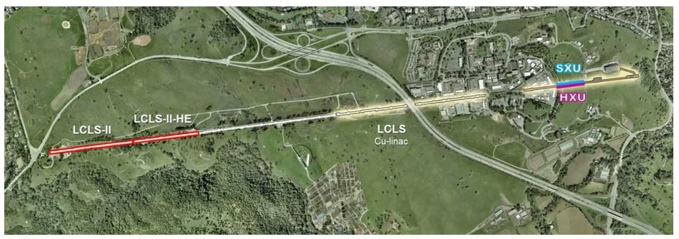
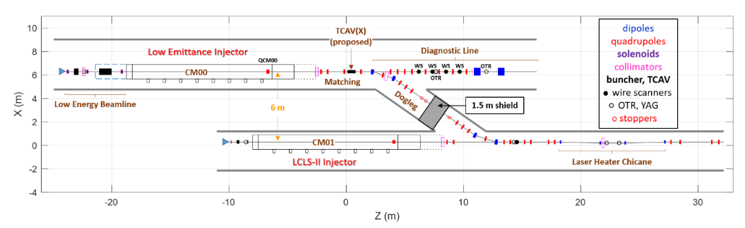
What do we need from the cathode?
LCLS-II-HE may install a new, low-emittance injector in a new tunnel at the west end of the SLAC linac. Goal: ε_{n,rms,95%}< 0.1 μm @ 100 pC
30 MV/m on cathode
MTE < 184 meV
Lifetime > 1 week
“green” illumination
QW SRF gun

Slide 7
Semiconductor Photocathodes
However:
  Require UHV (<0.1 nTorr)
  Limited Lifetime
  Response time
  Complicated
The primary path to high average current in photoinjectors
The good points:
  QE can be >10%
  Many use visible light
  Polarized cathodes possible
Common types:
Cs₂Te – QE ~7% @ 262 nm, Lifetime ~1yr
K₂CsSb – QE >4% @ 532 nm, Lifetime ~weeks
Cs:GaAs – QE ~0.5% @ 800 nm (polarized), >6% @ 527 nm
  W.E. Spicer & A. Herrera-Gomez, Modern Theory and Applications of Photocathodes, SLAC-PUB-6306 (1993)

Slide 8





Three Step Model of Photoemission - Semiconductors
Goal: understand the physics of electron excitation and emission
Empty States
Excitation of e⁻
Reflection, Transmission
Energy distribution of excited e⁻
Vacuum level Φ
hν
No States
Energy
Filled States
Medium
Vacuum

Slide 9


Three Step Model of Photoemission - Semiconductors
Excitation of e⁻
Reflection, Transmission
Energy distribution of excited e⁻
Transit to the Surface
e⁻-phonon scattering e⁻-defect scattering
e⁻-e⁻ scattering
Random Walk
Empty States
Magic Window
Vacuum level Φ
No States
Energy
Filled States
Medium
Vacuum

Slide 10

Three Step Model of Photoemission - Semiconductors
Excitation of e⁻
Reflection, Transmission
Energy distribution of excited e⁻
Transit to the Surface
e⁻-phonon scattering e⁻-defect scattering e⁻-e⁻ scattering Random Walk
Escape surface
Overcome Electron affinity
Surface termination impacts
Multiple tries
Empty States
E_{A}
No States
Energy
Filled States
Need to account for Random Walk in cathode suggests Monte Carlo modeling
Integrating probabilities at each step provides framework to predict QE
Medium
Vacuum

Slide 11
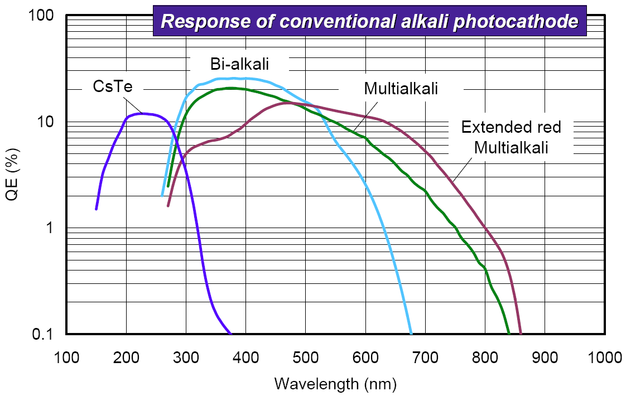

Slide 12


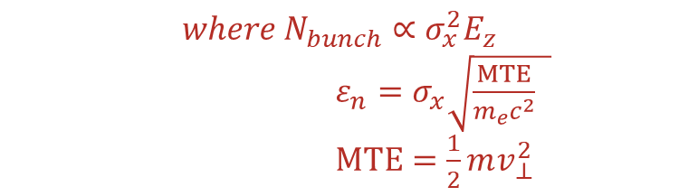


Maximum Achievable Brightness
E_{z} (5-100+ MV/m)
I. Bazarov et al., Phys. Rev. Lett. 102, 104801 (2009)
Child-Langmuir law
$$B_{4D}∝\frac{N_{bunch}}{ε_{n}^{2}}$$
$$∝\frac{E_{z}}{MTE}$$
Electron Bunch
$${{where N}_{bunch}∝σ_{x}^{2}E}_{z}$$
$ε_{n}=σ_{x}\sqrt{\frac{MTE}{m_{e}c^{2}} }$
$MTE=\frac{1}{2}mv_{⊥}^{2}$
Photocathode
$$σ_{x}$$
Laser pulse
Increase $E_{z}$
Brightness limited by photocathode MTE

Slide 13
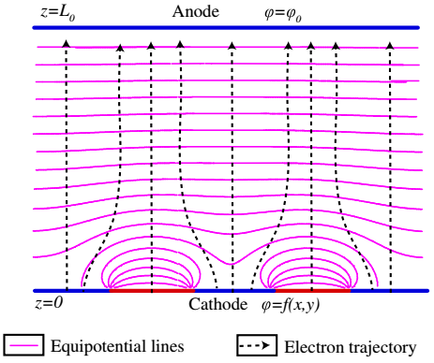
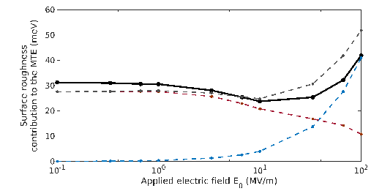
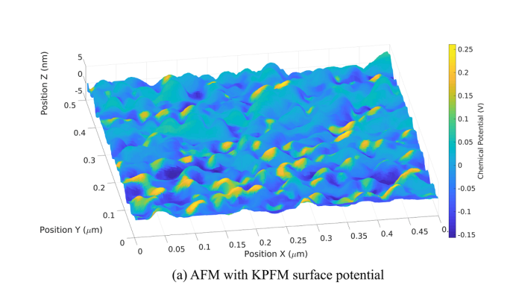




MTE limiting factors -Surface non-uniformities
Physical Roughness
Chemical Roughness
$${MTE}_{field}=\frac{π^{2}a^{2}E_{0}e}{2λ}$$
$$MTE_{wf}=\frac{π^{2}h^{2}e}{4\sqrt{2}aE_{0}}$$
$$2a$$
$$λ$$
J. Feng, S. Karkare et al, J. Appl. Phys. 121, 044904 (2017)
Combined Physical and Chemical Roughness
S. Karkare and I. Bazarov, Phys. Rev Applied, 4, 024015 (2015)
G. Gevorkyan et al. Phys. Rev. ST- Accel and Beams, 21, 093401(2018)
Need single crystal ordered surfaces to get sub-10 meV scale MTE

Slide 14
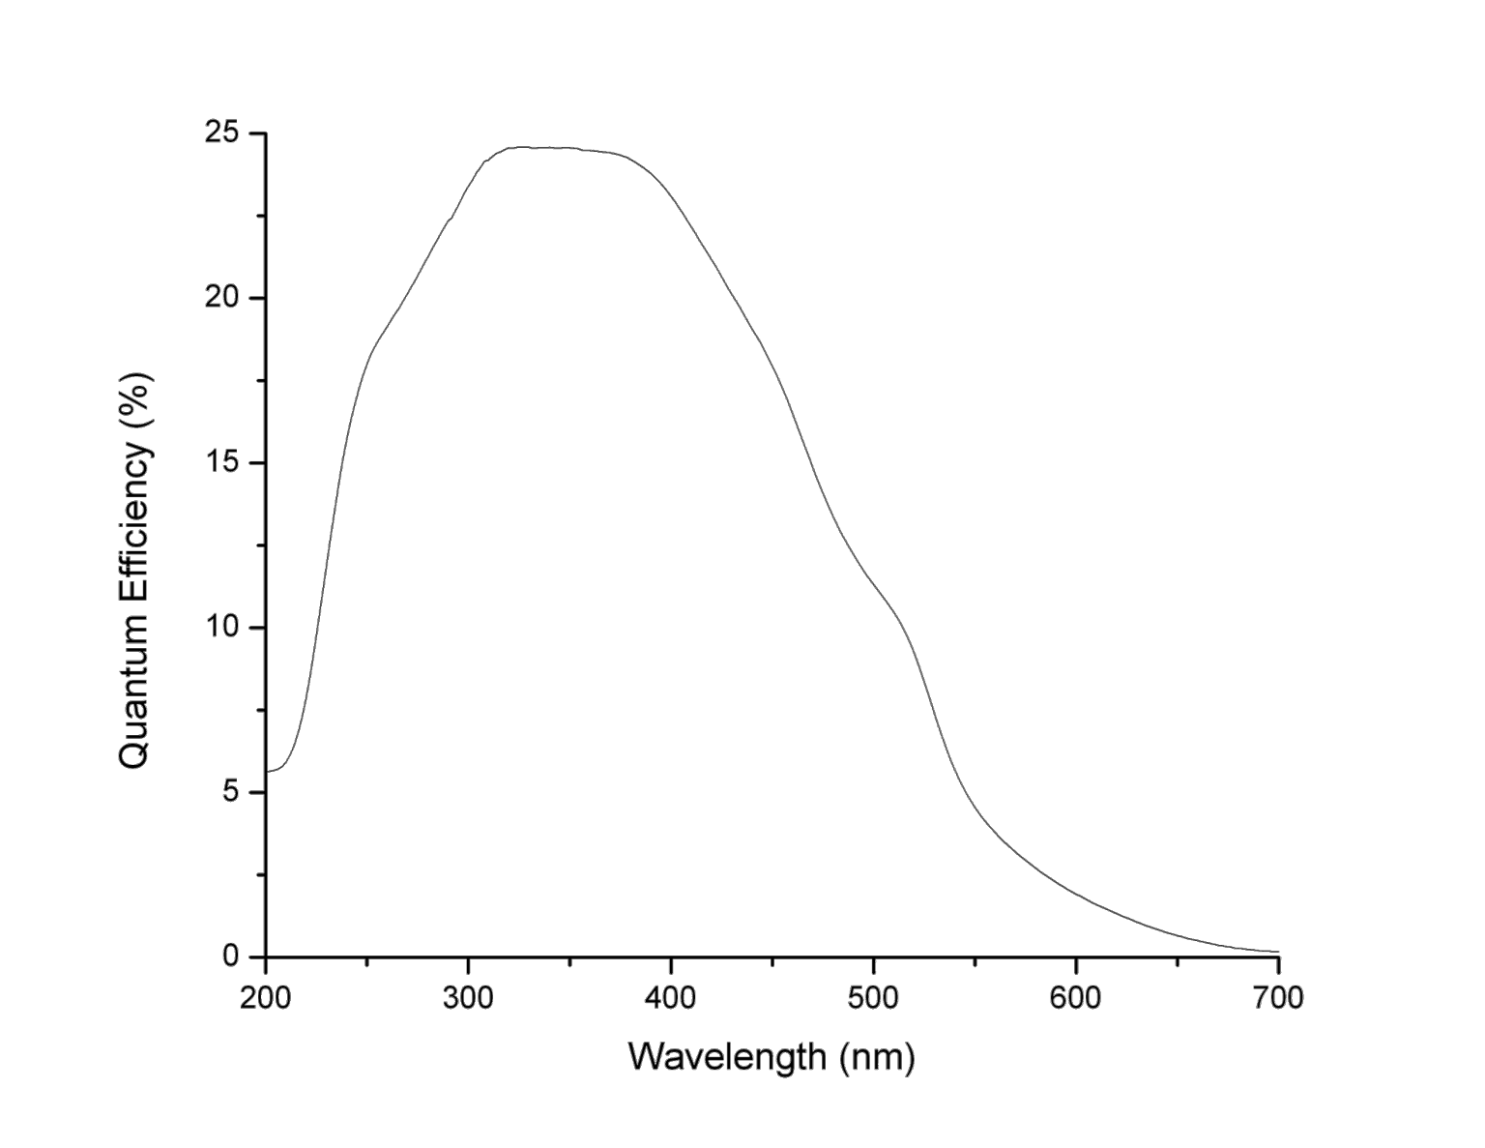
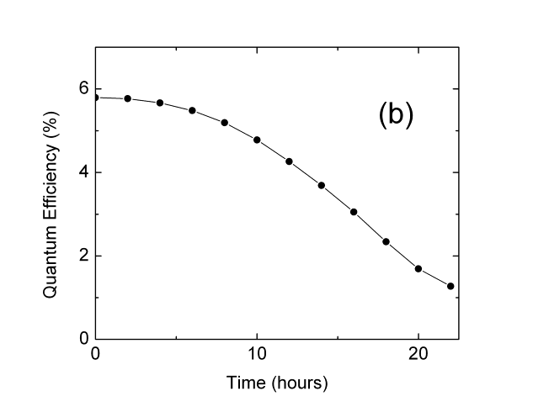
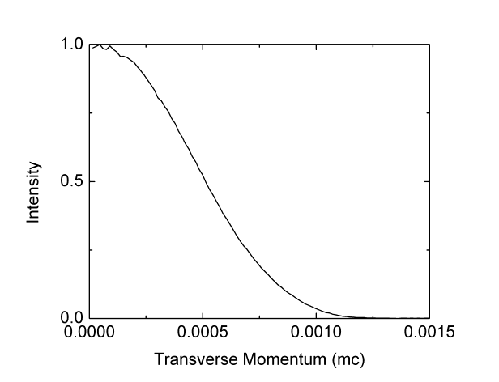
K₂CsSb: A Good Candidate
Good Lifetime 1e-9 mBar
In “magic window”
Caveats: Reflection mode Green light QE
Low transverse Momentum (543 nm)
0.36 µm/mm
Onset of e-e scattering
Unproductive absorption
T. Vecchione et al., Appl. Phys. Lett. 99, 034103 (2011)

Slide 15
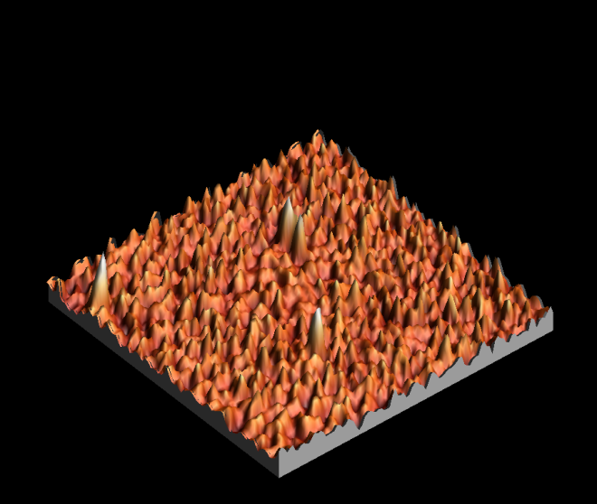
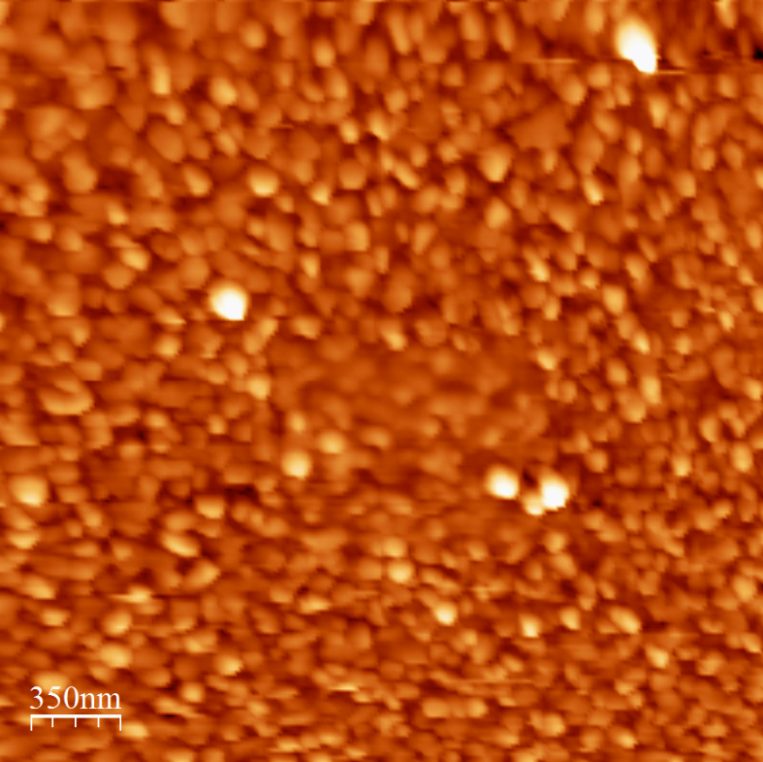
Traditional Sequential Deposition of K₂CsSb
High QE and Rough Surface
  25 nm roughness, 100 nm spatial period
  S. Schubert et al., APL Materials 1, 032119 (2013)
  Emittance vs field measured with Momentatron, 532 nm light
  T. Vecchione, et al, Proc. of IPAC12, 655 (2012)

Slide 16
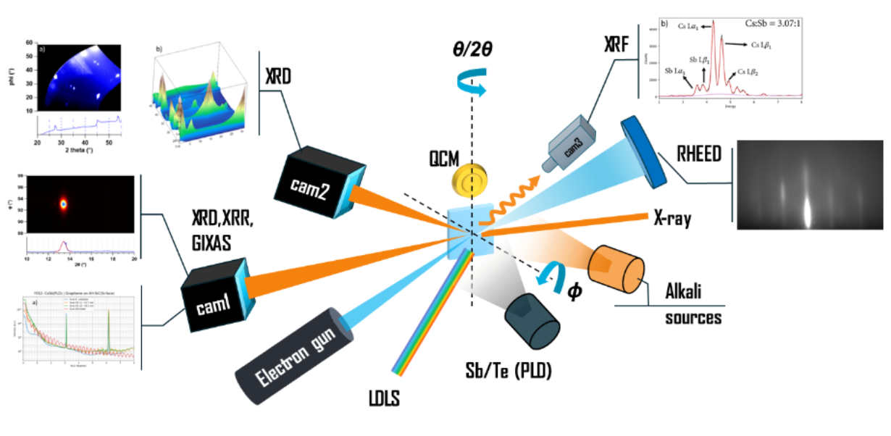
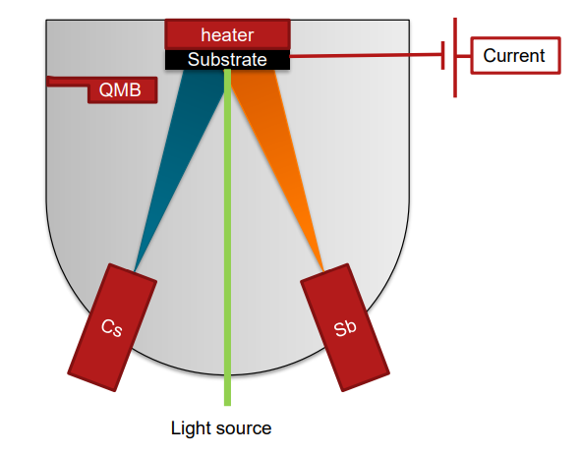
In operando analysis during growth
Our growth method:
  Real-time thickness, stoichiometry, XRD measurements
Conventional photocathode growth:
  Photocurrent oriented.
  Maximize quantum efficiency.

Slide 17
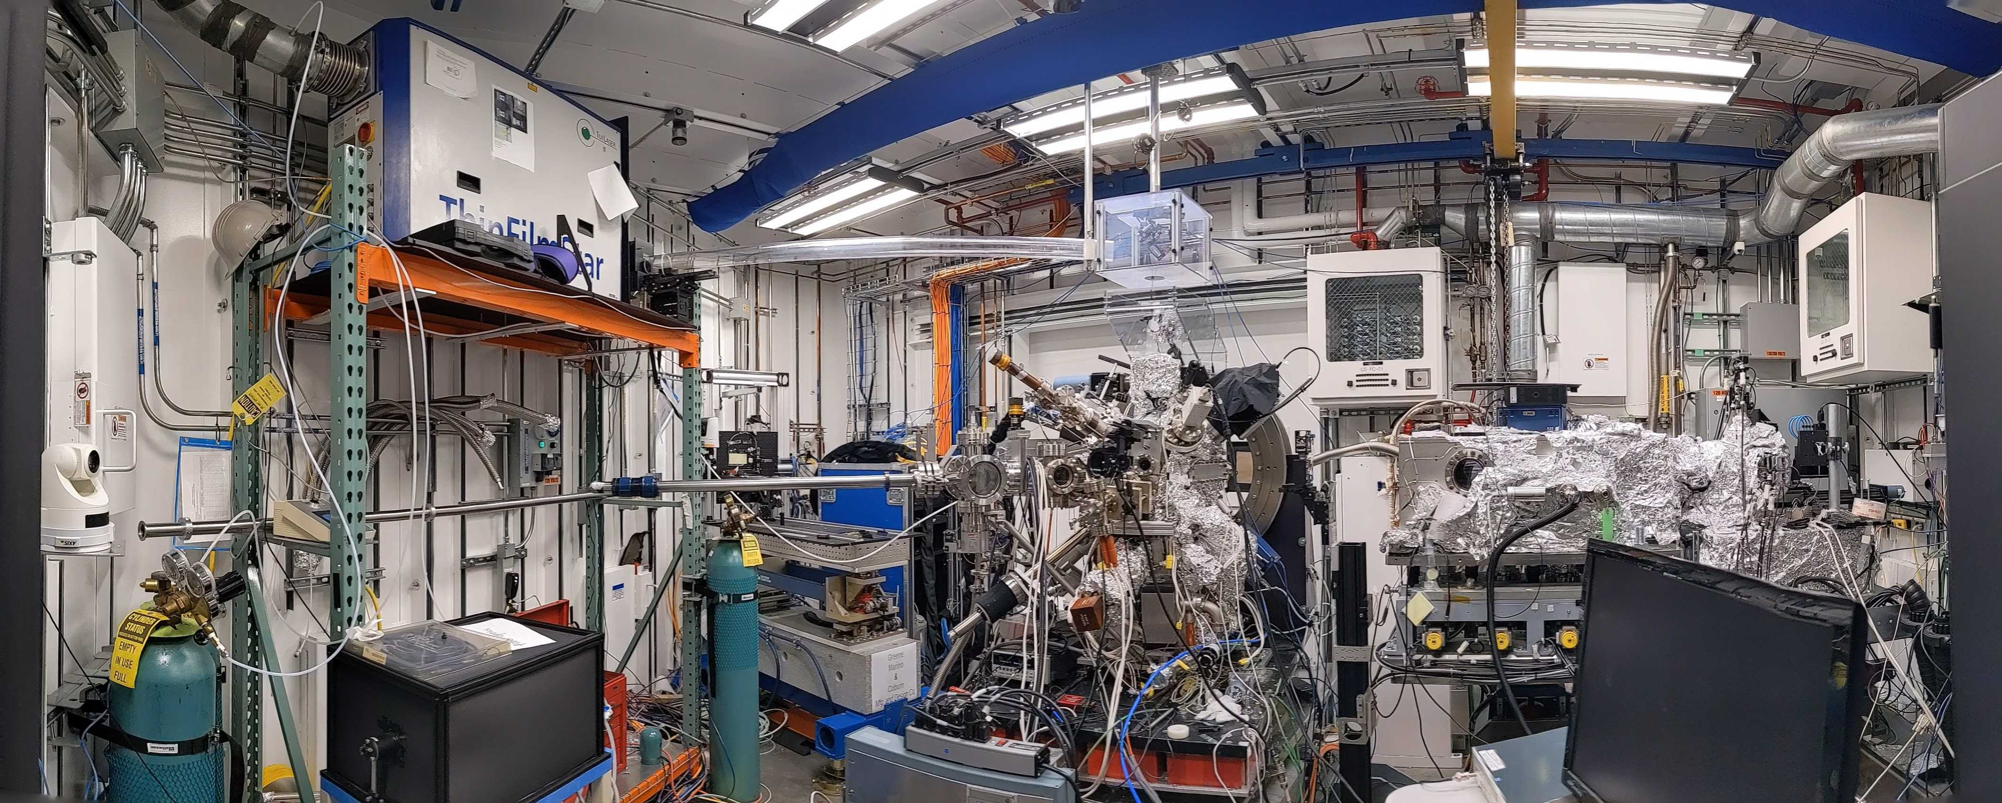
Experimental setup NSLS-II/ISR
Notes:
In real life the chamber looks like this:
Notably PLD laser, the chamber rotates on axis

Slide 18

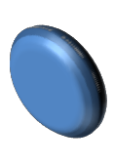

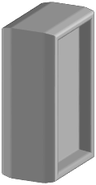

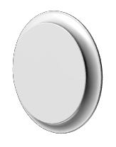






Experimental set up: K₂CsSb cathode growth
Horizontal evaporation of three sources:
P=1x10-10 mbar
FTM
Cs K
X-rays
Sb
Recipe:
QE during growth (532 nm laser)
Cs
QE(%)
K
T(C)
140
K
Cs
100
Sb
25
t
t
16

Slide 19
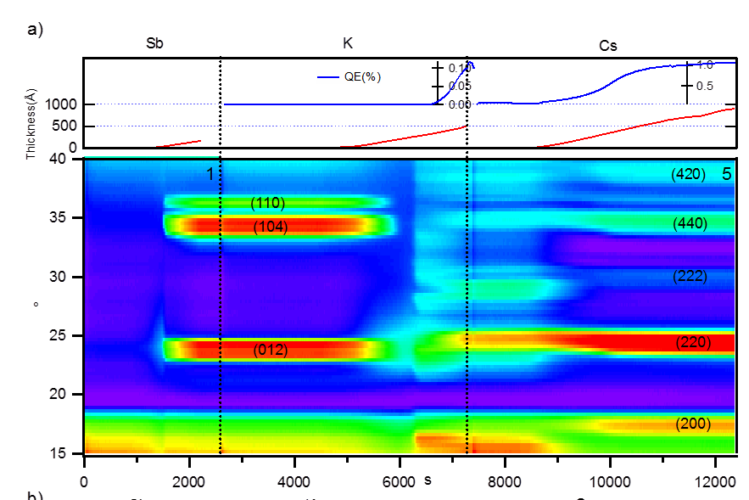
Reaction Dynamics
Antimony evaporated on Si, 0.2 Å/s; crystallize at 4nm
K deposition dissolves Sb layer - This is where roughening occurs!
QE increase corresponds with K_{x}Sb crystallization Cs increases lattice constant and reduces defects
M. Ruiz-Osés et al., APL Mat. 2, 121101 (2014)

Slide 20
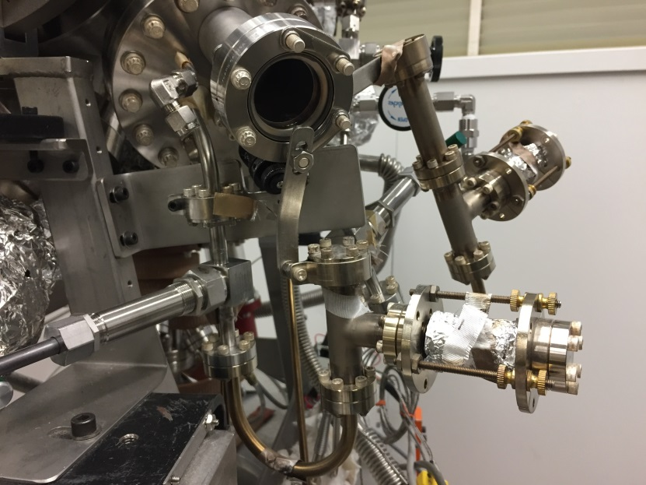
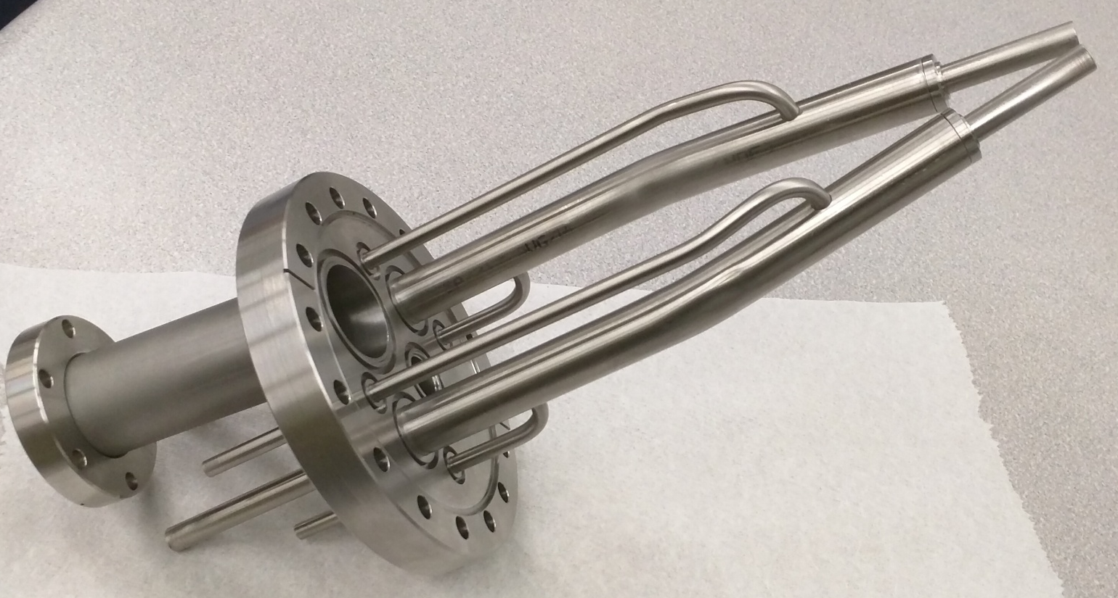
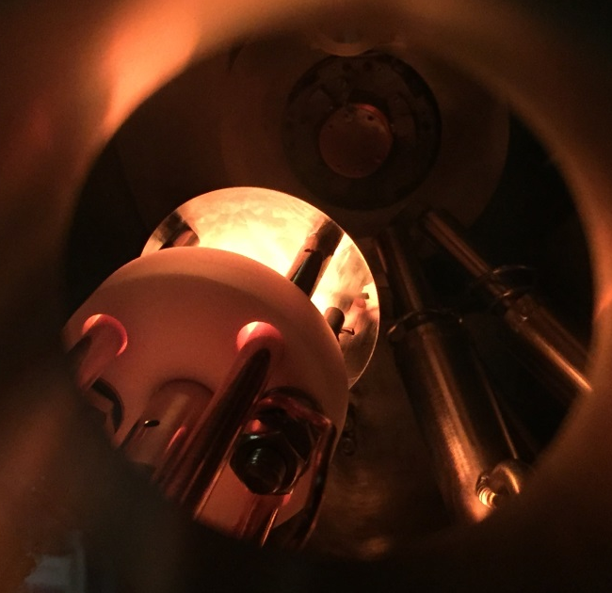
Ternary Co-evaporation
Simultaneously evaporate from Sb evaporator and K,Cs effusion cells
Cs Cell
J tube
K capsule
Growth rate are controlled by J tube temperature, valve and shutter
Stoichiometry controlled by real time XRF

Slide 21
Thickness
~10nm
(440)
Real time
XRD
(422)
(420)
(222)
Real time
Fluorescence
QE

Slide 22
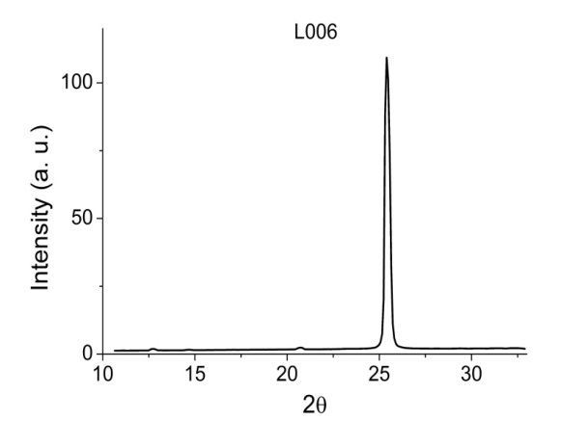
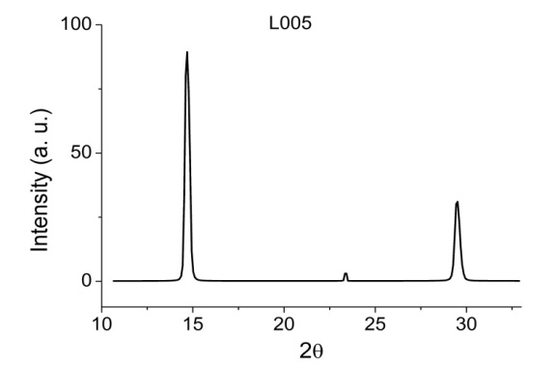
Stoichiometry & Structural Analysis
Camera 1
(200)
Grain size 27.7nm
Grain size 20.2nm
(222)
(400)
(111)
(220)
Camera 2
Highly textured
K₂CsSb phase!
mm size lateral grains
 | K | Sb | Cs
L004 Si | 2.50 | 1.00 | 1.16
L005 Si | 2.37 | 1.00 | 0.91
L006 Si | 2.21 | 1.00 | 0.95
L011 Si | 2.07 | 1.00 | 0.94
L012 MgO | 1.98 | 1.00 | 0.88
Good K/Cs/Sb ratio!
This works for the entire Alkali antimonide family – we’ve created pseudo single crystals with a wide range of stoichiometries

Slide 23
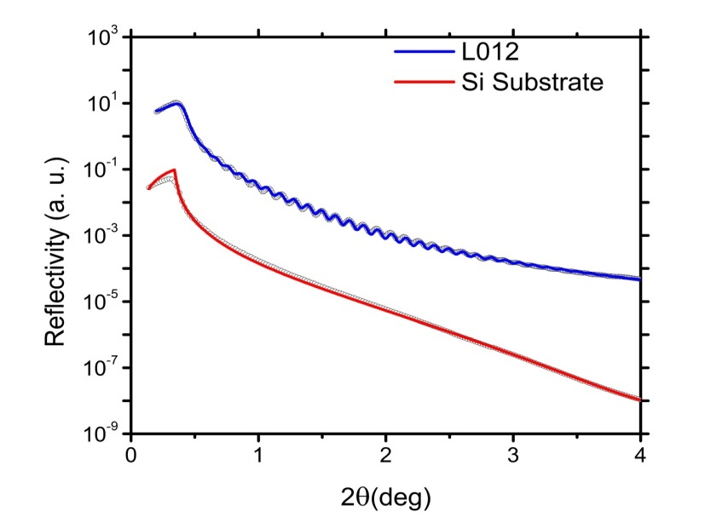
Surface Roughness & QE
 | QE@532nm(%) | Roughness(A) | Thickness (A) | Grain size (A)
L004 Si | 4.9 | 3.5 | 234 | 155
L005 Si | 5.8 | 11.5 | 815.3 | 277
L006 Si | 5.4 | 13.8 | 757.5 | 202
Simultaneous evaporation of all constituents results in no crystal phase transformation
Smooth, reproducible and ultra-high QE. Highly Crystalline!

Slide 24
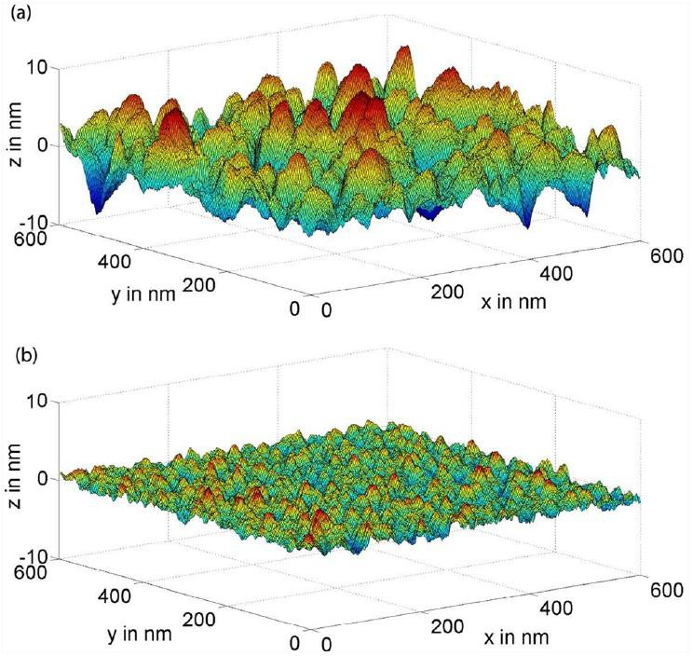
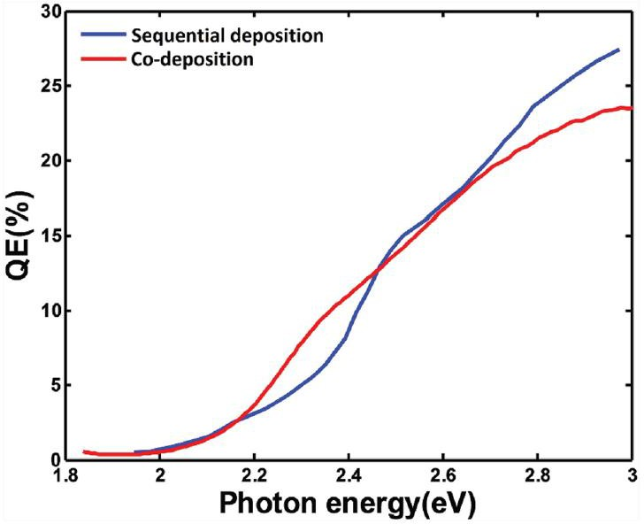
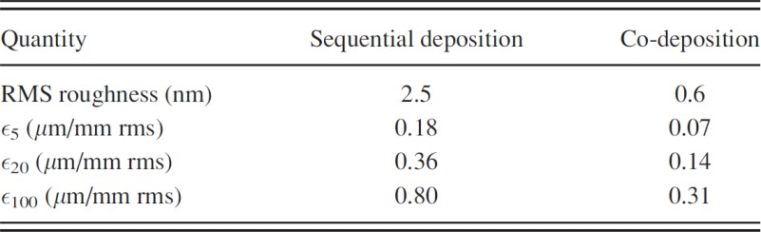
Co-deposition leads to efficient and ultra-smooth cathodes
Co-deposited K2CsSb yield spectrum
Sequential deposition
Co-deposition
20 MV/m
5 MV/m
- significant emittance degradation for sequential method
- no practical degradation with co-deposition
20 MV/m
100 MV/m
LN2 threshold emission
  significant degradation, even with co-deposition
  we need films smoother than 0.6 nm!!
J. Feng et al., J. Appl. Phys., 121(4) 044904, 2017

Slide 25
CsTe cathode Quantum efficiency
QE
Co-dep can result in much higher QE than sequential
Sequential cathode too rough to measure;
Codep cathode <2nm
Stoichiometry for sequential is Cs poor (1.75:1);
  co-dep near perfect (1.98:1)
Wavelength (nm)
M. Gaowei, J. Sinsheimer, D. Strom, J. Xie, J. Cen, J. Walsh, E. Muller, and J. Smedley
Phys. Rev. Accel. Beams 22, 073401 – Published 23 July 2019

Slide 26

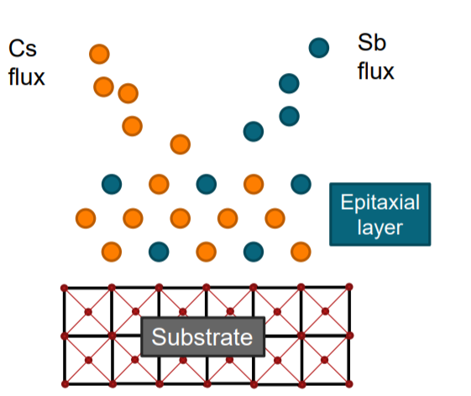
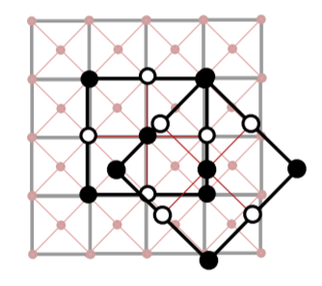
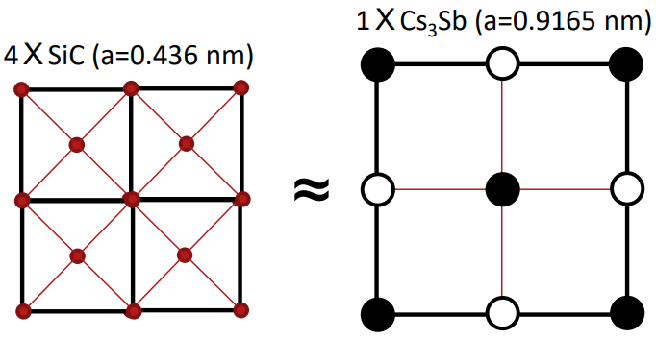
Epitaxial Growth
Cs₃Sb photocathodes are conventionally grown polycrystalline with disordered surfaces.
Reducing the intrinsic emittance may be limited by the surface disorder in the form of defects, grain boundaries, and roughness.
Epitaxy is the alignment of crystal layers with respect to an underlying crystal seed layer.
Cs₃Sb is grown on lattice matched, 3C-SiC substrates.
Notes:
MTE may be limited by epitaxy. Explain two diff orientations

Slide 27
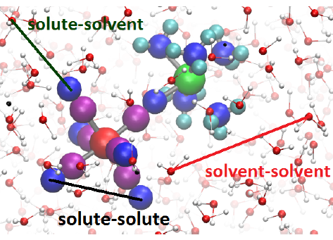

MHz MeV-UED to Enable Grand Challenge Science
Real-space observation of proton dynamics requires both proton sensitivity and high time resolution (< ~50 fs).
Neutron scattering lacks time resolution, X-ray diffraction lacks proton sensitivity. Electron diffraction is the only viable path.
MHz MeV-UED based on the SRF gun will possess exquisite sensitivity and atomic spatial temporal resolutions to address one of the grand challenge sciences:
Probing proton-transfer of chemical and biological process in its native environments.
Thanks to XJ Wang
Notes:
gas phase electron has a long history. MeV-UEM is uniques power tool to study the gas phase structure dynamics because the near spped of light to over come the velocity mismatch (in FEL jagon, slippage). Markus and I started the SLAC gas phase UED, in our first experiments, we demonstrated the MeV-UED has the atomic and sensitivity to study the gas phase …

Slide 28
Conclusions and Thanks
Historically, UED sources have emphasized brightness over charge
Single shot, nonreproducible dynamic UED is different – charge also matters
The source for such UED looks more like an FEL
MTE matters, but so does QE
Continue development of methods of achieving cathode uniformity
IF more uniform cathodes are available, increase gun gradients
The dawn of epitaxy in the alkali antimonides and tellurides is an exciting development which may enable this progress
The technology to do “high charge” UED is within reach

Slide 29
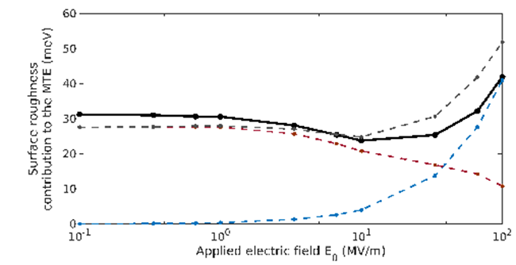
Cathodes for “High Charge” UED/UEM
Problem Statement High Charge UED/UEM will require higher bunch charge (>1 pC not 2fC) Increasing electric field is attractive to maintain brightness at higher charge However, the current state of the art in cathode uniformity will limit the utility of increasing gradient Cathodes must be improved | Current State of Research Coevaporation has made nm scale roughness with good QE achievable Need to disseminate this technology to accelerator systems Epitaxy has been achieved in the relevant systems, opening the possibility of more uniform surfaces – much more to do Requires gun compatible single crystal substrates – this has never been achieved
Relevant Graphics | Impact Achieving the beam brightness required for atomic resolution at high charge requires progress in this area There needs to be a test bed for high field testing of photocathodes with single crystal substrates Need a robust investment in basic materials science of the alkali antimonides and tellurides
John Smedley, SLAC, Smedley@slac.stanford.edu

Slide 31
Trends and observations
Modern photocathode development is focused in two areas:
High average current (e⁻ cooling, CW FEL – FLASH, EuXFEL, LCLS-II)
Ultra high brightness (UED/UEM)
These are driving development of semiconductor cathodes
Spatial uniformity (better than 0.6nm RMS), Single crystal
Ultra thin/optical etalon
Sealed photocathode systems for commercial delivery
Graphene or HBN covered cathodes
Galdi et al., Appl. Phys. Lett. 118, 244101 (2021)
M. Gaowei, et al., Phys. Rev. Accel. Beams 22, 073401 (2019)
A. Alexander, et al., AIP Advances 11, 065325 (2021)
J. Smedley, et al., Alkali Antimonide Photocathodes for Everyone, PAC 2013, 1178
J. Biswas, et al., APL Materials 10, 111115 (2022)
H. Yamaguchi, et al., npj 2D Materials and Applications, 12, (2017)

