Slide 1
+ UED Beamline Design for Optimising Temporal Resolution
Relativistic Ultrafast Electron Diffraction & Imaging
Julian McKenzie (on behalf of the RUEDI team)
UED Opportunities for Dynamical Imaging of Materials
7th November 2023 Santa Fe, New Mexico, USA

Slide 2
Contents
The RUEDI Facility Proposal
RUEDI Imaging/Microscopy Line
What do we want from a UED beamline?
UED Beamline Options
Bunch length control
Jitter suppression
Photoinjector
Dark current
Post-sample beamline
fs temporal diagnostics
TEM style optics
Summary

Slide 3
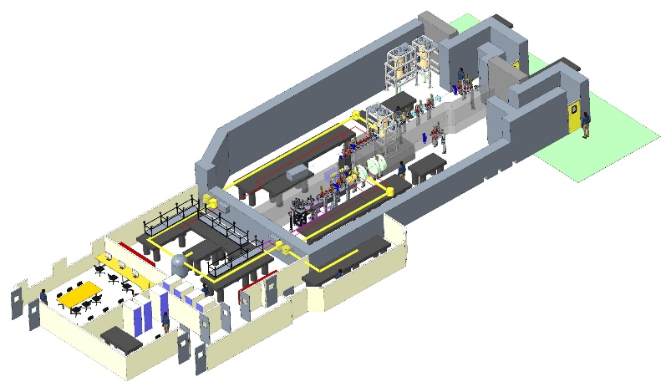
The RUEDI Facility Proposal
A new UK National User Facility at Daresbury Laboratory
Relativistic Ultrafast Electron Diffraction & Imaging
MeV UED and UEM
Time-resolved pump-probe experiments in both real and reciprocal space
With a large variety of pumps and sample environments
2020 - Funding bid
2022 - Design stage
2023 - Bid for capital
2025 - Construction
2030 - User facility
Solid
Liquid cells
Liquid/gas jets
Plasmas
Cryogenic (down to mK level)
Wide variety of laser wavelengths
THz, TW, HCF
(keV ion source)
To enable a large range of science:
Biosciences
Materials in Extremes
Energy Generation, Conservation, and Storage
Dynamics of Chemical Change
Quantum Materials & Processes
Daresbury Laboratory

Slide 4
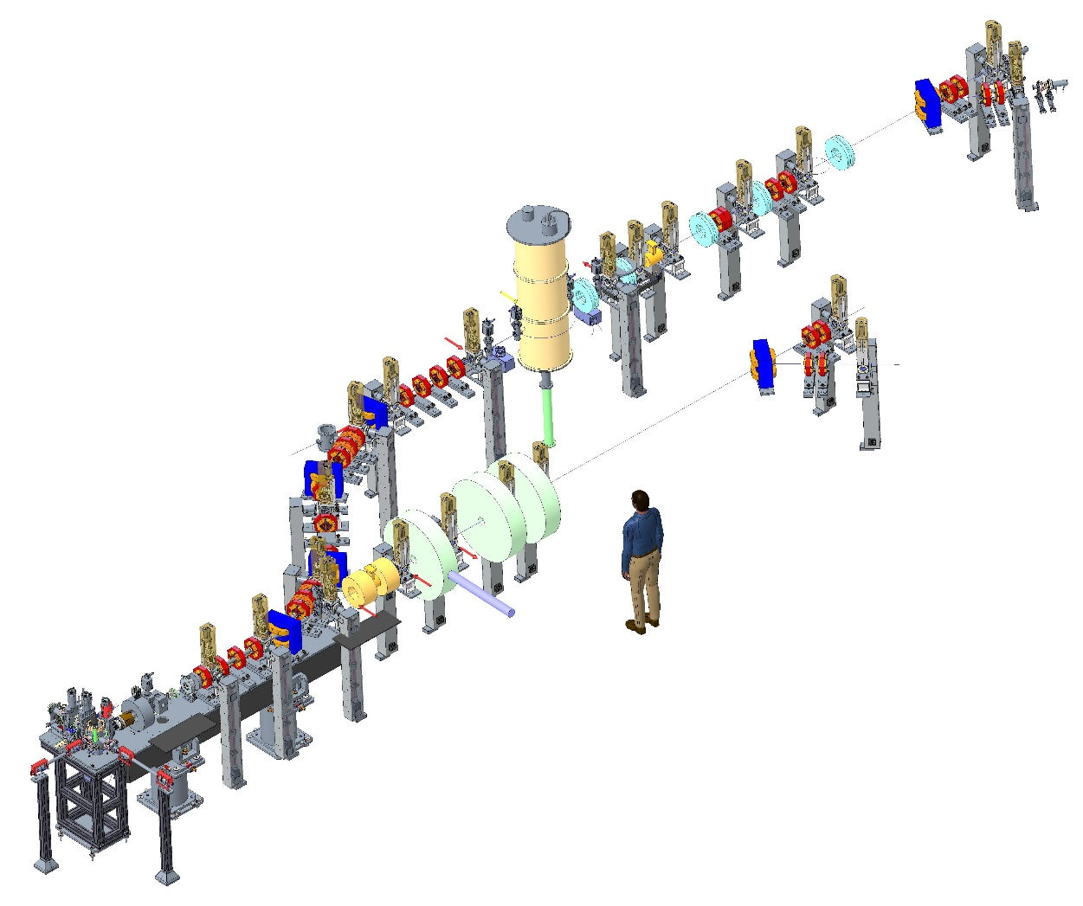
Facility concept
Ultrafast diffraction line
10-100s fs scale
Up to 400 fC
Stroboscopic + Single-shot
Current concept is one gun feeding two separately shielded beamlines
Exploring different options!
Microscopy/
Imaging line
S-band photoinjector 4 MeV
10s of nm rad emittance
ps scale
200fC - 20pC
Stroboscopic + Single-shot

Slide 5
Best spatial resolution
Ultrafast diffraction line
Microscopy/
Imaging line
S-band photoinjector
ps scale
200fC - 20pC
Stroboscopic + Single-shot

Slide 6
Imaging Beamline
Objective lens
Detector
16-64 MegaPixel
direct electron
~6.5um pixel size
Dechirper cavity reduces energy spread
(see next slide)
Imaging lens system
Series of magnetic lenses
Aiming for 6500x magnification

Slide 7
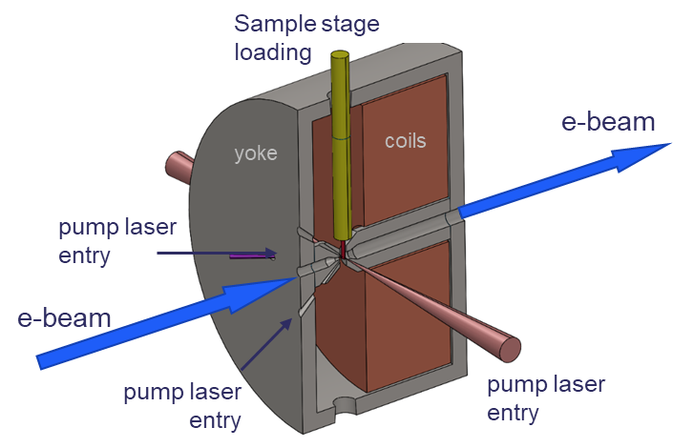
Imaging Beamline
Objective lens
The key to the whole system
Objective lens
Detector
16-64 MegaPixel
direct electron
~6.5um pixel size
Dechirper cavity reduces energy spread
(see next slide)
Imaging lens system
Series of magnetic lenses
Aiming for 6500x magnification
Samples inserted into middle
Multiple pump laser entry ports
Compatible with commercial TEM sample stages (enabling experiments in solid, liquid, cryogenic, heating etc)
Comparing round lenses (solenoids)
vs quadrupole quintuplets
Quadrupoles have worse aberrations
Round lens limited to 2 MeV beam energy at 1.7 T peak field

Slide 8
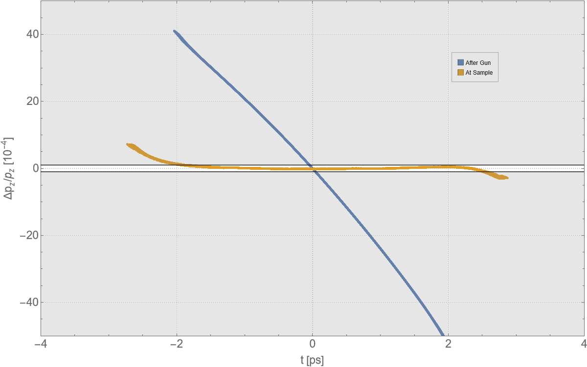
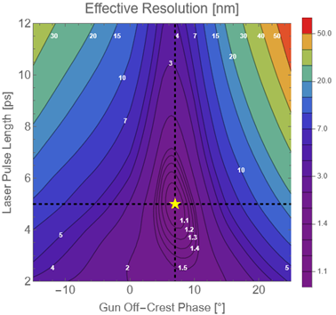
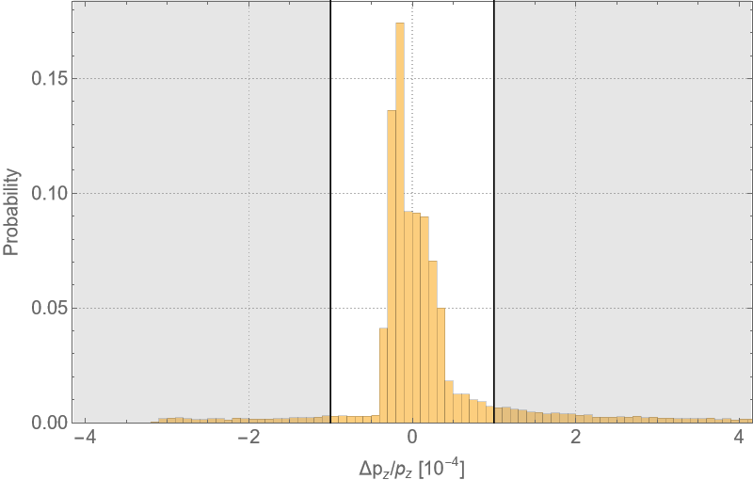
Microscopy Resolution
Resolution limit simplified…
RF dechirper cavity
Also used to decelerate from 4 to 2 MeV
$$r=\sqrt{{\left(C_{s}α^{3}\right)}^{2}+{\left(C_{c}α{δγ}/γ\right)}^{2}}$$
C_{s} = Spherical aberration (<10mm @ 2 MeV)
𝛼 = objective aperture collection semi-angle
C_{c} = Chromatic aberration (<10mm @ 2 MeV)
𝛿𝛾/𝛾 = relative beam energy spread
Blue – pre-dechirper
Yellow – post-dechirper
For 1nm resolution, need <10⁻⁴ relative energy spread
Also need ~10s nm rad level emittance to be able to focus beam down to ~10µm samples
Stroboscopic mode (10^6 electrons) has potential to reach down to 1nm resolution
Single-shot mode (10^8 electrons (20pC)) has resolution limited to 50 – 100 nm range, and hard to focus beam onto small samples
8

Slide 9
Best temporal resolution
Ultrafast diffraction line
10-100s fs scale
Up to 400 fC
Stroboscopic + Single-shot
Microscopy/
Imaging line
S-band photoinjector

Slide 10
UED beamline design
What do we want?
Maximum brightness
Maximise bunch charge
Minimise emittance
Minimise time resolution:
Minimise electron bunch length
Minimise time jitter (between laser pump and electron probe)
$$B_{4D}=\frac{q}{ε_{x}ε_{y}}$$
$$∆t=\sqrt{{∆t}_{Bunch length}^{2}+{∆t}_{Jitter}^{2}+{∆t}_{Laser pulse length}^{2}+∆_{velocity mismatch}^{2}}$$
Other talks this workshop are on optimising brightness
(guns, cathodes etc)
So this talk will concentrate on minimising time resolution
(whilst preserving beam brightness!)

Slide 11
UED Beamline Options:
$$∆t=\sqrt{{∆t}_{Bunch length}^{2}+{∆t}_{Jitter}^{2}}$$
Gun only
Just gun (+ focussing) into sample chamber
Gun
Sample
Limited control over bunch length

Slide 12
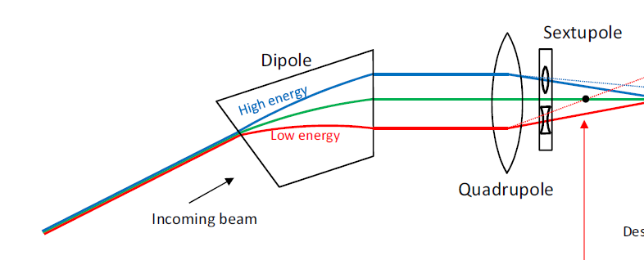
Bunch length control
Electron time of arrival is related to energy:
Path length term
Different energy electrons travel different paths through a magnetic beamline
There are two contributions to R56 (longitudinal dispersion)
Velocity term
Different energy particles having different velocities
Space-charge causes electrons to de-bunch
For 4 MeV it is 10 fs/keV per metre travelled
E
Can design a beamline to have fully tuneable R56 (to both signs as well)
Sextupoles can be used to correct higher order (T566)
t

Slide 13
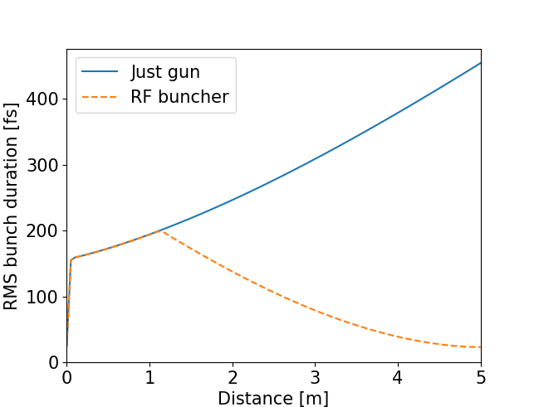
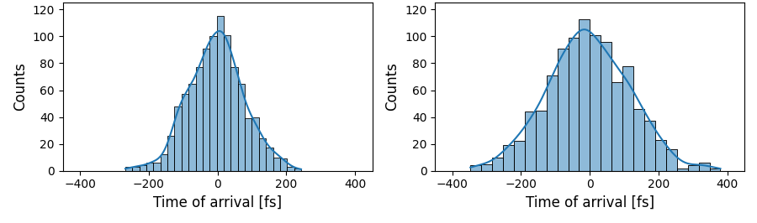
UED Beamline Options:
$$∆t=\sqrt{{∆t}_{Bunch length}^{2}+{∆t}_{Jitter}^{2}}$$
Gun only
Gun only
Buncher flips chirp
Just gun (+ focussing) into sample chamber
E
E
Gun
Sample
t
t
Limited control over bunch length
Gun + (RF) buncher
Jitter
Gun only
Gun + RF buncher
Additional component to provide velocity bunching
(RF cavity, or THz (R&D))
80 fs
rms jitter
120 fs
rms jitter
Gun
Buncher
Sample
Shorter bunches but increases jitter

Slide 14
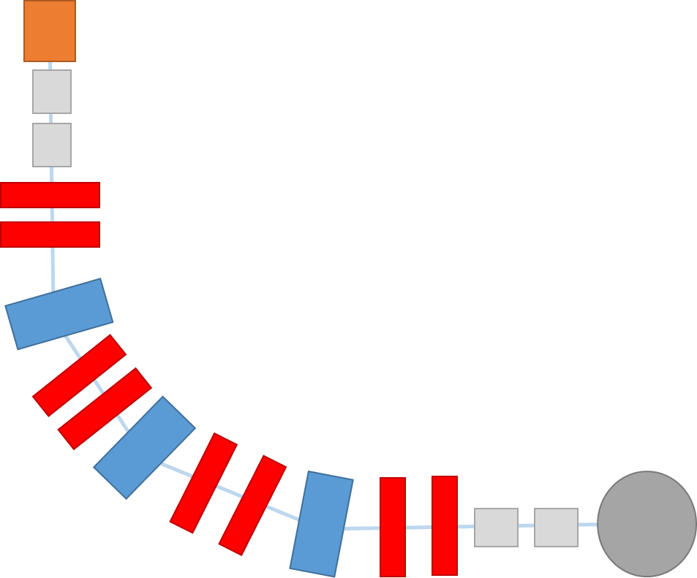
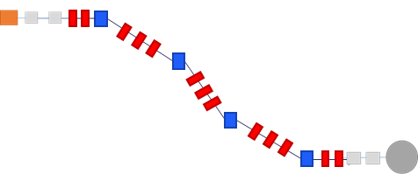
UED Beamline Options:
$$∆t=\sqrt{{∆t}_{Bunch length}^{2}+{∆t}_{Jitter}^{2}}$$
Gun only
Magnetic beamlines
Just gun (+ focussing) into sample chamber
Gun
Sample
Many possible topologies
- some allow 1 gun to feed multiple beamlines
More flexibility
Bends allow collimation of dark current
Possible to create very short bunches and simultaneously suppress the jitter
Gun
Sample
Gun
Examples of potential beamlines with different topologies
Limited control over bunch length
Gun + (RF) buncher
Sample
Additional component to provide velocity bunching
(RF cavity, or THz (R&D))
Gun
Gun
Buncher
Sample
Sample
Shorter bunches but increases jitter

Slide 15
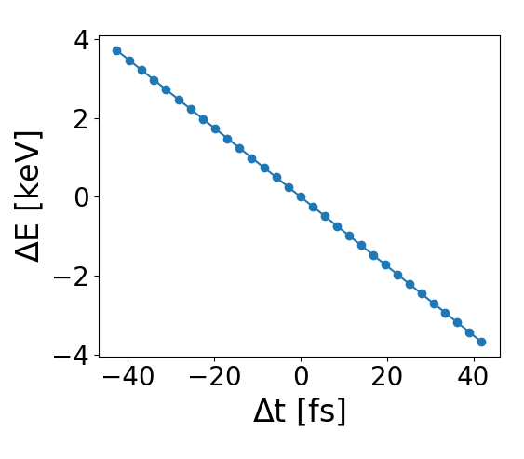
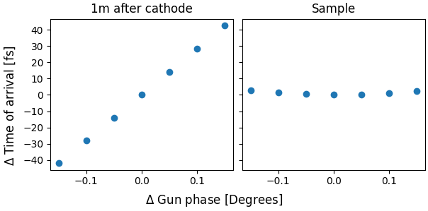
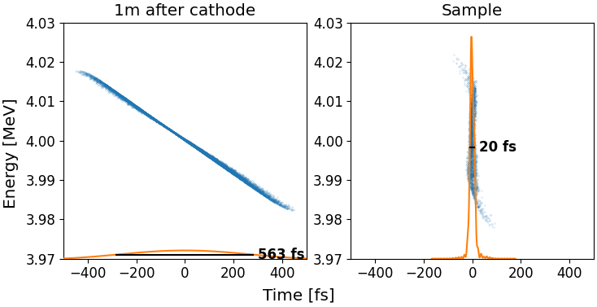
Jitter suppression
$$∆t=\sqrt{{∆t}_{Bunch length}^{2}+{∆t}_{Jitter}^{2}}$$
Jitter suppression
Gun jitters have a correlated $\frac{ΔE}{Δt}$
Set magnetic R56 to the opposite of the gun $\frac{ΔE}{Δt}$ jitter to cancel it
Set electron beam chirp (using space charge) to enable simultaneous compression and jitter cancellation
Experimentally proven by KAERI
Bunch compression
*H.W. Kim et al, "Towards jitter-free ultrafast electron diffraction
technology", Nature Photonics, Vol. 14, Pages 245–249,
2020.
Julian McKenzie, UED Opportunities for Dynamical Materials, Santa Fe, 07/11/2023

Slide 16
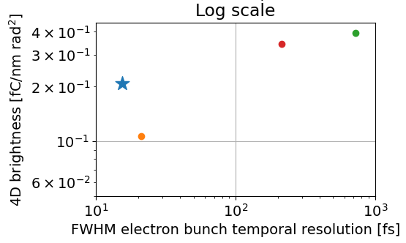
UED beamline choice
All for 10^6 electrons, after collimation
What do we want?
RF buncher
Gun only
Maximum brightness
TBA
$$B_{4D}=\frac{q}{ε_{x}ε_{y}}$$
4 dipole arc
Minimise time resolution:
$$∆t=\sqrt{{∆t}_{Bunch length}^{2}+{∆t}_{Jitter}^{2}}$$
Magnetic option has the potential for achieving both of these simultaneously
And could remove a lot of dark current

Slide 17
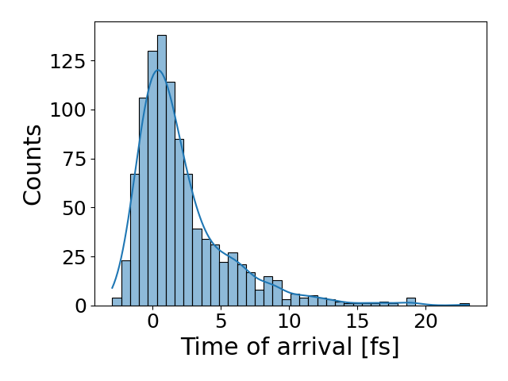
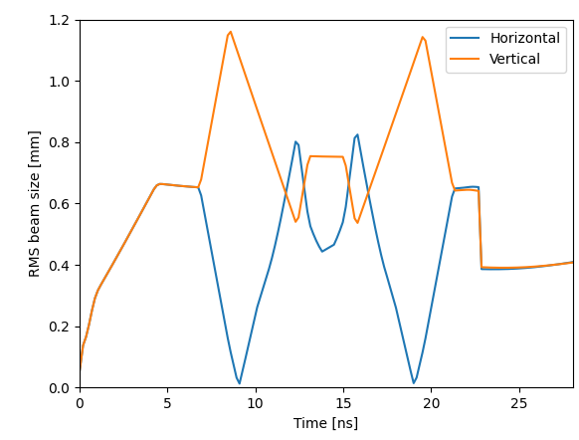
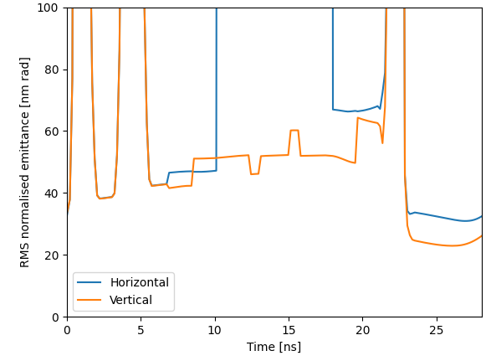
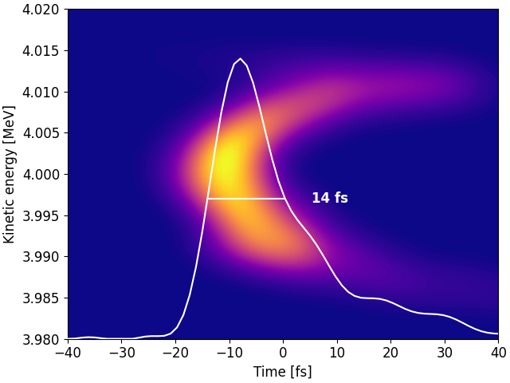
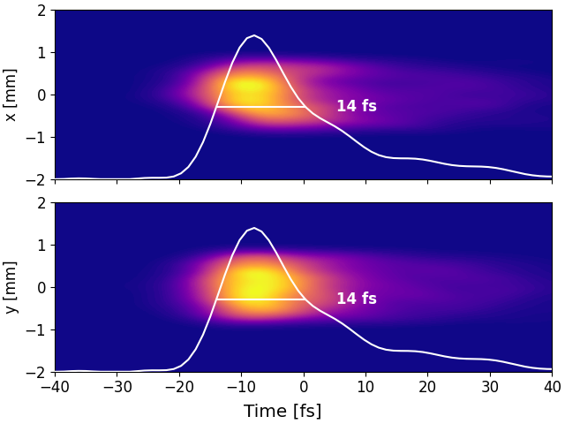
Example optics for a TBA
Gun
(Triple Bend Achromat)
3 fs
rms jitter
Sample
400 fC from gun
Collimate to 176 fC
After magnetic arc
(10^6 electrons)
Goal charge for single-shot
Doubles the brightness (0.2 $fC/{nm rad}^{2}$)
Reduces the bunch length from 21 → 14 fs FWHM
No residual dispersion
(which can dominate bunch length, space-charge induced)

Slide 18
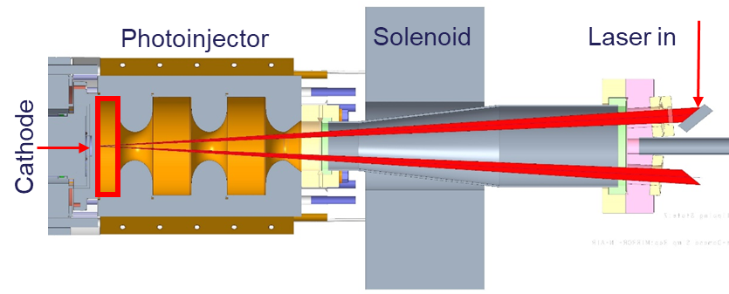
Photoinjector
2.4 cell S-band RF gun
1 kHz repetition rate
Side coupled RF input

Slide 19
Photoinjector
2.4 cell S-band RF gun
1 kHz repetition rate
Side coupled RF input
2.4 instead of 1.4 cell:
Beam dynamics studies:
Main benefit of 1.4 cell was shorter bunch length
But we have a compressor!
We are down to cathode emittance limit anyway
Much lower field required (for same energy beam)
Much lower dark current produced
 | 1.4 Cell | 2.4 Cell
RMS bunch length [fs] | 148.0 | 232.3
RMS transverse emittance [nm rad] | 35.9 | 37.3
Max field on cathode [MV/m] | 114.8 | 68.8

Slide 20
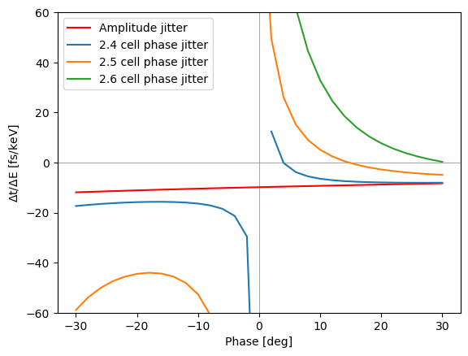
Photoinjector
2.4 cell S-band RF gun
1 kHz repetition rate
Side coupled RF input
2.4 instead of 1.4 cell:
Beam dynamics studies:
Main benefit of 1.4 cell was shorter bunch length
But we have a compressor!
We are down to cathode emittance limit anyway
Much lower field required (for same energy beam)
Much lower dark current produced
Half-cell length optimised so that effect of phase/amplitude jitter the same – so both can be supressed with same R56 beamline
 | 1.4 Cell | 2.4 Cell
RMS bunch length [fs] | 148.0 | 232.3
RMS transverse emittance [nm rad] | 35.9 | 37.3
Max field on cathode [MV/m] | 114.8 | 68.8
Operating phase

Slide 21
Photoinjector
Normal pulse
2.4 cell S-band RF gun
1 kHz repetition rate
Side coupled RF input
Short RF pulse via over-coupling, and stepped RF pulse
Reduces RF pulse length by 2 to get lower overall dark current
Overcoupled with step down
2.4 instead of 1.4 cell:
Beam dynamics studies:
Main benefit of 1.4 cell was shorter bunch length
But we have a compressor!
We are down to cathode emittance limit anyway
Much lower field required (for same energy beam)
Much lower dark current produced
Half-cell length optimised so that effect of phase/amplitude jitter the same – so both can be supressed with same R56 beamline
 | 1.4 Cell | 2.4 Cell
RMS bunch length [fs] | 148.0 | 232.3
RMS transverse emittance [nm rad] | 35.9 | 37.3
Max field on cathode [MV/m] | 114.8 | 68.8
Operating phase

Slide 22
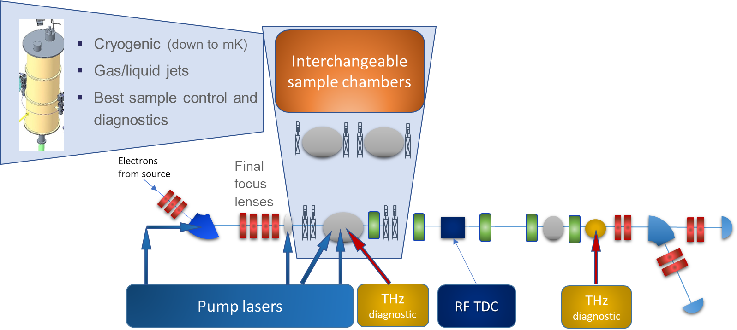
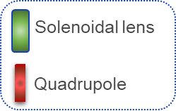
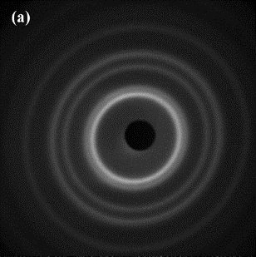
Post-sample beamline
Temporal properties:
Time of arrival
Bunch length
Diagnostic suite:
RF Beam Arrival Monitors
RF TDC
THz at sample position
For bunch length and calibration
THz post-detector
For shot-by-shot measurements
Spectrometer
Detector
Post-sample lenses similar to a UEM:
Variable magnification
Increase camera length
Correct for pre-sample optics
Correct for space-charge
22

Slide 23
Summary
RUEDI is a proposed UK National User Facility
Ultrafast Electron Diffraction & Imaging
Large variety of sample environments
Wide range of laser pumps, including 10fs HCF, THz, TW
Capital funding decision expected end of this year
UED Beamline Design
Magnetic beamlines have a lot of potential
Ultra-short bunches with jitter suppression
Preserves gun brightness
Importance of post-sample diagnostics and lenses

Slide 24
Acknowledgements
Nigel Browning
Angus Kirkland
Yoshie Murooka
Jan Nugara
Will Bryan
Simon Maskell
B. Layla Mehdi
Sven Schroeder
Carsten Welsch
Oznur Apsimon
Gwyndaf Evans
Dwayne Miller
Ian Robinson
Jasper Van Thor
Lee Kelsall
Alberto Acuto
Maulik Patel
and more…
Alex Bainbridge
James Bebbington
Rachael Buckley
Jim Clarke
Louise Cowie
Graham Cox
Joe Crone
Mike Ellis
Aaron Farricker
Omair Ghafur
Anthony Gilfellon
Clive Hill
Phil Hornickel
Ben Hounsell
Frank Jackson
James Jones
Nirav Joshi
Daniel Lake
Storm Mathisen
Russell McLean
Boris Militsyn
Bruno Muratori
Tim Noakes
Tom Pacey
Suzanna Percival
Lewis Reid
Mark Roper
Yuri Saveliev
Ben Shepherd
Rob Smith
Calum Tollervey
Andrew Vick
Alan Wheelhouse
Fatih Yaman
and more…
Daresbury Laboratory

