Slide 1

LANL’s CARIE MeV photoinjector test facility
Evgenya Simakov, Anna Alexander, Petr Anisimov, Walter C. Barkley, W. Brian Haynes, Enrique Henestroza, Sergey Kurennoy, Deepak Rai, S. Sosa, Tsuyoshi Tajima, Janardan Upadhyay, Haoran Xu, MD Zuboraj
Los Alamos National Laboratory
11/8/2023
Managed by Triad National Security, LLC., for the U.S. Department of Energy’s NNSA.

Slide 2
Outline of this talk
Introduction and LANL C-band project overview
Experimental activities
  CERF-NM: High gradient C-band test stand
  CARIE: new high gradient RF injector test facility
LANL thoughts on using C-band capabilities for the MeV UED

Slide 3
LANL must develop accelerators for various national security needs
LANSCE accelerator upgrades:
Applications such as pRad desire higher proton beam energy
→ add a booster to current LANSCE linac to increase beam energy to 3-5 GeV
New capabilities: improve accessibility
Material science at LANL will benefit from powerful directional high repetition rate X-ray sources
43 keV photons can be produced with 42 MeV electron beam
43 keV photons are DMMSC relevant
Compact Accelerators: enabling feasibility
Achieving high gradient performance (low breakdown rates, low field emission, new materials for HOM absorption, etc.) is a material science problem.
LANL is, at core, a material science laboratory

Slide 4
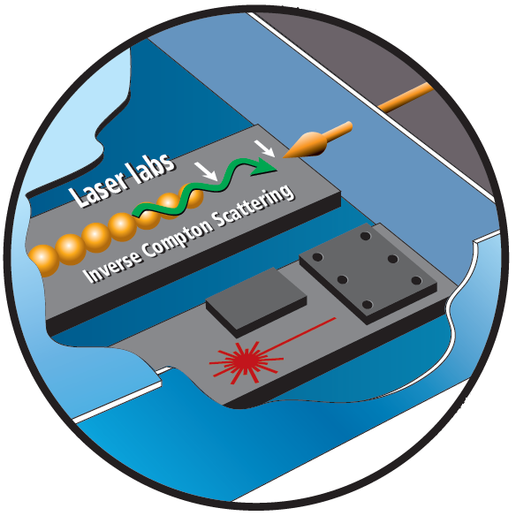
CARIE: Cathodes And Rf Interactions in Extremes test facility
We aim to develop a C-band accelerator test facility for advanced cathode, accelerator, and material studies.
CARIE will be the technology test bed for the future UED, ICS, and other imaging capabilities for LANSCE.
Example 1: LANSCE will benefit from getting 100 keV photon bursts for material studies.
Example 2: LANL has various material science needs for an MeV UED facility.

Slide 5
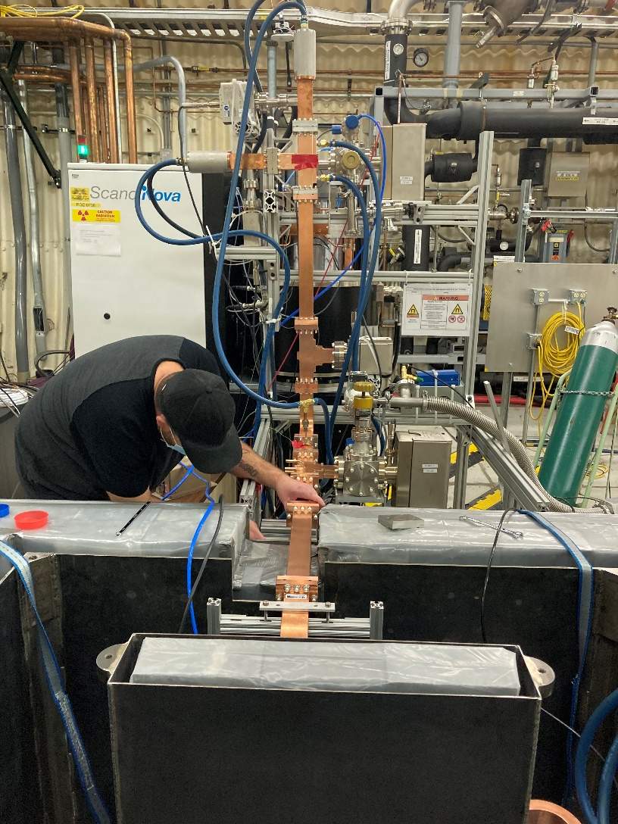
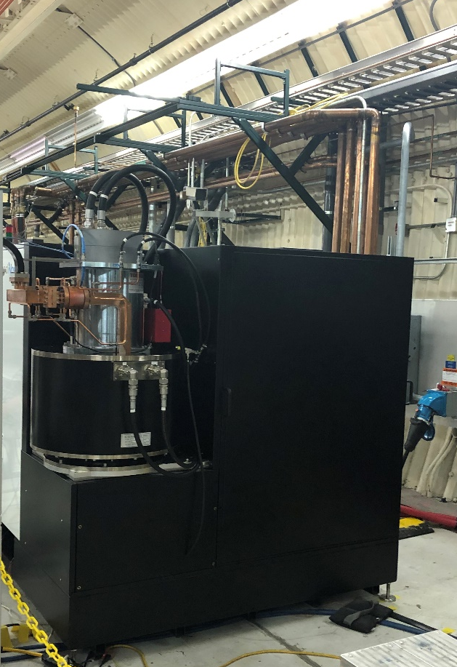
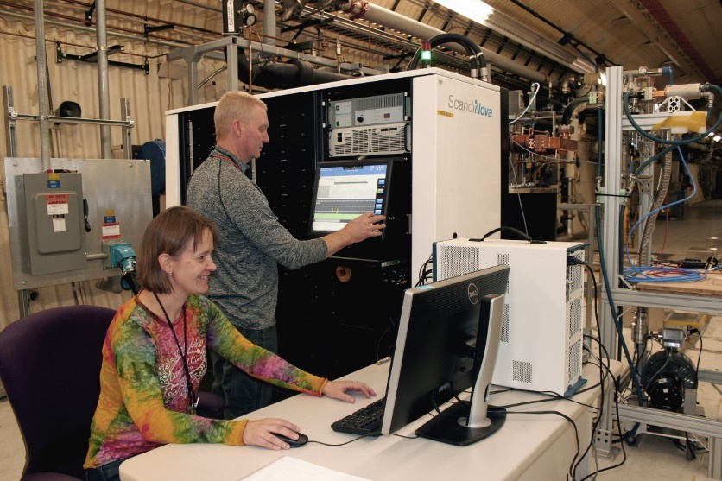
LANL C-band Engineering Research Facility (CERF-NM)
CERF-NM was built with $3M of LANL’s internal infrastructure investment.
Powered with a C-band Canon klystron
Conditioned to 50 MW
Frequency 5.712 GHz
300 ns – 1 µs pulse length
Rep rate up to 200 Hz (typical 100 Hz)
Nominal bandwidth 5.707-5.717 GHz

Slide 6
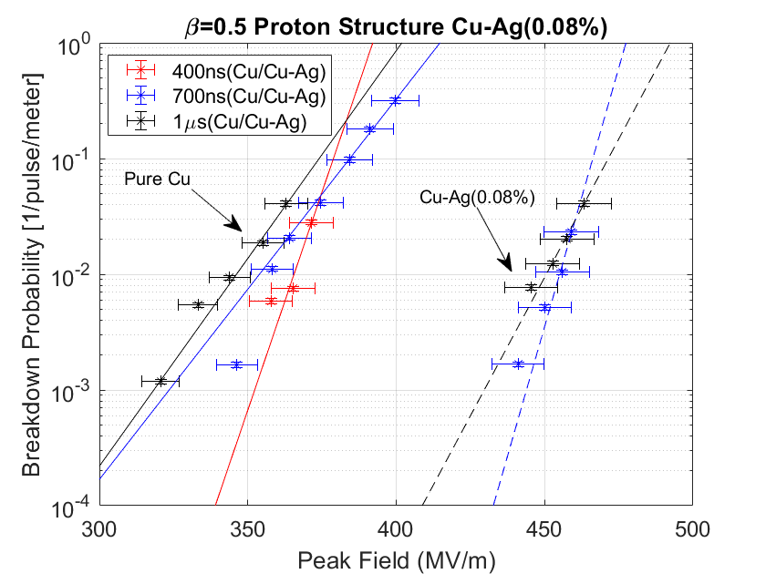
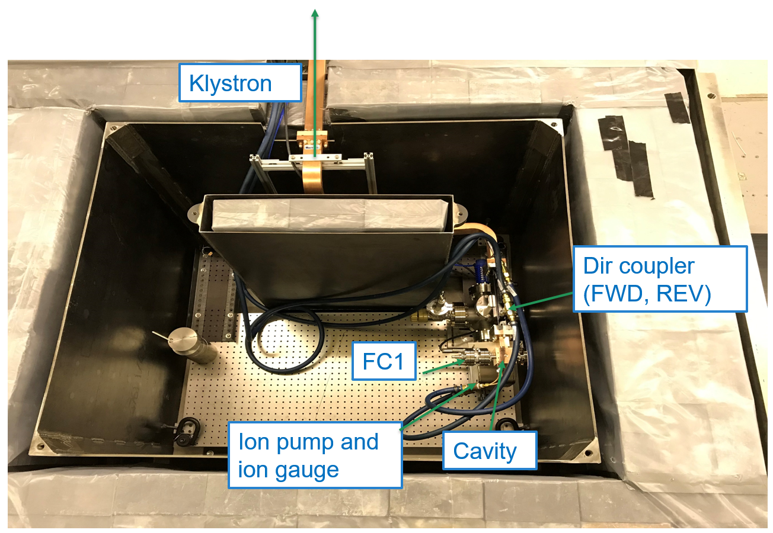
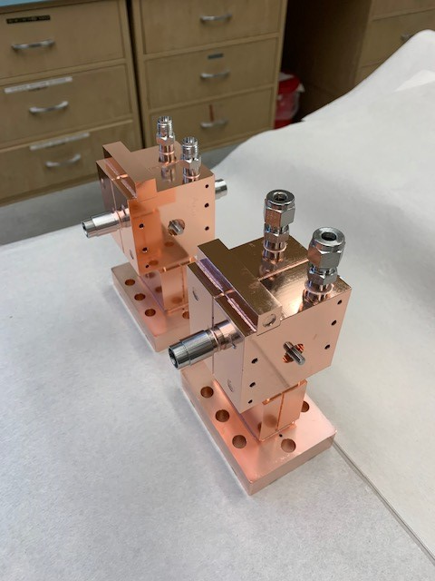
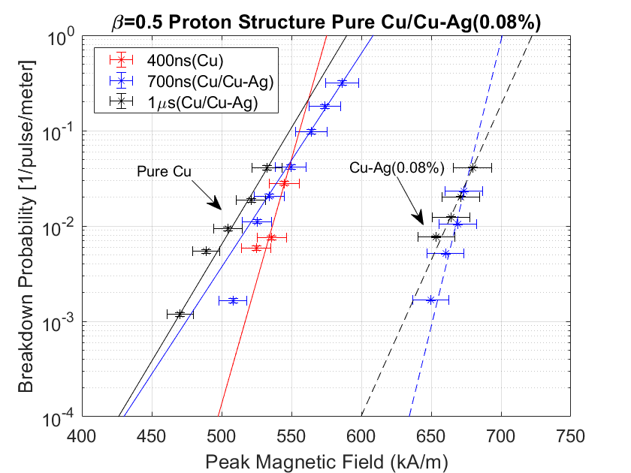
The first two high gradient cavities were tested at CERF-NM in FY21
This C-band high gradient test facility is nationally unique. The first cavities tested at CERF-NM were manufactured at SLAC.

Slide 7
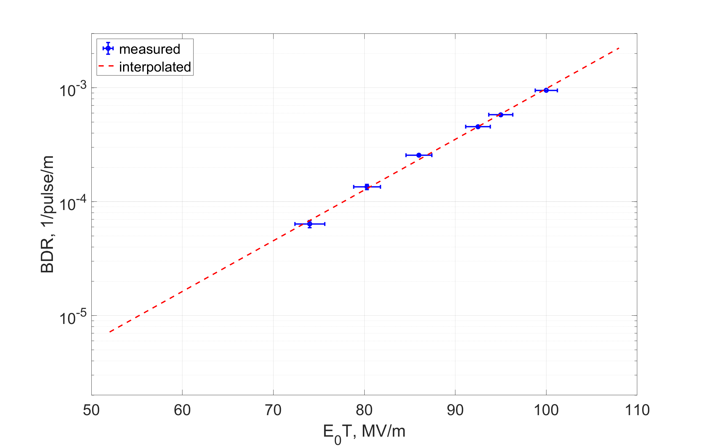
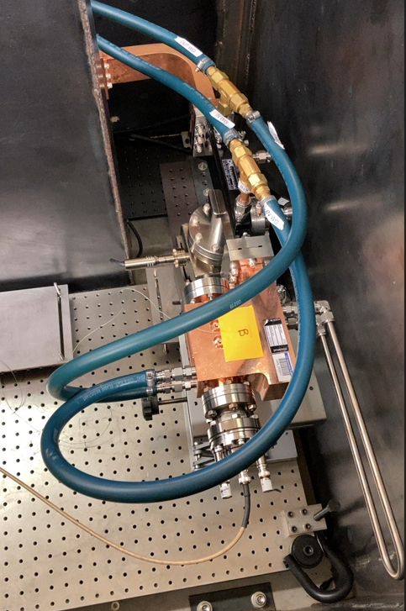
Prototype booster cell for LANSCE upgrade tested in FY23
The goal of this experiment was to measure the breakdown rates at accelerating gradients up to 100 MV/m.

Slide 8
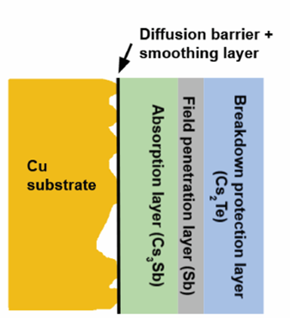
CARIE: Cathodes And Rf Interactions in Extremes
A new three-year project was funded at LANL to demonstrate operation of high-quantum-efficiency cathodes in a high-gradient RF injector.
Project builds upon LANL’s expertise in high-gradient C-band and high-QE photocathodes.
The proposed heterostructured cathode will include multiple layers to ensure atomic flatness of the surface, high QE, and the ability to withstand high electric fields with no breakdown.
Target beam parameters: 250 pC, 0.1 μm*rad, B_{5D} = 10¹⁶ A/m².
The project started in October of 2022.

Slide 9
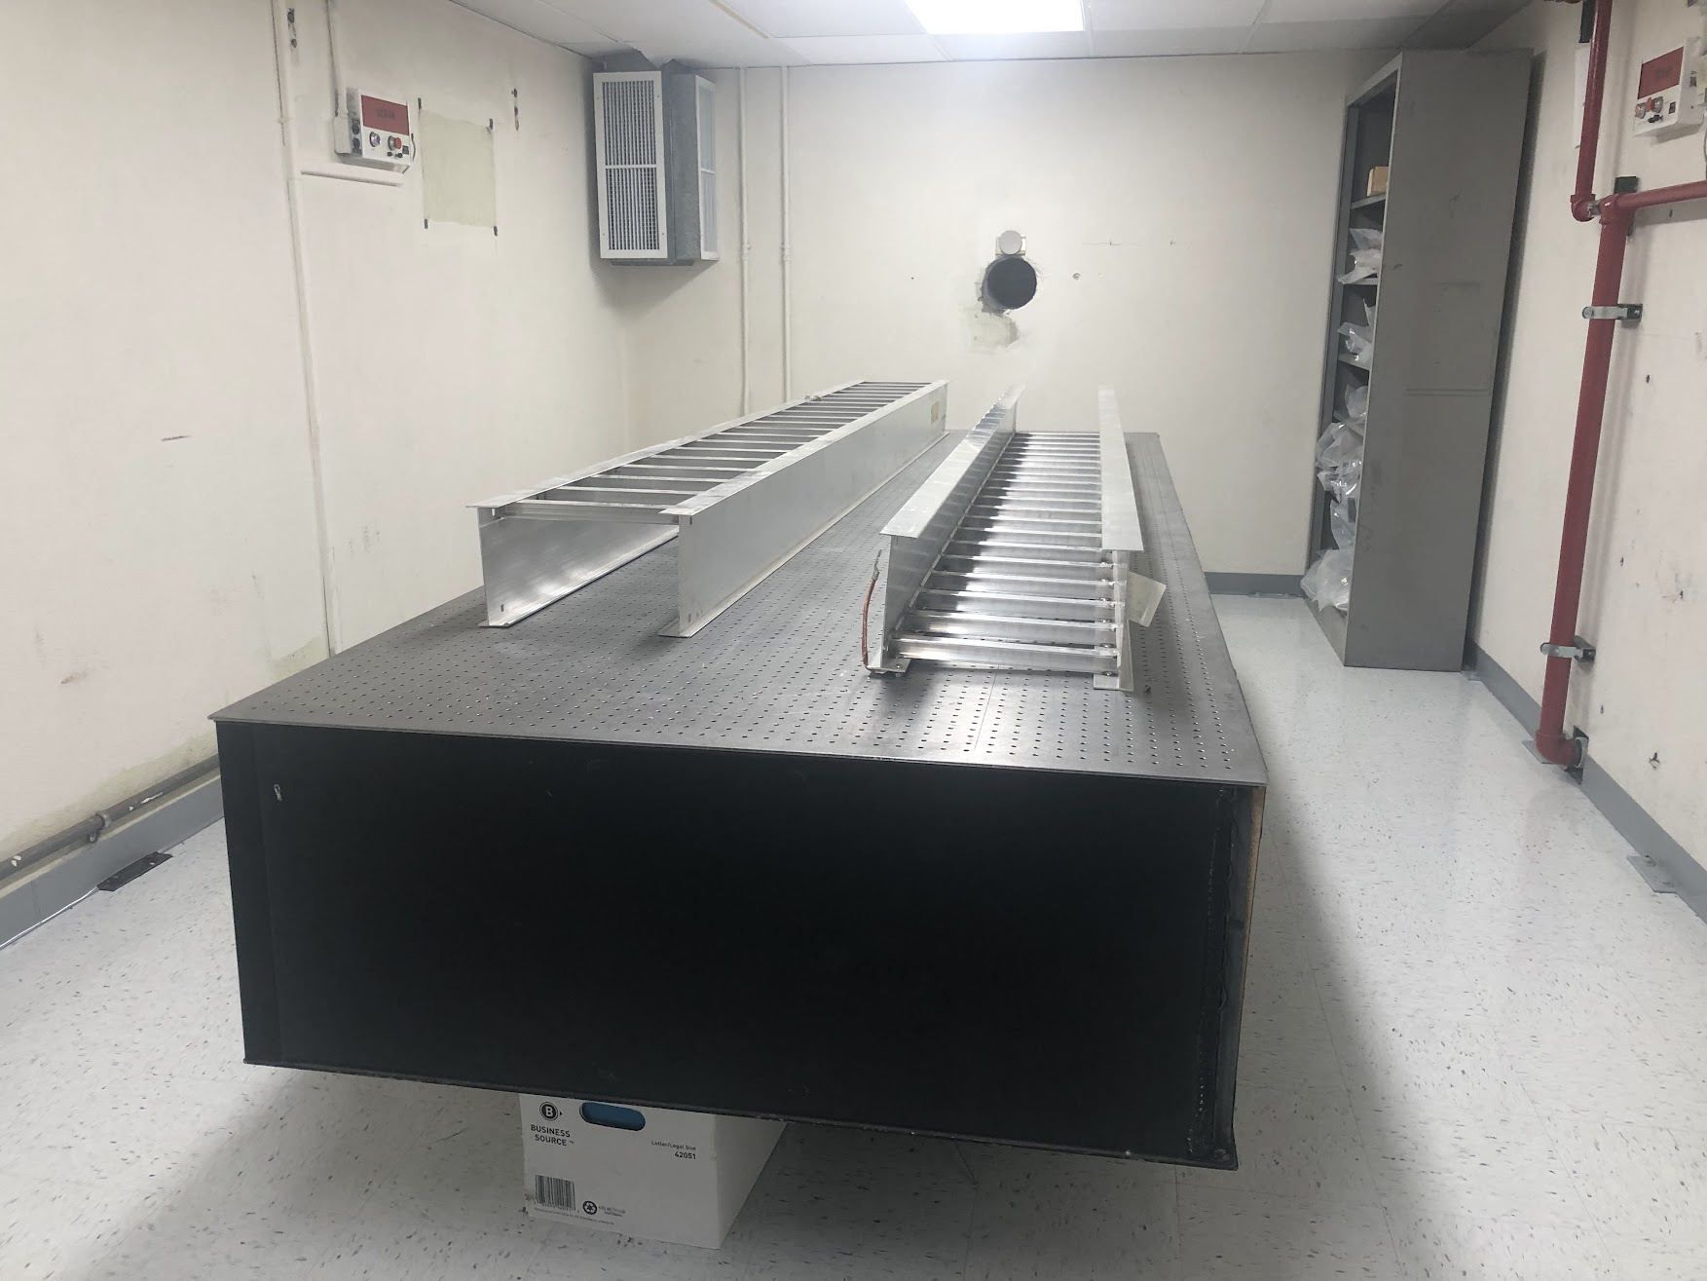
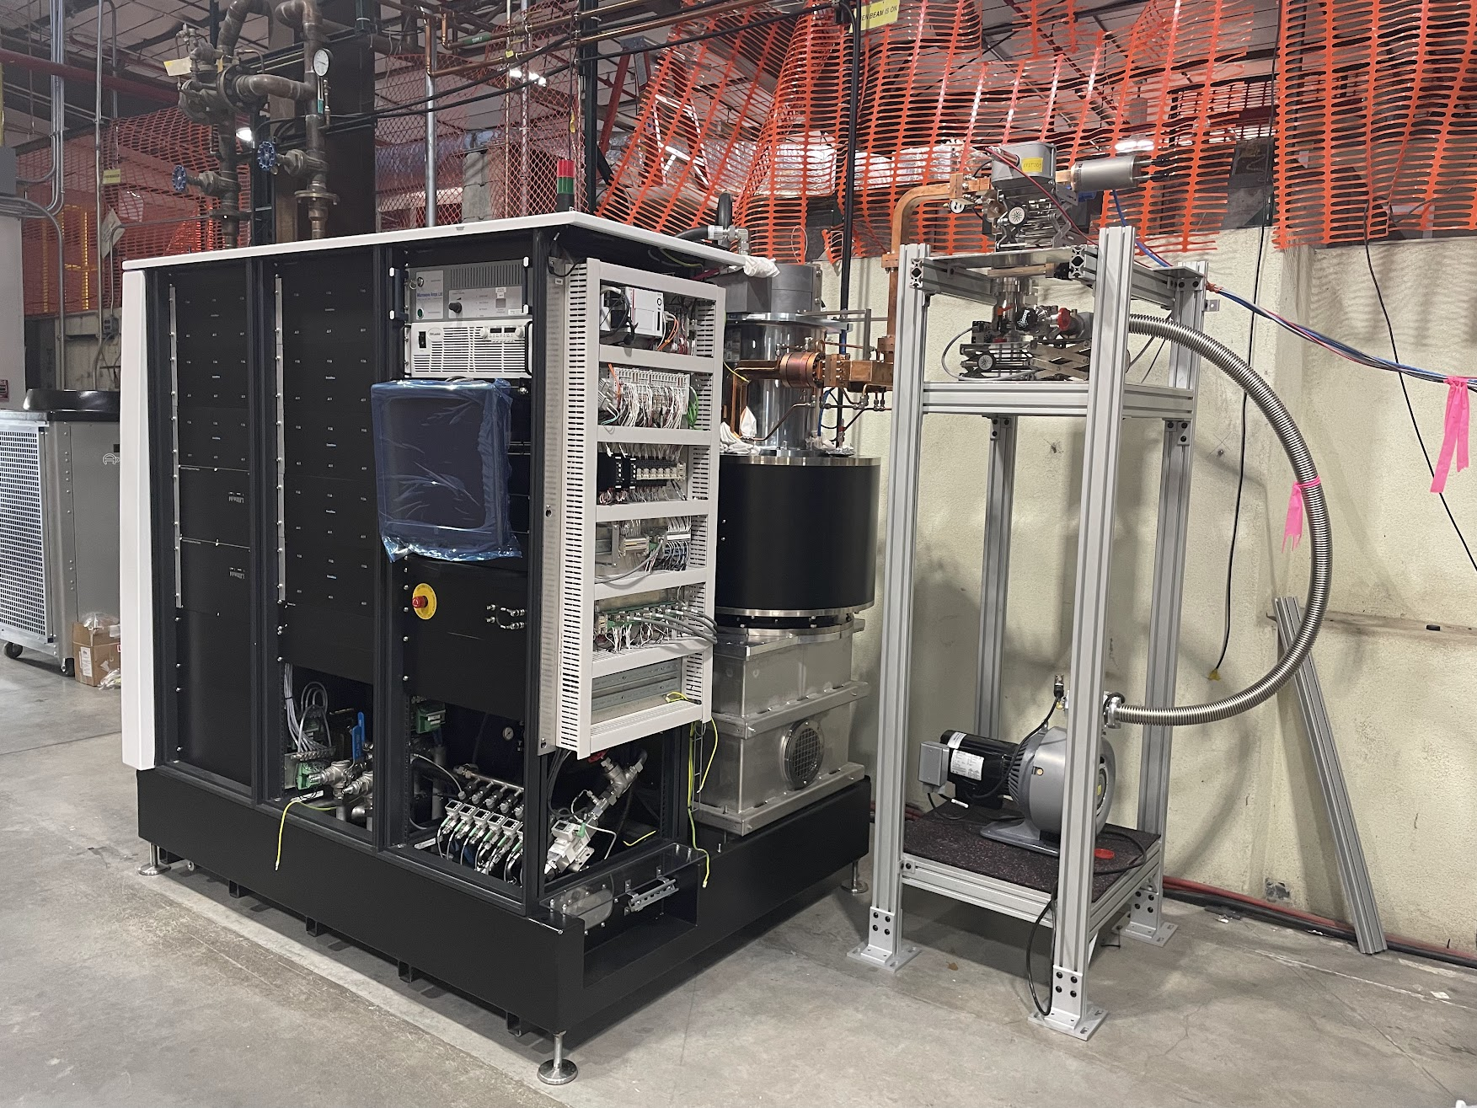
CARIE vault
A location was identified on LANSCE mesa that can accommodate a 20 kW electron beam.
Co-located with a cathode fabrication and characterization facility (ACERT).
The vault was cleaned for the new experiment.
A 50 MW C-band klystron is under commission and waveguide line assembly is to follow.

Slide 10
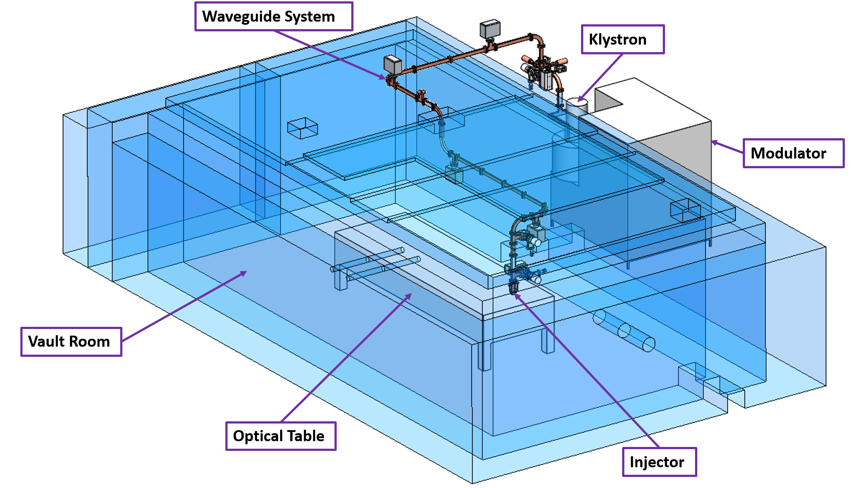
CARIE vault facility lineout

Slide 11
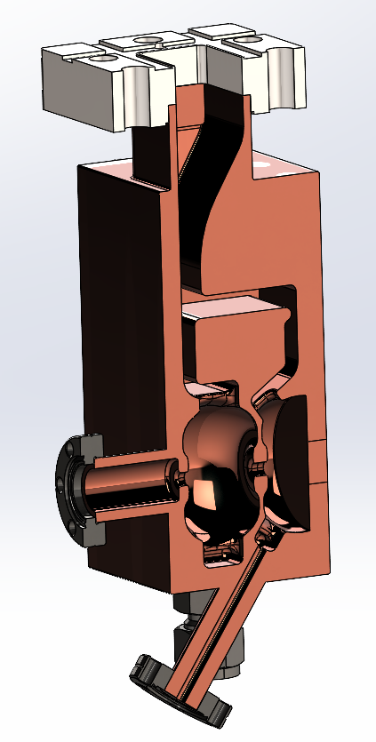
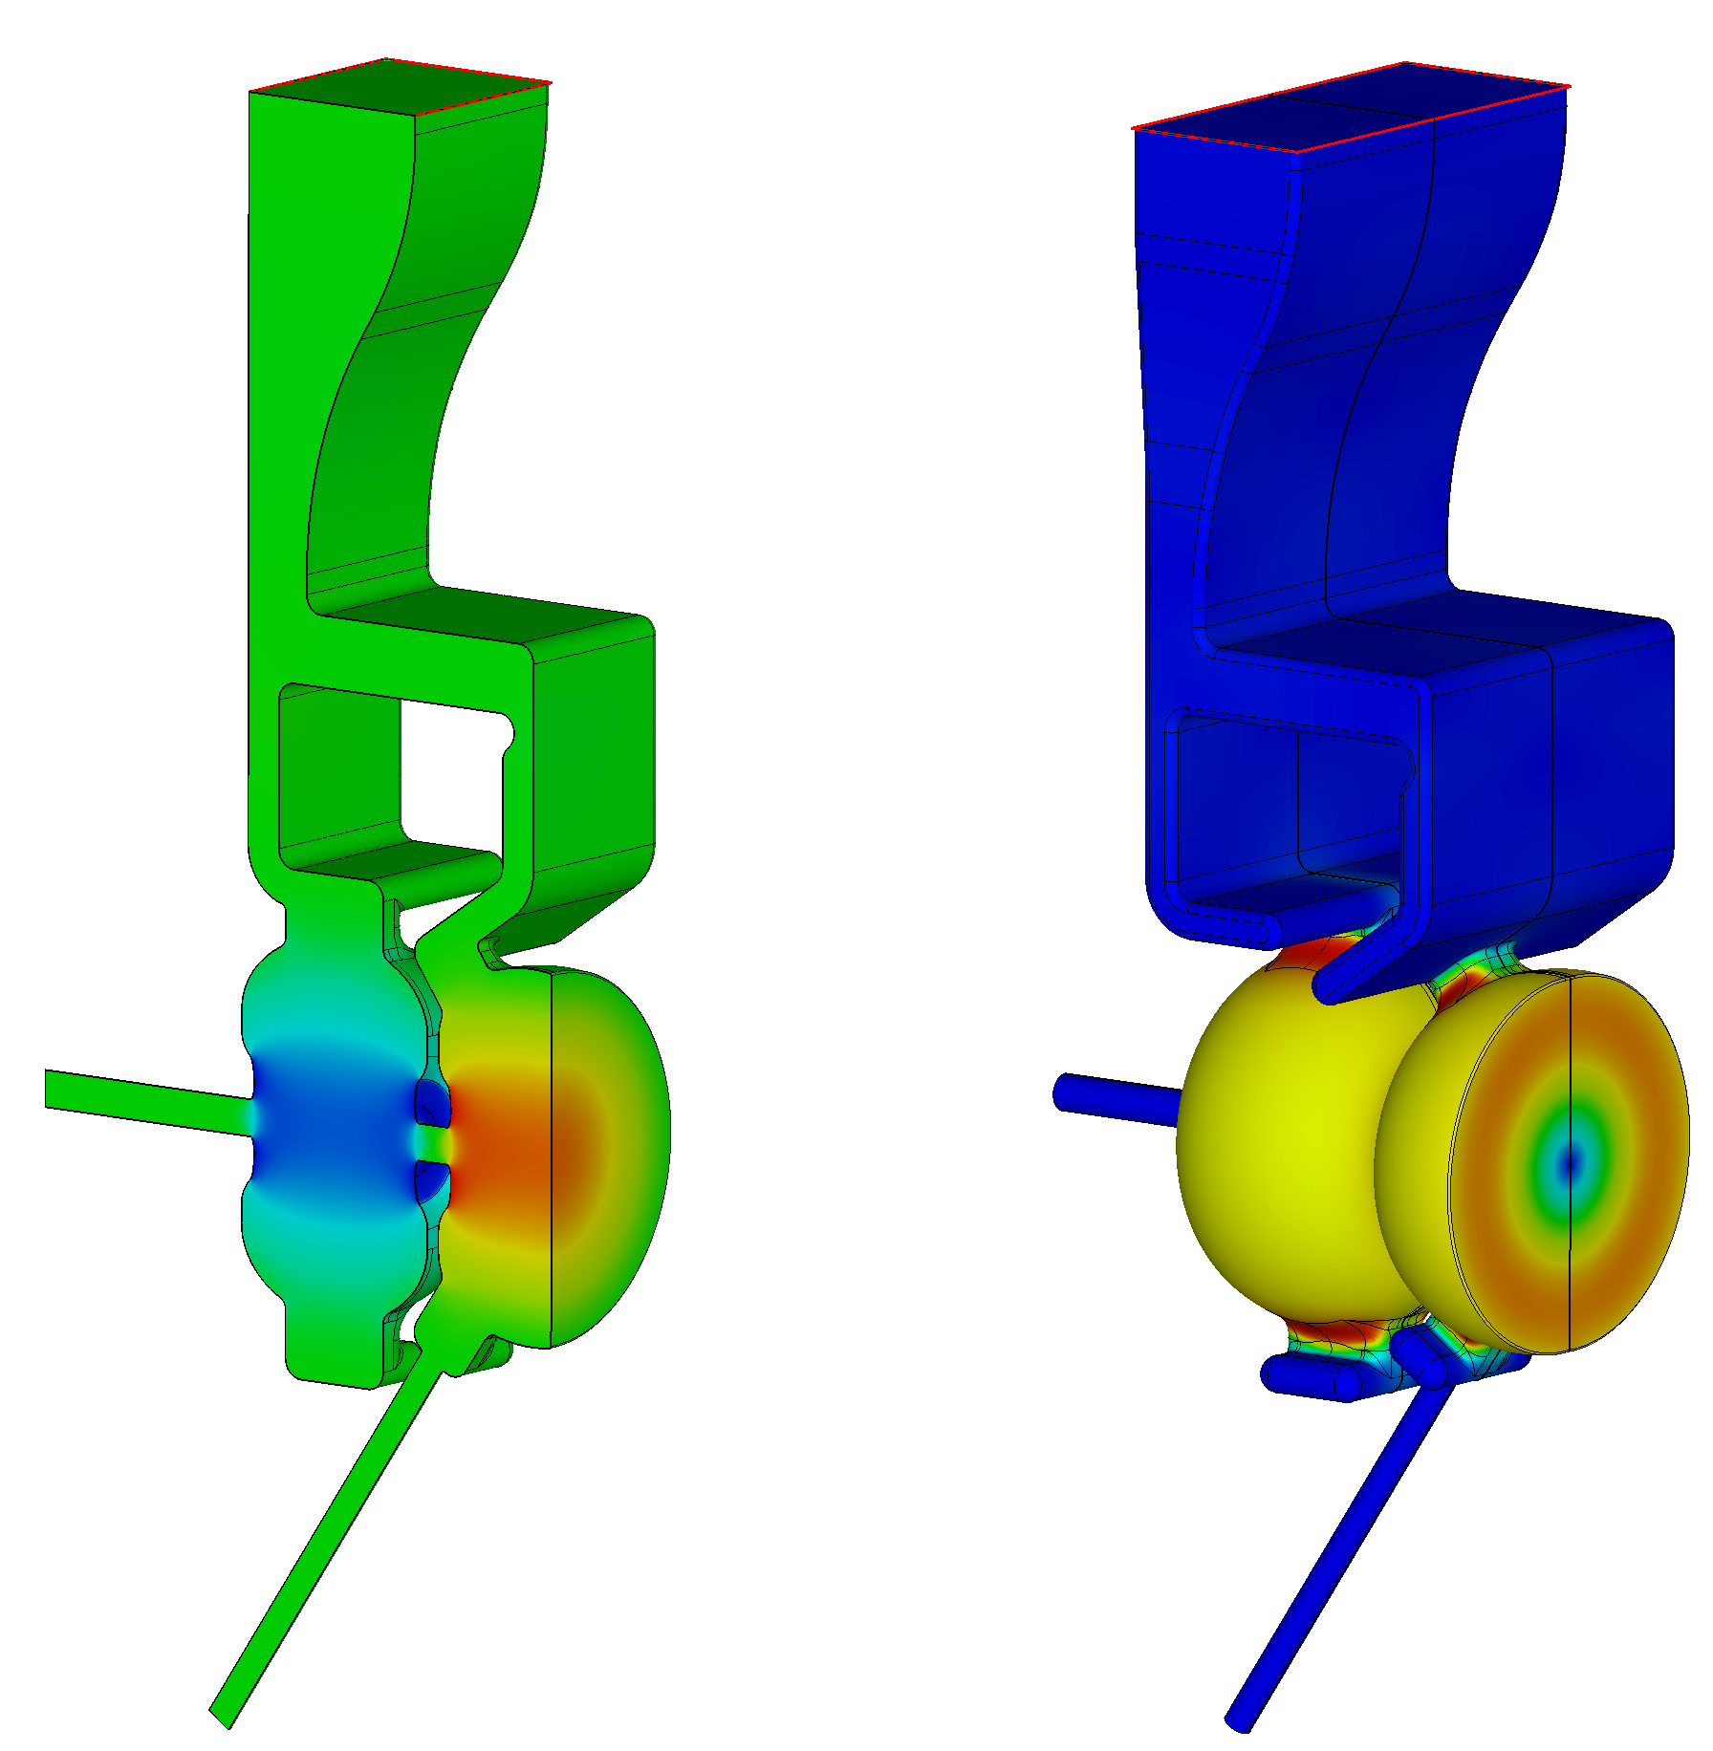
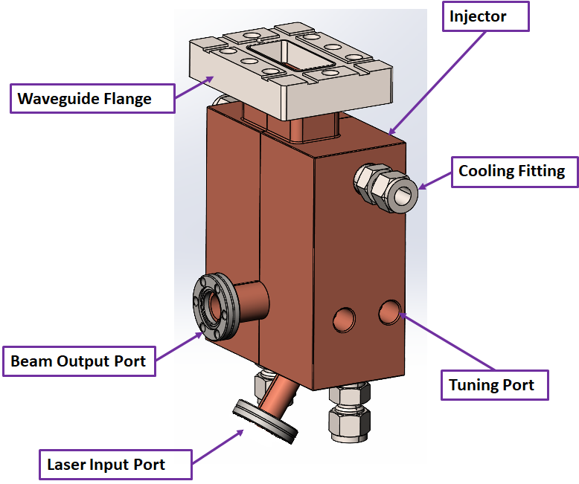


RF photoinjector design
We start with an all-copper injector with no cathode plug.
1.6 cell photoinjector. Two waveguides couple the half-cell and the full cell with 180⁰ phase advance.
Power for E_{cath}= 240 MV/m is about 8 MW.

Slide 12
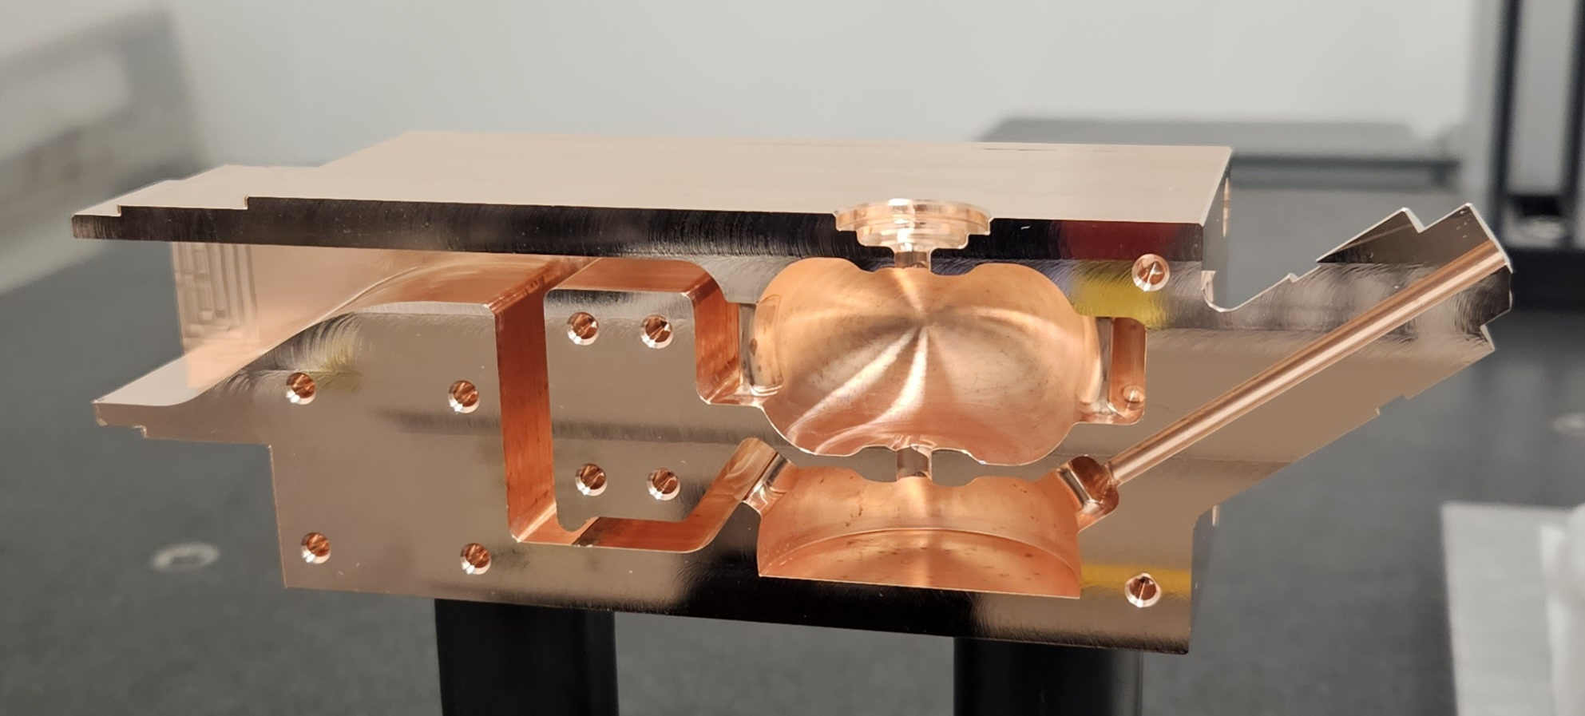
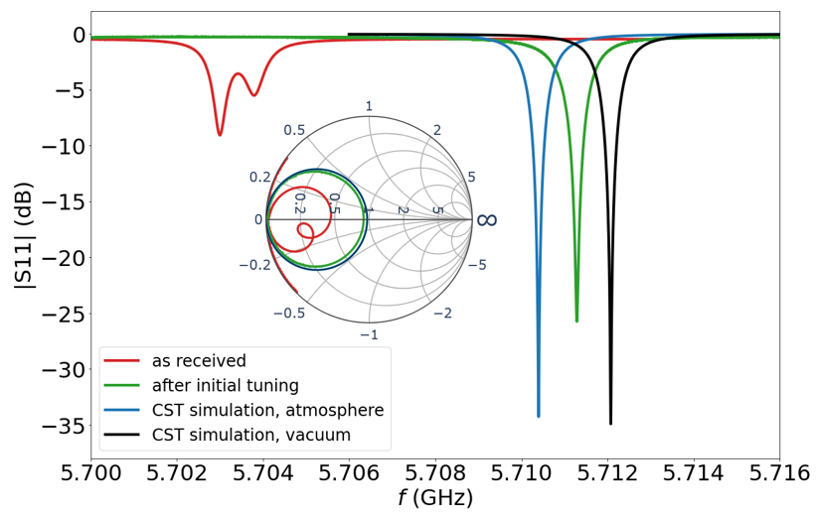
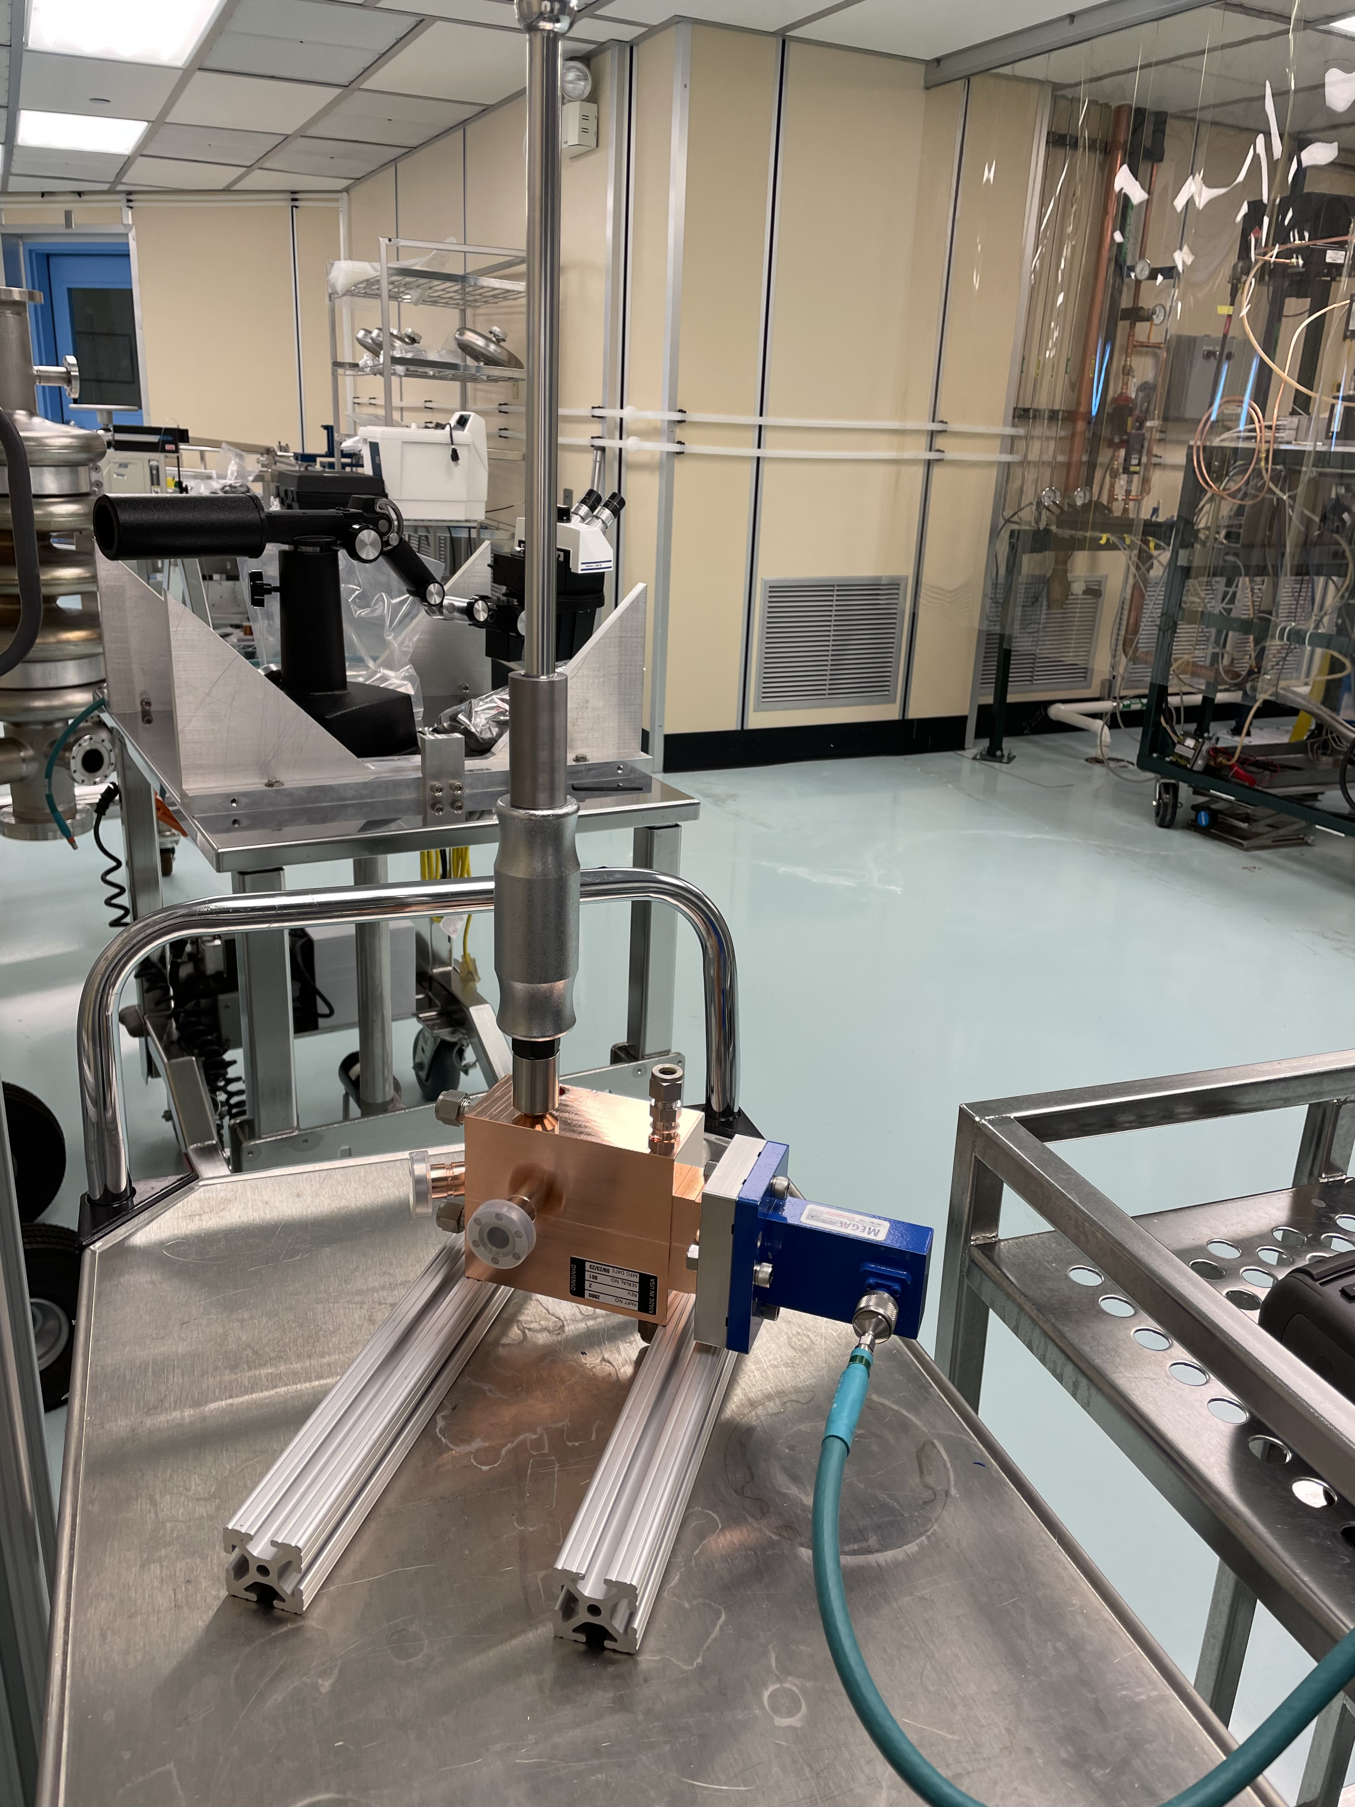
RF photoinjector fabrication and testing
The photoinjector was fabricated by Dymenso, LLC .
Initial tuning was successful.
Tuning of the injector will be completed next week.
Tuned frequency 5711.29 MHz in air (5712.15 MHz in vacuum).
Measured Q-factor 11949 (computed Q-factor 11934).

Slide 13
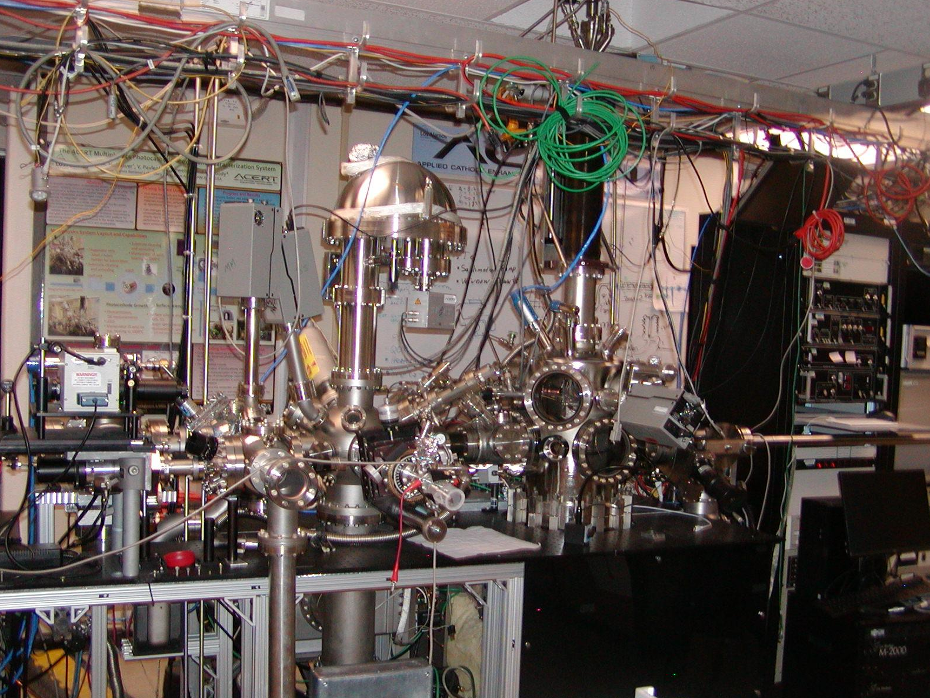
Photocathode deposition and characterization
Applied Cathode Enhancement and Robustness Technology (ACERT) test facility is a multi-disciplinary capability.
It combines cathode growing chamber, cathode characterization chamber, and a momentatron in a single vacuum envelope.
Available diagnostics: in-situ QE measurements and spectral response, ellipsometry, XPS, and Auger.

Slide 14
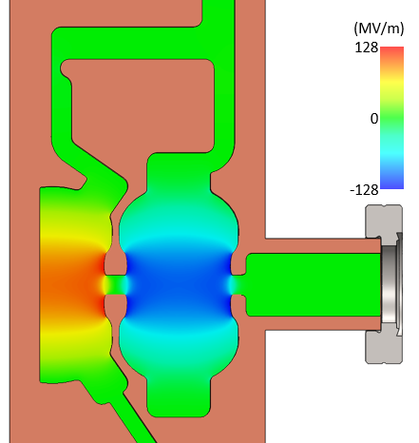
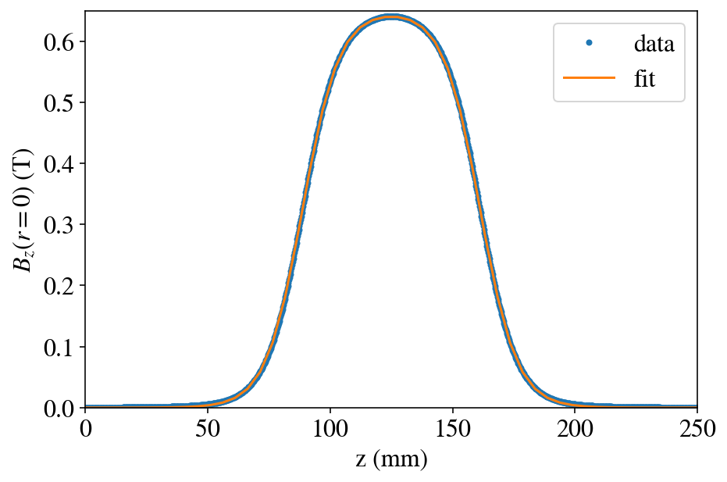
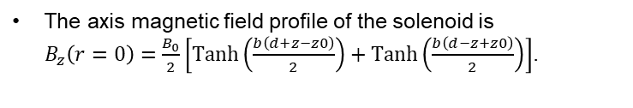
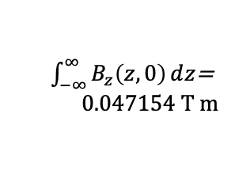
RF photoinjector beam physics simulations
$\int_{−∞}^{∞}{B_{z}\left(z, 0\right)ⅆz}$=
$$0.047154 T m$$
RF TopGun
solenoid
RF TopGun: Photoinjector design done in collaboration with UCLA (J. Rosenzweig).
The axis magnetic field profile of the solenoid is
$B_{z}\left(r=0\right)=\frac{B_{0}}{2}\left[Tanh\left(\frac{b\left(d+z−z0\right)}{2}\right)+Tanh\left(\frac{b\left(d−z+z0\right)}{2}\right)\right]$.

Slide 15
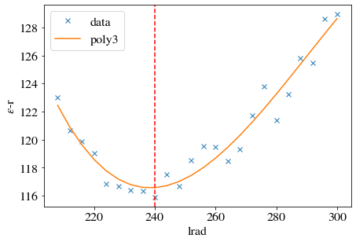
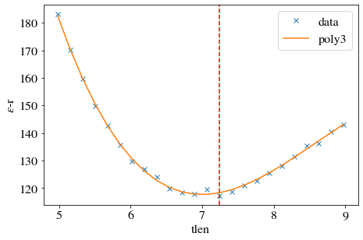





Space-Charge Emittance Compensation Optimization for
250 pC
In $π$-mode, the minimum projected normalized emittance can be optimized to $ε_{n}^{(r)}=116 nm$ for
$σ_{uv}= 240 μm$ and $ΔT=7.24 ps$ with 0.58 T solenoid field. This is 1.26x brightness gain.
These optimized values are slightly different (1.26x volume) from the scaled values ($205 μm$ and $7.87 ps$) that produces a slightly larger emittance of $ε_{n}^{(r)}=125 nm$ vs. $ε_{n}^{(r)}=116 nm$ here.
116 = 12ca:94rf:67sc
in quadrature
$$ε_{n}^{(r)} (nm)$$
$$ε_{n}^{(r)} (nm)$$
$$σ_{laser} (μm)$$
$$T_{laser} (ps)$$
2.07x emittance growth
Notes:
240 um and 7.24 ps give 94 ns of rf emittance
12 nm of emittance comes from Intrinsic value
If we add them in quadrature then 67 nm of emittance comes from space charge then!
For 100 pC case
151 um and 5.8 ps give 30 nm of rf emittance
7.6 nm of emittances that comes from intrinsic value
46.7 nm of space charge emittance

Slide 16
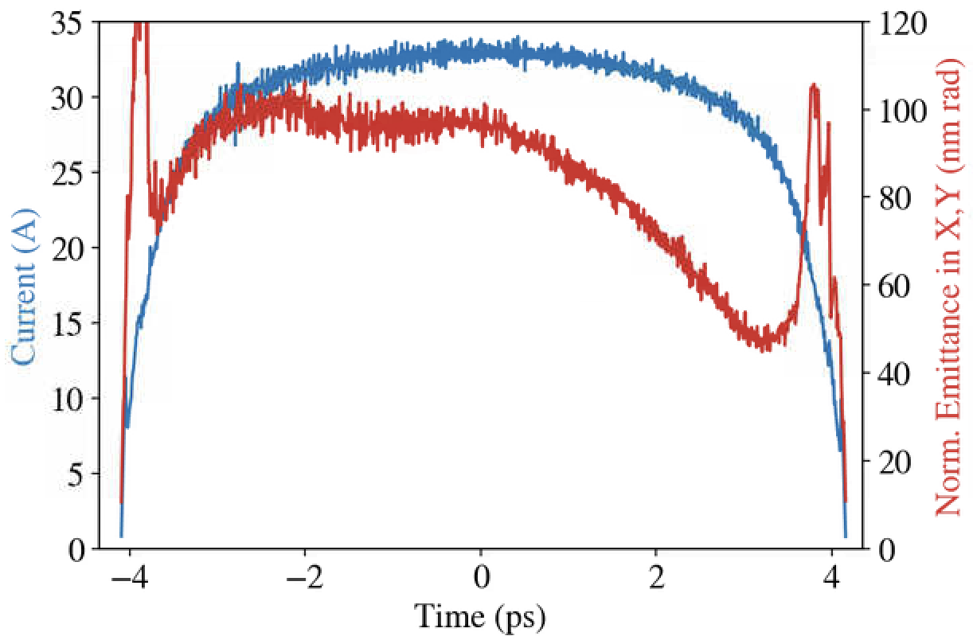
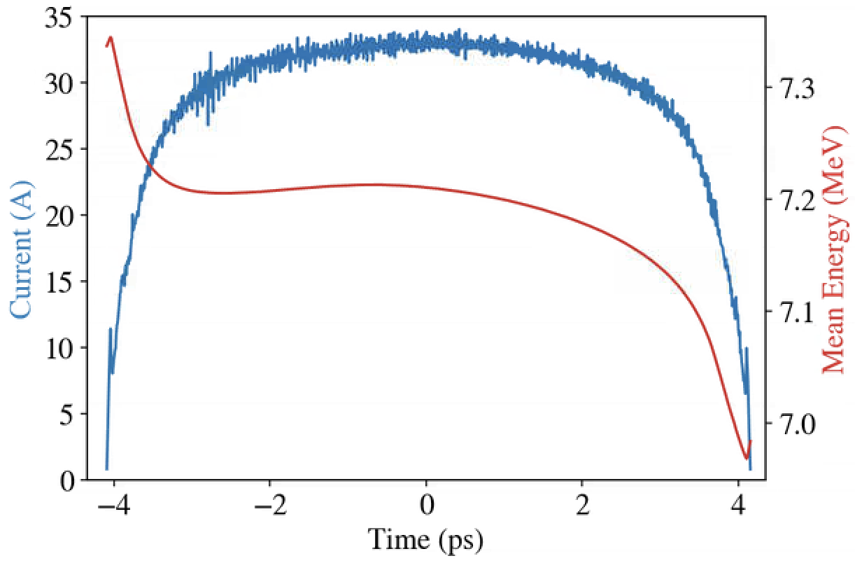
GPT simulations (250 pC): beam current, slice emittance and brightness at emittance minimum
238 pC out
projected emittance
131.5 nm rad

Slide 17
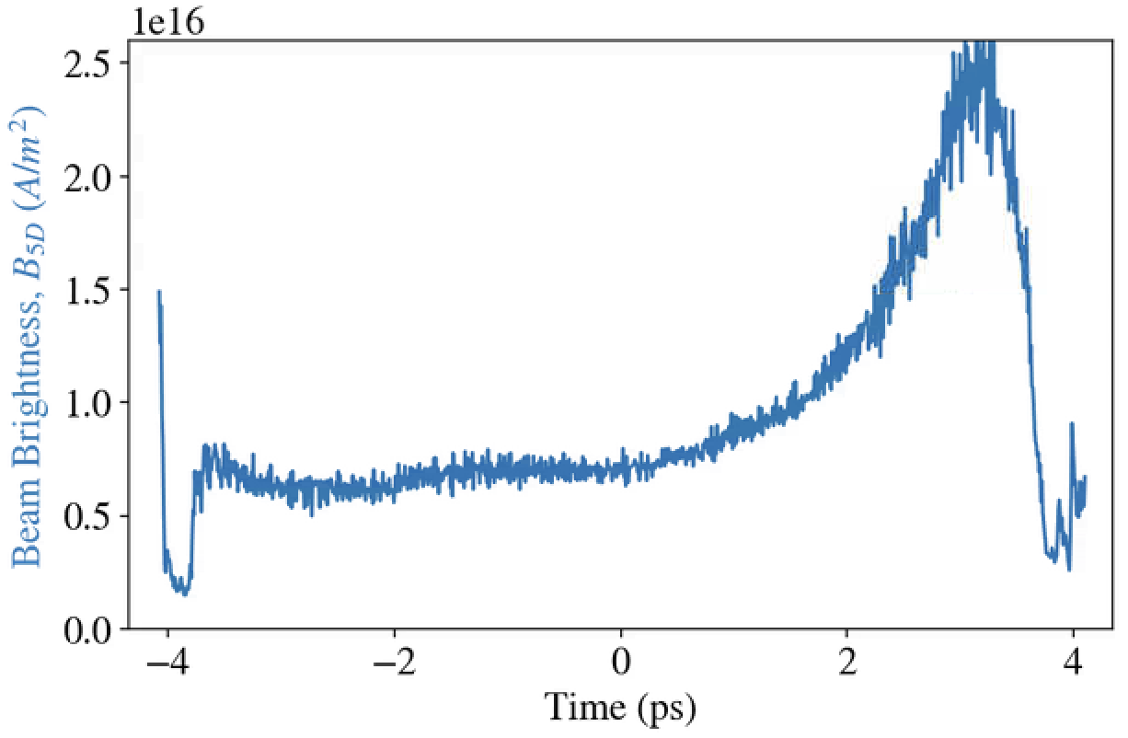
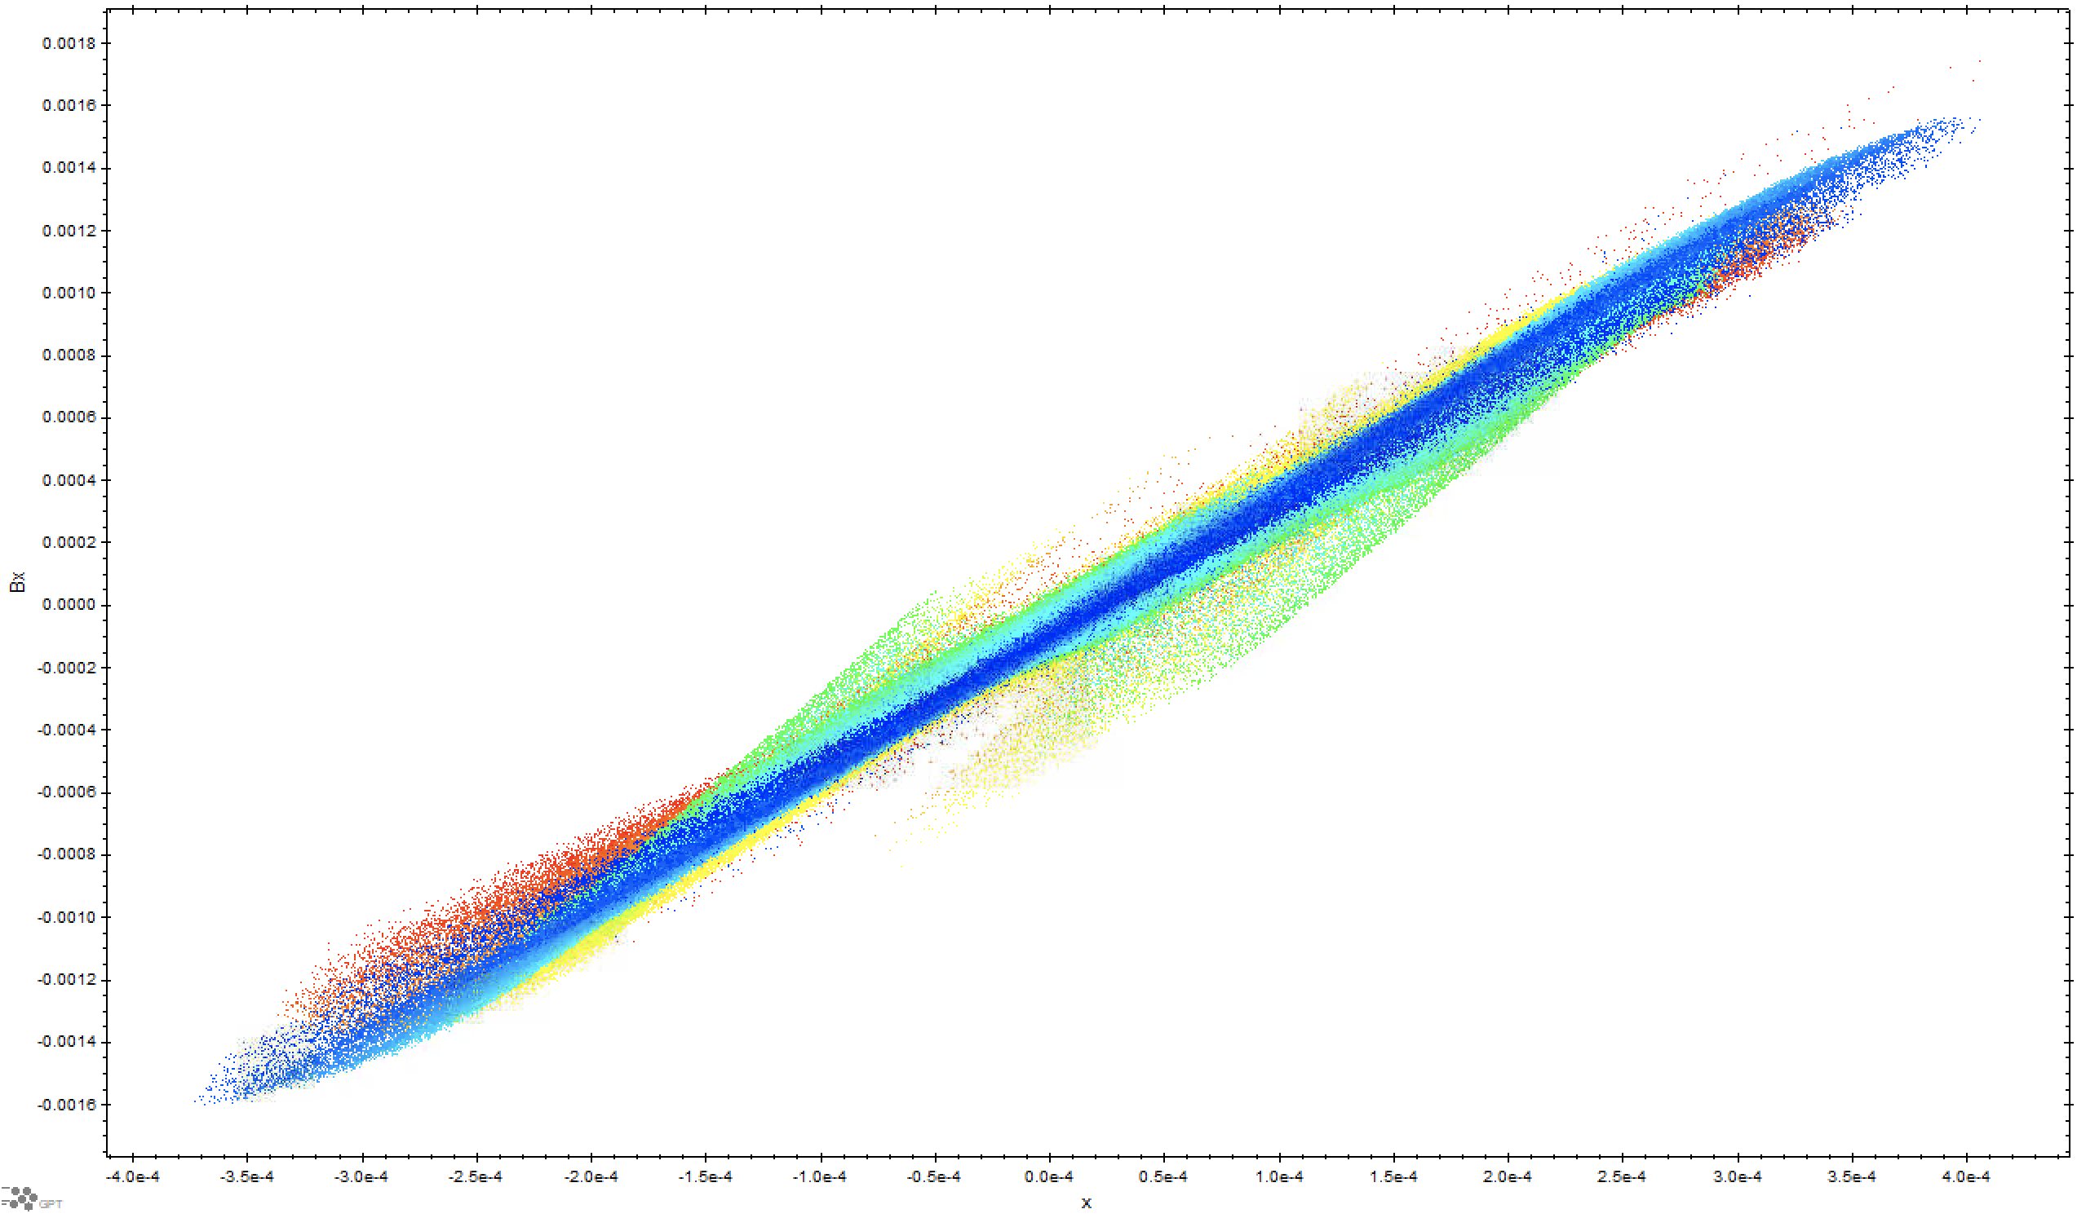


GPT simulations (250 pC): beam current, slice emittance and brightness at emittance minimum
131 nm rad projected emittance vs
86 nm rad current averaged slice emittance
macroparticle distribution colored by beam coordinate:
head (red) and tail (blue) are space charge dominated
core (green) has a hook shape!?
$$x^{′}∈[−1.6 mrad, 1.6 mrad]$$
$$x∈[−400 μm, 400 μm]$$

Slide 18
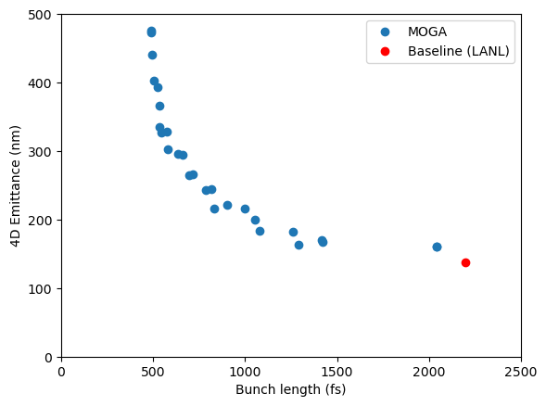
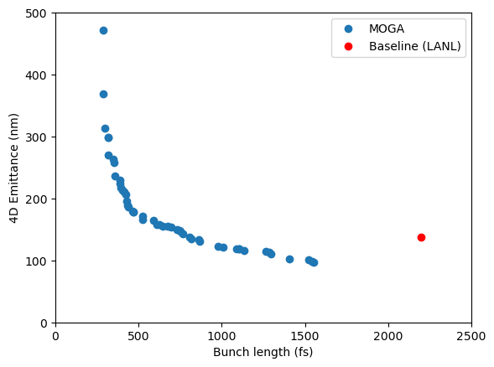
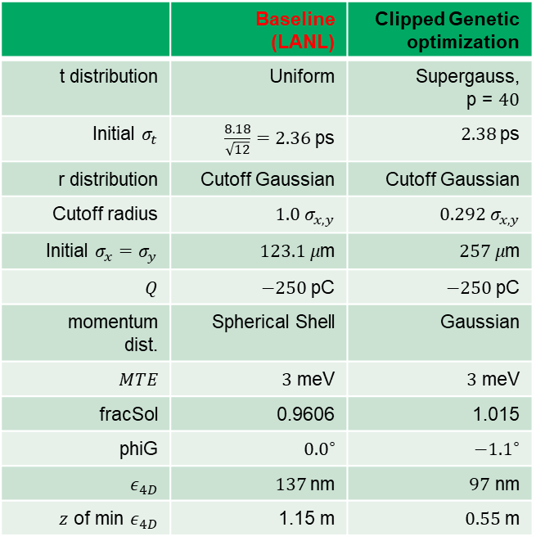
Optimization of LANL’s Injector
 | Baseline (LANL) | Clipped Genetic optimization
t distribution | Uniform | Supergauss, p = $40$
Initial $σ_{t}$ | $\frac{8.18}{\sqrt{12}}=2.36$ ps | $2.38$ps
r distribution | Cutoff Gaussian | Cutoff Gaussian
Cutoff radius | ${1.0 σ}_{x,y}$ | $0.292 σ_{x,y}$
Initial $σ_{x}=σ_{y}$ | $123.1 μ$m | $257 μ$m
$Q$ | $−250$ pC | $−250$ pC
momentum dist. | Spherical Shell | Gaussian
$MTE$ | $3$ meV | $3$ meV
fracSol | 0.9606 | 1.015
phiG | ${0.0}^{∘}$ | $−{1.1}^{∘}$
$ε_{4D}$ | $137$nm | $97$ nm
$z$ of min $ε_{4D}$ | 1.15 m | $0.55$ m
In collaboration with Cornell University (J. Maxson).
aperture

Slide 19
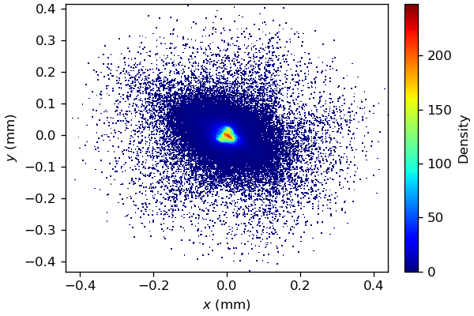
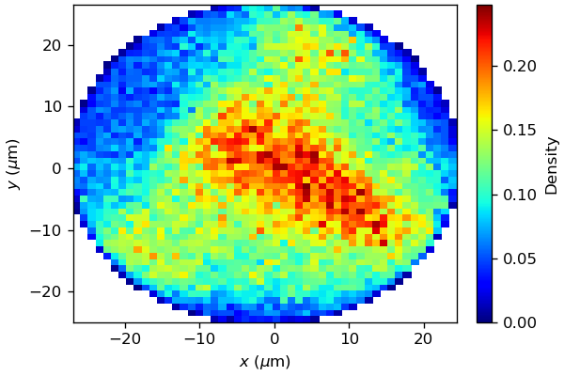
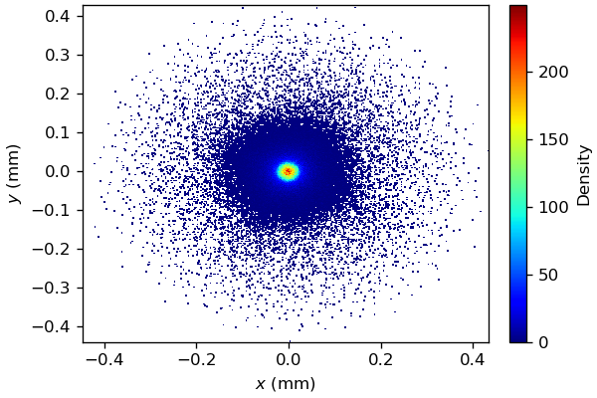
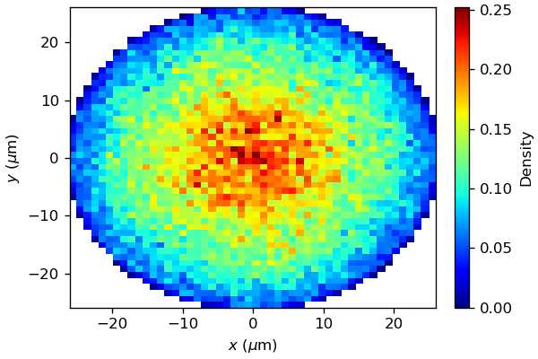
Effect of field asymmetry in LANL injector
490 pC, 440 nm emittance
250 pC, 97 nm emittance is reduced to 40 nm

Slide 20
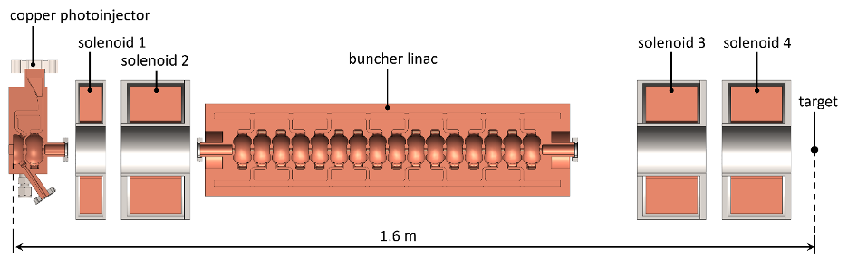
LANL has plans for using CARIE as a base for a future MeV UED
Parameters of Preliminary Design
CARIE C-Band 1.6 Cell 5.712 GHz photoinjector plus emittance compensation solenoid
6.6 MeV extracted beam at 240 MV/m
160 fC (1M electrons)
25 fs , 150 μm spot size laser
Minimum spot size of 25x25 μm (rms)
Bunch length ~30 fs (rms) at minimum beam spot size
Shorter bunches < 10 fs obtained by:
Magnetic compression (isochronous dogleg to minimize timing jitter problems)
RF compression (see figure below)
Machine learning for control & data analysis

