Slide 1
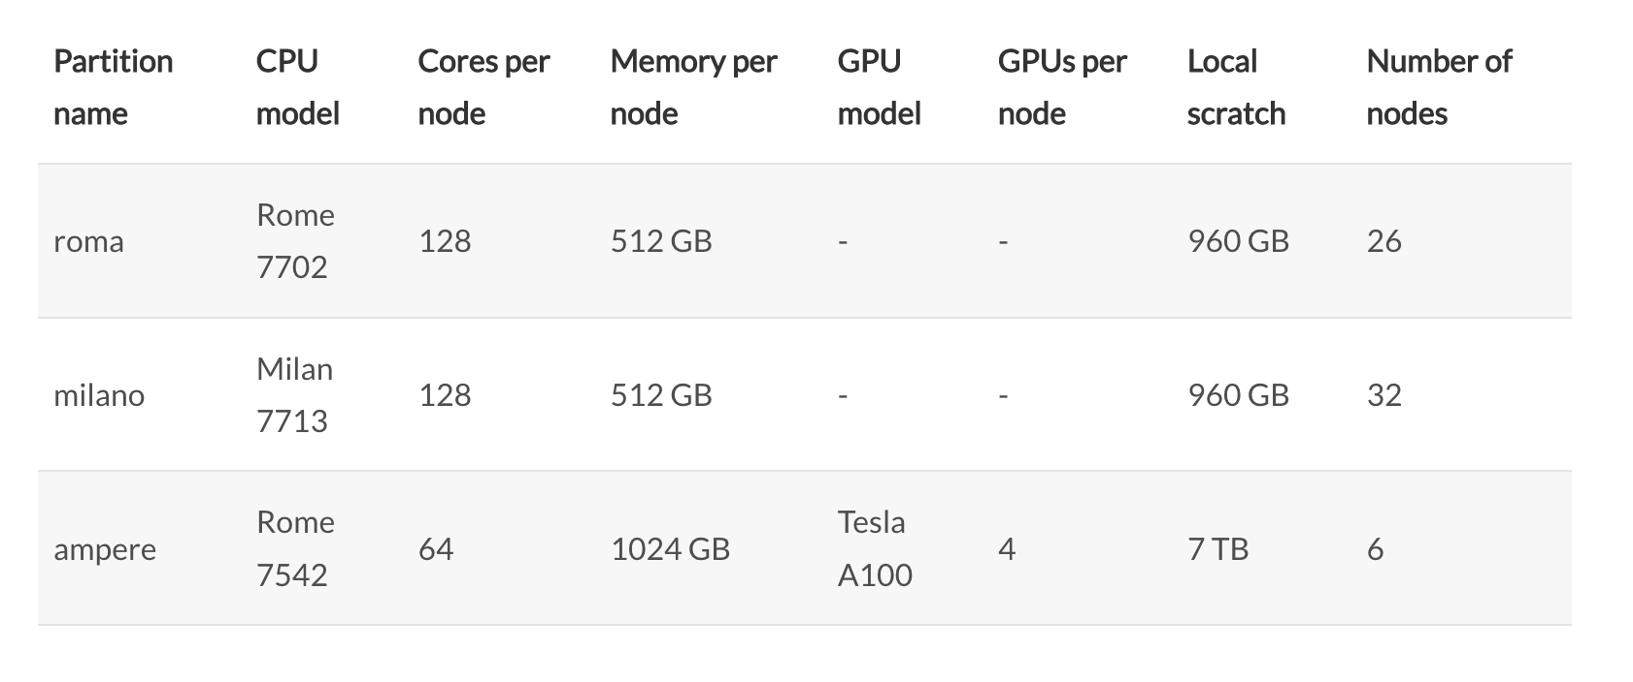
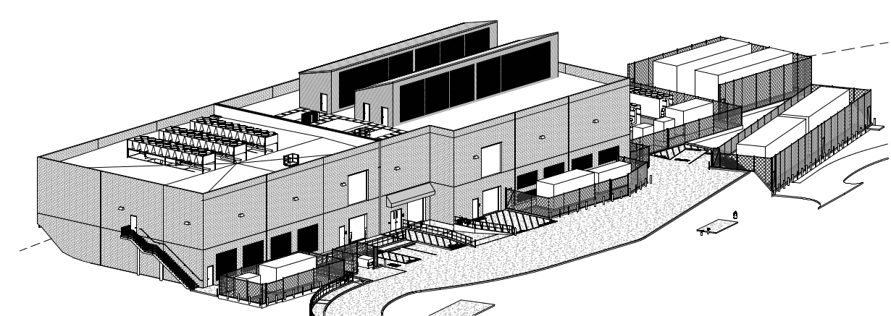
S3DF – SLAC’s new shared computing facility
Successor to SDF (~Aug 2023 EOL)
PFLOPS of CPU and 10s of PFLOPS of GPU
Emphasis on high throughput interconnects
Up to 6 MW and 300 racks
Groups “buy in”: either CPU, GPU, or storage
Get corresponding access to cluster resources for lifetime of hardware (≥5 years)
3 “stances”: Dedicated, priority, no priority
Interactive, batch, and service compute options
Facility support for code compilation/install
Not guaranteed

Slide 2
Current ‘menu’
Compute node, $40k
2x AMD EPYC Milan, 64 core
512 GB RAM
1 TB NVMe
Roughly corresponds to 5.6 million core-hours over 5 years
NVMe storage server, $40k
270 TB NVMe
JBOD storage server, $52k
900 TB HDD
GPU node, $40-60k (highly variable)
4x A100
No supply until at least 2024 though

Slide 3
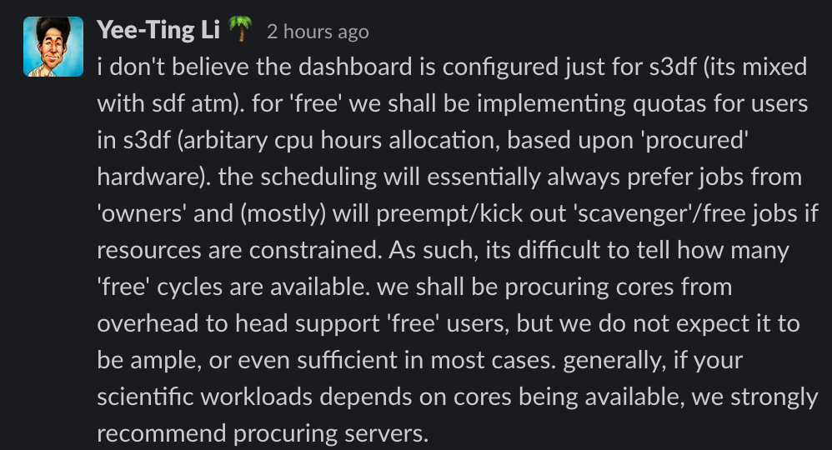
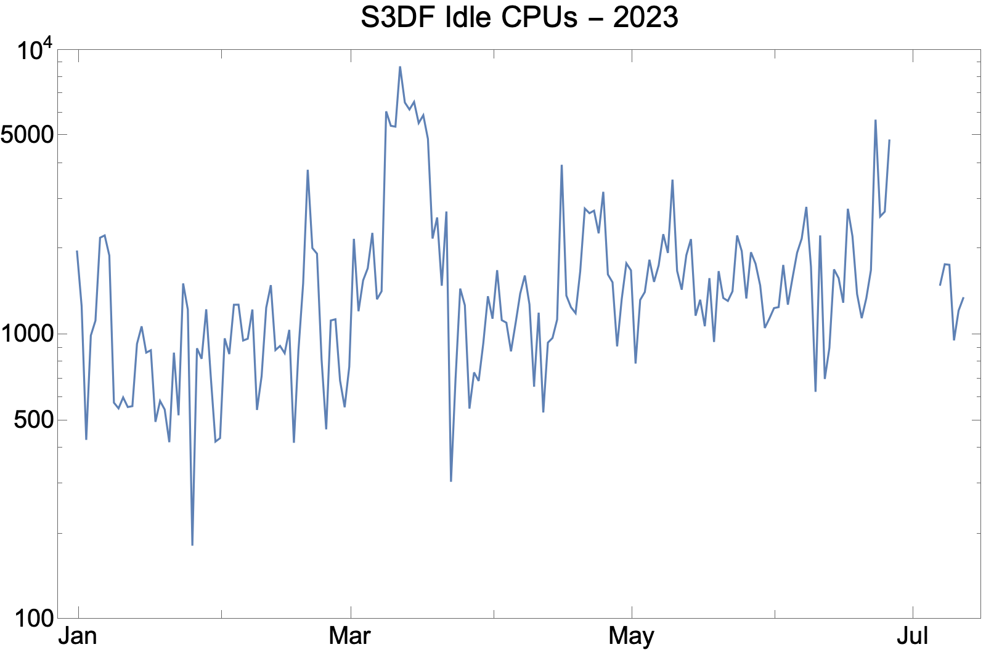

Suitability
Compute
If initial effort is 100k CPU-hours, minimum buy-in seems excessive
Could attempt to run on free resources
(Guessing!) Could probably get this much compute over a year
~0.1% total cluster CPU time
Short, small jobs preferred
Shorter queue times and less chance of preemption
Need to be tolerant of delays outside our control
Storage / Simulation database
FACET appears to have been allocated 10 TB (NVMe, auto backup) for startup
Cluster has plenty of free space though; could potentially request more
External users need a SLAC account
They are trying to introduce federated access this year so external users could use home institution credentials
Content can be served publicly with HTTP
Could be useful for linking from relational database
Mean idle cores
= 1700
Notes:
Median idle cores = 1330

Slide 4
Slides from S3DF presentation:
https://docs.google.com/presentation/d/1255ekxq8dscz7vvOAbgQ_tI4o13lOO-IMPMLm2A7gtg/edit?usp=sharing

Slide 5
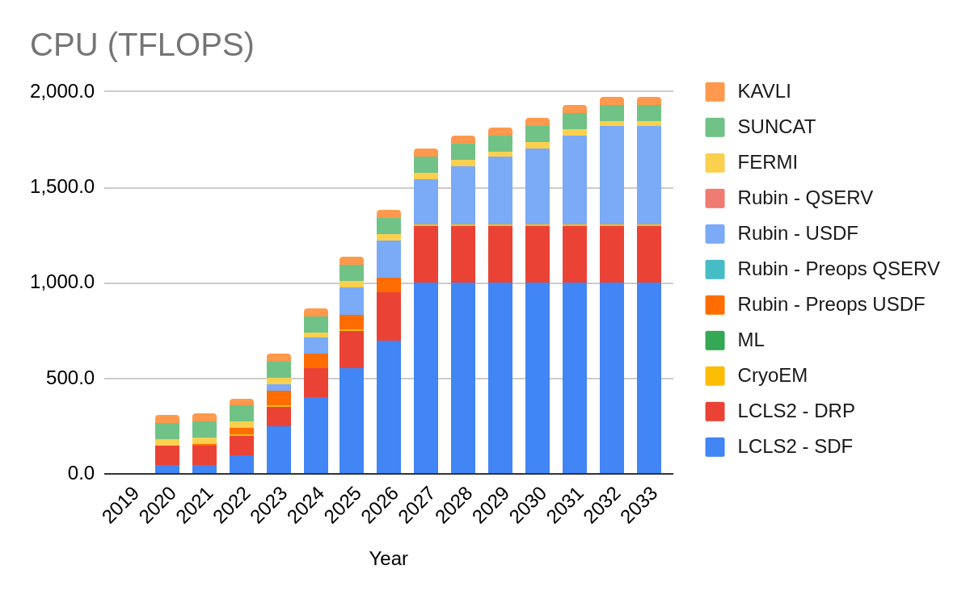
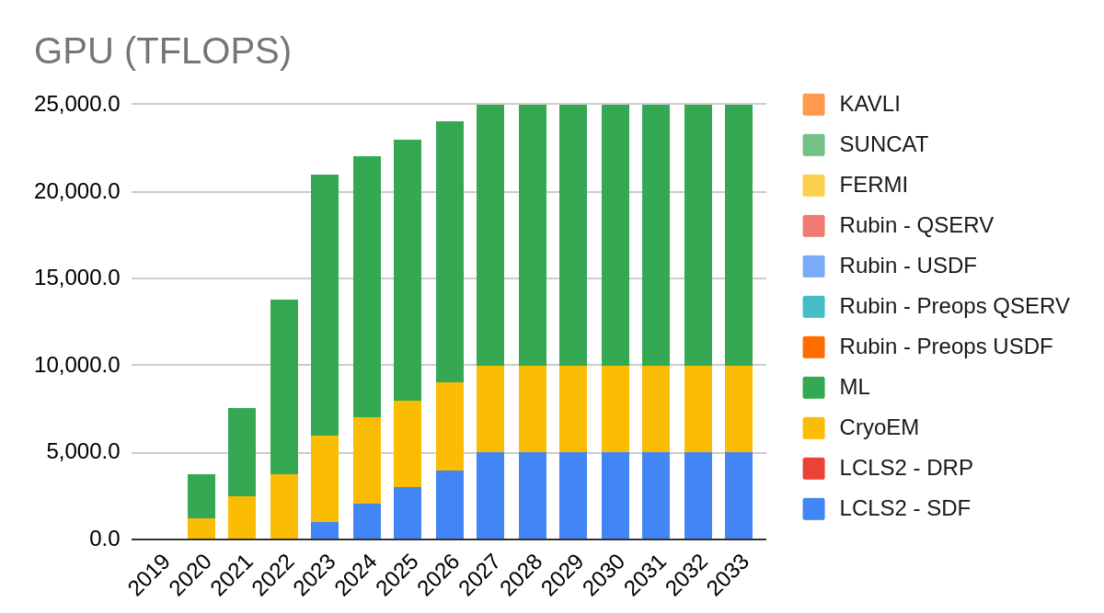
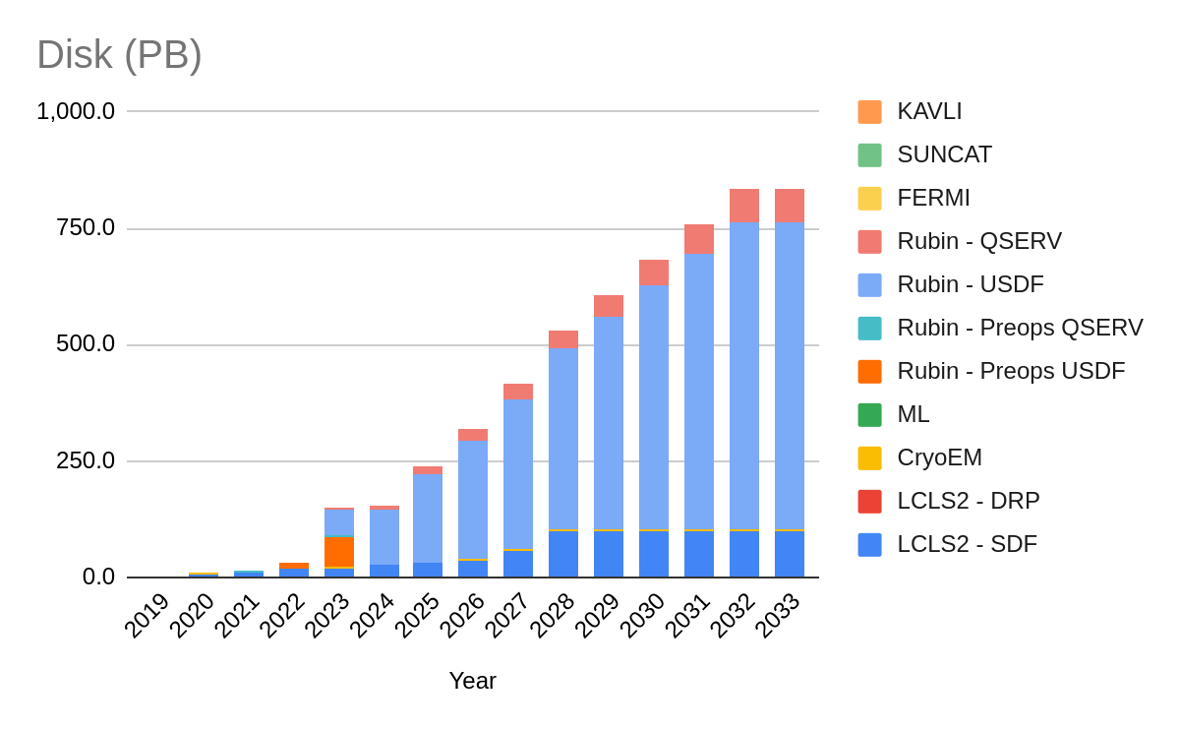
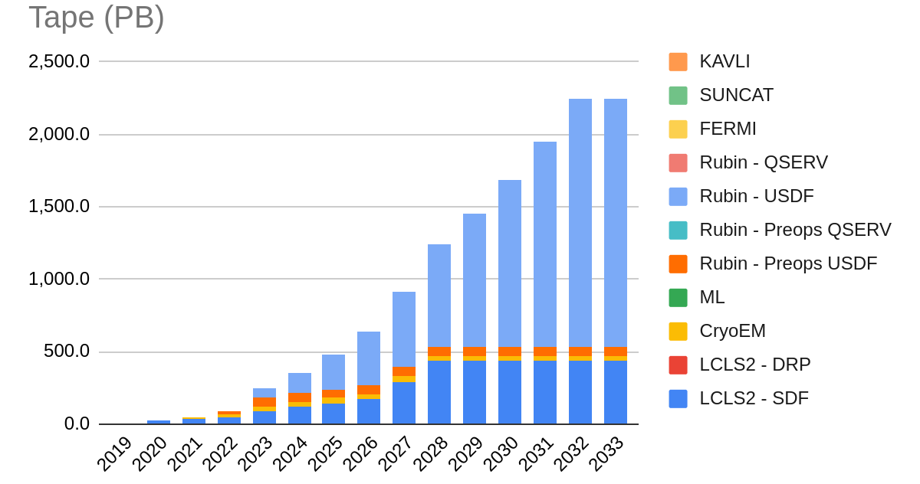
S3DF/USDF Projections for compute/storage needs
CPU dominated by LCLS-II, storage (and space) dominated by USDF (Rubin), GPU by ML
Notes:
FLOPS significantly less than high end supercomputers, but storage will be very large by any standard
CPU dominated by LCLS-II, storage (and real estate) dominated by USDF (Rubin)

Slide 6
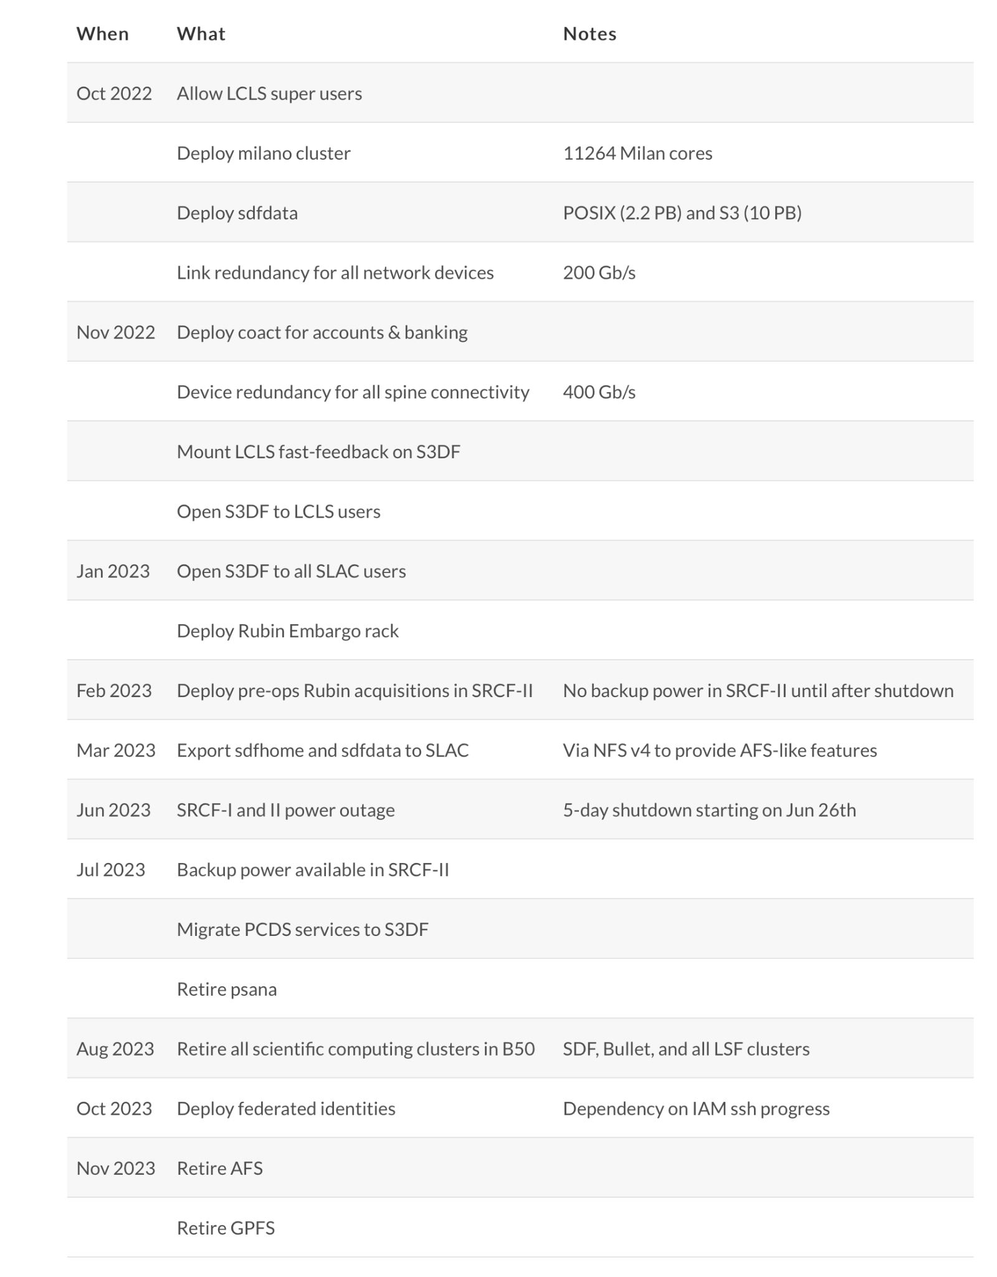
Go to:
https://s3df.slac.stanford.edu
(Status & Outages->Roadmap)
Key Milestones:
1/2023: Open S3DF to all users
2/2023: First hardware deployment in SRCF-II (without backup power)
3/2023: Export S3DF filesystems via NFS v4
8/2023: Retire all B050 legacy clusters
10/2023: Federated Identity (IAM)
11/2023: Retire AFS and GPFS

