Slide 1
FACET-II E300 Meeting: QuickPIC/QPAD comparison
Lance Hildebrand, Thamine Dalichaouch, Qianqian Su, Warren Mori
July 13, 2023

Slide 2
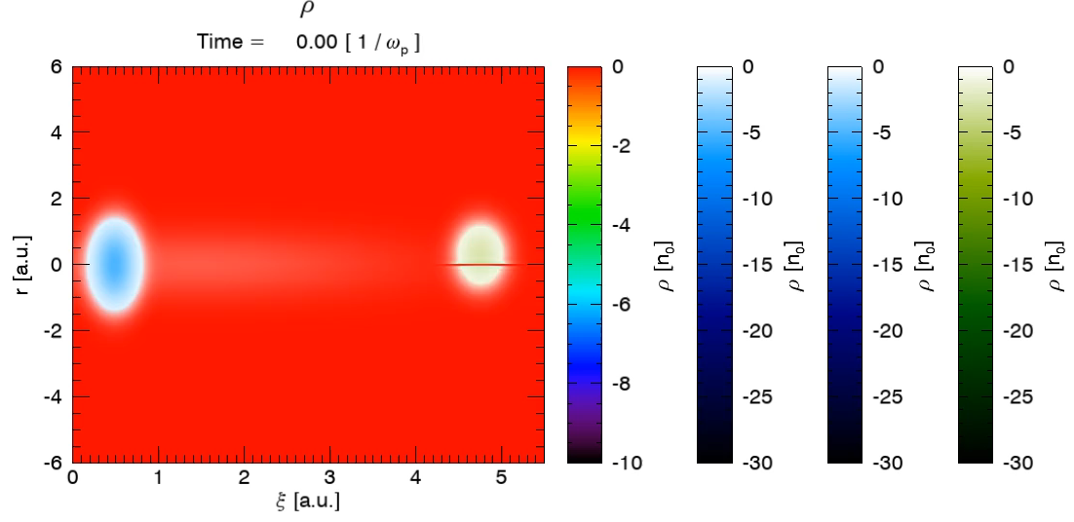
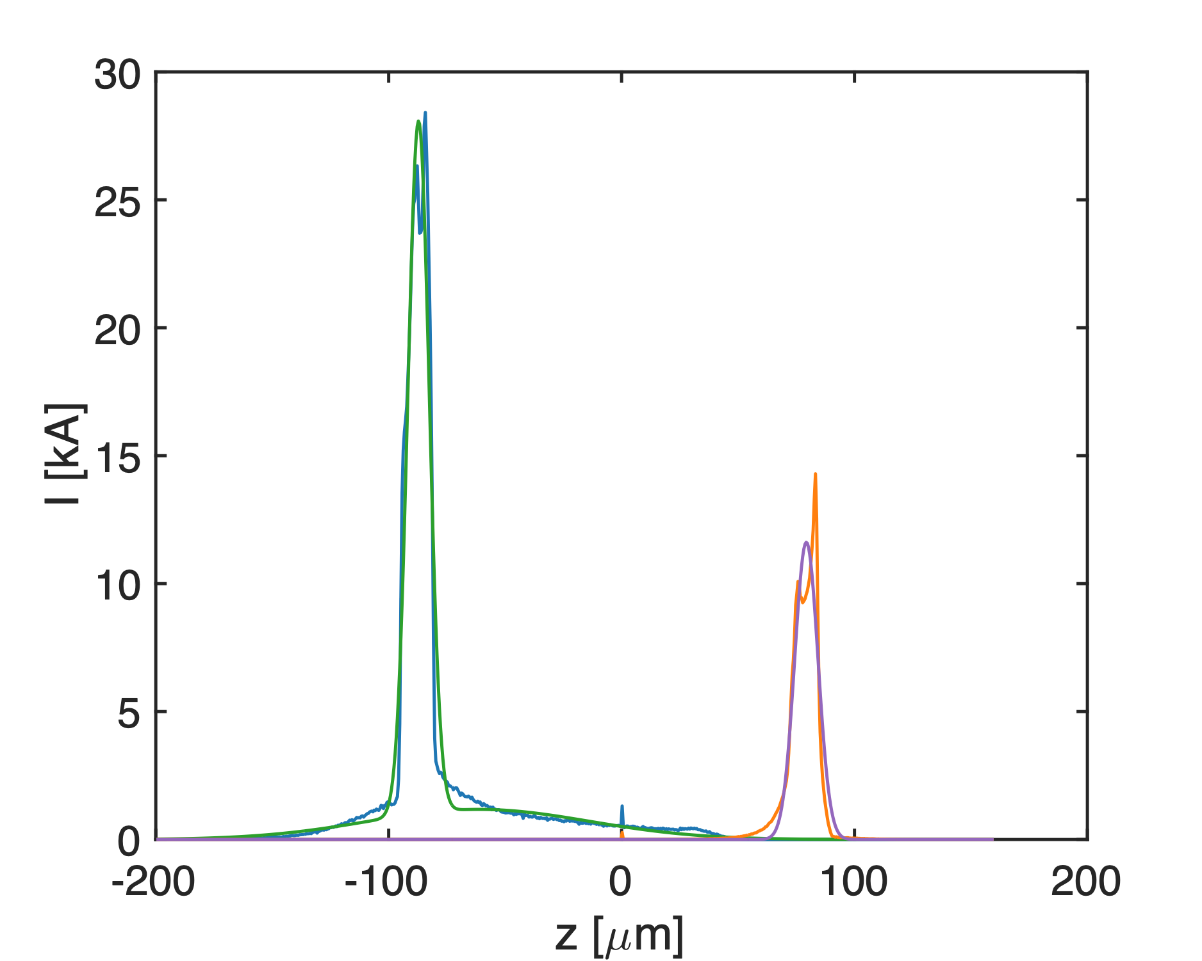
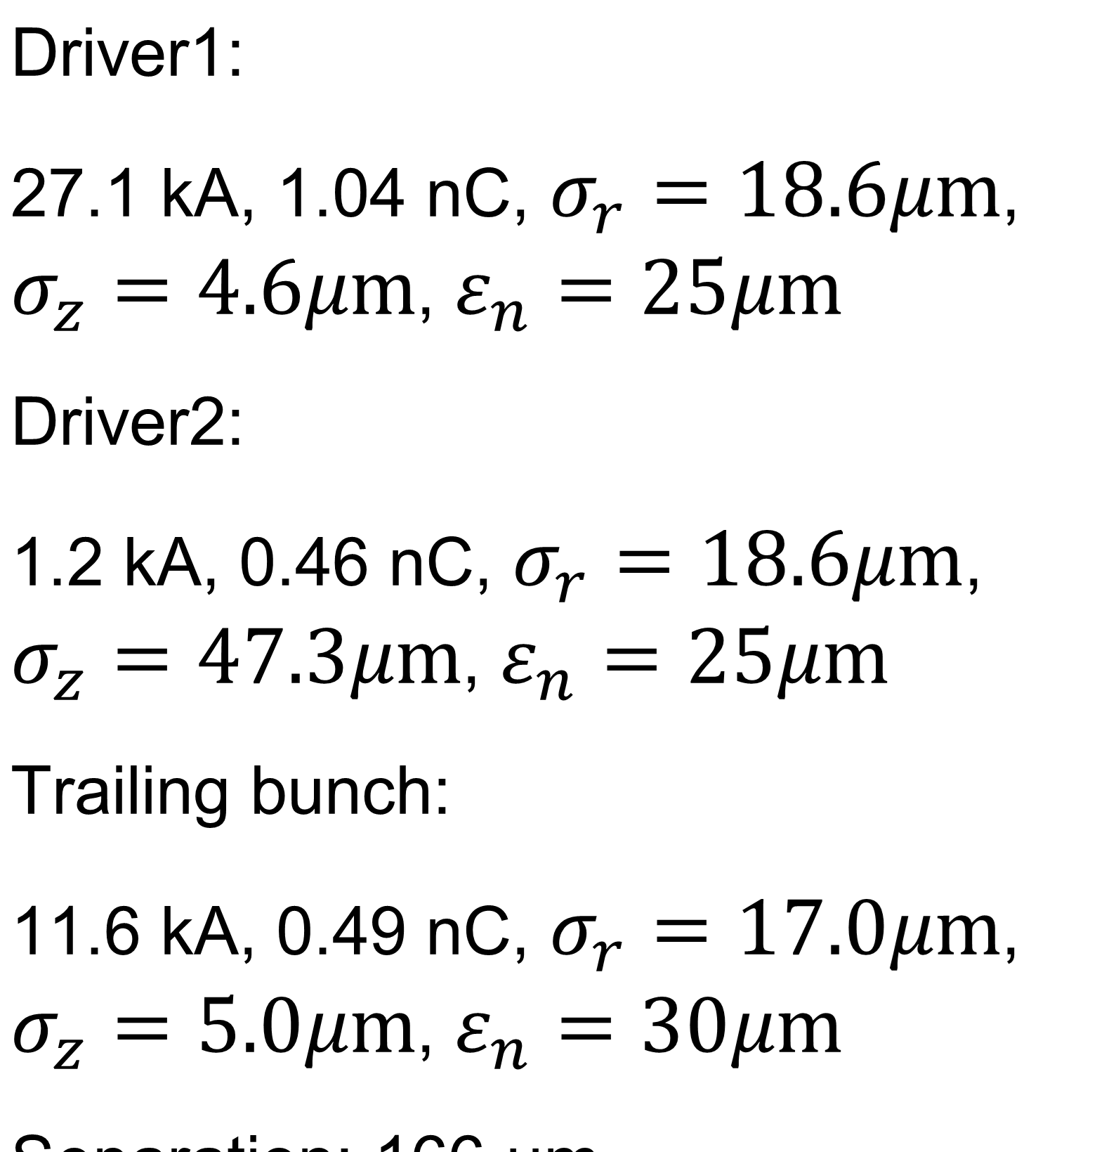
Accuracy of QPAD compared to QuickPIC
Using the Gaussian model from Chaojie with hosing, the problem I showed last meeting.
There are still some issues when running QuickPIC with field ionization (haven’t been actively using this branch), so we will use pre-ionized plasma
There are some small differences between QuickPIC and QPAD, e.g. QPAD uses open boundaries while QuickPIC uses conducting boundaries.
27.1 kA
11.6 kA
1.2 kA

Slide 3
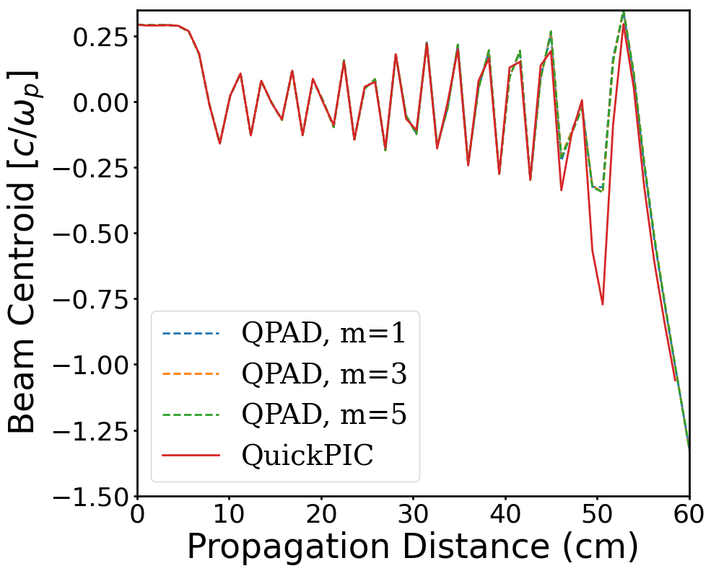
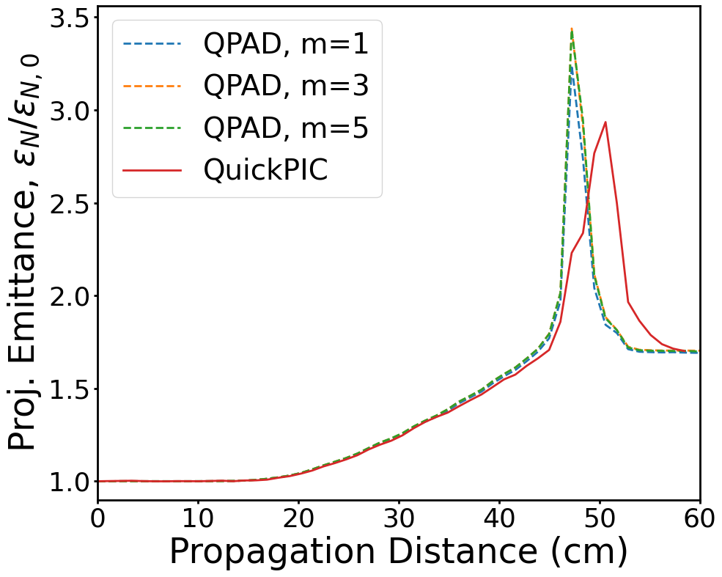
Accuracy of QPAD compared to QuickPIC
We can see even in this problem with moderate asymmetry, strong agreement even with just m=1.
There are some discrepancies in the downramp when the beam particles leave the bubble.
Some particles leave the bubble here

Slide 4
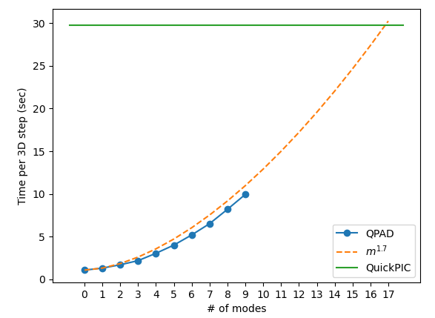
Timing QPAD vs QuickPIC
We test over 50 3D timesteps for the hosing problem for various number of total modes used in QPAD on a fixed number of cpus (128 on Perlmutter).
Drive has 2.1+0.5 million particles and witness has 2.1 million particles.
  QPAD uses cartesian initialization to match QuickPIC
QPAD uses a 512x1024 r-z grid and QuickPIC uses a 1024x1024x1024 grid
QPAD runs fastest with many stages, 32 stages used here with 4 MPI tasks per stage (no OpenMP)
QuickPIC was fastest with 2 stages and 64 MPI tasks per stage (OpenMP available but found to not speed up this run)
QPAD has significant speed up even with many modes

Slide 5
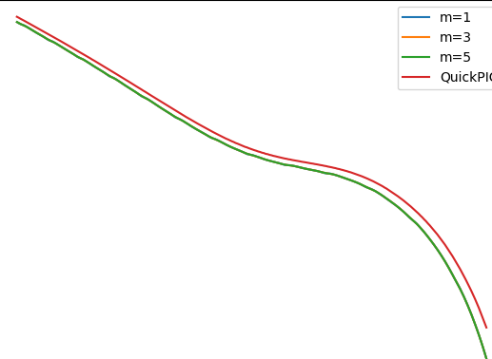
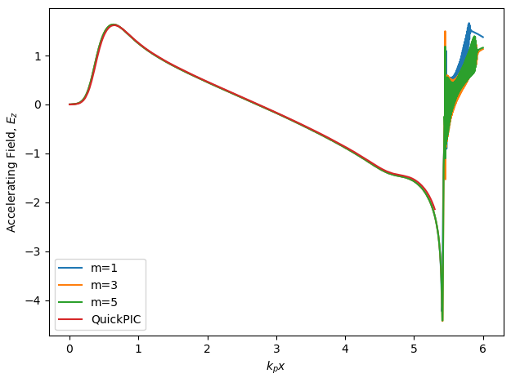
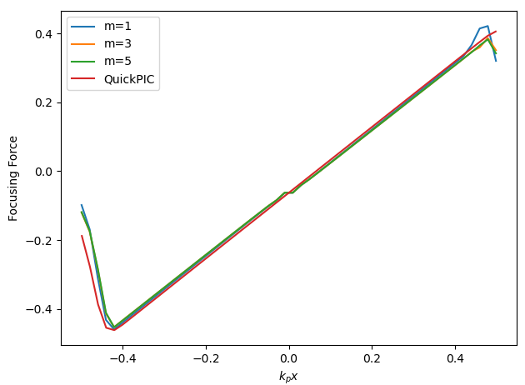
Wakefield comparison
Wakefields from previous runs, halfway through simulation
Small discrepancy probably based on boundaries
Slice at the beam tail

Slide 6
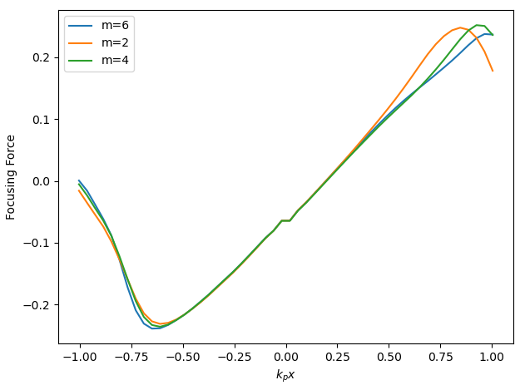
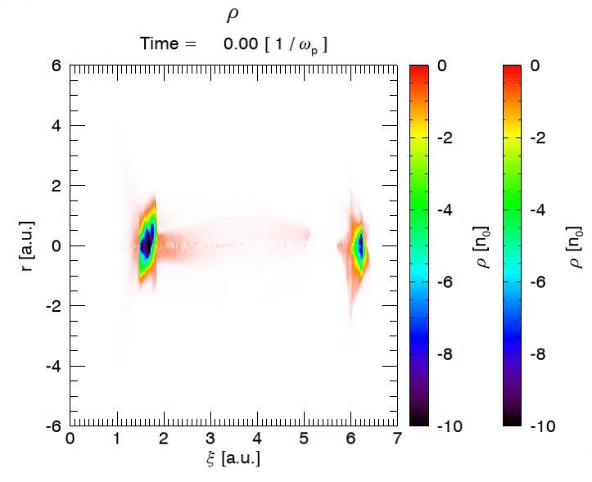
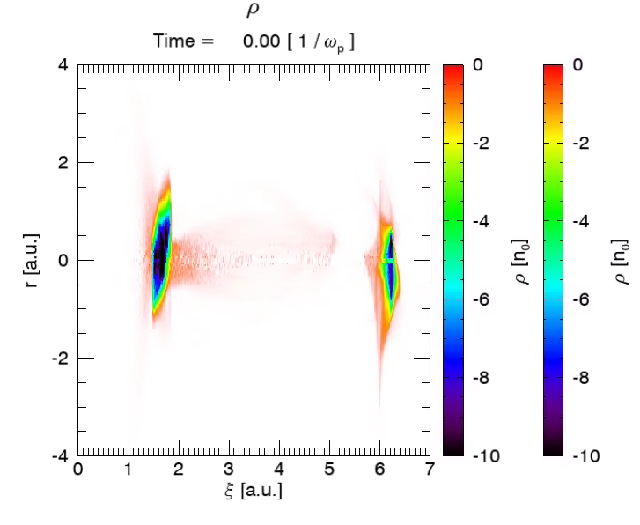
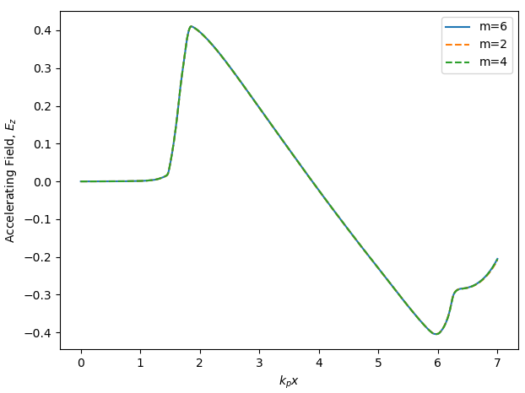
Imported beam comparison
We can see significant differences in charge and the focusing force if we use less modes
Ez is the same, dominated by m=0
m=2
m=6

Slide 7
Conclusion
QPAD seems to be accurate enough for these problems and comes with significant speedup
  Might want to do a few more tests with asymmetric beams
Still need to compare imported beam runs with QuickPIC
Based on preliminary simulations, there seems to be some issues with using these imported beams with the ramp from Chaojie.
Probably will have to do more runs to understand the physics.
  QPAD can run many scans with few modes, QuickPIC can be used to check results.

