Slide 1
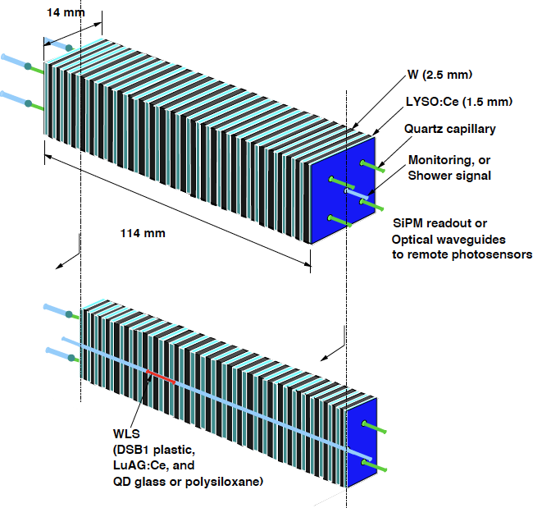
RADiCAL Input - Methodology for Discussion
Design Features
Compact Modular Structure
Ultracompact, RAD Hard EM CAL
Modules scaled by Moliere Radius (13.7mm)
Localization at Shower max scaled by Radiation Length (4.5mm)
Energy resolution
~ 10% / Sqrt (E), < 1% constant term
Current values: 16%, 0.9%
Improve by increasing sampling fraction overall. Current sampling fraction (17%)
Timing resolution
~ 10 ps at high energy
Current values: 27ps at 150 GeV, with ~ 18ps at HE limit
Improve by increasing sampling fraction at Shower maximum
Shower position localization
Few mm at Shower maximum, independent of tracking

Slide 2
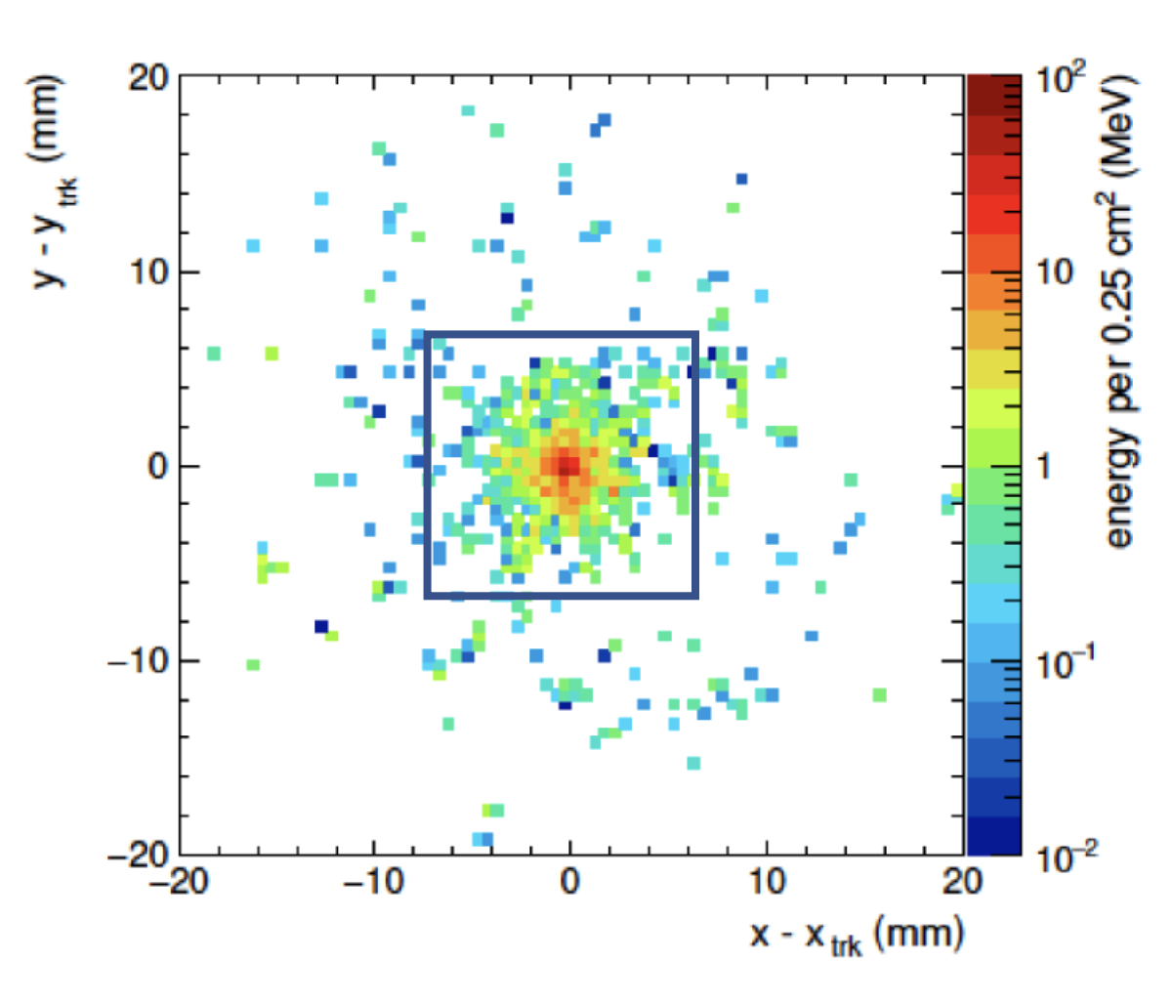
Features of Shower Max measurement for timing and spatial localization
Simulation of EM shower distribution for 50 GeV at Shower Max. Note nearby EM showers can be identified within a single module.
RADiCAL WLS Capillaries are read out from both upstream and downstream ends.
Upstream readout:
WLS light from timing filament
Downstream readout:
WLS light from timing filament
Cherenkov light from quartz-fill of capillary
Placement of WLS filaments can be used for timing, shower localization, and shower depth profile.

Slide 3
R&D Connections to other groups and for collaboration…
Some ideas for R&D:
Inform collaboration on:
Scintillators
Wavelength Shifters to match scintillators.
Capillary Structures.
SiPM Readout (upstream and downstream).
Fast front end sampling with ps time resolution
Optimization/compatibility with additional calorimetry for excellent hadron measurement
LYSO:Ce, LuAG:Ce/Ca, LuAG:Pr, LuO:Yb…
DSB1, LuAG:Ce, Quantum Dots, pTP, Flavenols, …
Structure optimization
New SiPM R&D
For multiple channels. High gain, Low gain, ps sampling. Collaborative development of Frontends and DAQ.
Simulation and Beam Testing

Slide 4
Comments:
Many of the techniques described for RADiCAL application could benefit developments across other calorimetry approaches.
We would hope to build upon a broad knowledge base to benefit this technique as well as others to build a strong collaboration.
Thanks to DOE for support under DE-SC0017810.009

