Slide 1
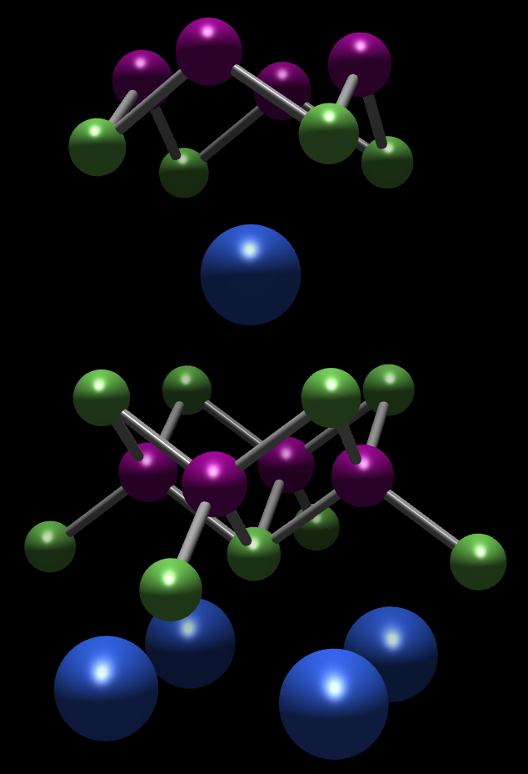
Quo vadis, materiae?
Why you should care about materials for detectors and sensors
(and why you should talk to your solid-state physics friends)
Sinéad M. Griffin
LBNL

Slide 2
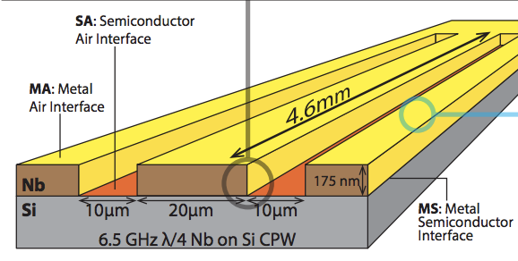
The Trouble with Materials
What Theorists Want
M.V.P. Altoé et al. arXiv.2012.07604 (2020)

Slide 3
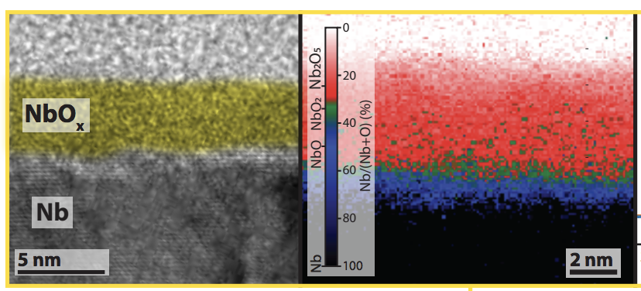
The Trouble with Materials
What Theorists Want
What We Get
Real materials are messy
We find a Hamiltonian that is good enough to describe them (and integrate out everything else)
M.V.P. Altoé et al. arXiv.2012.07604 (2020)

Slide 4
New materials for detectors and sensors
State-of-the-art in materials discovery
Superconducting qubits losses
Designer Hamiltonians for dark matter detection

Slide 5
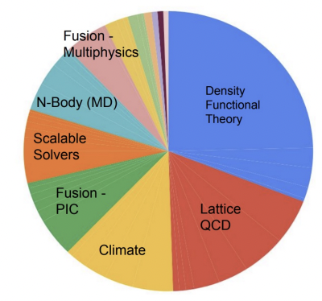
The Landscape of Quantum Materials Theory & Calculations

Slide 6
The Landscape of Quantum Materials Theory & Calculations
Expansion of classical calculations to larger and more complex systems
Application of QC to many-body systems e.g. strongly-correlated materials

Slide 7
The Landscape of Quantum Materials Theory & Calculations
Expansion of classical calculations to larger and more complex systems
Application of QC to many-body systems e.g. strongly-correlated materials
Expertise from solid-state physics and chemistry specifically focused on HEP and QC challenges

Slide 8
The Landscape of Quantum Materials Theory & Calculations
Expansion of classical calculations to larger and more complex systems
Application of QC to many-body systems e.g. strongly-correlated materials
Expertise from solid-state physics and chemistry specifically focused on HEP and QC challenges
Materials informatics and databases for accelerated discovery and inverse design
e.g. Quantum Defect Genome for Si (quantum comms.)

Slide 9
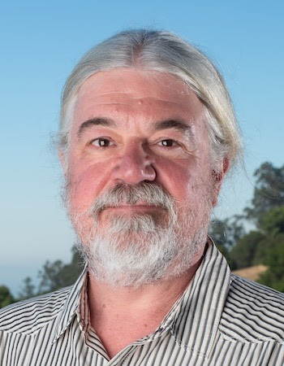
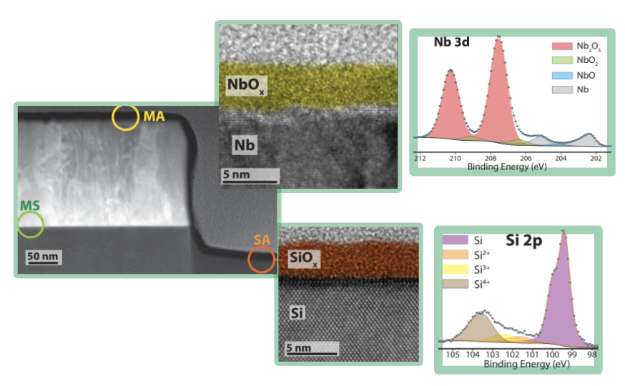
Materials Origin of Superconducting Circuit Decoherence
D. F. Ogletree
Siddiqi (UCB/LBL)
Santiago (LBL)

Slide 10
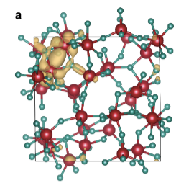
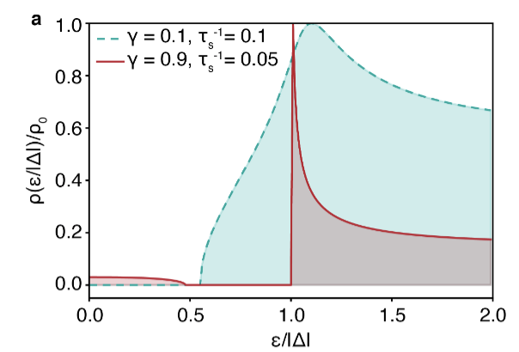
Materials Origin of Superconducting Circuit Decoherence
D. F. Ogletree
Siddiqi (UCB/LBL)
Santiago (LBL)
Notes:
Crucial to have everything under the same roof

Slide 11
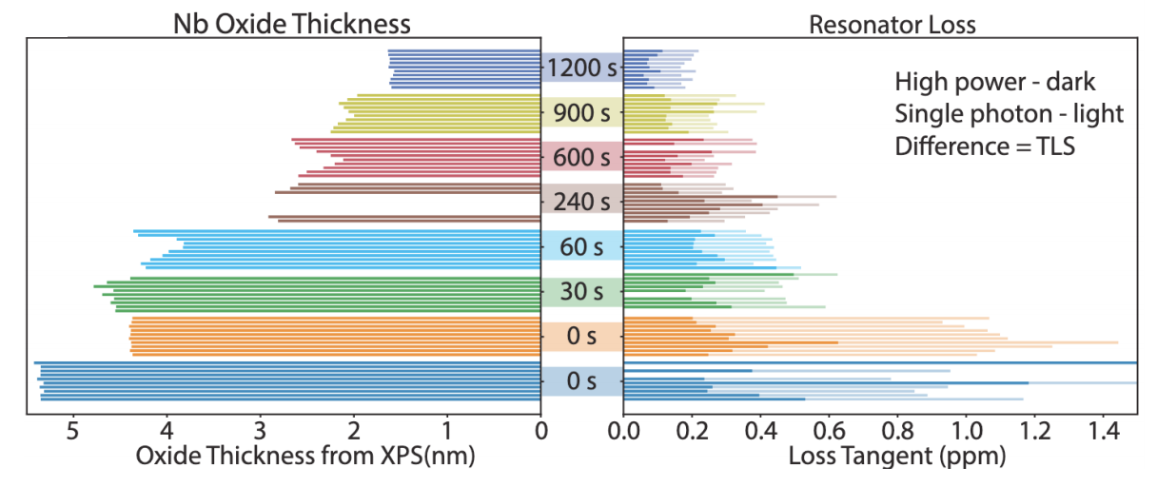
Materials Origin of Superconducting Circuit Decoherence
D. F. Ogletree
Siddiqi (UCB/LBL)
Santiago (LBL)
DOE BES “Superconducting Coherence Structures for QIS”

Slide 12
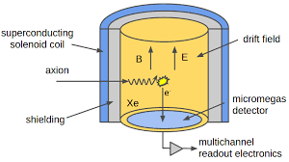
Axion Detection in Multiferroics
Axion-field coupling in cavity searches
Axions – proposed to solve CP violation
Axion in large B field causes E field oscillation + photons
arXiv:2102.10171v2

Slide 13
Axion Detection in Multiferroics
Axion-field coupling in cavity searches
Axions – proposed to solve CP violation
Axion in large B field causes E field oscillation + photons
E.B term in material causes and axion-induced E field:
arXiv:2102.10171v2

Slide 14
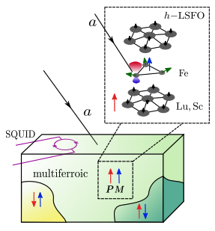
Axion Detection in Multiferroics
Axion-field coupling in cavity searches
Axions – proposed to solve CP violation
Axion in large B field causes E field oscillation + photons
Axion-matter coupling in magnetoelectrics
E.B term in material causes and axion-induced E field
arXiv:2102.10171v2

Slide 15
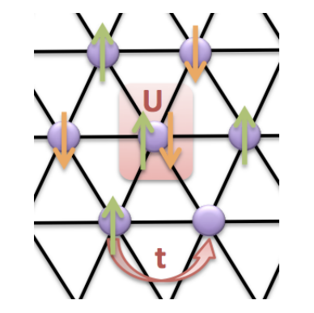
Non-controversial hot-takes
Materials-specific calculations are needed for next-generation detectors and experiments and for QC
Methodology for systems discovery from solid-state physics, chemistry and materials science can accelerate hardware improvements in HEP and QC
Facilitate using contemporary discoveries in quantum materials (e.g. topological and entangled systems) for applications in HEP/QC
Designer H
Griffin, Staar, Schulthess, Troyer, Spaldin. PRB 93, 075115 (2015)
QuantISED

