Slide 1
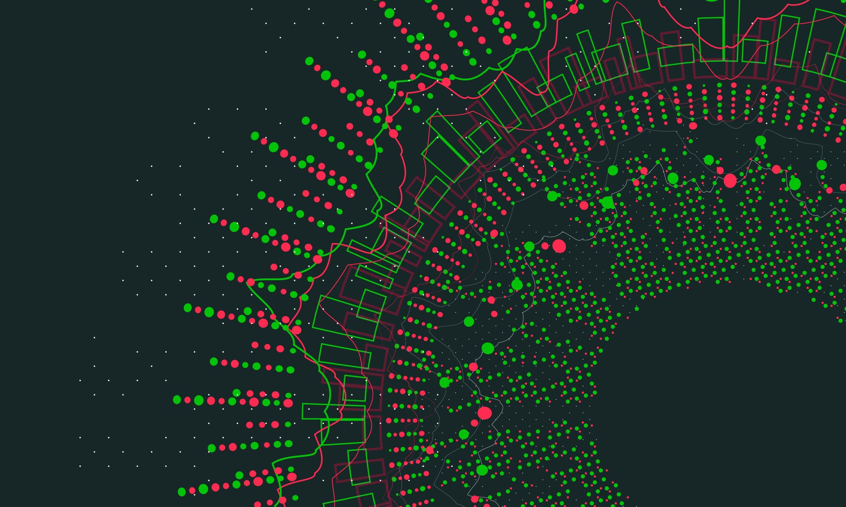
CPAD RDC 5: Trigger and DAQ
Zeynep Demiragli (Boston University)
Jinlong Zhang (Argonne National Lab)

Slide 2
RDC 5 Timeline (So-Far):
First meeting (09/29)
To discuss key R&D areas and survey questions
Kick-off meeting (early Oct): https://indico.fnal.gov/event/61511/
To identify and organize subgroups/subareas through survey
To understand relevant teams, existing activities, facilities/infrastructures
Second meeting (late Oct): https://indico.fnal.gov/event/61763/
To formulate and discuss work packages
CPAD workshop at SLAC (Nov 7-10) => You are HERE
https://indico.slac.stanford.edu/event/8288/registrations/539/
Present RDC 5 status at CPAD
In-person discussion to advance our preparation for proposal(s)

Slide 3
Snapshots from the Meetings

Slide 4
Snapshots from the Meetings

Slide 5
Ideas for Work Packages (based on BRN Report 2019)
PRD 21
Real-time / low-latency data reduction and feature extraction
Fast artificial intelligence and neuromorphic computing on real-time hardware
High-bandwidth, rad-hard, low-power optical link (>50Gbps)
Wireless readout
PRD 22
Intergrading modern computing architecture and emerging technologies
Self-running DAQ system
PRD 23
Timing distribution with picosecond synchronization (1ps over 1km)

Slide 6
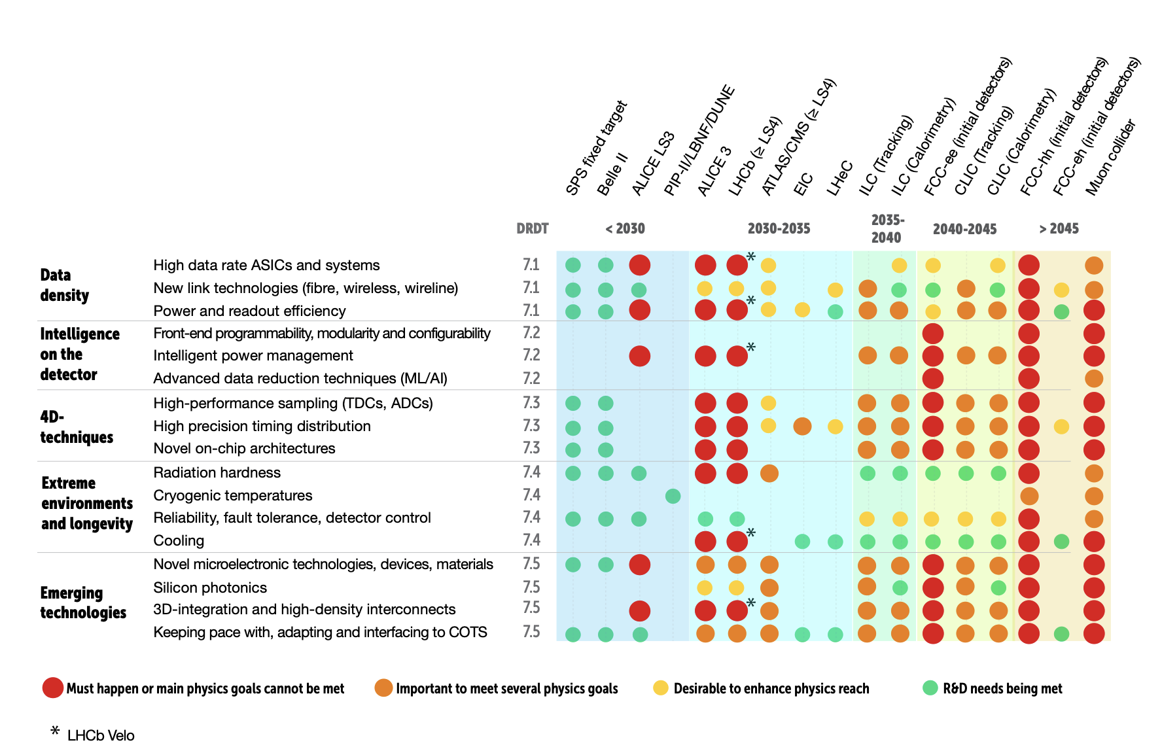
Connection with the ECFA Road Map (2021)

Slide 7
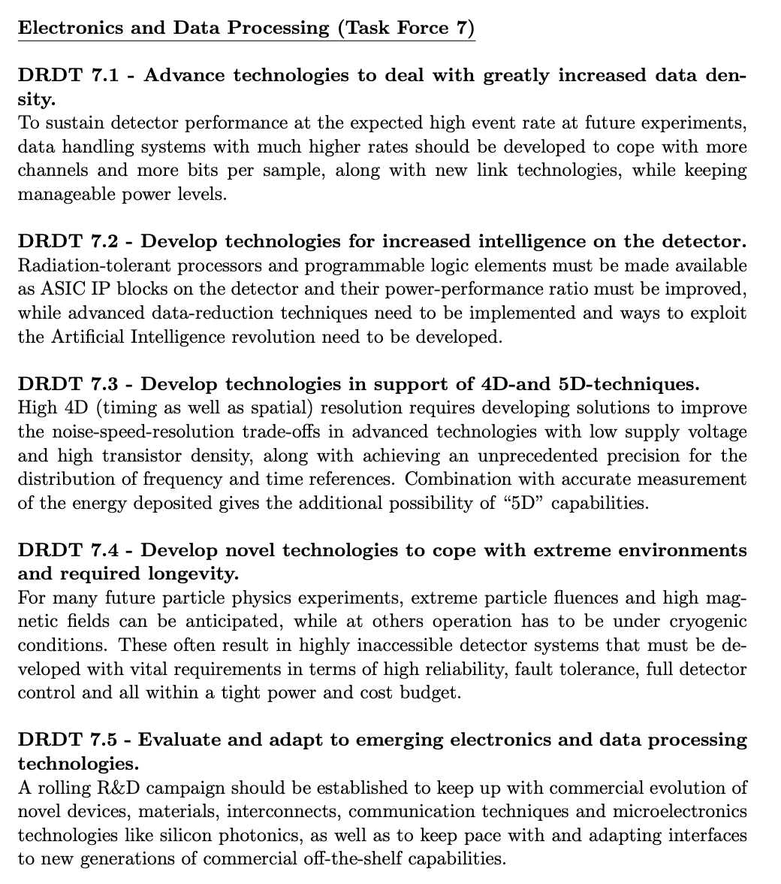
Summary of the Recommendations
In ECFA Electronics and Data processing is combined Task Force (DRDT 7)
This also highlights that the coordination between RDC4 (Readout and ASICs) & RDC5 groups is crucial

Slide 8
Notes on the funding Opportunities
During this year, the FOA of interest is: https://science.osti.gov/grants/FOAs/-/media/grants/pdf/foas/2023/DE-FOA-0003177.pdf (specifically section 5F, page 63 for multi-institutional projects).
Content: Blue Sky Proposals. Ideally teams working together! => Collaboration Proposals
We propose we pull together a few multi-institutional proposals for submission Blue Skies or non-experiment specific general R&D (aligned with BRN)

Slide 9
Agenda
Tuesday
Thursday

