Slide 1
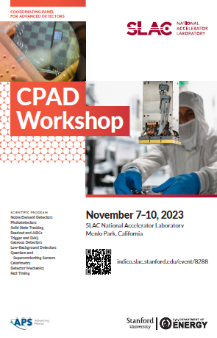
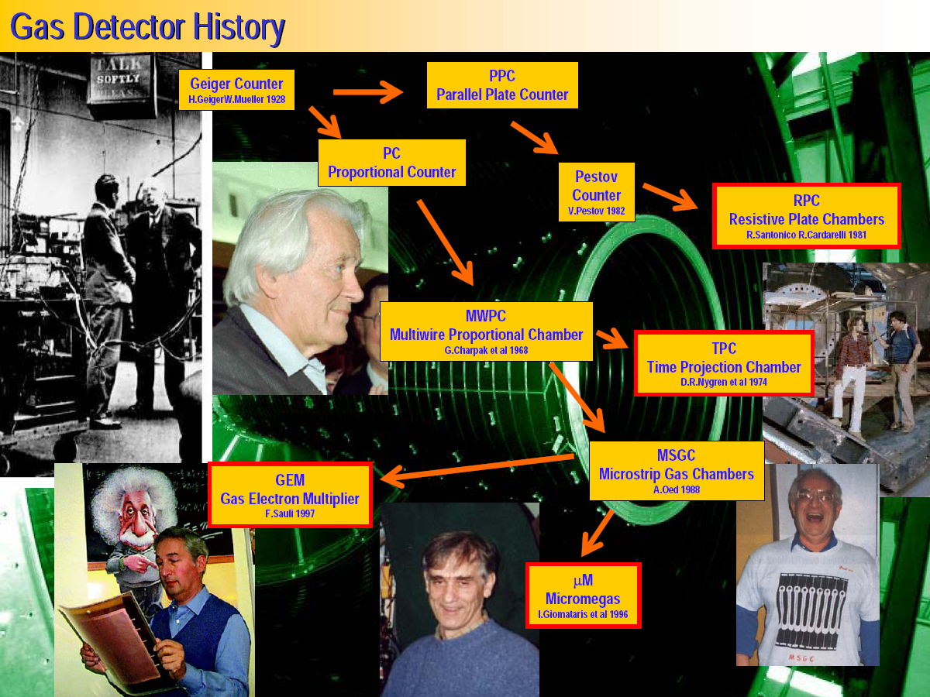
Overview and Status of the DRD1 Collaboration
Maxim TITOV,
CEA Saclay, France
(on behalf of the TF1 Conveners & DRD1 Implementation Team)
CPAD Instrumentation Frontier Workshop, SLAC, USA, November 7-10, 2023
1

Slide 2
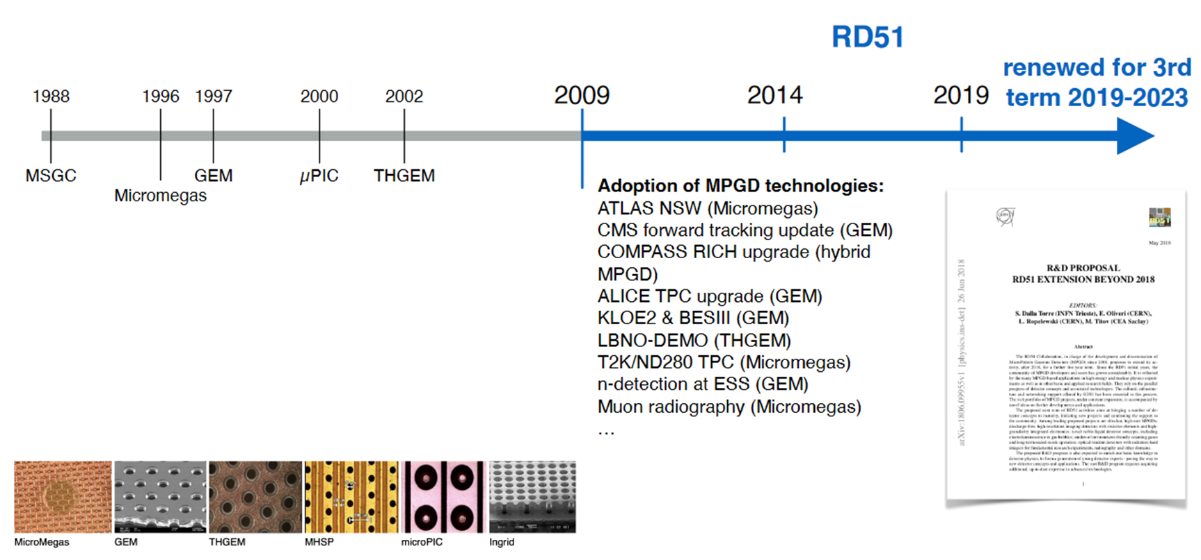
CERN-RD51 Collaboration & MPGD Technology Advances
RD51 CERN-based “TECHNOLOGY - DRIVEN R&D COLLABORATION” was
established to advance MPGD concepts and associated electronics readout systems
2018:
2008:
https://arxiv.org/pdf/1806.09955.pdf
Renewed by the CERN Research Board for the 3rd term 2019 – 2023
Beyond 2023, RD51 will serve as a nuclei of the new DRD1 (“all gas detectors”) collaboration, anchored at CERN, as part of the ECFA Detector R&D Roadmap implementation

Slide 3
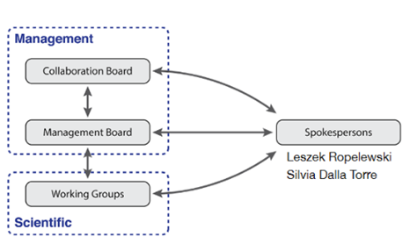
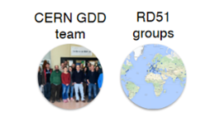
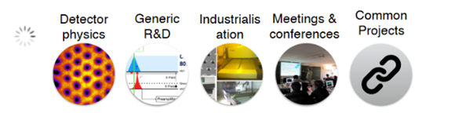
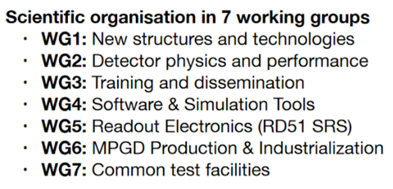
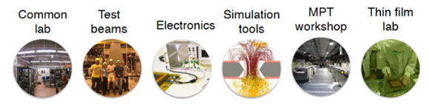
https://cernbox.cern.ch/s/ZLUOEzRBJ7sdhVA
CERN-RD51 Collaboration Legacy and “RD51” Model
The success of the RD51 is related to the “RD51 model” inperforming R&D: combination of generic and focused R&D with bottom-up decision processes, full sharing of experience, “know-how”, and common infrastructure, which allows to build community with continuity and institutional memory and enhances the training of younger generation instrumentalists.
Community and Expertize
(RD51 Scientific Network)
RD51:
3 MAJOR
ASSETS
MPGD community:
~ 90 institutes
~ 500 members
MPGD Technology Development
& Dissemination
Updated RD51 website -https://rd51-public.web.cern.ch/
R&D Tools, Facilities and Infrastructure

Slide 4
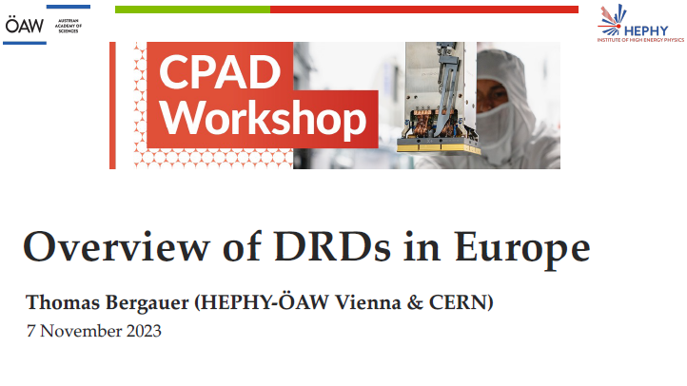
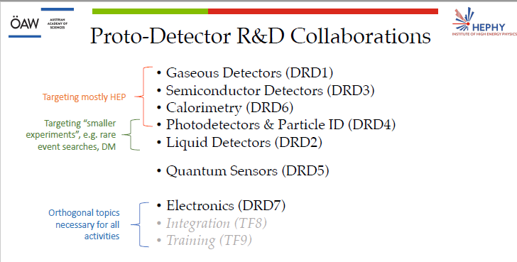
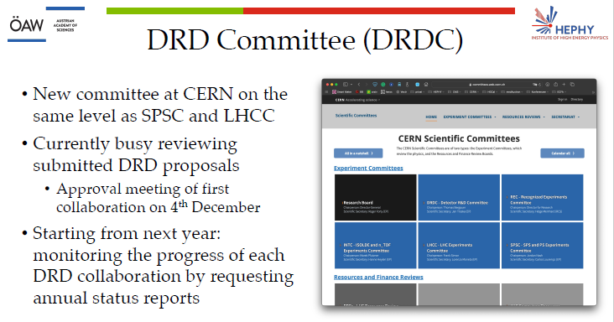
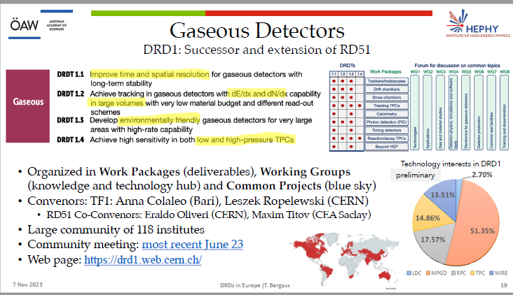
Overview of DRD Collaborations in Europe
See Thomas Bergauer talk, CPAD Plenary, Nov. 7

Slide 5
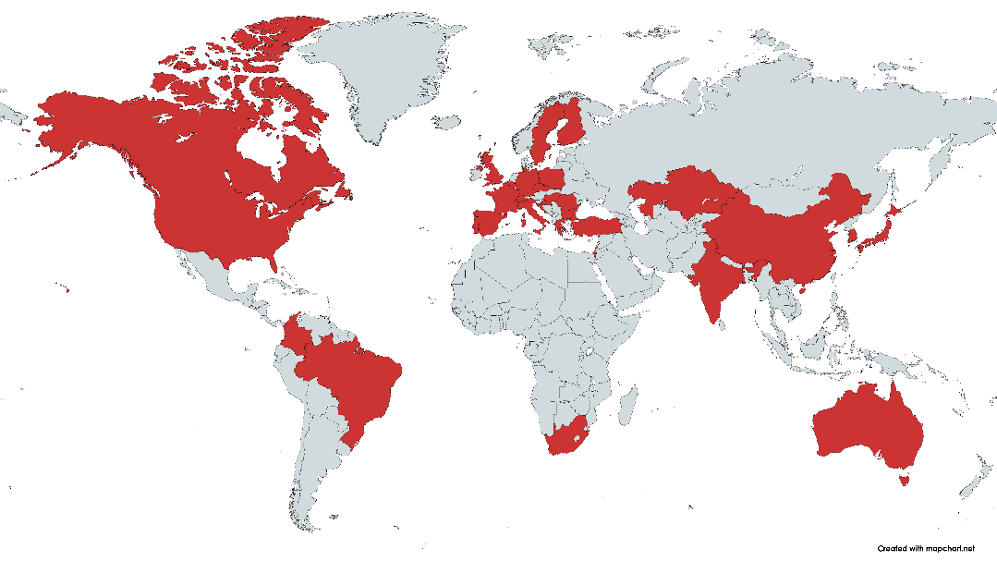
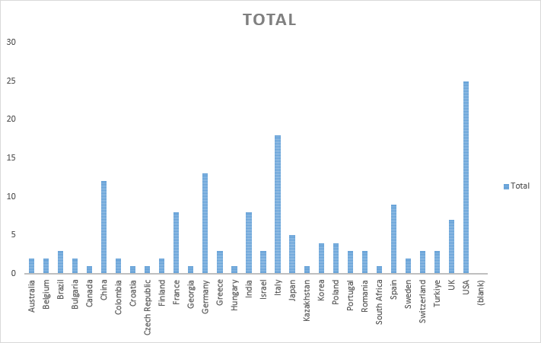
DRD1 Collaboration Proposal Submitted to DRDC
Latest DRD1 Proposal
(v1.3, re-submitted to DRDC, 31/10/2023):
https://cernbox.cern.ch/s/ZLUOEzRBJ7sdhVA
DRD1 Collaboration Website:
https://drd1.web.cern.ch/
Expression of interest form 153 institutes from 31 countries

Slide 6
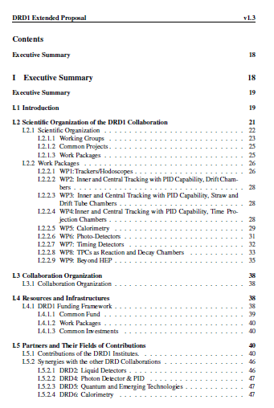
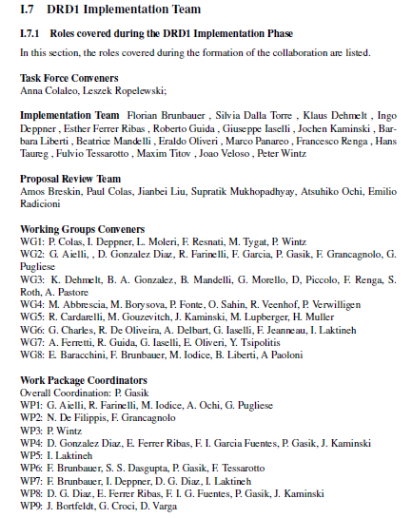
DRD1: Scientific Organization & Implementation Team
Collaboration Type: Community-driven (“bottom-up”) with the cross-disciplinary R&D environment & exchange: common infrastructures (labs, workshops), common R&D tools (software and electronics)
Scientific Organization in Working Groups (WG): provides a platform for sharing knowledge, expertise & efforts by supporting strategic detector R&D directions, facilitating the establishment of joint projects between institutes.
Work Packages (WP): long-term projects addressing strategic R&D goals, outlined in the ECFA Detector R&D roadmap with dedicated funding lines.
Common Projects (CP): short-term blue-sky R&D or common tool development with limited time and resources, supported by the Collaboration Common funds.
Big APPRECIATION to the DRD1 COMMUNITY for great TEAMWORK, which allowed to shape the “legacy document” for gaseous detectors domain for decades to come

Slide 7
DRD1 Scientific Organization: Working Groups
DRD1 Working Groups structure, similar to RD51, but with mixed technologies (MPGD, RPC; TPC, Wire, etc …), flexibility, and possible parallel configurations, is defining the platform for:
Sharing experience: Work Packages (WPs), Common Projects(CPs), Experiments, Blue Sky and generic R&D, and detector physics studies
Identifying directions for the future strategic detector R&D: by assisting in the establishment of Work Packages (WPs) and Common Projects (CPs)
Maintaining an R&D environment for developing gaseous detector technologies: gas and material studies, link to the novel technologies; software tools and detector physics; electronics for gaseous detectors; detector production; infrastructure for detector R&D; training and dissemination
A. Colaleo

Slide 8
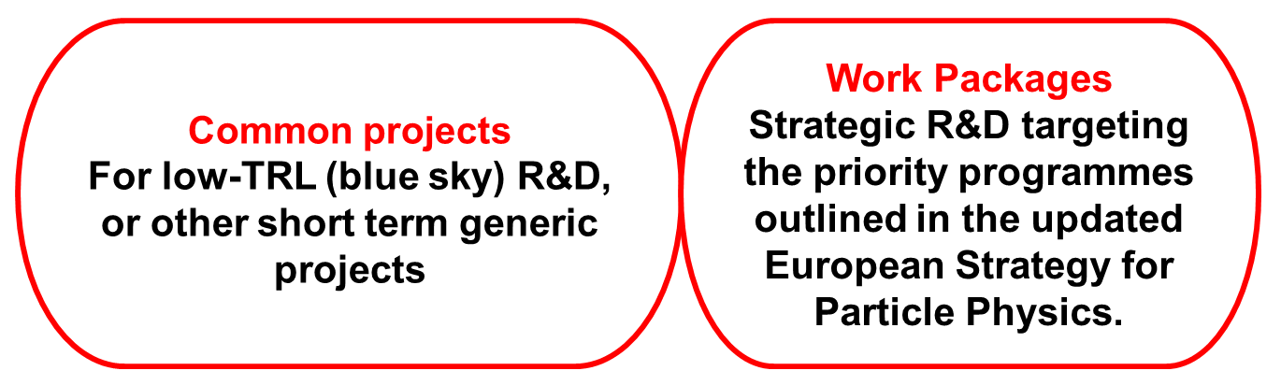
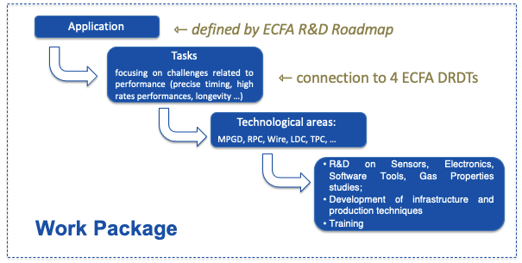
DRD1 Scientific Organization: Common Projects & Work Packages
Two Areas of Detector R&D:
Detector R&D developments via:
”Blue-sky” R&D : competitive, short-term responsive grants, nationally organised
”Strategic R&D”: organized in Work Packages, by grouping activities of the Institutes with shared research interests around Applications with a focus on specific Detector R&D Theme (DRDTs) challenges
*some Common Projects may reach sufficient maturity
to become Work Packages in the future
Current Work Packages
in the DRD1 proposal:
WP1: trackers/hodoscopes
WP2: Drift Chambers
WP3: Straw Chambers
WP4: Tracking TPCs
WP5: Calorimetry
WP6: Photon detectors
WP7: Timing detectors
WP8: Reaction/Decay TPCs
WP9: Beyonf HEP
A. Colaleo
There is no obligation to participate in the WP to be a member of DRD1

Slide 9
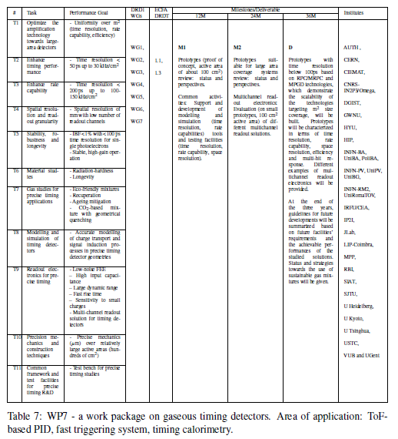
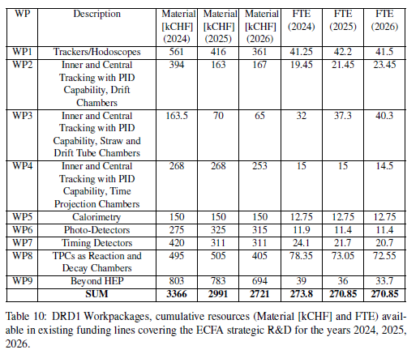
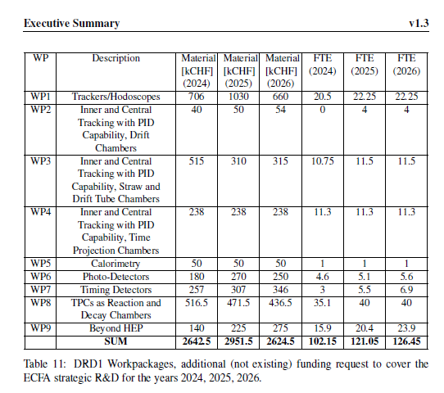
DRD1 WP Proposal: Milestones/Deliverables, Infrastructure, Funding
In addition to the DRD1 public proposal, supporting DRD1 document (over 300 pages) exists containing a detailed description of WPs along with the required resources.
The stripped part will be public soon and used in the future for the MoU (WP) Annexes.

Slide 10
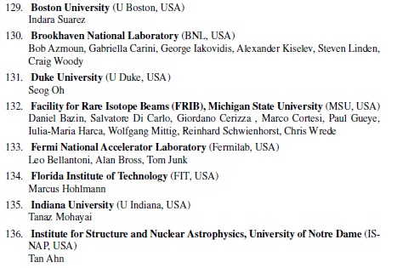
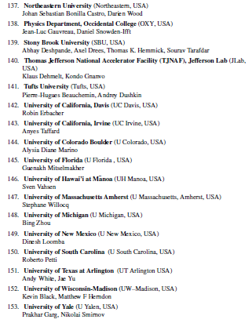
DRD1 Collaborations
Interplay & US Participation
25 US institutes and/or laboratories signed up the most recent DRD1 proposal (v. 1.3 – 31/10/2023)
Following people agreed to act as DRD1 link persons in other DRD areas:
DRD2 - liquid detectors - Diego Gonzalez Dia
DRD4 - photon and PID - Fulvio Tessarotto
DRD5 - quantum technologies - Florian Brunbauer
DRD6 - calorimetry - Imad Laktineh
DRD7 - electronics - Sorin Martoiu, Marco Bregant
US-CPAD: M. Titov, S. Vahsen
US-FCC/ILC: M. Hohlmann, G. Iakovidis, B. Zhou

Slide 11
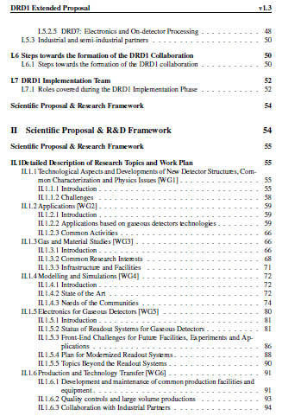
Next Steps with DRDC & Towards Forming the DRD1 Collaboration
Next Steps with DRDC:
November 15, 2023
  Final Proposals Distributed
  Proposals sent to CERN Directorate and Research Board
  Incorporate DRDC-Requested Changes
  Publicly Available Versions
December 4, 2023
  First Official DRDC Meeting
  Representatives from DRD Collaborations Present Proposals
  Q&A Session
December 6, 2023
  Official Approval of Proposals
  Decision at CERN Research Board
Towards DRD1 Collaboration:
Oct-Nov 2023: DRD1 Search Committee seeks Spokespersons and CB Chair nominations.
Dec 2023 – Jan 2024: Organize open meeting where candidates for Spokespersons and CB Chair present their statements. Electronic election campaign.
Jan-Feb 2024: Hold DRD1 Collaboration Meeting at CERN, announce election results, and establish collaboration bodies.

