Slide 1
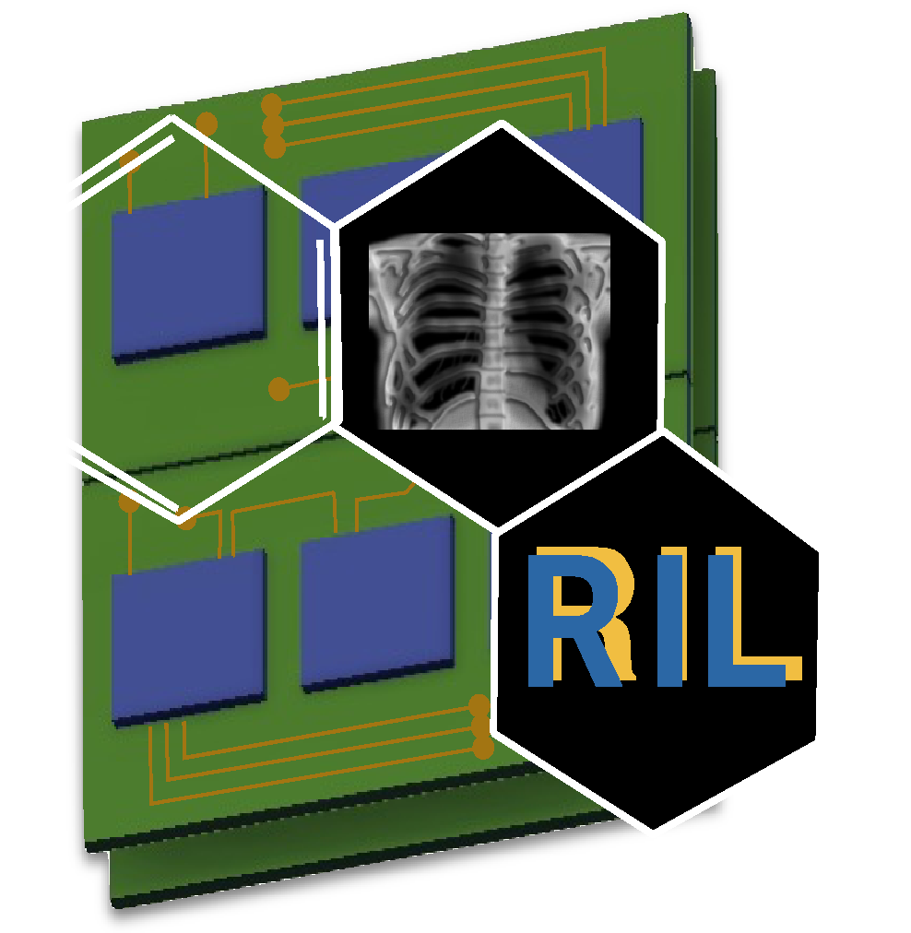
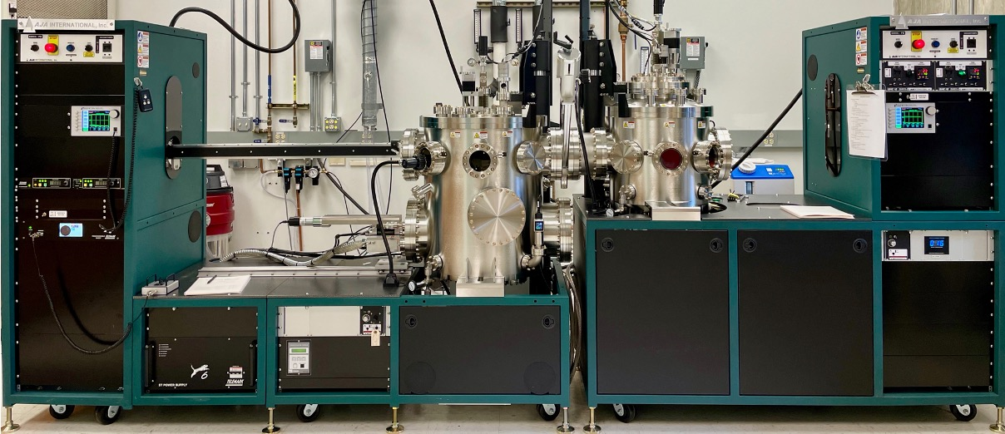
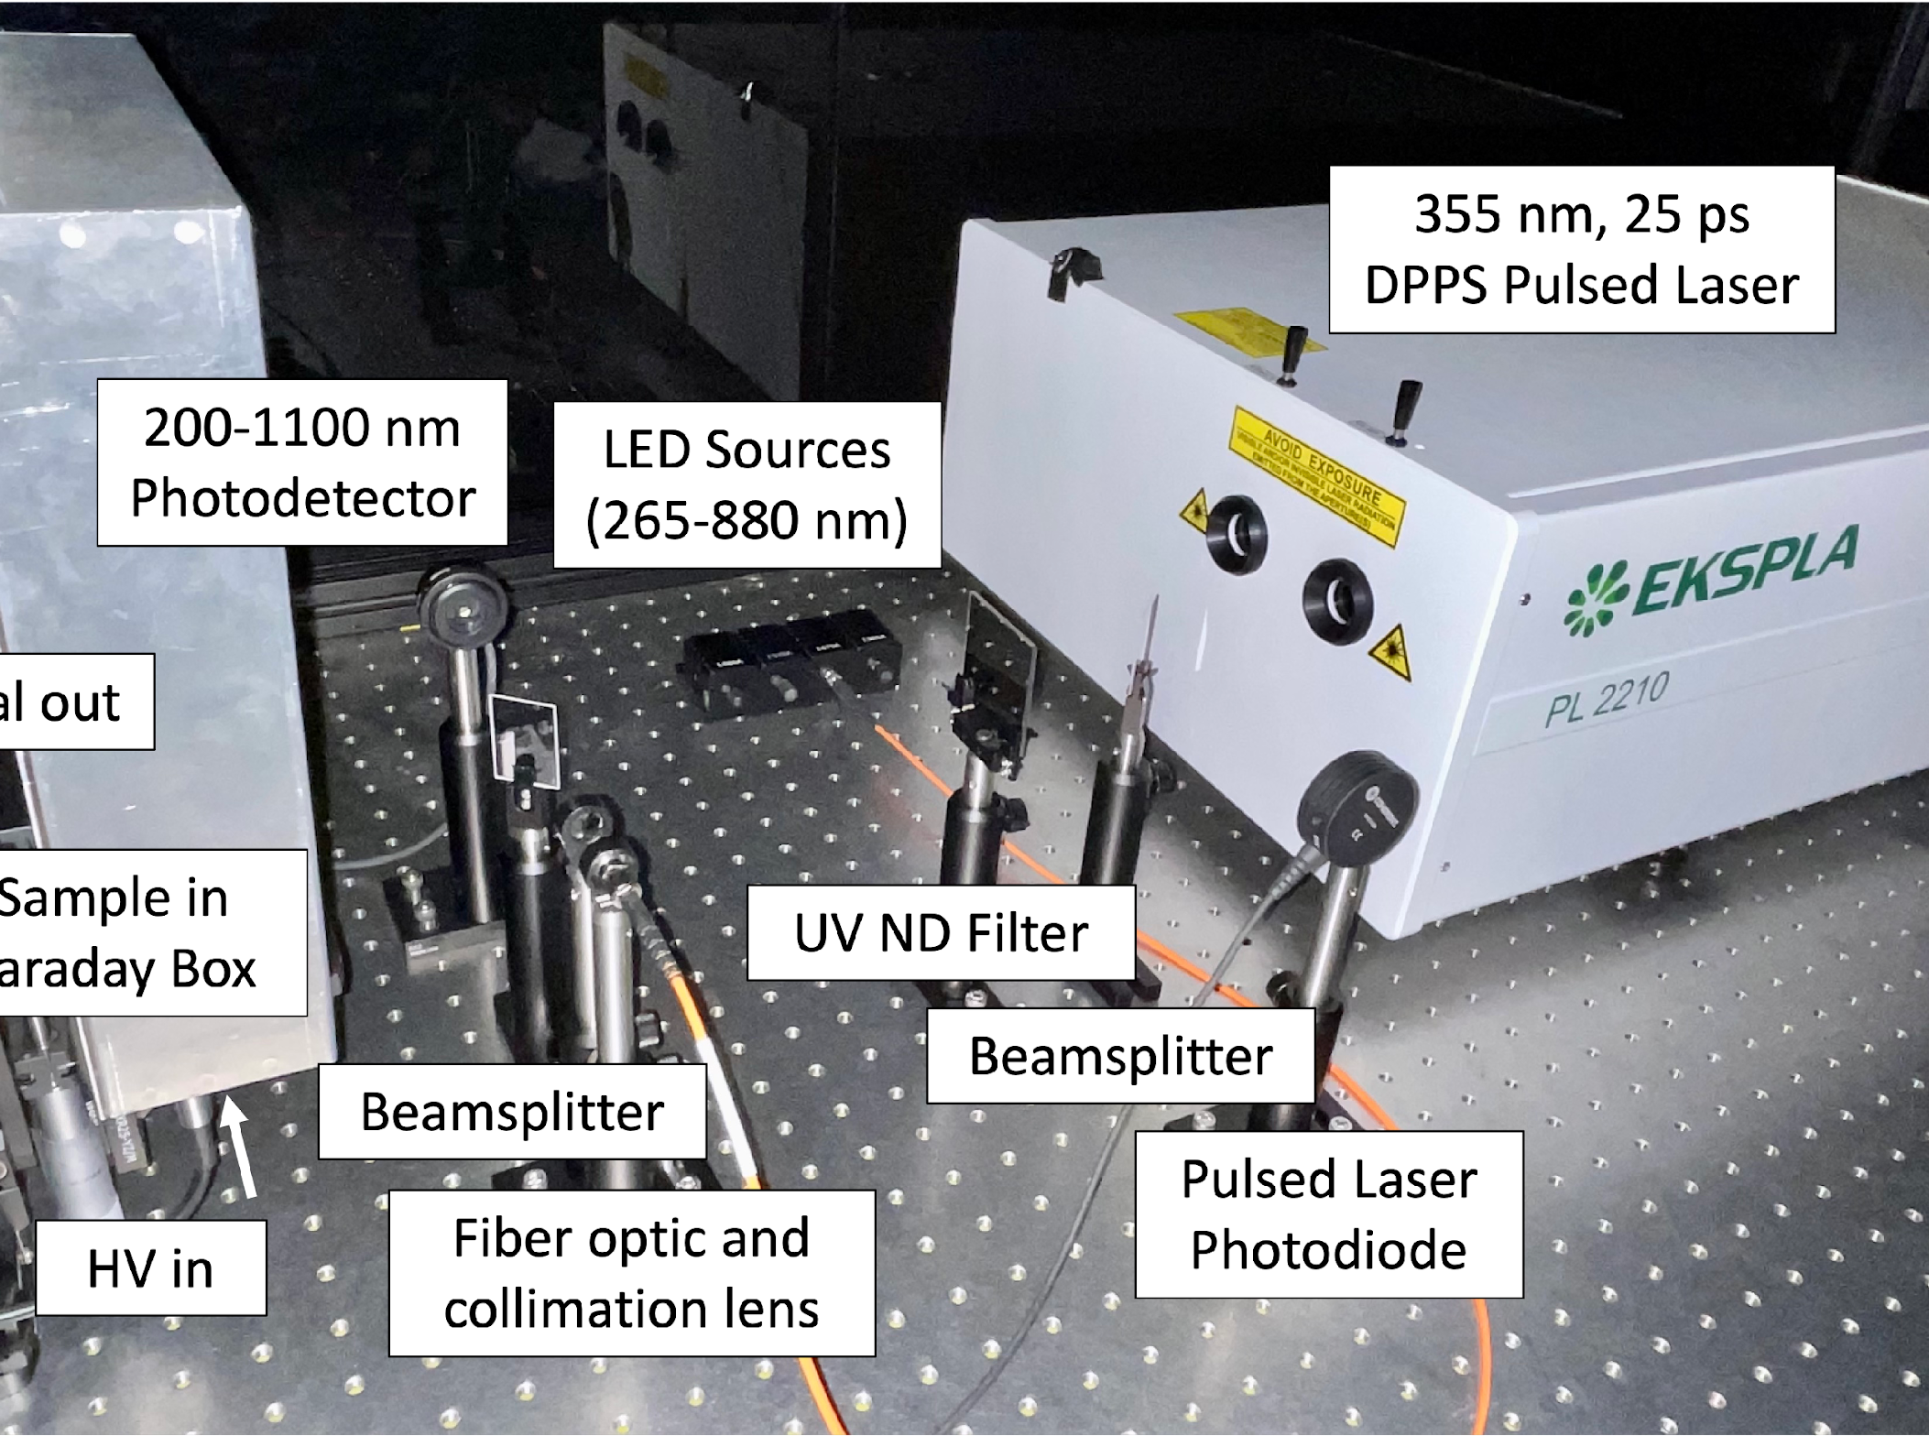
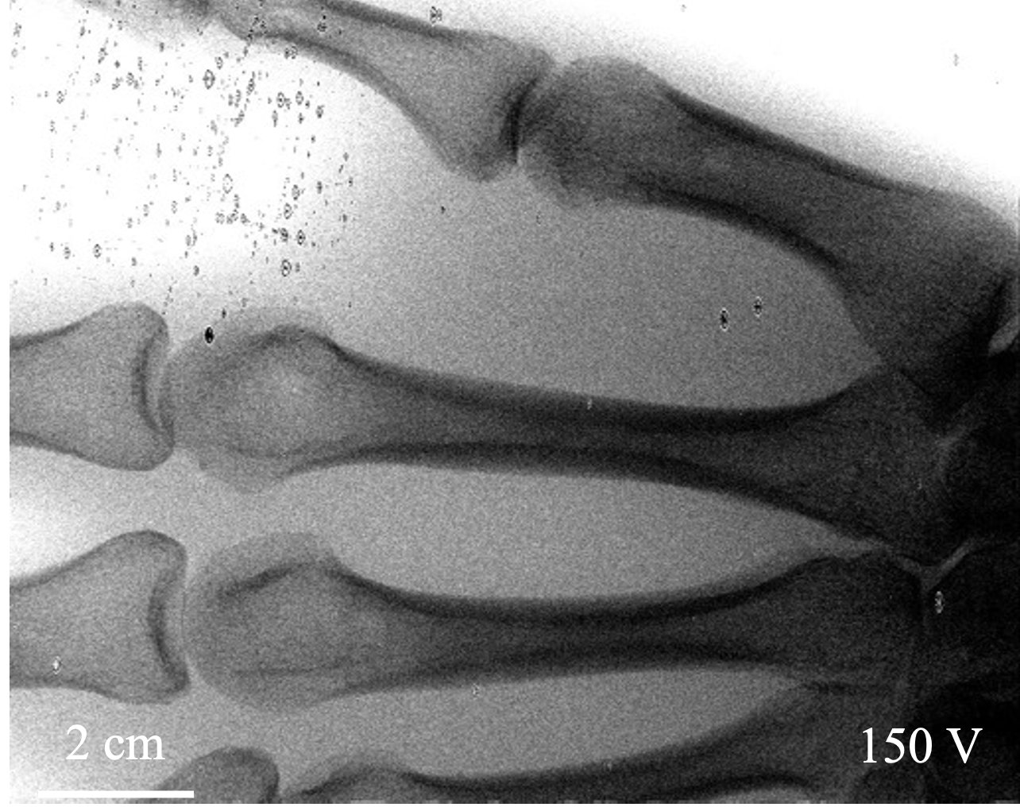
Improving the Performance of Amorphous Selenium Photodetectors by Alloying for Indirect X-ray Imaging
Kaitlin Hellier, Molly McGrath, Shiva Abbaszadeh
Radiological Instrumentation Laboratory
Electrical and Computer Engineering, University of California, Santa Cruz
ril.soe.ucsc.edu
Notes:
Thank you very much Shiva! I’m Molly, an undergrad working under Dr. Kaitlin Hellier and Prof. Abbaszadeh in the Radiological Instrumentation Laboratory at UC Santa. Cruz.
Unfortunately Kaitlin can’t join us today due to presenting at the IEEE NSS-MIC conference in Vancouver, so I will be presenting for her today on our work on alloying amorphous selenium for photo and X-ray detection.

Slide 2
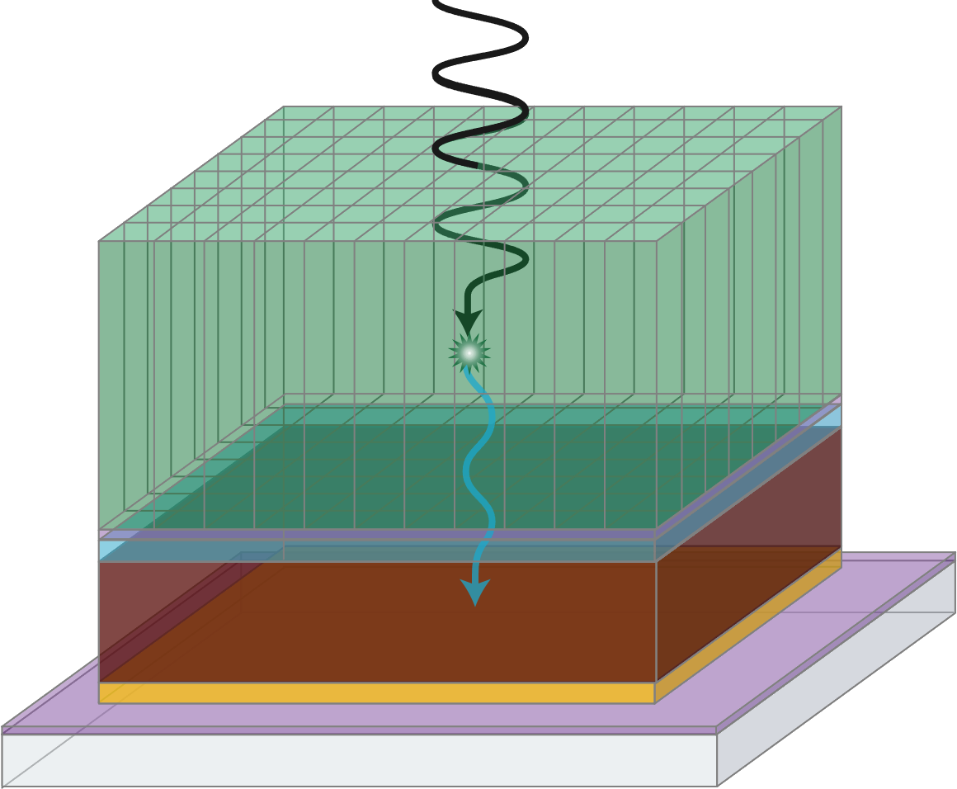
Improving detector performance
New applications for photodetection are on the rise
Need higher sensitivity and resolution, low noise, large area, and low cost
Several applications require stability at low temperatures, unique architectures for charge collection
Investigating new and old materials for specific applications is essential for advancing field of detection
Notes:
New applications of photodetection are popping up every day, including in particle detection and low photon counting
Many of these applications require detectors with higher sensitivity and resolution, low noise levels, large area coverage, and therefore low cost for fabrication
Several applications, such as noble element detectors, require stability at low temperatures and unique architecture for charge collection
To meet these needs , we must revisit materials with a new eye for our evolving applications

Slide 3
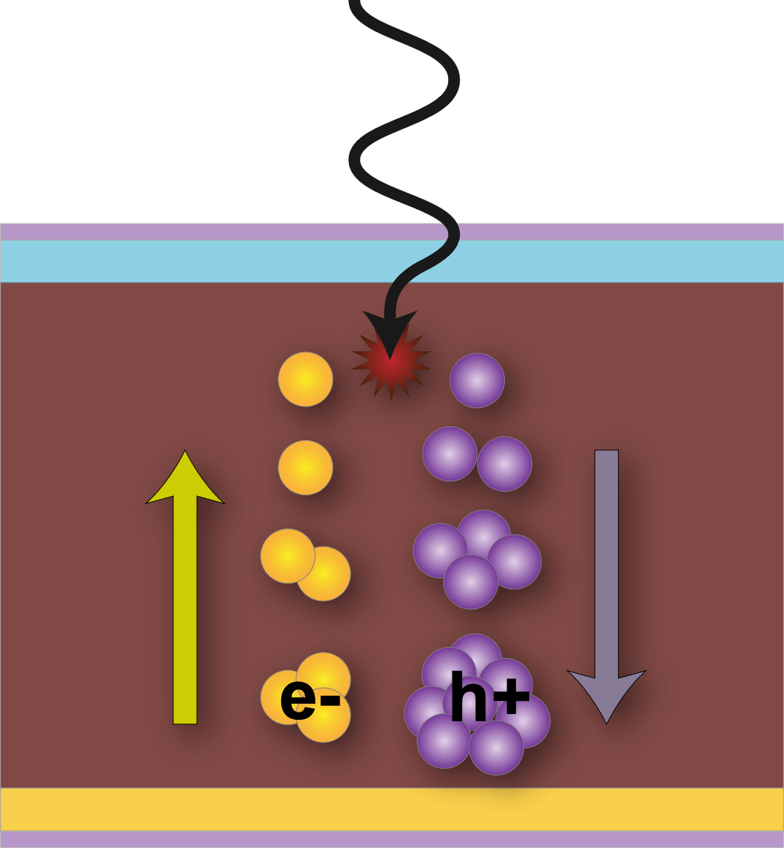
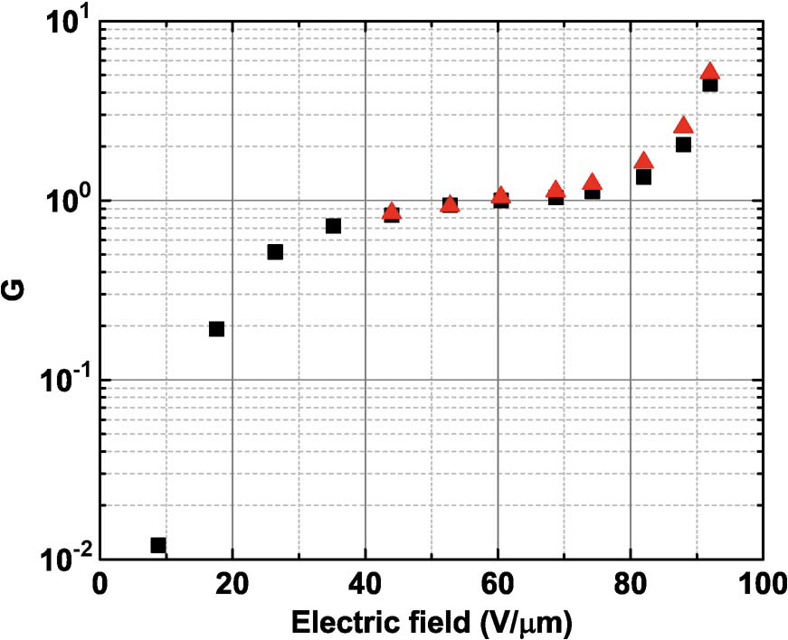
Why a-Se?
High resistance 🡪 Low DC Dark Currents (high SNR)
High attenuation coefficients from visible (E_{G} ~2 eV) to X-ray (<70 keV)
High resolution, minimal spread
Low threshold for avalanche multiplication (>65 V/um)
Low-cost, large area fabrication
Tunable properties through doping/alloying
Applications in:
Medical Imaging
Bio Sensors
Crystallography
High Energy Physics
Threat Detection
Abbaszadeh et al. IEEE Trans. on Elec. Dev. (2012) DOI:10.1109/TED.2012.2204998
Notes:
The Radiological Instrumentation Laboratory strongly focuses on amorphous selenium for both photo and X-ray detection.
Amorphous selenium has found applications in
Medical Imaging
Bio Sensors
Crystallography
High Energy Physics
Threat Detection
It exhibits an intrinsic high resistance, and when paired with blocking layers has very low leakage currents
It has a high absorption coefficient above the band gap, from visible to VUV to X-rays
The semiconductor has minimal charge spreading in the material, leading to high resolution
In addition, it is capable of impact ionization, with a low threshold for avalanche at approximately 65 to 70 V/um, making it ideal for high sensitivity needs
It can be deposited uniformly across large areas by thermal evaporation, leading to low costs of the photoconductor layers
Of interest to this talk, it is easily doped and alloyed, leading to tunable properties to target specific applications

Slide 4
Doping and Alloying with Group IV, V, & VI elements
<r> = 2.13
Can change properties such as:
Band gap
Leakage currents
Carrier transport
Sensitivity
Structure & coordination
Crystallization
Stability
<r> = 2.40
<r> = 2.80
Se
X
Notes:
Doping or alloying a-Se with group 4, 5 and 6 elements has been under study for over 50 years
This can change the properties of the material such as
Band gap
Leakage currents
Carrier transport
Sensitivity
Structure & coordination
Crystallization
Stability

Slide 5
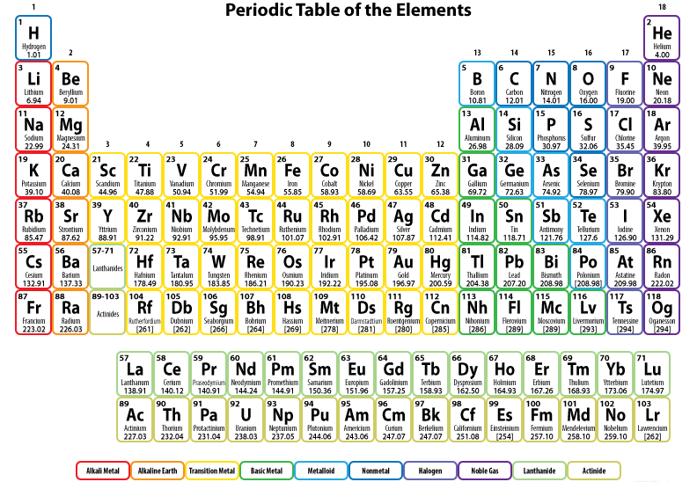
Doping and Alloying with Group IV, V, & VI elements
Notes:
a-Se is a group 6 chalcogenide, and as a film in a pure form tends towards a ring-like molecular structure, with frequent coordination defects and dangling bonds.
Studies have largely included Metals and Metalloids, though there has been some work with transition metals and halogens

Slide 6
Doping and Alloying with Group IV, V, & VI elements
Arsenic
Chlorine
Doped at 0.1 – 0.5 %
Stabilizes, preventing crystallization
Introduces deep hole trap states, lowering carrier lifetime
10-40 ppm
Mitigates deep hole traps from As
Improves carrier lifetimes, with minimal effect on mobilities
Kasap et. al, JMS Mat. in Elec. (2000), v 11, 3, p 179
Kasap et. al, Semiconductors, V 37, 7, p 789
Notes:
The most commonly used elements are arsenic and chlorine
Films of a-Se naturally tend towards crystallization over time
Doping with arsenic at 0.1-0.5% helps in stabilize a-Se, preventing tendency to crystallize
However, induces deep traps lowering hole carrier lifetimes
This can be mitigated with very small amounts of chlorine about 10-40ppm
Thus filling the deep hole traps from As and improving carrier lifetimes and having minor effect on carrier mobilities with additional shallow traps
As transport in a-Se is trap assisted, the addition of a small number of shallow traps is not detrimental to device performance
We see that even these small amounts of dopants can make a big impact on material performance

Slide 7
Doping and Alloying with Group IV, V, & VI elements
Tellurium
Germanium
Increasing Te decreases E_{g}
Induces traps, lowering µ and 𝜏
Increases conductivity
Increases crystallization temperature
Increasing Ge first raises E_{g}, then lowers it
Lowers µ_{e}, then increases
First increases thermal stability, then lowers
Very content dependent
Can we find the right compositions to harness the benefits while mitigating the downsides for our applications?
Notes:
Our particular interests lie in altering properties to increase the device responsivity at longer wavelengths, improve transport, and modify the impact ionization field
Tellurium has been shown to decrease the band gap of a-Se, though induces shallow and deep trap states resulting in reduced mobility and lifetimes of charge carriers
Increasing tellurium content increases the conductivity of the film, resulting in greater leakage currents
but also raises the crystallization temperature of the amorphous film, though at a threshold of 30% Te content, the alloy tends back towards a crystalline structure
Germanium has a more complicated relationship with a-Se
Increasing Ge content first raises the bandgap of a-Se, until beginning to decrease at high levels of Ge
It also initially reduces electron mobility, until at roughly 10% beginning to increase it
This is in large part due to the structural changes induced by the molecular coordination
We also see this as the thermal stability increases then lowers as Ge increases
Selenium-tellurium is already in use as a photo absorbing layer in a-Se detectors, particularly high-gain avalanche rushing amorphous photodetectors
Germanium-selenium is of high interest for ovanic threshold switching devices for memory applications
But what if we could harness the advantages of these alloys without all of the downsides?
To that end, we have begun studying tellurium and germanium alloying, taking a deeper look for our specific applications in photodetection.

Slide 8
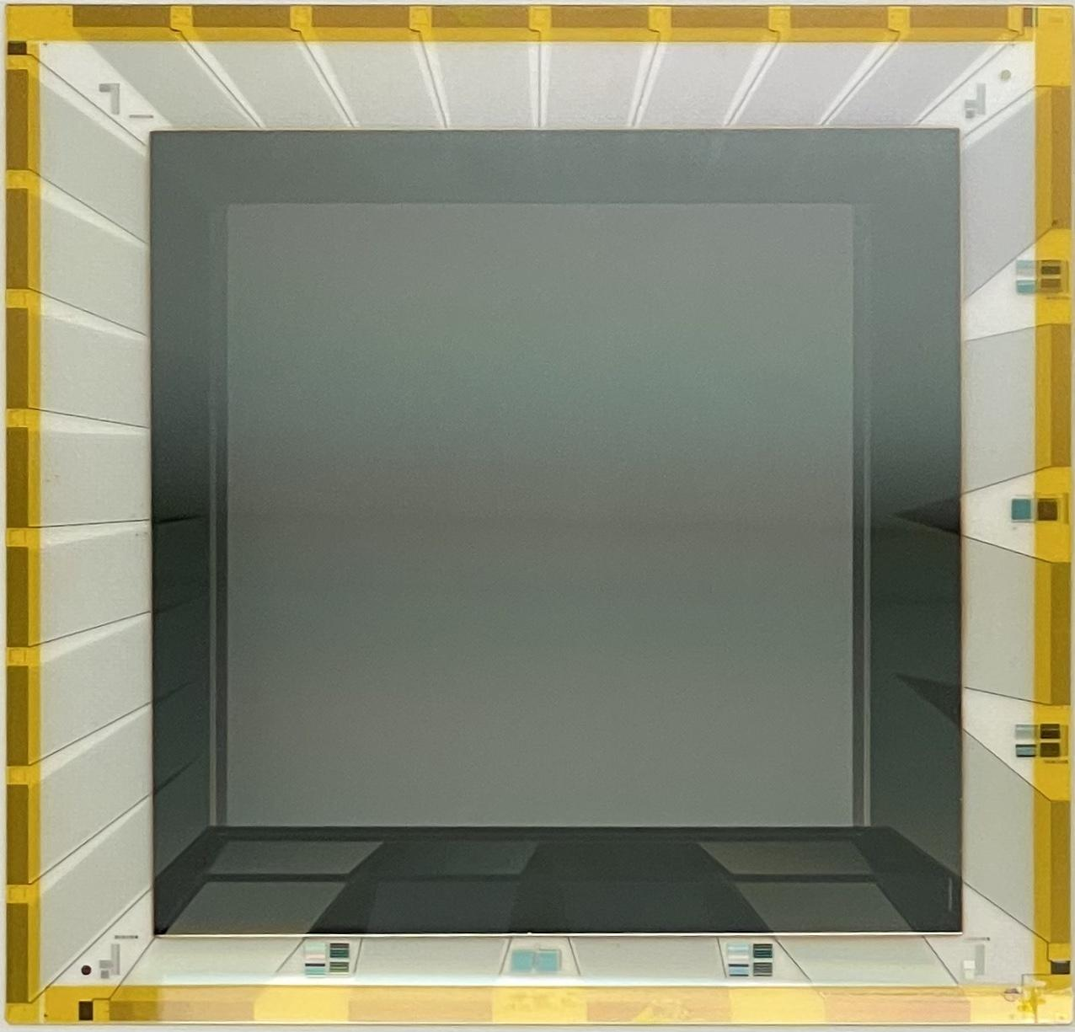
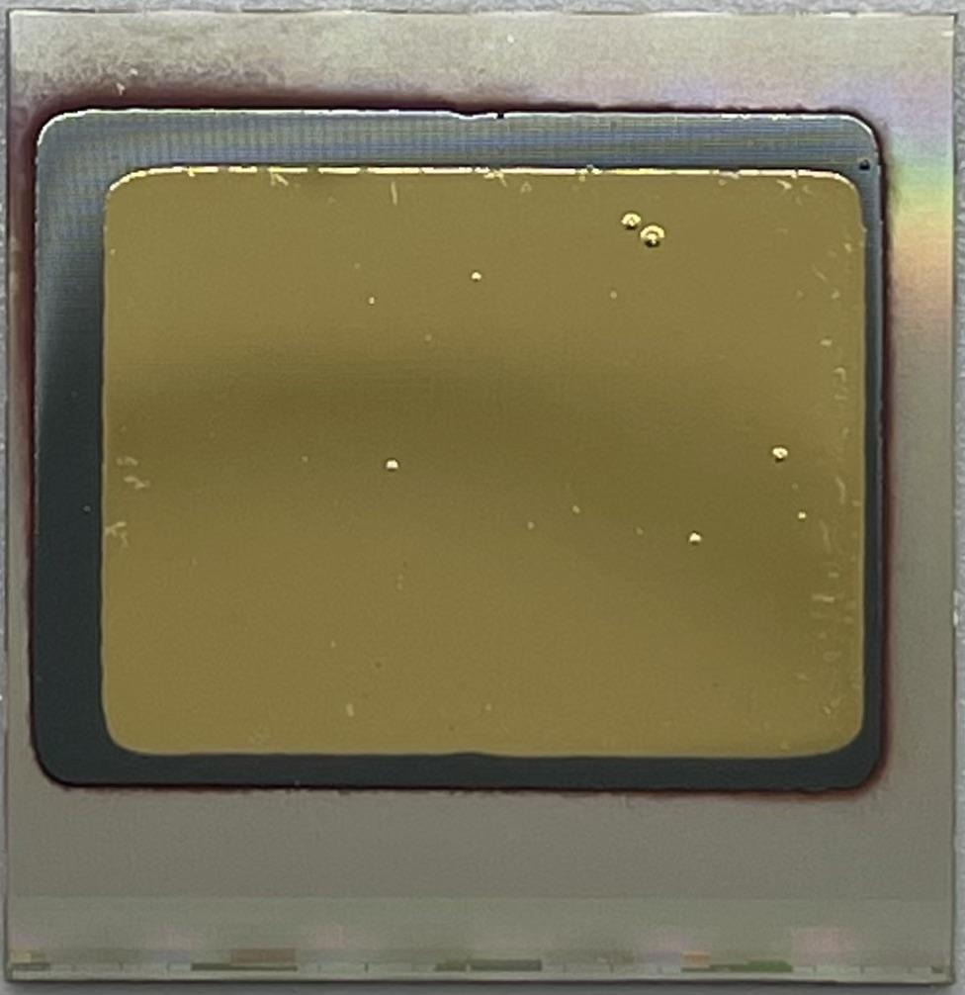
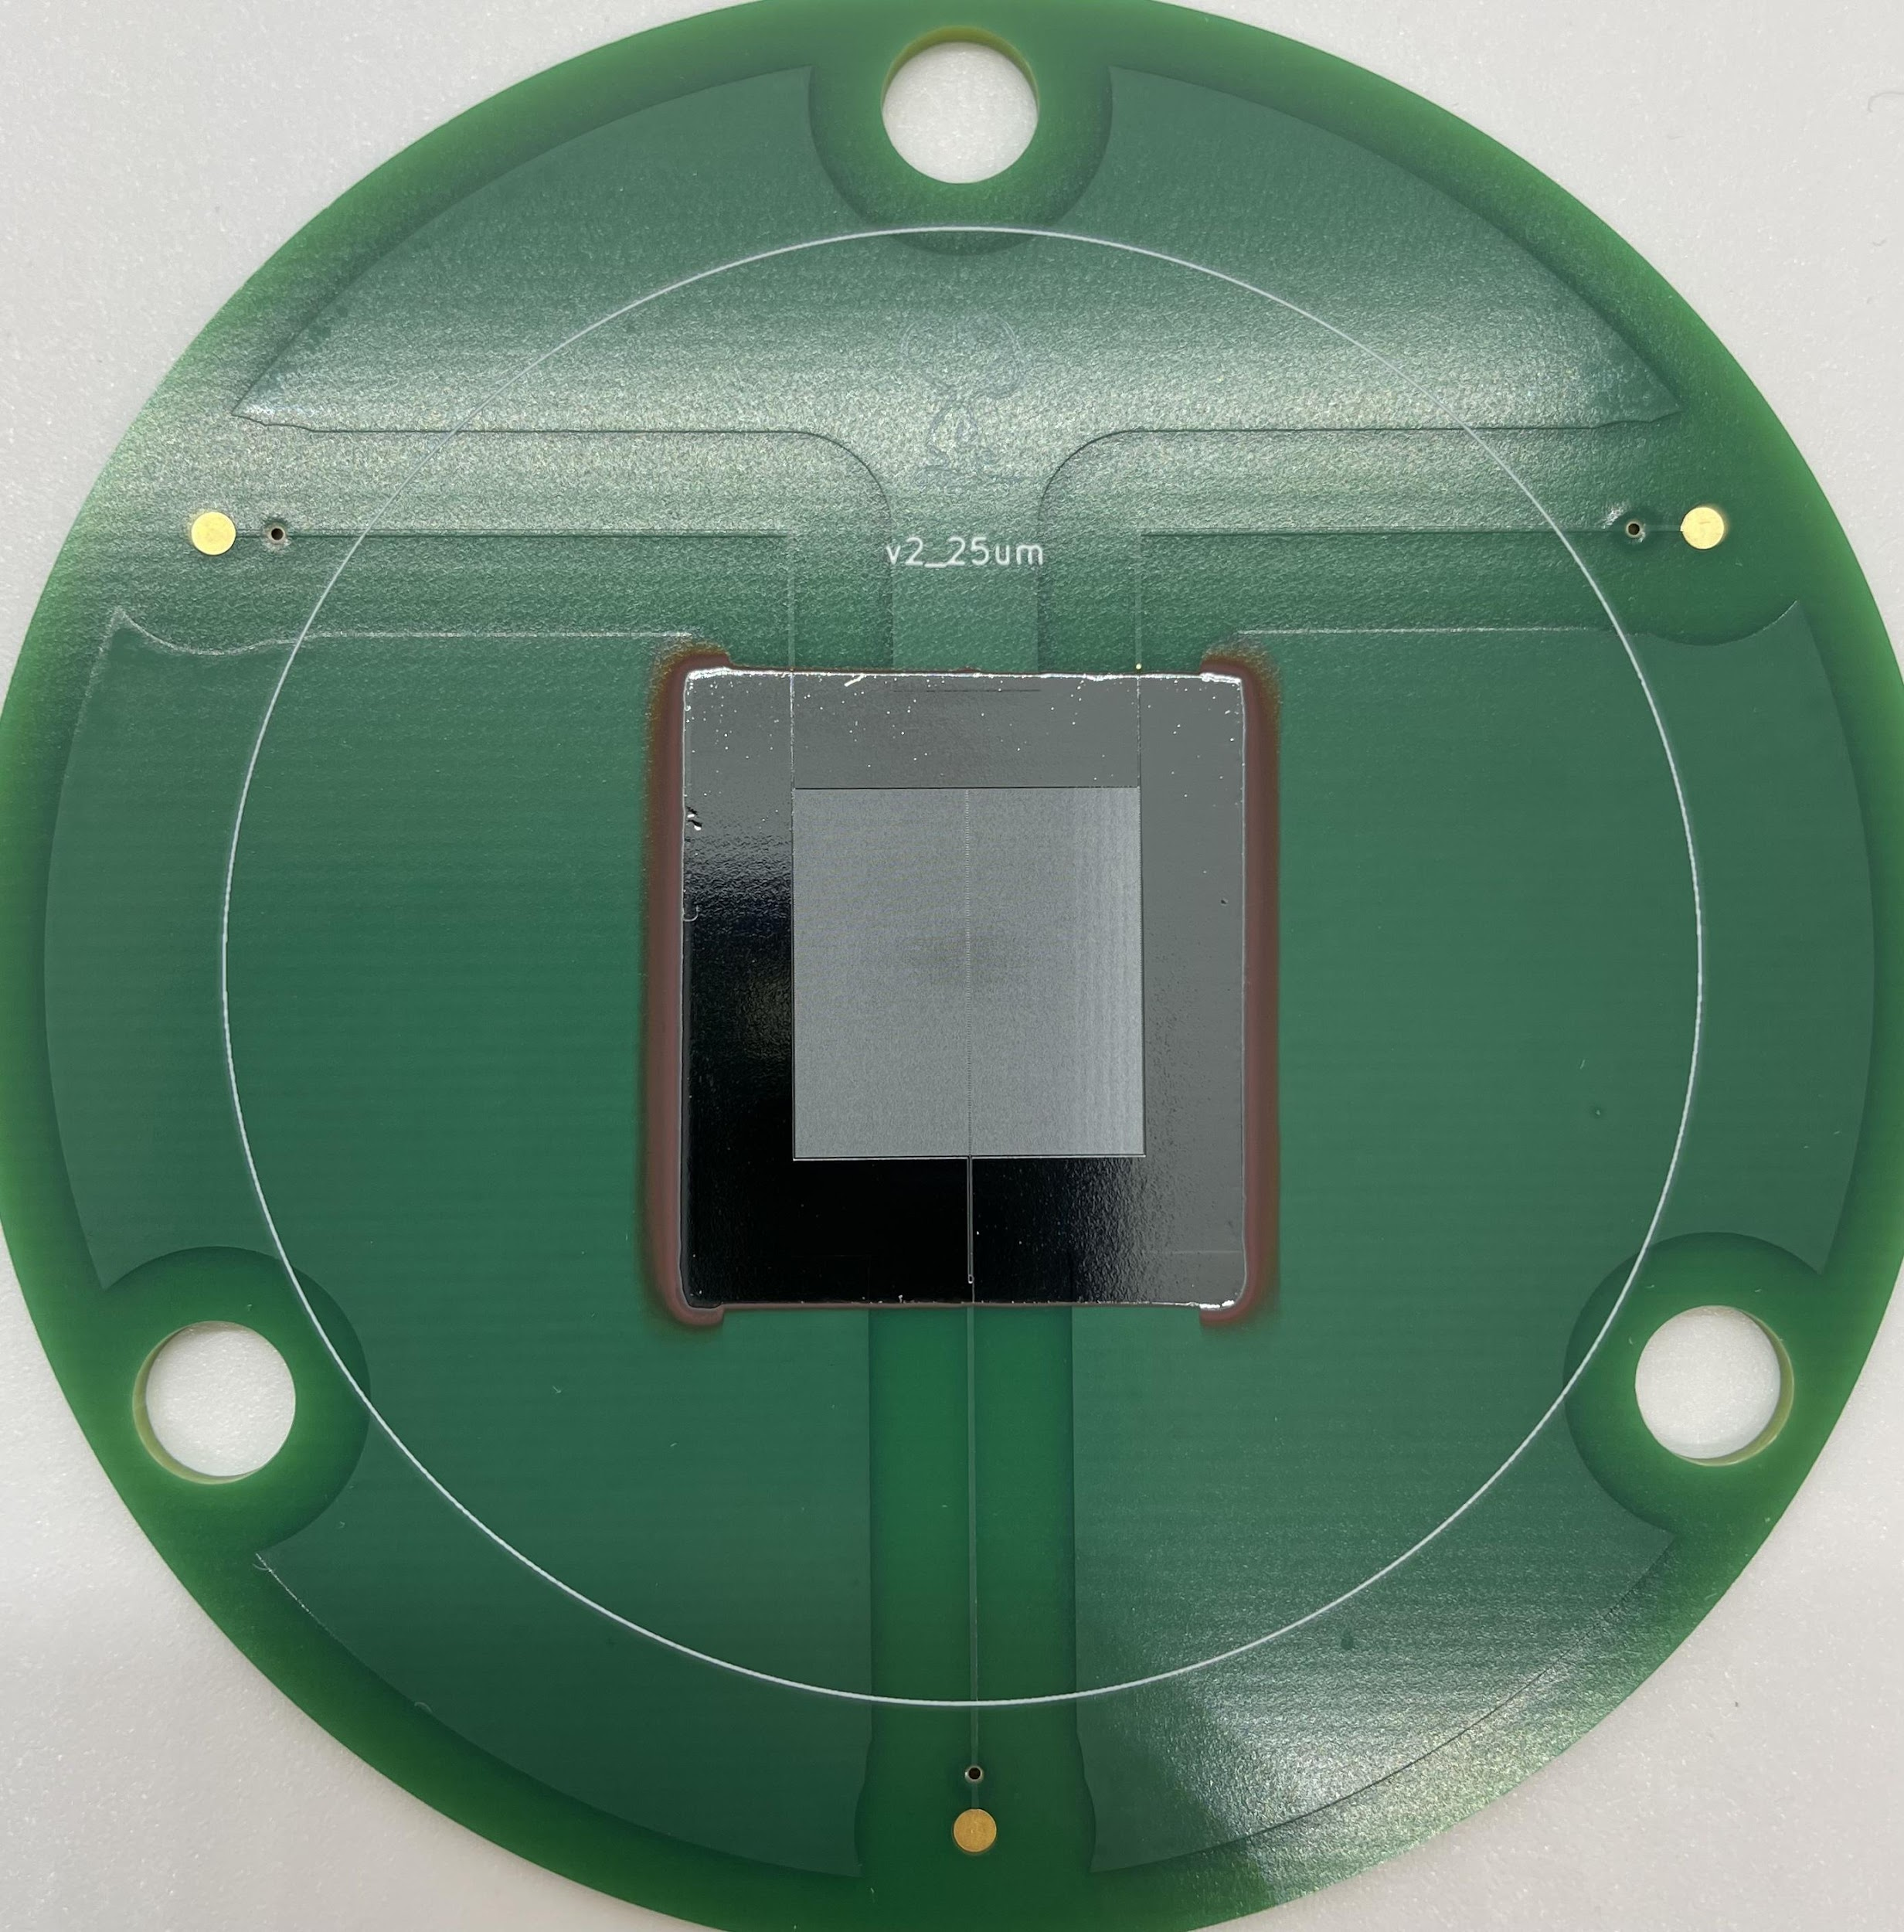
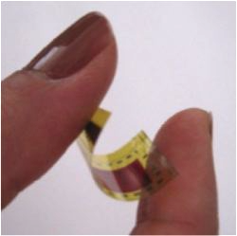
Fabrication
Custom-built, dedicated selenium thermal evaporator and e-beam deposition systems
Capable of multi-material depositions, including all layers for detector architecture
One of the few or only U.S. research facilities capable of uniform, large area a-Se detector fabrication
Notes:
We fabricate our devices in house, varying from single pixel detectors to large area flat panels, CMOS chips, and interdigitated electrode devices
This is done via a custom-built, dedicated selenium thermal evaporator paired to an electron-beam evaporator
These systems are capable of multi-material depositions, designed to be able to deposit each layer of detector; we also utilize a clean room for some blocking layers.
We believe this to be one of the few or only US research facilities cable of full detector fabrication, with uniform areas up to 5”x5”

Slide 9
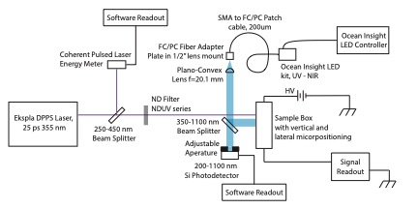
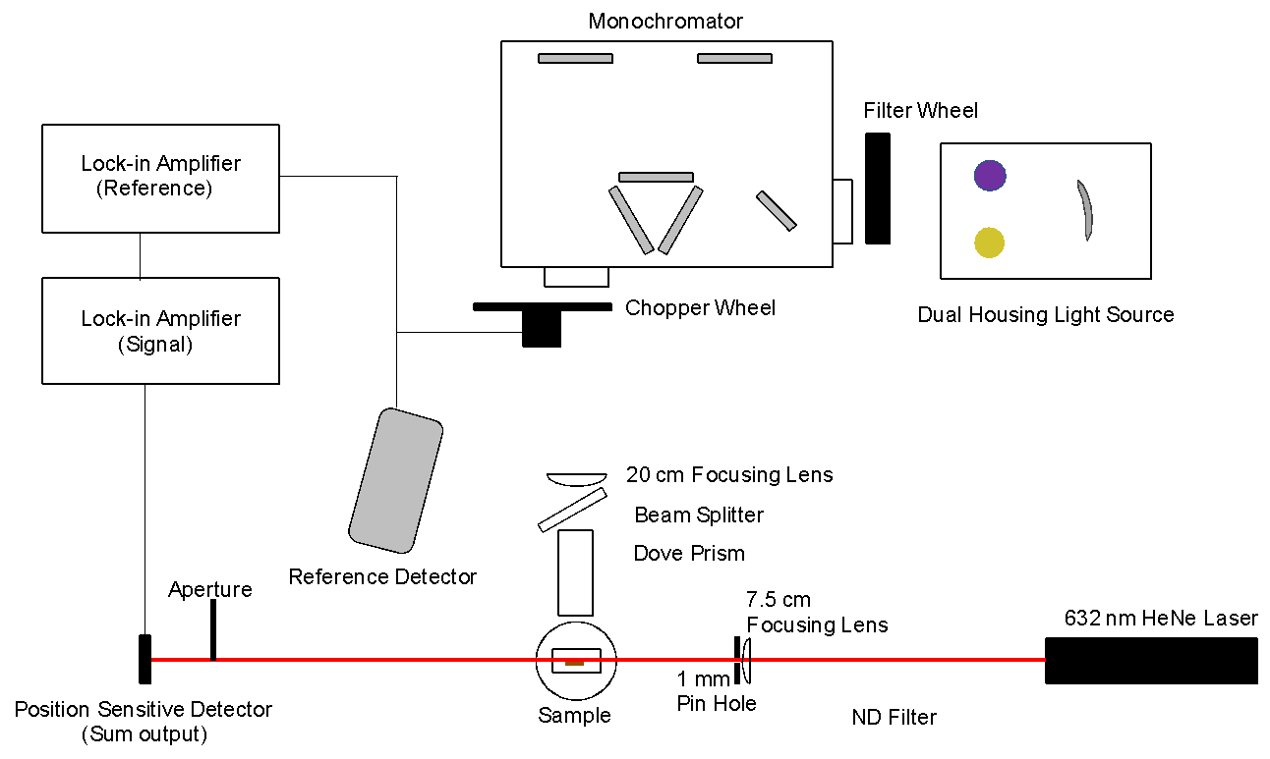
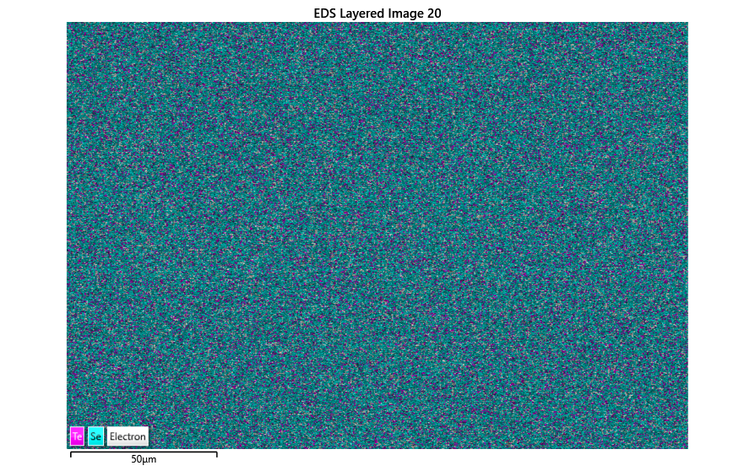
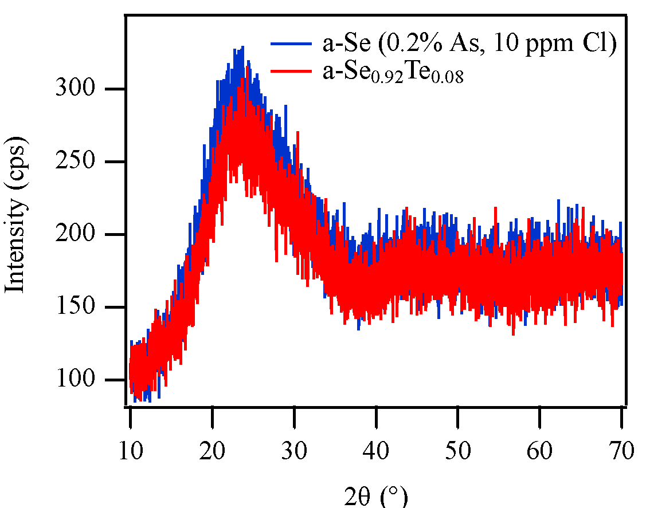
Characterization
Transient Photocurrent Time of Flight
&
Dark/Photocurrent
Electric field
ITO
Au
+
–
+
–
+
–
+
–
Laser
+
–
+
–
–
+
+
–
+
–
+
–
+
–
Photothermal Deflection Spectroscopy
SEM-EDS Mapping
X-ray Diffraction
Notes:
We characterize our devices by various means, including
Transient photocurrent time of flight, which allows us to extract carrier transit times, giving mobility and trap state information,
dark and photocurrent measurement for leakage current, quantum conversion efficiencies, and lag in our material
Photothermal deflection spectroscopy, commonly referred to as PDS, for analyzing optical band edge and sub-gap absorption,
And energy dispersive X-ray spectroscopy and X-ray diffraction to analyze composition and structure (or lack there of)

Slide 10
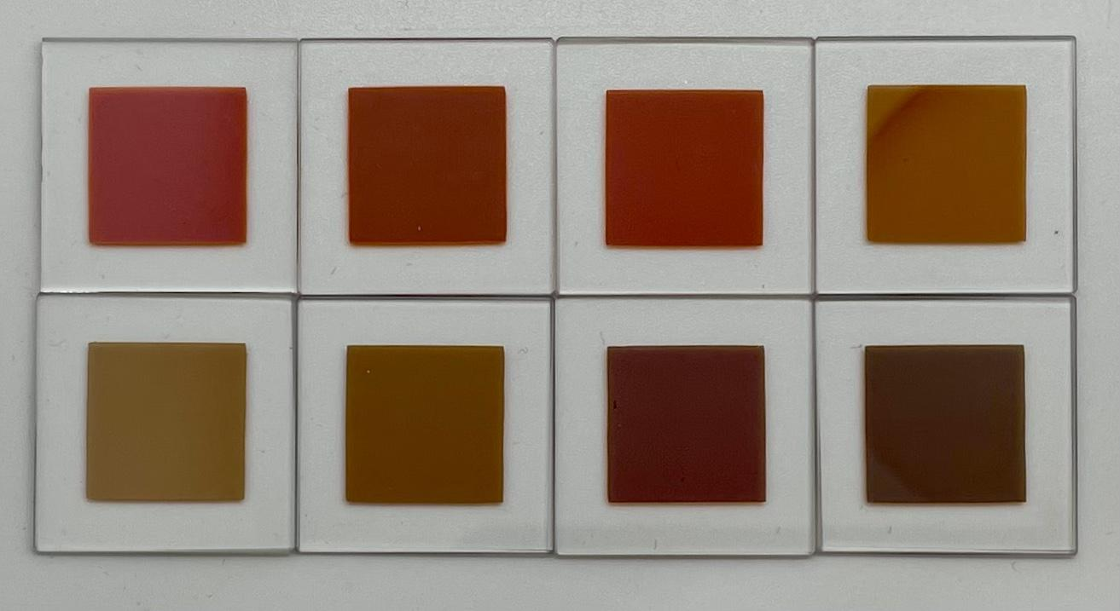
Alloying of a-Se_{1-x}Te_{x}
Increasing Te Content
Hellier et. al, ACS AEM (2023), v 5, 5, p 2678
Notes:
We began by studying thin films of selenium-tellurium, which were fabricated from pre-alloyed pellets by our provider at 10%, 20%, and 30% tellurium
The resulting films often ended up deficient in tellurium, likely due to a slightly higher melting point of tellurium relative to selenium
As you can see on the left, the films undergo a visible change in color, indicative of the lowering of the band gap that we extract from PDS measurements, seen on the right.
You can note the decrease in slope for the selenium-tellurium over pure selenium, (slide change)

Slide 11
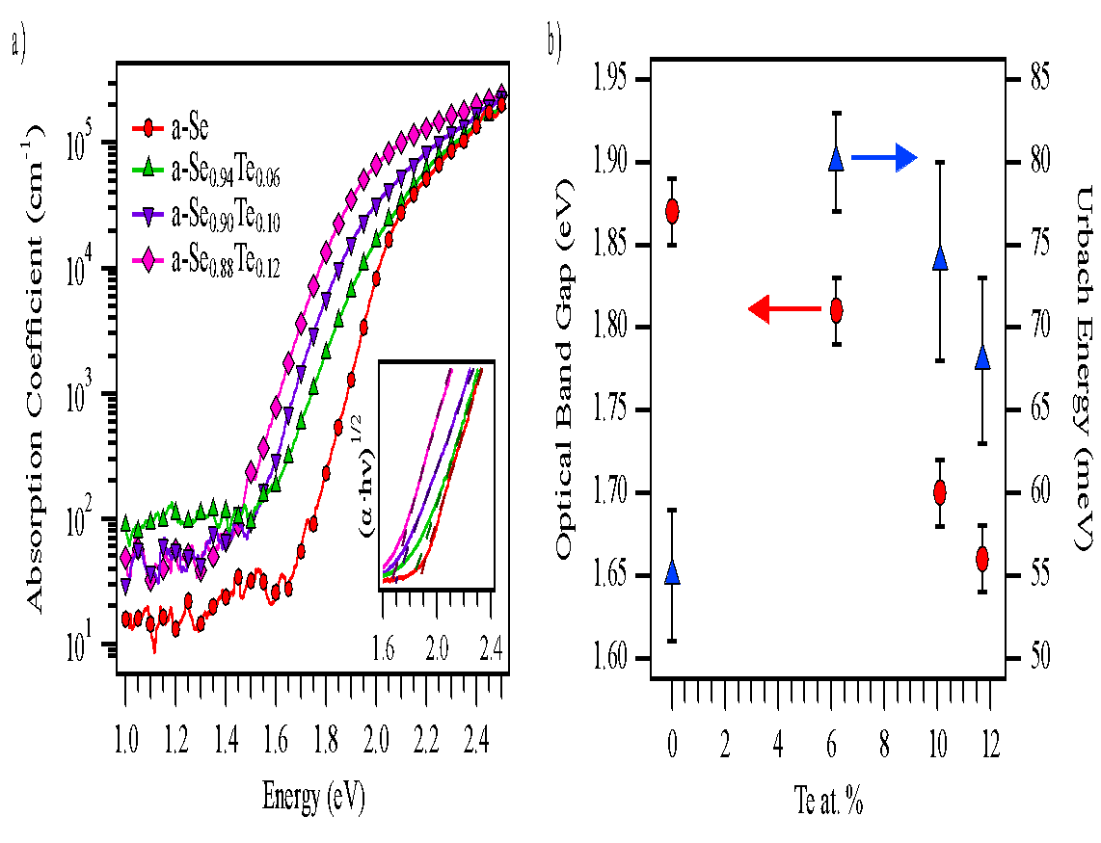
Alloying of a-Se_{1-x}Te_{x}
Increasing Te Content
Hellier et. al, ACS AEM (2023), v 5, 5, p 2678
Notes:
Which gives a higher Urbach energy and disorder in the materials, as you can see on the right in the blue triangles.
Adding tellurium up to 12% results in a drop of the optical bandgap from 1.87 to 1.66 eV, similar to results previously reported.

Slide 12
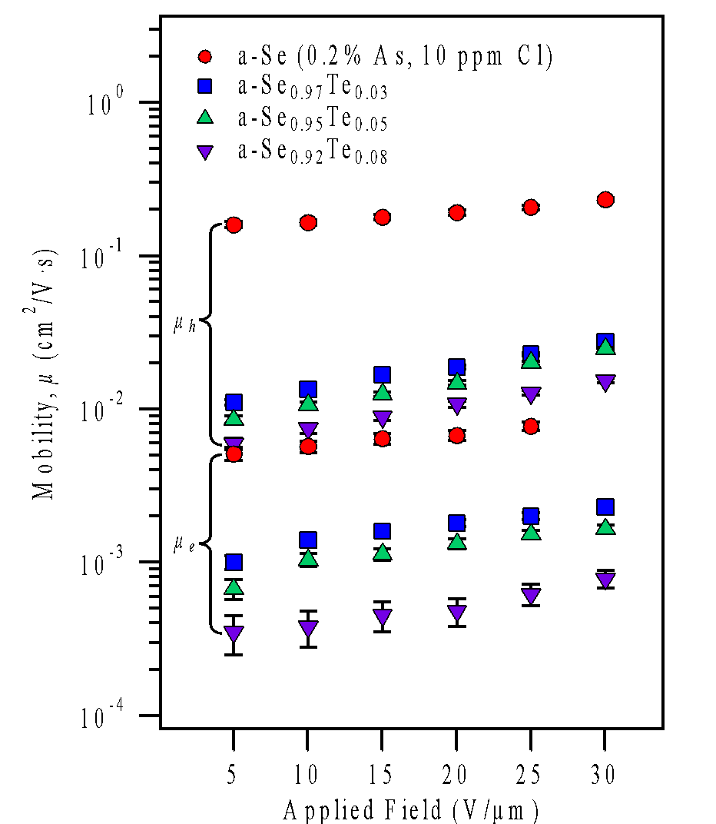
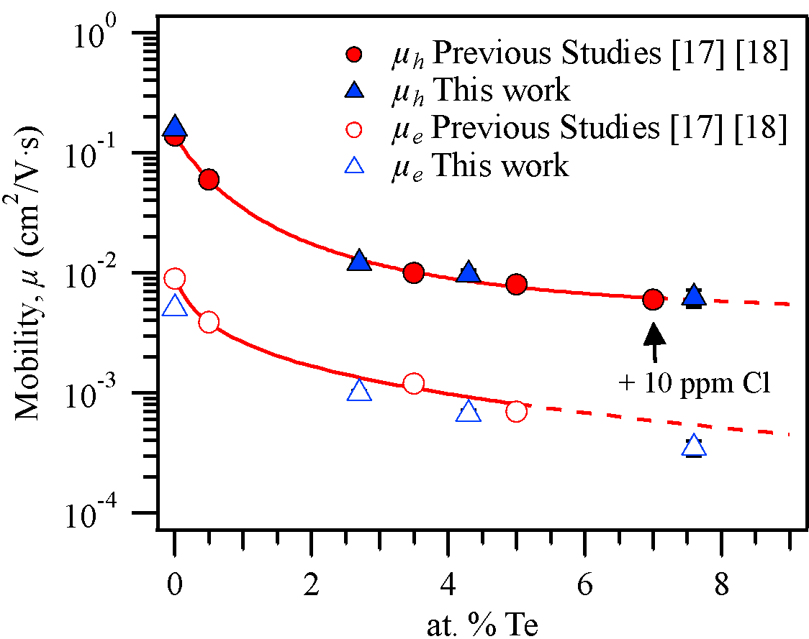
Alloying of a-Se_{1-x}Te_{x}
a-Se_{0.90}Te_{0.10} sample
5 V/um
Hole
Electron
Hellier et. al, ACS AEM (2023), v 5, 5, p 2678
Notes:
For device measurements, films of 15 um were deposited on ITO, then a 100 nm top contact of gold was deposited on top.
TOF studies showed that increasing the tellurium content resulted in a drop in both hole and electron mobilities
In the plot on the left, we see a significant drop in both with just a small addition of tellurium, in line with previous studies
We also biased our samples at higher fields, as you see on the right, and observed an exponential increase in the mobilities with increasing field across all samples.

Slide 13
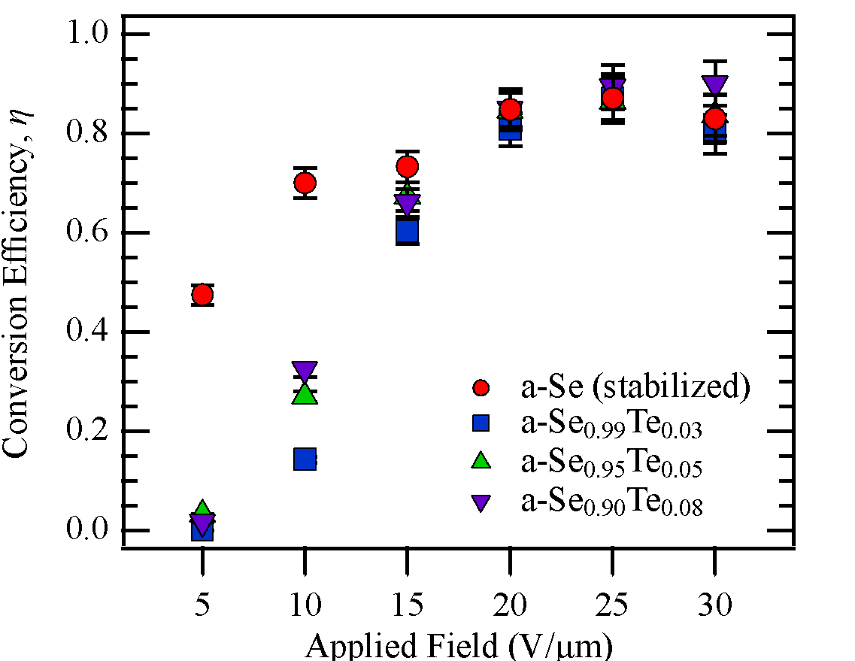
Alloying of a-Se_{1-x}Te_{x}
Hellier et. al, ACS AEM (2023), v 5, 5, p 2678
Notes:
With mobilities in hand, we turned to our conversion efficiency to evaluate performance as a photodetector.
At low fields, we saw as expected; the alloyed samples did not perform as well as the stabilized selenium.
However, as we went to higher fields – up to 30 V/um, which in previous studies had not been explored – we discovered that the alloyed samples increased in efficiency to within error of the stabilized Se sample.
After much discussion and modeling with the established Onsager mechanism for amorphous selenium, we established that this was due to a field dependent thermalization length, likely induced by energy barriers too great to surmount at low fields.

Slide 14
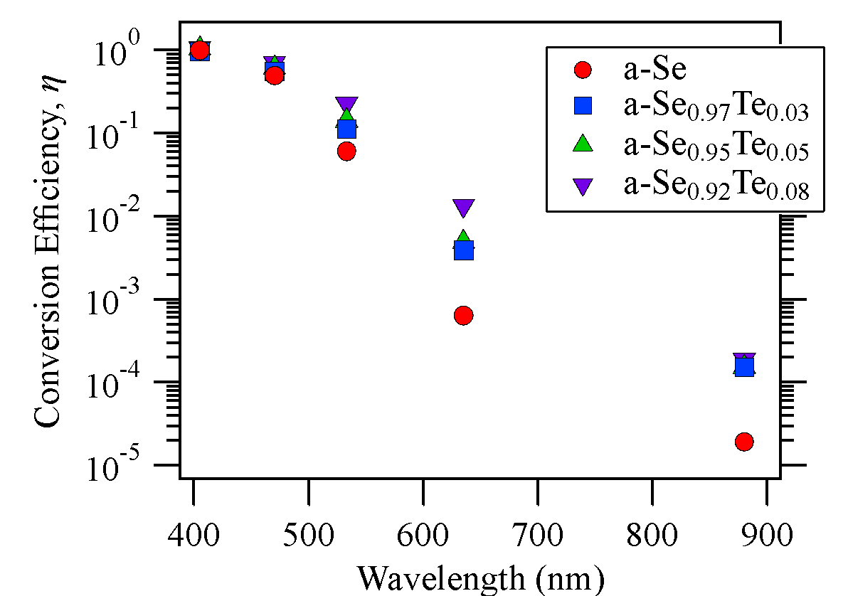
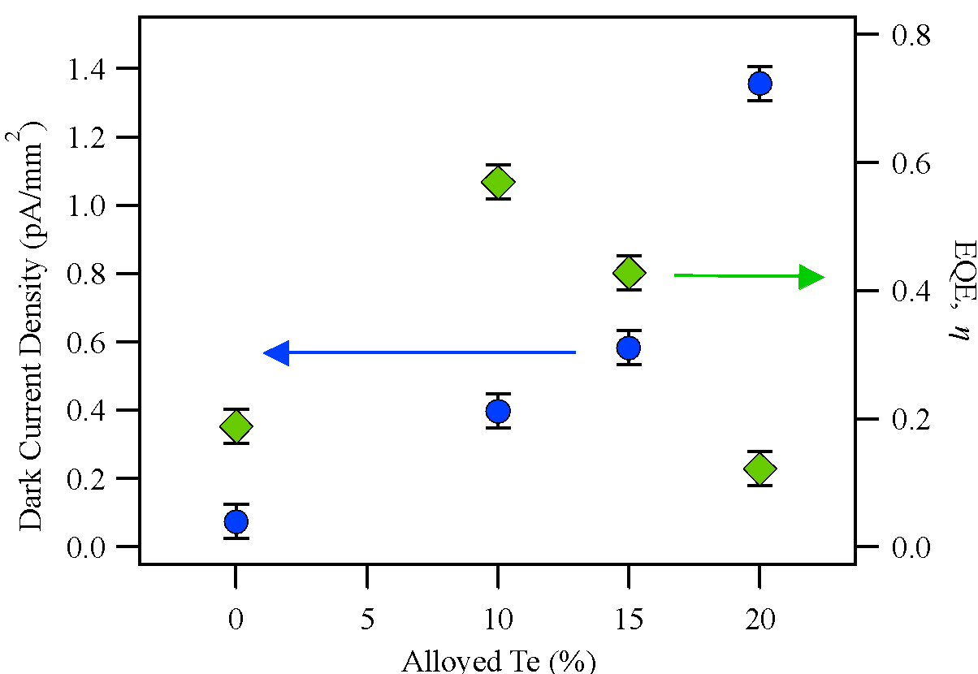
Alloying of a-Se_{1-x}Te_{x}
Increase from 0.05% to 1.5% with Te at 635 nm
(Small) response at 880 nm from Te alloys, minimal from Se
Leakage & QE @ 533 nm
40 V/um
15 V/um
New samples with blocking layer at higher concentrations show increasing but low leakage
Much large EQE response from 10% alloy, though response decreases at higher Te
Notes:
Next we analyzed the behavior of the devices at longer wavelengths, seen on the left. At shorter wavelengths, the Te-alloys behave similarly as the stabilized Se. As we increase our wavelength, we see an improved response from the alloyed samples, with an increase of 0.05 to 1.5 % at 635 nm and a response, albeit small, at 880 nm from the Te alloys where the stabilized sample signal was minimal.
To probe higher alloy levels, we fabricated additional samples at 10, 15, and 20%. We specifically probed them at 533 nm, close to the emission wavelength of ahigh performing scintillator. We see dark current densities increase slightly but remain low, and see a large increase in external quantum efficiency with the 10 % alloy, increasing from 21 to 58%. As the Te concentrations increase past this, we see a lower EQE, possibly due to too many deep traps induced.

Slide 15
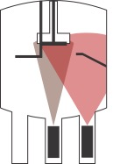
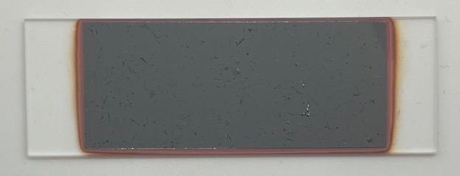
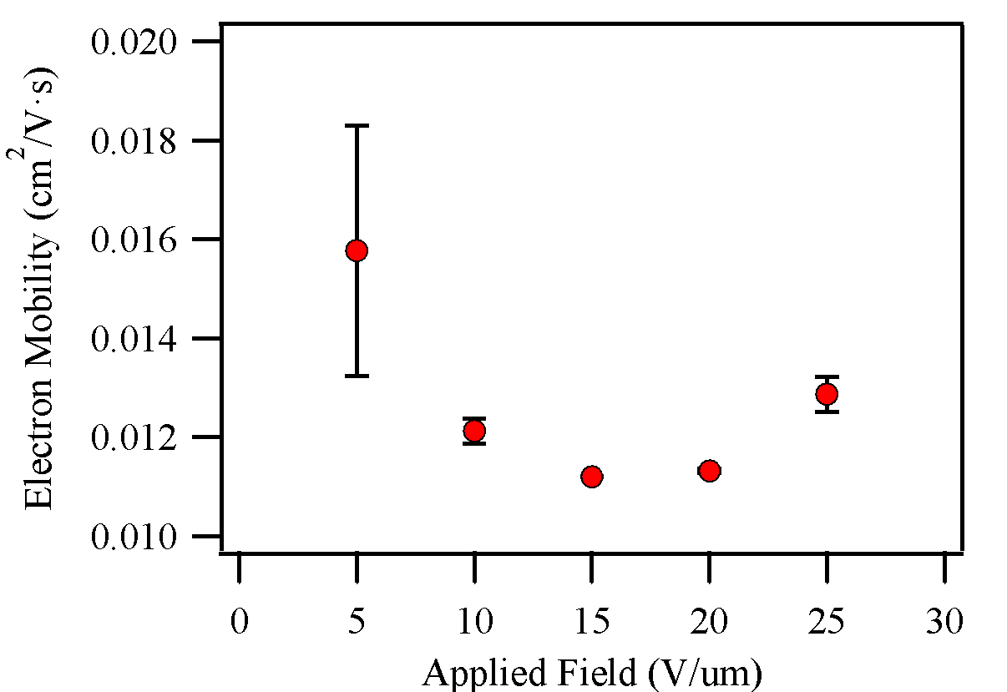
Alloying of a-Ge_{x}Se_{1-x}
Evaporated alloy of Ge_{0.1}Se_{0.9}
🡪 Fabricated Ge_{0.004}Se_{0.996}, only 6 um thick
Issue: Se melting temperature is 220 C, Ge is 938 C
Se is evaporating, leaving behind solid Ge
Overall drop in electron mobility, however the limited thickness may have resulted in slew rate issues for TOF
🡪 Requires co-deposition of Se and Ge to achieve high quality, uniform films
Heater
Sample
shutter
Sample
Thickness
monitor
a- Ge_{0.004}Se_{0.996}
Ge
Se
Crucible
Notes:
More recently, we have also begun investigating the alloying of Ge into a-Se.
We attempted fabrication of a 10% Ge sample from pre-alloyed material by evaporation; At best we were able to fabricate a 0.4% Ge sample at 6 um thick. Unfortunately, we ran into issues of large melting point differences between Se and Ge, 220 C and 938 C respectively, which resulted in spitting of the material and germanium remaining in the crucible post deposition.
Electron mobilities were reduced compared to pure or stabilized a-Se, as expected at low Ge level., however exhibited some unusual behavior, first decreasing then increasing with field.
In order to address this and move further with our system, we must convert to co-deposition.
In doing so allowing for Ge to reach its melting point to evaporate our desired Ge content alloy

Slide 16
Summary & Future Development
In Summary:
We’ve fabricated a-Se alloyed with Te up to 20%
Found photodetector performance meets that of stabilized a-Se at fields > 15 V/um
At higher fields & concentrations, found 10% Te to give the best response
Begun studies on Ge-Se
Resolving issues in deposition techniques by transitioning to a co-deposition setup
Next Steps:
Continue studying material properties of Se-Te systems
Impact ionization, crystallization, X-ray performance, and mutli-pixel devices
Develop additional evaporation source for co-deposition of Ge-Se, then optimize composition for best properties
Investigate a combined Ge-Se-Te system, utilizing co-deposition and pre-alloyed pellets, and optimize for responsivity, charge transport, and impact ionization

Slide 17
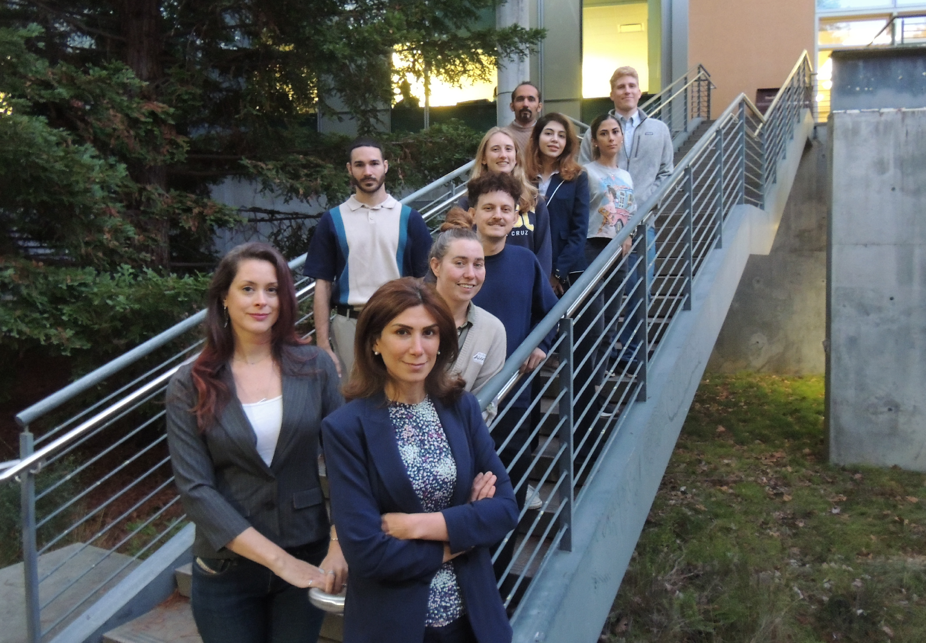
Radiological Instrumentation Laboratory (RIL)
Dr. Shiva Abbaszadeh
Electrical & Computer Engineering
sabbasza@ucsc.edu
Funding Provided by:
National Institute of Health
R01EB033466
Postdoctoral Scholars
Dr. Kaitlin Hellier
Dr. Emily Enlow
Dr. Jennifer Ott (SCIPP)
Graduate Students
Gregory Romancheck (UIUC)
Akyl Swaby
Mariana Huerta
Greyson Shoop
Daniel Fiallo
Kimia Gholemi
Mohammadreza Mohseni Ferezghi
Parissa Aghaei
Hamid Mirzanezhad
Undergraduate Students
Molly McGrath
Max Teichera
Department of Energy High Energy Physics
DE-SC0022343
Western Digital Corporation
Notes:
Thank you for joining me today, I am happy to answer your questions if I'm able!

