Slide 1
KID-based phonon-mediated detectors
presented by Osmond Wen¹
in collaboration with Taylor Aralis¹, Ritoban Basu Thakur^{1,2}, Bruce Bumble², Yen-Yung Chang¹, Lauren Hsu⁴, Noah Kurinsky³, Karthik Ramanathan¹, Brandon Sandoval¹, Zoe Smith³, Dylan Temples⁴, and Sunil Golwala¹
¹ ² ³ ⁴
Overview
Position & energy performance
KIPM detector + KI-TWPA
Summary

Slide 2
A particle detector shopping list
highly energy resolving
sub-eV energy thresholds for sub-GeV dark matter
event reconstruction
position sensitivity
event-type discrimination
→ requires pixelized and multiplexed readout
 | Dark Matter | Neutrinos
sub-eV energy thresholds | sub-GeV dark matter, both nuclear- and electron-recoiling | sensitivity to p-p solar neutrinos
event reconstruction | background rejection nuclear recoils vs electron recoils (DM & CEνNS searches) scintillation backgrounds (CUORE/0νDBD) detector surface backgrounds (SuperCDMS)
Overview
Position & energy performance
KIPM detector + KI-TWPA
Summary

Slide 3
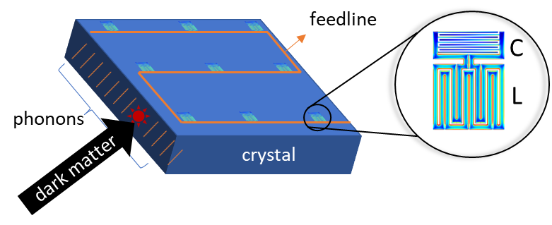
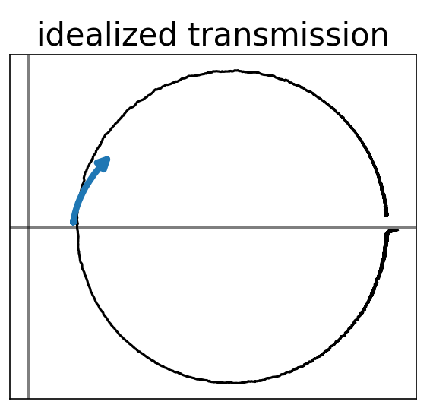
Kinetic inductance detectors
superconducting microwave resonator
phonons in substrate → broken Cooper pairs → shifted resonance and RF transmission
two quadrature readout of RF transmission: dissipation and frequency
key advantage: natively multiplexable, i.e. simultaneous readout of many resonators coupled to one feedline → enables position reconstruction for rejecting surface backgrounds
Kinetic inductance phonon-mediated detectors: KIPM detectors
Main sources of noise
type of noise | affected quadrature | source/description of noise
amplifier white noise | both | thermal noise from the cryogenic amplifier (typically at 4K)
two level systems | only frequency | loss from surface defects, e.g. metal oxides
generation-recombination (fundamental) | both | poissonian noise of Cooper pairs breaking and then recombining
frequency
|transmission|
dissipation
frequency
Overview
Position & energy performance
KIPM detector + KI-TWPA
Summary

Slide 4
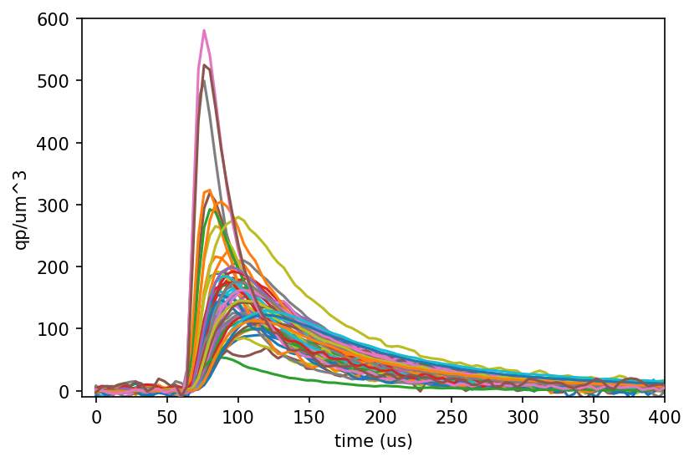
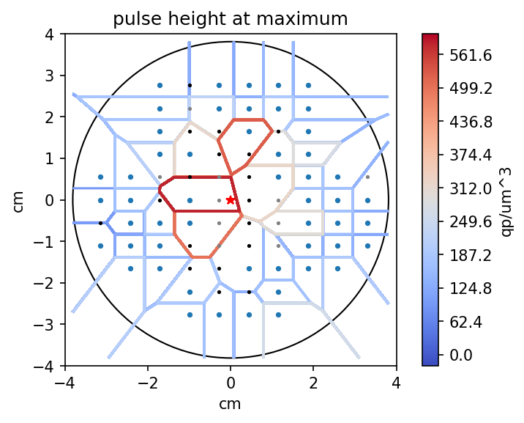
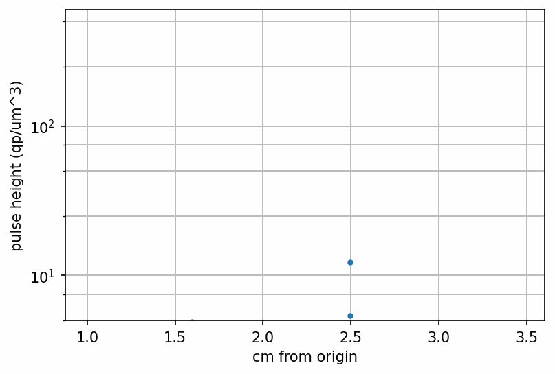
Phonon imaging with a KIPM detector
80-resonator KIPM detector pulsed with a 475nm LED and ~50 good resolution resonators were asynchronously readout
different “prompt” responses based off position
similar “delayed” responses
phonon movie!
blue dot = good resolution resonator
Overview
Position & energy performance
KIPM detector + KI-TWPA
Summary

Slide 5
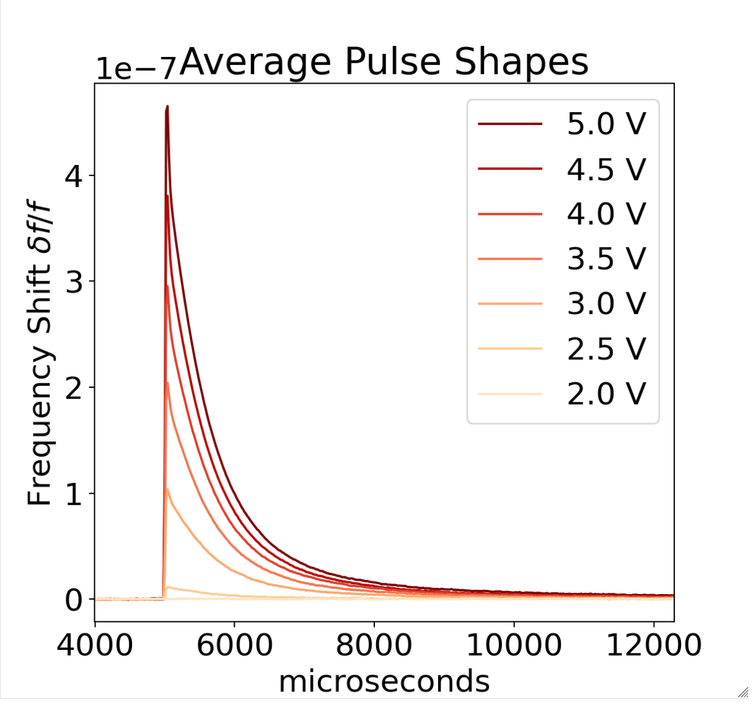
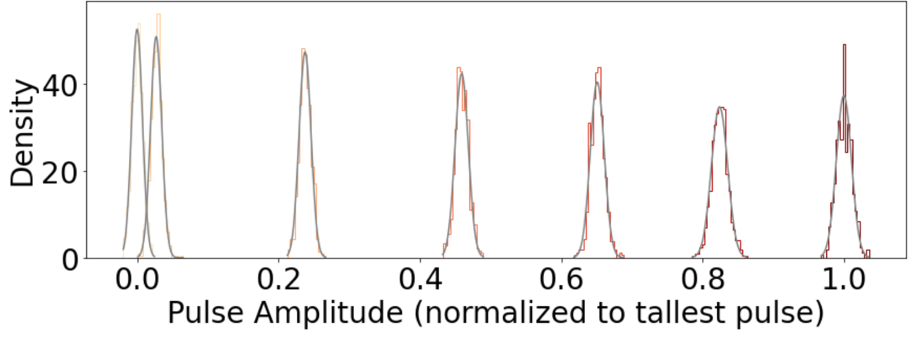
Energy resolution of KIPM detectors
energy reconstruction with multiplexed phonon sensors $σ_{E}=\sqrt{N_{sensors}}\frac{σ_{E,abs}}{η_{ph}}$
$\sqrt{N_{sensors }}$: quadrature sum of multiplexed sensor response
$σ_{E,abs}$: resolution on energy absorbed by a phonon sensor; “intrinsic energy resolution”
$η_{ph}$: phonon collection efficiency
calibrated a single resonator KIPM detector at Fermilab using shot noise of optical photons
Lederman Fellow Dylan Temples
millisecond lifetimes achieved with readout chain IR shielding
optical fiber
device parameters
$$N_{sensors}$$ | 1
$$η_{ph}$$ | 0.8%
$$σ_{E,abs}$$ | 2.5 eV
$$σ_{E}$$ | 320 eV
ms lifetimes!
Overview
Position & energy performance
KIPM detector + KI-TWPA
Summary

Slide 6
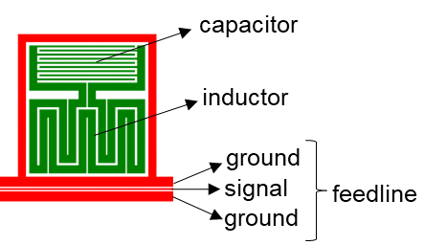
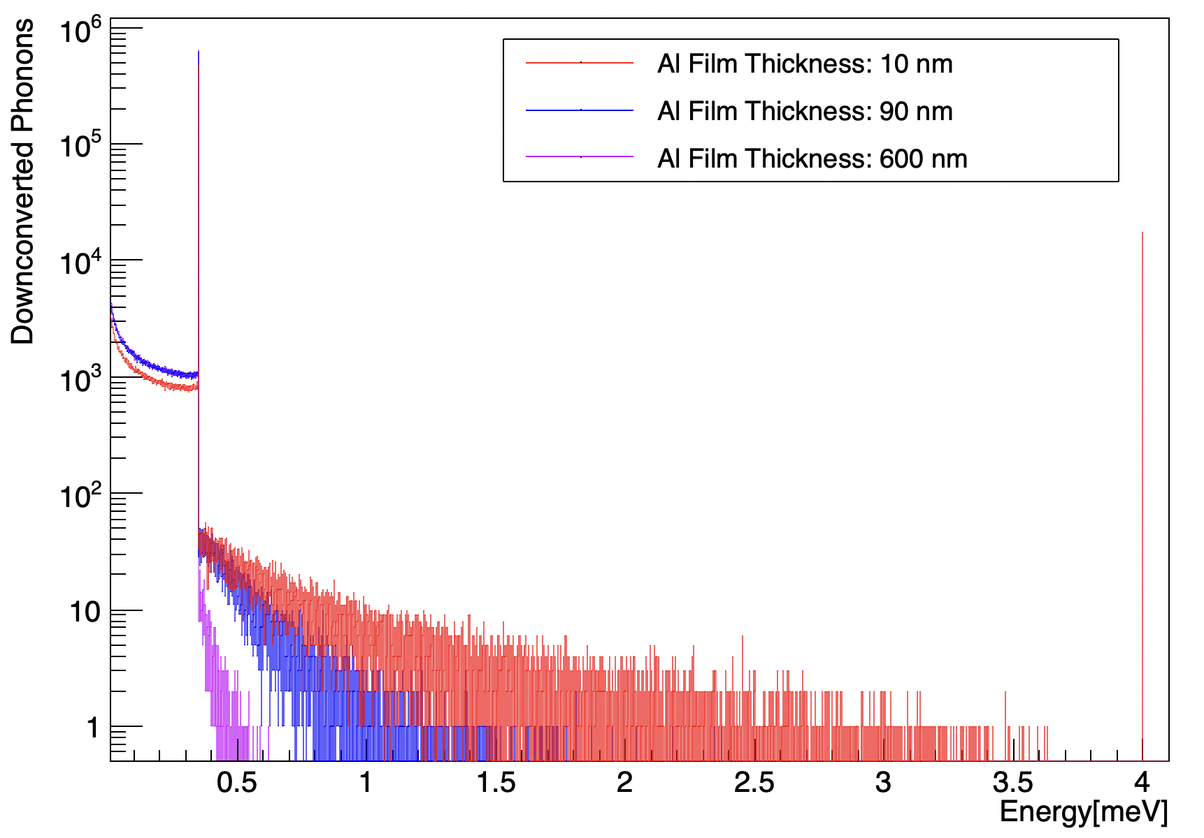
Phonon physics of the substrate
$$σ_{E}=\sqrt{N_{sensors}}\frac{σ_{E,abs}}{η_{ph}}$$
Why is the phonon collection efficiency $η$_{ph} so poor? What are the dominant loss mechanisms?
down-conversions in high-gap materials (feedline, bond pads)
recent simulations: these materials are more down-converting than expected
current workplan: remove as much high-gap material as possible
mounting
In progress: Geant4 simulations to study how superconducting sensors impact the phonon distribution in the substrate
Ryan Linehan (FNAL)
high-gap material
sensor
high-gap material
silicon
loss
loss
mounting
mounting
Energy spectrum of phonons leaving the sensor
peaked due to recombination phonons
Overview
Position & energy performance
KIPM detector + KI-TWPA
Summary

Slide 7
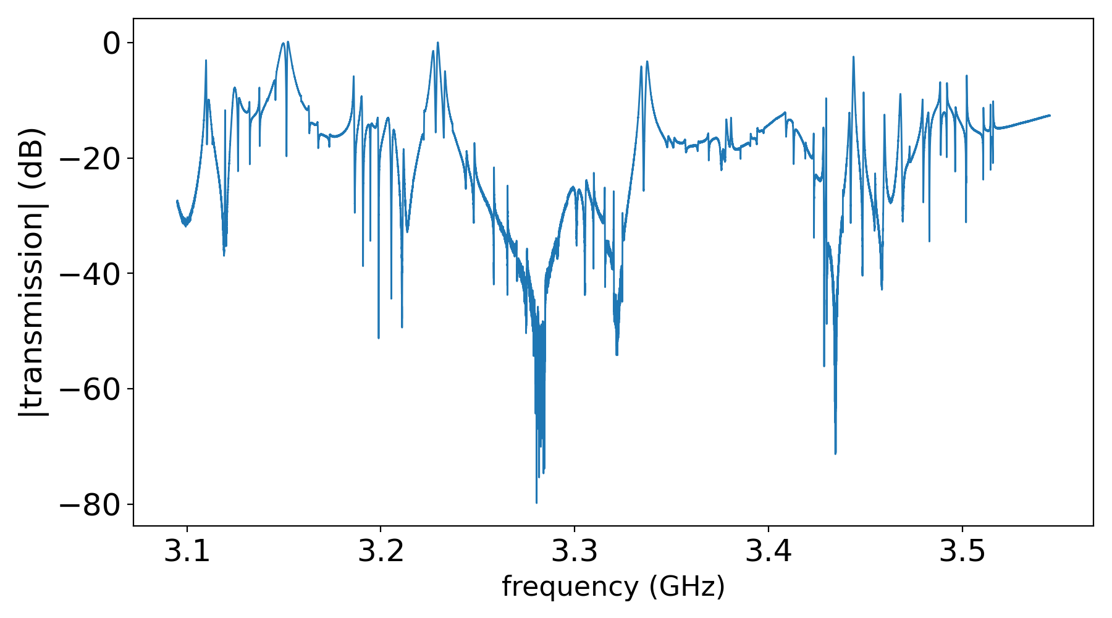
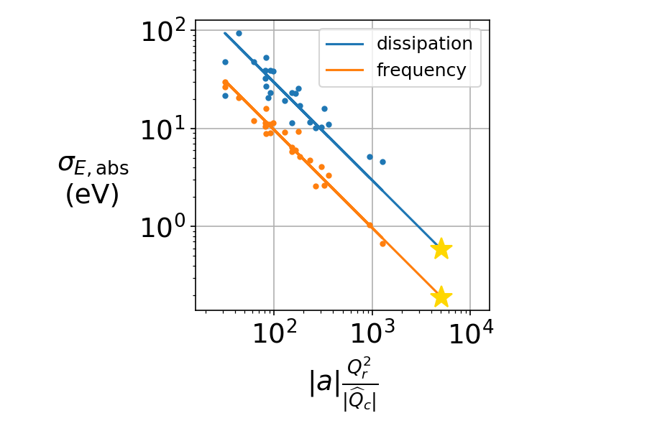
Limitations on $σ_{E,abs}$
$$σ_{E}=\sqrt{N_{sensors}}\frac{σ_{E,abs}}{η_{ph}}$$
large KIPM detector showed hugely varying transmission and resonator quality factors
hypothesis: RF excitations of the physical box and poor grounding of the CPW feedline
for amplifier-dominated noise, variations in $σ_{E,abs}$ are due to RF responsivity
capacitor
inductor
transmission variation
ground
signal
feedline
ground
7.5cm
$$\frac{dV_{ADC}}{dE_{abs}}=\left|a\right|\frac{Q_{r}^{2}}{|\hat{Q_{c}}|} αγκ \frac{1}{V_{sc}Δ}$$
@ optimal RF responsivity, $σ_{E,abs}$ given by:
580meV
190meV*
!
transmission
film responsivity
*assumes no TLS
RF responsivity: $R_{Q}$
Overview
Position & energy performance
KIPM detector + KI-TWPA
Summary

Slide 8
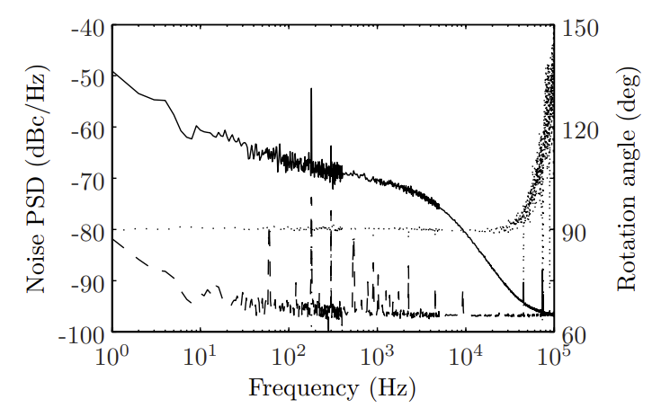
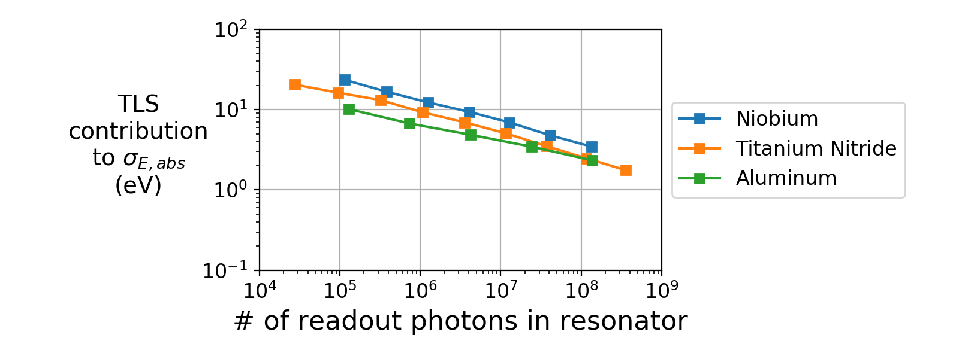
Limitations on $σ_{E,abs}$
$$σ_{E}=\sqrt{N_{sensors}}\frac{σ_{E,abs}}{η_{ph}}$$
Two-level systems (TLS) are present in surface oxides and contribute noise in the capacitor
TLS cause fluctuating epsilon, leading to dissipation and thus noise (F-D theorem)
only affects frequency quadrature
We have seen some amount of TLS noise in all our detectors, regardless of capacitor metal choice
Noise levels
Al₂O₃
frequency readout
capacitor
SiO₂
aluminum
dissipation readout
silicon
TLS will limit $σ_{E,abs}$ in the frequency quadrature to ~1-5eV
Overview
Position & energy performance
KIPM detector + KI-TWPA
Summary

Slide 9
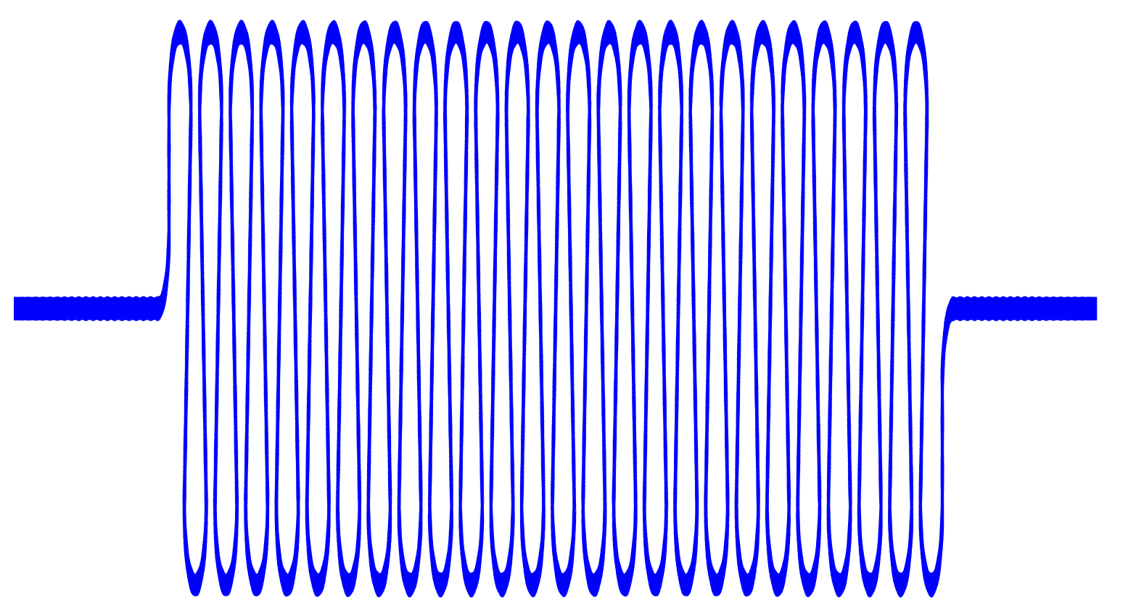
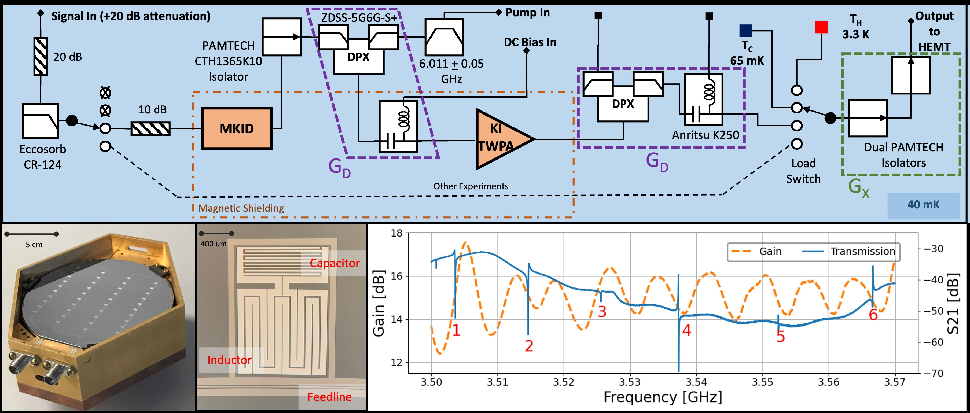
Toward quantum-limited amplification
$$σ_{E,abs}∝\sqrt{T_{amplifier}}$$
Operated a KIPM detector with a kinetic inductance traveling wave parametric amplifier
a carefully engineered transmission line that uses a non-linearity in the kinetic inductance of Cooper pairs to amplify a signal in an essentially lossless manner
purple = necessary components
green = helpful components
Overview
Position & energy performance
KIPM detector + KI-TWPA
Summary

Slide 10
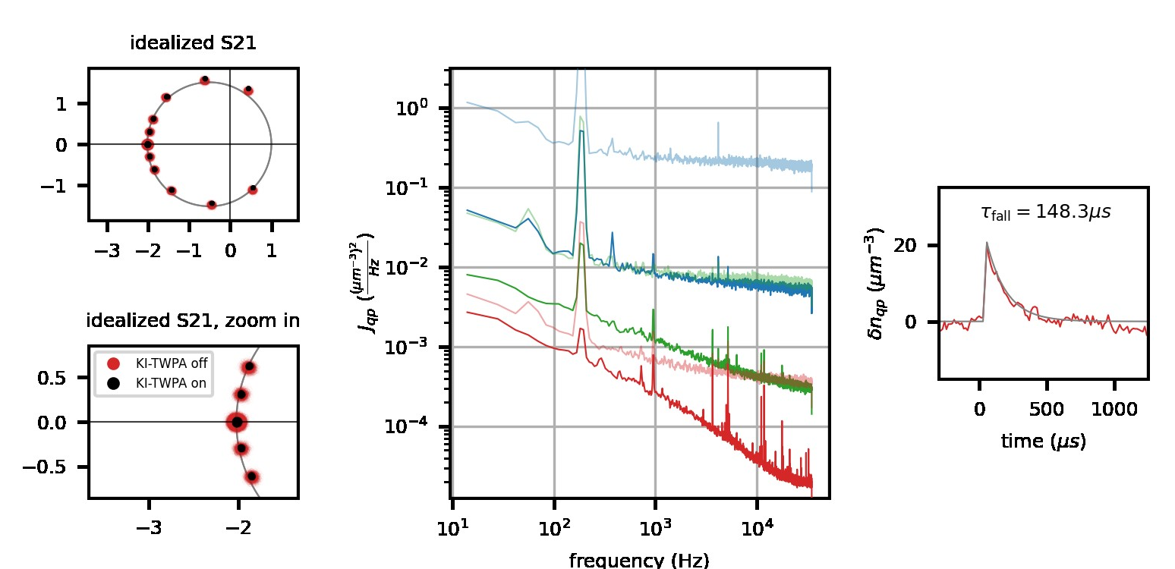
Toward quantum-limited amplification
$$σ_{E,abs}∝\sqrt{T_{amplifier}}$$
in-depth look at one resonator reveals TLS noise – not surprising
faded = KI-TWPA off solid = KI-TWPA on
(blue, green, red) = (lowest, medium, highest) readout power
first ever KI-TWPA amplified phonon-mediated particle detection!
Overview
Position & energy performance
KIPM detector + KI-TWPA
Summary

Slide 11
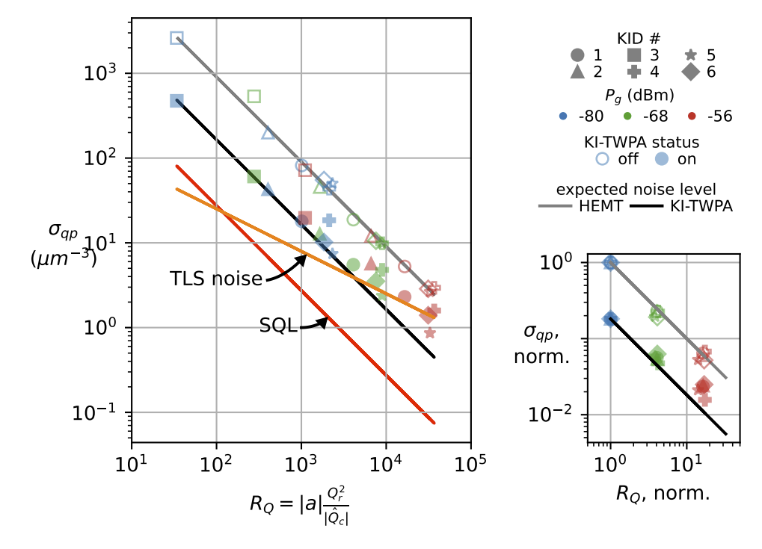
Toward quantum-limited amplification
$$σ_{E,abs}∝\sqrt{T_{amplifier}}$$
noise improvement across all resonators inhibited to some level by TLS noise
KI-TWPA and SQL lines are calibrated with an in situ blackbody load calibration
Failure to reach SQL is largely attributable to the losses in the lines that arise from passive components that are needed or helpful for operation
$$\frac{dV_{ADC}}{dE_{abs}}∝\left|a\right|\frac{Q_{r}^{2}}{|\hat{Q_{c}}|} αγκ \frac{1}{V_{sc}Δ}$$
Overview
Position & energy performance
KIPM detector + KI-TWPA
Summary

Slide 12
KIPM detectors: summary
Surface backgrounds in rare event search experiments present a need for event reconstruction
KIPM detectors are natively multiplexable and can directly provide this functionality
Beginning to understand what is needed for sub-eV energy resolutions, which will enable sub-GeV dark matter sensitivity
different “prompt” responses based off position
similar “delayed” responses
 | $σ_{E,abs}$ (freq.) | $σ_{E,abs}$ (diss.) | $σ_{E }$ $η$_{ph} = 30%
current performance | 2.5eV | 7.5eV | 8.3eV*
@ optimal RF resp. | TLS-limited | 580meV | 1.9eV*
SQL amplifier |  | 140eV | 460meV*
QIS: noiseless gain & vacuum squeezing |  | 10meV | 35meV*
literature value
*projection
need to reduce $N_{qp}$?
(GR noise)
Overview
Position & energy performance
KIPM detector + KI-TWPA
Summary

Slide 13
KIPM detector consortium
a multifaceted approach to developing the next generation of particle detectors
We are a broad consortium of individuals and institutions dedicated to this cause, with multiple fridges, cleanrooms, and high-performance computing clusters at our disposal.
Caltech & JPL: fabrication and device testing (the birthplace of KIDs and KI-TWPAs)
Fermilab: detector deployment in a low background environment
SLAC: fabrication and device testing (up and coming!)
In April of this year, Caltech hosted a hybrid remote workshop on KIPM detectors with attendance from 22 people across 8 institutions
We convene over Zoom every six weeks to catch up on KIPM detector related work
Please let me know if you are interested in attending! You can reach me at owwen@caltech.edu
Overview
Position & energy performance
KIPM detector + KI-TWPA
Summary

