Slide 1

Quantum-Enhanced Telescopy for HEP Science
Paul Stankus, BNL
CPAD 2023, RDC8 Nov 8, 2023

Slide 2
“Keep watching the skies”
HEP Cosmological Frontier invests in observing photons from the sky
Galaxy position, shape, photometric redshift
  Tech: Low-noise CCD’s Projects: DES, LSST/VRO
Galaxy precision redshift
  Tech: Low-noise spectrograph Projects: BOSS, DESI
Cosmic microwave background, incl polarization
  Tech: TES Projects: CMB-S4
HI intensity mapping, including dark ages
  Tech: RF spectrometers & interferometry Projects: LuSEE Night
Precision astrometry of bright stars and binaries
  Tech: Fast spectrograph, quantum optics Projects: TBD
New!

Slide 3
“Keep watching the skies”
HEP Cosmological Frontier invests in observing photons from the sky
Galaxy position, shape, photometric redshift
  Tech: Low-noise CCD’s Projects: DES, LSST/VRO
Galaxy precision redshift
  Tech: Low-noise spectrograph Projects: BOSS, DESI
Cosmic microwave background, incl polarization
  Tech: TES Projects: CMB-S4
HI intensity mapping, including dark ages
  Tech: RF spectrometers & interferometry Projects: LuSEE Night
Precision astrometry of bright stars and binaries
  Tech: Fast spectrograph, quantum optics Projects: TBD
New!

Slide 4
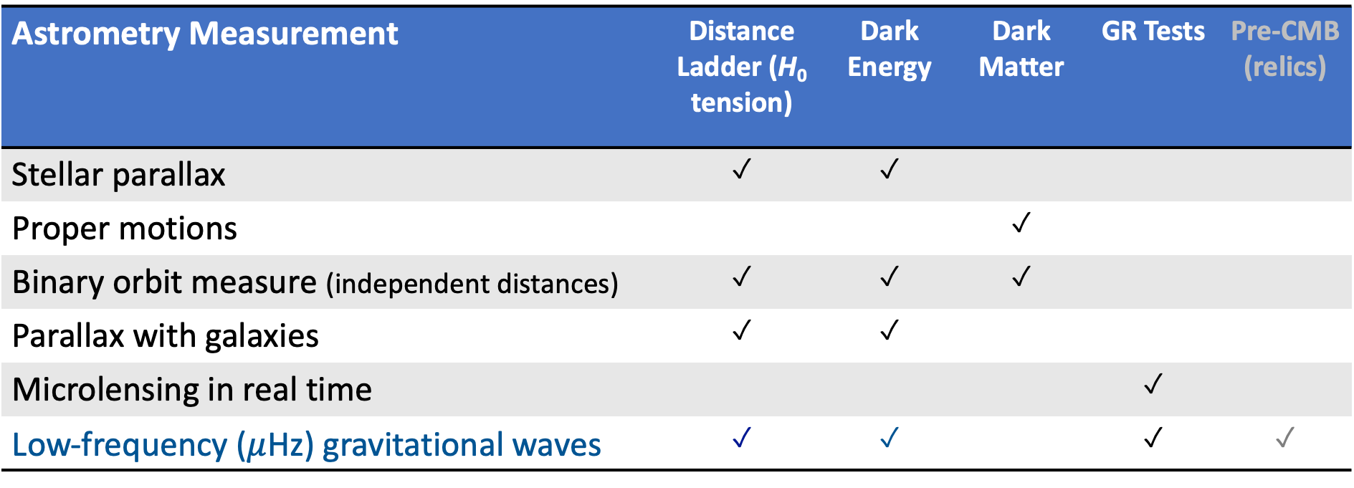
Idea: Quantum engineering can improve astronomical interferometry, both for high-resolution imaging and precision astrometry
Astrometry Measurement | Distance Ladder (H₀ tension) | Dark Energy | Dark Matter | GR Tests | Pre-CMB (relics)
Stellar parallax | ✓ | ✓
Proper motions |  |  | ✓
Binary orbit measure (independent distances) | ✓ | ✓ | ✓
Parallax with galaxies | ✓ | ✓
Microlensing in real time |  |  |  | ✓
Low-frequency ($μ$Hz) gravitational waves | ✓ | ✓ |  | ✓ | ✓

Slide 5
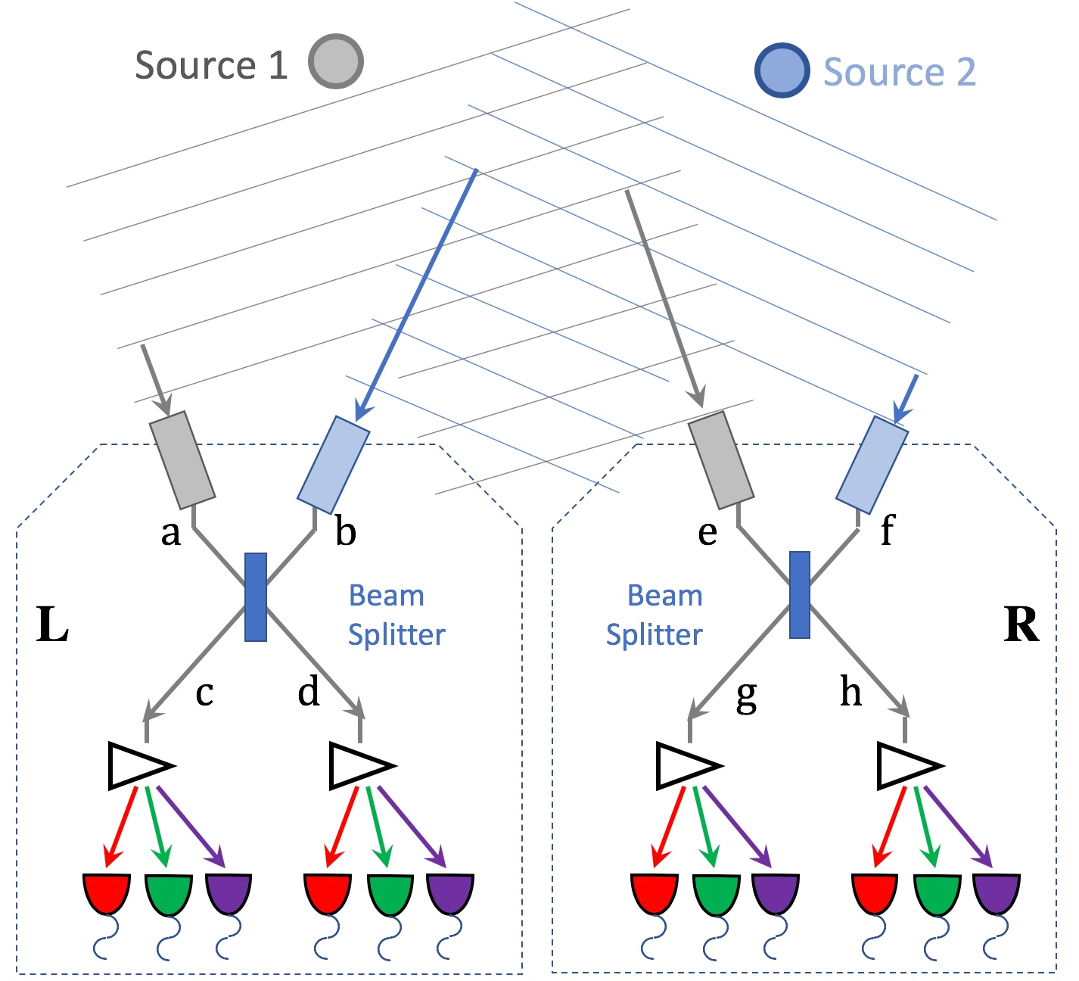

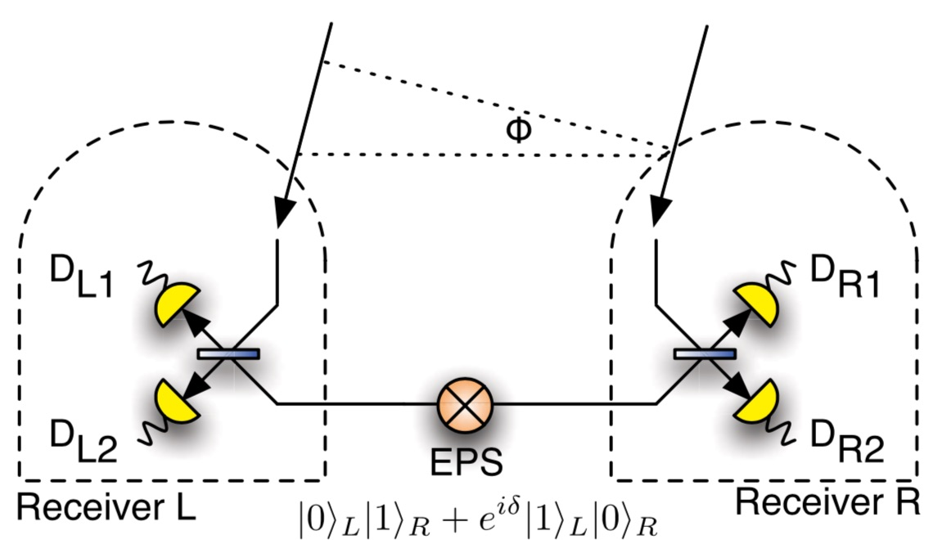
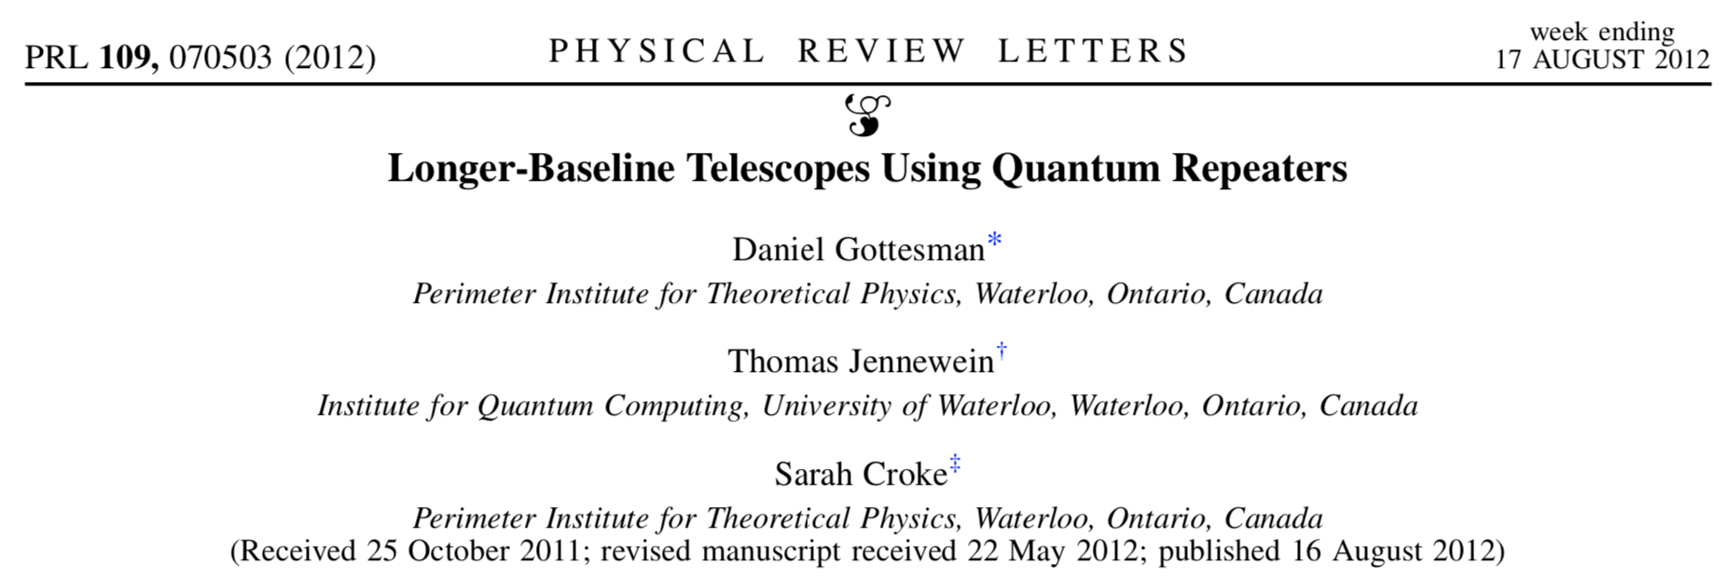
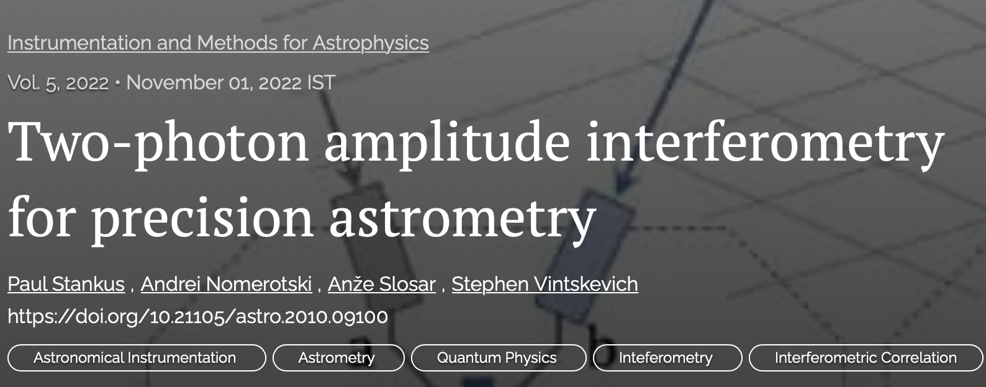





















Entanglement-Assisted Michelson
Quantum networks
Two-source, generalized HBT
Arbitrary baselines
Very Large Arrays Higher rates, multipartite states
O
$$∞$$
Sky Photon In (W state)
$$a_{1}$$
$$c_{1}$$
$$a_{2}$$
$$c_{2}$$
$$a_{3}$$
$$c_{3}$$
$$a_{4}$$
$$c_{4}$$
$$a_{5}$$
$$c_{5}$$
$$b_{1}$$
$$d_{1}$$
$$b_{2}$$
$$d_{2}$$
$$b_{3}$$
$$d_{3}$$
$$b_{4}$$
$$d_{4}$$
$$b_{5}$$
$$d_{5}$$
Heralded Single Ground Photon In (W state)

Slide 6
Entanglement-Assisted Michelson
Quantum networks
Two-source, generalized HBT
Arbitrary baselines
Very Large Arrays Higher rates, multipartite states
Subtle but important point:
The entire system, not just one device or sensor, is a quantum detector for a coherent extended EM quantum field.
O
$$∞$$
Sky Photon In (W state)
$$a_{1}$$
$$c_{1}$$
$$a_{2}$$
$$c_{2}$$
$$a_{3}$$
$$c_{3}$$
$$a_{4}$$
$$c_{4}$$
$$a_{5}$$
$$c_{5}$$
$$b_{1}$$
$$d_{1}$$
$$b_{2}$$
$$d_{2}$$
$$b_{3}$$
$$d_{3}$$
$$b_{4}$$
$$d_{4}$$
$$b_{5}$$
$$d_{5}$$
Heralded Single Ground Photon In (W state)

Slide 7

Long-distance quantum coherence
Interferometers are sensitive to very small details and differences in stars’ positions.
Quantum State Distribution
Telescopes (on Earth or in space)
Production and distribution of custom quantum states enables long-baseline, high-resolution optical interferometry, opening new observations directly relevant to DOE HEP science.
Quantum Entanglement Network
Dark Matter Sensors (e.g. Magnetometers)
Entangled states distributed over quantum networks can link detectors together coherently, improving sensitivity and directional resolution; a leading example is detection of wave-like dark matter.
Dark Matter Wave

Slide 8
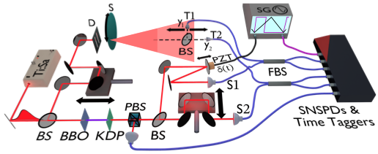
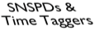
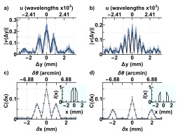
Sky
Pseudo-thermal light with slits source profile
Single ground photon
Single photon herald
Ground
Herald
To appear in PRL

Slide 9
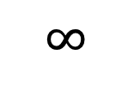
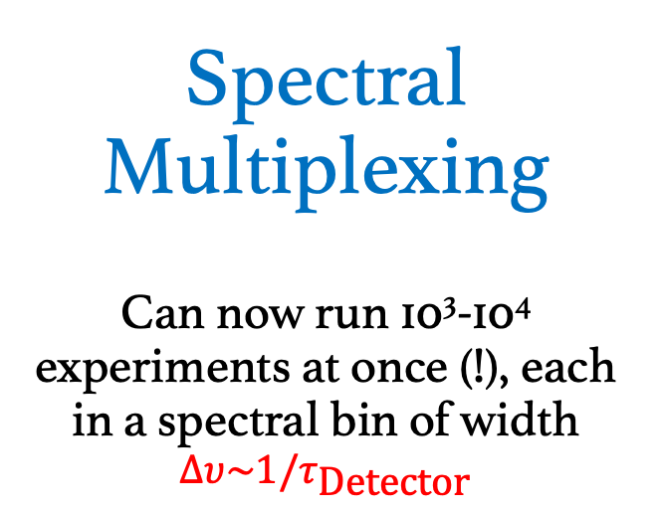
Spectral Multiplexing
Can now run 10³-10⁴ experiments at once (!), each in a spectral bin of width $∆υ\sim 1/τ_{\text{Detector}}$
Source
SP Timing Detectors
L
R
f
a
c
g
$$∞$$
Idlers
Pair Source, Energy Entangled
Signals
e
b
d
h

Slide 10
arXiv:2304.11999

Slide 11
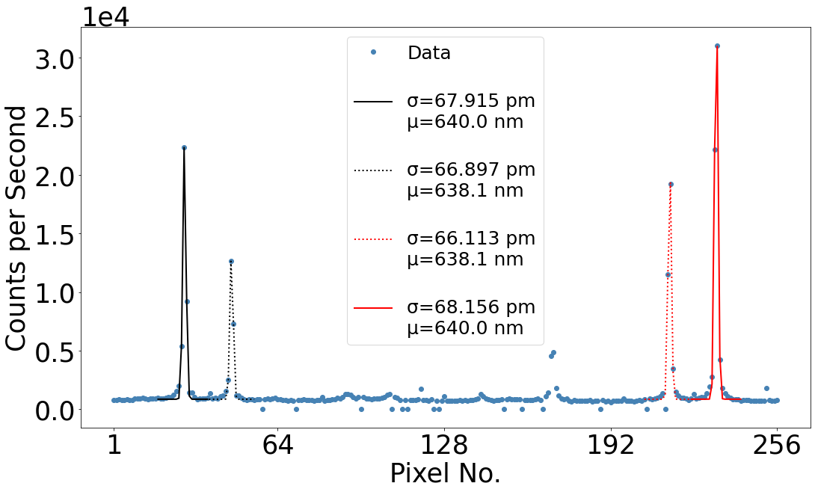
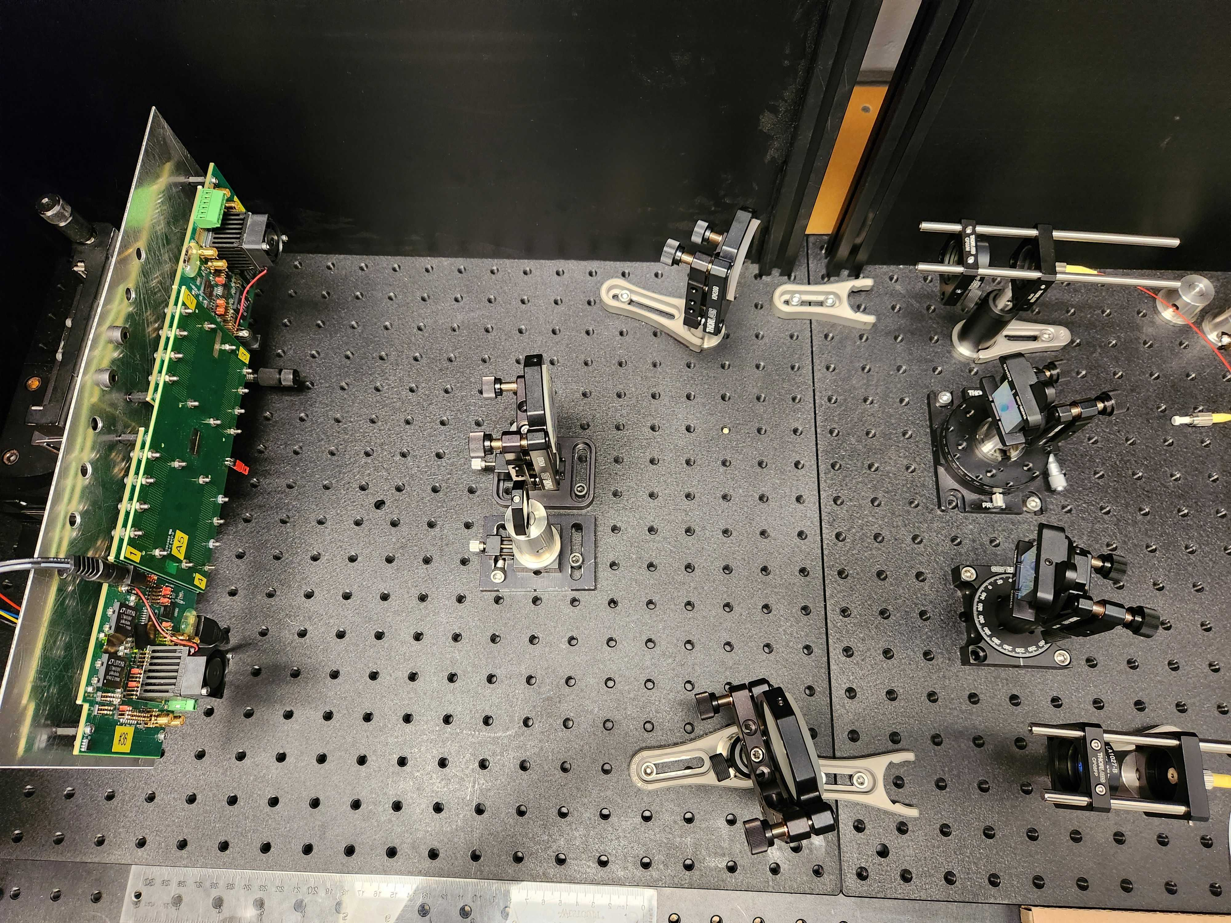
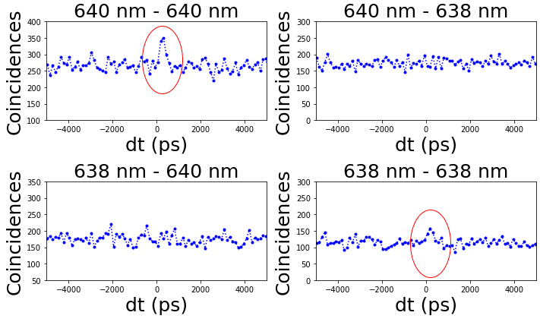
Double spectrograph prototype at BNL
Ne Spectral Peaks
Diffraction Gratings
LinoSPAD
Quantum enhancement (HBT) observed

Slide 12
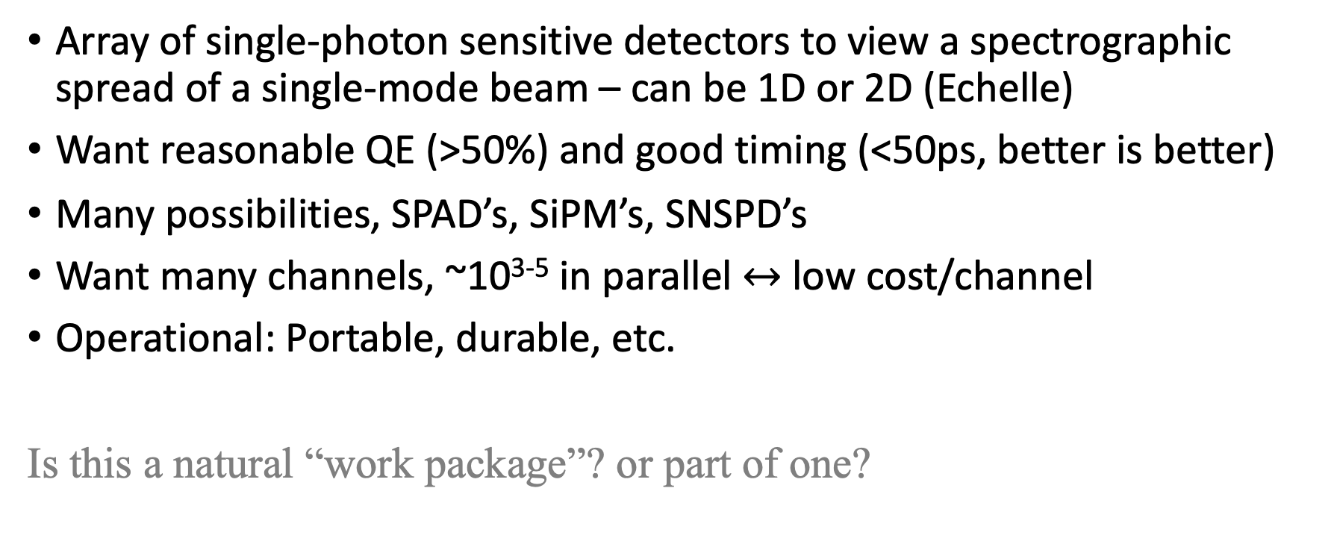
Technology needs: Fast Spectrograph
Enabling technology for many quantum-enhanced telescopy approaches
Very natural fit for HEP detector expertise
Array of single-photon sensitive detectors to view a spectrographic spread of a single-mode beam – can be 1D or 2D (Echelle)
Want reasonable QE (>50%) and good timing (<50ps, better is better)
Many possibilities, SPAD’s, SiPM’s, SNSPD’s
Want many channels, ~10³⁻⁵ in parallel $↔$ low cost/channel
Operational: Portable, durable, etc.
Is this a natural “work package”? or part of one?

Slide 13
Technology needs: Quantum/Optics
New for HEP detector portfolio, but definitely some overlaps with traditional expertise
Quantum entangled state creation, e.g. parametric down-conversion; higher rates, high brightness, custom lineshapes, etc.
Photon transport, e.g. stabilizing long fiber runs
Remote synchronization, ~psec across 10’s km
Futuristic: long-distance quantum networks using repeaters, quantum memory storage, QND detection
Collection optics, not usually an HEP specialty; but, air shower arrays -> HBT observatories for example

Slide 14
Summary
Quantum devices can greatly improve optical interferometry; q-astro is a new and growing field independent of HEP
Precision astrometry enabled by improved interferometers can be directly relevant to HEP Cosmic Frontier science
A distributed array of detectors can act as a quantum sensor, even if individual pieces look like phototdetectors, e.g.
Immediate technology path ahead, from very concrete HEP expertise to longer-range QIST capabilities

Slide 15
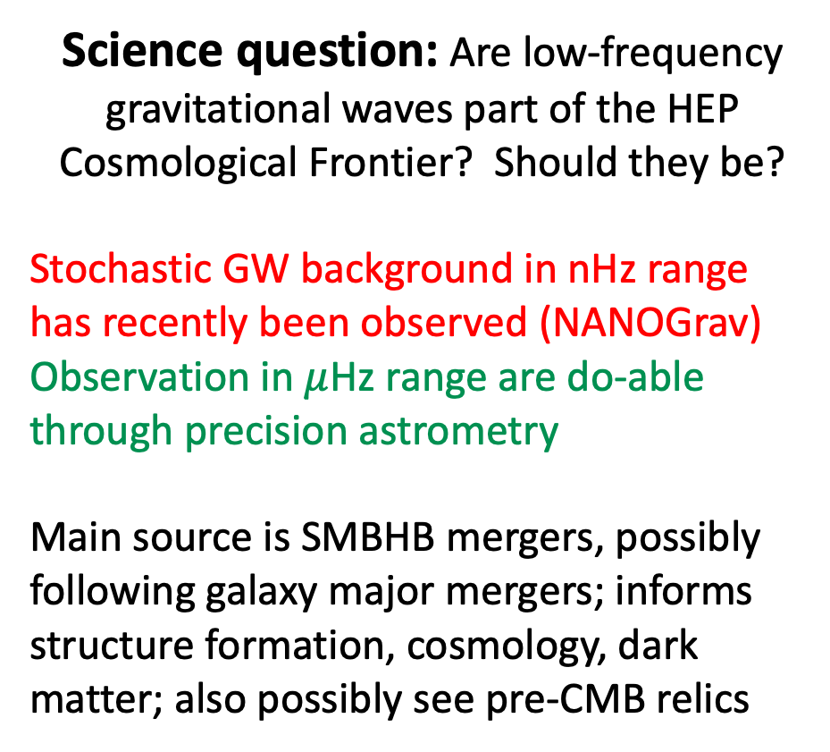
1/Year
1/Week
Science question: Are low-frequency gravitational waves part of the HEP Cosmological Frontier? Should they be?
Stochastic GW background in nHz range has recently been observed (NANOGrav)
Observation in $μ$Hz range are do-able through precision astrometry
Main source is SMBHB mergers, possibly following galaxy major mergers; informs structure formation, cosmology, dark matter; also possibly see pre-CMB relics
1/Month
1/Day
NANOGrav
Accessible?
LIGO

Slide 16
Extras

Slide 17

1990’s: Parody
2020’s: Solid Advice

Slide 18
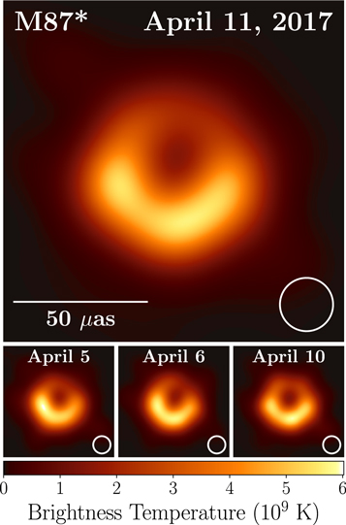
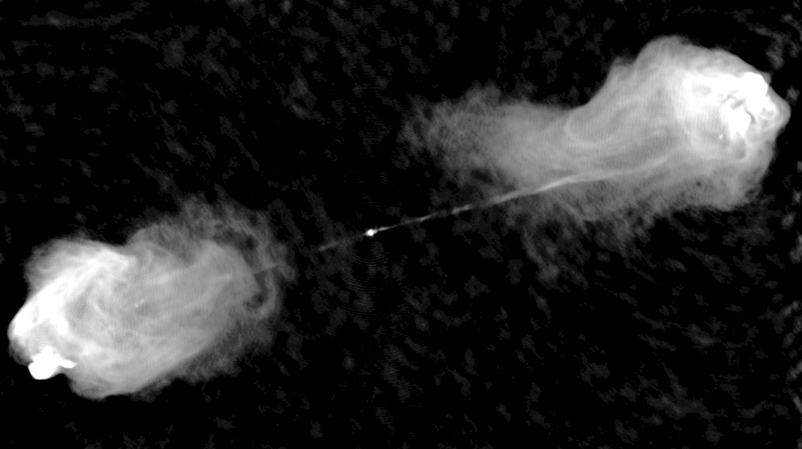
Interferometry is good
Radio source Cygnus A imaged at 6cm
Center of M87 imaged at 1.3mm
2019 ApJL 875

Slide 19
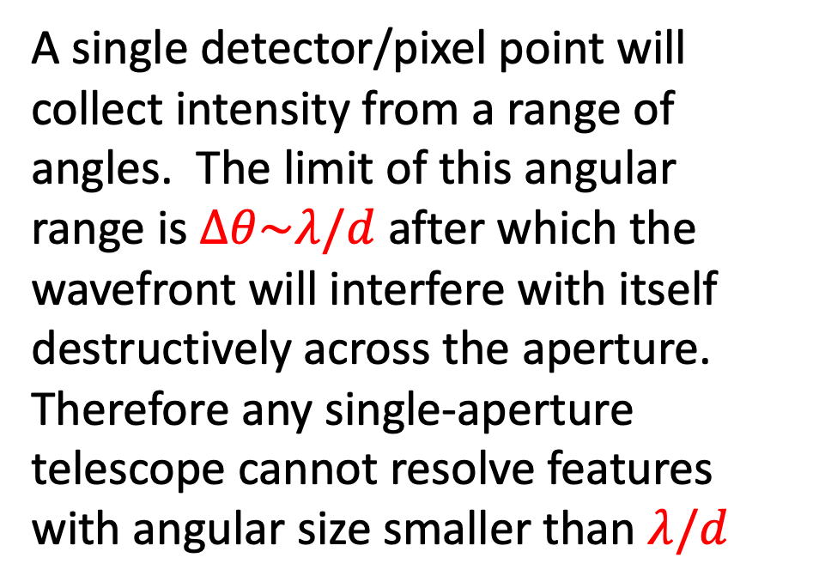

Single Aperture Diffraction Limit
$$λ$$
A single detector/pixel point will collect intensity from a range of angles. The limit of this angular range is $∆θ\sim λ/d$ after which the wavefront will interfere with itself destructively across the aperture.
Therefore any single-aperture telescope cannot resolve features with angular size smaller than $λ/d$
d

Slide 20
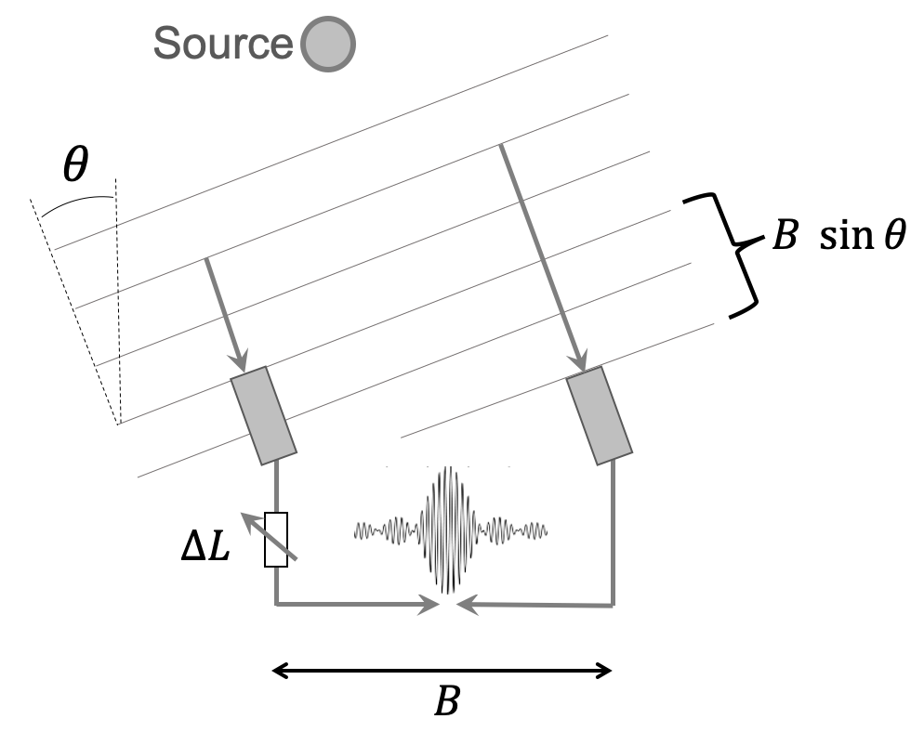
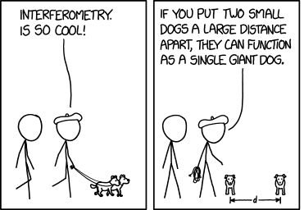
Idea: Separate apertures over long baselines
Michelson Stellar Interferometer ca.1890
https://xkcd.com/1922/
Interference fringe pattern sensitive to features of angular size $∆θ\sim λ/B$
Contrast visibility measures Fourier component of source distribution at $k\sim B/λ$

Slide 21
Idea: Separate functions of photon capture, photon transport, and photon interference
Standard Michelson Single sky photon interferes with itself
GJC: Sky photon is mixed with a single “ground” photon at each station
The single ground photon is assumed delivered through a quantum network which can provide entanglement on demand

Slide 22
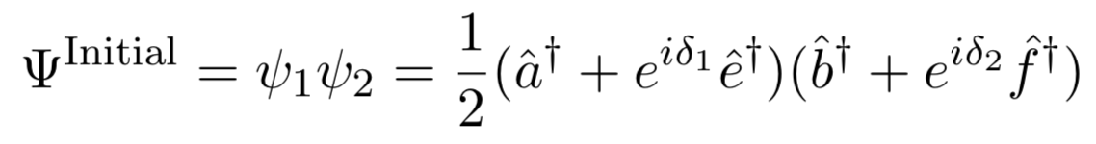
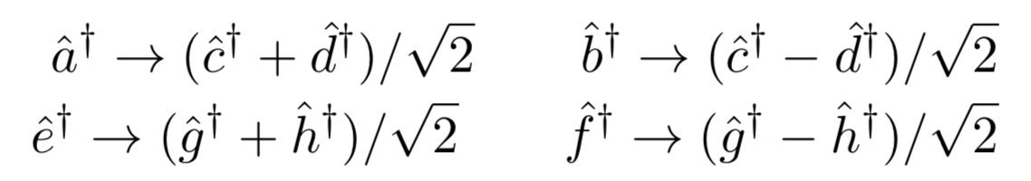
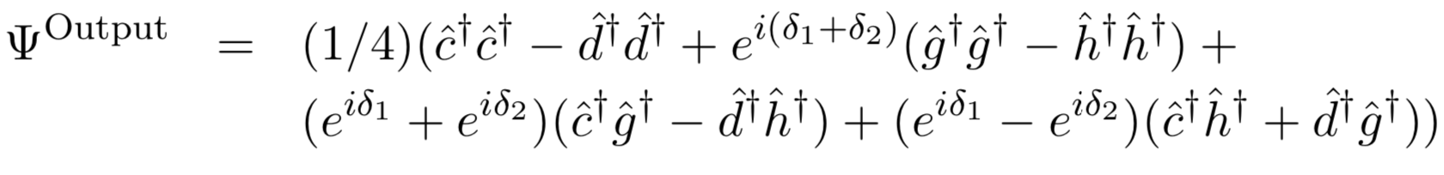
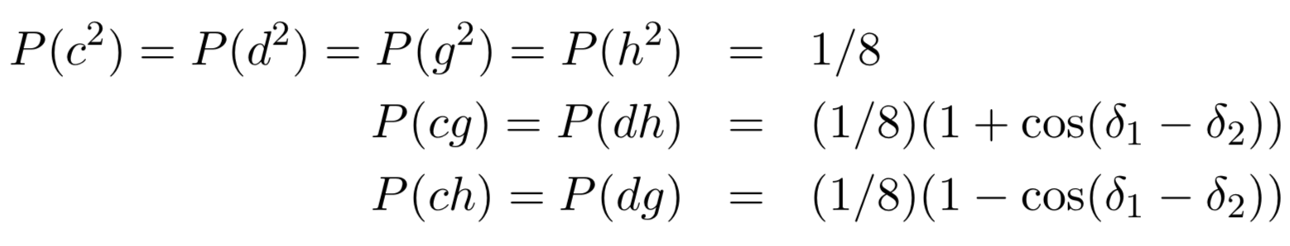
Pattern of coincidences measured at L and R stations reveals phase difference of sky photon arriving in two places: interferometry
Sky direction
Sky photon
Ground photon
Beam Splitters
a
e
c
g
d
b
f
h

Slide 23






Enabling very large arrays
$${\overset{⃑}{B}}_{4}$$
$${\overset{⃑}{B}}_{5}$$
$${\overset{⃑}{B}}_{2}$$
$${\overset{⃑}{B}}_{1}$$
$${\overset{⃑}{B}}_{3}$$
O
Timing and Wavelength Detector
An array of N apertures yields N(N-1)/2 different baseline pairs; in Michelson interferometry each pair would require its own beam combiner and detectos
Pair Source, Wavelength Entangled
$$∞$$

Slide 24




















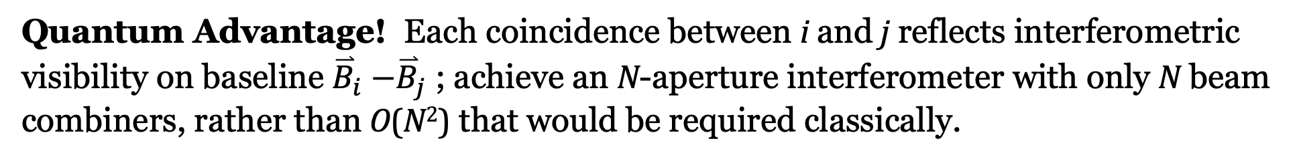
Sky Photon In (W state)
$$a_{1}$$
$$c_{1}$$
$$a_{2}$$
$$c_{2}$$
$$a_{3}$$
$$c_{3}$$
$$a_{4}$$
$$c_{4}$$
$$a_{5}$$
$$c_{5}$$
$$b_{1}$$
$$b_{2}$$
$$b_{3}$$
$$b_{4}$$
$$b_{5}$$
$$d_{1}$$
$$d_{2}$$
$$d_{3}$$
$$d_{4}$$
$$d_{5}$$
Heralded Single Ground Photon In (W state)
Quantum Advantage! Each coincidence between i and j reflects interferometric visibility on baseline ${\overset{⃑}{B}}_{i}$ ${−\overset{⃑}{B}}_{j}$ ; achieve an N-aperture interferometer with only N beam combiners, rather than O(N²) that would be required classically.

