Slide 1
Machine learning based developments for LHC / CMS Level-1 triggers
CICADA & AXOL1TL for LHC Run-3
Possibilities for HL-LHC
JINST 13 P07027 (2018)
https://fastmachinelearning.org/hls4ml/

Slide 2
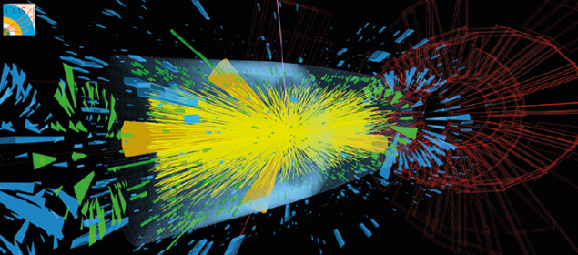
Why Machine Learning Based Triggers?
Physics searches at LHC demand low thresholds
No new physics at TeV scale has been discovered
Hopes for new physics hiding in profusely produced SM backgrounds remain
Has new physics escaped our object-threshold-based triggers?
Can one exploit complex correlations escaping simple triggers?
Can we use machine learning, say, anomaly detection technique, to search for any rare/new physics in a model-independent way?
Unknown correlations in interesting physics are unearthed by the ML model which is trained on many minimum-bias events.
With ~200 piled-up events every crossing will look like this at the HL-LHC

Slide 3
Why ML at Level-1?
Traditional event selection at L1 based on object thresholds $⟹$
High-level and Data analysis selections limited to use those objects
ML decisions based on level-1 inputs themselves $⟹$
Reduce potential bias for later detailed analysis

Slide 4
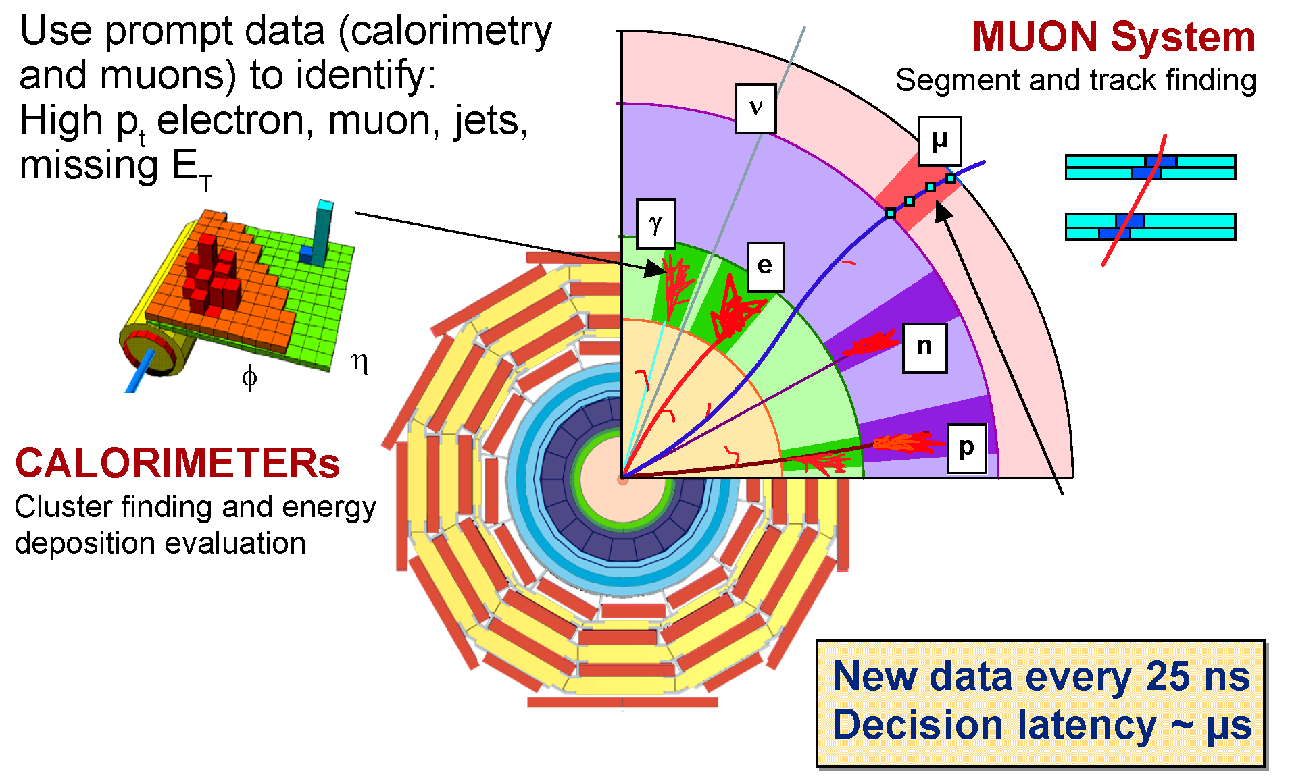
Level 1 Trigger Input Data & Traditional Algos

Slide 5
Opportunities & Challenges at Level-1
Level-1 trigger system features
Massively parallel processors (FPGAs)
Very fast IO based on multi-gigabit transceivers
Modern high level synthesis tools to implement complex models
Level-1 trigger system constraints
Extremely low latency < O(1) 𝜇s
Extremely tight resources from a single FPGA board
Extremely low background rate < O(10^{–4})
CMS is trying improvements in Run-3 systems before getting to HL-LHC!

Slide 6
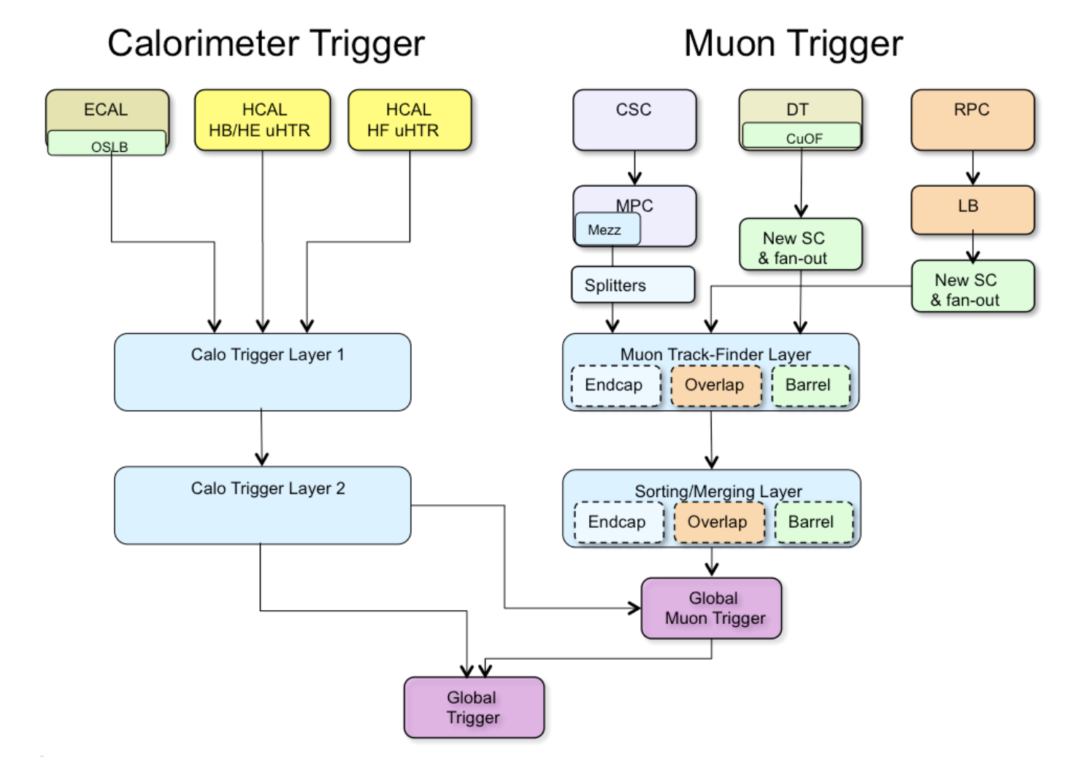
CMS L1 Trigger System for LHC Operations
CICADA
ML-Based Improvements for Run-3
AXOL1TL

Slide 7
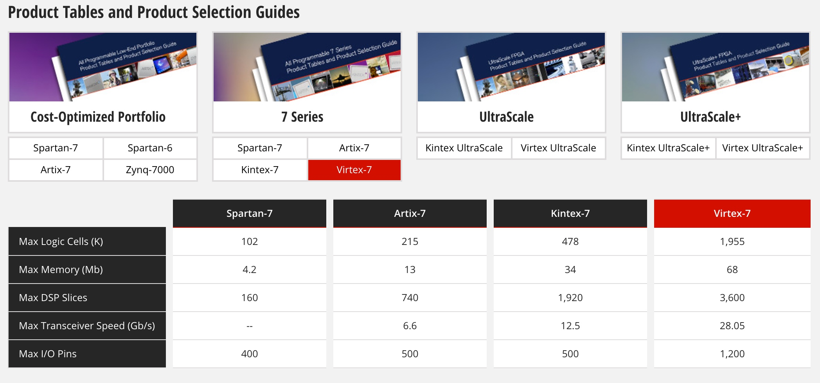
Xilinx FPGAs In Use LHC Run-2/3 : V7 690T ; At HL-LHC: VU13P
Currently Deployed at LHC
Planned for HL-LHC

Slide 8
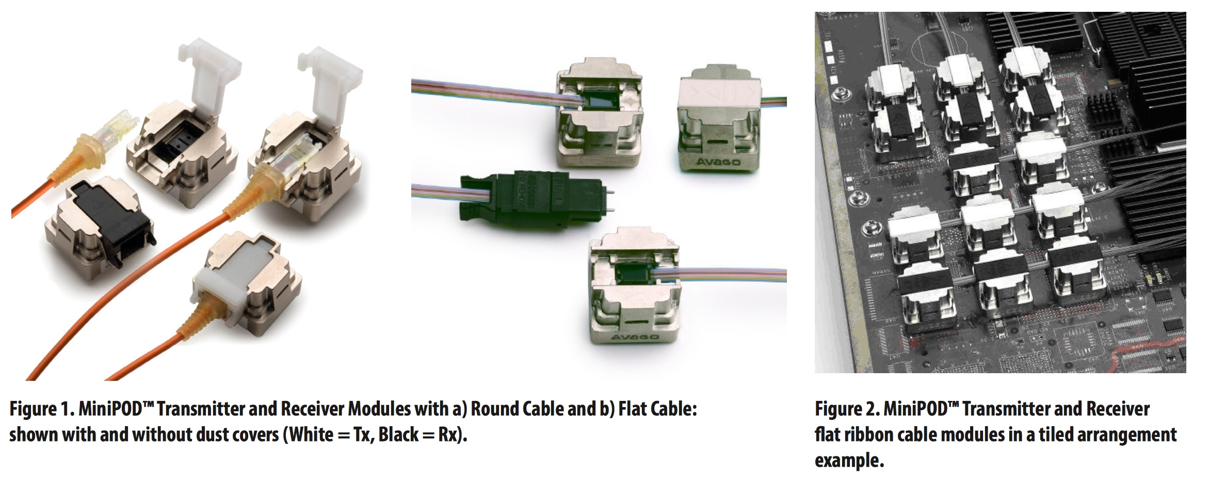
Key element - Multi-gigabit Opto-electronics

Slide 9
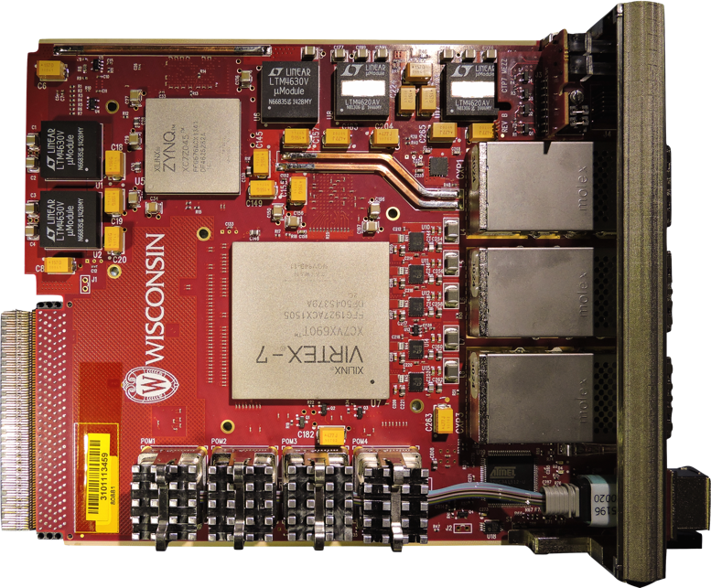
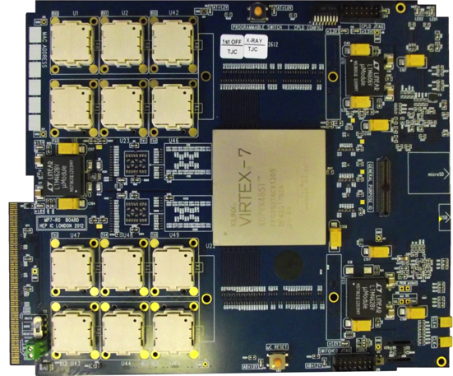
CMS Level-1 Trigger Electronics Boards
JTAG
USB
Interface
Power Supplies
Rx
Tx
ZYNQ
2V5
3V3
μSD
3 CXP modules
1V5
1V8
2xQDR
(Bottom)
FPGA
FPGA
USB
Rx
Tx
μC
(Bottom)
MiniPODs
MMC
MiniPod modules
1V0
Calorimeter Trigger Processor(CTP7 – left), and Master Processor (MP7 - right)
CTP7 (Layer-1) – μTCA Single Virtex 7 FPGA, 67 optical inputs, 48 outputs, 12 RX/TX backplane
Virtex 7 allows 10 Gb/s link speed on 3 CXP(36 TX & 36 RX) and 4 MiniPODs (31 RX & 12 TX)
ZYNQ processor running Xilinx PetaLinux for service tasks, including virtual JTAG cable
MP7 (Layer-2) – μTCA Single Virtex 7 FPGA, up to 72 input & output links
Virtex 7 has 72 input and output links at 10 Gb/s
Dual 72 or 144MB QDR RAM clocked at 500 MHz
Notes:
oRSC – optical Receiver Summary Card
CTP7 – Calorimter Trigger Processor
MP7 ?

Slide 10
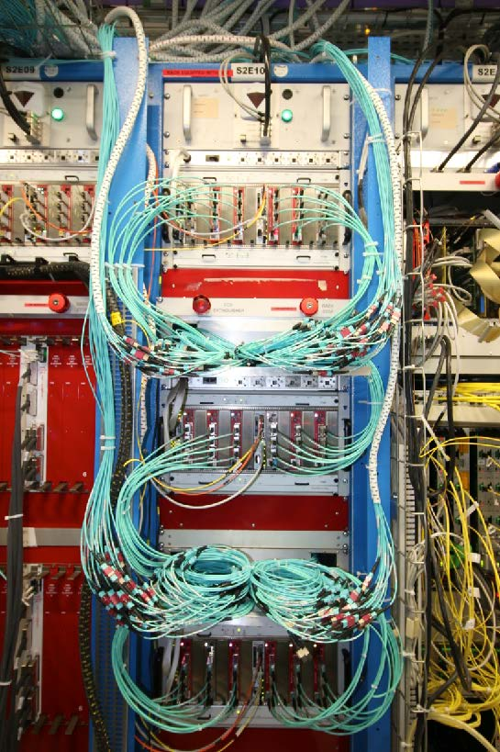
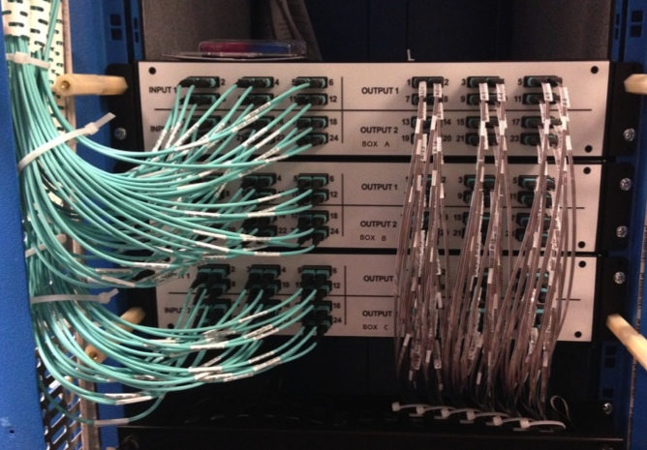
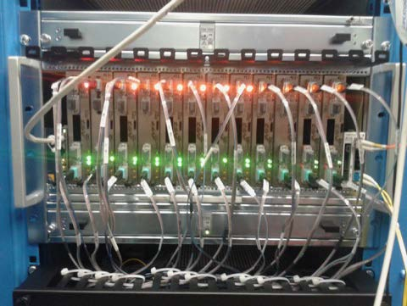
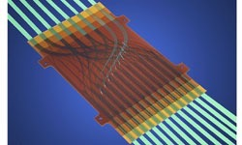
CMS Calorimeter Trigger Run-2/3
Layer-1 CTP7
Layer-1 to Layer-2 Patch Panel
Layer-2 MP7
MOLEX
FlexPlane

Slide 11
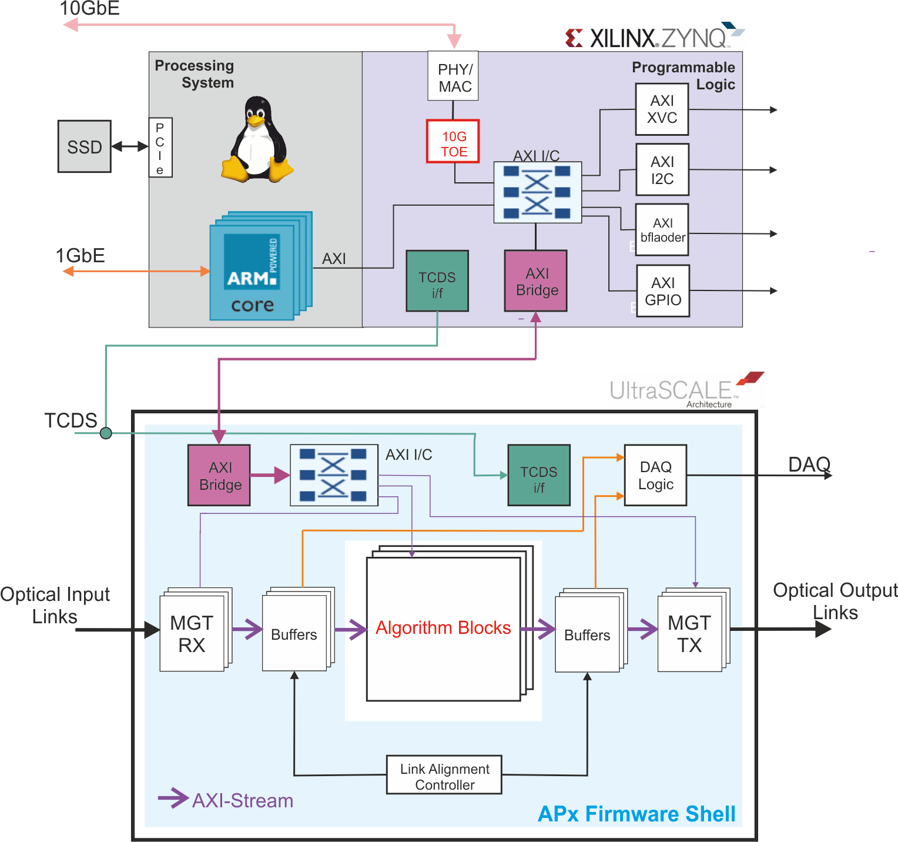
Firmware / Software: Decoupling with Modern Tools
A new paradigm for firmware development
Core firmware written in VHDL by engineers
Gigabit link support
Data exchange between SLRs within chip
Test buffers
Clock and control
Physics
Algorithmic firmware in high-level languages like C++ written by physicists
Linux / ZYNQ:
Control endpoint,
providing complete
board overhead
functionality
Processing FPGA:
I/O
data processor
DAQ
Algorithm Sandbox HLS-built RTL
Originally deployed on CTP7 with ZYNQ + Virtex-7

Slide 12
CICADA Team
Calorimeter Image Convolutional Anomaly Detection Algorithm (CICADA)
Model/Implementation/Emulator/Firmware/Software/Hardware/Operations
University of Wisconsin-Madison
Kiran Das, Sridhara Dasu, Tom Gorski, Alexander Savin, Varun Sharma, Ales Svetek, Jesra Tikalsky, Ho Fung Tsoi
Princeton University
Pallabi Das, Kiley Kennedy, Andrew Loeliger, Luis Moreno, Isobel Ojalvo, Adrian Alan Pol

Slide 13
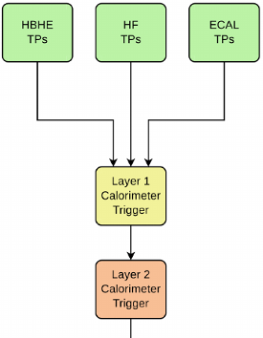
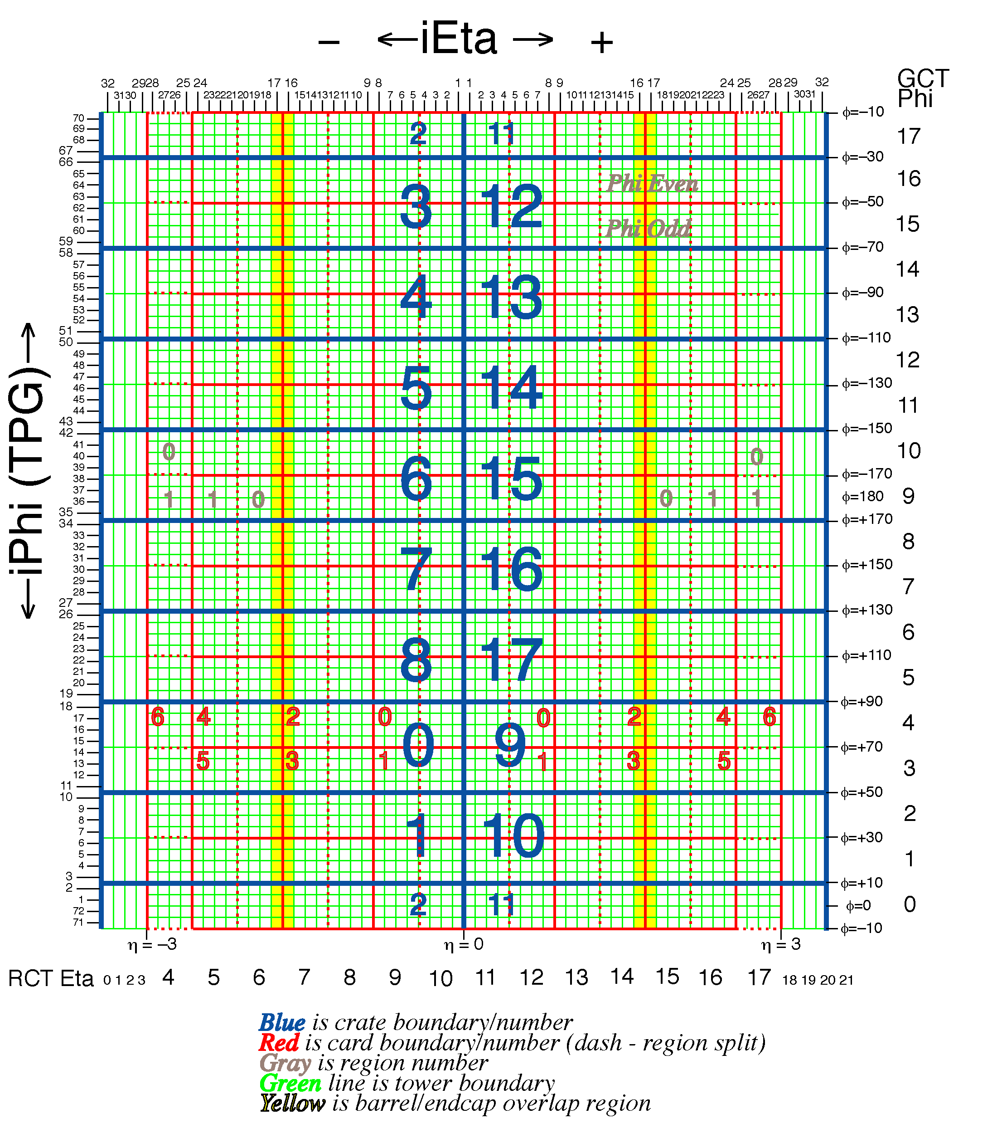
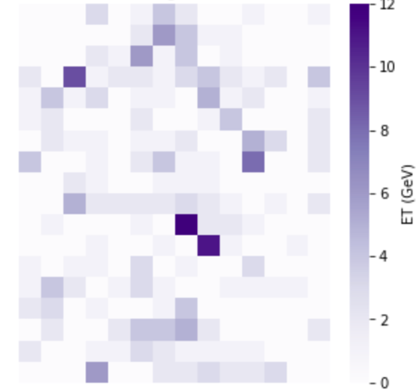
Calorimeter Input to CICADA
One region = 4x4 trigger towers
CICADA input from CaloLayer1
18 φ x 14 η regions 252 regions in total
Each region contains energy deposits from both ECAL and HCAL
Summary of the energy distribution profile within the region
Low-level information not dependent on jet reconstruction etc.
One ZeroBias event
Calo region map

Slide 14
Auto-encoder Model
Autoencoder-based anomaly detection
Input is a 2D tensor from the Calo region energy information
Encoder and decoder are Convolutional Neural Networks
Unsupervised learning : train only on ZeroBias data to learn input reconstruction

Slide 15
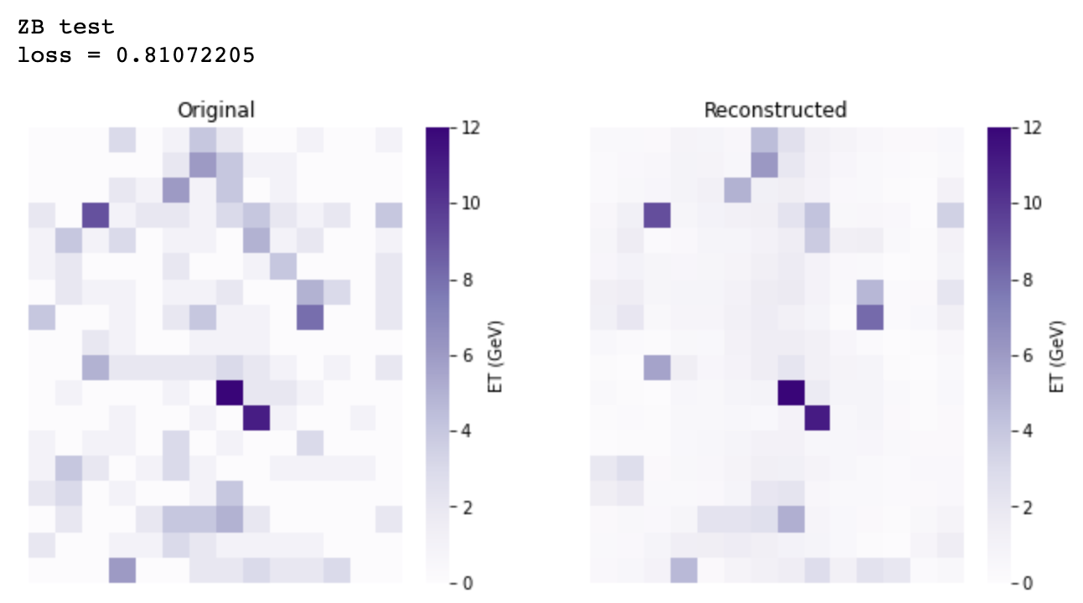
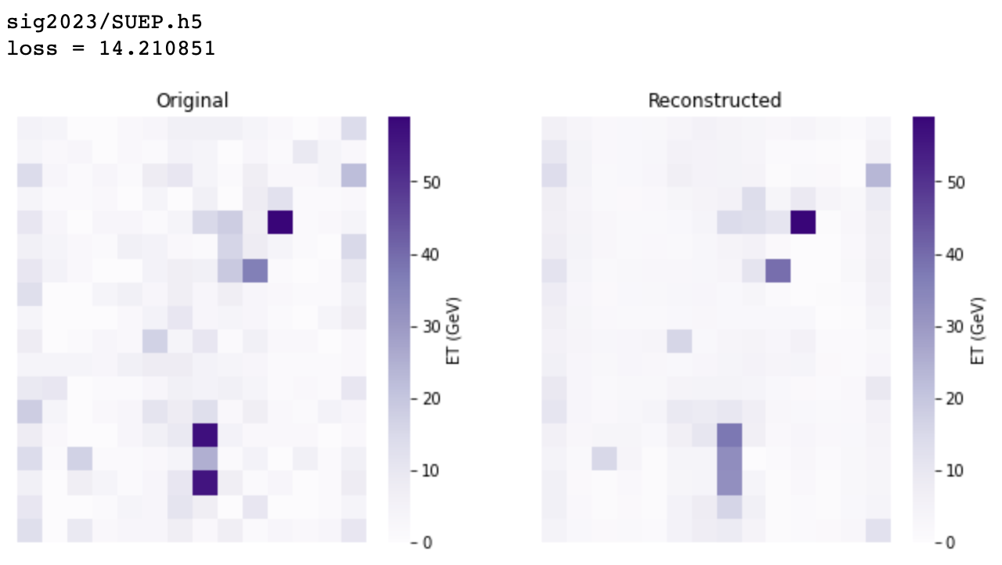
Event Reconstruction
ZeroBias data
BSM MC signal
Input
Reconstruction
Input
Reconstruction
Expectation:
Good reconstruction on normal events (ZeroBias used for training)
Bad reconstruction on anything else such as BSM signals (never seen during training)
Goal:
Use metric like MSE(input, output) as anomaly score to trigger on anomalous events

Slide 16
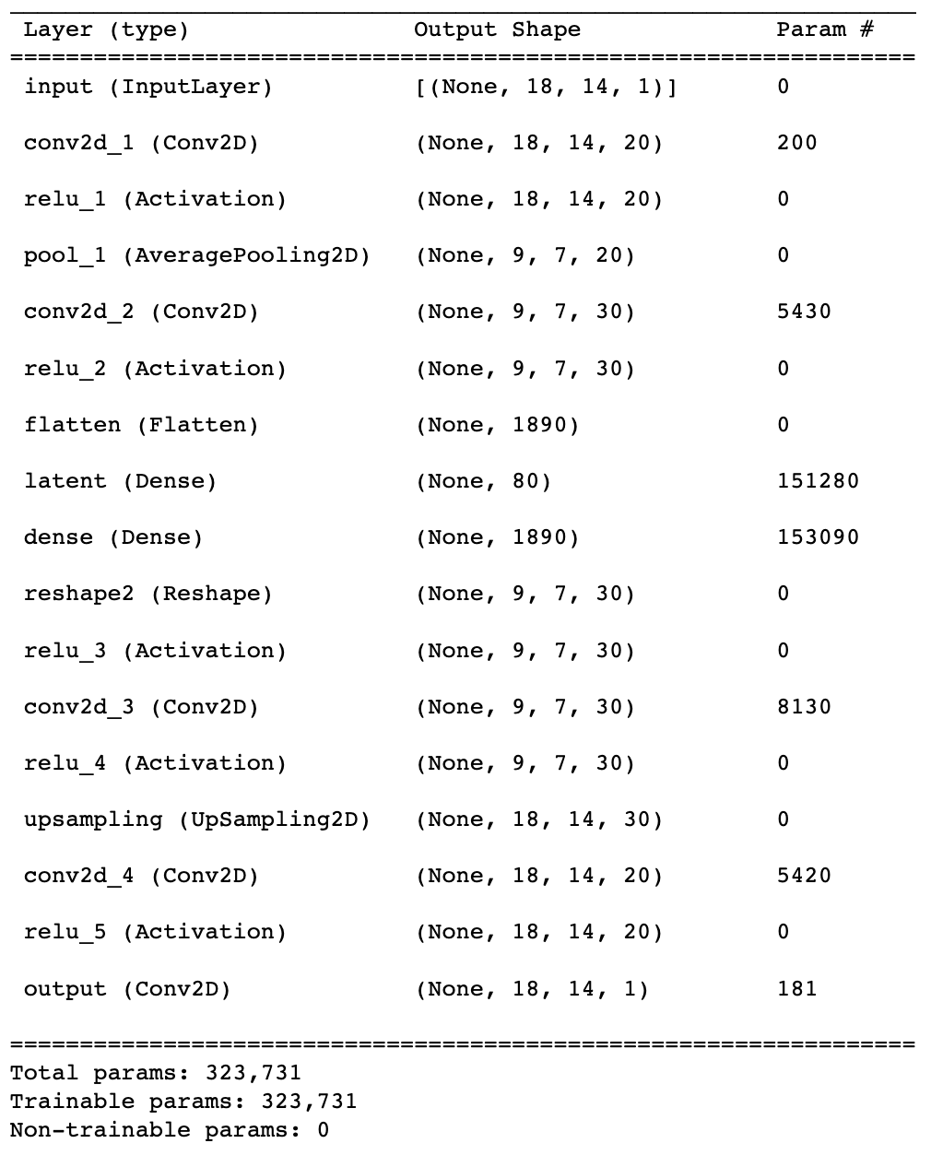
Naïve Auto-encoder Model
Encoder (compressor)
Latent space (compressed input)
Decoder (decompressor)
324 K parameters model size cannot fit L1 constraints…

Slide 17
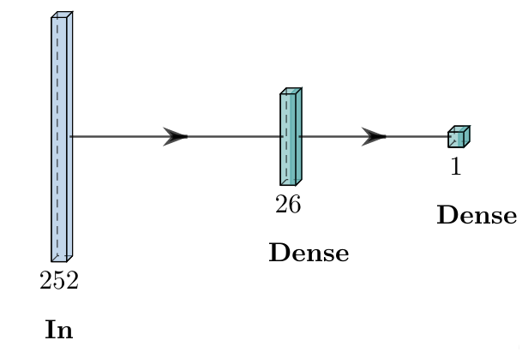
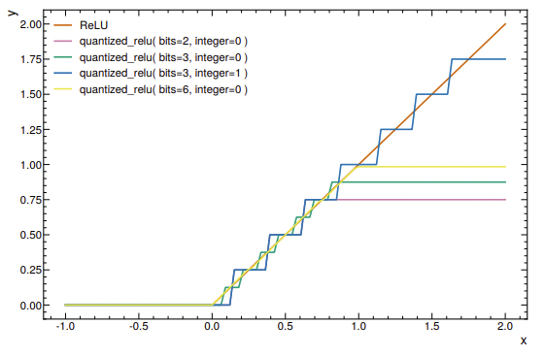
Knowledge Distillation + Quantization
Anomaly score
Compute score
(e.g. MSE)
Compare with teacher’s score
Teacher
Knowledge Distillation
Train a smaller model (student) under the guidance of a bigger model (teacher)
The student learns to regress MSE from teacher outputs
Score regression
Student
e.g.,quantized ReLu
Quantization-aware training (QKeras)
Model weights quantized to fixed precision (e.g., 2 bits for integer, 4 bits for fraction)
Train a quantized model rather than quantize a trained model
$→$ x10 reduction
in resources/latency

Slide 18
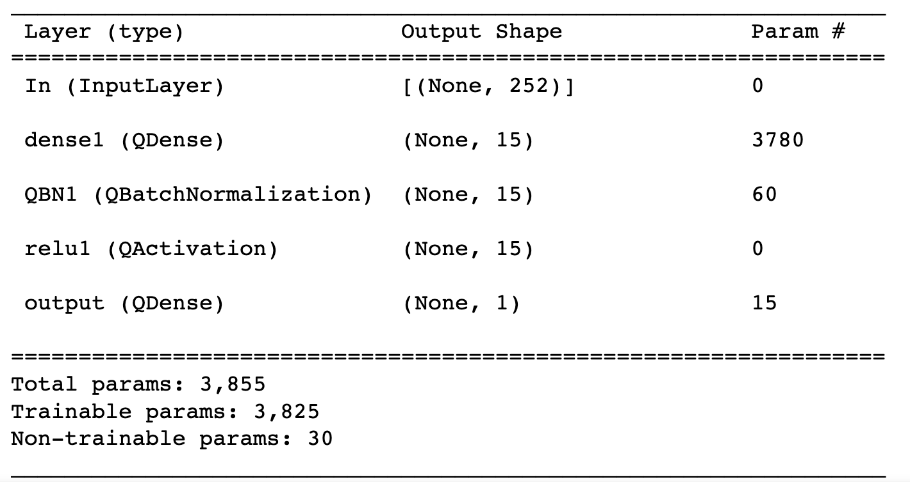
Teacher → Student
Student
324K parameters go down to 3.8K parameters

Slide 19
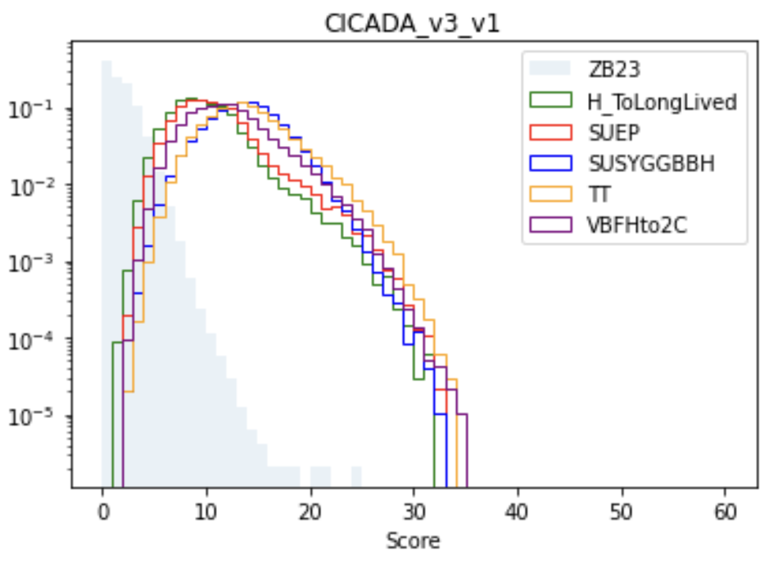
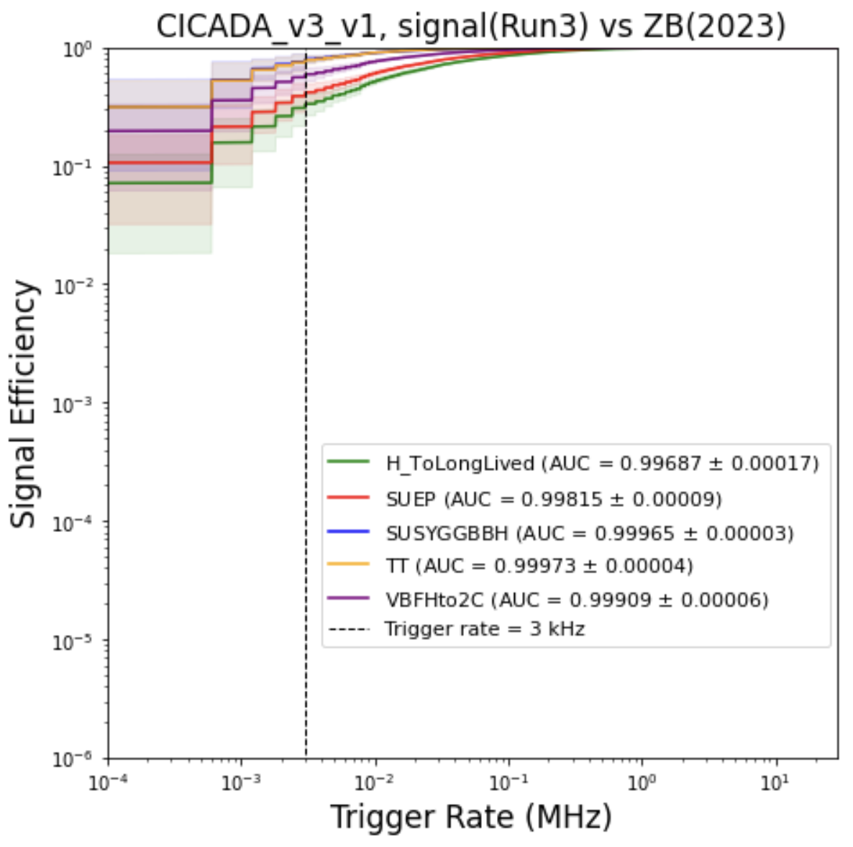
Physics Performance (MC signals)
Model trained on 2023 ZB, evaluated on 2023 MC signals
Able to pick up a wide range of signals

Slide 20
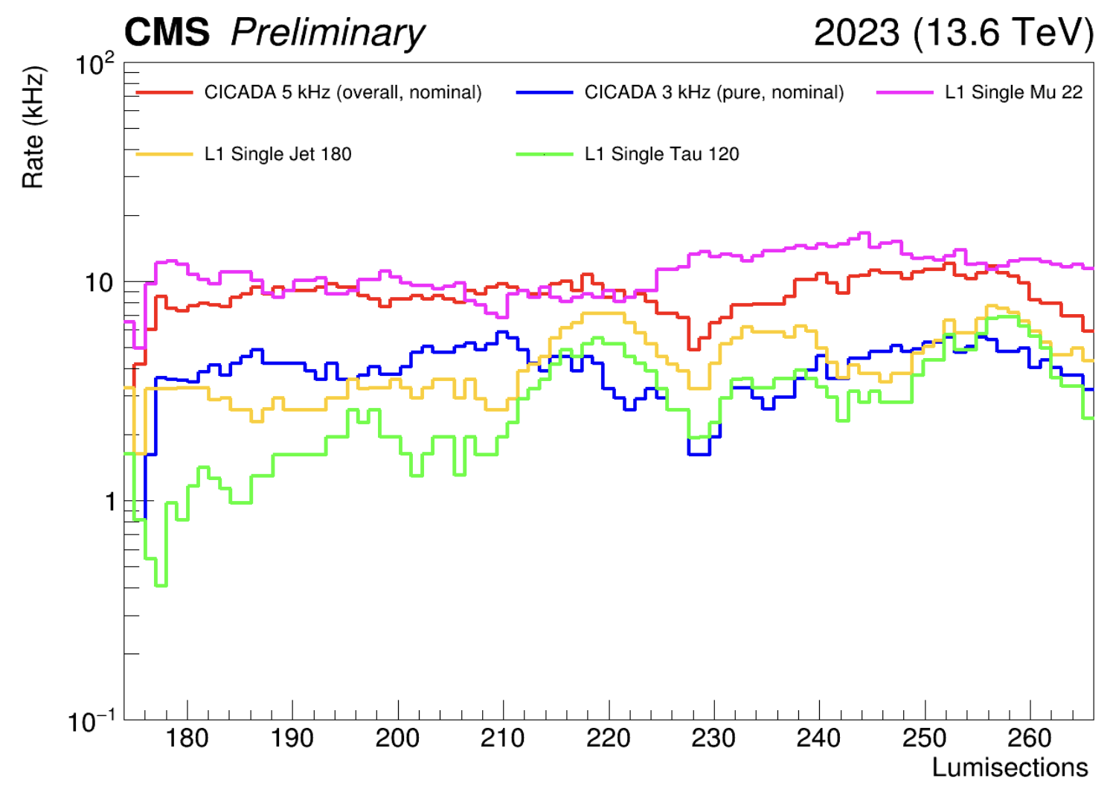
CICADA Rate Stability over the Run
Flexible trigger: tunable threshold for different rates, stable over the run

Slide 21
AXOL1TL Team
Anomaly eXtraction Online Level-1 Trigger Lightweight (AXOL1TL)
Model/Implementation/Emulator/Firmware/Software/Operations
Fermilab
Abhijith Gandrakota, Jennifer Ngadiuba
University of California – San Diego
Javier Duarte, Melissa Quinnan, Andrew Skivington
University of Colorado
Jannicke Pearkes, Reece Rupp, Noah Zipper, Keith Ulmer
ETH-Zurich
Chang Sun, Patrick Odagiu, Thea Arrestad

Slide 22
AXOL1TL is also Auto-encoder Based

Slide 23
Inputs: Same as Traditional Global Trigger
Unlike CICADA, AXOL1TL also includes muons

Slide 24
Anomaly Score Distribution : Good Rate Control

Slide 25
Firmware Implementation & Results
Fits comfortably in the existing CMS Global Trigger running on MP7
Example performance improvement for BSM decay $H\left(125\right)→aa→bbbb$

Slide 26
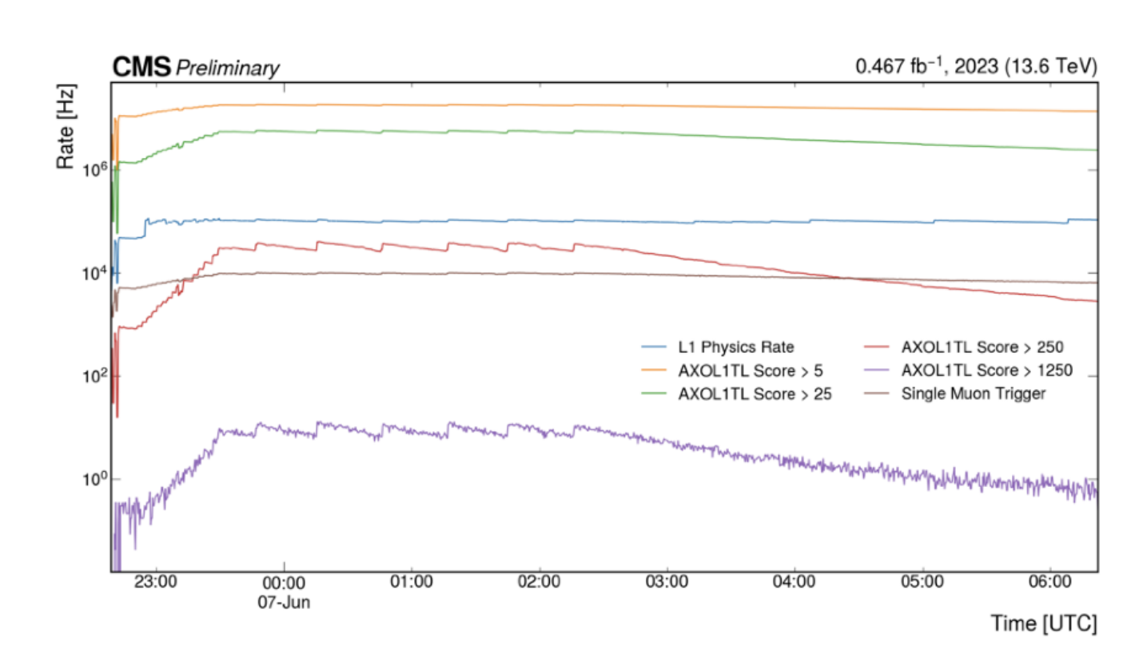
Rate for various AXOL1TL scores
Rates monitored on the μGT test crate

Slide 27
Highest anomaly AXOL1TL event

Slide 28
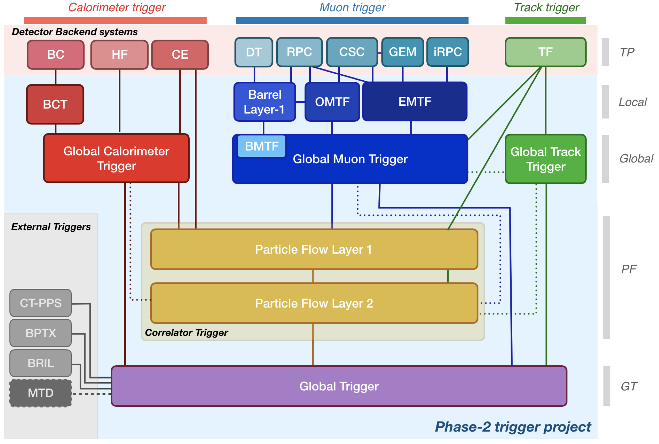
CMS HLLHC Level-1 Trigger 2029+
New for HLLHC
Many opportunities with tracking included at Level-1

Slide 29
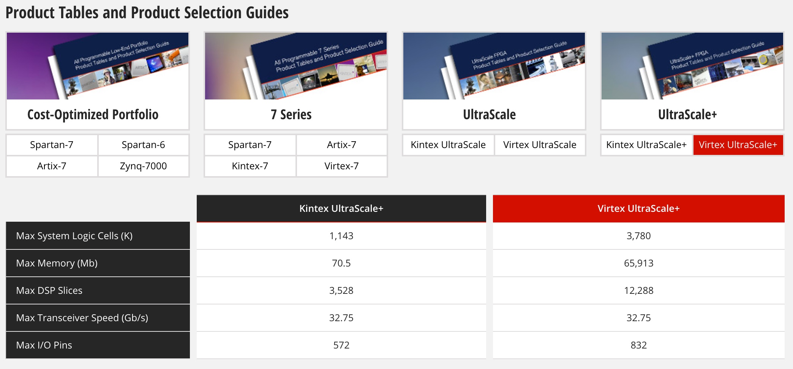
HL-LHC L1 Trigger Challenge Xilinx – Ultrascale+ Processors
Times 2
Many times
Times 3
Times 2.5

Slide 30
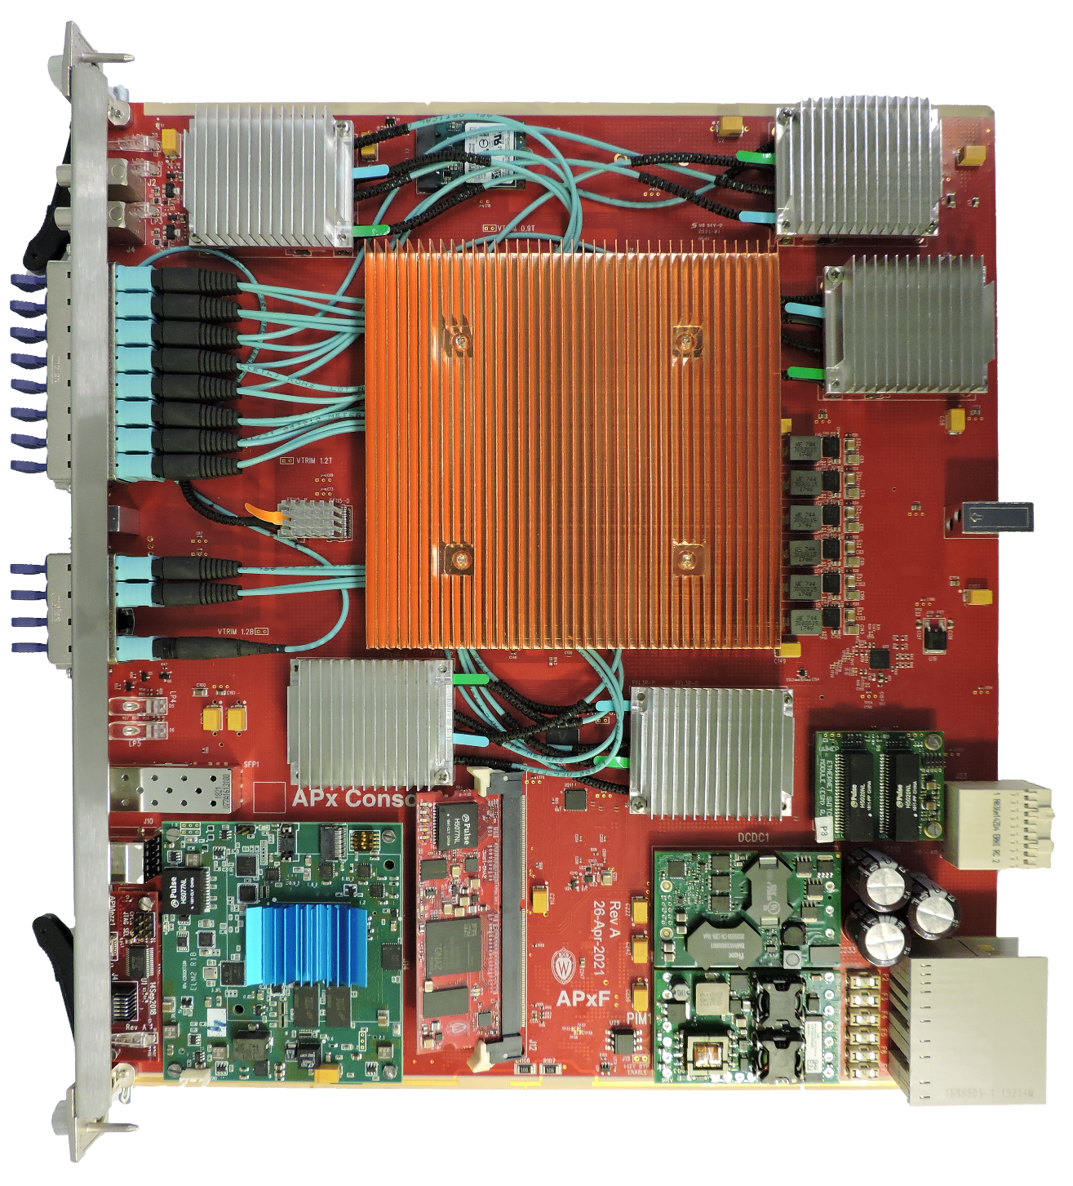
Advanced Processor Prototype for HL-LHC
Wisconsin APxF Board
Xilinx VU13P or VU9P FPGA
ZYNQ-IPMC (ATCA IPMI controller)
ELM (ZYNQ-based embedded Linux)
ESM (GbE switch)
High efficiency heatsinks
Front-panel inputs
25G Samtec Firefly optics – 10x12 + 1x4 (124 25 Gbps links)

Slide 31
Summary
Run-3 will see machine learning based triggers
Improved technologies for easy high-level synthesis
Improved auto-encoder model implementations
Potential opportunity for hitherto unattainable physics reach
HL-LHC
Increased resources in new boards
Availability of tracker data at level-1
Opportunities for ML-based discoveries are opening up.

