Slide 1
A 5GHz input buffer for PSEC5 a 16-channel waveform sampling ASIC in 65nm CMOS
Authors: Richmond Yeung^{1,†}, Jinseo Park¹, Evan Angelico², Troy England³, Henry Frisch¹, Eric Oberla⁴, Nathaniel Pastika³, Hector Rico-Aniles⁵, Paul Rubinov³
† Presenter
1 Enrico Fermi Institute, University of Chicago
2 Stanford University
3 Fermi National Accelerator Laboratory
4 Kavli Institute for Cosmological Physics, University of Chicago
5 North Central College

Slide 2
Motivation
There is active development on detectors with time resolution of 1 ps.
4.1 ps timing was already achieved for charged particles in a beam (Cherenkov radiation) in 2006¹
Examples of Applications: LHCb (CERN), KOTO (JPARC), Redtop (Fermilab), EIC (Electron-Ion Collider – Brookhaven)
It may be possible.
[1] K. Inami, N. Kishimoto, Y. Enari, M. Nagamine, and T.Ohshima; A 5-ps Tof-counter with an MCP-PMT}; Nucl. Instr. Meth. A560, p.303, 2006
R. Yeung CPAD 2023 Electronics
11-09-2023

Slide 3
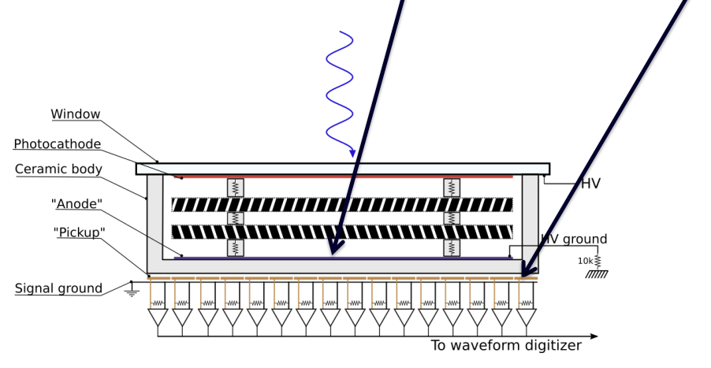
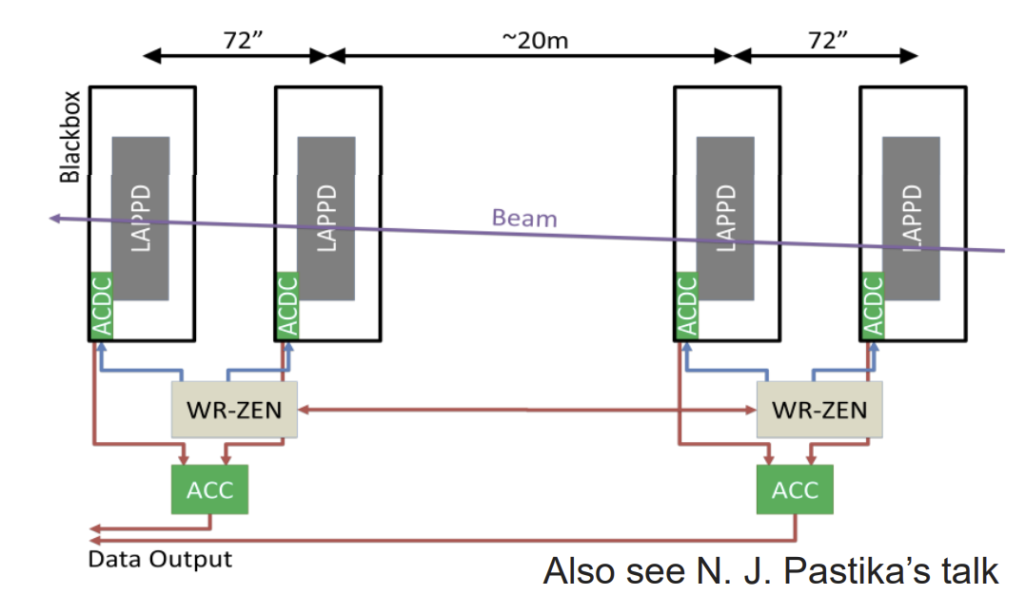
Front End
Capacitively couple anode
External signal pickup
R. Yeung CPAD 2023 Electronics
11-09-2023

Slide 4
Factors affecting timing resolution
[1]Stefan Ritt; The role of analog bandwidth and signal-to-noise in timing for waveform digitizing; Timing Workshop, Chicago April 28th 2011
11-09-2023
R. Yeung CPAD 2023 Electronics

Slide 5
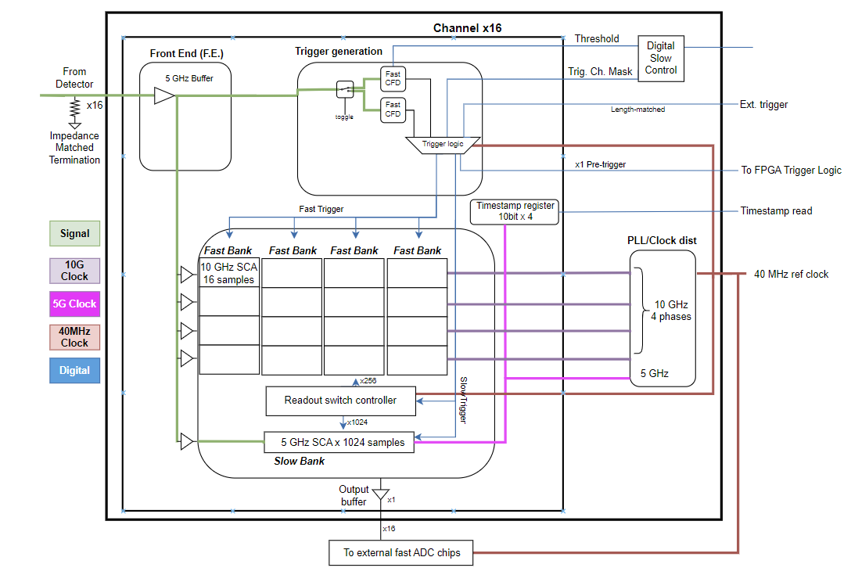
Block Diagram- PSEC5
CFD Trigger
Buffers
Sampling Block
- See J. Park’s talk, fast timing, CPAD 2023

Slide 6
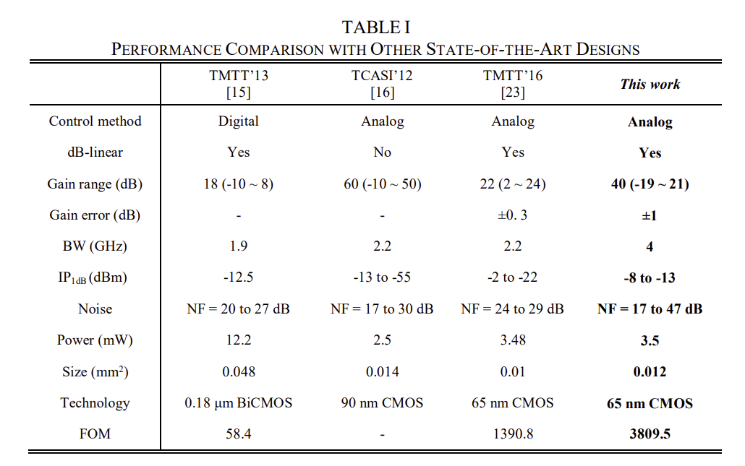
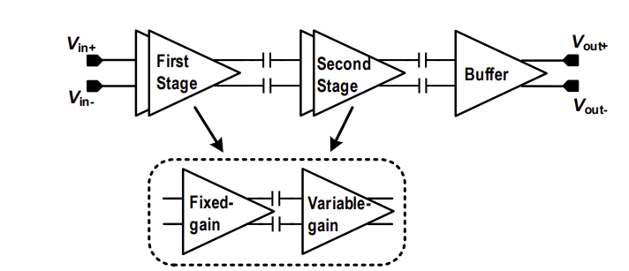
Where I began: Objectives - buffer
dB-linearity (Unitary gain)
3-4GHz (initial goal)
Low thd
65nm CMOS (TSMC)
[2] Kong, L., Liu, H., Zhu, X., Boon, C. C., Li, C., Liu, Z., & Yeo, K. S. (2020). Design of a wideband variable‑gain amplifier with self‑compensated transistor for accurate dB‑linear characteristic in 65 nm CMOS technology. IEEE Transactions on Circuits and Systems I: Regular Papers, 67(12), 4187‑4198. doi:10.1109/TCSI.2020.2995725
R. Yeung CPAD 2023 Electronics
11-09-2023

Slide 7
Problems with the first design
Pin requirements: Far too many
Size: Given that a column of the SCA is $45μm×25μm, This is far too large.$
Power consumption: 10 mW per channel, amplifier is taking up 3.5
R. Yeung CPAD 2023 Electronics
11-09-2023

Slide 8
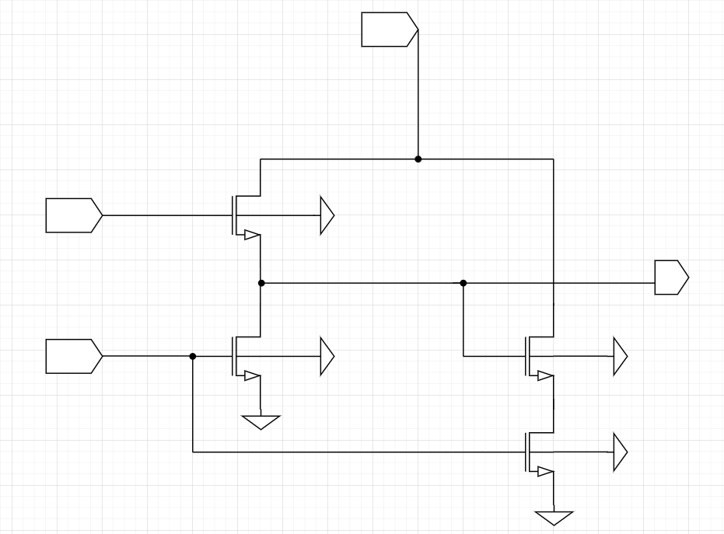
Current Schematic
VDD
V_bias | 0.65 V
M1_w | 5 µm
M2_w | 10 µm
M1_l | 280 nm
M2_l | 280 nm
Input
M1
Output
V_bias
M2
Dummy transistors (on a multiplier to simulate the capacitive load)
Source Follower
“Dummy” transistors
R. Yeung CPAD 2023 Electronics
11-09-2023

Slide 9
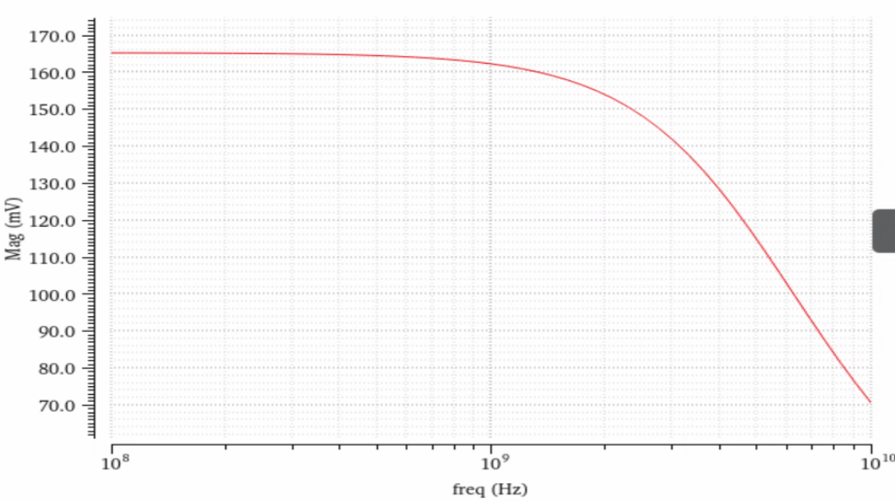
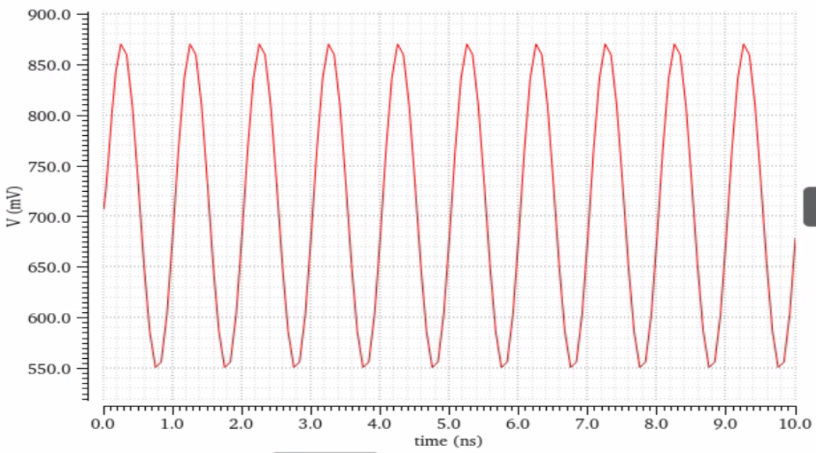
Specifications – simulation results
AC Sweep (100MHz – 10GHz)
Transient – 0 to 10 ns, 1GHz – 200mV sine curve, 1.5V offset
 | Bandwidth | Peak-to-peak | DC offset | thd | Power consumption
Original VGA | 4GHz | 240 mV | ~200 mV | / | 3.5 mW
Current design | 4.94 GHz | 319.29 mV | 551 mV | 2.172 | 0.48 mW
R. Yeung CPAD 2023 Electronics
11-09-2023

Slide 10
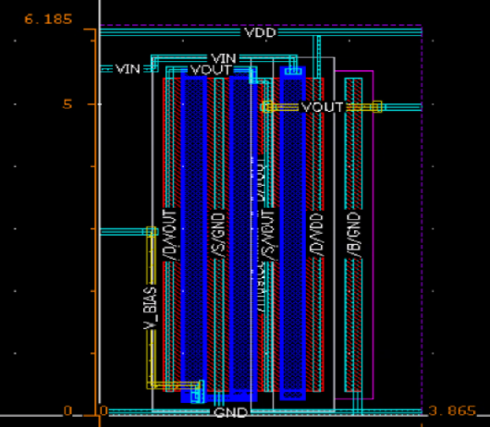
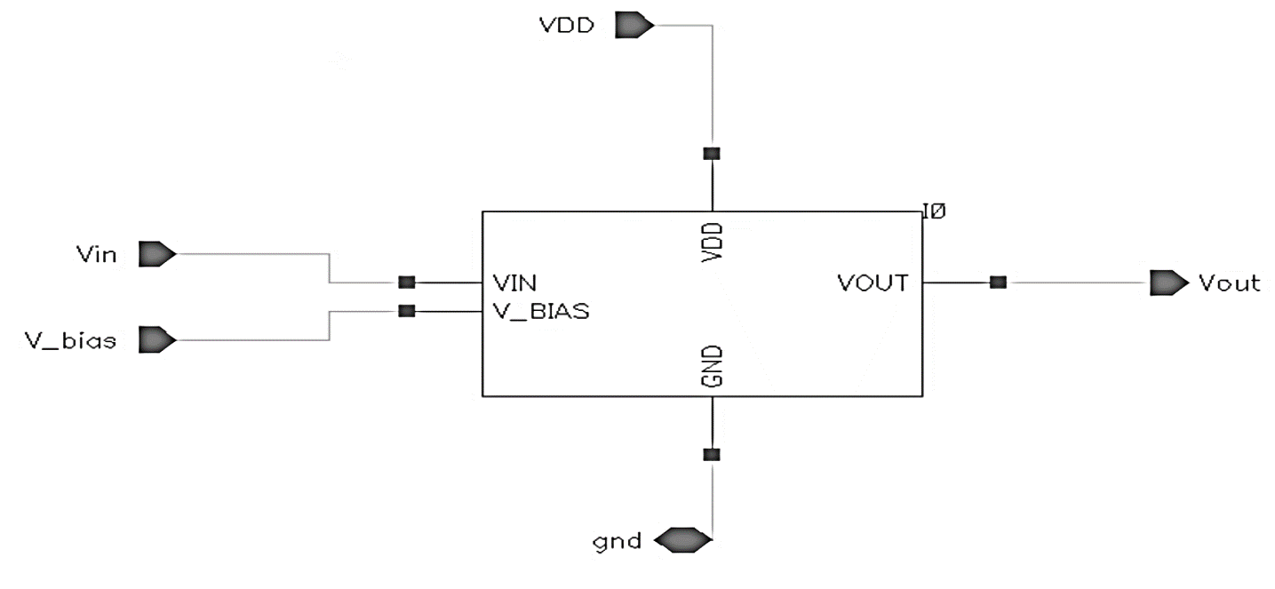
Layout and pin requirements
- Connections between transistors and pins only utilize the M1 and M2 layers.
- Layout complies with DRC, passed LVS and a PEX analysis has also been completed.
R. Yeung CPAD 2023 Electronics
11-09-2023

Slide 11
Comparison with existing ASIC Projects
[3] Petra Merkel, CPAD 2022, https://indico.bnl.gov/event/17072/contributions/70981/attachments/44878/75698/CrossCutting-Summary_120222.pdf
R. Yeung CPAD 2023 Electronics
11-09-2023

Slide 12
Summary
There exist detectors with picosecond timing resolution, and we are trying to achieve a matching resolution for the front-end electronics.
A buffer serves as a bottleneck for the input bandwidth of the entire chip, which also impacts Δt
We have designed a buffer with an analog bandwidth of 5 GHz, which will be employed in both the front-end of the chip, and in every channel of the SCA.
Bandwidth may be limited by the packaging – TBD
To do: Noise analysis, impedance matching for the entire chip.
R. Yeung CPAD 2023 Electronics
11-09-2023

