Slide 1
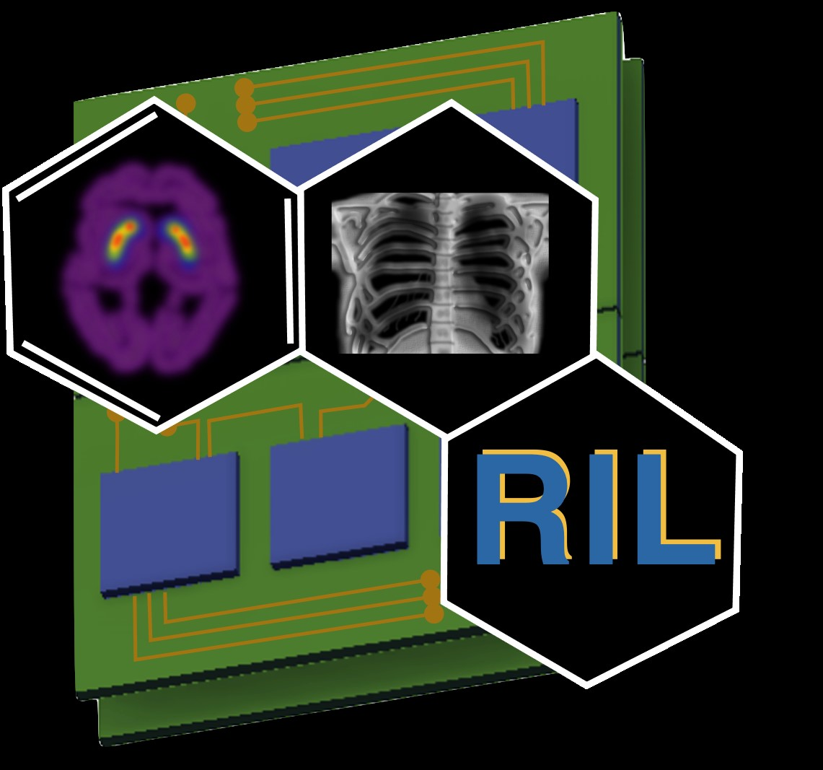
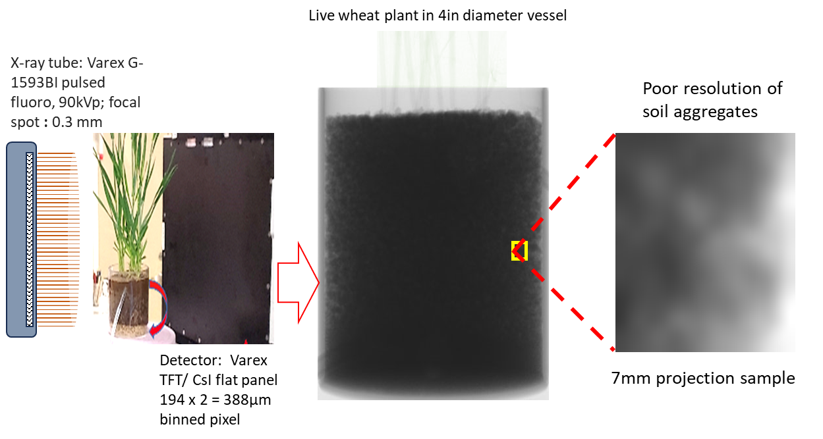
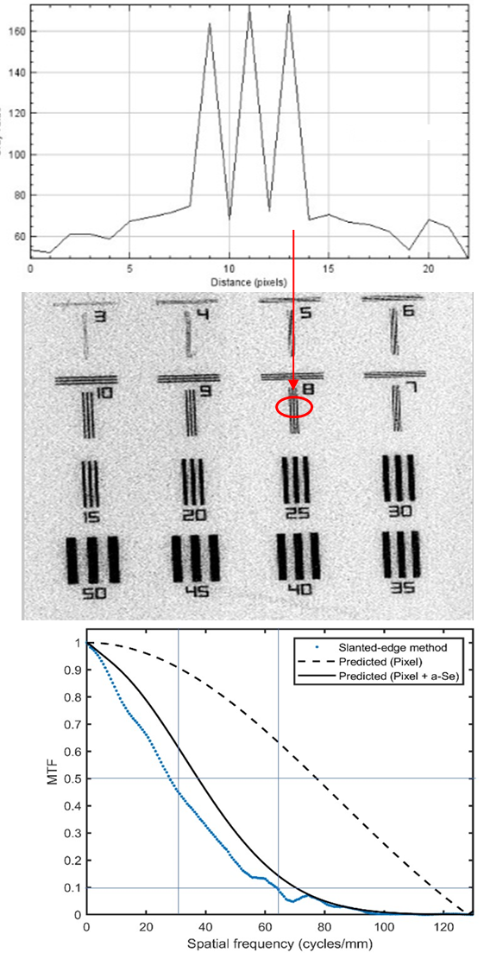
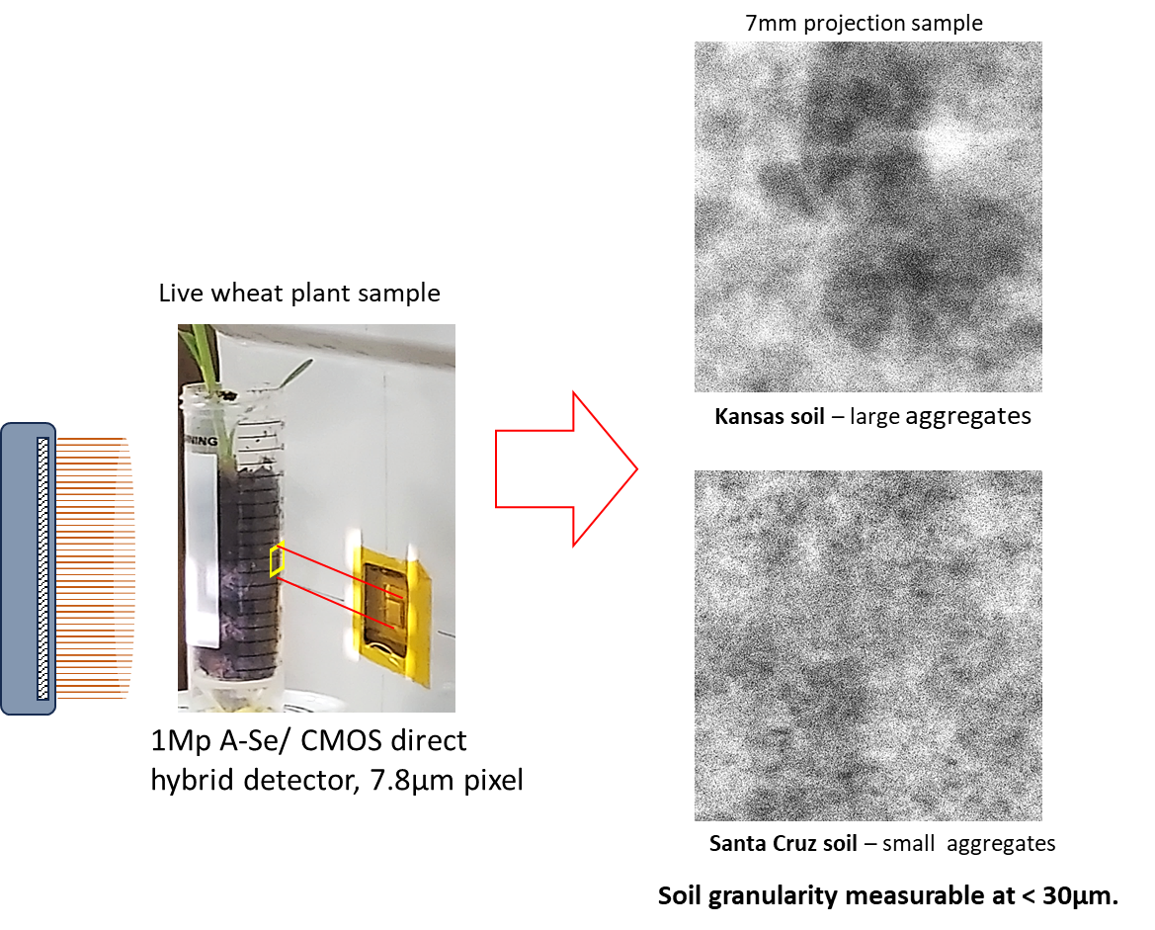
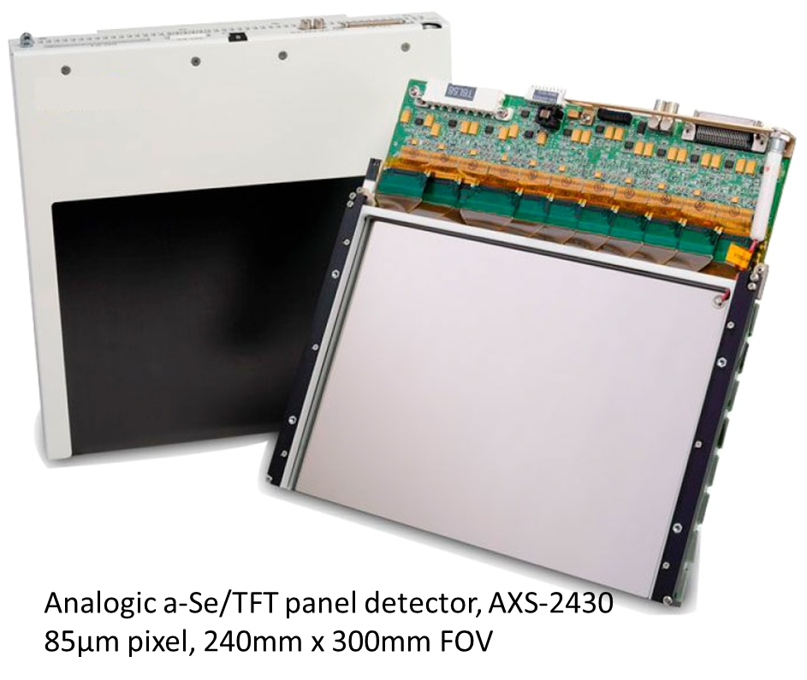
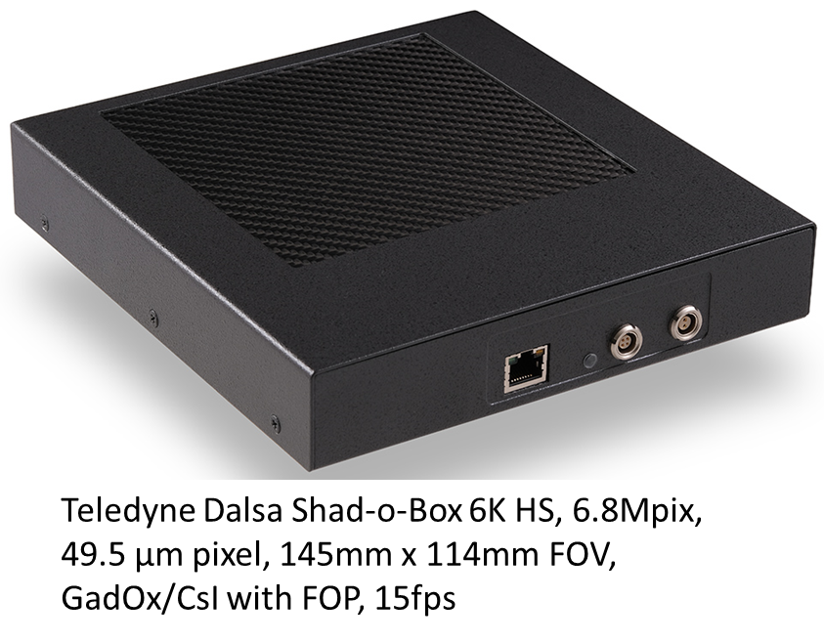
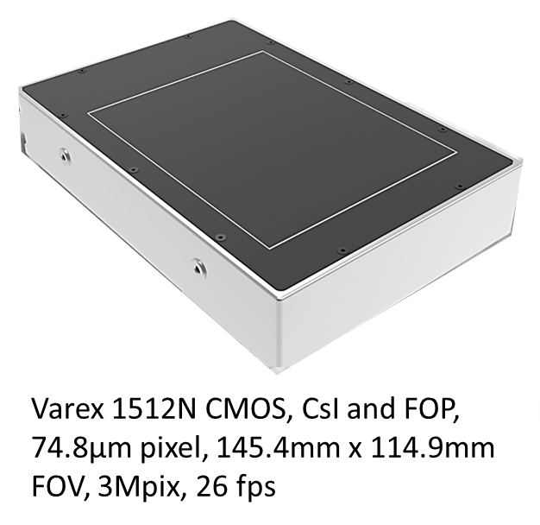
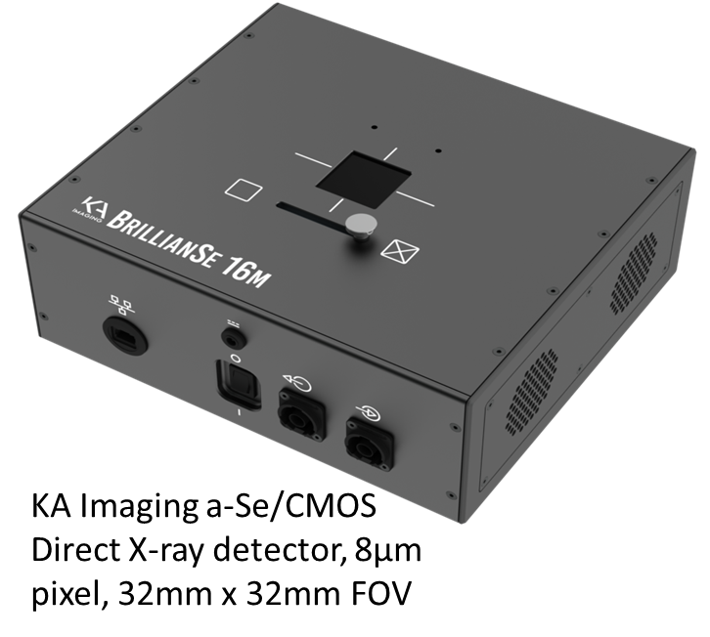
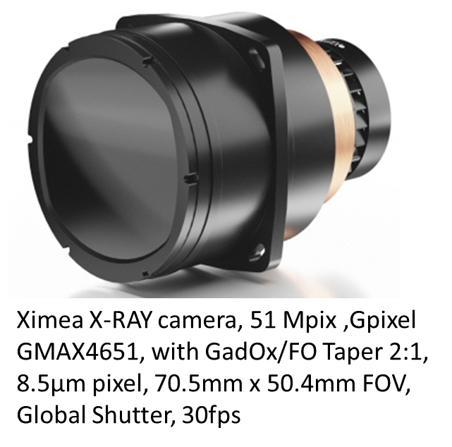
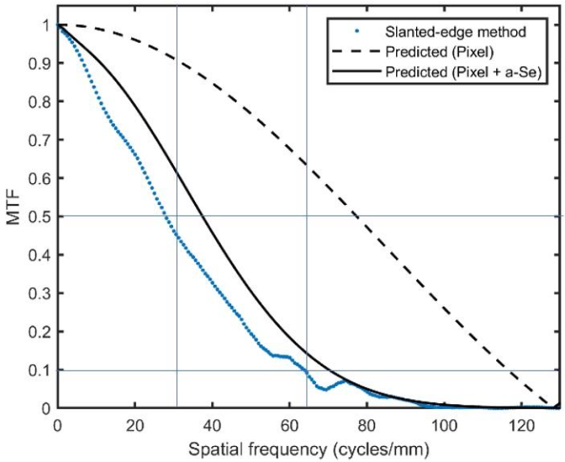
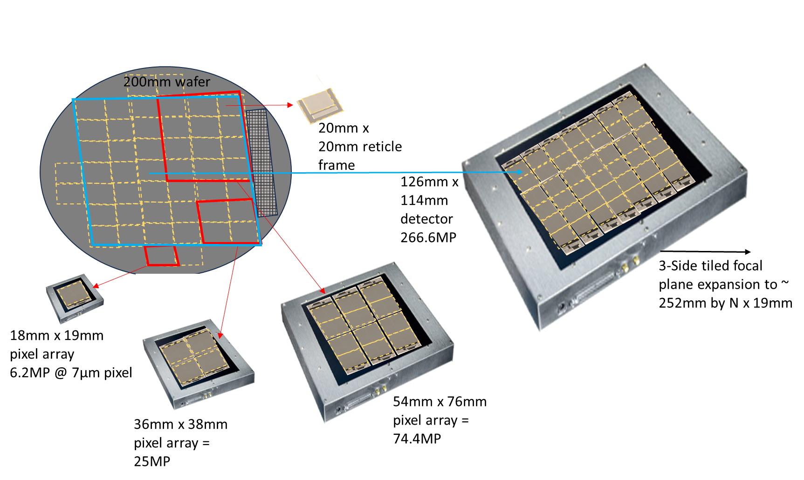
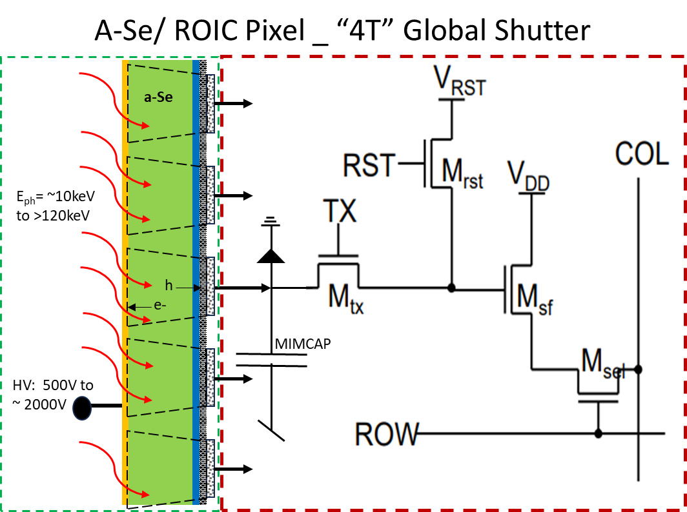
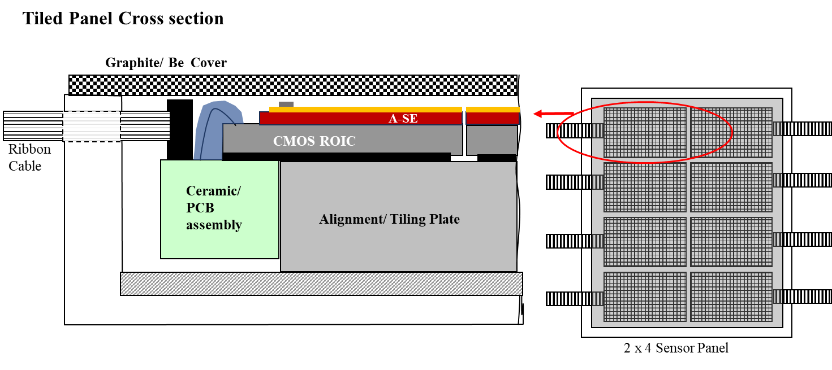
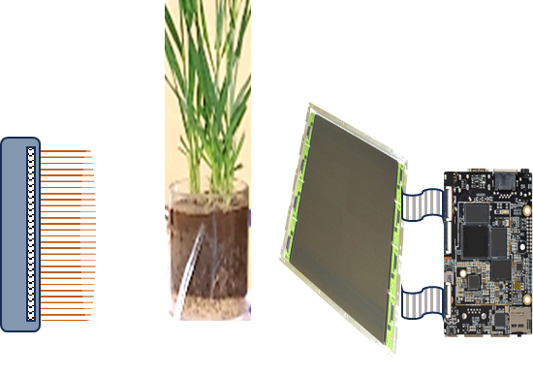
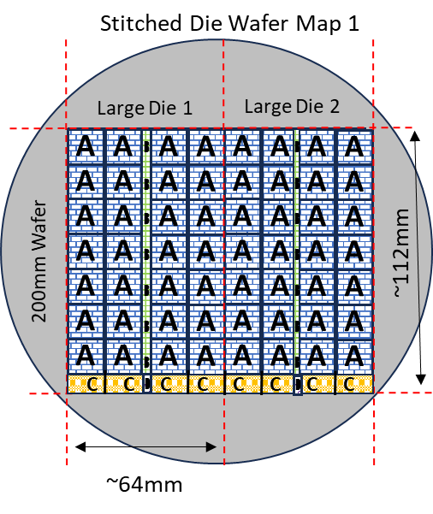
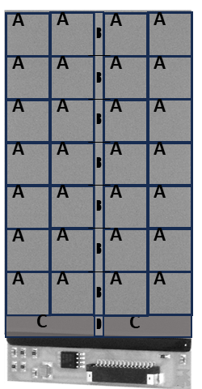
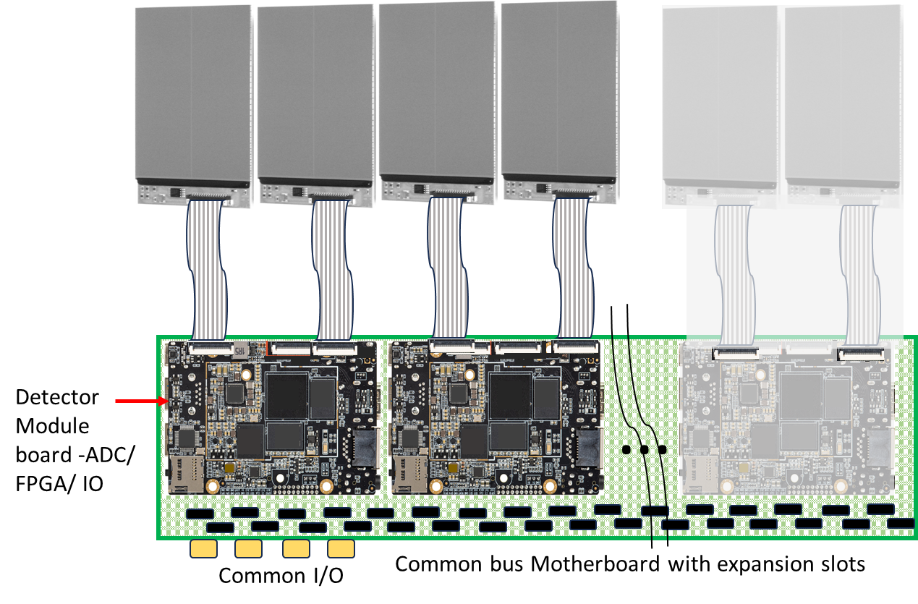
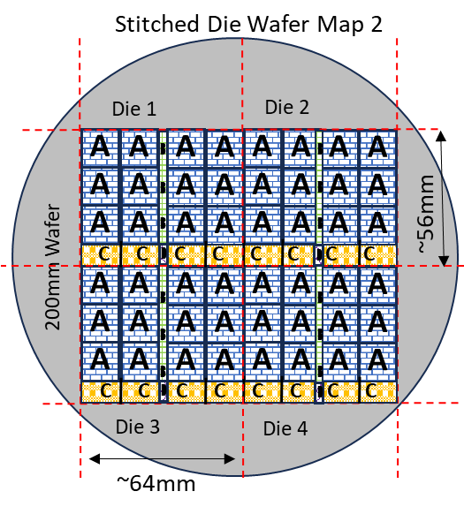
Scalable Scientific Detector Platform (SSDP)
Daniel Fiallo¹, Akyl Swaby¹, Michael G. Farrier² and Shiva Abbaszadeh¹
University of California, Santa Cruz, Santa Cruz 95064, USA¹; Farrier Microengineering LLC, 1298 E. Gruler Rd., Petoskey, MI 49770, USA²
INTRODUCTION
Increasingly demanding requirements in bio-imaging and materials science research, using Computed Tomography (CT) imaging methods, creates the need for A) micron scale resolution, B) large object field of view, C) frame rates optimized for artifact free CT image reconstruction and dynamic processes, D) high conversion efficiency for small signal with high contrast and signal-to-noise ratio (SNR) at reduced X-ray dose, and E) wide photon energy detection range (~10keV to >120keV). Available X-ray detector technologies fail to meet all these requirements in a single X-ray imaging platform. Engineering costs and cycle time for development of application specific X-ray detectors are prohibitive and impede timely research. There are no known configurable or scalable X-ray detector tools available to service the research community.
At university of California Santa Cruz (UCSC), we are working towards a modular, cost-effective X-ray detector camera system with A) micron scale resolution with global shutter pixel design, B) configurable Field of view (FOV), C) full resolution frame rates suitable for artifact free X-ray CT and Fluoroscopy applications, D) high conversion efficiency direct X-ray detection, and E) wide range of photon detection energies.
Our solution combines proven a) amorphous Selenium (a-Se) detector layer hybridization on small pixel CMOS readout ASICS, b) wafer scale reticle stitching for mixed signal CMOS fabrication, c) 3-side close die tiling focal plane construction, and d) camera platform design with detector tile expansion ports. One stitched ROIC reticle mask set can create hybrid detector tiles of multiple sizes, which may be tiled or used individually, connected to a common bus of the camera. –UV-VisNIR detector tile fabrication is conceivable using mask options.
Examples of commercially available X-ray detector cameras with critical features
RESULTS
a) Bio-Imaging study using small area prototype a-Se/CMOS direct detector.
Live wheat plant in 4in diameter vessel
b) Argonne APS BM-1 Synchrotron Imaging, JIMA bar target resolution, and MTF Calculation.
c) Prototype a-Se/ 3T CMOS ROIC Detector built with 10mm x 10mm base unit array.
CONCLUSION
METHODS
a) Family of variable FOV a-Se/CMOS detector panels. Active area selection based on target size.
b) Present DOE Earthshot research goal: Generate XCT images for live root soil samples using 4in diameter growth vessels. Resolve dynamic processes at soil aggregate and root interface with resolution of 10µm
1) 4T ROIC Pixel with a-Se layers applied. Global shutter design for best performance in CT and other dynamic target applications.
3) Multiple detector tiles can be close tiled for expansion of target FOV.
X-ray Source with ~10µm spot size
A-Se/CMOs panel _ FOV > 100mm x 100mm, 7µm pixel
2) From one CMOS ROIC mask set detectors with variable FOV can be fabricated.
4) Modular camera design enables multiple detector expansion on common bus.
Expandable multiport Camera platform M x N base units close tiling assembly on common backplane
a-Se directly hybridized to small pixel CMOS readout technology proven for small area detectors.
Live plant XCT imaging requires micron scale resolution plus large FOV > 100mm x 100mm. Effectiveness of micron scale pixel a-Se/CMOS detector was demonstrated with small FOV prototype.
CMOS reticle stitching to achieve large variable die sizes is well established with acceptable yield.
Three side close tiling for large FOV detector panel construction is a proven technology for large pixel detectors.
Modular camera design with expansion ports and common bus established for tiled X-ray panels of 250mm x 300mm field of view.
Global shutter, pixel charge binning, X-ray shot noise, high DQE, low lag, and high frame rate detector performance have been demonstrated. ROIC Pixel Design may include photodiode option for visible and indirect X-ray photon detection.
Present development of a SSDP: Combine multiple proven detector technologies to create a family of scalable FOV digital X-ray panels, with micron scale resolution, using high X-ray conversion efficiency of a-Se directly hybridized to a small pixel readout IC.
ACKNOWLEDGMENT
DOE DE-SC0019626 SBIR phase 1 grant_ High Energy Micron Scale Pixel Hybrid Detector.
DOE DE-SC0021975 CZT PET Rihzosphere Imaging.
Dr. Weixin Cheng, Environmental Studies Department, UCSC _ Live plant sample preparation and consultation.
Dr. Adam Wang, Robert Bennett, Rad/Radiological Sciences, Stanford _ Use of XCT facilities, CT image reconstruction.
University of California, Santa Cruz © 2023

