Slide 1

Machine-learning-based regression for edge data reduction of small pixel, high-bandwidth silicon detectors
Mathieu Benoit ¹, Aaron Young ¹, Shruti Kulkarni ¹, Rao Narasinga Miniskar ¹, Jeffrey Vetter ¹, Alice Bean ²
¹Oak Ridge National Laboratory
² Kansas University

Slide 2
Introduction
Practical problems with high bandwidth pixel data streams
Classifying, encoding and compressing pixel data
Neuromorphic Computing
  SNN
  Practical examples
  Work at ORNL
Perspectives

Slide 3
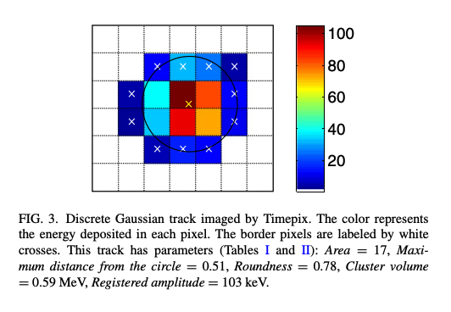
Practical problems with high bandwidth pixel data streams
Modern pixel detectors can produce zero-suppressed data stream with very large bandwidth (100’s of Gb/cm²)
There is a rich source of information on the underlying events in the data stream
  Multiple pixels belong to an event
  Each pixel carry information (Energy, timing)
  Geometrical and charge distribution tells us more about an interaction
The event generating the data stream can be complex

Slide 4
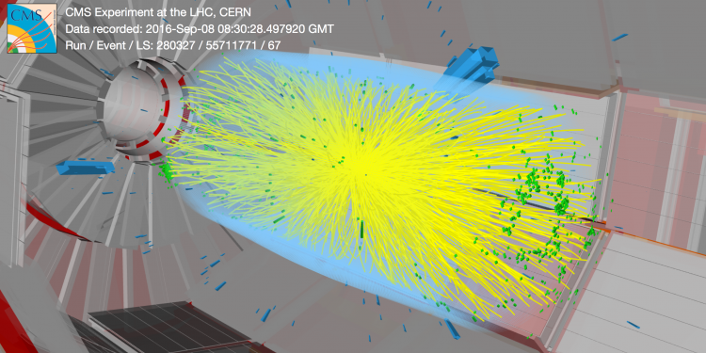
Practical problems with high bandwidth pixel data streams

Slide 5
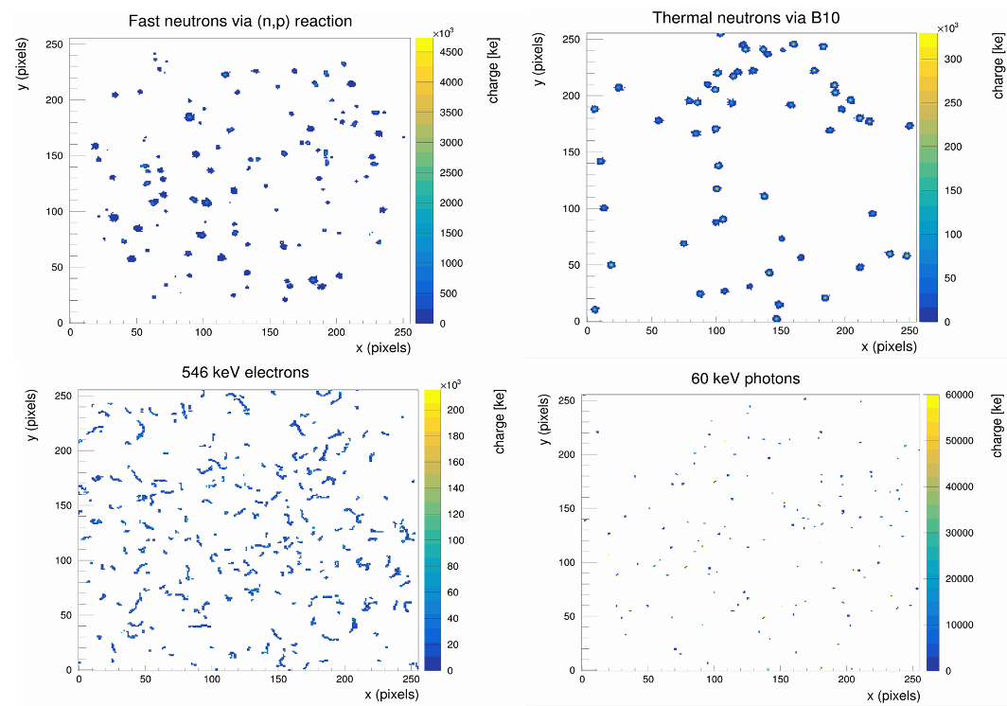
Classifying, encoding and compressing pixel data

Slide 6
Classifying, encoding/decoding and compressing pixel data
On Detector
Pixel raw data is collected, serialized and transmitted to DAQ
DAQ
Data is aggregated, event assembled and written to disk
Offline
Pixel are aggregated in clusters
position is extracted
unrelated data and noise is discarded
Large amount of of information are carried to disk, offline reconstruction perform data decoding and reduction in multiple manner :
Data calibration
Clustering of pixels and calculation of a (X,Y,T,t) coordinate of the event using energy and timing information
Removal of noise related data and physical data related to unrelated events

Slide 7
Classifying, encoding and compressing pixel data
On Detector
Pixel raw data is collected, serialized and transmitted to DAQ
DAQ
Data is aggregated, event assembled and written to disk
Offline
Pixel are aggregated in clusters
position is extracted
unrelated data and noise is discarded
As detector and ASIC technology improved, the data stream that can be produced increases faster that our capabilities to handle it, for various reasons :
Small experiments with new opportunities
Restriction in budget, supply chain
Cost/benefit analysis
Data storage, computing and transmission comes to a cost that can be better used in the project
  Potential cost savings for small medium and large scale experiments

Slide 8
Classifying, encoding/decoding and compressing pixel data , at the edge
On Detector
Pixel raw data is collected, serialized and transmitted to DAQ
DAQ + Edge Data reduction
Data is aggregated, event assembled, classified and simple quantities reconstructed
Offline
Computing receives ready to used qualified logical data
Event are reconstructed and higher order objects are recorded to disk
Change of paradigm ! Yes, we must throw away data, we already do !
With sufficiently smart and efficient algorithms , we can process data as it stream and reduce the data stream efficiently close to data acquisition
Data is aggregated and transmitted to DAQ and stored in High-Speed Memory, accessible by a high-speed bus (For example PCI express and DDR4 memory)
Commodity FPGA/ Custom cards consume the data stream and reduce the data
High performance network consumes the reduced data and transmit to offline

Slide 9
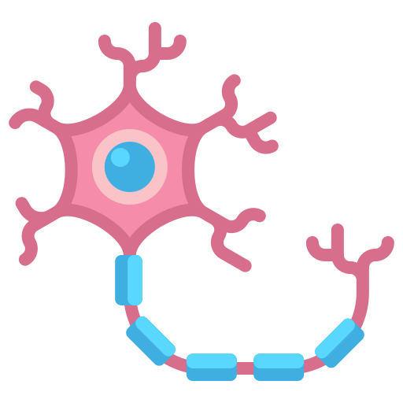


Neuromorphic Computing
20W !!
Neurons process and store information as needed
L
-Processing and Memory Separated
-Clocked data uses lots of power
Processing Unit
Lots of watts!!
Memory
9

Slide 10
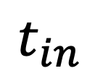
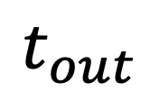
Spiking Neural Networks (SNN)
- Data spikes excite “neurons” which communicate via synapses
- Use temporal information
- Event driven cameras have been shown to process data faster with less energy
Spiking Neuron
Weight, Delay
$$t_{in}$$
$$t_{out}$$
Synapse
Threshold, Leak
Leaky Integrate and Fire Neuron

Slide 11
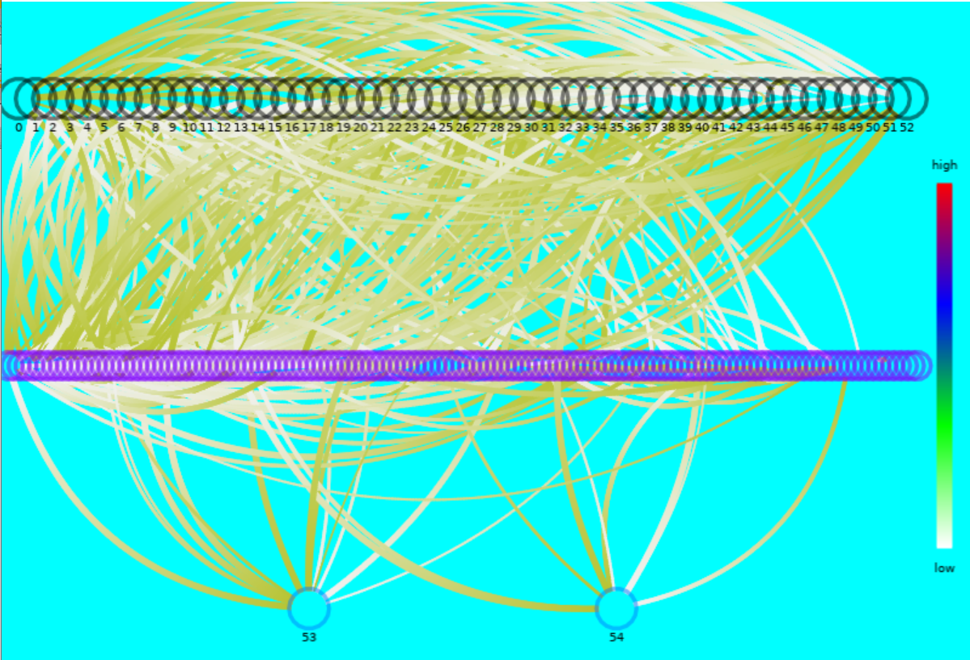
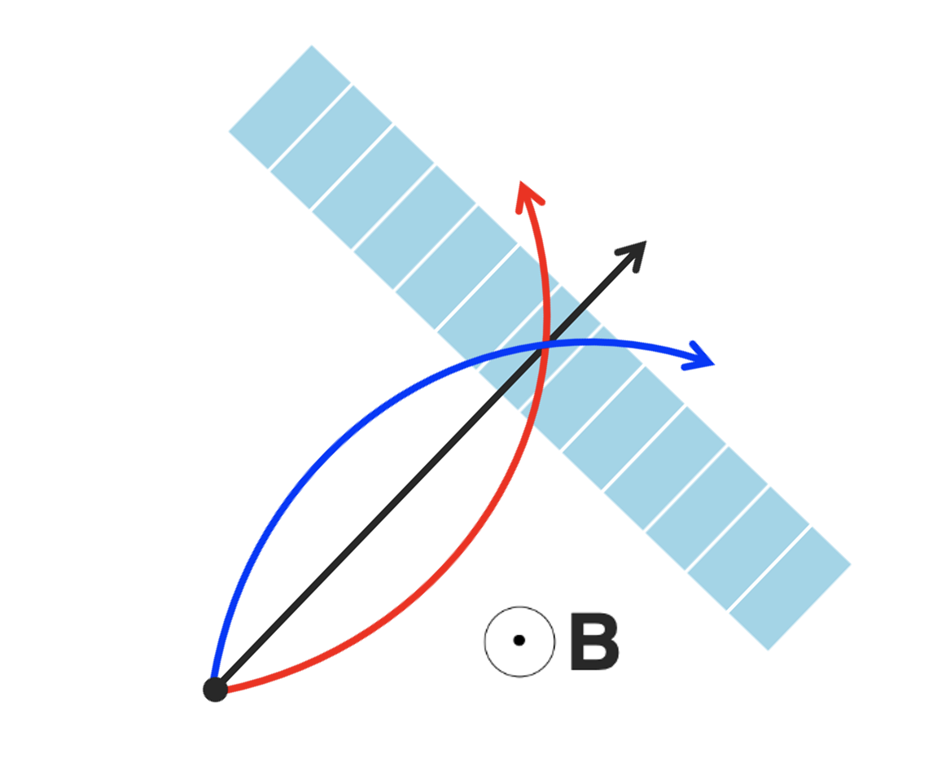
Results of SNN trained classifier for Smart Pixels
Use Network with highest signal efficiency for p_{T}> 2.0GeV clusters
  Trained Network size: 84 neurons, 493 synapses
Models | DNN | DNN (quantized) | SNN (this work)
Signal Efficiency | 94.8 % | 91.7 % | 91.89%
Data Reduction | 24.02 % | 25.71 % | 25.47%
Neurons | 128 | 128 | 84
Parameters | 2049 | 2561 | 930

Slide 12
Ongoing work at ORNL/KU
ORNL team is working on the implementation of Neural Networks for pixel detector data reduction using State-Of-The-Art Spiking Neural Network models and training tools
  SNN design and simulation tools are used to generate networks of interest using Simulation Data and Monte-Carlo Truth
  Generated networks can be implemented in RTL using HLS tools
  RTL Models can be implemented in FPGA for data processing
  Ultimately, they can be integrated in ASIC for ultimate performance, latency and power consumption
Encoding of spikes
Data from the ASIC are encoded into spikes on the input channels of the SNN
SNN perform data reduction via classification or regression
Spike decoding
Spikes are decoded back and serialized with a reduced bandwidth
Data Stream
reduced Stream

Slide 13
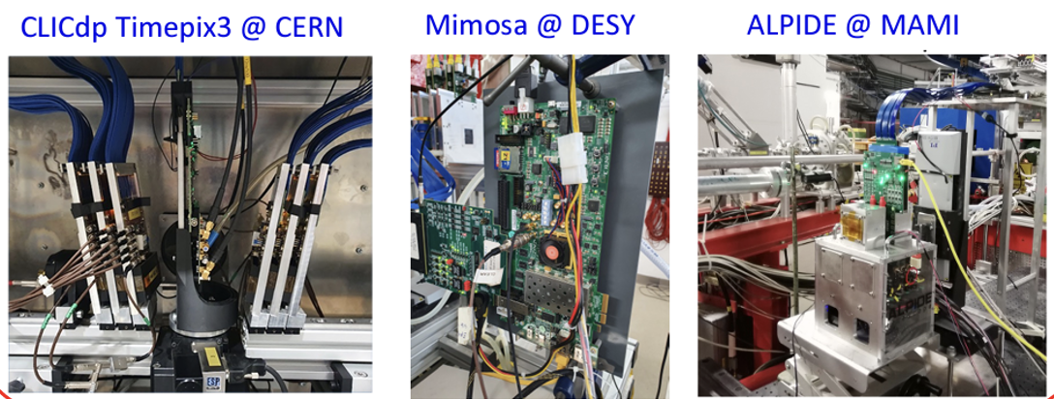
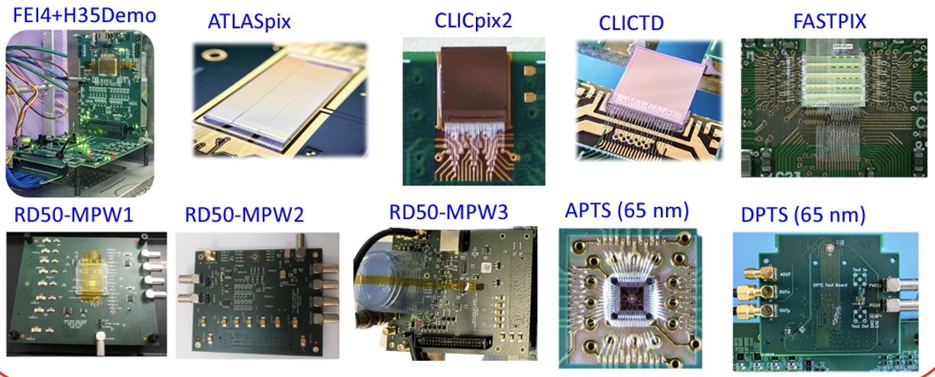
The CARIBOu 2.0 Framework
The CaRIBOu 1.x framework was originally developed in 2014, in collaboration between BNL (HW and Felix integration), UNIGe, and CERN (FW and SW design) as a versatile platform for DAQ development of our prototypes
  Over 50 systems in use across the world
  Large base of users across multiple experiments , multiple ASIC and sensors
  Focus on sharing code, experience in system design to reduce time to first test by avoiding hardware, firmware and software work duplication and providing robust design tested by fire by the large base of users.
Collaboration between ORNL, BNL OMEGA group, University of Carleton, Canada in the development of the next generation system hardware , CARIBOu 2.0
  Strong requirements from pixel R&D for large bandwidth, analog signal processing, timing and more system integration, scalability to large array, AI/ML algorithm integration
  Software and firmware design in collaboration with CERN EP, DESY, RD50/AIDANova, DRD3
  ORNL wants to deliver a scalable Timepix4 readout using CARIBOu 2.0
https://indico.cern.ch/event/1214410/contributions/5325456/attachments/2616558/4522699/Caribou_DRD3_Workshop-23Mar2023.pdf

Slide 14
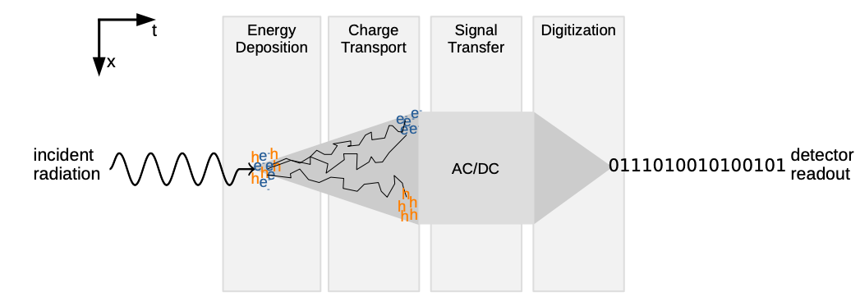
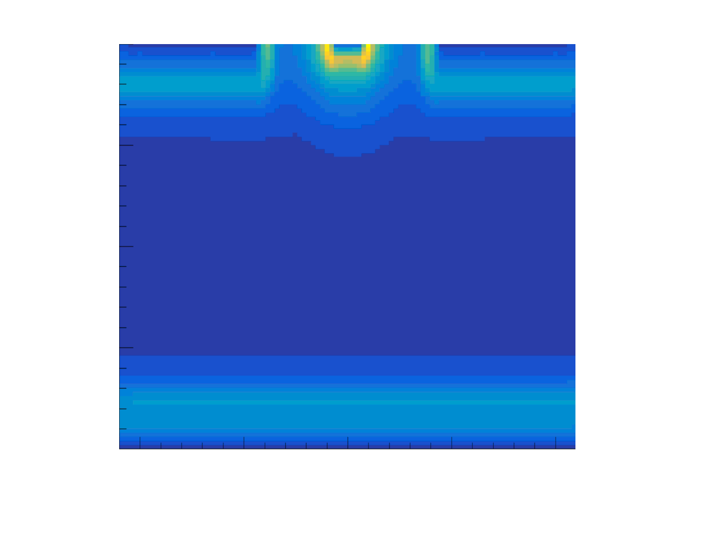
The Allpix² Framework
A Modular, Generic Simulation Framework for pixel Detectors
The framework aims at facilitating the different steps of the simulation of semiconductor detectors
  Energy deposition in the detector material (GEANT4 etc.)
  Charge Transport in the semiconductor (TCAD, various substrate and geometries)
  Transfer, Digitization and Analysis
  Excellent training tool for AI/ML
The developpers aim at implementing the best practices in semiconductor detector simulation in a generic way to provide to the community verified and standardardized methods and a developement environment for further improvement to simulation methods
  Framework infrastructure
  Documentation, examples and code demonstration
Website https://cern.ch/allpix-squared
Repository https://gitlab.cern.ch/allpix-squared/allpix-squared

Slide 15
Possible collaborative opportunities
Similar issues are common to pixel detectors in various experiments
  Clustering and position extrapolation of hits
    ETA correction, merge-hits disentanglement, Delta-electron removal
  Reduction of background un-associated to interesting physics
    Sorting of interaction by particle, nature of interaction
    Sorting hits by geometrical origin (for example removing beam halo!)
Similar challenges
  How to obtain good efficiency, deal with imperfect detectors
  How to deal with pile-up , various pixel shapes
  Etc...

Slide 16
Conclusion and perspective
New experiments will produce larger than even data volume that we need to handle in an intelligent way
  Machine Learning and AI provide new opportunities to design smart data acquisition system that integrate data reduction schemes
  Similarities between experiments calls for a collective effort
We propose the formation of a Working group on smart edge data reduction techniques in the framework of this RDC
  Share common tools and standard for simulation and training
    Allpix², SNN training tools
  Federate expertise and tackle identified challenges, providing solution for the communities
    IP for FPGA integration -> Neuromorphic accelerator ASICs etc.

Slide 17
References
Shruti R. Kulkarni et al., “On-sensor Data Filtering using Neuromorphic Computing for High Energy Physics Experiments”, ICONS 23 Proceedings, arXiv:2307.11242
Jieun Yoo et al., “Smart pixel sensors: towards on-sensor filtering of pixel clusters with deep learning,” arXiv: 2310.02474v (3 Oct 2023)

