Slide 1
Workforce for Next Generation Detector Systems Development, Training, Maintenance & Support
Emergent Needs for Next Gen Systems..
Mitch Newcomer RDC4

Slide 2
Topics Training, Maintence, Support
Who …Needs for Training
DOE sponsored Traineeship experience/status comments from leadership
Cherry picks from the HEPAP Benchmarking Panel Presentation Nov 2
Looking on the Horizon

Slide 3
Training Experts Who… Us
Experimental Physicists /PHD students
  As Instrumentation designers and system managers
  As reviewers
  As Mentors for large scale projects
  As Liaison among systems
Electrical Engineers
  In ASIC & FPGA design/development, HS Communications System Reliability Performance
  For Extreme Environments eg. Temperature, Radiation Radio-purity
Mechanical Engineers
  Detector construction
  Structural Design

Slide 4
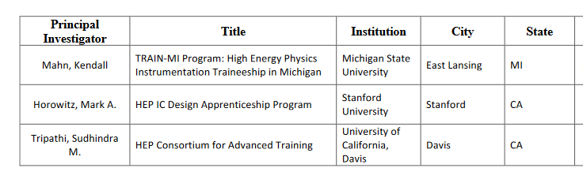
DOE sponsored Instrumentation Traineeship
TRAIN-MI (HEP Instrumentation focus) status and comment on their experience..
Currently 8 trainees ( the planned number) & students in a graduate instrumentation certificate program established by MSU with DOE support. They have given two courses: Detectors Lab and DAQ lab that full with 5 on the waiting list. - So the course work part of their program is well subscribed.
Two impediments: Citizenship Requirement & 2yr support for 4yr PHD candidates.
Faculty are happy with the program. Note that these are introductory courses…
Notes:
We currently have (Kendall correct me) eight official trainees, which is our target number, and a somewhat larger number of students who have been taking classes and are enrolled in a related graduate certificate program that was established by MSU as a result of the DOE support (the trainees must do the work for the certificate, but the certificate itself is broadly open). To quantify these numbers are a bit, we have so far taught two entirely new graduate classes -- a detectors lab and a DAQ lab -- as part of the program. The most recently offered, the DAQ lab, in spring hit its enrollment cap of 16 with 5 people on the waiting list. So the coursework part of this seems to be popular and working well, and we had hoped to have exactly this kind of larger impact as a result of the traineeship.
For the traineeship per se, we have hit two main limits in my view. The US citizenship requirement has made things difficult; our ATLAS group, in particular, seems for whatever reason to have largely non-citizen students. The other major hurdle in getting people enrolled has been that the support period is on the short side compared to a PhD, which makes faculty reticent to bring in new students unless they have funding in hand to support them all the way through. And, if they do have that funding, then they usually want to spend it. So we are in the somewhat odd situation that the program itself is very locally popular, and we can easily get people to take our classes, but we can't always get people to take our money. I haven't seen much concern among faculty about students being away from campus, since that usually takes the form of them working with collaborators at national labs. It also takes some time to ramp these programs up, so some of these may also be teething pains during start that go away as more people get used to things.

Slide 5
HEPIC ASIC Traineeship Led by Stanford University combined comment from Stanford, SLAC & LBL
@ SLAC 3 interns so far:
  2 express high interest in HEP , 1 in early stages of ASIC training
Program could be expanded based on subscription to 2 years of the HEPIC summer study at SLAC ( especially true with MSEE’s )
Struggled to get University faculty to join in.
  Stanford, UCSC & UC Davis joined Initially then UT Arlington with student at FNAL
Creating opportunities for internships is Key..
  Hands on projects capture interest.
  Creates experience in multi-disciplinary environment.
  Detector systems have grown in complexity and require a mix of skillsets
    ASIC designs require expertise in EE skillsets (not restricted to EE’s)

Slide 6
HEPIC comment continued
Students work on small unique interesting projects fit the needs of labs.
Students are trained in skills they will need for the next generation collider projects.
Number of students that can be accommodated is constrained by the ability of an available trained engineers to mentor.
Inspirational Thought.. Joint student driven R&D ASIC program for HEPIC
…. Following initial training or a more formal candidacy process
  Immersion research project with mentorship researchers in the field but self driven with reporting and archiving requirements so that allow rotation of membership…
  1 FTE per institution with 2 or 3 students / Institution and several institutions involved in a consortium of members.
  Design process would mirror the distributed design model developed for ATLAS…
  Produces new R&D results and students trained in HEP IC design techniques..
…Developing this idea could be part of a training work package….

Slide 7
DOE sponsored Traineeship FOA
Path to improve subscribership*
  Relax Requirement for US Citizenship
  Duration of support should be compatible with the degree program. 2 yrs Masters, 2 additional for PHD
University Faculty perspective
  Physics Majors the program requirement to be at a lab or away from the home institution several months at a time after academic requirements are complete delays their contributions to faculty research objectivers. Shorter periods away from the home institution, remote learning or participation at a University affiliated project lab would be useful.
  EE departments - Faculty incentives publishing or particpatoin as co-PI’s in HEP projects might be helpful..
* Useful comments here from Stanford, SLAC, LBL program leaders
Notes:
ore difficult than I expected for two reasons:
1. The need to have US citizens (many students interested in VLSI are foreign born today)
2. The restriction on the amount of money which can paid to a student each year (which is less than a std Stanford RA).

Slide 8
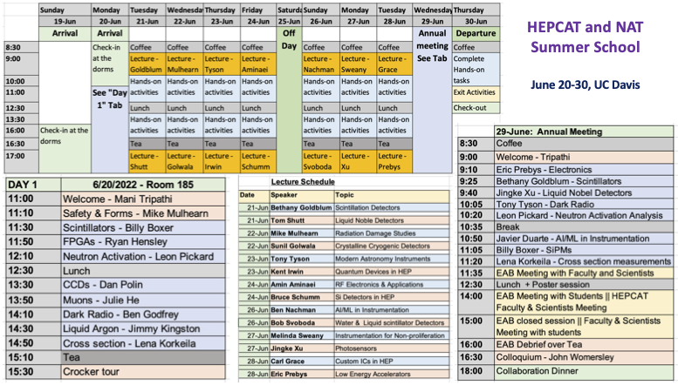
Nuclear Science & Security Consortium and HEP Consortium for Advanced Training

Slide 9
Identified areas of Importance for advanced detector design / training
ASIC’s Training/Access/collaboratoin
FPGA design Training, advanced implementation communication
Computing
AI/ML
QIS
Modeling & Verification ASICs, modules, Sub-systems, Detector Levels
……
… not too often mentioned System Aware Design
  Modeling / Verification that enables a vision of system performance

Slide 10
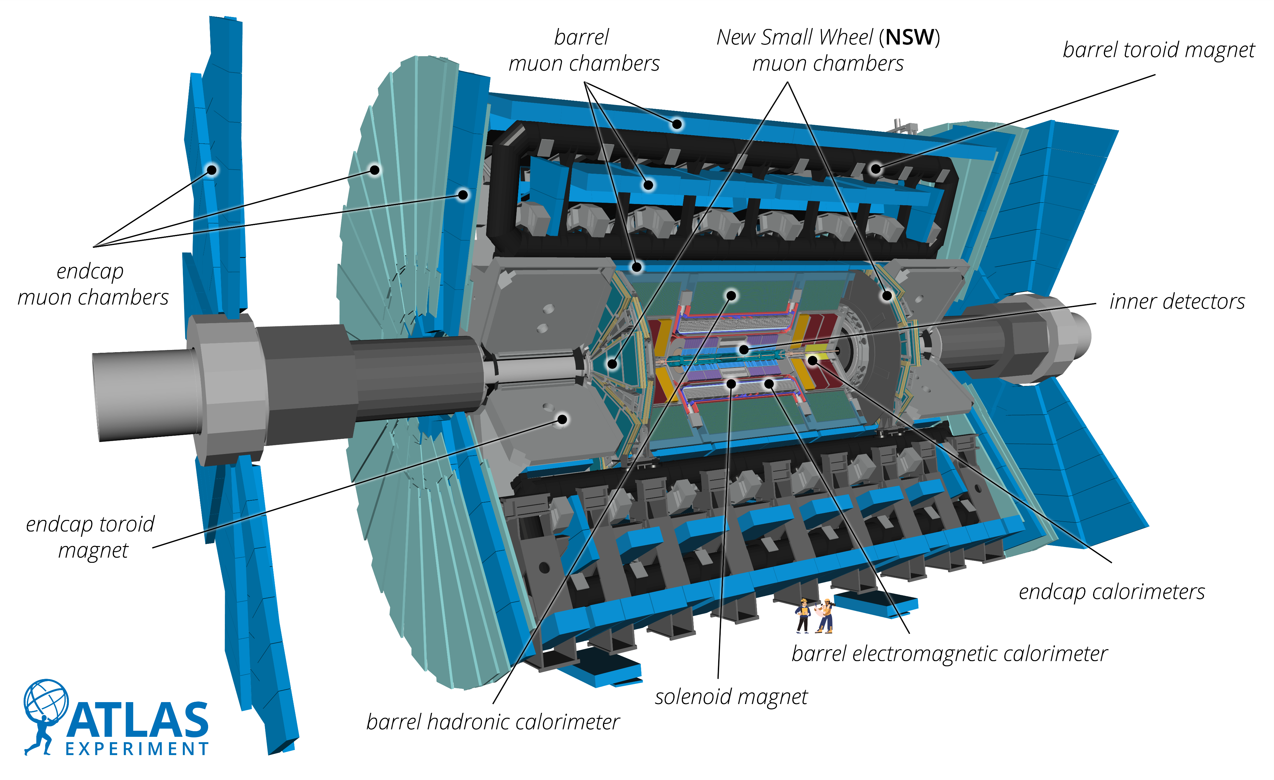
Integration of the Detector System …Excellent in the past, but becoming strained as “off” and “on” detector readout & triggering sub-systems specialize in different silos… Unlikely to spontaneously evolve without specific investigation and community investment in modeling, verification & training.
5 billion pixels
50 million strips

Slide 11
Emergent Skills and Disciplines
Required for System Level Design
Co–Design/Development tool to Model & Verify the Full Detector Readout system
Potentially a “Work Package” to develop the process…
Initially an Abstracted description of a future Detector as the Model.
Expand to keep pace with evolving sub-system
Integrate elements as they are conceived as models that can be verified as designs are completed. Sample data may be all that is needed for detector level simulation.
Optimize Data FLOW
  constructing Managing transmitting Receiving Decoding Big Data

Slide 12
Support
Common observations
The research tools we need have a cost that puts many but the most basic tools beyond the reach of our Labs and Universities.
The US needs to find a model similar to Europractice and the support that CERN’s ESE groups have provided for ASICs that levels the playing field among users and allows for collaboration among institutions.
Shared IP and broad institutional technology access is essential to integrating community wide participation that optimizes creativity and allows the scrutiny necessary to find and correct flaws in designs.
This essentially defines the process by which Science takes leaps and bounds forward.

Slide 13
Some Crucial Points about Training and Support from the HEPAP Benchmarking presentation on Instrumentation
These ideas have percolated up through BRN and SNOWMASS and been embellished with new perspectives.

Slide 14
Natural Training & Discovery

Slide 15
Crucial Recommendations underway to Encourage & Sustain membership in a world class R&D Workforce

Slide 16
HEPAP sub panel report…

Slide 17
Common Observations…

Slide 18
Encourage Workshops & Topical training among Peers:
Encourage sharing state of the art Ideas / Techniques.

Slide 19
Foster Training of Instrurmentation Specialists at Universities to acknowledge the value of their Contribution to Discovery in Basic Science

Slide 20
Concluding Thoughts
The commercial technologies exploited in our sub-systems designs off and on the detector are highly complex and many require specialized training. We need to arrange ways of sharing the knowledge and updating the skills of our workforce. Shared access to technology and IP will encourage the highest levels of innovation and scrutiny. Both of which are requirements for breakthrough designs.
Instrumentation Workshops and Conferences share the knowledge of what can / is being done.
Immersion projects like small scale experiments are likely the most natural way for young PHD’s to gain experience and learn about HEP instrumentation
(Including the limitations and capabilities of ASICs).
Broad topic Traineeships seem to be very effective. We need to explore synergistic ways to scale up subscribership…
Recommendation…
We might want to follow in the footsteps of our European colleagues who have a specialized Training Panel like DRD9 to preserve and enhance the capabilities and support for the US Advanced Detector workforce.

