Slide 1
RDC 4 Generic & Cross RDC Co Developments in ASICs & Electronics
Coordinators: A. Dragone, M. Newcomer
November 7, 2023

Slide 2
Recived Abstract (via CPAD – RDC4 call)
Received a total of 57 abstracts
  27 RDC4 specific
  13 shard with RDC3 and RDC11
  4 shared with RDC5
  5 shared with RDC1
  2 shared with RDC10
  3 with RDC2
  2 shared with RDC8

Slide 3
RDC 4 R&D Priorities
Areas of R&D Priorities
Topic Area #1: Circuits and Architectures for 4D Tracking and Calorimetry
  Picosecond Timing Circuits
  Efficient methods for increased granularity
  Monolithic Readouts
  Models and Techniques for extreme radiation
Topic Area #2: Big Data Management
  Energy efficient architectures and circuits
  On-Chip Computing (e.g., eFPGA)
  On-Chip AI/ML
  Fast Interconnections and I/Os
  Advanced Integration (3D, Photonics, Wireless)
Topic Area #3: Cryogenic and Deep Cryogenics
  4K Circuits and Architectures for QIS
  Circuits and Architectures for Noble Liquid Detectors
  Cryogenic Models and Libraries
Topic Area #4: Methodologies, Tools, IC blocks, SoCs and Workforce Development
  Design for Verification methodologies
  CAD Tools and Foundries shared joint access
  Common IC blocks, Shared libraries and access model
  Domain knowledge transfer and training

Slide 4
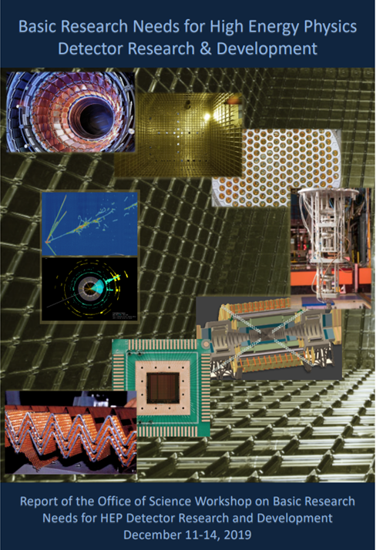
RDC 4: R&D Priorities from the community
A cross-cutting Area with big challenges
 | BRN PRIORITY RESEARCH DIRECTION
CALORIMETRY | PRD 1: Enhance calorimetry energy resolution for precision electroweak mass and missing-energy measurements
 | PRD 2: Advance calorimetry with spatial and timing resolution and radiation hardness to master high-rate environments | RDC9/RDC11/RDC4
 | PRD 3: Develop ultrafast media to improve background rejection in calorimeters and particle identification detectors
NOBLES | PRD 4: Enhance and combine existing modalities to increase signal-to-noise and reconstruction fidelity | RDC1/RDC7/RDC4
 | PRD 5: Develop new modalities for signal detection
 | PRD 6: Improve the understanding of detector microphysics and characterization
PHOTODETECTORS | PRD 7: Extend wavelength range and develop new single-photon counters to enhance photodetector sensitivity
 | PRD 8: Advance high-density spectroscopy and polarimetry to extract all photon properties
 | PRD 9: Adapt photosensors for extreme environments
 | PRD 10: Design new devices and architectures to enable picosecond timing and event separation | RDC2/RDC4
 | PRD 11: Develop new optical coupling paradigms for enhanced or dynamic light collection
QUANTUM | PRD 12: Advance quantum devices to meet and surpass the Standard Quantum Limit
 | PRD 13: Enable the use of quantum ensembles and sensor networks to fundamental physics
 | PRD 14: Advance state of the art in low-threshold quantum calorimeters
 | PRD 15: Advance enabling technologies for quantum sensing | RDC8/RDC4
ASIC | PRD 16: Develop process evaluation and modeling for ASICs in extreme environments | RDC 4
 | PRD 17: Create building blocks for Systems-on-Chip for extreme environments
SOLIDSTATE | PRD 18: Develop high spatial resolution pixel detectors with precise high per-pixel time resolution to resolve individual interactions in high-collision-density environments | RDC3/RDC11/RDC4
 | PRD 19: Adapt new materials and fabrication/integration techniques for particle tracking
 | PRD 20: Realize scalable, irreducible-mass trackers
TDAQ | PRD 21: Achieve on-detector, real-time, continuous data processing and transmission to reach exascale | RDC5/RDC4
 | PRD 22: Develop technologies for autonomous detector systems
 | PRD 23: Develop timing distribution with picosecond synchronization
X-CUT | PRD 24: Manipulate detector media to enhance physics reach
 | PRD 25: Advance material purification and assay methods to increase sensitivity
 | PRD 26: Addressing challenges in scaling technologies
+
Snowmass

Slide 5
Snowmass IF Recommendations

Slide 6
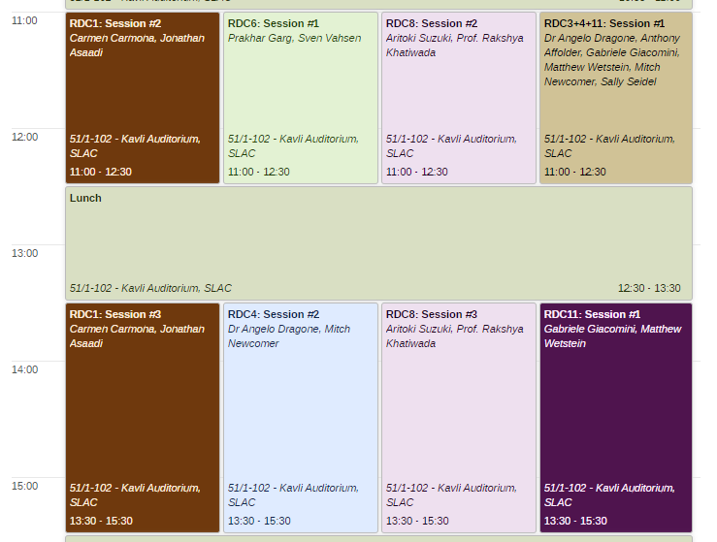
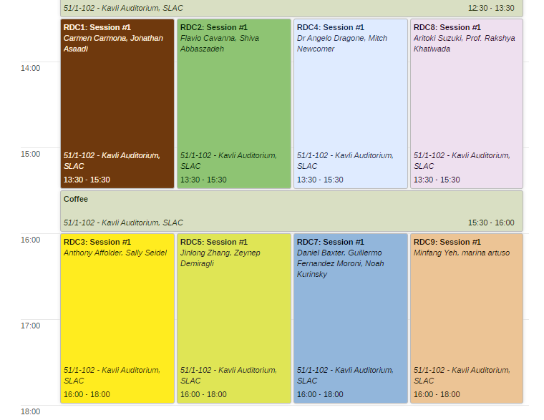
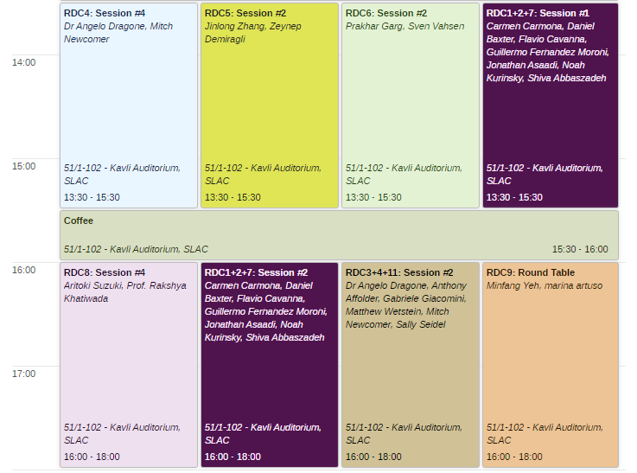
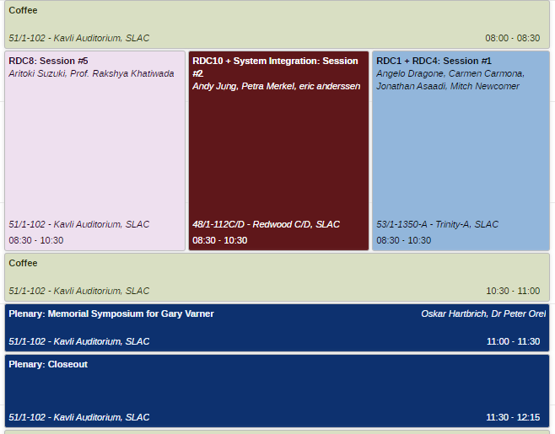
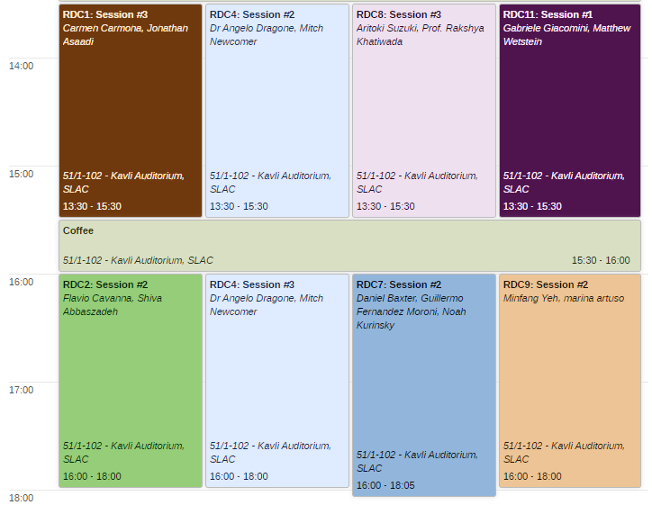
RDC4 Sessions
Four 2hr long parallel sessions
Two joint 1.5hr/2hr long sessions with RDC3 and RDC11
One joint 1.5hr long session with RDC1
Poster sessions
11:00am
1:30pm
1:30pm
8:30am
1:30pm
4:00pm
4:00pm
Tuesday
Wednesday
Thursday
Friday

Slide 7
ASICs and Electronics RDC4 roles
Foster collaborations for generic “long term” R&D in alignment with PRDs related to ASIC and Electronics
Taking input from synergistic activities (e.g., HEPIC) and creating opportunities for implementations
Ensuring coordination and collaboration between US groups (Other US collaborations: US FCC, Linear Collider workgroup, Muon Collider Workgroup), other International groups DRD7 and other synergistic initiatives like US Initiative on Microelectronics
Support the organization of work packages following input from this community
Promote RDC4 work packages and advocate for funding
Foster a cross-institution framework for training new generations of designers with hands-on components in HEP-funded facilities
We would like this to be an interactive workshop

Slide 8
Work plan
RDC4 Sessions:
  Circuits blocks and IC architectures for 4D Tracking and Calorimetry (circuit focus)
  Big Data Management
  Cryogenic and Deep Cryogenics
  Methodologies, Tools, Libraries, and Workforce Development
RDC3/RDC4/RDC11 Sessions:
  Circuits blocks and IC architectures for 4D Tracking and Calorimetry (system focus)
  Fast Timing (system focus)
RDC4/RDC1 Session
  Circuits blocks and IC architectures for (system focus)
Session’s structure:
  Invited talk on broad topic for the session 15+5 min
  6 Talks 12+3 min
  10 min organization of working groups for work packages definition
  Working groups meet during the workshop to prepare an outline for a work package (one pager template) to be given to coordinators by the end of the workshop (no later than Nov. 30th)

