Slide 1
ASROC discussion and preliminary results
Prepared by Gabriel Saffier-Ewing and Anadyne Inc for CPAD 2023

Slide 2
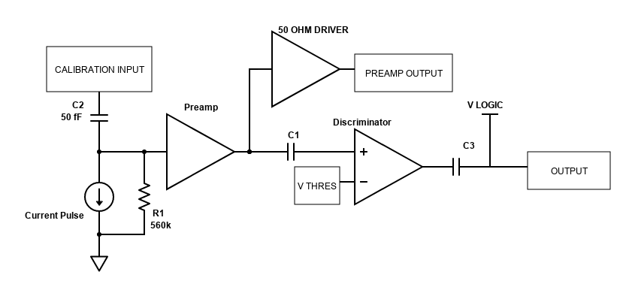
Block Diagram

Slide 3
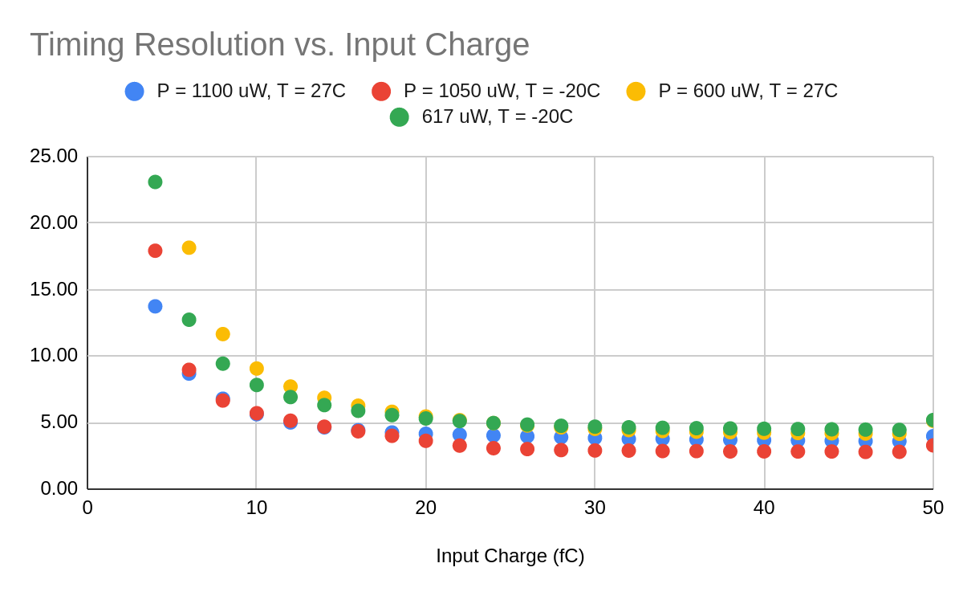
Simulated Timing Resolution, Preamp + Discriminator
Low input charge timing resolution strongly dependent on power consumption
Less power (LP) and more power (MP) versions of the chip fabricated
Design is extremely tuning conscious: Monte Carlo shows individual channel calibration should not be required. Only wafer level characterization.

Slide 4
Preliminary measured results
LP preamp physical device lab measurements
10 ps resolution for 20 fC input instead of simulated 8 fC. Note that the preamp external driver attenuates the on chip signal by around 20 percent.
Around 50 percent higher rise time than in simulation. More lab time and testing of the MP chip required.
1V input pulse corresponds to 20 fC input charge

Slide 5
Open questions from our point of view
SiGe biCMOS offerings currently limited to 130nm CMOS feature size: does that preclude these processes from being used due to digital back end power consumption?
Slightly faster transistors would improve performance, but past around 25 Ghz ft the design will probably suffer from bad matching, fragile transistors, increased cost, without analog performance benefit. There is an optimum process speed that we suspect is much lower than the latest and greatest SiGe developed for telecom. How fast is appropriate?
What are the input requirements for upcoming 10 ps timing TDC circuitry?
Appropriate discriminator design for timing resolution/low power/high rep rate is much more challenging than preamplifier design in our opinion.

Slide 6
Thanks!
Supported by DoE SBIR grant: DE-SC0021800
Santa Cruz Institute for Particle Physics
My analog electronics teachers: Ned Spencer and David Dorfan
Anadyne, Inc. staff: Zachary Galloway
Tower Semiconductor

