Slide 1


GAMPix
Electron Track Detection with a Dual Scale LArTPC System
Bahrudin Trbalic
Stanford
11/10/2023

Slide 2
GAMPix detector
Electron Track Detection with a Dual Scale System in TPCs
Low
Noise
Threshold
Power
Diffusion Independent
(Can use diffusion to estimate drift length)

Slide 3

GAMPix detector
Electron Track Detection with a Dual Scale System in TPCs
Low
Noise
Threshold
Power
Diffusion Independent
(Can use diffusion to estimate drift length)

Slide 4
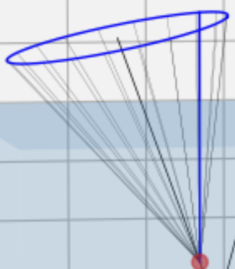
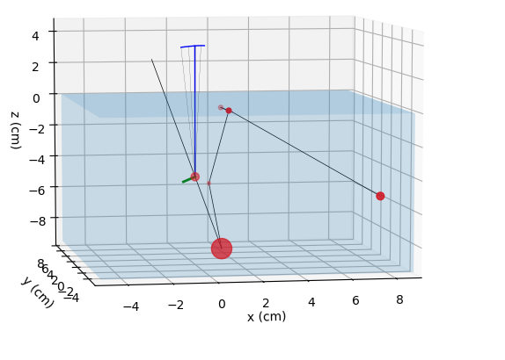
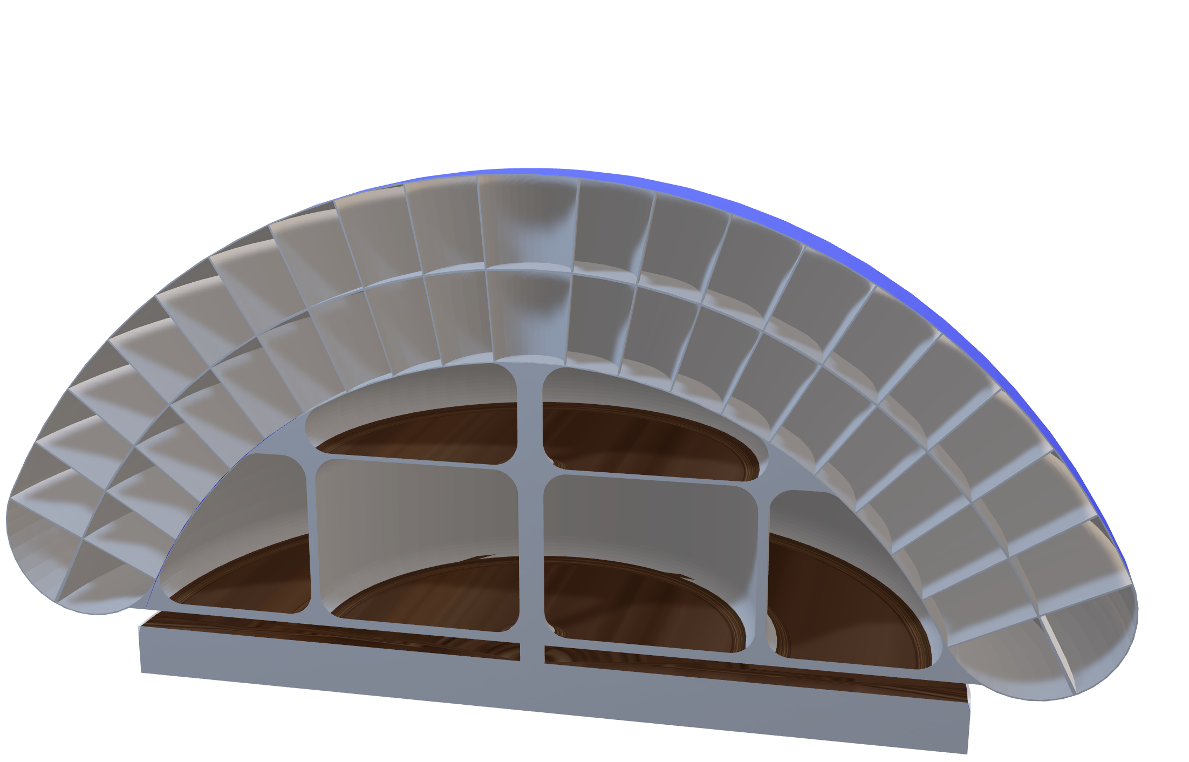
GammaTPC
3m
Notes:
A new Compton telescope concept for gamma rays. Large area/mass 10m^2, 4 tons, 2π FOV
Compton Scatters in LAr
Incoming Gamma Ray Compton Scatters and Produces:
- Electrons Tracks [this talk]
- Light (Scintillation)
To reconstruct the energy/direction we need:
- Positions of the Tracks
- Energies of the Tracks [part of it is in light signal]

Slide 5
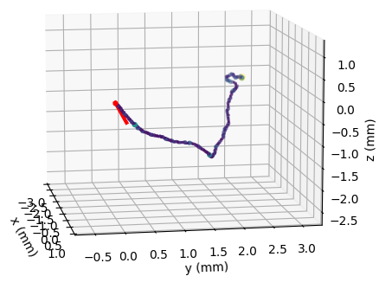
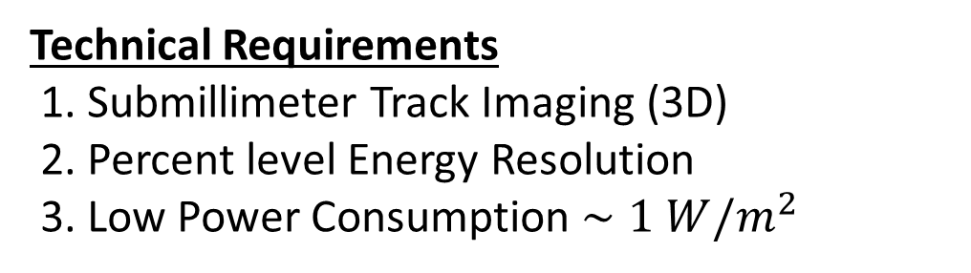
GammaTPC
3m
Technical Requirements
1. Submillimeter Track Imaging (3D)
2. Percent level Energy Resolution
3. Low Power Consumption $∼1 W/m^{2}$
1 MeV, 21K e⁻/ion pairs
Notes:
A new Compton telescope concept for gamma rays. Large area/mass 10m^2, 4 tons, 2π FOV
Compton Scatters in LAr
Incoming Gamma Ray Compton Scatters and Produces:
- Electrons Tracks [this talk]
- Light (Scintillation)
To reconstruct the energy/direction we need:
- Positions of the Tracks
- Energies of the Tracks [part of it is in light signal]

Slide 6

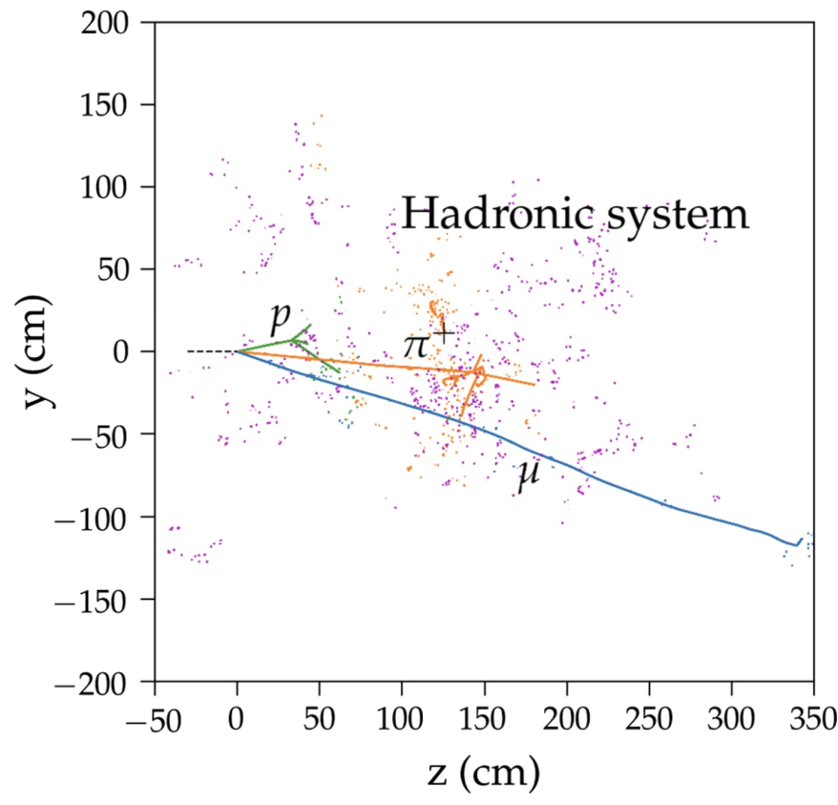
Possible Application in DUNE FD Phase 2
Low-energy “blips” produced by neutrons and electrons in DUNE events.
- Many of those are below threshold in current readout schemes
Proposed GAMPix detector enables the detection of low energy scatters
- Greatly improves the Supernova neutrino (MeV scale) detection.
A. Friedland and S. W. Li, “Understanding the energy resolution of liquid argon neutrino
detectors,” Phys. Rev. D 99, no.3, 036009 (2019) [arXiv:1811.06159 [hep-ph]]

Slide 7
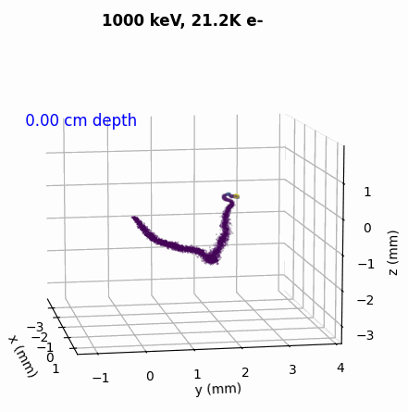
How to Image the Electron Tracks?
Challenges:
- Charge loss when diffusion is on the scale of sensors

Slide 8
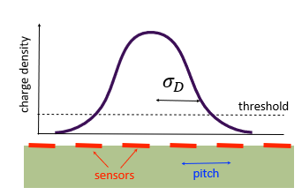
How to Image the Electron Tracks?
Challenges:
- Charge loss when diffusion is on the scale of sensors

Slide 9
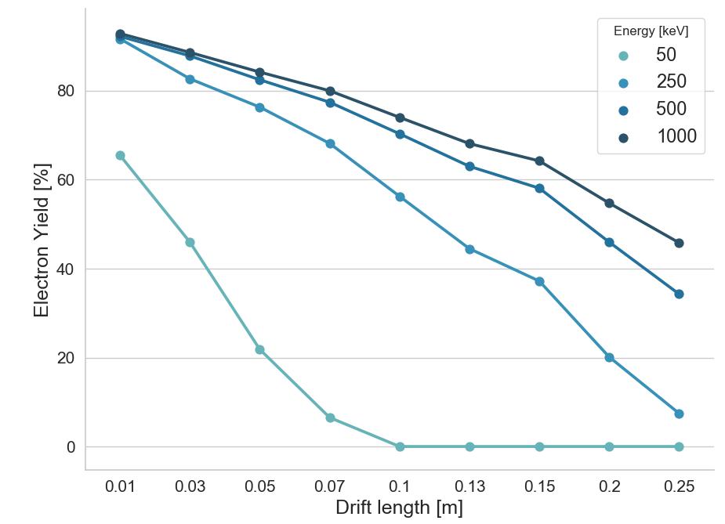
Example of Pixels Only Readout
> 10ms lifetime
Lost charge due to threshold
Lost Charge
*threshold of 80 e

Slide 10
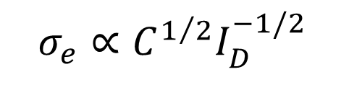
How to Image the Electron Tracks?
Challenges:
- Charge loss when diffusion is on the scale of sensors
- Low noise needs high power
Noise sets the
- energy resolution
- threshold
$σ_{e}∝C^{1/2}I_{D}^{−1/2}$
noise power

Slide 11
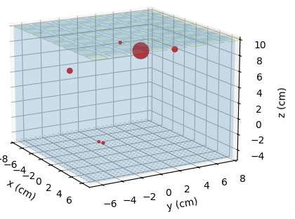
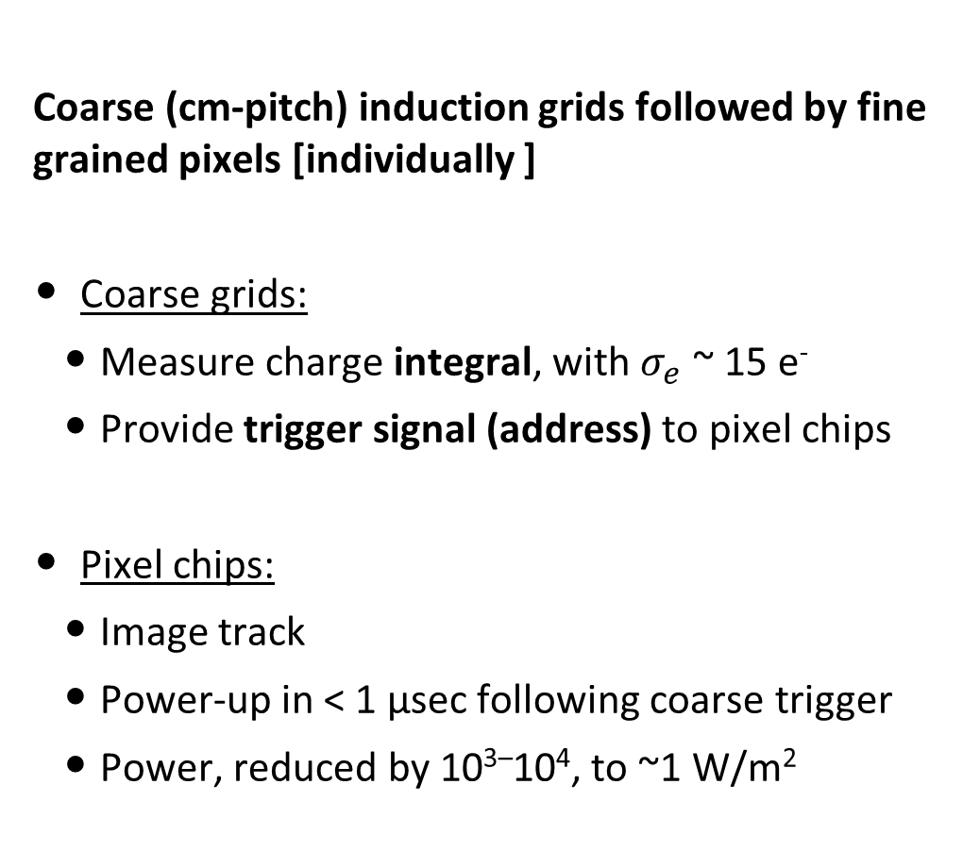
Grid Activated Multi-scale Pixel readout: GAMPix
TPC cell
Coarse (cm-pitch) induction grids followed by fine grained pixels [individually ]
Coarse grids:
  Measure charge integral, with $σ_{e}$ ~ 15 e⁻
  Provide trigger signal (address) to pixel chips
Pixel chips:
  Image track
  Power-up in < 1 µsec following coarse trigger
  Power, reduced by 10^{3–}10⁴, to ~1 W/m²
Cathode
Anode
pixels
pixel chip
1 cm

Slide 12
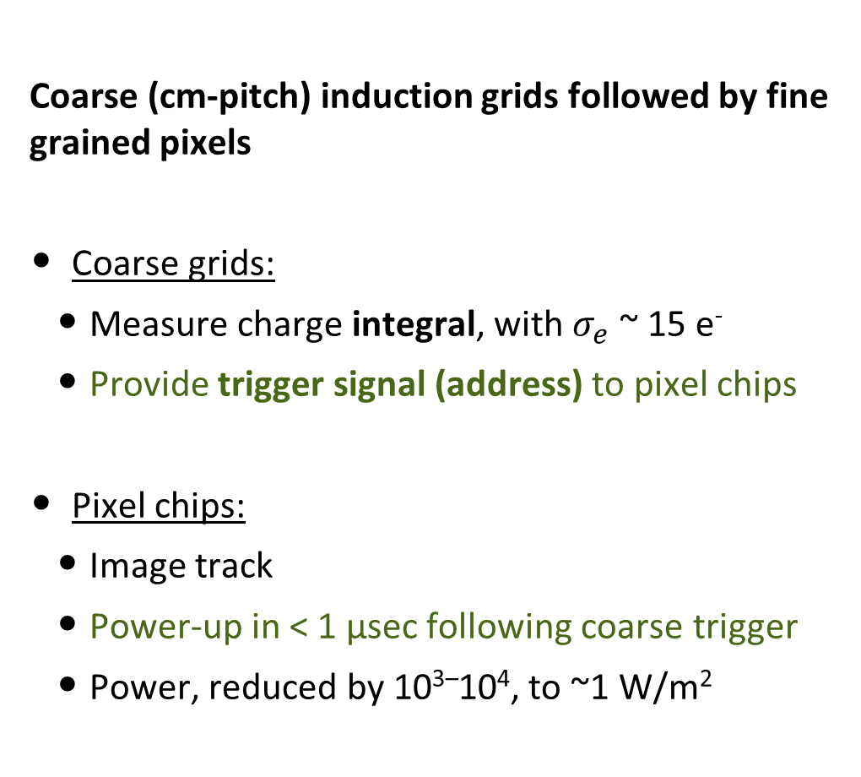
Grid Activated Multi-scale Pixel readout: GAMPix
TPC cell
Coarse (cm-pitch) induction grids followed by fine grained pixels
Coarse grids:
  Measure charge integral, with $σ_{e}$ ~ 15 e⁻
  Provide trigger signal (address) to pixel chips
Pixel chips:
  Image track
  Power-up in < 1 µsec following coarse trigger
  Power, reduced by 10^{3–}10⁴, to ~1 W/m²
Cathode
Anode
coarse electrode
wires
1 cm
pixels
pixel chip

Slide 13

Grid Activated Multi-scale Pixel readout: GAMPix
TPC cell
Coarse (cm-pitch) induction grids followed by fine grained pixels
Coarse grids:
  Measure charge integral, with $σ_{e}$ ~ 15 e⁻
  Provide trigger signal (address) to pixel chips
Pixel chips:
  Image track
  Power-up in < 1 µsec following coarse trigger
  Power, reduced by 10^{3–}10⁴, to ~1 W/m²
Cathode
Anode
electron track
v
coarse electrode
wires
1 cm
$$\overset{⃗}{E}$$
pixels
pixel chip

Slide 14
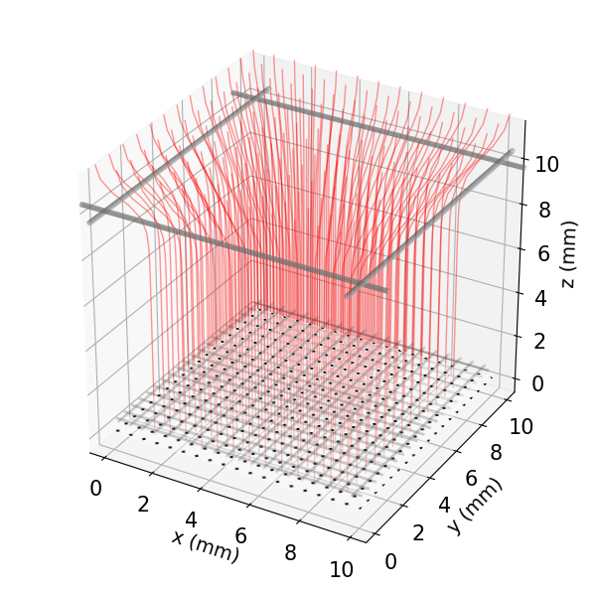
Grid Activated Multi-scale Pixel readout: GAMPix
TPC cell
Electric Fields in GAMPix Unit
Cathode
Anode
v
coarse electrode
wires
1 cm
$$\overset{⃗}{E}$$
pixels
pixel chip

Slide 15
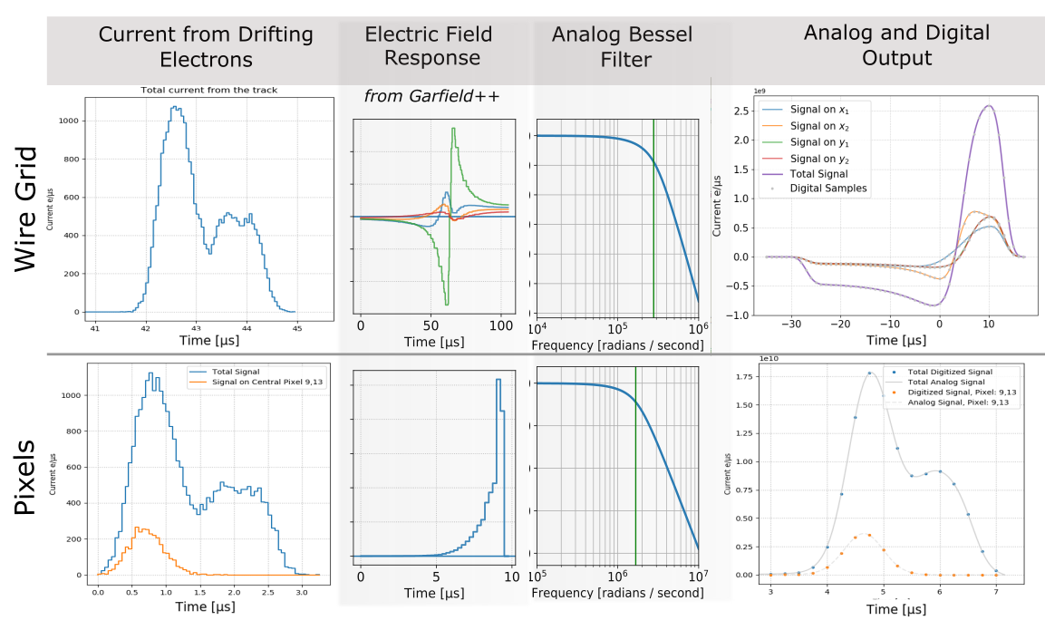
GAMPix | Simulated Signal Chain

Slide 16
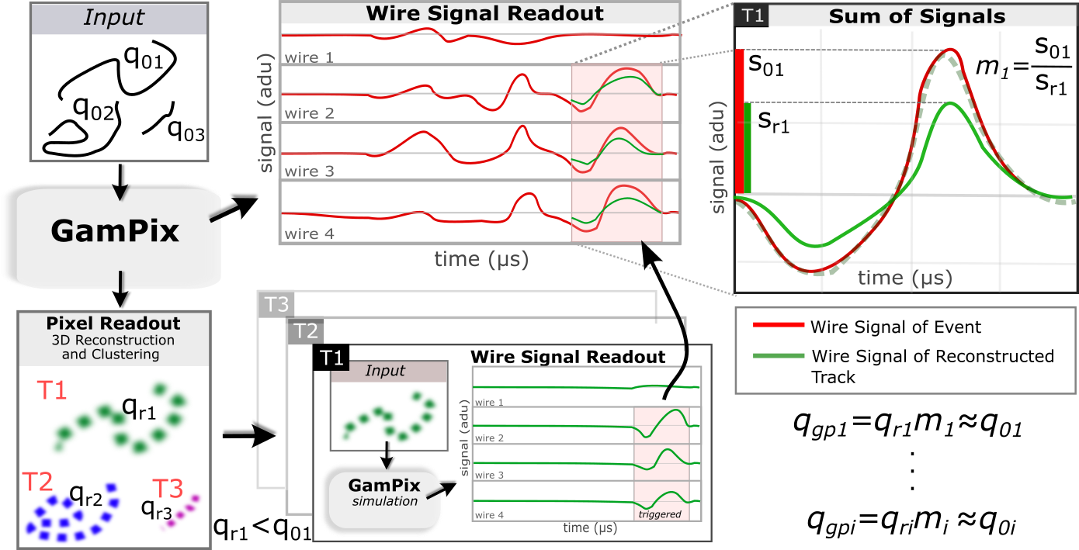
GAMPix | Simulated Signal Chain
Issue: Non-uniform response from the wire grid

Slide 17
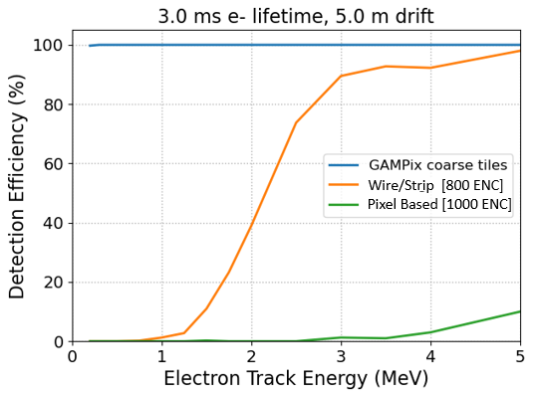
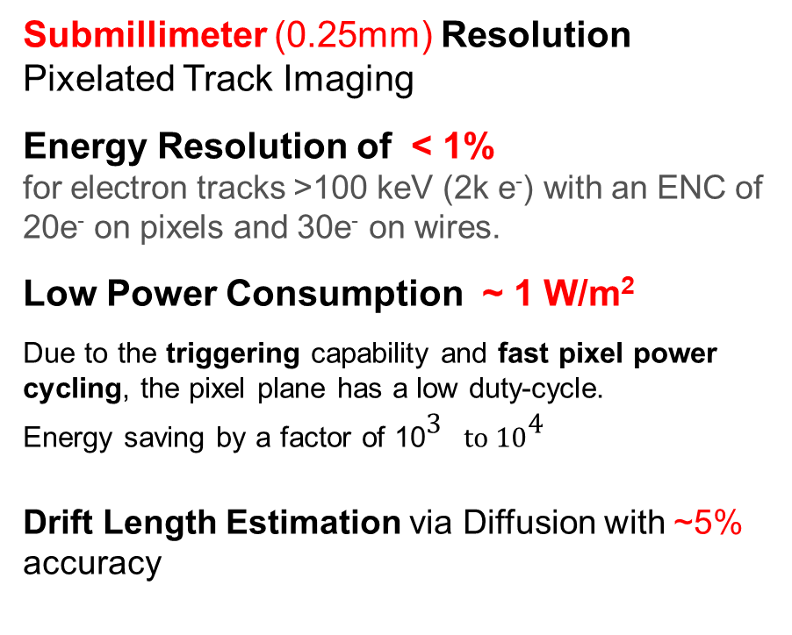
GAMPix | Simulation Results
GammaTPC
DUNE
Submillimeter (0.25mm) Resolution Pixelated Track Imaging
Energy Resolution of < 1%
for electron tracks >100 keV (2k e⁻) with an ENC of 20e⁻ on pixels and 30e⁻ on wires.
Low Power Consumption ~ 1 W/m²
Due to the triggering capability and fast pixel power cycling, the pixel plane has a low duty-cycle.
Energy saving by a factor of 10$3^{}to 104^{}$
Drift Length Estimation via Diffusion with ~5% accuracy
Geometry:
~ 5mm pitch pixels
~ 5 cm pitch grid
Outcomes
Electronic noise reduction from ~500e- to ~50e- lowers threshold for “blip” detection from >1MeV to much less
Power cycling the pixels’ front-end reduces the average power to acceptable levels
Drift Length Estimation via Diffusion with ~5% accuracy
(Helps with background rejection for SN)

Slide 18
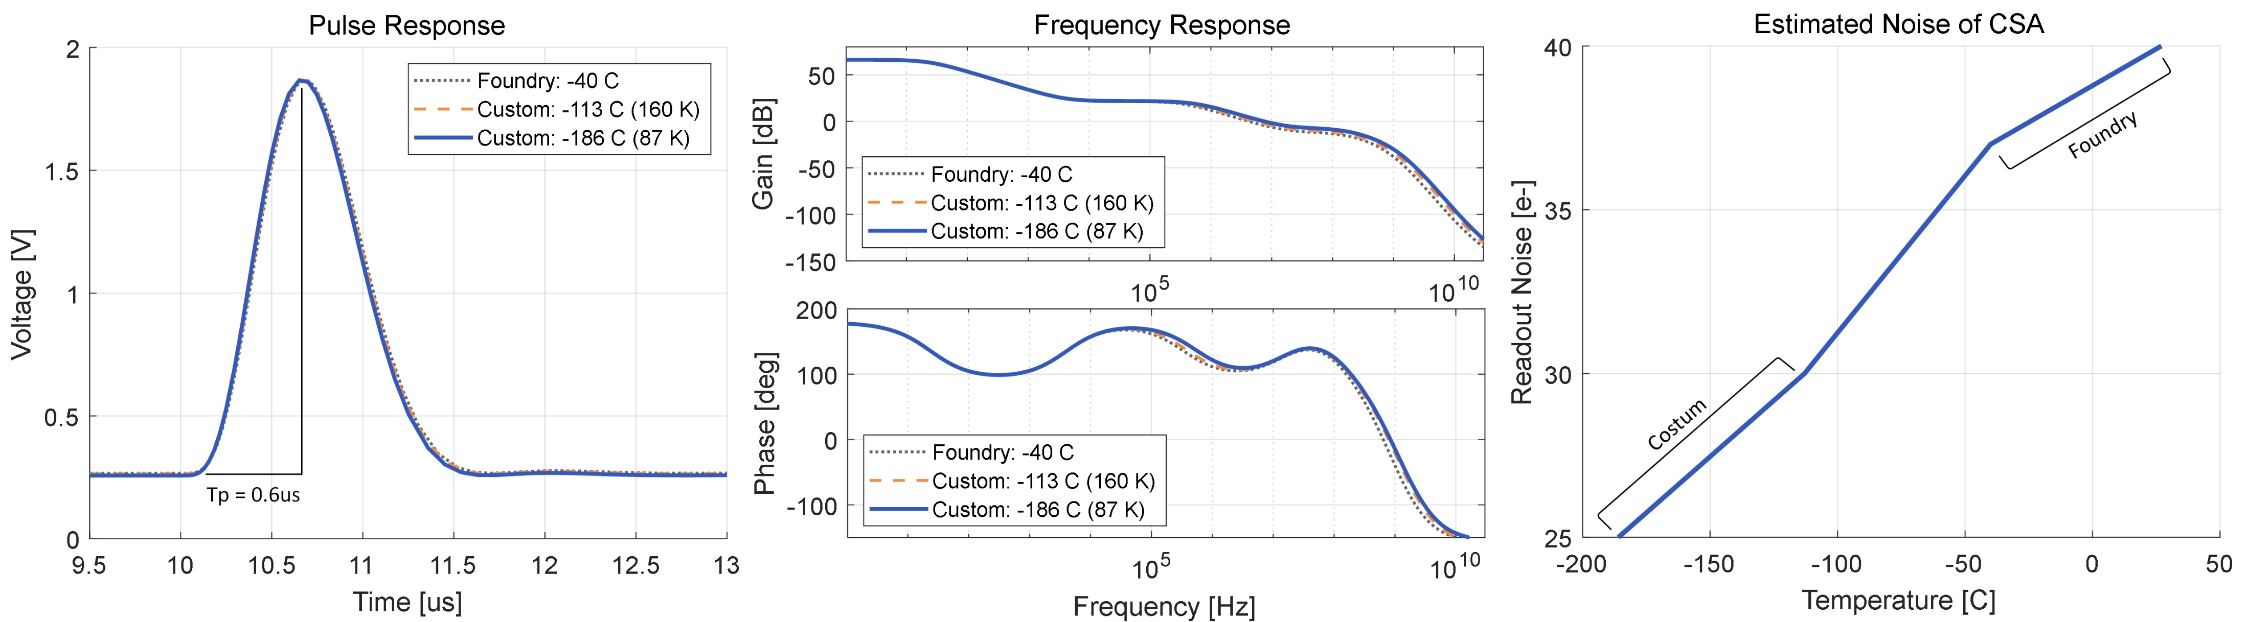

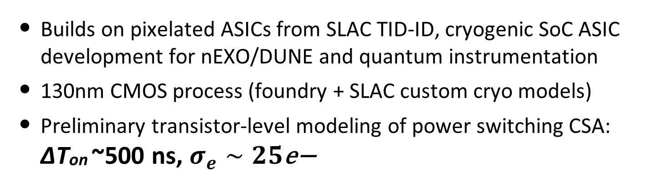
GAMPix fast power cycle ASIC
Builds on pixelated ASICs from SLAC TID-ID, cryogenic SoC ASIC development for nEXO/DUNE and quantum instrumentation
130nm CMOS process (foundry + SLAC custom cryo models)
Preliminary transistor-level modeling of power switching CSA: ∆Ton ~500 ns, $σ_{e}∼25\text{e}\text{−}$

Slide 19
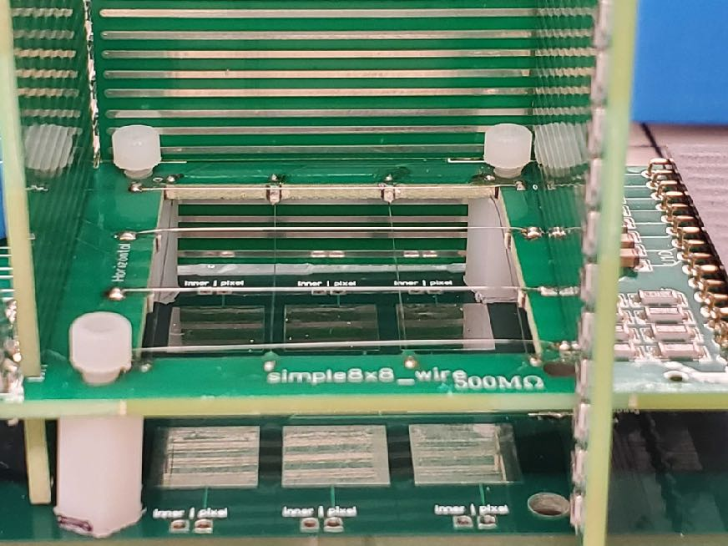

I would like to continue talking about…
Other possible applications of GAMPix
GAMPix hardware test
GammaTPC
- Machine learning for GAMPix
+ Depth estimation via diffusion
+ Initial electron direction estimation
Upcoming test with CRYO ($σ_{e}$~100e-) readout

Slide 20
BACKUP Slides

Slide 21
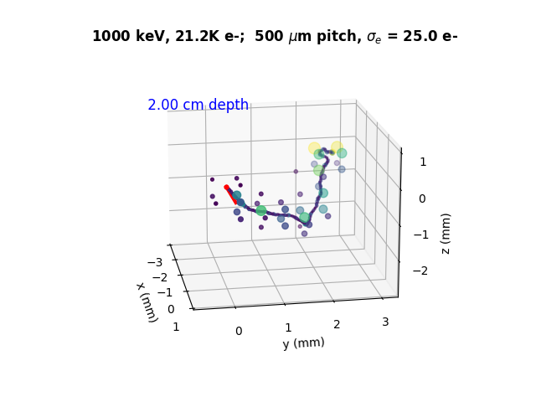
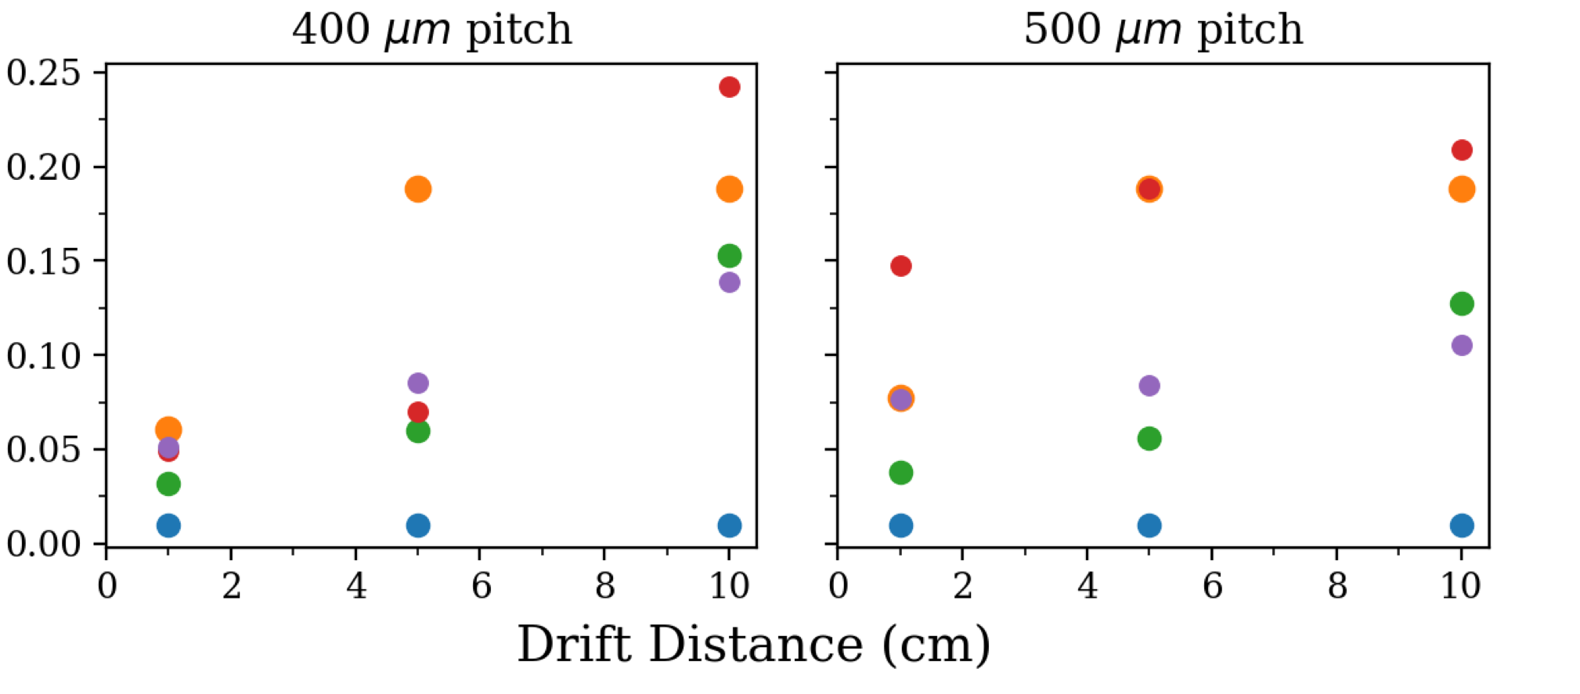
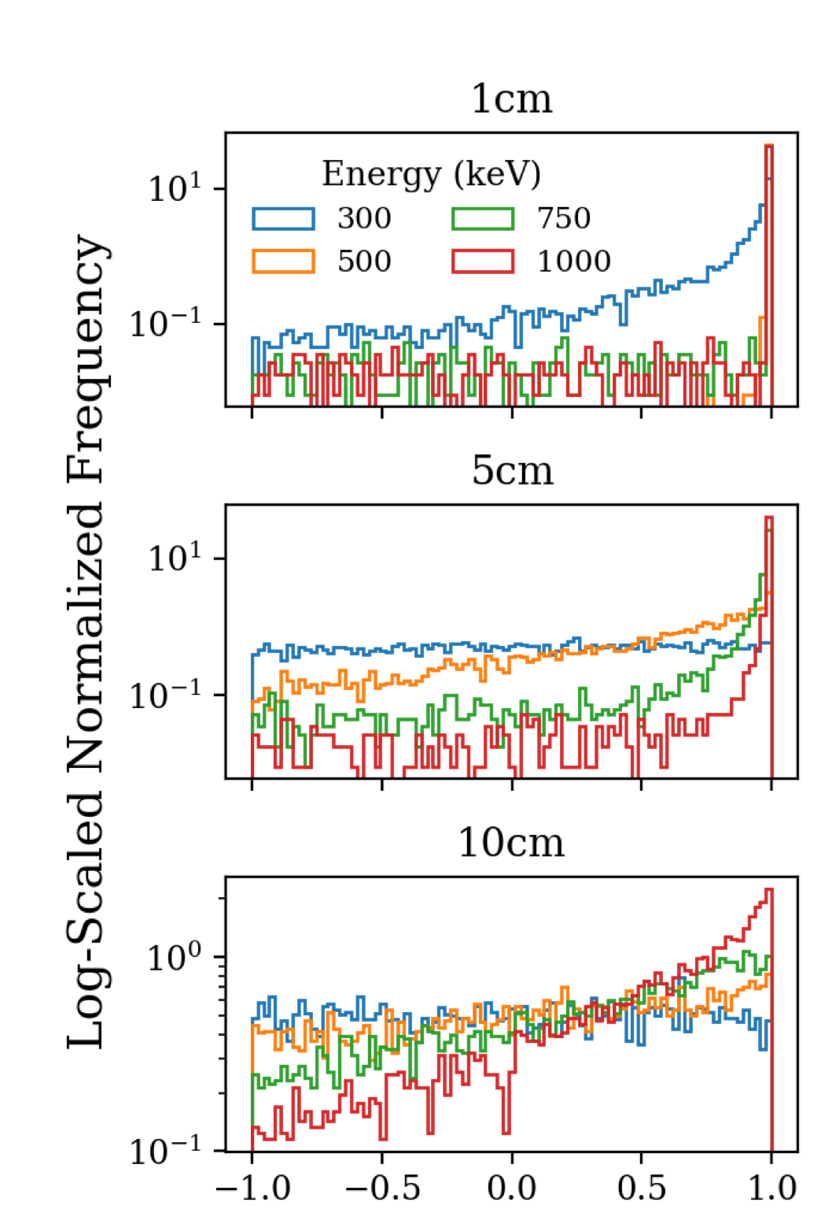
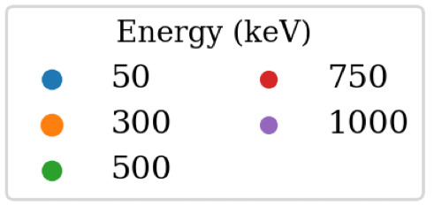
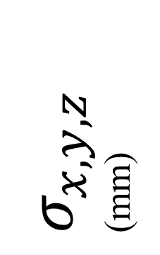
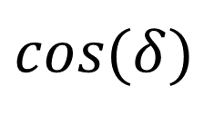
Track reconstruction promising
Track head location
Initial direction
$σ_{x,y,z}$ (mm)
CNN study: M. Buuck, B. Khek, A. Mishra, ArXiv/2207.07805
0.25 mm !!!
Powerful measurement of initial direction
Also: ~5% estimate of drift distance
$$cos(δ)$$
Notes:
Dune Applications – neutrino : gamma rays

Slide 22
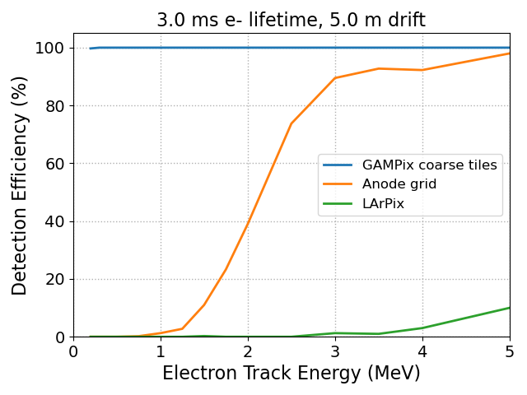
GAMPix for DUNE
Geometry:
~ 5mm pitch pixels
~ 5 cm pitch of unified grid
Outcomes
- A pixel-based readout system that reduces that electronic noise from ~500e- to ~50e- lowers threshold for “blip” detection from >1MeV to much less
- An “activation” signal from a coarse electrode “grid” to power the pixels’ front-end and reduce the average power to acceptable levels
- Drift length estimation via diffusion measure (with ~ 5% accuracy)
Wire/Strip [800 ENC]
Pixel Based [1000 ENC]
Energy Threshold Improvement

