Slide 1
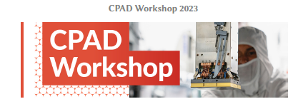
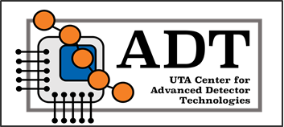
Measuring the transverse diffusion of electrons in gasses: A laboratory-scale demonstration of the physics capabilities of Q-Pix.
N. Hochª, O. Seidel^{b}, K. Keefe^{b}, A. B. Enriquez^{b}, I. Parmaksiz^{b}, A. D. Mcdonald^{b},
V. A. Chirayath^{b}, W. Weiª, H. Mahdy^{b}, M. Rooks^{b}, J. B. R. Battatª, J. Asaadi^{b}
ª Physics Department, Wellesley College, Wellesley, MA 02481
^{b} Department of Physics, University of Texas at Arlington, Arlington, TX - 76019

Slide 2
Q-Pix – The Concept
Q-Pix – Charge Integrate/Reset
https://arxiv.org/abs/1809.10213
2

Slide 3
Q-Pix – Charge Integrate/Reset
https://arxiv.org/abs/1809.10213
2

Slide 4
Q-Pix – Charge Integrate/Reset
https://arxiv.org/abs/1809.10213
2

Slide 5
Q-Pix – Charge Integrate/Reset
https://arxiv.org/abs/1809.10213
2

Slide 6
Q-Pix – Charge Integrate/Reset
https://arxiv.org/abs/1809.10213
2

Slide 7
Q-Pix – Charge Integrate/Reset
https://arxiv.org/abs/1809.10213
2

Slide 8
Q-Pix – Charge Integrate/Reset
https://arxiv.org/abs/1809.10213
2

Slide 9
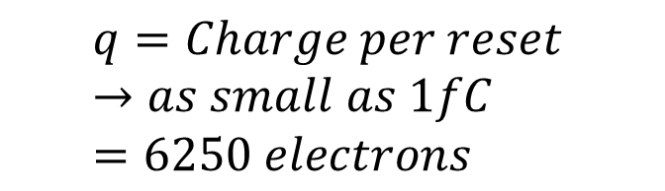
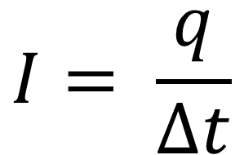

Q-Pix – Charge Integrate/Reset
K. Keefe et al., CPAD 2023
$$I= \frac{q}{∆t}$$
$$∆t$$
$$q=Charge per reset →as small as 1fC=6250 electrons$$
https://arxiv.org/abs/1809.10213
2

Slide 10
Opportunity for the technology
Phase 0: Demonstrate the capabilities of analog front-end and digital backend using commercial-off-the-shelf (COTS) components
      Q-Pix front-end demonstration using discrete OpAmp and CMOS transistors (Peng Miao, Yuan Mei, under preparation)
      Measurement of transverse diffusion of electrons in noble gas detectors using Q-Pix demonstrator made with COTS components (this talk)
      Investigation of Digital backend: Experiments and Simulation (K.Keefe et al., CPAD 2023).
      Demonstration of Charge+Light read out (M. Rooks et al., CPAD 2023).
Phase 1: Testing the design in silicon
      The ASIC implementation of Q-Pix in TSMC 180 nm and Skywater 130 nm process.
Phase 2: Scaling up to large detectors
3

Slide 11
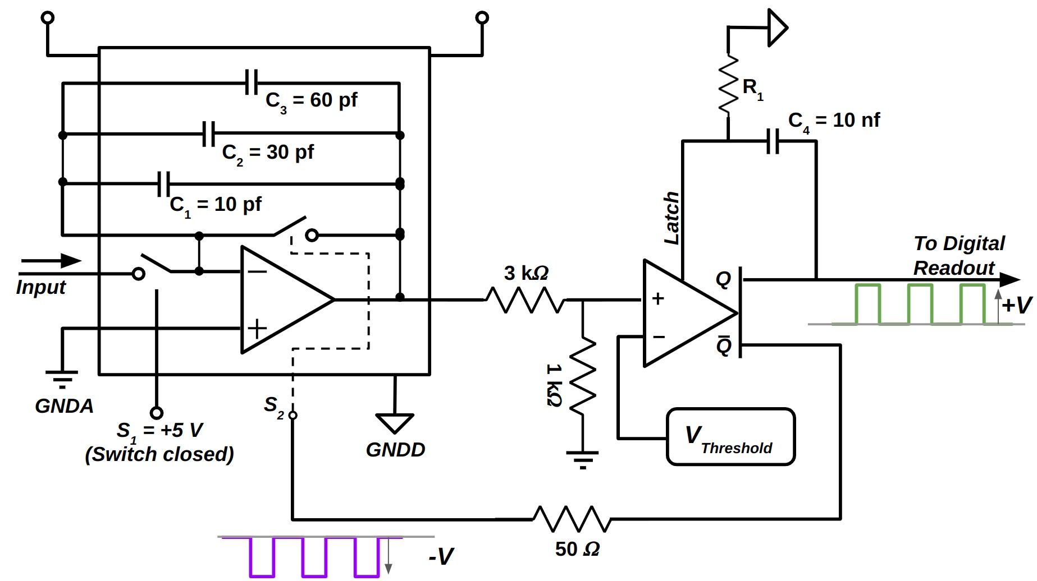
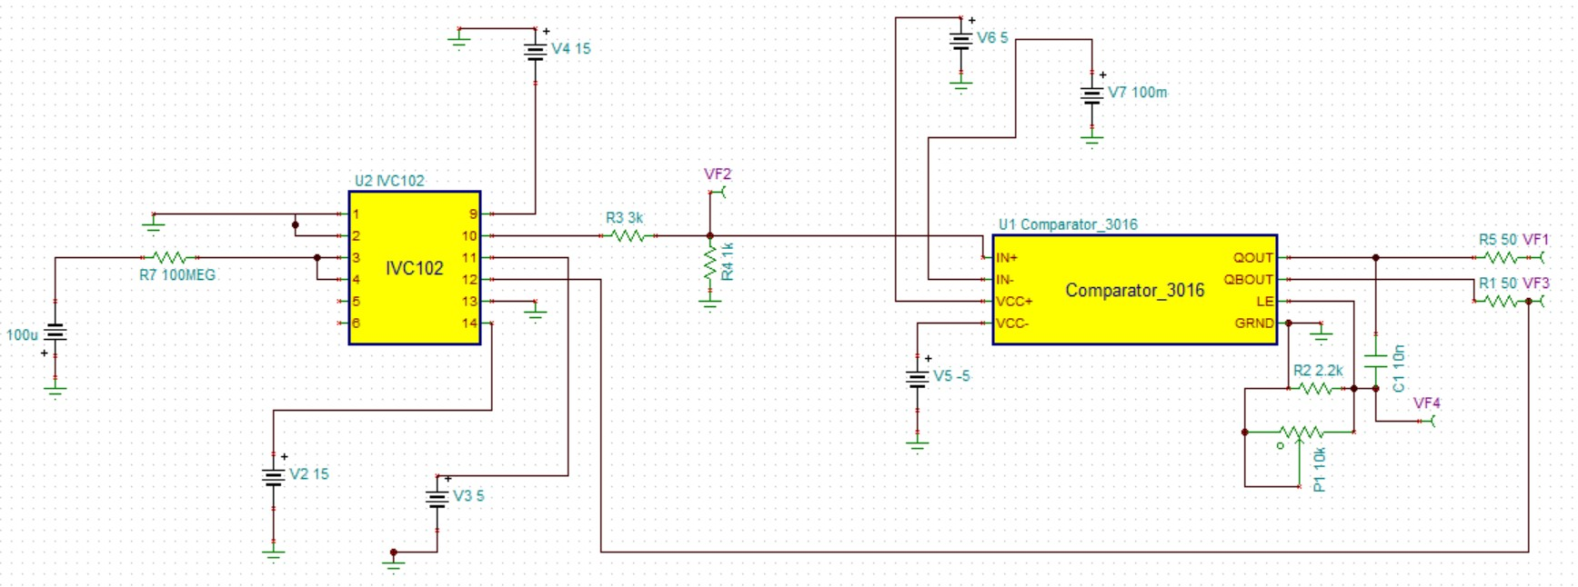
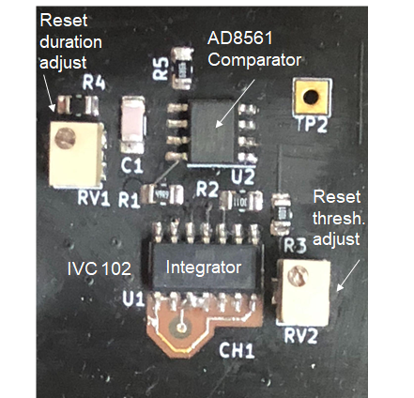
    Q-Pix demonstration using COTS
1. IC chip with Q-Pix functionality: IVC 102 (Precision Switched Integrator Transimpedance Amplifier)
2. Comparator operated as a Schmitt trigger (AD8561)
Comparator
4

Slide 12
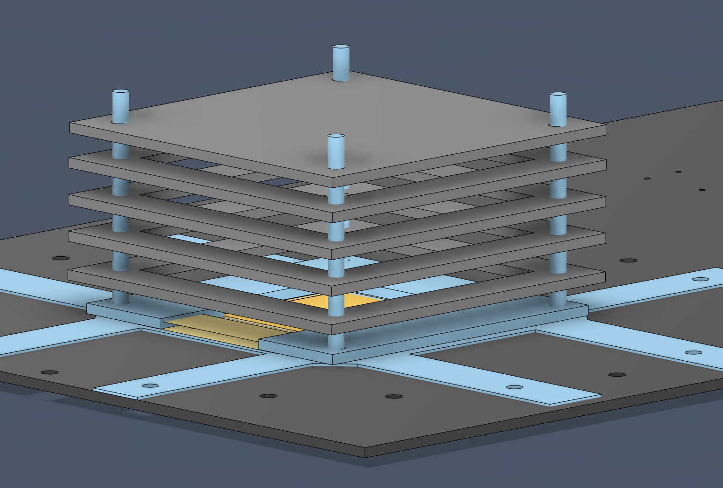
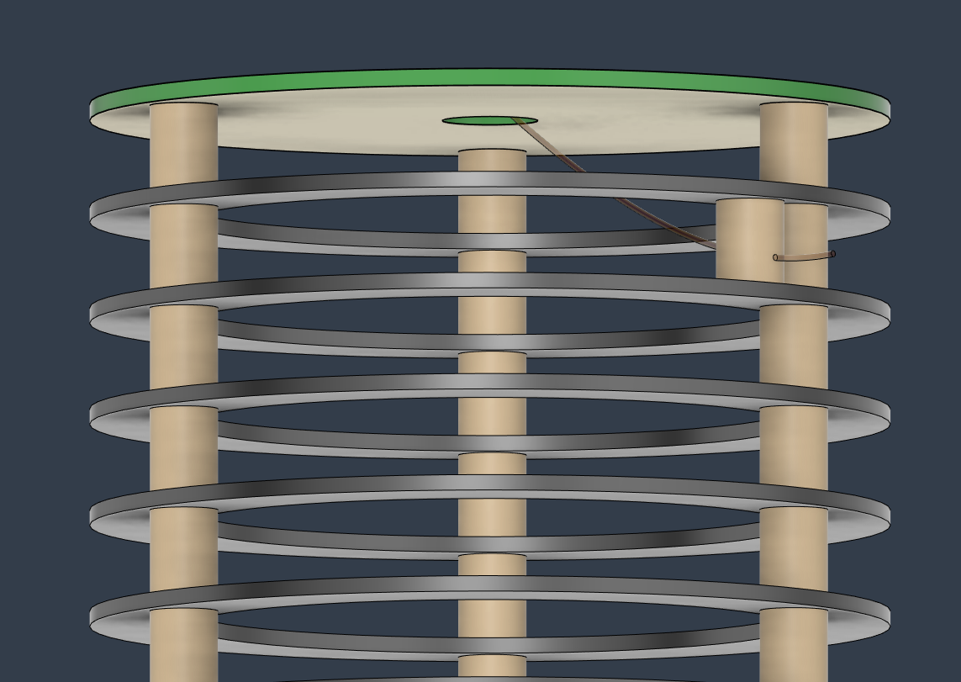
Measurement of transverse diffusion of electrons in noble gas detectors
    5 cm drift setup @ Wellesley
    10 cm drift setup @ UTA
5

Slide 13
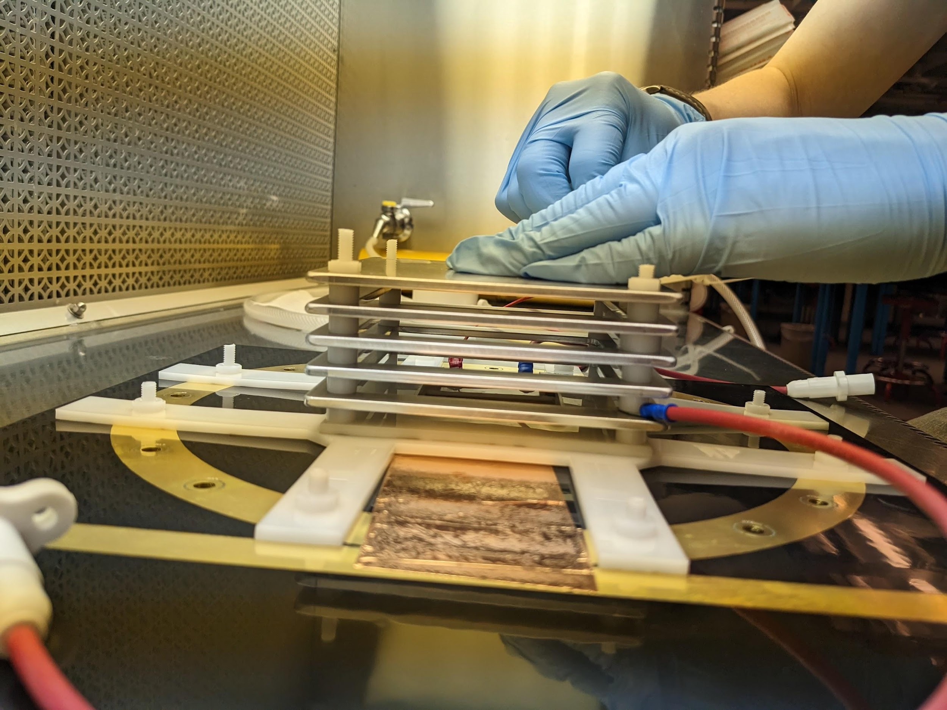
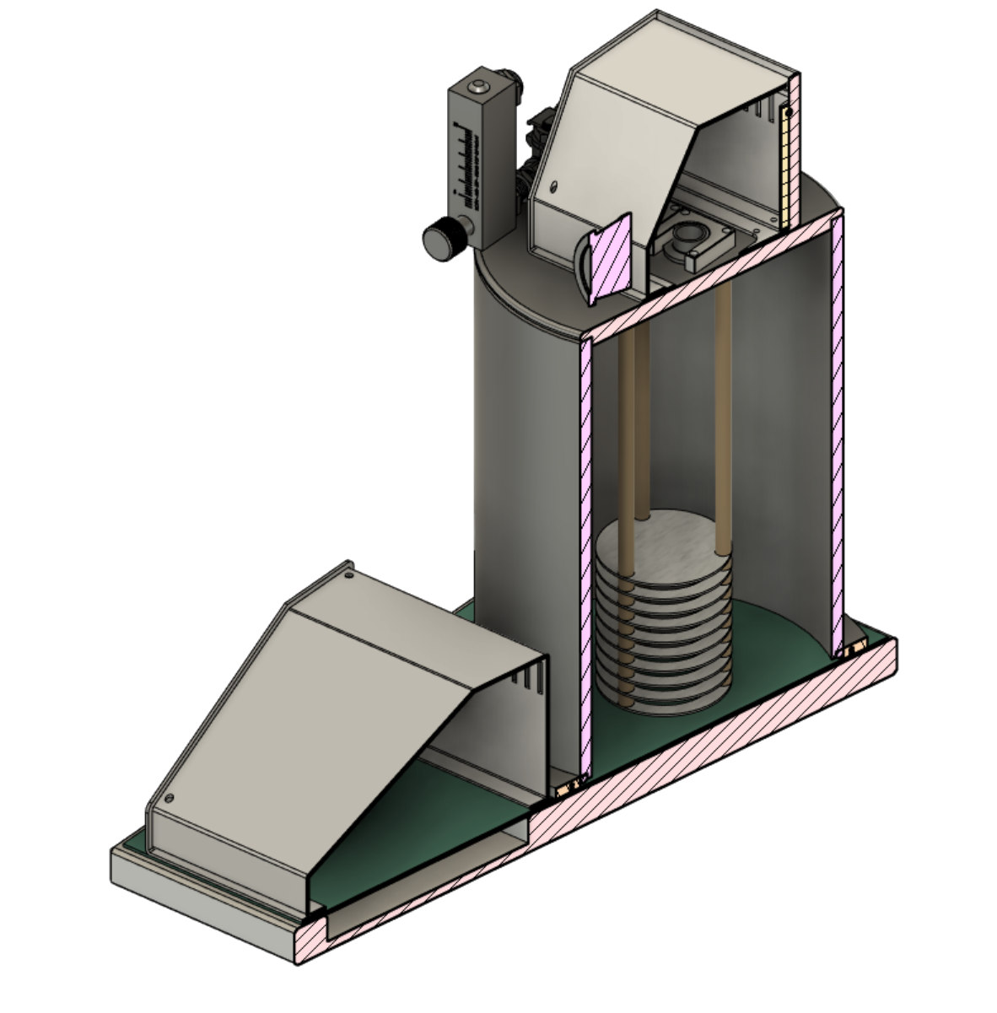
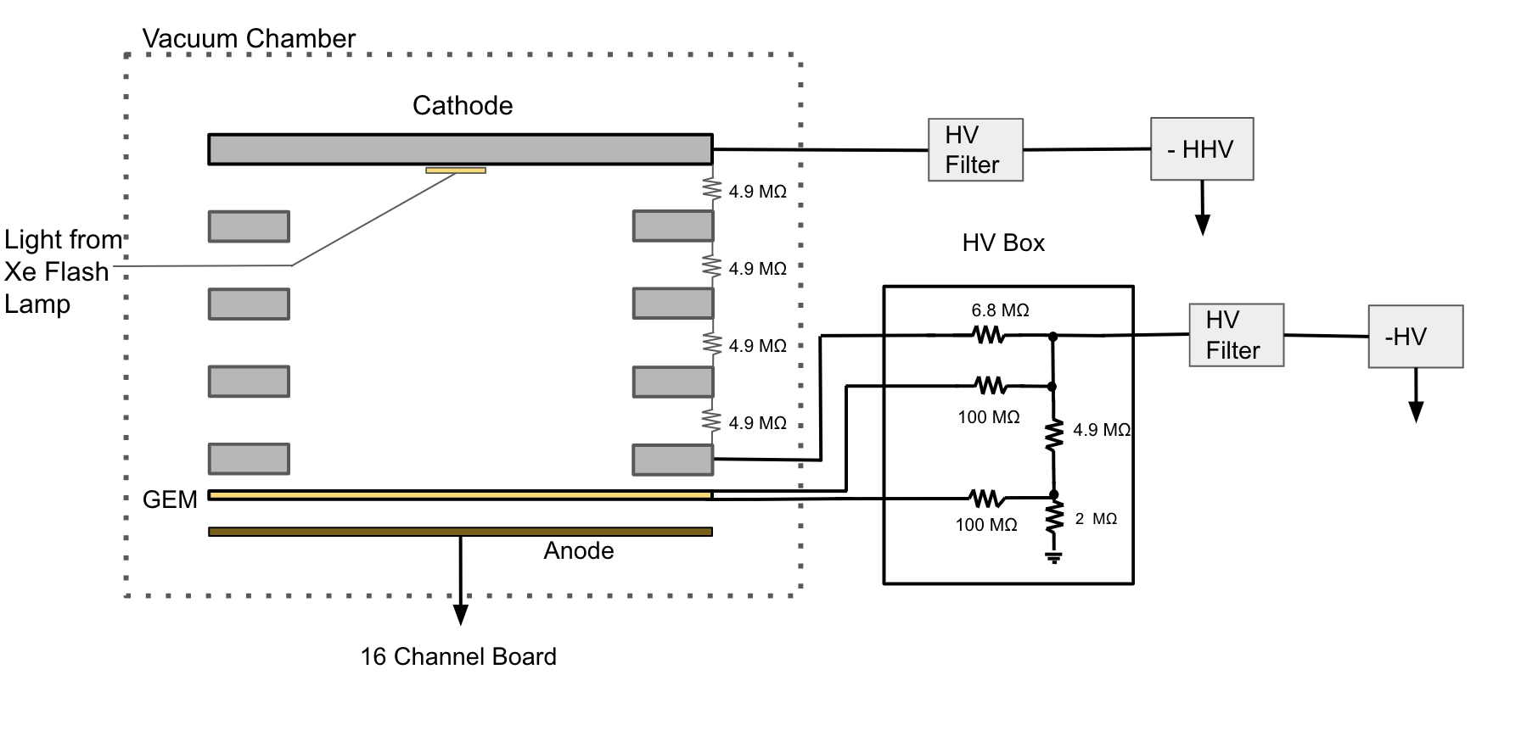
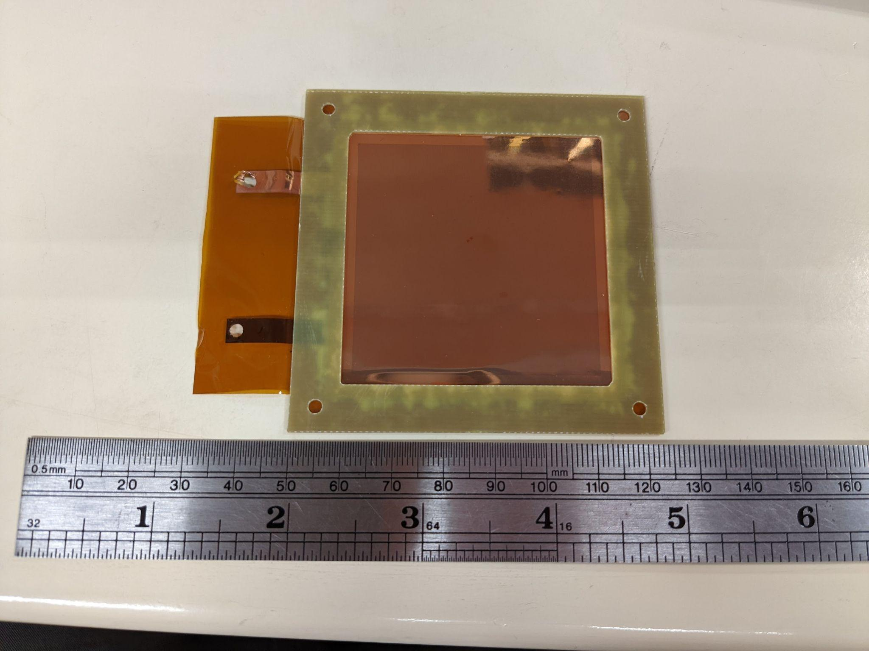
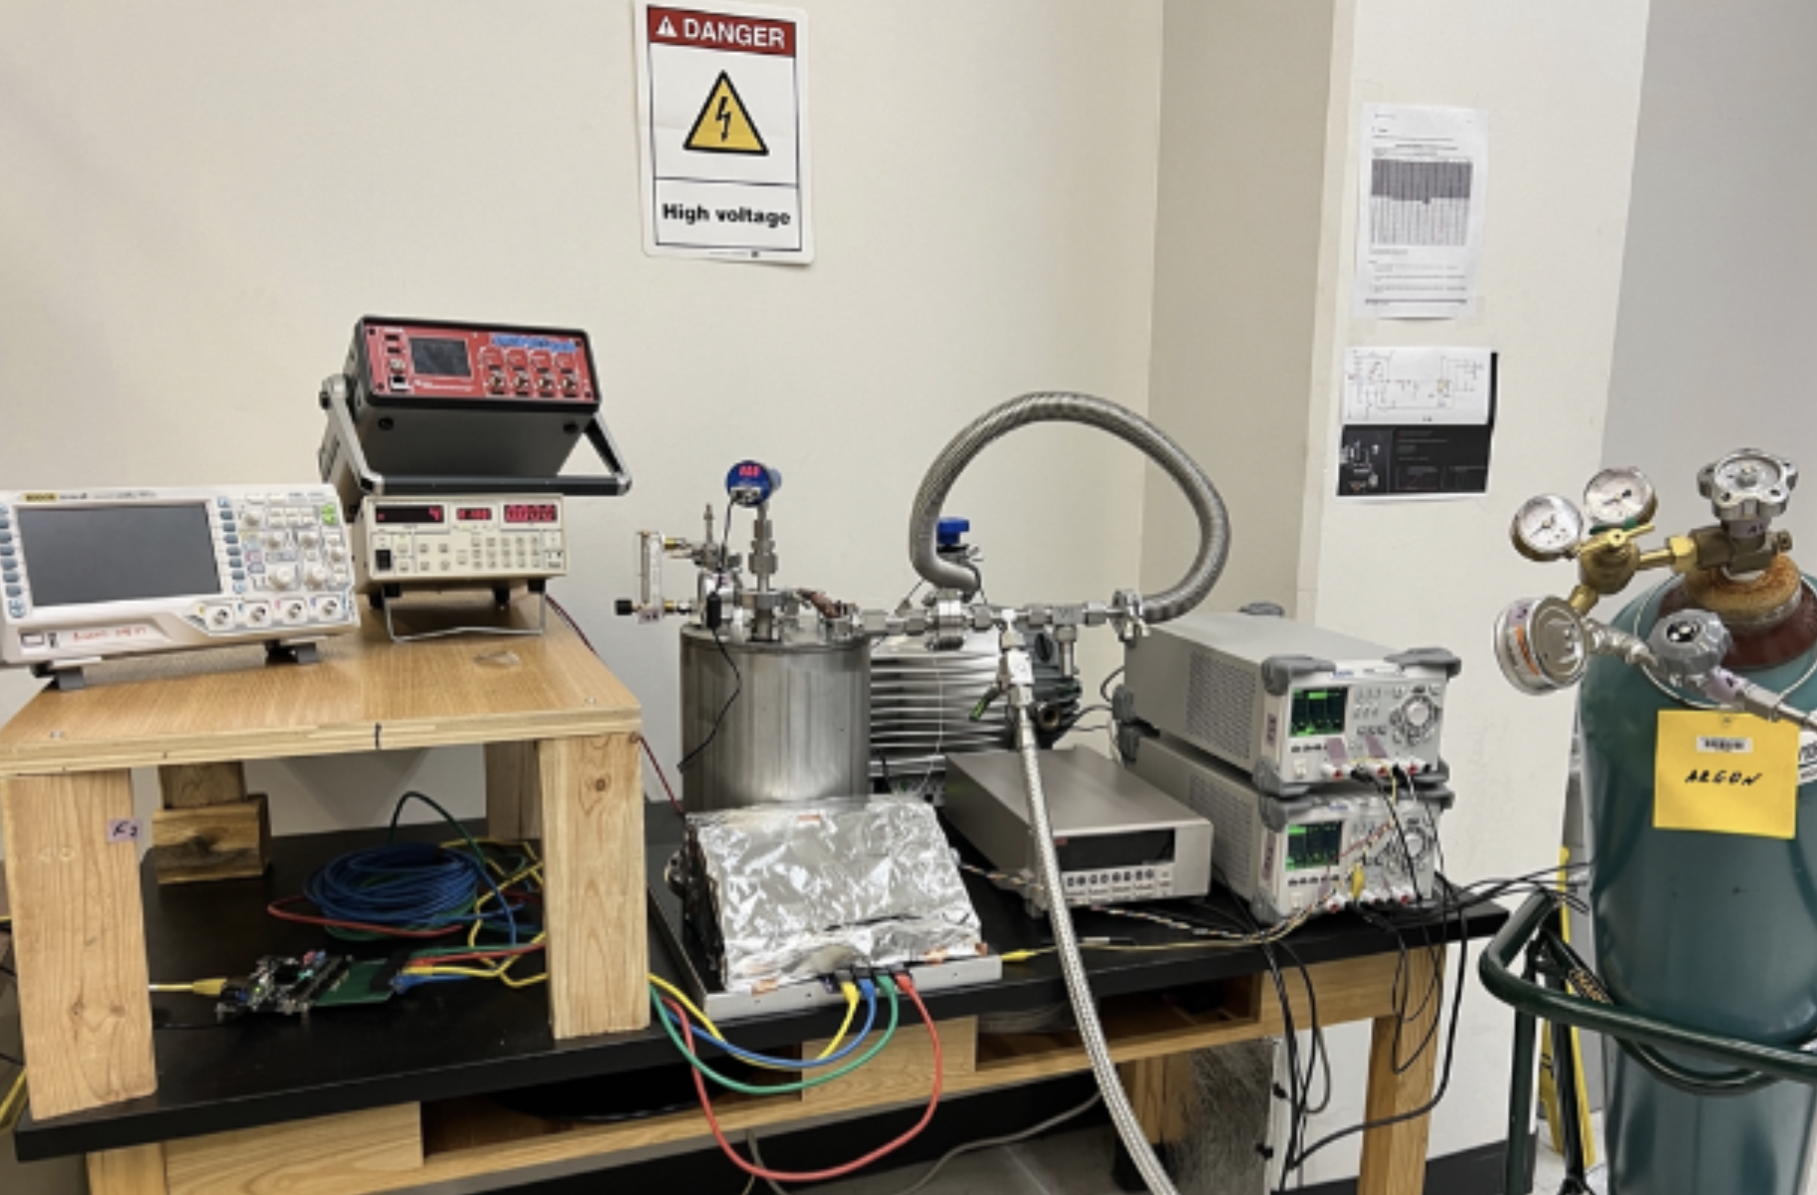
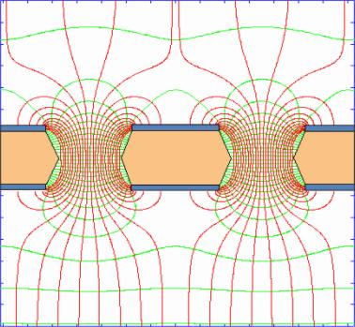
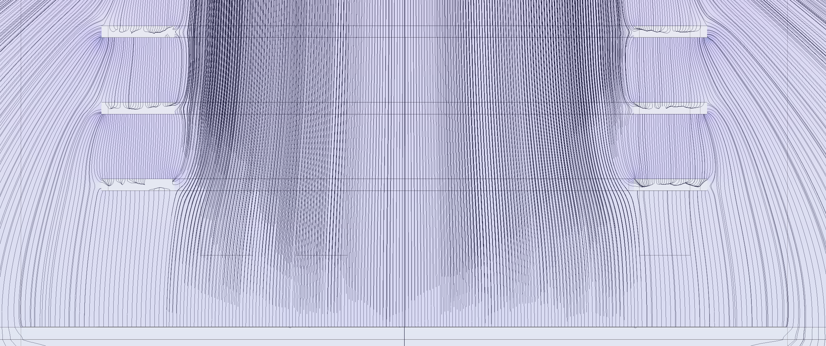
    5 cm drift setup @ Wellesley
    10 cm drift setup @ UTA
16-channels
5 cm drift
GEM
Electrode structure is supported on the anode
HV (-500 to -5000 V)
50 MΩ
50 MΩ
16-channels
10 cm drift
No GEM
Support from top frame
50 MΩ
6

Slide 14
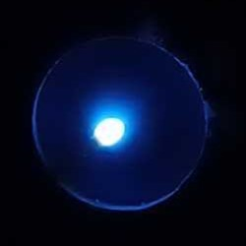
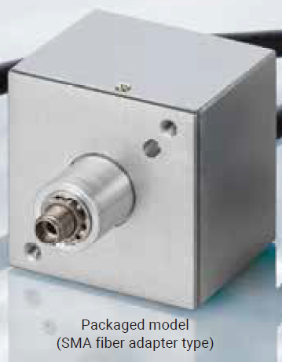
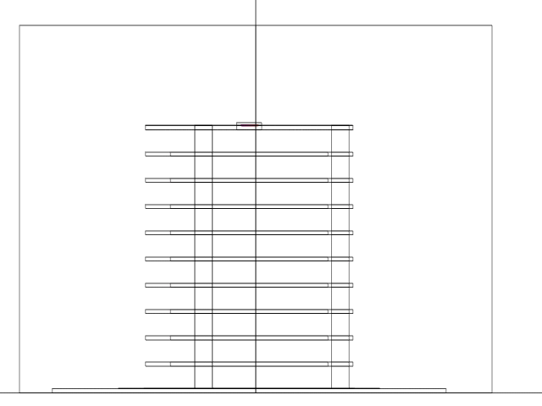
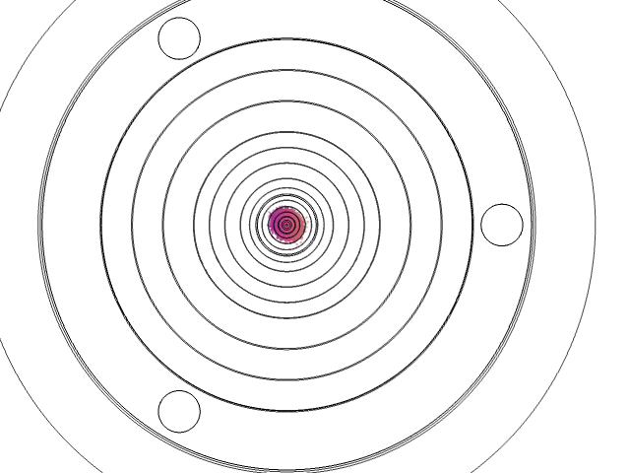
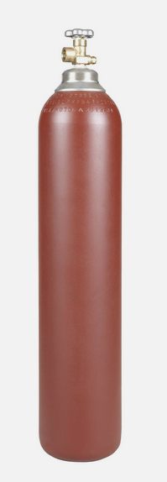
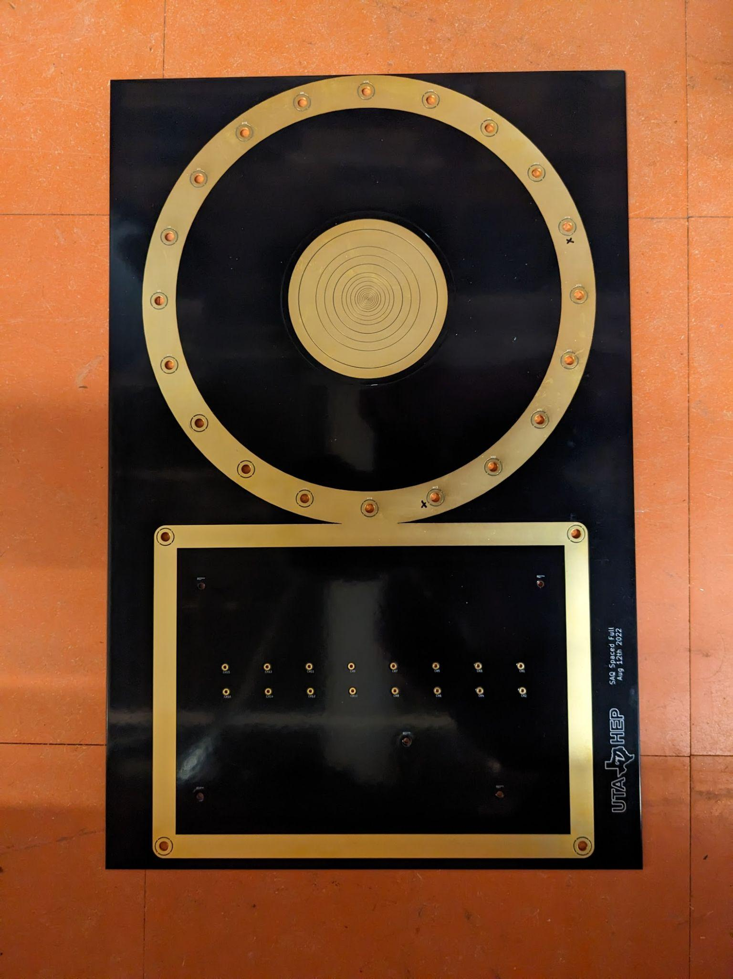
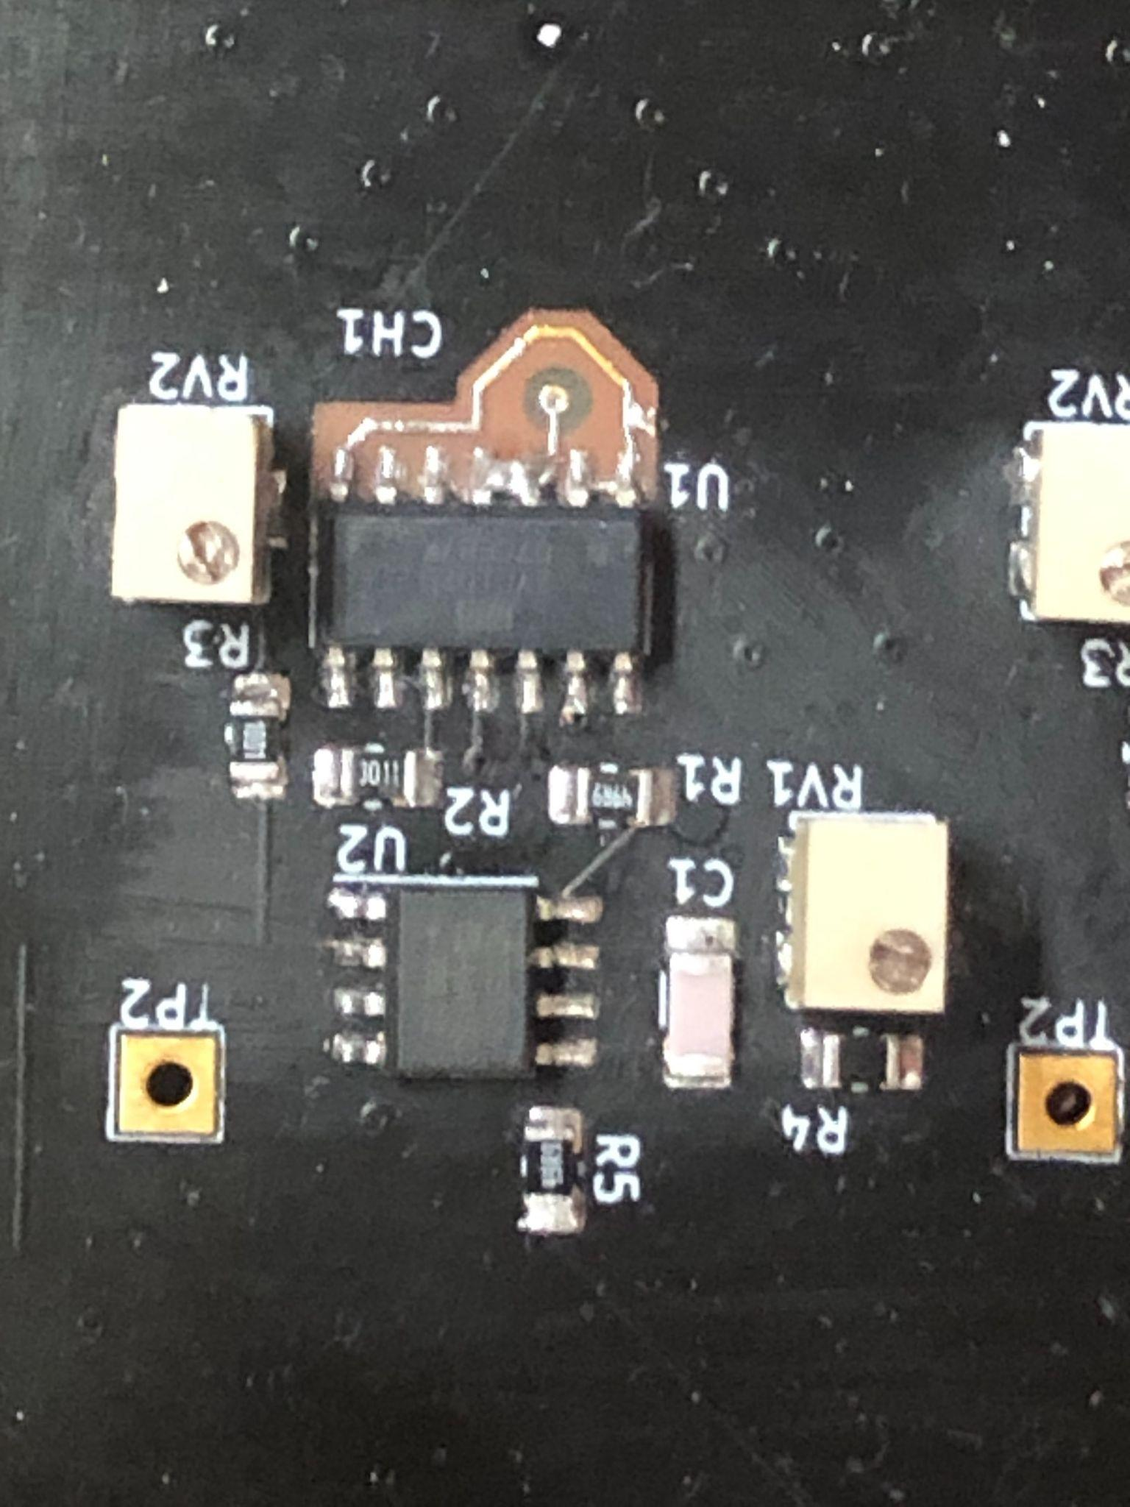
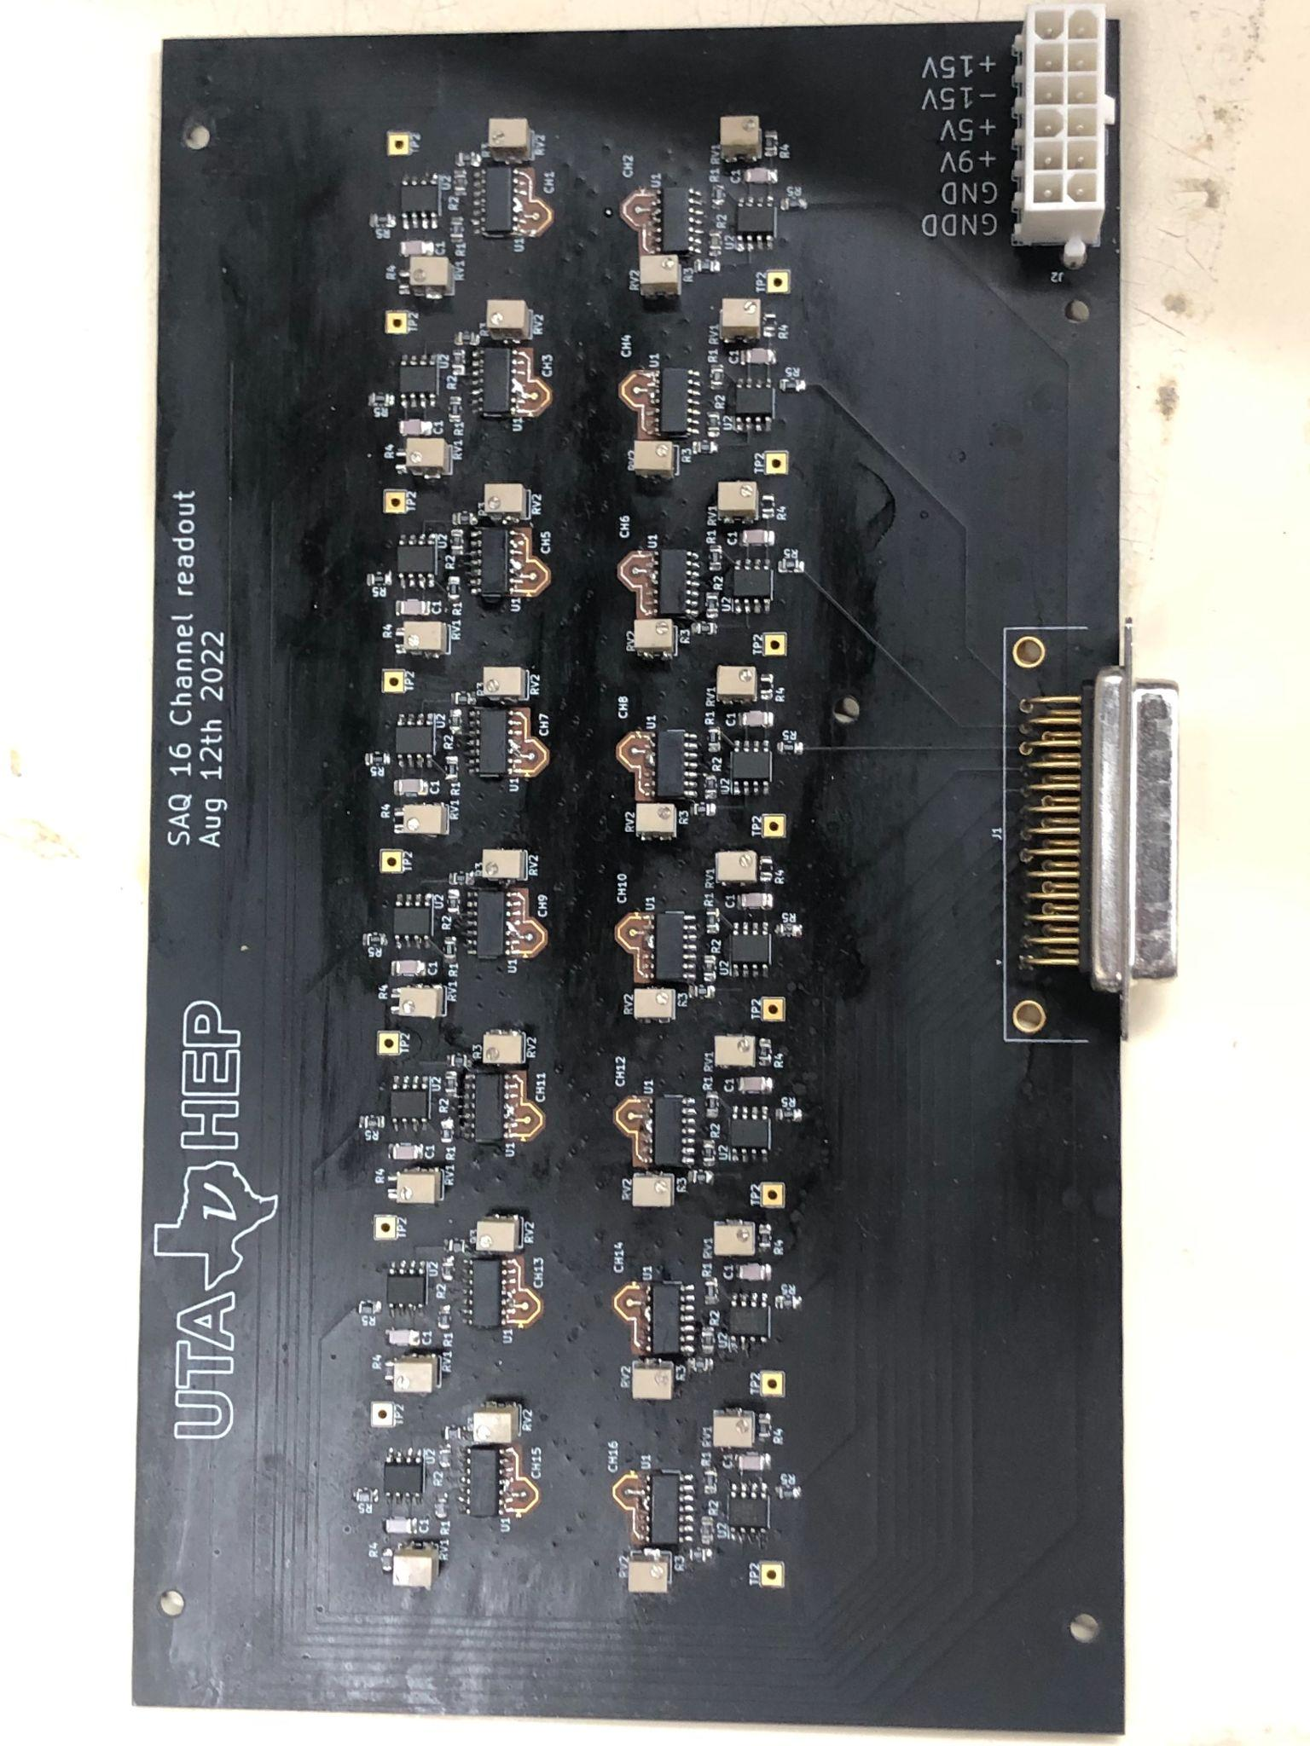
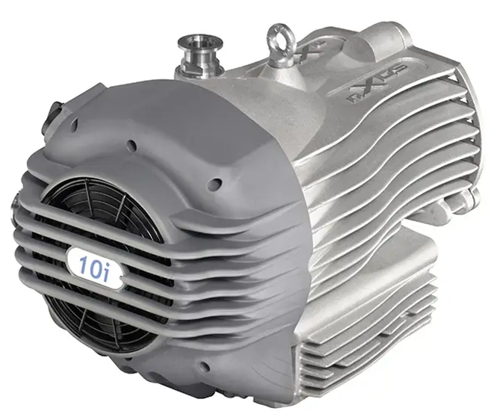
    Experiment
7

Slide 15
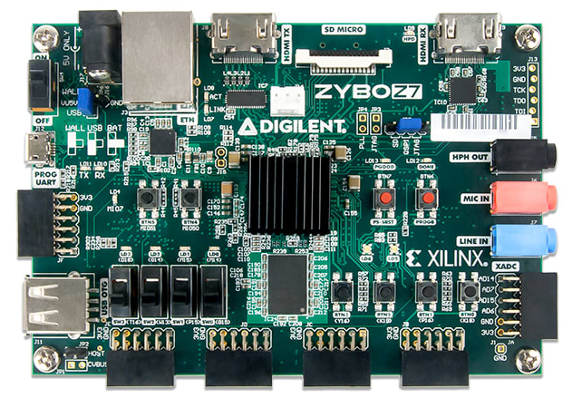
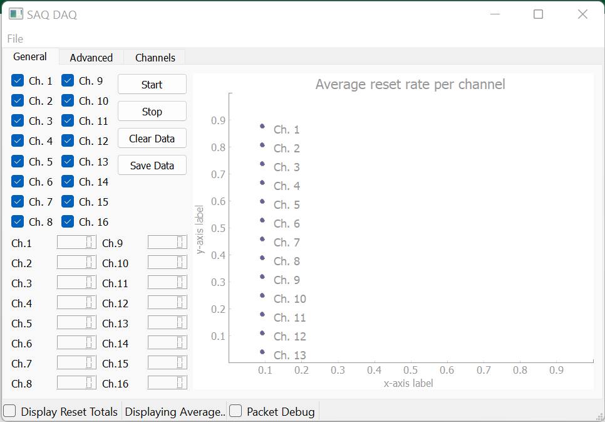
Data Acquisition
Zybo Z7-20
K.Keefe et al., CPAD 2023
TCP
UDP
Digital Back-end
Programmable Logic + Software
GUI
Analog Front-end
Data
8

Slide 16

Calibration of channels
$$I= \frac{q}{∆t}$$
9

Slide 17



Diffusion of Electrons in gasses
$$n\left(\overline{r}, t=0\right)$$
$$n\left(\overline{r}, t\right)$$
10

Slide 18
Monte Carlo Simulation of Electron Transport in Noble gas mixtures
11

Slide 19
5 cm Drift: Diffusion as a function of Pressure
12

Slide 20
10 cm Drift: Diffusion as a function of Pressure
13

Slide 21
Transverse Diffusion of electrons in P10
14

Slide 22

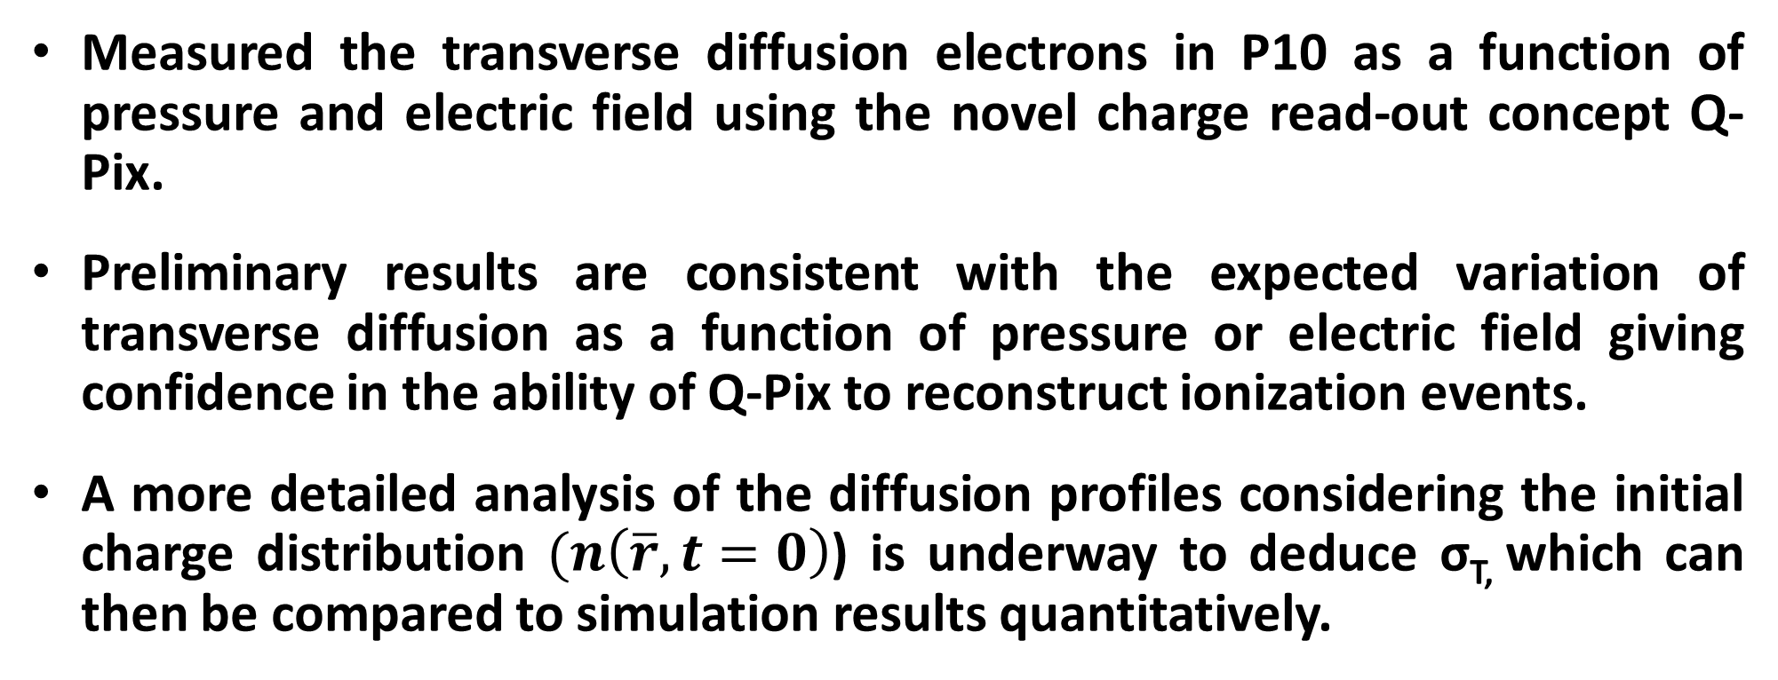
Conclusions & Future Work
Measured the transverse diffusion electrons in P10 as a function of pressure and electric field using the novel charge read-out concept Q-Pix.
Preliminary results are consistent with the expected variation of transverse diffusion as a function of pressure or electric field giving confidence in the ability of Q-Pix to reconstruct ionization events.
A more detailed analysis of the diffusion profiles considering the initial charge distribution $(n\left(\overline{r}, t=0\right)$) is underway to deduce σ_{T,} which can then be compared to simulation results quantitatively.
Acknowledgments
Research is supported by awards DE-SC0020065, DE-SC 0000253485, FNAL-LDRD-2020-027
15

Slide 23













Slide 24
Q-Pix – The Concept
Proposed by Yuan Mei (LBNL) and Dave Nygren (UTA) (https://arxiv.org/abs/1809.10213)
Electronic principle of least action - Don’t do anything unless there is something to do (Low Power detection – Low data volume).
https://arxiv.org/abs/1809.10213
Phys. Rev. D 106, 032011 (2022)
1
Notes:
Q-Pix is a novel concept proposed by Mei and Nygren sometime in 2018 to capture and digitize ionization signals like the ones produced in a Liquid Argon TPC. Q-pix consists of a pixel scale self-triggered charge readout. Self-triggered means the pixel does not do anything until something of interest happens in the detector. This methodology minimizes energy consumption by the charge read-out channel. We also read out the data only when there is something to read - this leads to low data volume. The schematic on the left shows the concept of Q-Pix and the expected signal in its quiescent state and the expected output when there is actually something to detect. Q-Pix measures the ionization current reaching the pixel and through its novel concept it can reconstruct any complex current signal as seen in plot on the right.
A recent study by Q-Pix consortium on Supernova neutrinos showed that Q-Pix enhances the low energy physics capabilities of a kTon scale LArTPC (Phys. Rev. D 106, 032011 (2022)).

Slide 25
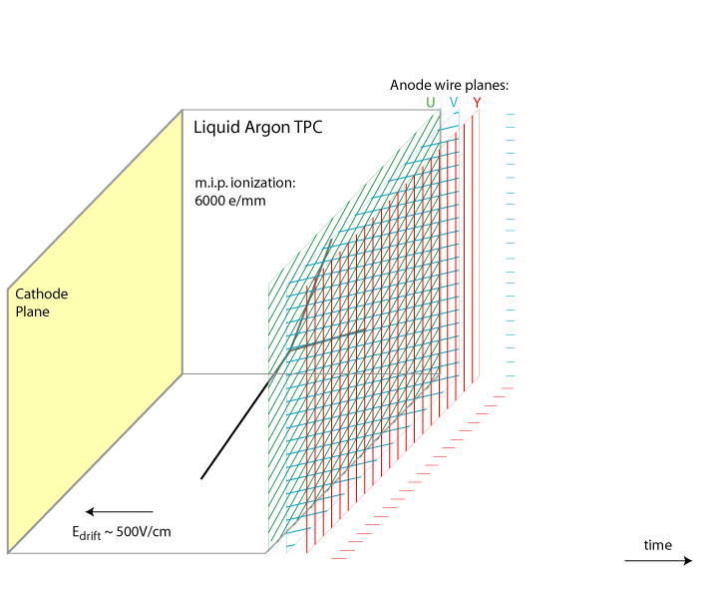
Liquid Argon Time Projection Chamber (LArTPC) – 2D wire plane
Reconstructing the 3D ionization track using projection onto a 2D wire plane is non-trivial.
Intrinsic reconstruction pathologies associated with charge deposited along the direction of the wires.
kiloTon scale LArTPC’s use “wrapped wire” geometries – engineering challenge.
Simultaneous detection of scintillation light is not straight forward.
Image Credit BNL:
https://lar.bnl.gov/wire-cell/

Slide 26
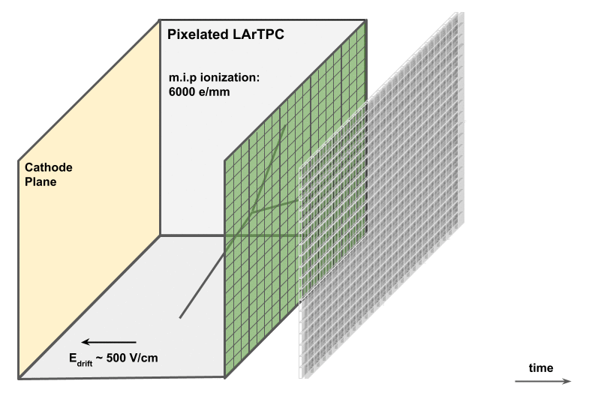
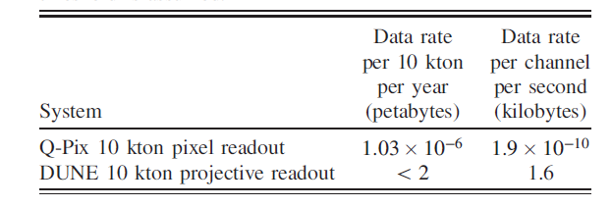
Liquid Argon Time Projection Chamber (LArTPC) – Pixelated Anode
3D-based readout offers significant improvement over 2D projective read out. (C. Adams et al., 2020, JINST 15 P04009)
Couple charge + light detection into a pixelated detector (see M. Rooks et al., CPAD 2023) to overcome the opaqueness.
3
Notes:
If Q-Pix works as it says it works then it opens the possibility of constructing a fully pixelated low-power charge readout that can be used with large noble gas/liquid based TPCs – for example, in the multi kilton LArTPC planned for the DUNE FD. Therefore Q-Pix provides the possibility for a complete pixelization of a large Anode Plane. If Q-Pix is implemented for Dune FD it would require around 170 million channels in comparison to around 380K channels envisioned for the projective wire readout. Even in that scenario, the power dissipation requirements for cryogenic temperatures would be met since an analog front-end-digital backend readout planned would require less than 50uW per channel. Additionally, the data rate is much smaller as shown by a recent study that looked at Physics enhancement achieved when using pixel read out when studying supernova neutrinos.

Slide 27

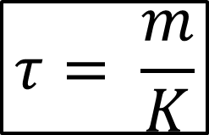
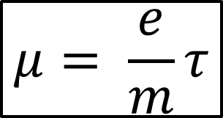



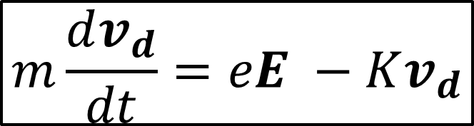
Drift and Diffusion of Electrons in gasses
$$m\frac{dv_{d}}{dt}=eE −Kv_{d}$$
$$μ= \frac{e}{m}τ$$
$$τ= \frac{m}{K}$$
$$v_{d}= μE$$
$$n\left(\overline{r}, t=0\right)$$
$$n\left(\overline{r}, t\right)$$
11

Slide 28
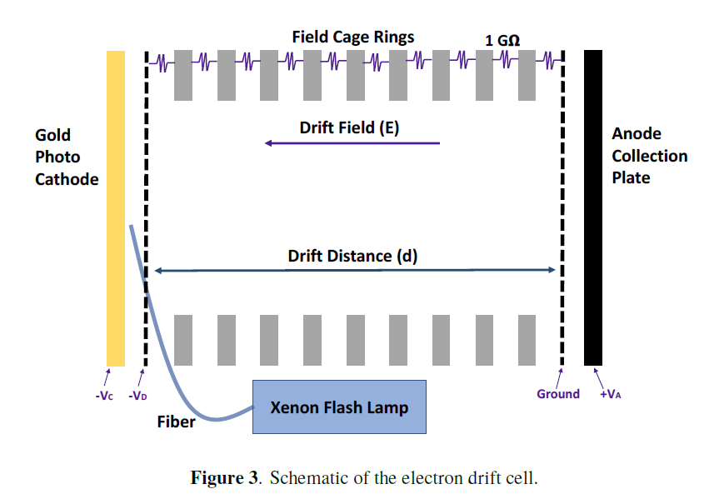
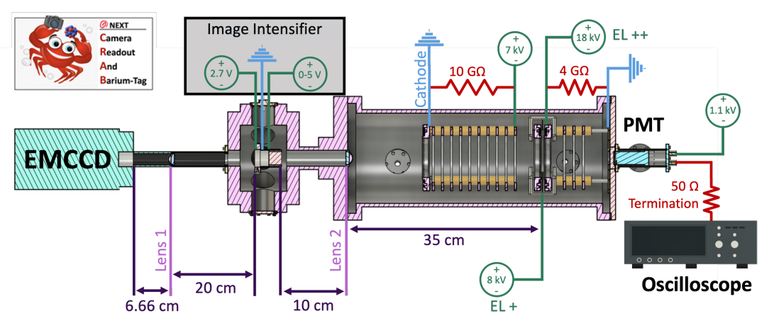
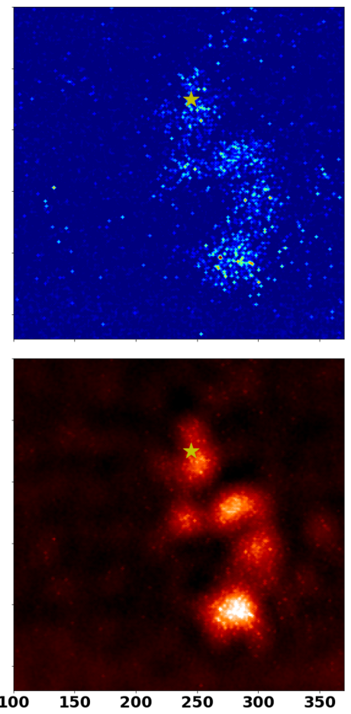
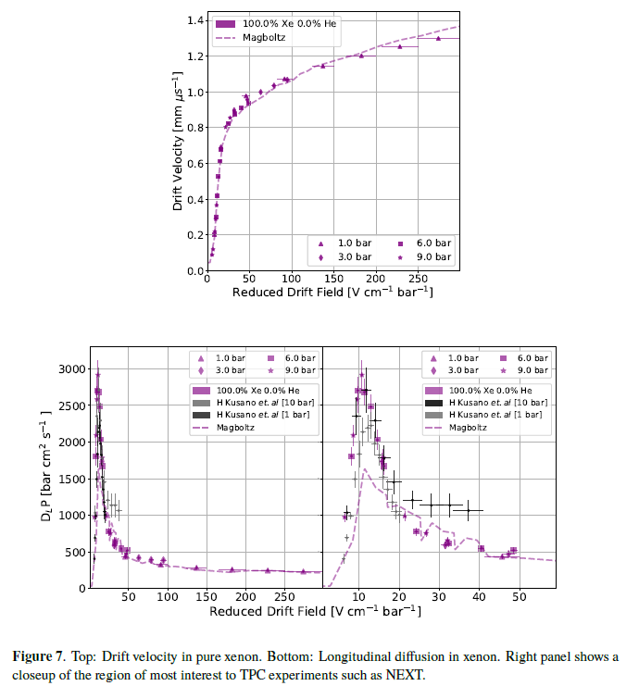
    Some recent experimental results from noble gases – Swarm Physics is alive!
(Ilker et al., CPAD 2023)
Pulsed – Townsend Experiment
Measures drift velocity and longitudinal diffusion
Pulsed – Townsend Experiment + Pixelated Read out
Measures drift velocity, longitudinal diffusion, and transverse diffusion

Slide 29
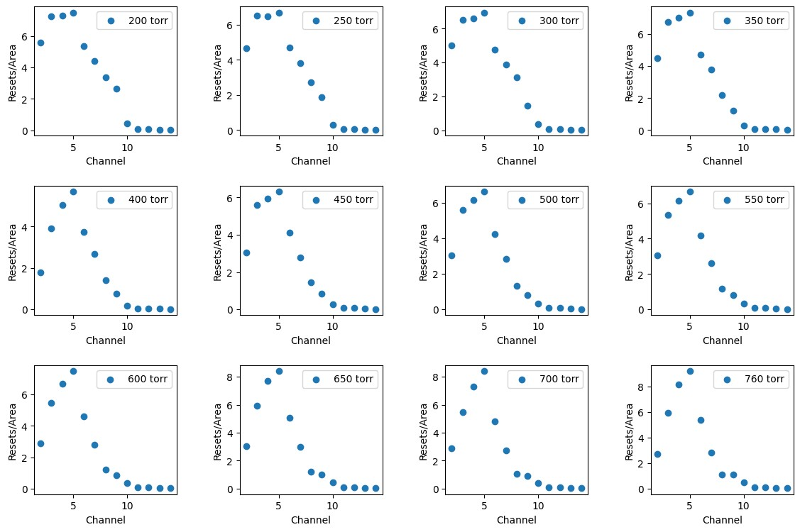
5 cm Drift: Diffusion as a function of Pressure and Electric Field

Slide 30
10 cm Drift: Diffusion as a function of Pressure and Electric Field

