Slide 1
RDC #3
Solid State Tracking
Introduction

Slide 2
Welcome
We are very excited to see everyone
There are three RDC3 sessions:
Tuesday 1600-1800: Sensors/modules/interconnections
Wednesday 1100-1230: MAPs (joint with RDC4: ASICs)
Thursday 1600-1800: LGADs (joint with RDC11: Timing)
There are also many sessions related to Solid State Detectors:
Tuesday 1330-1600: RDC4: Circuits and Architectures for 4D tracking and calorimeters
Wednesday 1330-1600: RDC4 Big Data Management
Thursday: 1100-1230: RD10: Mechanics and Cooling
Thursday: 1330-1600: RDC4: Methodologies, Tools, IC Block, SoCs, and Workforce Development

Slide 3
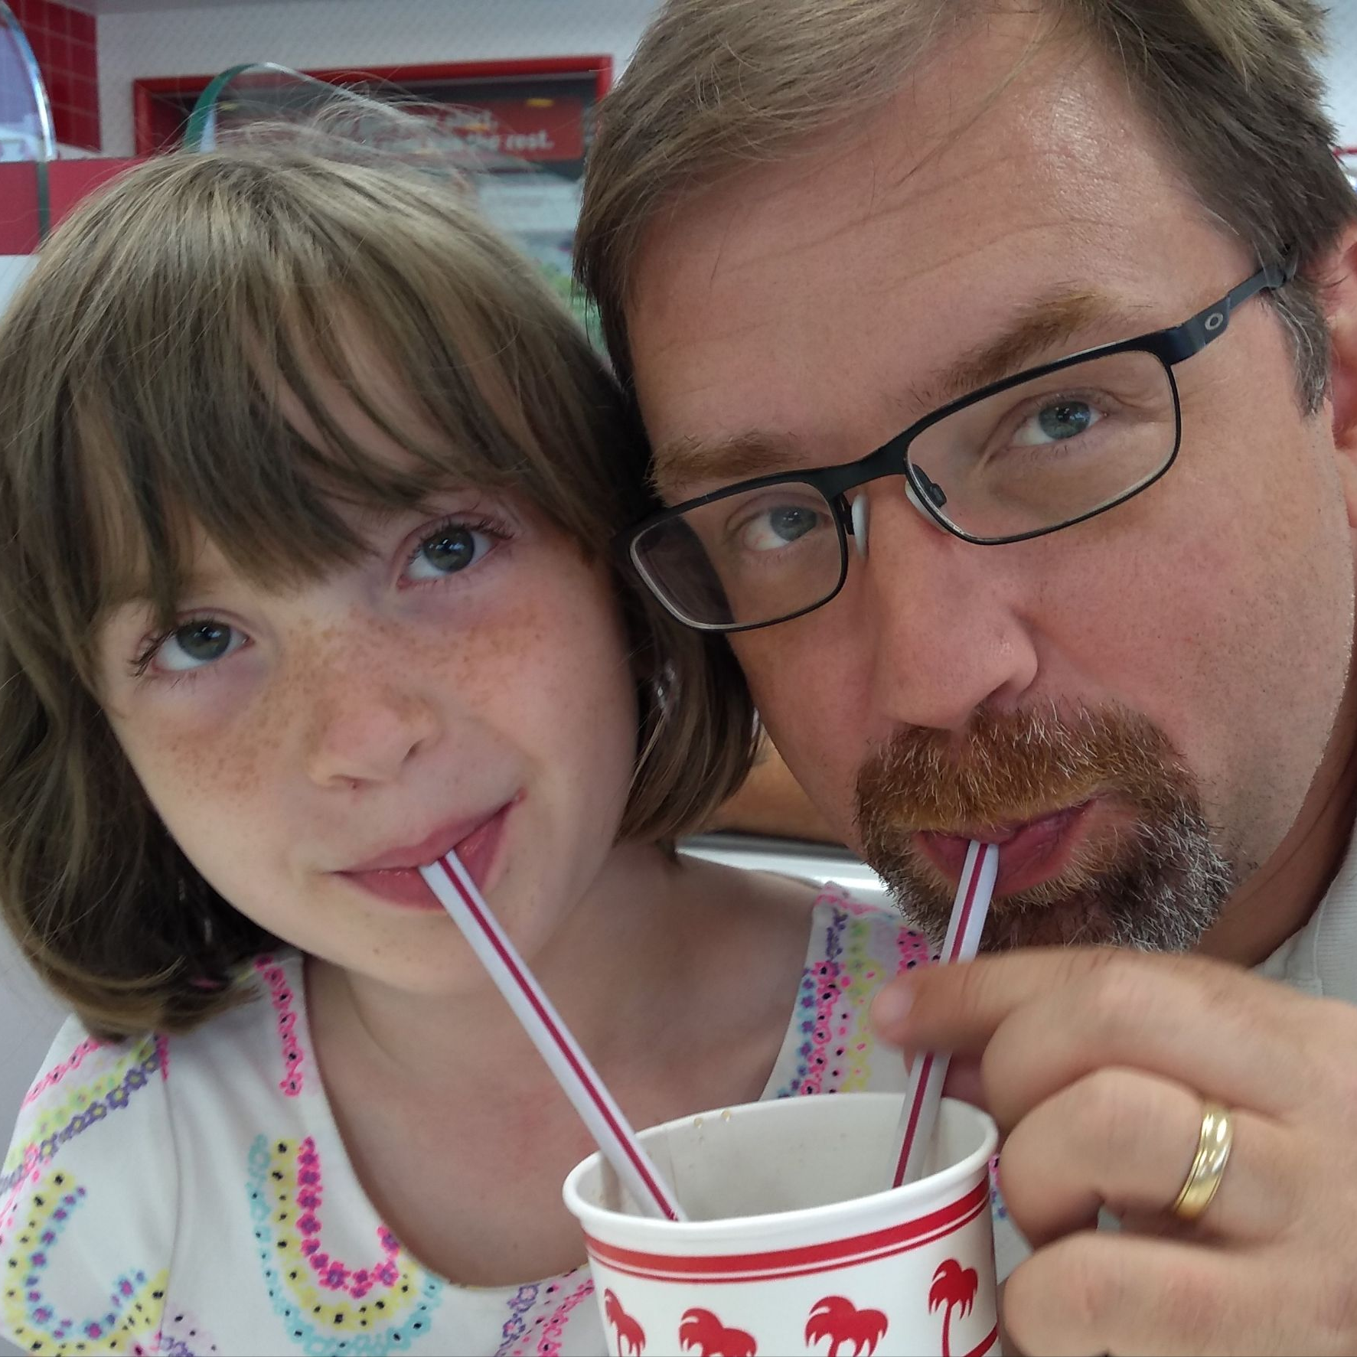
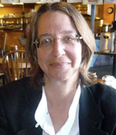
RDC 3: Solid State Tracking
RDC Coordinators
Name: Tony Affolder
affolder@ucsc.edu
Name: Sally Seidel
seidel@unm.edu
Dedicated RDC Email List
cpad_rdc3@fnal.gov
To subscribe:
Send an e-mail message to listserv@fnal.gov
Leave the subject line blank
Type “SUBSCRIBE cpad_rdc3 FIRSTNAME LASTNAME” (without the quotation marks) in the body of the e-mail message
Tony Affoder
UCSC-SCIPP
Silicon Sensors, Modules and Tracking Systems
Sally Seidel
New Mexico
Silicon Sensors, Radiation Tolerance, Trackers

Slide 4
Meetings
We had an RDC3 Introductory Meeting on Oct. 4th: https://indico.fnal.gov/event/61509/
At it, there was a series of 2-3 page flash-talks where groups got to introduce themselves, what they are doing presently, and their future interests.
If you didn’t present, please send us a few slides and we will add it to the agenda to collect everyone’s interests in one place
We are still looking for a good method to gather all our material.
We plan to have regular ~quarterly meetings of RDC3 in order to keep in touch, communicate new information, discuss how we are interacting with DRD3,….
We may have ad-hoc meetings when necessary for grant planning,….

Slide 5
Goals for this week:
Improve understanding of the size and interests of the community in order to better organize and start gathering around a few ideas for funding proposals, and common projects
RDC3 should be community driven; we want to be facilitators working towards common projects and goals
Learn about all the great new ideas and developments in the US
There is a notable critical mass around MAPs and LGAD-based systems
At the end of these sessions, we have reserved a few minutes to start collecting thoughts on common goals, areas needing development, etc.

Slide 6
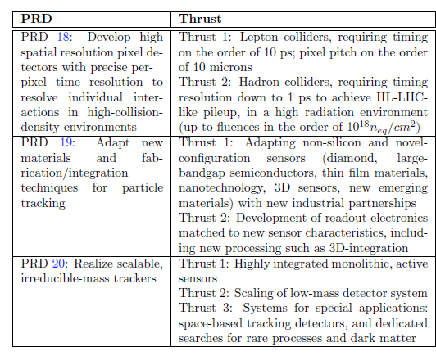
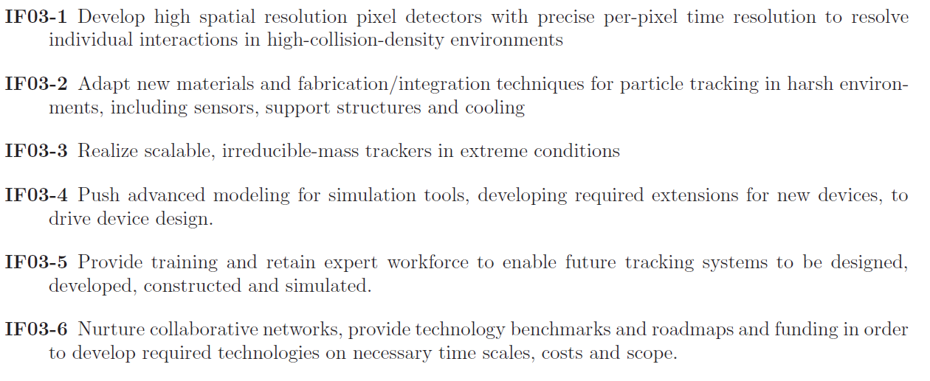
Longer Term R&D Priorities
Directions encompassed in BRN and Snowmass Reports
Areas of R&D Priorities
Topic Area #1: Adapting non-silicon and novel-configuration sensors
Improved costs, area, radiation tolerance, performance
Topic Area #2: Scalable, low-mass detector systems
MAPs based tracking
Topic Area #3: Trackers for Lepton Colliders
Similar requirements for timing and spatial resolution
Topic Area #4: Trackers for Hadronic Colliders
Extreme radiation with fine timing and spatial resolution
Topic Area #5: Advanced modeling
Table 20 of BRN
Key Points from IF03 in Snowmass Instrumentation Report

Slide 7
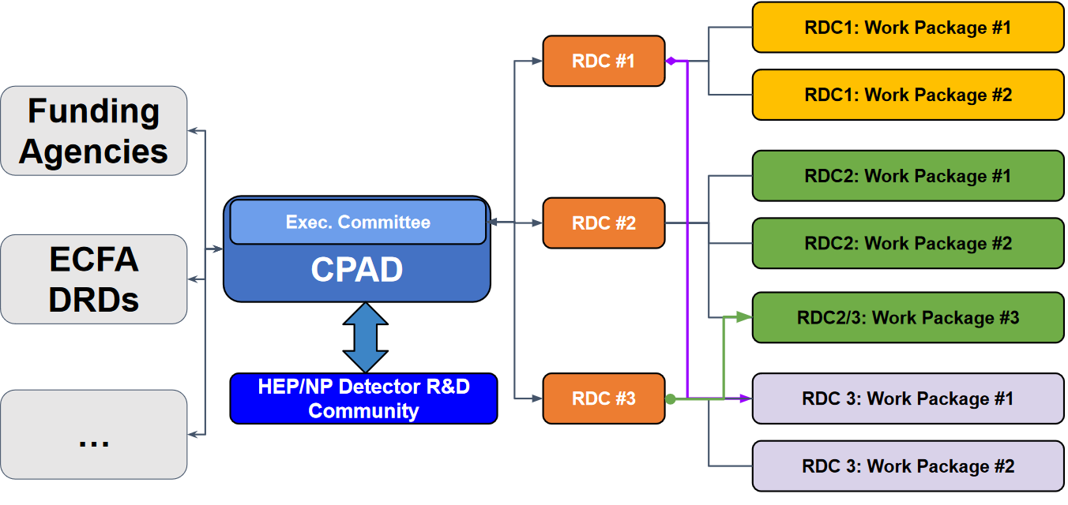
Our vision of the scope of RDC3
Future systems will be very challenging and require co-design at the early stages to reach the targets our physics goals demand
Silo’d designs which worked for the LHC and HL-LHC upgrades cannot work in our opinion
In the long term, we would like to target larger work packages which will study the topic areas on the previous slide
Requires working closely with other RDCs and DRDs at the beginning
DRC4 (Readout and ASICs), DRC10 (Detector Mechanics), DRC11 (Fast Timing), ECFA DRD3 (Solid State), ECFA DRD7 (Electronics), ECFA DRD8 (Integration)
How we work with the ECFA DRDs is not clear but such collaboration is welcomed on both sides
In addition to the sensor elements themselves, we need to make sure we can read them out, support and service the full system.

Slide 8
Funding in the near term
For the foreseeable future (next 2 years), there is no new earmarked funds within CPAD from the DOE for R&D
The presentation of the P5 report at the Dec. 7-8th HEPAP may give some guidance.
How to fund our work and the split between the frontiers (R&D, Energy, Intensity,…) is not clear
In the next year, only available path is in the FOA: DE-FOA-0003177, section 5F, page 63 for multi-institutional projects
At the first RDC3 meeting, we were encouraged to promote:
Blue Skies proposals
Teams working together more: as in ~2-3 options of common submission to foundries for CMOS MAPs, more common submissions in LGADs and electronics for it
Holistic (non-silo’d) design and development
Because of the above, we propose we pull together a few multi-institutional proposals for submission before September 2024 for Blue Skies or non-experiment specific general R&D for timing and MAPs

