Slide 1

CPAD 2023
NAPA-p1: Nanosecond Timing Pixel for Large Area Sensors
Alexandre Habib¹, Christos Bakalis¹, James E. Brau², Martin Breidenbach¹, Lorenzo Rota¹, Caterina Vernieri¹ and Angelo Dragone¹
¹ SLAC National Accelerator Laboratory, 2575 Sand Hill Road, Menlo Park, CA 94025, USA
² Department of Physics, University of Oregon, Eugene, OR 97403, USA
*Correspondence: alexhab@slac.stanford.edu
November 8, 2023

Slide 2
Presentation Outline
Application: Future e+e- Colliders
Target Specifications Vs State of the Art
SLAC Development: NAPA_p1
Going Towards a Large Area Sensor
Conclusion & Perspectives

Slide 3
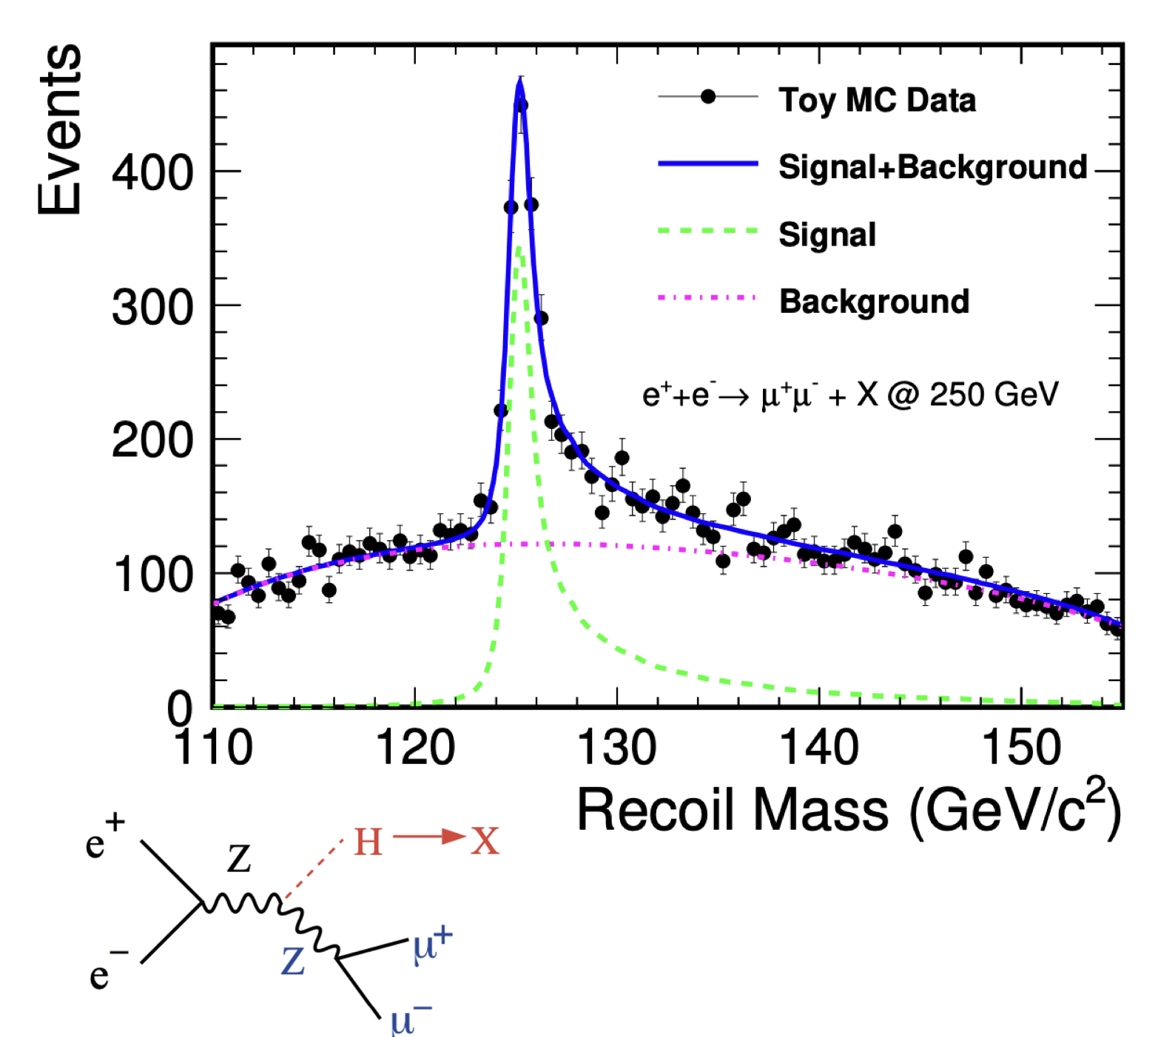
Future Linear e+e- Colliders
Designed to work ad Higgs Factory driving the requiring for detectors:
Material budget <0.3% X₀
Gas cooling → Very low average power consumption
Spatial resolution: 5 µm
Time-tagging in the order of O(1ns)
ILC Timing Structure
C³ Timing Structure
Duty Cycle = 0.03 %
Duty Cycle = 0.48%
~1 ns time resolution is needed
3

Slide 4
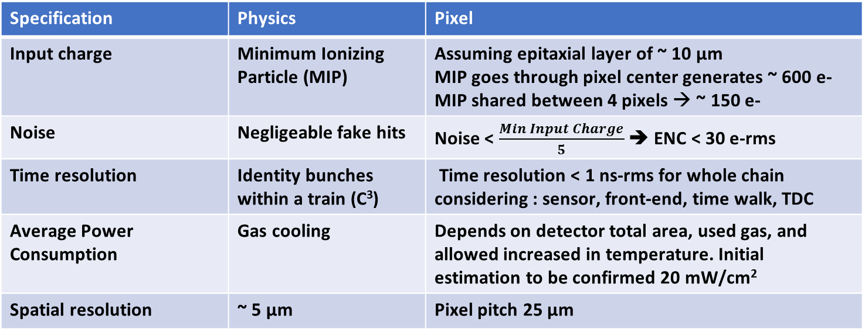
Specifications from Physics to Pixel
Specification | Physics | Pixel
Input charge | Minimum Ionizing Particle (MIP) | Assuming epitaxial layer of ~ 10 µm MIP goes through pixel center generates ~ 600 e- MIP shared between 4 pixels → ~ 150 e-
Noise | Negligeable fake hits | Noise < $\frac{Min Input Charge}{5}$ ➔ ENC < 30 e-rms
Time resolution | Identity bunches within a train (C³) | Time resolution < 1 ns-rms for whole chain considering : sensor, front-end, time walk, TDC
Average Power Consumption | Gas cooling | Depends on detector total area, used gas, and allowed increased in temperature. Initial estimation to be confirmed 20 mW/cm²
Spatial resolution | ~ 5 µm | Pixel pitch 25 µm
These initial specifications serve as a baseline for the first prototype developed at SLAC : NAPA-p1

Slide 5
Presentation Outline
Application: Future e+e- Colliders
Target Specifications Vs State of the Art
SLAC Development: NAPA_p1
Going Towards a Large Area Sensor
Conclusion & Perspectives

Slide 6
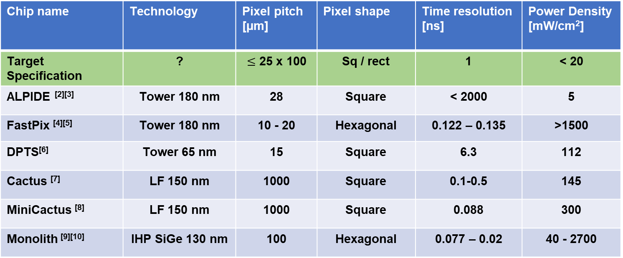
Target Specs Vs State of the Art
Chip name | Technology | Pixel pitch [µm] | Pixel shape | Time resolution [ns] | Power Density [mW/cm²]
Target Specification | ? | $≤$ 25 x 100 | Sq / rect | 1 | < 20
ALPIDE ^{[2][3]} | Tower 180 nm | 28 | Square | < 2000 | 5
FastPix ^{[4][5]} | Tower 180 nm | 10 - 20 | Hexagonal | 0.122 – 0.135 | >1500
DPTS^{[6]} | Tower 65 nm | 15 | Square | 6.3 | 112
Cactus ^{[7]} | LF 150 nm | 1000 | Square | 0.1-0.5 | 145
MiniCactus ^{[8]} | LF 150 nm | 1000 | Square | 0.088 | 300
Monolith ^{[9][10]} | IHP SiGe 130 nm | 100 | Hexagonal | 0.077 – 0.02 | 40 - 2700
No design fulfills all target specification ➔ The need to develop a custom design
We decided to go with the Tower 65nm technology, which has been optimized by CERN WP1.2 to have low sensor capacitance allowing very good performance with low power consumption.
+ it has the possibility of a wafer-scale stitched sensor
+ it has been proven to be radiation tolerant

Slide 7
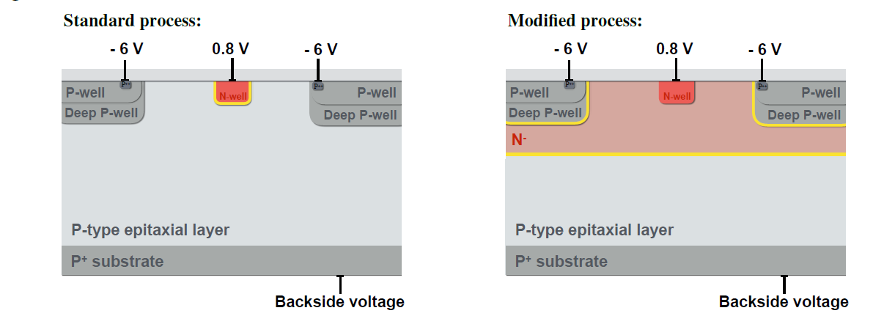
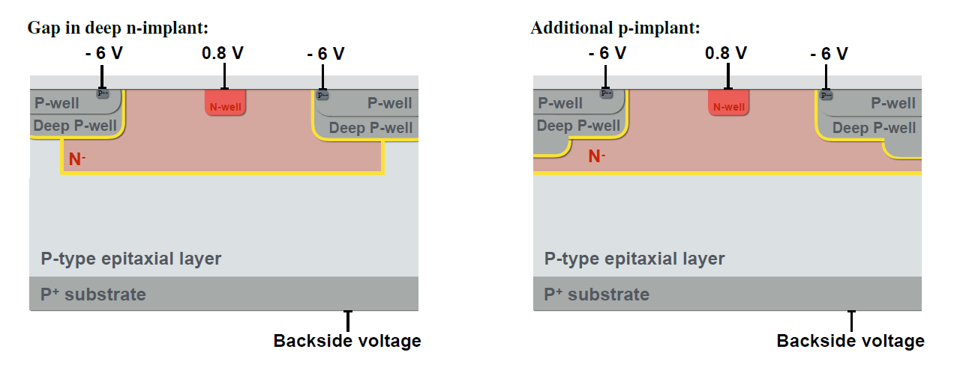
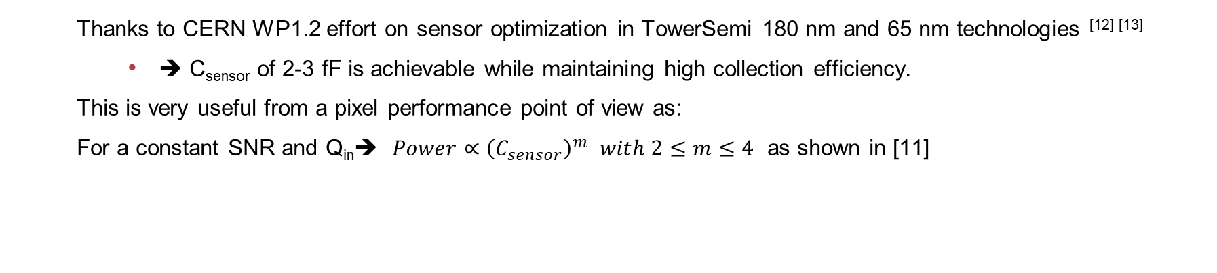
Tower Semiconductor 65 nm Imaging technology
  Thanks to CERN WP1.2 effort on sensor optimization in TowerSemi 180 nm and 65 nm technologies ^{[12] [13]}
    ➔ C_{sensor} of 2-3 fF is achievable while maintaining high collection efficiency.
  This is very useful from a pixel performance point of view as:
  For a constant SNR and Q_{in}➔ $Power∝{\left(C_{sensor}\right)}^{m}$ $with 2≤m≤4$ as shown in [11]
Sensor optimization in TowerSemi 180 nm process from [12] and [13]

Slide 8
Presentation Outline
Application: Future e+e- Colliders
Target Specifications Vs State of the Art
SLAC Development: NAPA_p1
Going Towards a Large Area Sensor
Conclusion & Perspectives

Slide 9
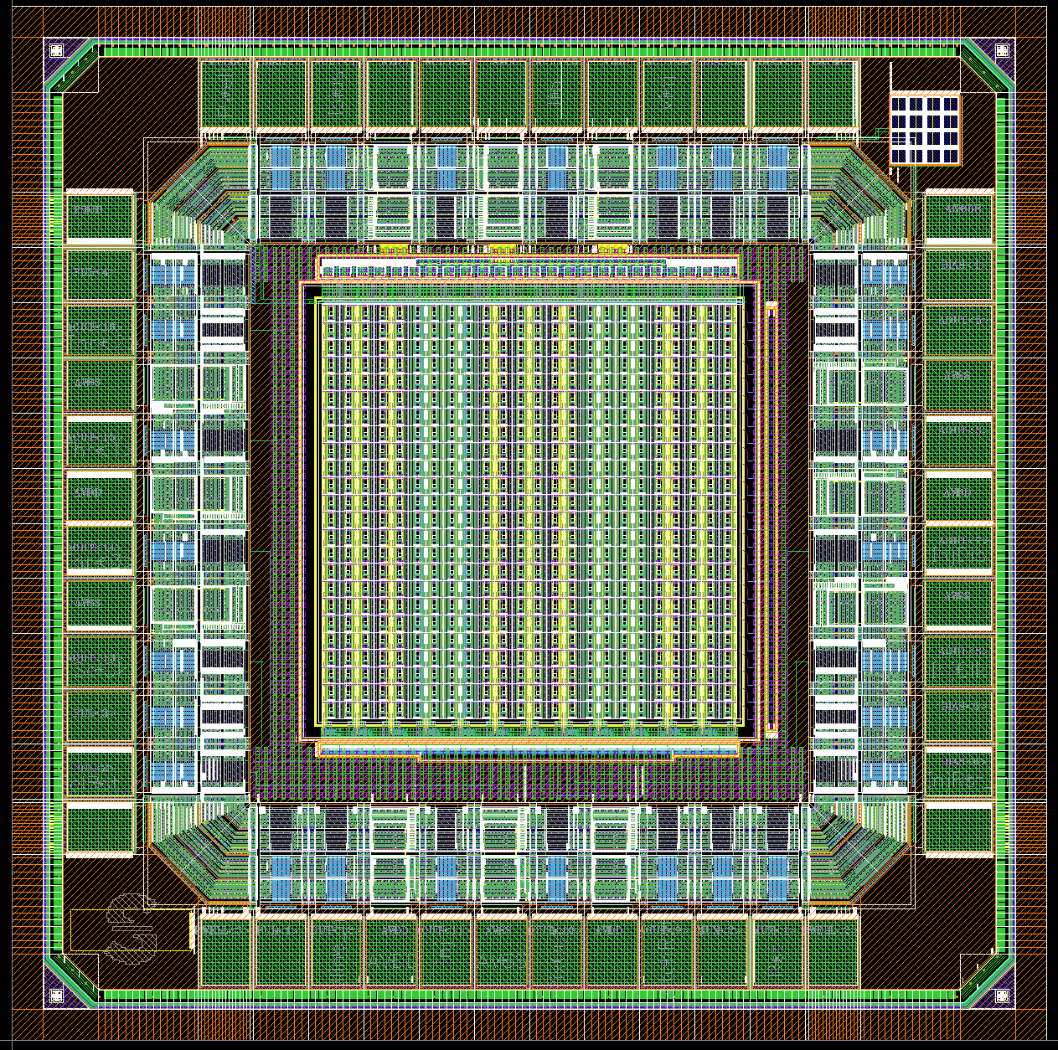
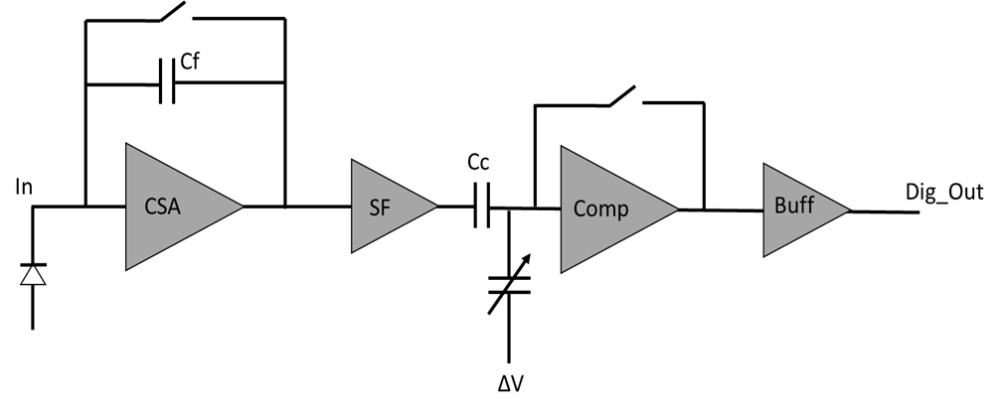

NAPA_p1: NAnosecond Pixel for large Area sensors – Prototype 1
The prototype design submitted with a total area 5 mm x 5 mm and a pixel of 25 µm $×$ 25 µm, to serve as a baseline for sensor and pixel performance.
Design motivation ➔ Synchronous architecture (known beam time structure), Correlated Double Sampling, eliminating low frequency noise, allowing use of minimum size transistors
Power pulsing → reduce average power consumption by more than 100
Layout of MAPS SLAC prototype for WP1.2 shared submission
Global threshold

Slide 10


Simulation of Jitter and ENC as a Function of C_{sensor}
C_{sensor_typ}
C_{sensor}__{max}
C_{sensor_typ}
C_{sensor_max}
jitter = 400 ps for C_{sensor_typ} $≈$2 fF
Ok for Specs
ENC = 13 e-rms for C_{sensor_typ} $≈$ 2 fF
These simulations are with a nominal pixel current of 600 nA ➔ <Power density> = 115 mW/cm² x duty cycle
For e+e- machines such as ILC and C³, duty cycle is expected < 1%

Slide 11
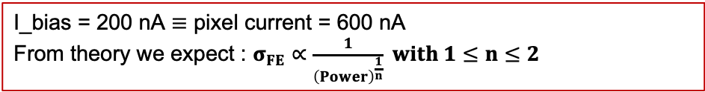
Simulation Results : Jitter and Time Walk
Jitter
Time Walk
C_{sensor} = 2 fF
MIP/4
MIP
16 ns
nominal
I_bias = 200 nA $≡$ pixel current = 600 nA
From theory we expect : $σ_{FE}∝\frac{1}{{\left(Power\right)}^{\frac{1}{n}}} with 1≤n≤2$
Time walk for MIP → MIP/4 = 16 ns
Not negligeable and must be corrected
(in pixel? In balcony? Offline? TBD)

Slide 12
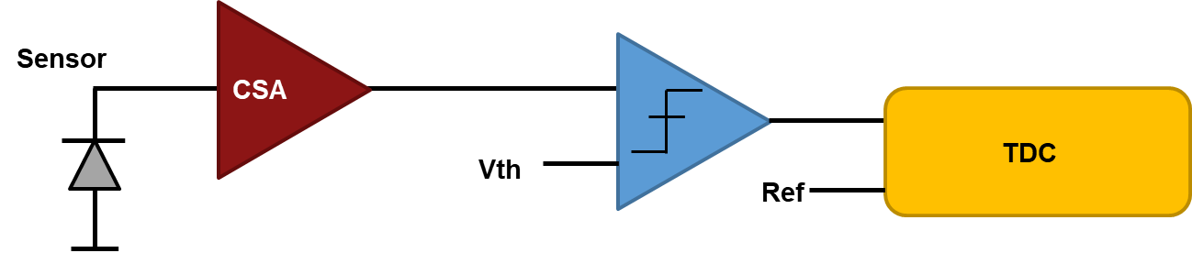
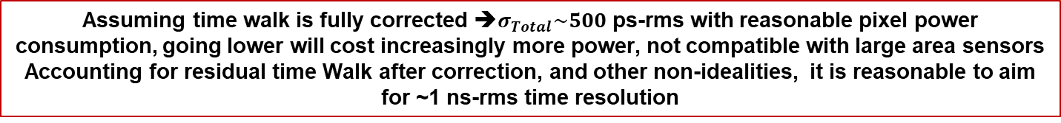


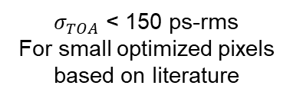
Timing Limits for a Complete Detection Chain
$$σ_{Total}^{2} =σ_{TOA}^{2}+ σ_{FE}^{2}+σ_{Timewalk}^{2}+σ_{TDC}^{2}$$
$σ_{TOA}$ < 150 ps-rms
For small optimized pixels
based on literature
$σ_{TDC}$ < 150 ps-rms
Limited by quantization noise
$σ_{FE}$ < 400 ps-rms for < 1 µW/pixel
Can be corrected if we measure the ToT inside the pixel
Assuming time walk is fully corrected ➔$σ_{Total}\sim 500$ps-rms with reasonable pixel power consumption, going lower will cost increasingly more power, not compatible with large area sensors
Accounting for residual time Walk after correction, and other non-idealities, it is reasonable to aim for ~1 ns-rms time resolution

Slide 13
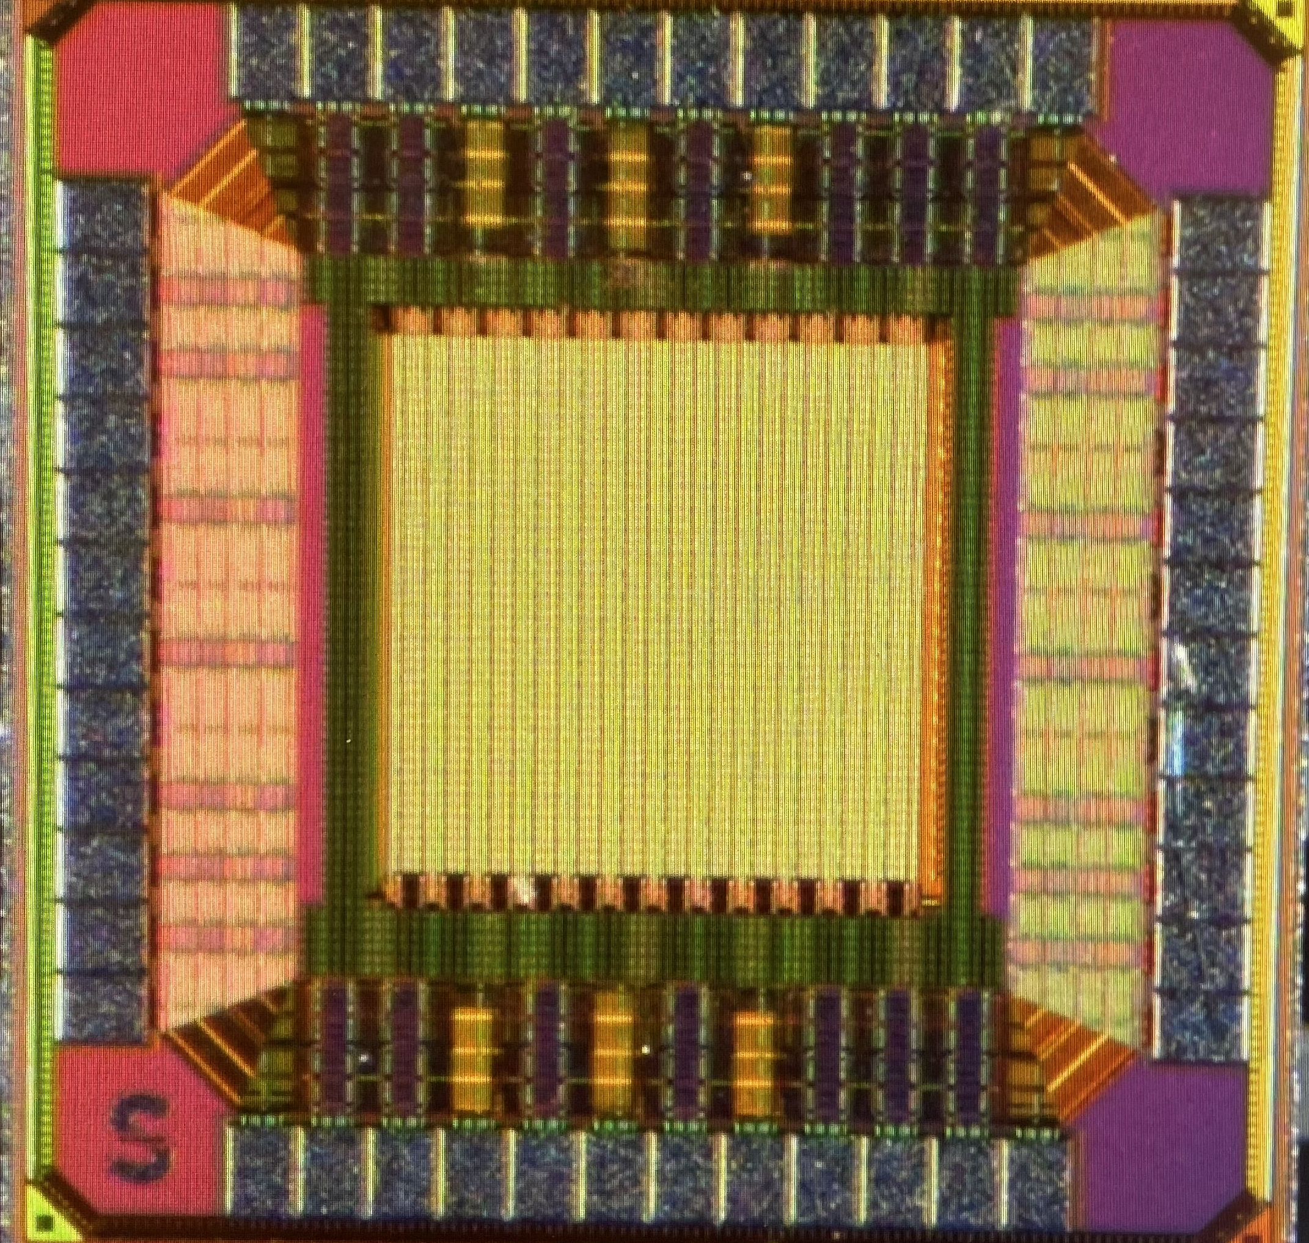

Summary of NAPA-p1 Performance
The chip was received at SLAC in September 2023
 | Specification | Simulated NAPA-p1
Time resolution | 1 ns-rms | 0.4 ns-rms
Spatial Resolution | 7 µm | 7 um
Noise | < 30 e-rms | 13 e-rms
Minimum Threshold | 200 e- | ~ 80 e-
Average Power density | < 20 mW/cm² | 0.1 mW/cm² for 1% duty cucle
Microscope photo of NAPA-p1
Acknowledgement: to CERN WP 1.2 for the excellent cooperation: NAPA-p1 uses the pixel masked developed and optimized by CERN, and was fabricated in a shared run led by CERN

Slide 14
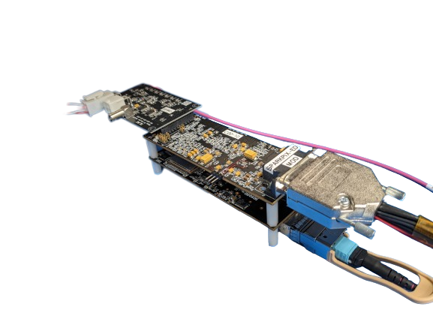
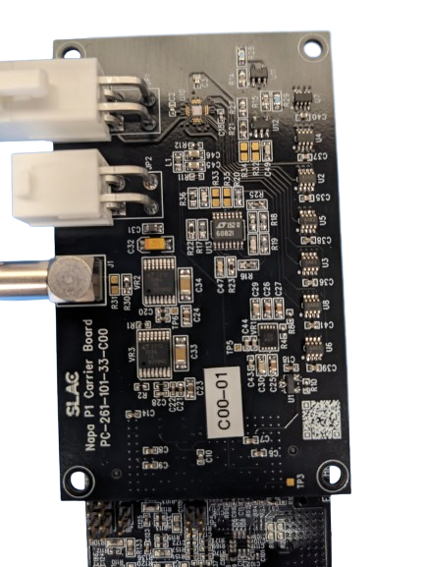
Test Setup for NAPA-p1
A custom carrier was designed at SLAC for the NAPA-p1 chip providing all analog references
The chip was wire-bonded at SLAC
The carrier board connects to a digital board containing an FPGA and several DAC’s
Carrier Board
Digital Board
NAPA_p1
Carrier Board

Slide 15
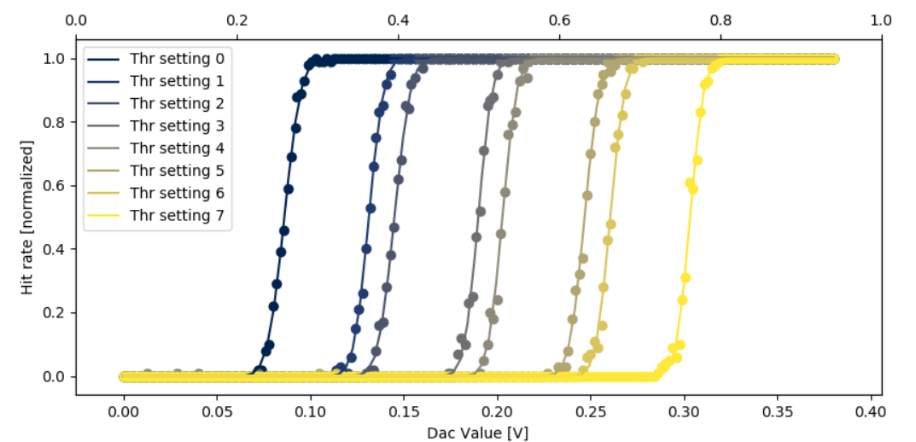
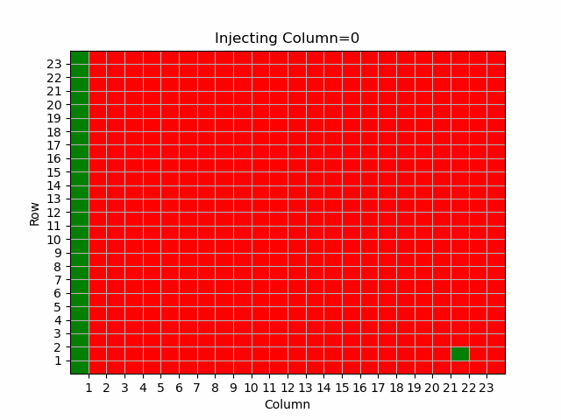
Preliminary Characterization Results
Functional Testing
Injection charge scan across different threshold configuration
Columns Scan
Preliminary
V_pwell = 0
V_substrate = 0
No calibration
No fine tuning

Slide 16
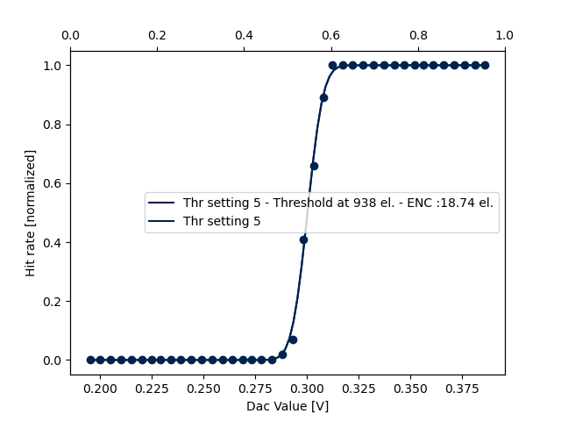
ENC measurement
Preliminary
Pwell = 0
Psub = -3V
Injection cap not calibrated yet. A Laser setup is needed for that. Design value is used for C_{inj}
ENC value is close to simulation ~ 13 e-rms for C_{sensor} = 2 fF
ENC value satisfies the specification < 30 e-rms
More measurements to be available soon

Slide 17
Presentation Outline
Application: Future e+e- Colliders
Target Specifications Vs State of the Art
SLAC Development: NAPA_p1
Going Towards a Large Area Sensor
Conclusion & Perspectives

Slide 18
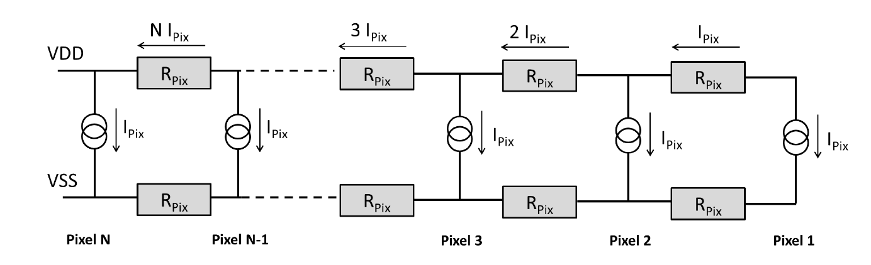
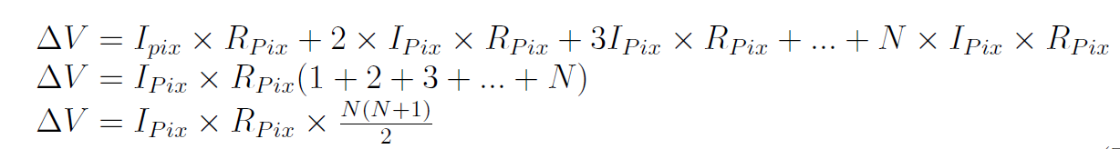

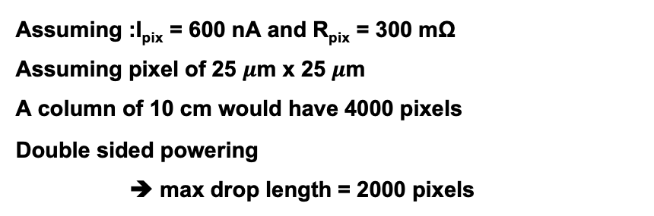
Going Towards a Large Sensor → Challenge
Assuming :I_{pix} = 600 nA and R_{pix} = 300 mΩ
Assuming pixel of 25 $μ$m x 25 $μ$m
A column of 10 cm would have 4000 pixels
Double sided powering
➔ max drop length = 2000 pixels
Local VDD
1.2V
0.48V
VDD-GND goes from 1.2 V near the power pads down to around 480 mV after 2000 pixels
Local GND
The main limitation comes from large scale power distribution rather than cooling constraints
After 10³ pixels (reticle, 2.5 cm), V_{drop} $≈$ 0.1 V
After 4 x 10³ pixels (sensor, 10cm), V_{drop} = 1.5V !

Slide 19
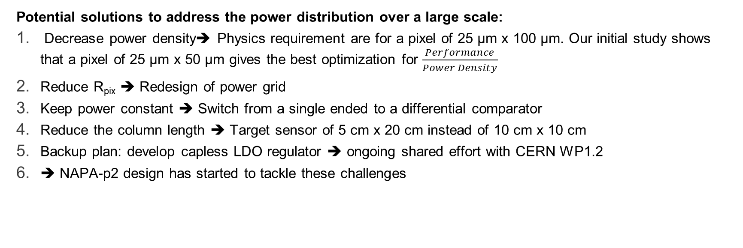
Going Towards a Large Sensor → Solutions
Potential solutions to address the power distribution over a large scale:
Decrease power density➔ Physics requirement are for a pixel of 25 µm x 100 µm. Our initial study shows that a pixel of 25 µm x 50 µm gives the best optimization for $\frac{Performance}{Power Density}$
Reduce R_{pix} ➔ Redesign of power grid
Keep power constant ➔ Switch from a single ended to a differential comparator
Reduce the column length ➔ Target sensor of 5 cm x 20 cm instead of 10 cm x 10 cm
Backup plan: develop capless LDO regulator ➔ ongoing shared effort with CERN WP1.2
➔ NAPA-p2 design has started to tackle these challenges
Potential Configuration of NAPA-p2
Simulation by Jacob Sillman
Power = constant
19

Slide 20
Presentation Outline
Application: Future e+e- Colliders
Target Specifications Vs State of the Art
SLAC Development: NAPA_p1
Going Towards a Large Area Sensor
Conclusion & Perspectives

Slide 21
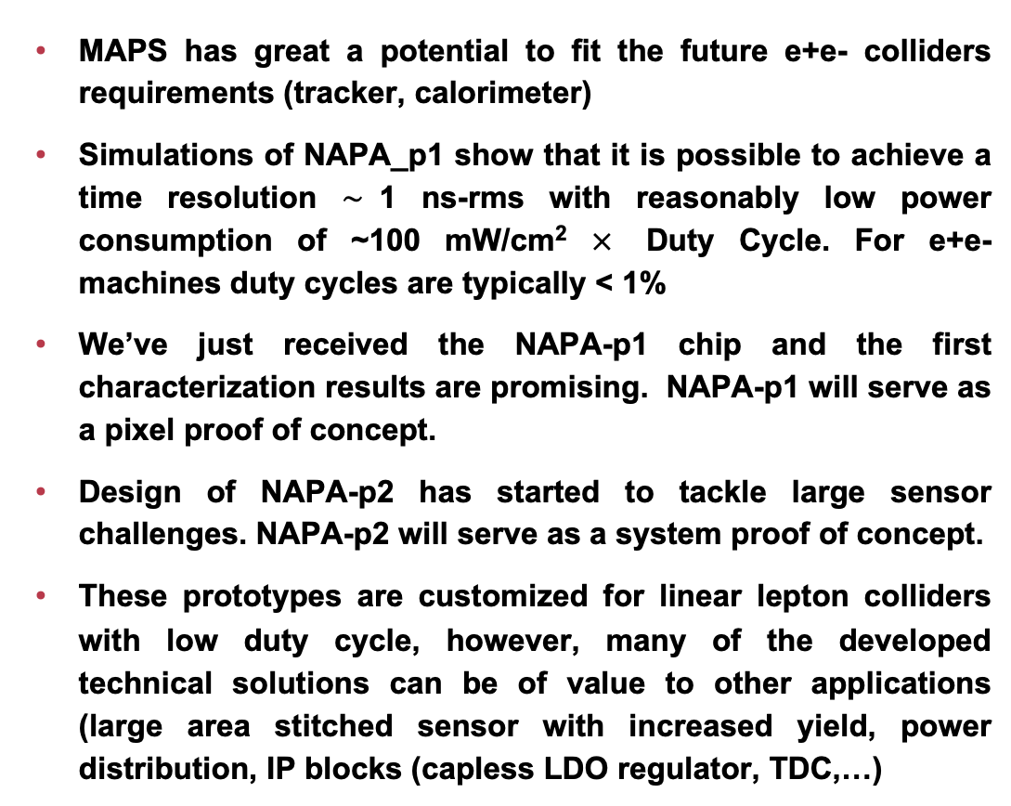
Conclusion & Perspectives
MAPS has great a potential to fit the future e+e- colliders requirements (tracker, calorimeter)
Simulations of NAPA_p1 show that it is possible to achieve a time resolution $\sim$1 ns-rms with reasonably low power consumption of ~100 mW/cm² $×$ Duty Cycle. For e+e- machines duty cycles are typically < 1%
We’ve just received the NAPA-p1 chip and the first characterization results are promising. NAPA-p1 will serve as a pixel proof of concept.
Design of NAPA-p2 has started to tackle large sensor challenges. NAPA-p2 will serve as a system proof of concept.
These prototypes are customized for linear lepton colliders with low duty cycle, however, many of the developed technical solutions can be of value to other applications (large area stitched sensor with increased yield, power distribution, IP blocks (capless LDO regulator, TDC,…)
Microscope photo of NAPA-p1
Thank You For Your Attention!

Slide 22
References
[1] Brau JE, Breidenbach M, Habib A, Rota L, Vernieri C. The SiD Digital ECal Based on Monolithic Active Pixel Sensors. Instruments. 2022; 6(4):51. https://doi.org/10.3390/instruments6040051
[2] Gianluca Aglieri Rinella, “The ALPIDE pixel sensor chip for the upgrade of the ALICE Inner Tracking System, Nuclear Instruments and Methods in Physics Research, Volume 845,2017, https://doi.org/10.1016/j.nima.2016.05.016
[3] M. Mager, “ALPIDE, the Monolithic Active Pixel Sensor for the ALICE ITS upgrade”, Nuclear Instruments and Methods in Physics Research, Volume 824, 2016, https://doi.org/10.1016/j.nima.2015.09.057
[4] T. Kugathasan et al., “Monolithic CMOS sensors for sub-nanosecond timing”, Nuclear Instruments and Methods in Physics Research, Volume 979, 2020, https://doi.org/10.1016/j.nima.2020.164461.
[5] J. Braach et al., “Performance of the FASTPIX Sub-Nanosecond CMOS Pixel Sensor Demonstrator”, Instruments 2022, 6(1), 13; https://doi.org/10.3390/instruments6010013
[6] G.A. Rinella et al. “Digital Pixel Test Structures implemented in a 65 nm CMOS process” https://doi.org/10.48550/arXiv.2212.08621
[7] Y. Degerli et al 2020 JINST 15 P06011 DOI 10.1088/1748-0221/15/06/P06011
[8] Y. Degerli et al., “MiniCACTUS: Sub-100 ps timing with depleted MAPS”, Nuclear Instruments and Methods in Physics Research, Volume 1039, 2022, https://doi.org/10.1016/j.nima.2022.167022.
[9] S. Zambito et al 2023 JINST 18 P03047 DOI 10.1088/1748-0221/18/03/P03047
[10] L. Paolozzi “A Picosecond Avalanche Detector in SiGe BiCMOS’ ULITIMA Conference 2023
[11] W. Snoeys, Monolithic Pixel Detectors for High Energy Physics, Nuclear Instruments and Methods in Physics Research A 731 (2013) 125–130
[12] M. van Rijnbach et al., Radiation hardness and timing performance in MALTA monolithic pixel sensors in TowerJazz 180 nm, 2022 JINST C04034
[13] M. Munker et al., Simulations of CMOS pixel sensors with a small collection electrode, improved for a faster charge collection and increased radiation tolerance,2019 JINST 14C05013

