Slide 1
Use of CVD Diamond Sensors in Extreme Environments and Applications
Mohammad Nizam
(On behalf of the Advanced Accelerator Diagnostic (AAD) Collaboration)
November 7th, 2023
CPAD Workshop 2023
SLAC

Slide 2
Outline:
AAD introduction
Motivation
TCAD Simulation
Real-Time radiation damage in Diamond
High bandwidth diagnostic
Summary

Slide 3
Advanced Accelerator Diagnostics (AAD) Collaboration
A consortium funded by the University of California Office of the President
UC-National Laboratory Fees Research Program grant ID #LFR-20-65323
Also now supported by the US Department of Energy, grant DE-SC0024205
E. Prebys, C. Rowling
University of California, Davis
P. Freeman, D. Stuart
University of California, Santa Barbara
E. Gonzalez, S. Kachiguine, M. Kennedy, F. Martinez-McKinney, S. Mazza, N. Nagel, M. Nizam, E. Potter, R. Padilla, E. Ryan, B. Schumm, M. Wilder
University of California, Santa Cruz
C. Grace, T. Prakash, J. Bohon
Lawrence Berkeley National Laboratory
D. Kim
Los Alamos National Laboratory
J. Smedley, B. Jacobson, I.S. Torecilla, D. Zhu
SLAC National Accelerator Laboratory

Slide 4
Why diamond?
Superior radiation tolerance
Fast saturation drift velocity( ~ 200 um/nm, 100 um/nm for Si) M. Pomorski et. Al
Superior thermal conductivity (2200 W/m-K)
Charge collection time for a 30 mm thick diamond sensor ~ 150 ps
low X-ray absorption

Slide 5
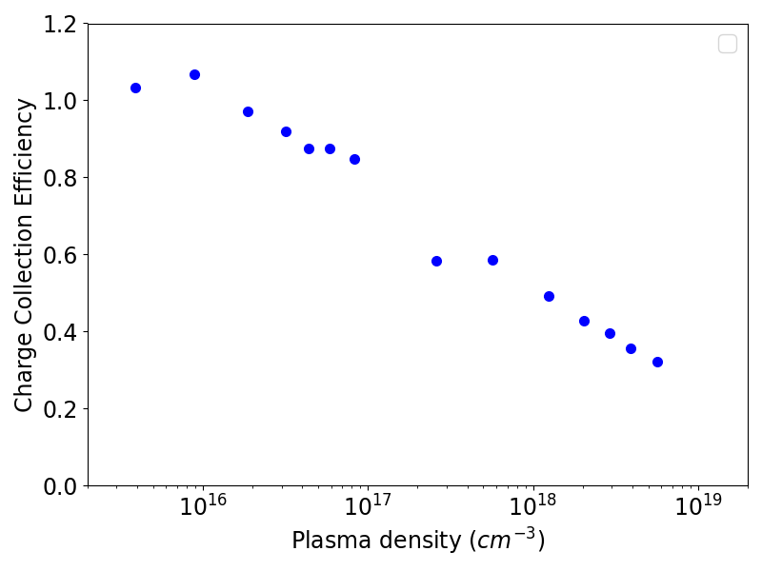
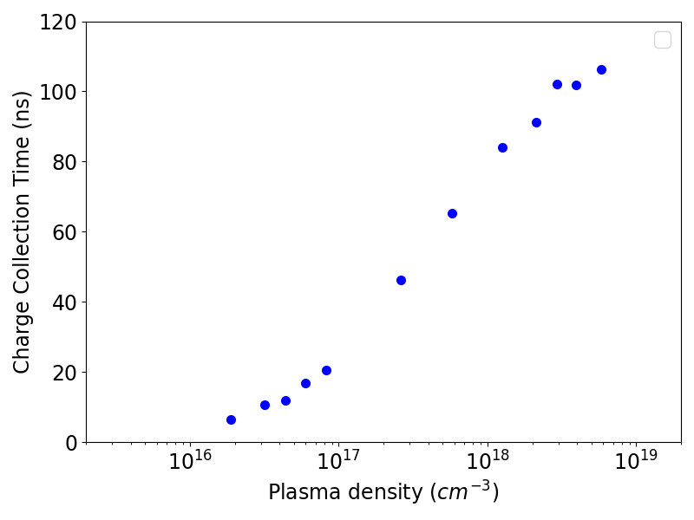
Charge collection time and efficiency of diamond sensor:
A thin (37 ± 10 µm) diamond sensor was exposed to intense X-ray beams from the XPP beamline of LCLS to study charge collection time and efficiency of diamond sensor at increasing plasma densities and bias voltages.
Bias = 100V
Bias = 100V
J. Synchrotron Rad. (2022). 29, 595-601
We make use of 3D Silvaco tools to simulate diamond sensor response and benchmark with 100 V bias data.

Slide 6
Introduction to Silvaco TCAD
Tool to simulate the electrical, optical and thermal behaviour of semiconductor devices.
Individual sensor designs with arbitrary materials possible.
Simulation can be done in 2D, quasi 3D and 3D.
Electric field distribution is directly linked to the detector efficiency.
Electrical Field properties depend on:
-- Drift behaviour of charge carriers
-- Properties of traps in Diamond
-- Creation of space charge
-- etc, …

Slide 7
3D TCAD Simulation:
Dimensions: 120umx120umx35um, Bias:100V
Beam Diameter = 43 um
Non-mixed mode: Only device simulation without any electronic circuit.
Mobility parameters were tuned to achieve Saturation Electron drift velocity=220 um/ns, hole drift velocity=100 um/ns
The currents are collected on the electrodes under the assumption that their potentials are fixed (i.e., perfect signal return path).

Slide 8
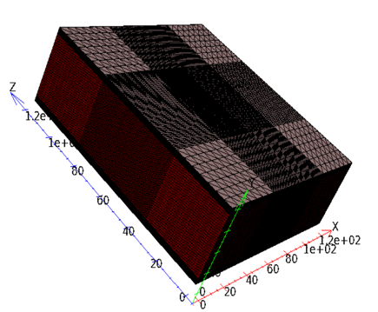
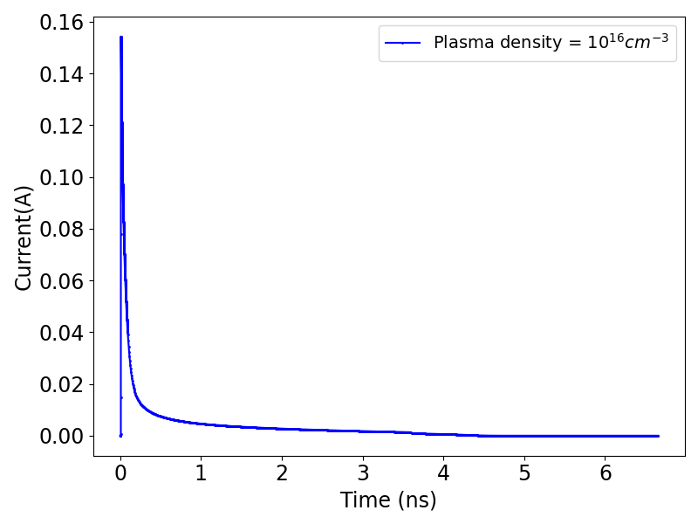
3D TCAD Simulation:
Bias = 100V

Slide 9
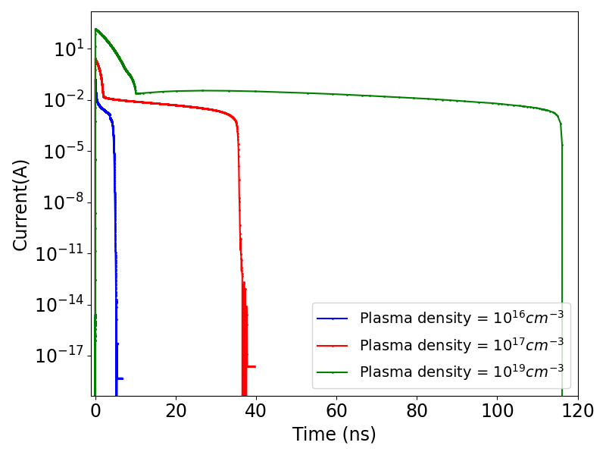
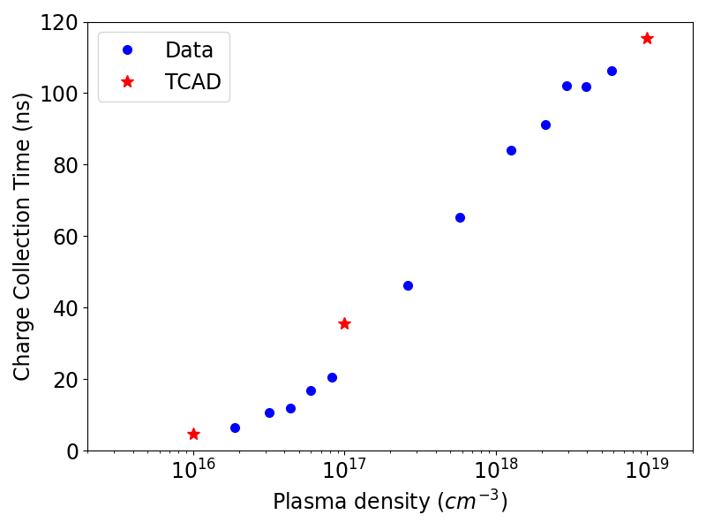
3D TCAD Simulation:
Charge Collection Efficiency simulation is underway.

Slide 10
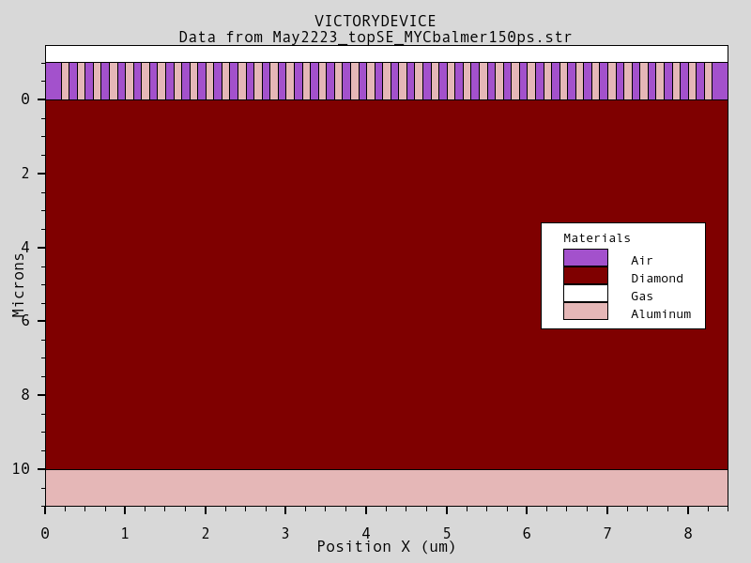
2D TCAD Simulation (Charge diffusion):
We simulate a highly segmented thin device to explore resolution limit of diamond sensors.
A 10um thick diamond under 1 - 50V bias.
There are 41 channels in the segmented geometry with 200nm pitch and 100nm electrode width.
A linear charge is deposited along the central axis of the device.

Slide 11
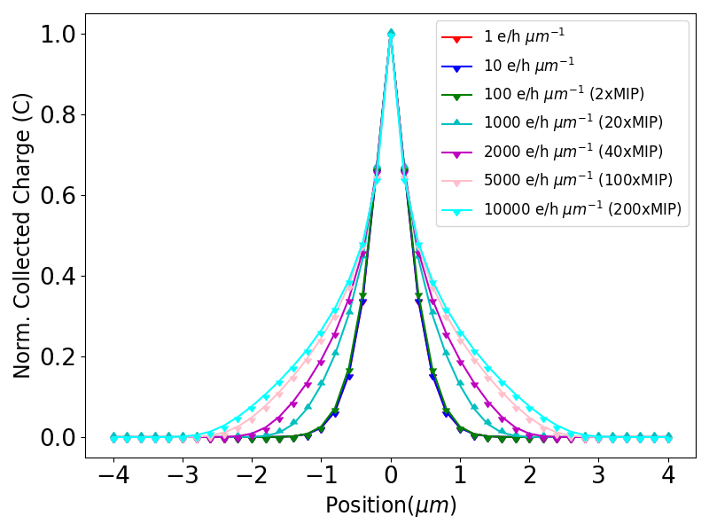
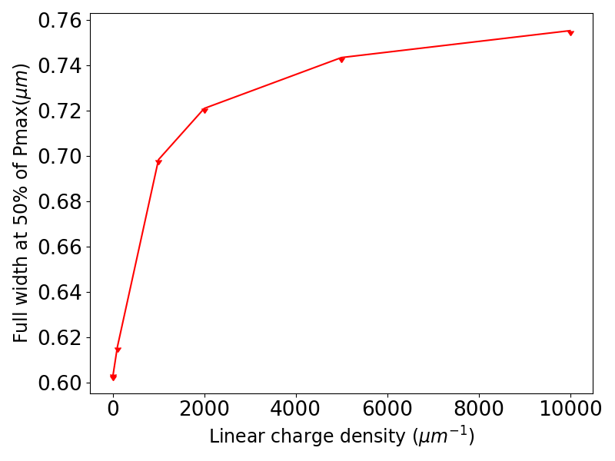
2D TCAD Simulation (Charge diffusion):
Sub-micron feature size resolution looks possible, but results need to be confirmed in heavy ion beam

Slide 12
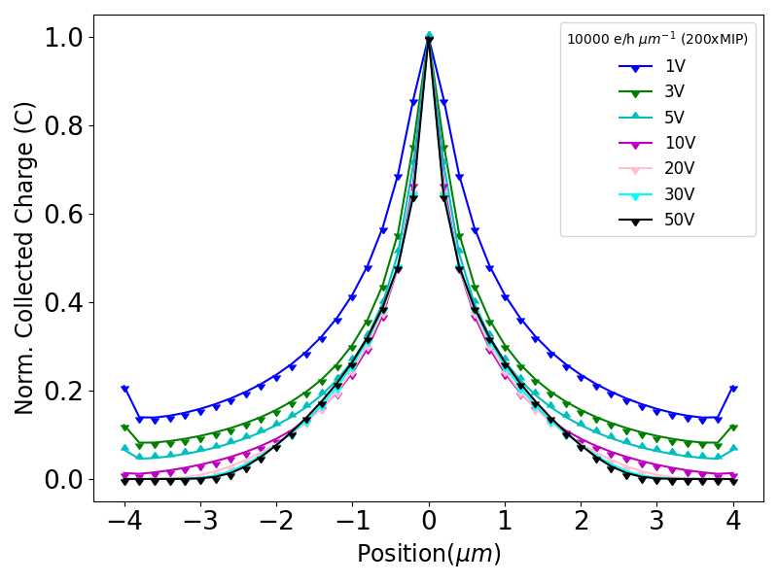
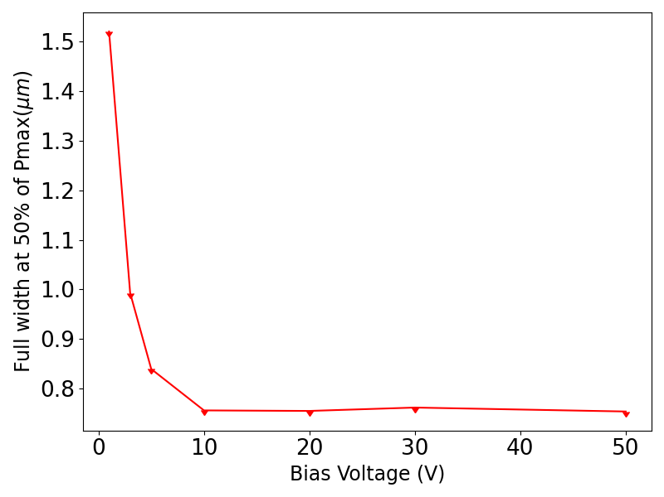
2D TCAD Simulation (Charge diffusion):

Slide 13
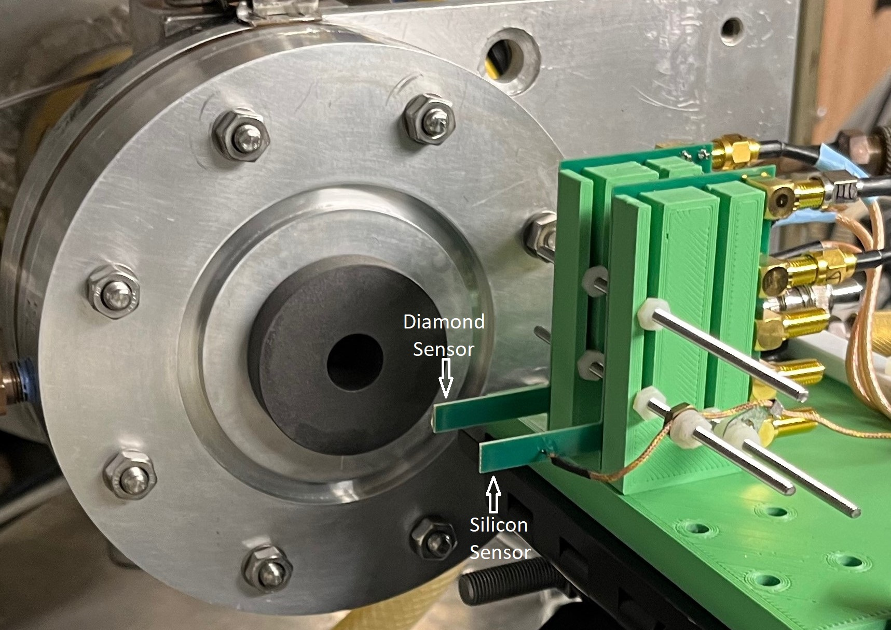
Radiation damage study @ Proton Synchrotron (Crocker Nuclear Lab on the UC Davis Campus) :
A 4mm x 4mm x 0.030 mm diamond and a Silicon sensor with similar dimensions were mounted in parallel on two four-channel readouts board designed at SCIPP. The proton beam energy was 67.5 MeV and the total fluence was ~ 4 x 10¹⁶ .

Slide 14
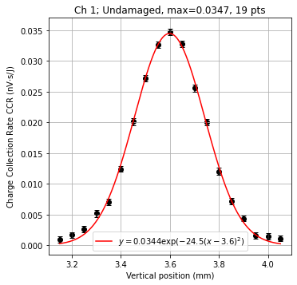
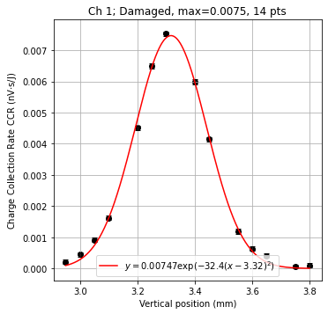
Damaged v/s Undamaged sensor:
Since, the sensor was already damaged a bit during the setup of the experiment, we do not have the absolute charge collection efficiency (CCE).
We took a fresh and fully damaged sensor to the LCLS to measure the absolute CCE.

Slide 15
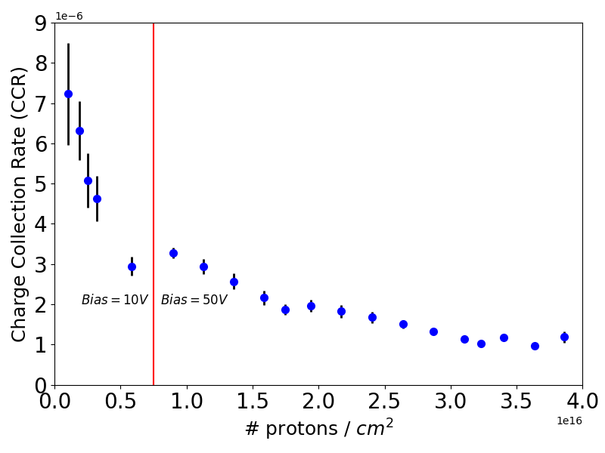
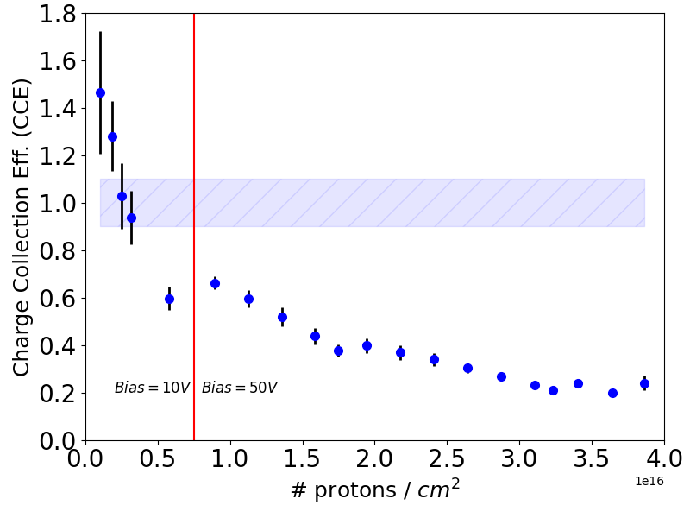
Charge collection efficiency:
The charge collection efficiency of the fully damaged sensor was found to be ~ 24% of that of the undamaged sensor.
We use that final point to set the absolute scale of the relative CCE by scaling the results so that the CCE measured for the highest fluence has a value of 0.240.
10% error band from LCLS data

Slide 16
High Bandwidth Diagnostic system:
Upgraded and next generation XFELs envisioned mJ scale pulses
delivered at repetition rates up to 10 GHz.
-- Need to understand intrinsic charge collection limitations of diamond.
-- Need to develop high bandwidth (10 GHz) readout of ionising particle sensor.
Monitoring of the evolution of the plasma on time scales in the 100-ps regime during laser ignition of plasma events.
AAD Collaboration has been awarded a DOE grant for the Basic Energy Science and Accelerator Stewardship to pursue the development of Mult-GHz diagnostic capable to address these challenges.

Slide 17
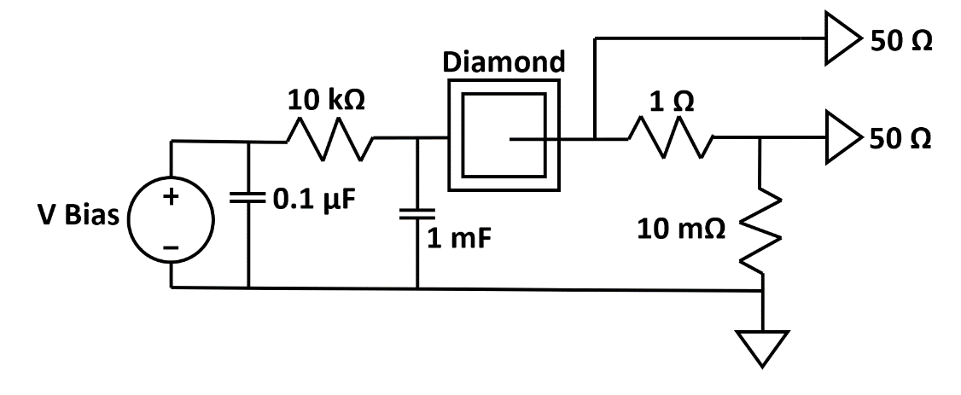
High Bandwidth Diagnostic system:
Initial Attempt at Low-Impedance Signal Path
Sensor connected to the readout path through an Indium band.
A series array of 1 Ω and 10 mΩ shunt the signal current directly to ground.
50 Ω pick-off traces connected to the sensor side of both the 1 Ω and 10 mΩ resistors.

Slide 18
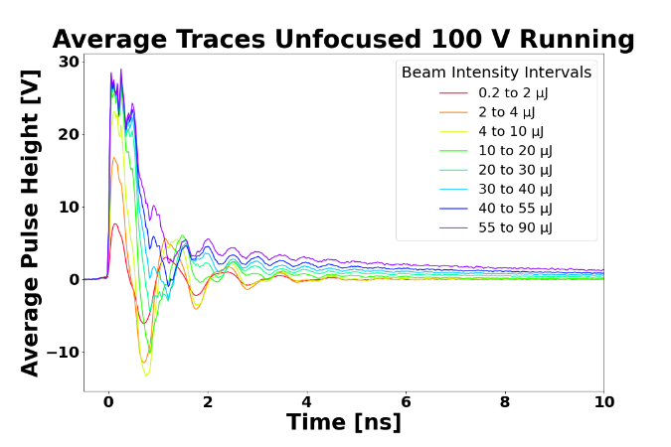
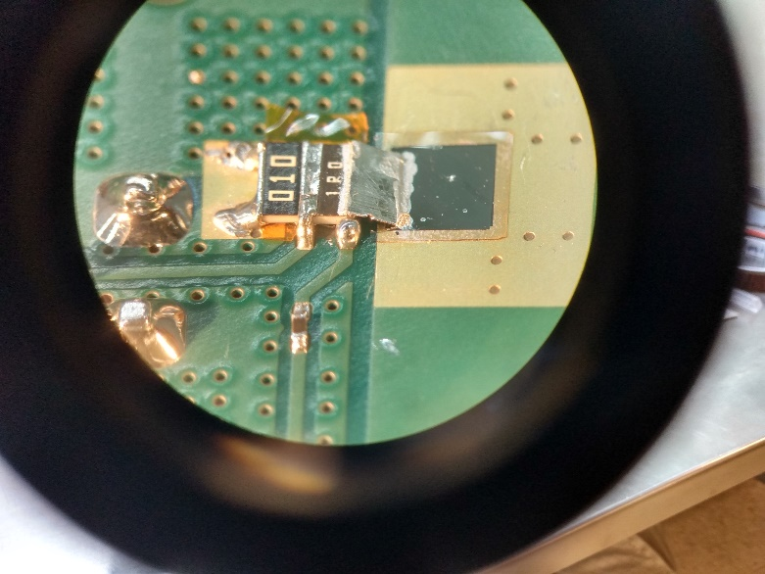
High Bandwidth Diagnostic system:
Shunt R
Signal Pickoff
Signal pulse extends for 1-2 nsec, limiting the system for repetition rates above 0.5-1 GHz.
The ”ringing” suggests that inductive impedances are limiting the performance of the system.

Slide 19
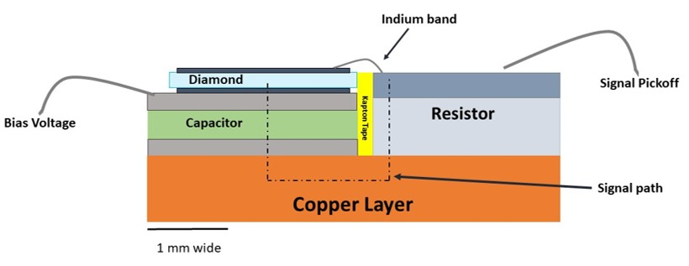
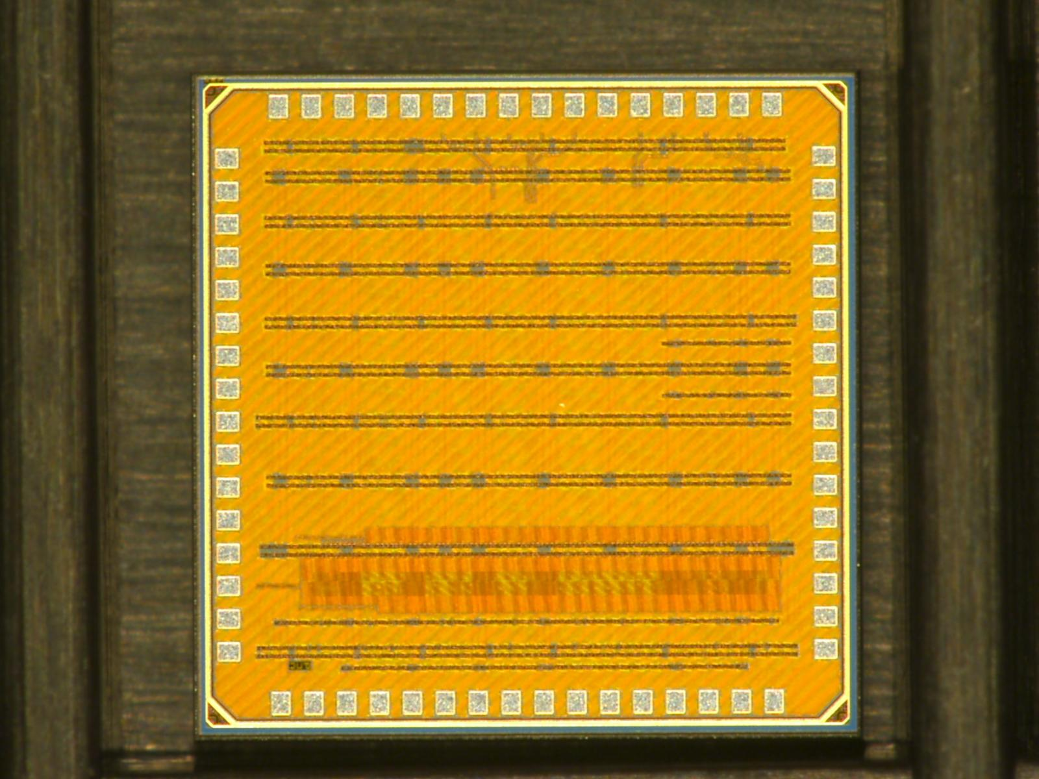
High Bandwidth Diagnostic system (Multi-GHz):
High bandwidth amplifier/buffer ASIC
Significantly more compact geometry
limiting the enclosed area of the signal circuit loop
Use of miniaturized components developed for RF communications applications.
Frequencies of internal resonances within individual components above 10 GHz.

Slide 20
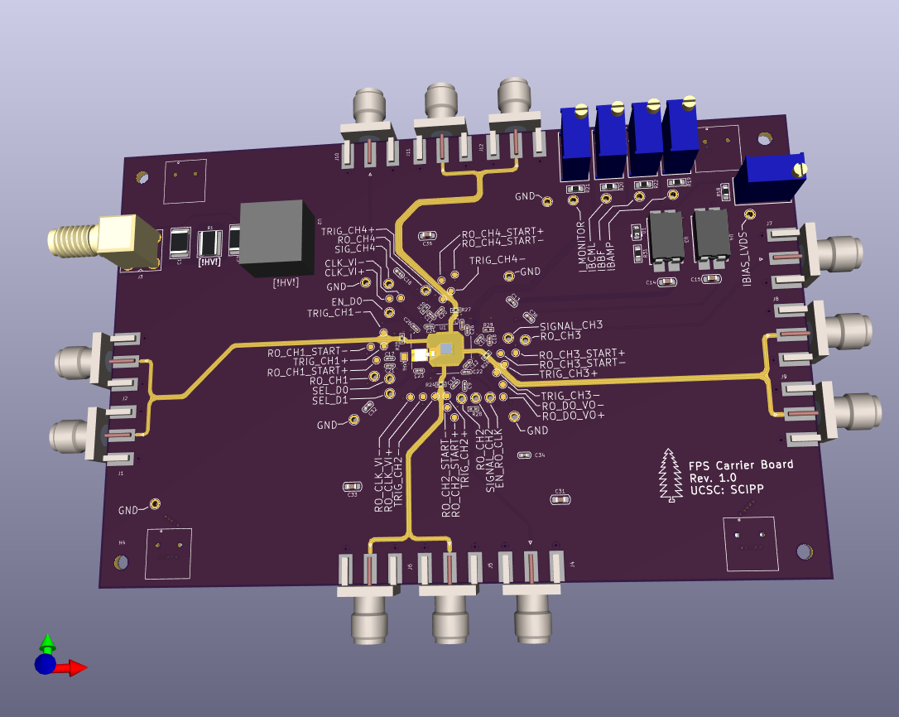
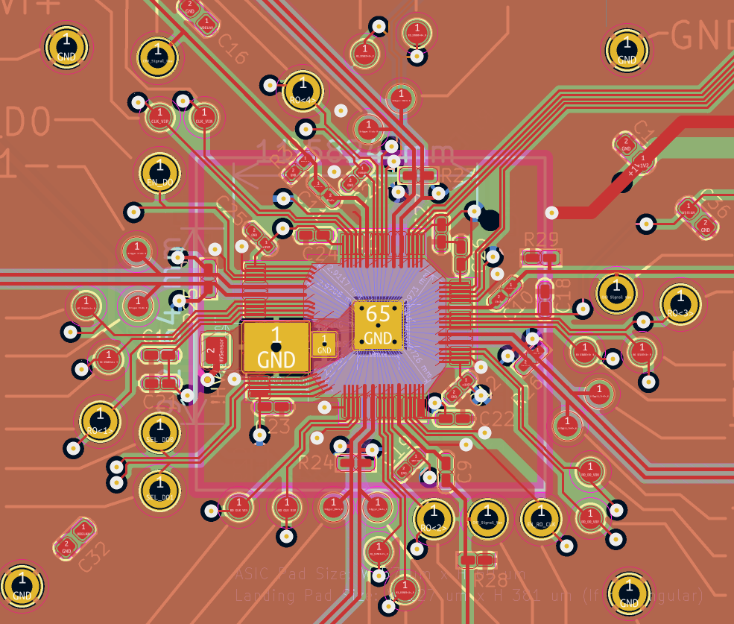
High Bandwidth Diagnostic system (Multi-GHz):
Integration of the signal stackup and the ASIC
Signal path
2mm
Chip
An RF-simulator (HFSS) model is under development for the signal and readout path

Slide 21
Summary and Future:
3D TCAD simulations are in good agreement with the actual data in terms of charge collection time. We plan to use TCAD tools to understand radiation damage in diamond by introducing lattice defects.
2D Simulation of charge diffusion in diamond sensors agree with the sub-micron resolution possibility. We need to experimentally verify by irradiating such a sensor with a heavy ion beam.
Radiation damage study done using the proton beam at the Crocker Lab confirms that these sensors can be safely used in the proton beam monitor at the Isotope Production Facility (IPF), LANL.
The Multi-GHz detection system is expected to greatly improve the next generation XFEL diagnostics and monitoring of high plasma ignition.

Slide 22
Backup

Slide 23
Charge collection rate:
Beam current = 1 uA
Beam Diameter = 1.5 cm
Fluence = 3.54e12 p/s/cm^2
Maximum Frequency = 22 MHz
Both Silicon and Diamond sensors mounted
Total number of events collected = 11367
Trigger rate = 1Hz
Bias voltage for diamond = 10 V – 50 V

Slide 24
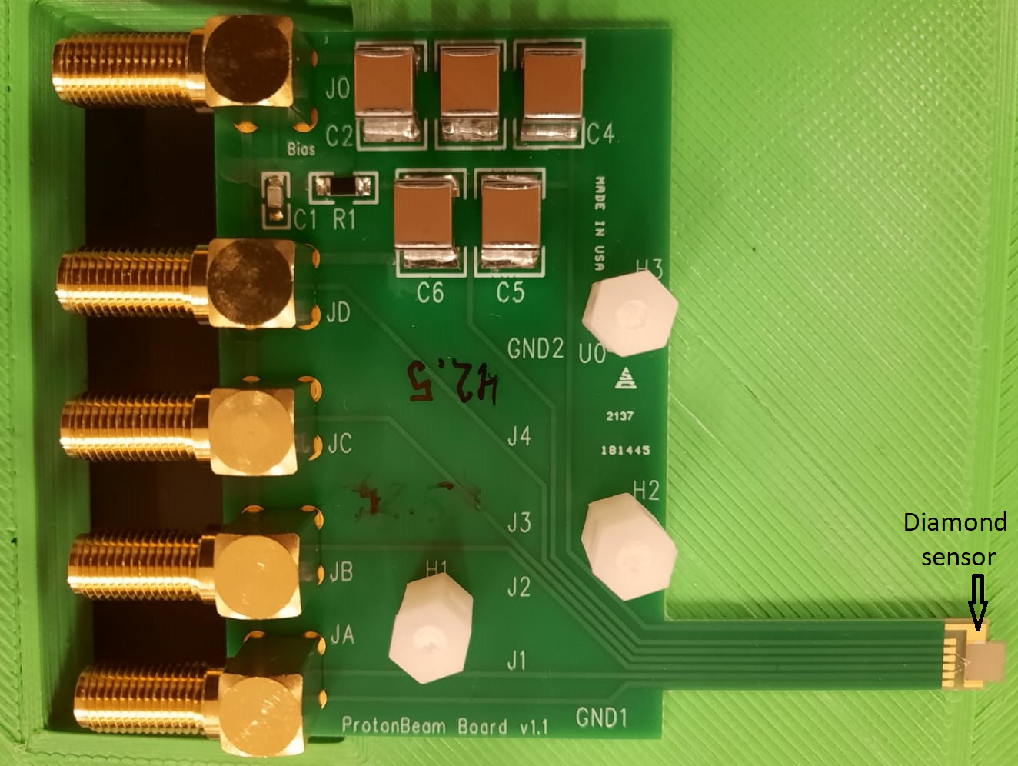
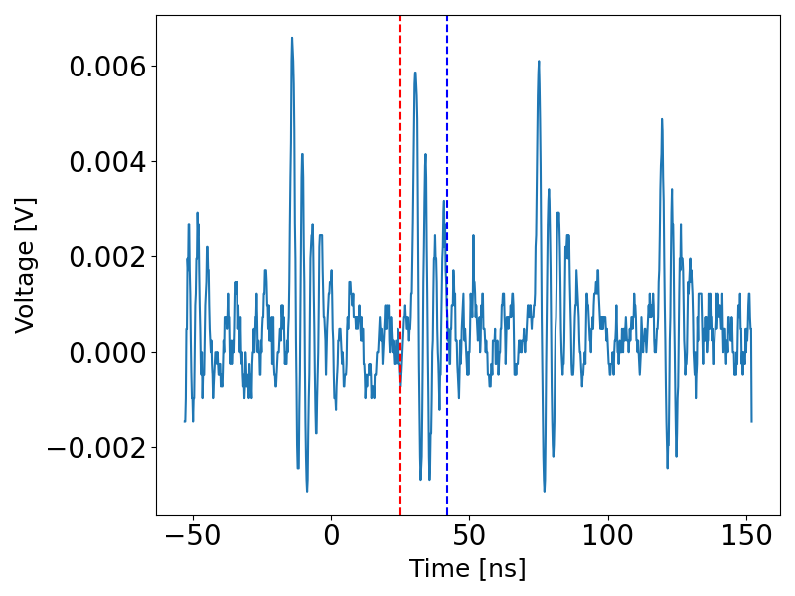
Diamond sensor signal:

