Slide 1
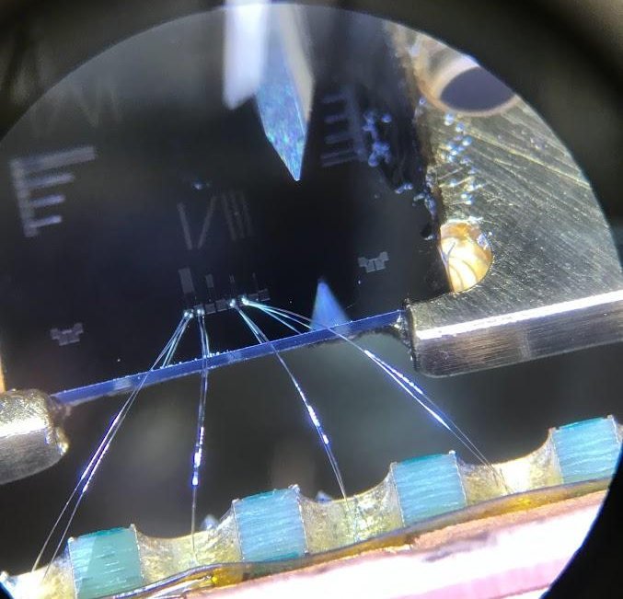
A Case for Iridium-Platinum: an ultrasensitive bilayer Transition Edge Sensor
Maggie Reed: On behalf of the TESSERACT Collaboration
Nov. 8th: RDC7 CPAD 2023

Slide 2
Motivation
Aka who cares?

Slide 3
Overview: TES Design Choices
Design options: Build-A-TES
Material
Method of Tc Control
Thermal isolation
Absorber
Superconducting, low transition temperature
Multilayers, magnetically doped SC, elemental SC
micro structures, phonon decoupling (acoustic mismatch, hot electron effect)
Radiation type dependent
Notes:
Heat capacity of absorber should be small compared to the TES (extra heat capacity decreases sensitivity and increases noise). Controlling thermal conductance (G).

Slide 4
Overview: Calorimeter Model and Design Choices
Sensor
Method of Tc Control
Absorber
Thermal isolation
Thermal Bath
Absorber
Your choices will impact this system heavily, and will be made depending on your purpose! In our case….
Notes:
Our system relies on making choices which efficiently thermalize the input energy, measure the change from that energy, while also isolating how we measure thermally.

Slide 5
Motivation: a Single Photon Device
If we wanted to make a single photon device, we would need:
High quantum efficiency
Excellent energy resolution
Fast response time
Low background rates
Traditionally, Tungsten has been the thin film choice* in the past, given the above requirements
Quantum information, rare event searches, astroparticle experiments…
For good reason! (hot electron effect^{[3]}, low background rate….)
So why focus on anything else?
Notes:
*W TES’s can act as the actual absorber material directly, or as a secondary absorber (like in QET’s). Hot electron effect: electrons and phonons at two different temperatures. Electron temp is not in equilibrium with phonons. Enhanced in W.

Slide 6
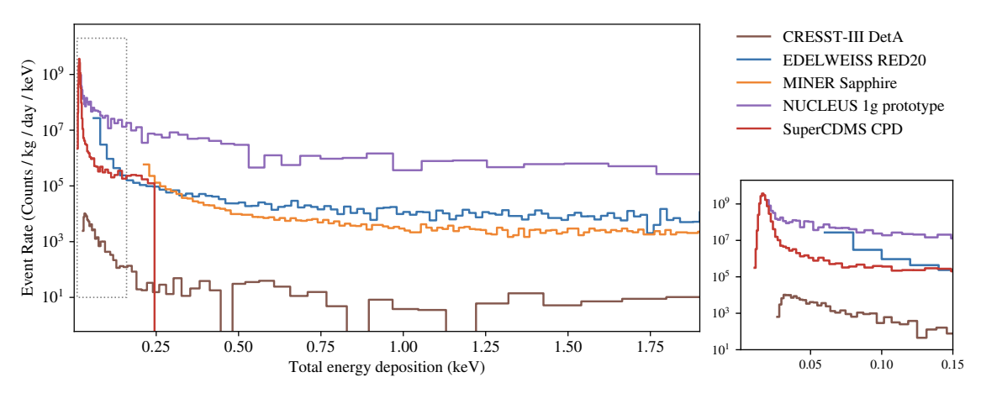
Motivation: W Film Limitations (why we care!)
LEE Noise:
T_{c} precision and variability
Mixed phase is needed to get T_{c} in desired range
Sensitive to fabrication parameters
High electrical resistivities
For single photon applications, we want fast energy spread!
Noise: bare TES have Low Energy (<200eV) Excess (LEE) noise^{[1]}.
Seen in W films (stress?)
See R. Romani RDC7+8 Thurs 4PM
Notes:
*high resistivity mean small thermal conductivities mean thermal energy from a single photon must spread in a time much less than thermal time constant. This limits your detector speed and area.

Slide 7
On Iridium Platinum

Slide 8
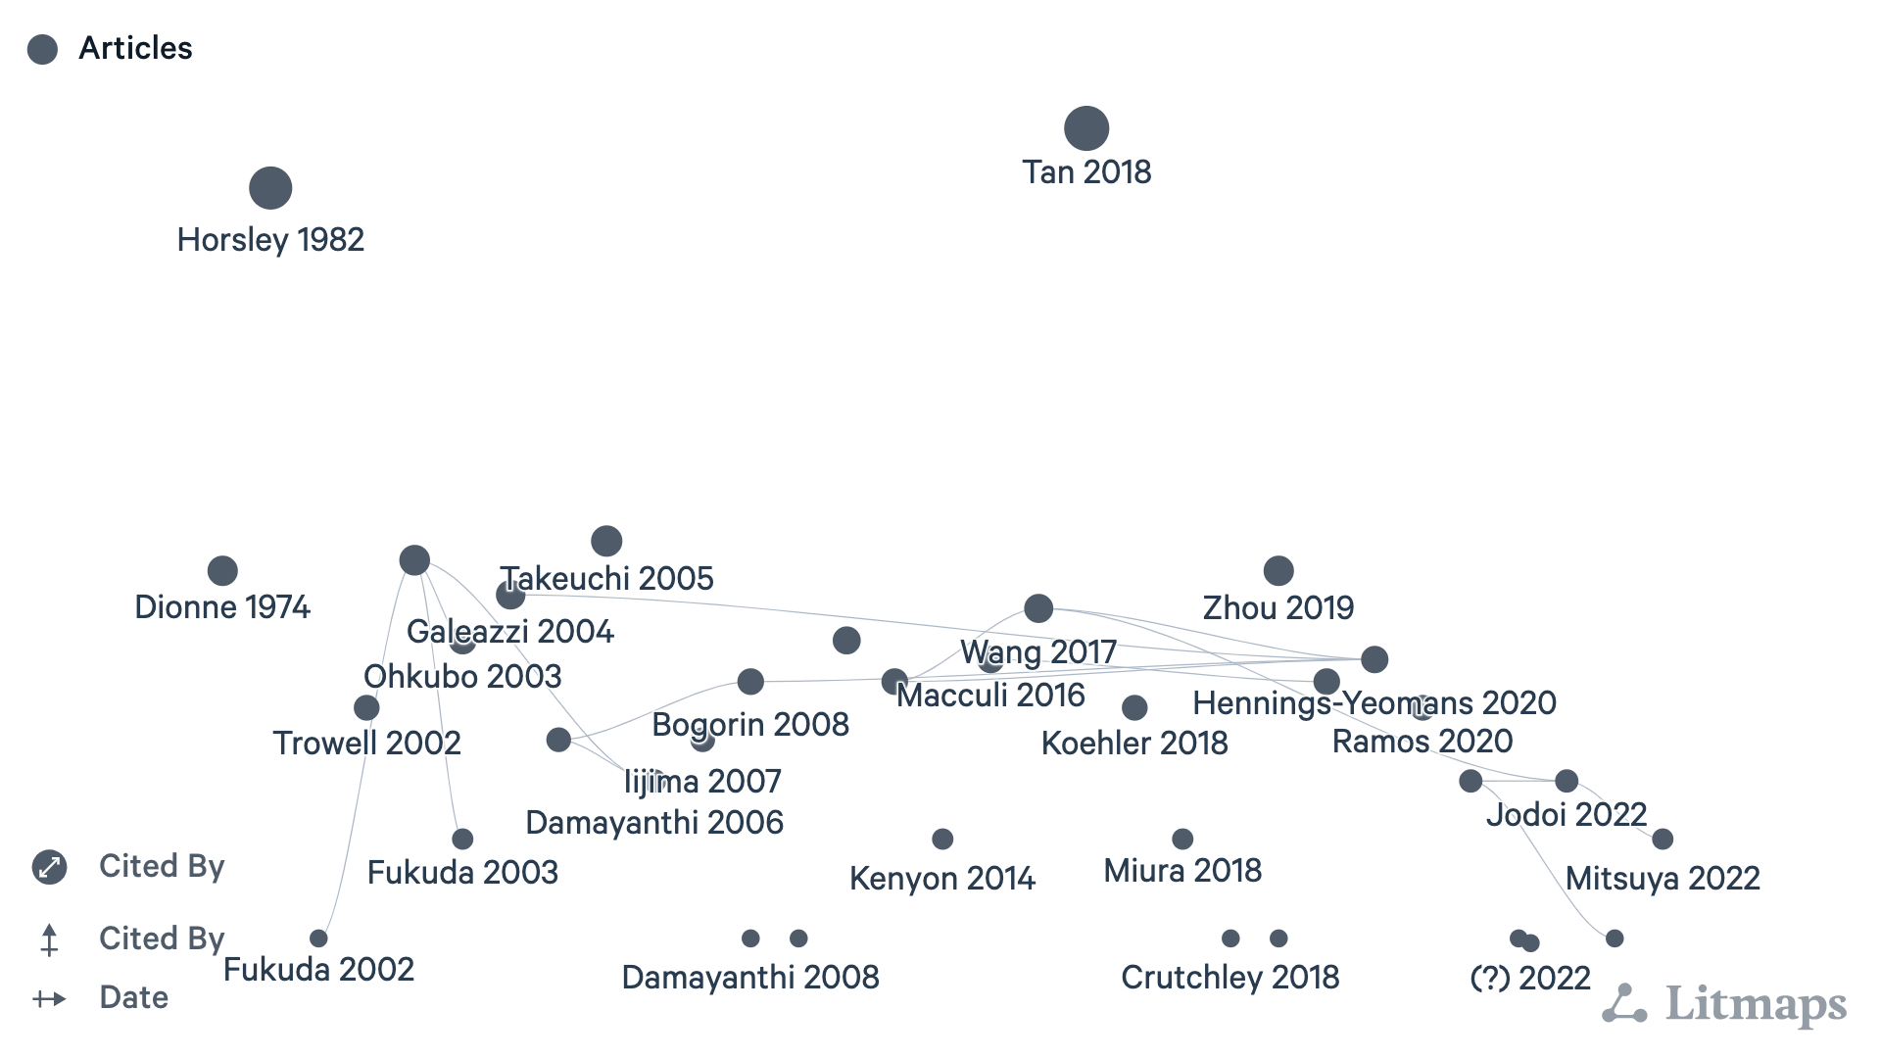
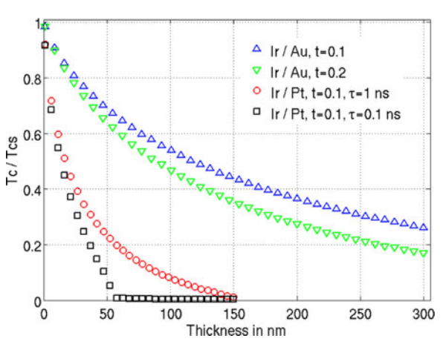
An Iridium-Platinum Bilayer Device: Why Ir-Pt?
Ir-Pt Bilayer:
Tuneable T_{c} (proximity effect)
Reproducibility
T_{c} suppression:
High performance (as we will see!), hits requirements for single photon applications
Already beginning to be more widely used
[2] G. Wang et al. (2017)
Notes:
Multilayer systems: superconductor + normal metal composite. Layers are thinner than the SC coherence length, composite film has reduced Tc compared with the SC film

Slide 9
Performance and Results
Can we achieve competitive single photon detectors with excellent energy resolution using IrPt? (Spoiler: Yes!)

Slide 10
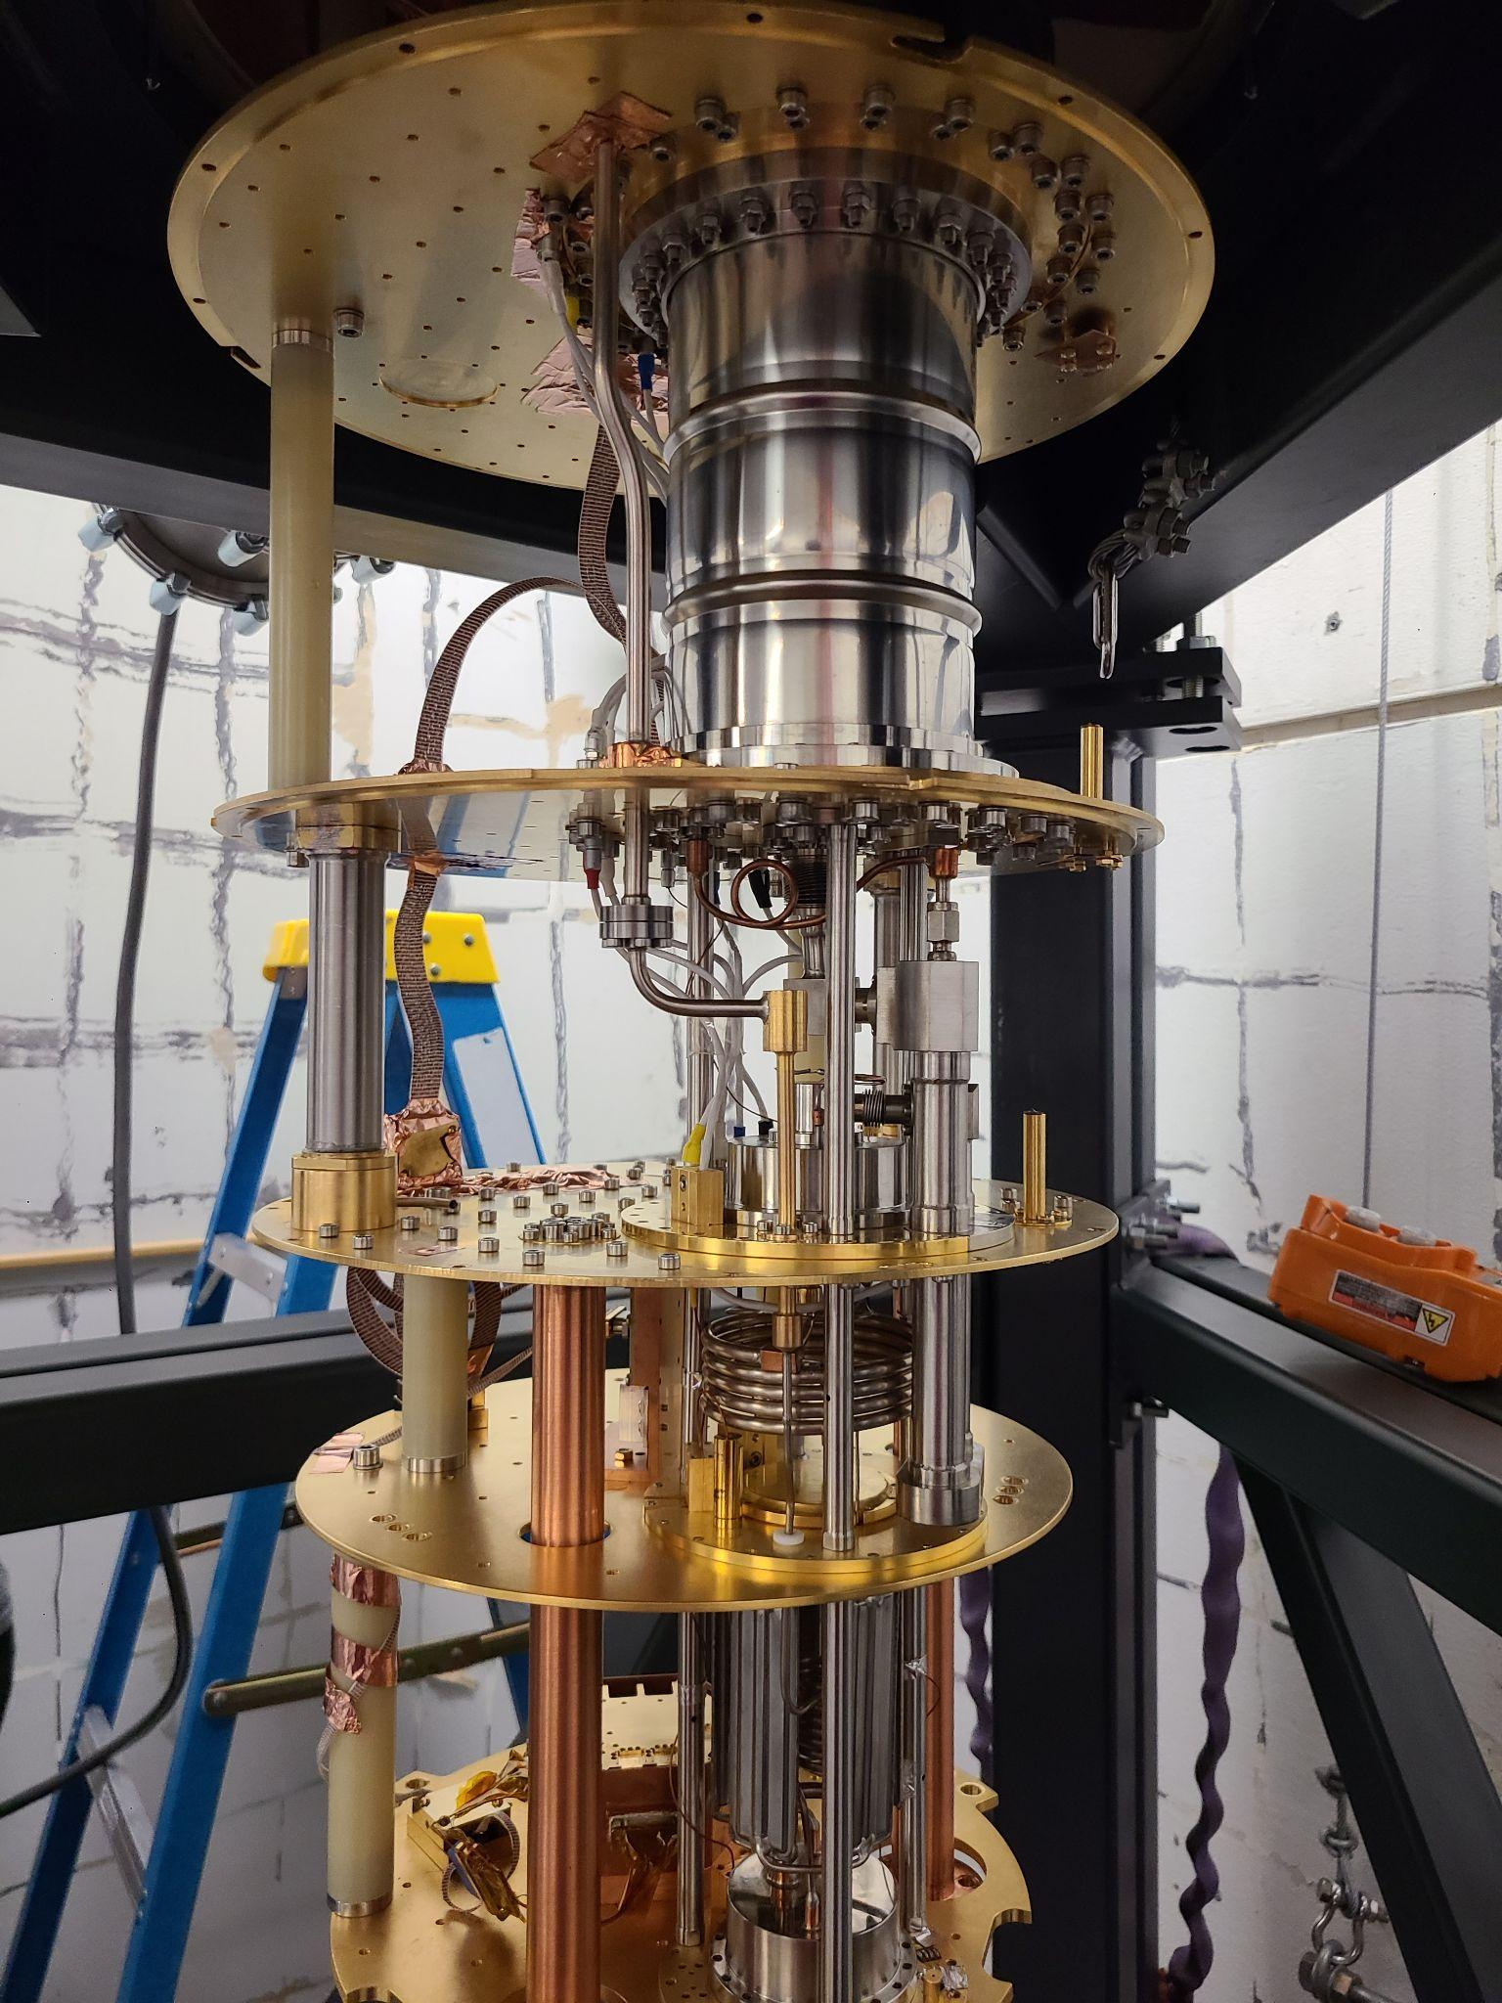
Setup
Two devices of different sizes on single wafer (Correlated noise studies!)
Fab at Argonne National Laboratory^{[5]} (see: initial thermal studies at ANL)
T_{c} tuned at 74-76 mK
Device characterization at UC Berkeley Pyle Lab in a CryoConcept fridge at base 6mK
Big and small devices

Slide 11
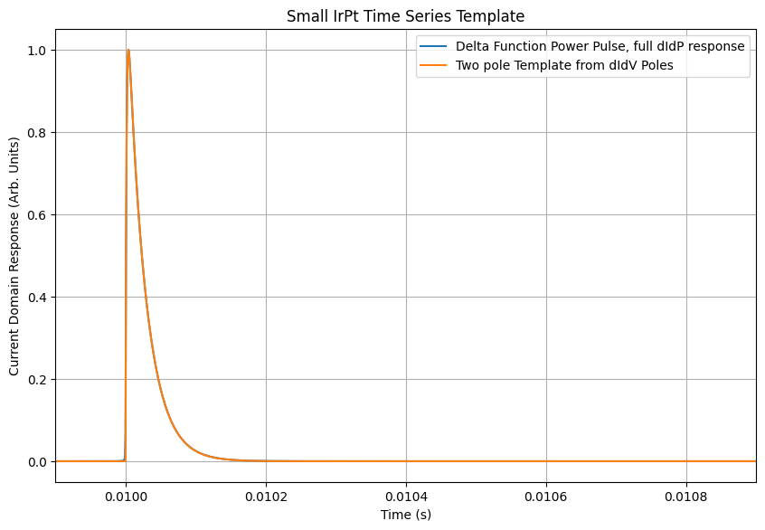
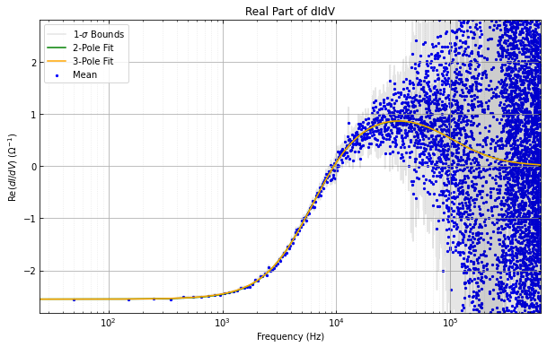
Device Characteristics: Quick and Dirty Overview
For a more in depth breakdown of our characterization flow see my poster from LTD20!
DC Characteristics
AC Characteristics
Noise Modeling
Feature extraction from OF, analysis
I_{TES} v I_{bias} for static parameters. Helps us build the next step.
dIdV: device response to an impulse. Builds the template we will use to do Optimum Filtering (OF)
Preliminary estimate of energy resolution + backgrounds (start getting excited)
Energy resolution of devices from continuous random data!

Slide 12
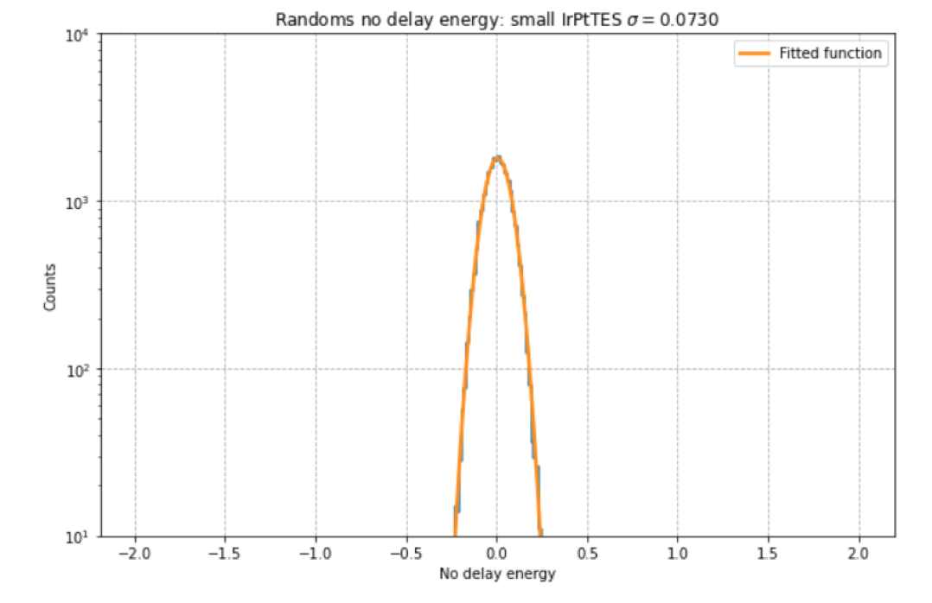
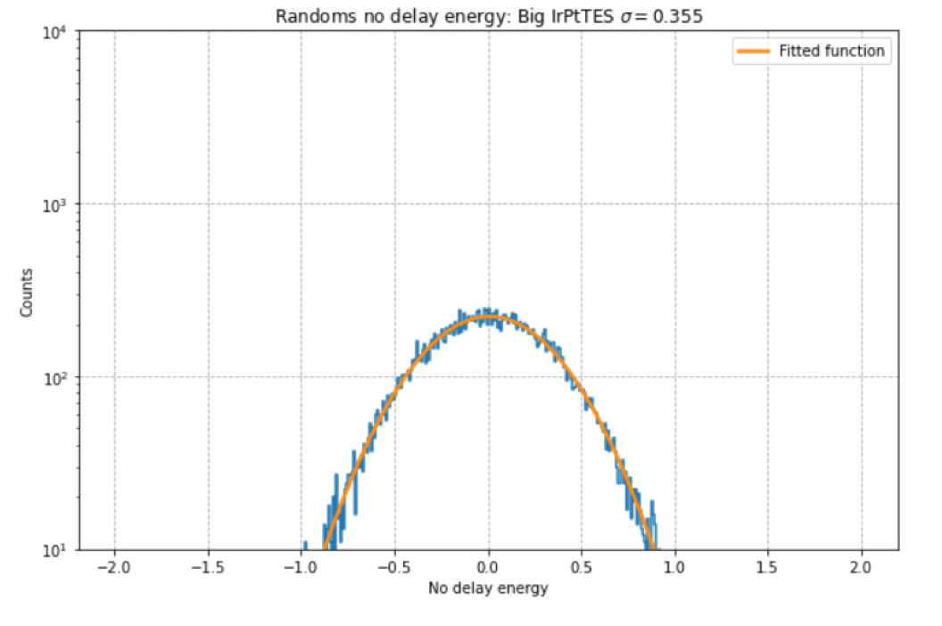
IrPt Bilayer: Energy Thresholds
The big cheese: energy baseline resolution from randoms (4𝞼 trigger)
𝞼_{E}= 73 meV

Slide 13
IrPt Bilayer: sub-eV threshold
Sub-eV baseline energy resolution in context
W and Ti are not the only ways to make competitive single photon sensitive devices
LEE fundamentally limits us below 200 eV
Alternatives should be explored!
Relative performance of single photon TES’s
TES | T_{c} (mK) | V_{TES}(um³) | 𝛔_{E}(meV)
Ti | 50 | 0.13 | 47
TiAu | 106 | 90 | 48
MoCu | 110 | 2000 | 295
W | 125 | 22 | 120
IrPt | 74 | 7500 | 73 (preliminary)
[4] C.W. Fink et al. (2020)
Notes:
With volume correction: sigma_E / Sqrt(V_TES). C and G depend linearly on TES volume. Sigma_E ^2 goes as Volume*Tc^3 in the non athermal case (Tc is higher in the athermal case since minimization occurs when phonons bounce for a long time). Heat capacity and volume are proportional in normal metals and entirely due to electrons. SC has both phonon and electrical contributions but generally at Tc heat capacity is like 2 times the normal metal value. C is actually measured by complex impedance.

Slide 14
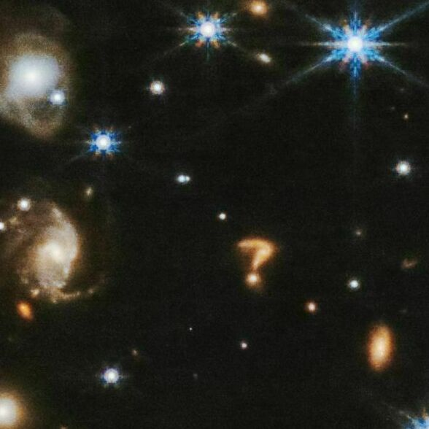
Mysteries in the Data
Fantastic energy resolution! But…
Courtesy of NASA, ESA, CSA, J. DePasquale: The James Webb ? galactic merger

Slide 15
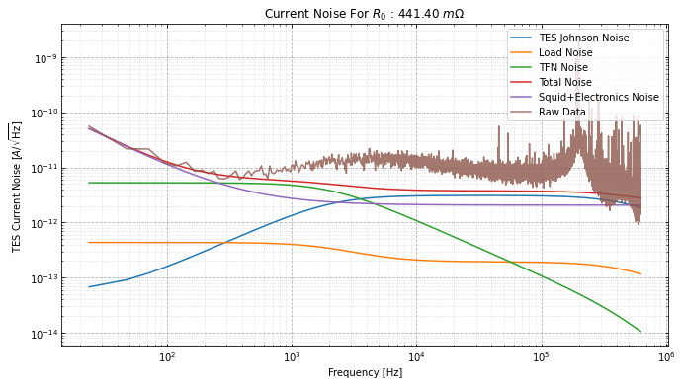
Big IrPt TES: Issues
Current noise for the big device at the bias point
Energy threshold of big TES was only 355 meV
Means we can’t properly analyze events across both devices (recall our amazing 73 meV small TES threshold)
Excess broadband noise
Current Noise [A/√Hz]
Frequency [Hz]

Slide 16
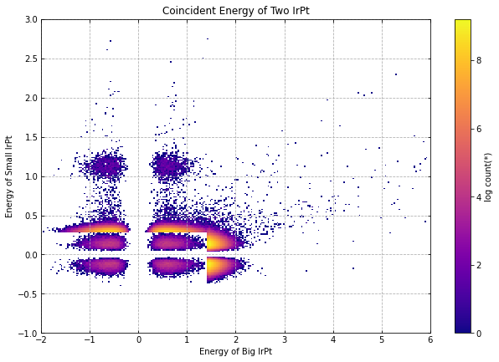
Unknown “Blob” on Small Device
Big v Small Device Energies
Can’t check if coincident (big TES threshold too high)
Further analysis confirms these are real events (random in time, normal pulse shape)
Not from stress: single energy, not a continuum
So…. what is it?
[meV]
Weird blob
Small TES energy [meV]
Randoms
Threshold
Big TES energy [meV]

Slide 17
Blob Possibilities
IR leak
Poisoning from FR4 board scintillation internal to the device housing
Something else?
These are both solved now after our most recent hardware upgrades!

Slide 18
Final Thoughts

Slide 19
Food for Thought
Bilayer IrPt TES devices are promising low-energy devices with excellent energy thresholds (𝞼_{E}= 73 meV )
Recent hardware improvements at our UC Berkeley Lab motivate our intentions to do a Dark Matter search with these devices! (At even lower T_{C})
Stress problems (LEE) encourage device ingenuity and forays into new materials and methods
Further study is needed to investigate!
We do not have to stick with W!
Potential new backgrounds? (Blob)

Slide 20
Thank You!
TESSERACT
Visit us at: https://tesseract.lbl.gov/

Slide 21
References
[1]Adari, Prakruth et al. “EXCESS workshop: Descriptions of rising low-energy spectra.” (2022).
[2]G. Wang et al., "Modeling Iridium-Based Trilayer and Bilayer Transition-Edge Sensors," in IEEE Transactions on Applied Superconductivity, vol. 27, no. 4, pp. 1-5, June 2017, Art no. 2100405, doi: 10.1109/TASC.2016.2646373.
[3]Irwin, Kent D. and G. C. Hilton. “Transition-Edge Sensors.” (2005).
[4]Fink, C. etal., Characterizing TES power noise for future single optical-phonon and infrared-photon detectors. AIP Advances. 10. 085221. 10.1063/5.0011130. (2020).
[5]Zhang, J., Chang, C.L., Fujikawa, B. et al. Characterization of the Thermal Properties of Ir/Pt Bilayer Transition Edge Sensors. J Low Temp Phys 210, 194–208 (2023)

Slide 22
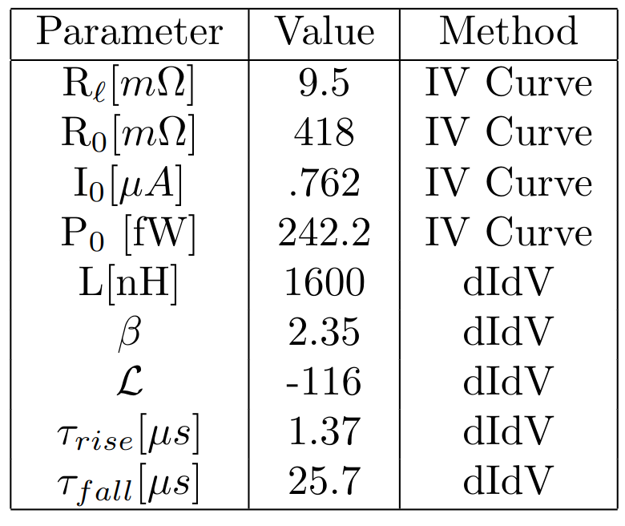
Small TES

Slide 23
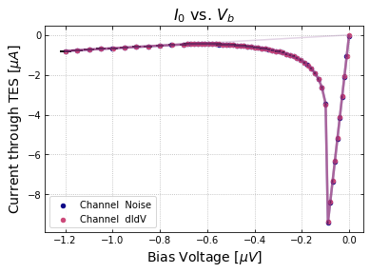
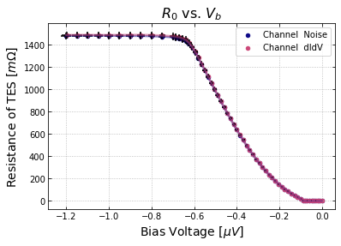
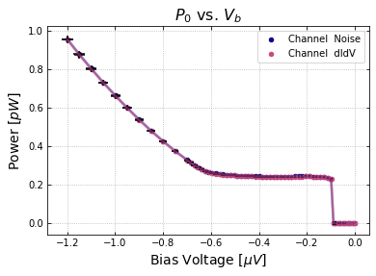
Small TES

Slide 24
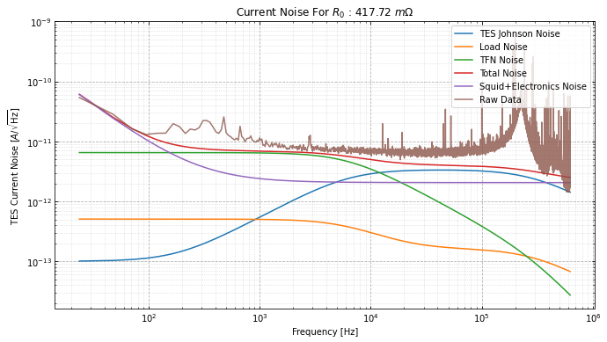
Small TES

Slide 25
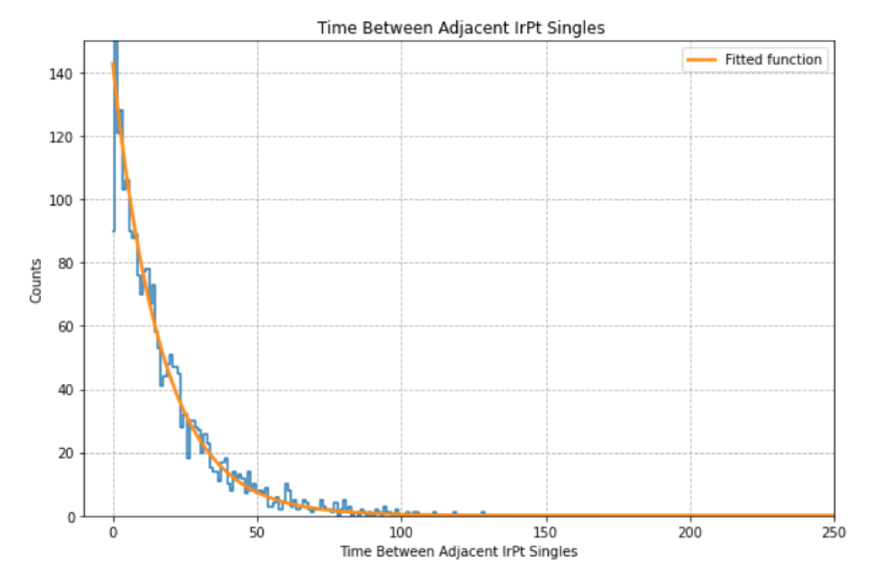
Small TES blob population time since last event

Slide 26
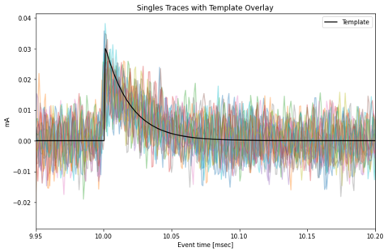
Small TES blob population actual traces

Slide 27
