Slide 1
A Cryogenic Witness Detector for Low-Energy Neutron Backgrounds
A.N. Villano
University of Colorado Denver

Slide 2
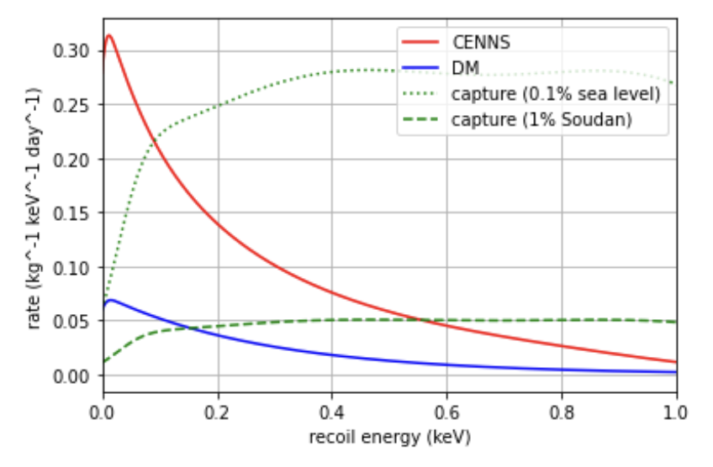
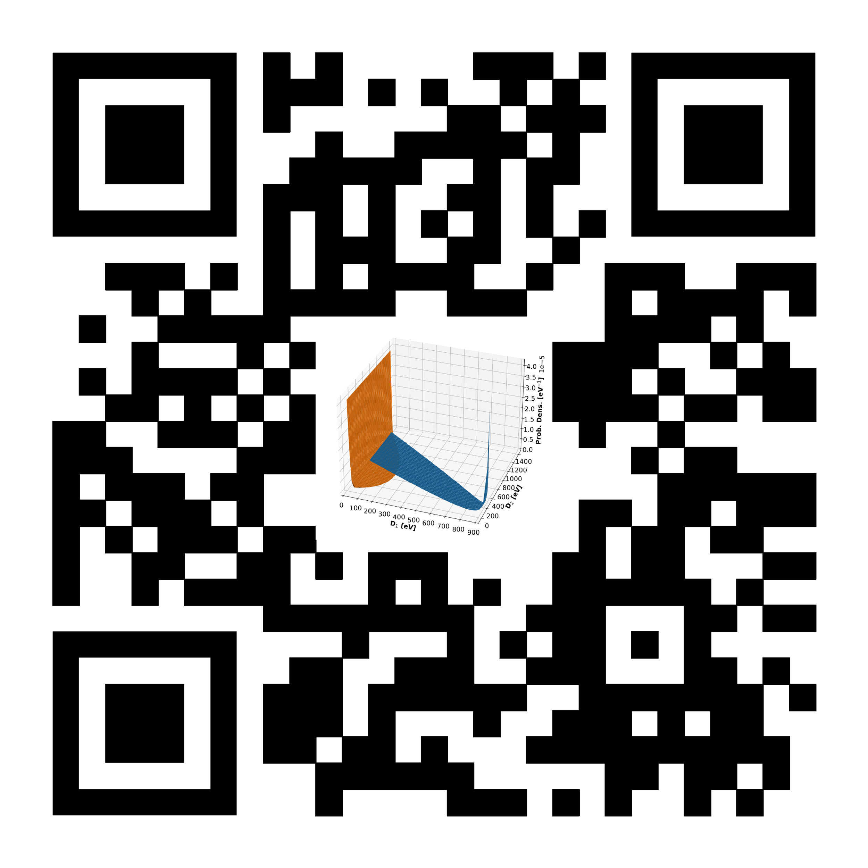
Neutrons are (still) DM Backgrounds
Thermal neutrons (which predominately create captures) have been traditionally not important b/c their backgrounds are very low energy. Now, they are because of the low-energy reach of new detectors.
Also: neutrons in the energy range 1 keV – 1 MeV will quickly create thermal fluxes and have their own impact in this energy range via elastic scattering.
K. Harris; A. Gevorgian; A.J Biffl, A.N. Villano ; Physical Review D (PRD) 107 076026 (2023)
https://journals.aps.org/prd/abstract/10.1103/PhysRevD.107.076026

Slide 3
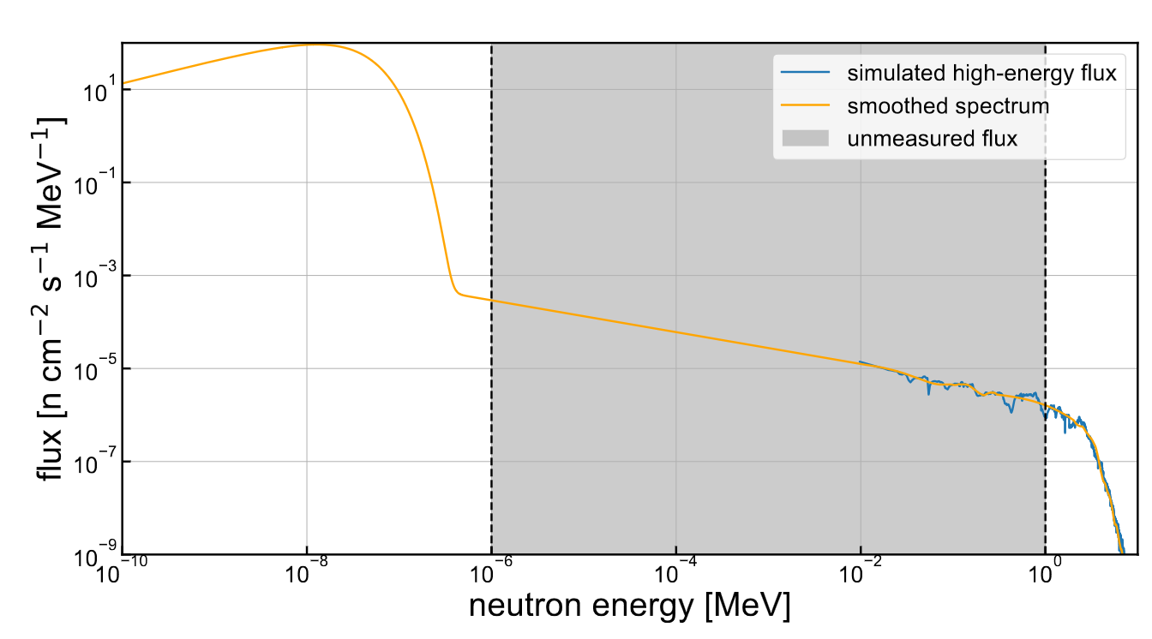
Neutron Backgrounds Underground: SNOLAB
One of the lowest-flux environments for neutrons is the SNOLAB underground lab
Only the thermal neutron flux and “fast” neutron flux (> 1 MeV) are measured
Villano, A.N.; Journal of Low Temperature Physics (LTD20); under review

Slide 4
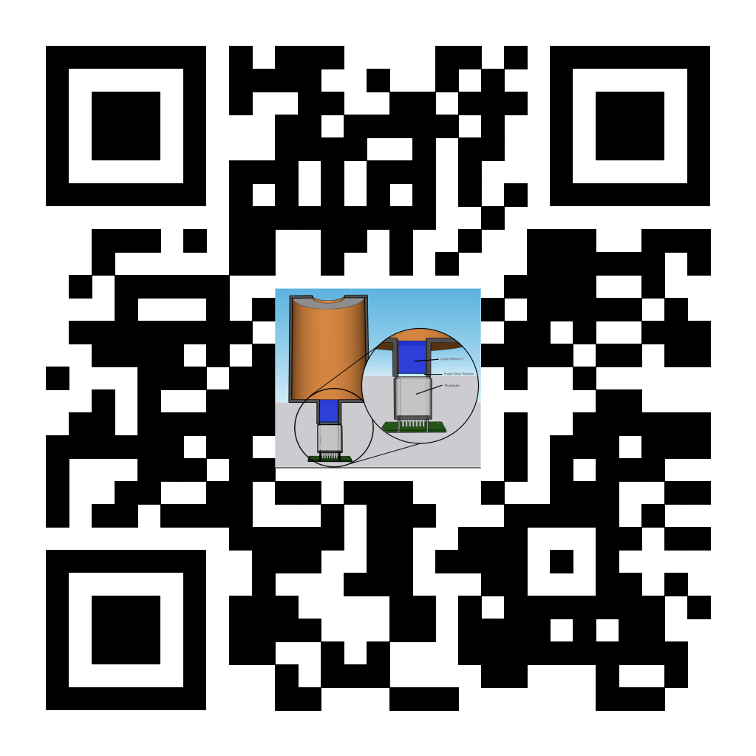
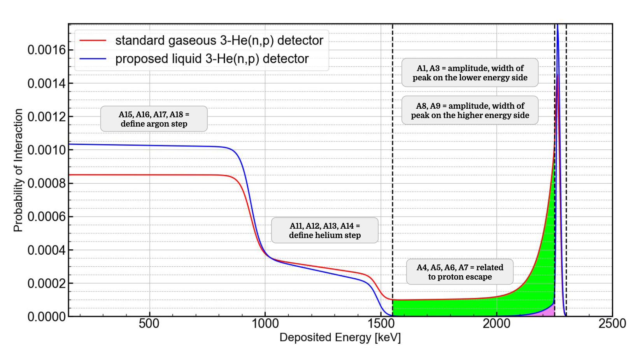
³He Detectors: Used for Decades
Gaseous ³He detectors have been used for many years to detect neutrons for two main reasons:
The process ³He(n,p) has a high cross section and;
Displays a mono-energetic peak that maps directly to the incoming neutron energy
Partial Pressure 2.5 atm; balance filled w/ Argon
Sharbaugh, A.E., Jones, L., Villano, A.N.; Journal of Undergraduate Reports in Physics (JURP); in press
https://arxiv.org/abs/2305.00145

Slide 5
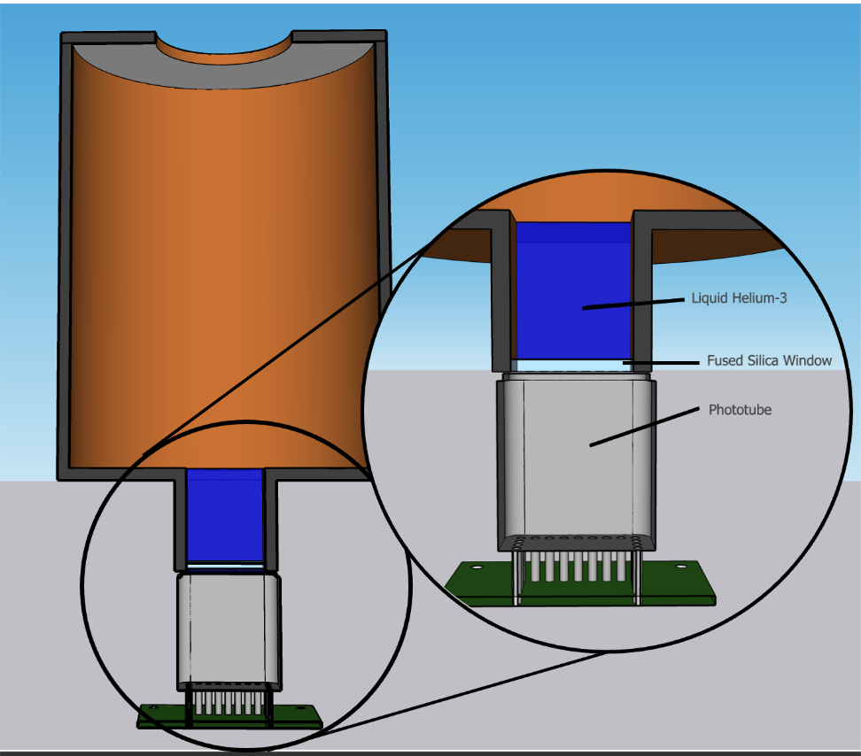
³He Detectors: Liquid Design
SPICE/HeRALD collaboration demonstrated phototube readout (see: Phys. Rev. D 105 092005 (2022))
Density boost of ³He is between a factor of 64 – 107x compared to gas detectors of 4—10 atm partial pressure
Hermetic design with copper vessel shown at right; copper is important for background mitigation (see later slides)
Sharbaugh, A.E., Jones, L., Villano, A.N.; Journal of Undergraduate Reports in Physics (JURP); in press
https://arxiv.org/abs/2305.00145

Slide 6
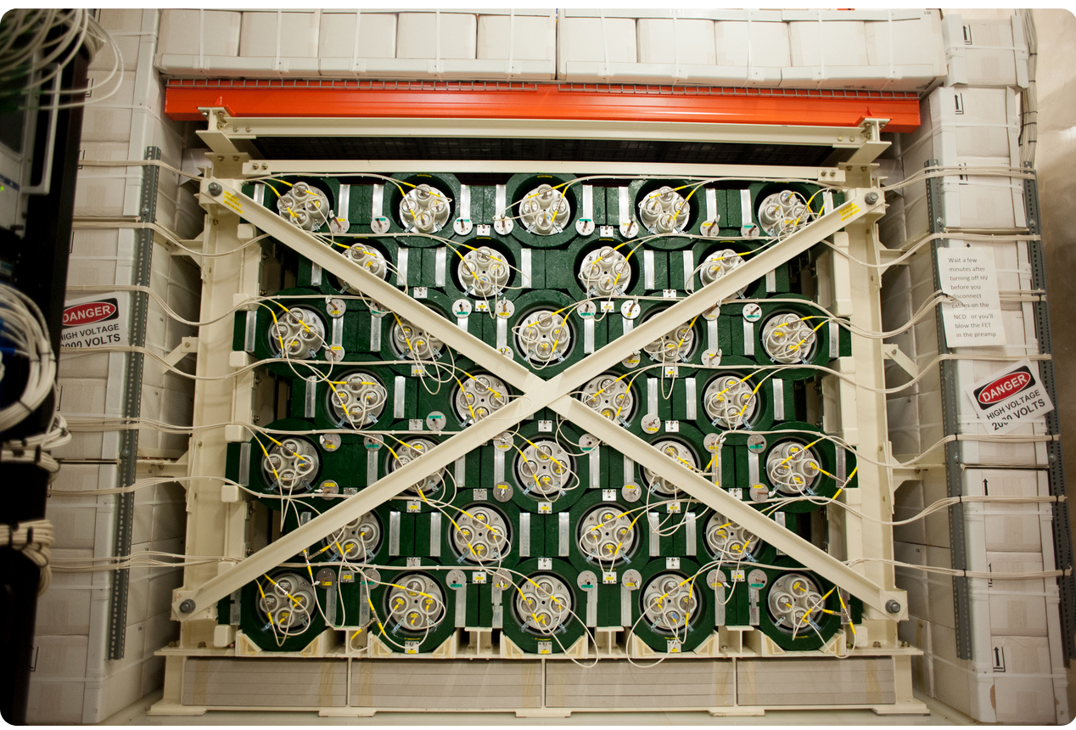
Gaseous ³He Performance: HALO @ SNOLAB
Compare to HALO detector at SNOLAB: 0.75 m³ of ³He gas at 2.5 atm partial pressure
Very low neutron flux environment.
In 1 year of running will reach 11,000 neutron counts in the 1 keV and above region but will also have around 140,000 alpha background events from surfaces
These tubes are probably the lowest background available with 1 ppt thorium contamination (see NIMA 449(1) p 172 (2000))
Villano, A.N.; Journal of Low Temperature Physics (LTD20); under review

Slide 7
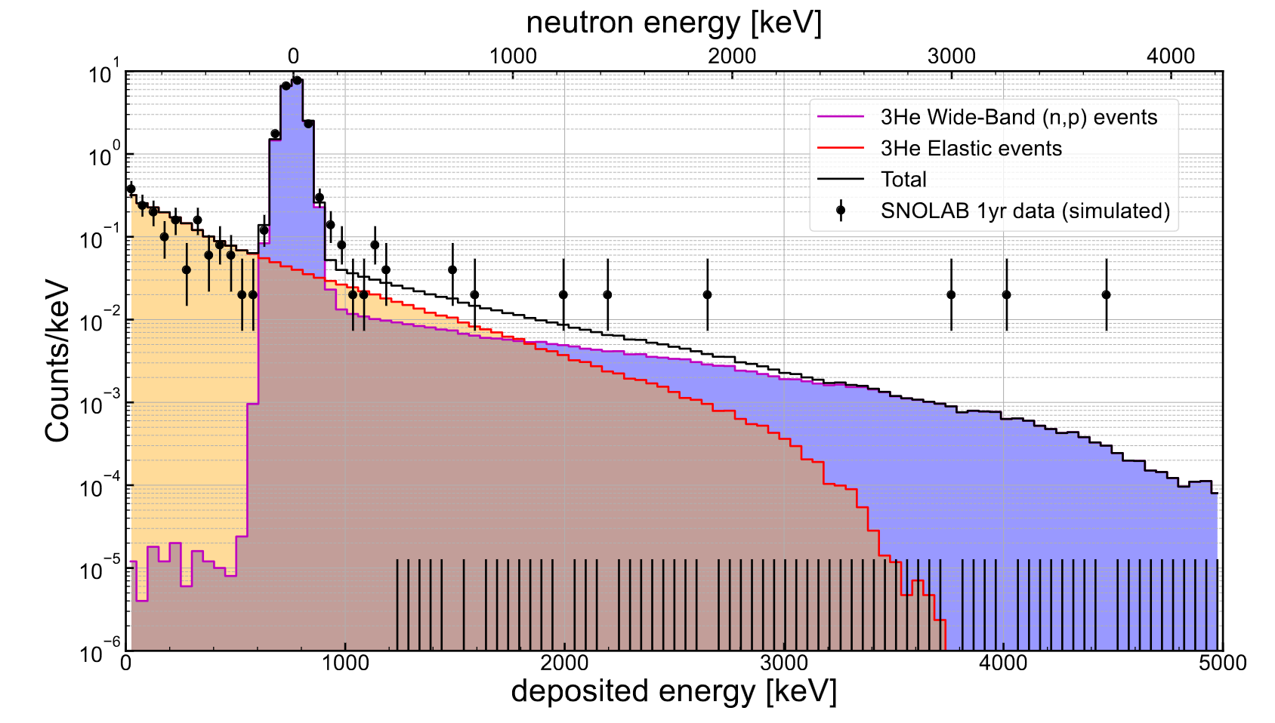
Liquid ³He: 8 cm³ @ SNOLAB
Same very low neutron flux environment as HALO
Only 30 total neutron events over 1 yr of running in the region 1 keV—1 MeV compared to 11,000
…BUT…
Small volume can be integrated into or near other detectors; including deep cryogenic ones as a witness
Expect ~ 100 bknd alpha events dominated by PMT (might be able to remove)
Sharbaugh, A.E., Jones, L., Villano, A.N.; Journal of Undergraduate Reports in Physics (JURP); in press
https://arxiv.org/abs/2305.00145

Slide 8
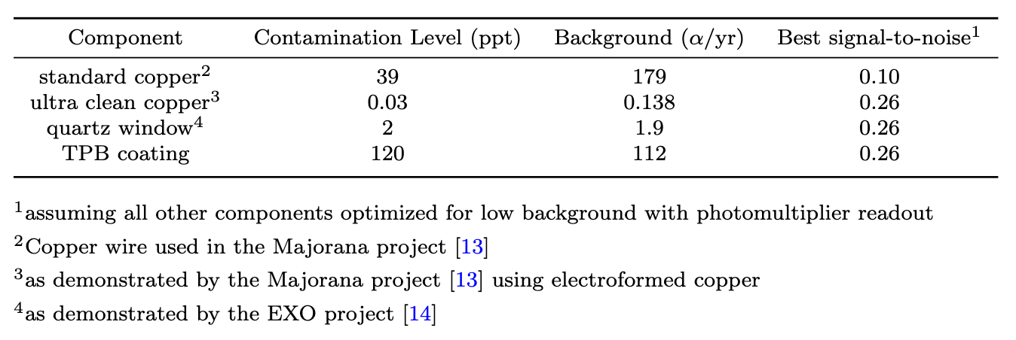
Liquid ³He Performance: Background Budget
Alpha backgrounds from surface are dominant, other ambient gammas or (α,n) from detector less important
Use low-background copper
If modifications can be done to remove PMT readout (maybe with TES or MKID detector coupled to silicon substrate inside the hermetic volume), then we can have signal-to-noise of around 217 for this detector
Large, PMT-related backgrounds
Villano, A.N.; Journal of Low Temperature Physics (LTD20); under review

Slide 9
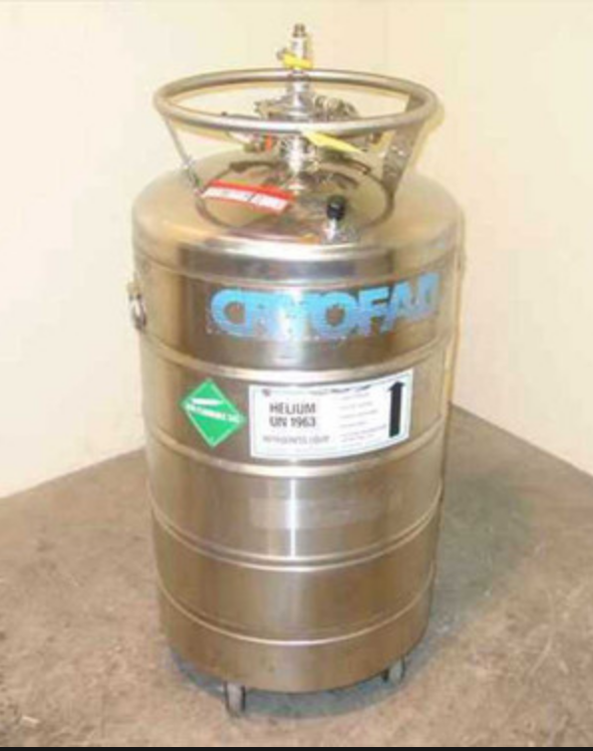
Prototype Design:
Build a low-cost L⁴He prototype on a 2” KF-50 dipstick and put into LHe Dewar
Test for scintillation yield with neutrons and gammas—
Design a ³He system to keep detector volume on a closed cycle; can pump on Dewar volume to reach lower temperatures for ³He liquification
Test with neutrons of reasonable between 10 keV and 1 MeV; can use neutron beam such as at Notre Dame
Re-design the detector volume with clean copper for deployment as a low-flux detector
Possible re-design without PMT

Slide 10
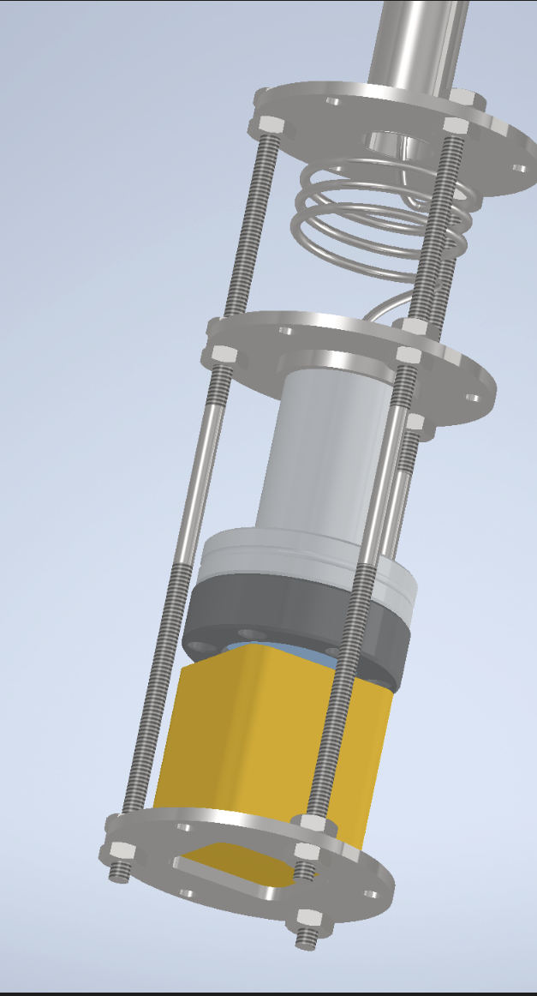
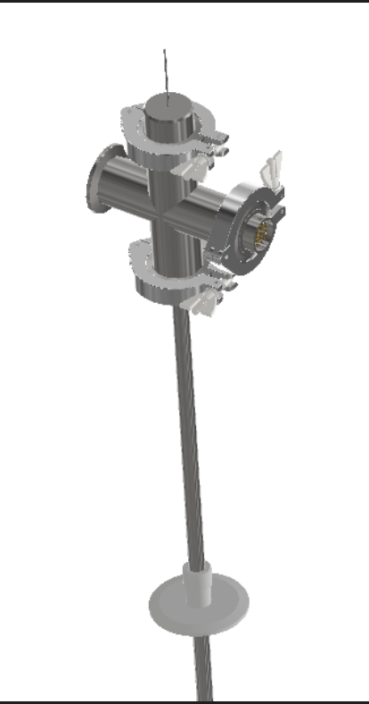
Initial ⁴He Design and Costs
Cold End: Design by Weijun Yao @ ORNL
Simple initial design for liquid ⁴He using mostly off-the-shelf parts and a capillary tube to a small LHe volume
Read out with a Hamamatsu 2 cm x 2 cm square PMT through a quartz window
TPB coating as a LHe wavelength shifter
About $30k including 1 extra PMT and electronics and ~ $11k of LHe
$11k of LHe is for 10 60L Dewars which last around 10—15 days of running each (unless include boiloff mitigation).
Warm End: Design by Weijun Yao @ ORNL

Slide 11
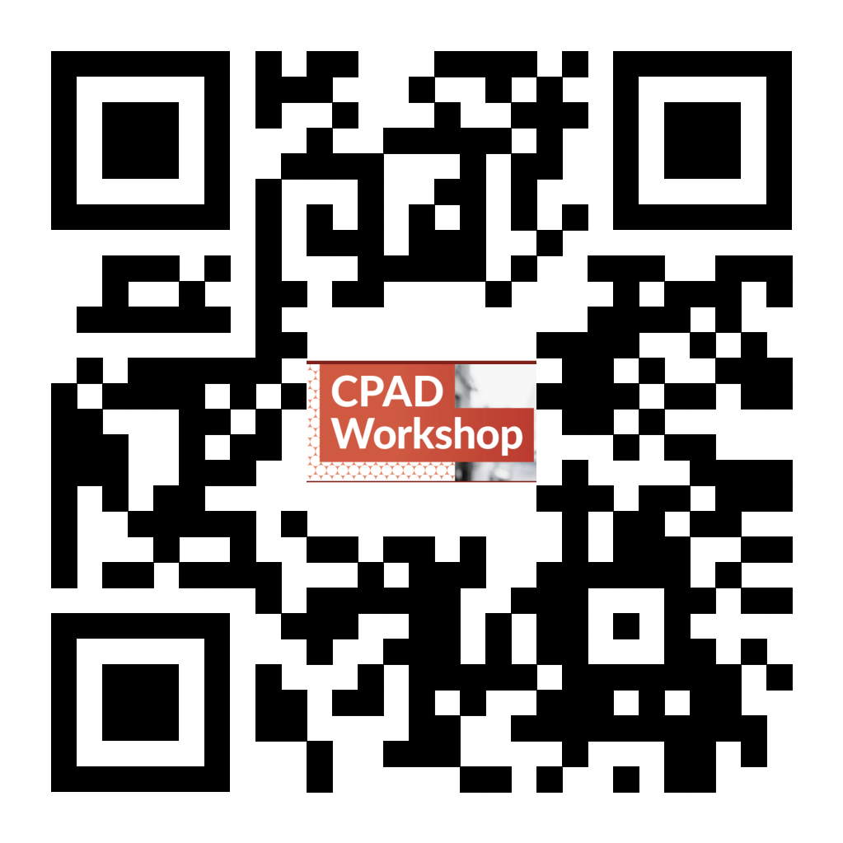
Summary
Backgrounds from neutron energies that have traditionally been overlooked are important now! All the way from 1 MeV to thermal energies
It’s hard to get a precise measurement of flux there; best bet is to use the ³He(n,p) process
Liquid ³He detectors can offer advantages in compactness, and radiopurity
Prototyping is underway
See QR code for talk slides

