Slide 1
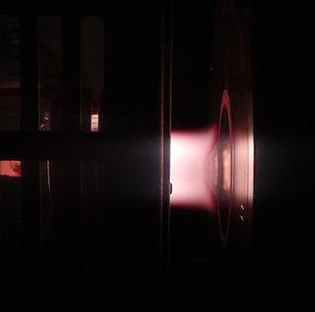
An ICP-MS based monitoring methodology to inform dust radioactive backgrounds on detector materials
Maria Laura di Vacri
S. Scorza, A. French, N.D Rocco,
T.D. Schlieder, I.J. Arnquist, E.W Hoppe, J. Hall

Slide 2
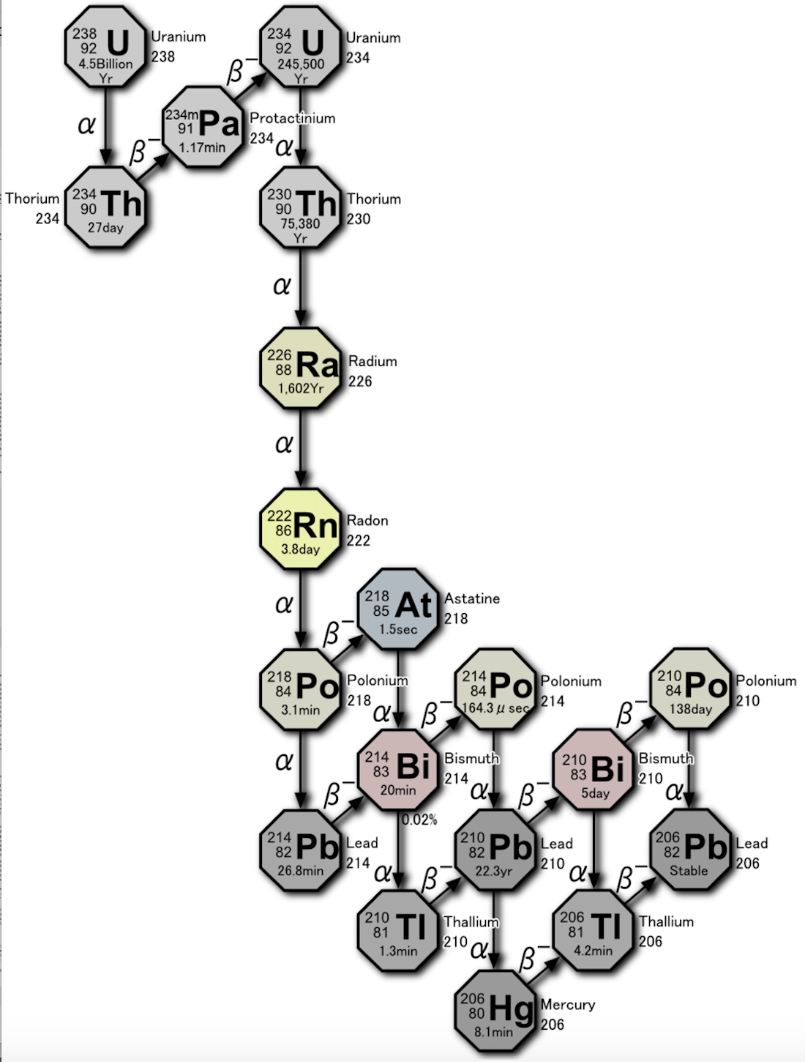
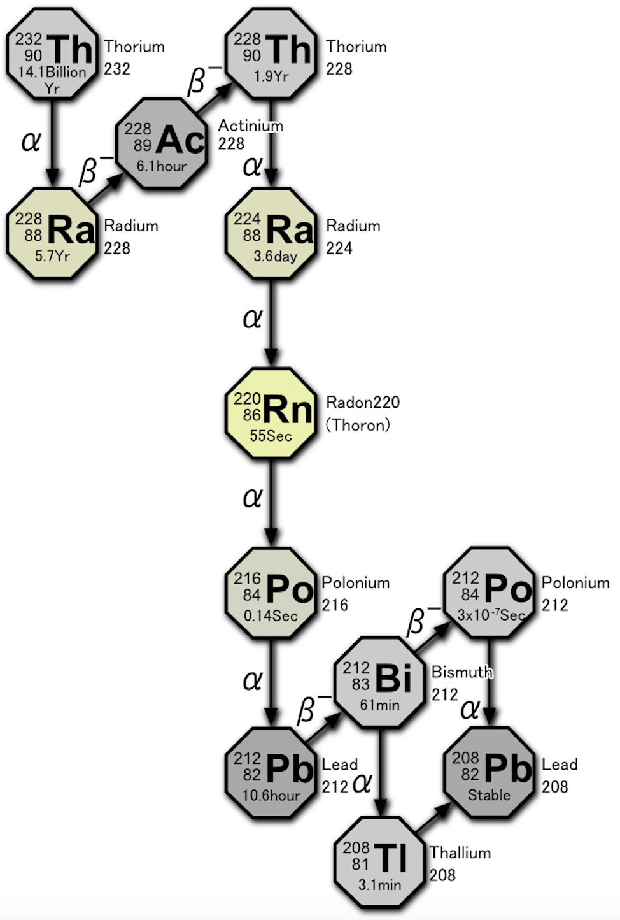
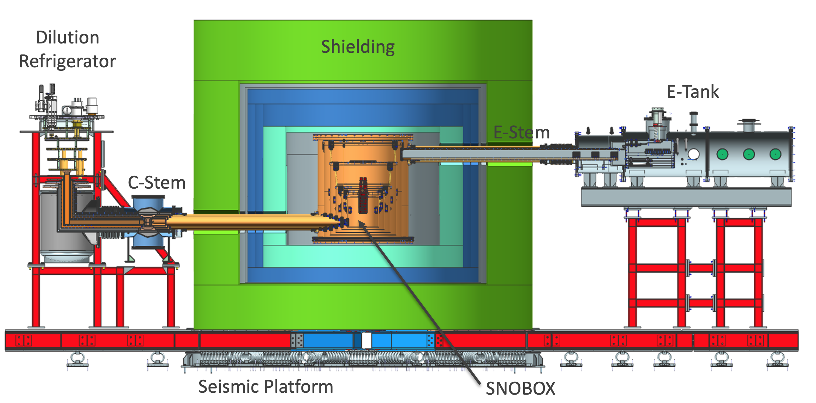
Background mitigation in ultrasensitive detectors
Underground facilities and detector shielding
Ultrapure material sourcing
Uranium-238
Thorium-232
SuperCDMS detector
Images from
By Tosaka - Own work, CC BY 3.0, https://commons.wikimedia.org/w/index.php?curid=5531106

Slide 3
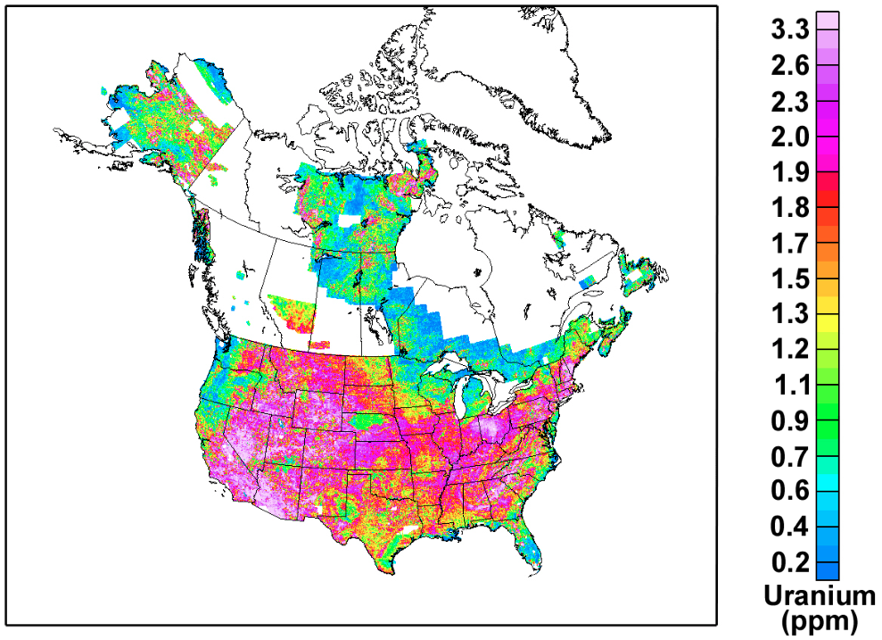
The challenge
Material radiopurity requirements ≈ μBq/kg
Bq/kg from Th, U, K
Sourcing
Selection
Ultrasensitive analytical methods
Contamination
Handling
Exposure: DUST
Even more problematic in underground facilities
https://pubs.usgs.gov/of/2005/1413/maps.htm
1 ppt Th = 4.1 μBq ²³²Th/kg
1 ppt U =12.4 μBq ²³⁸U/kg
1 ppb ^{nat}K = 30.5 μBq ⁴⁰K/kg
11/08/2023

Slide 4
Dust background monitoring
X-ray fluorescence (XRF) analysis for Th and U proxy elements (e.g., Ca and Fe)
Optical and fluorescence microscopy analysis
Backgrounds predicted based on dust fallout models and assumed composition
Boger, Jea, et al. "The Sudbury neutrino observatory." Nuclear Instruments and Methods in Physics Research Section A: Accelerators, Spectrometers, Detectors and Associated Equipment 449.1-2 (2000): 172-207
Akerib, D. S., et al. "The LUX-ZEPLIN (LZ) radioactivity and cleanliness control programs." The European Physical Journal C 80 (2020): 1-52.

Slide 5
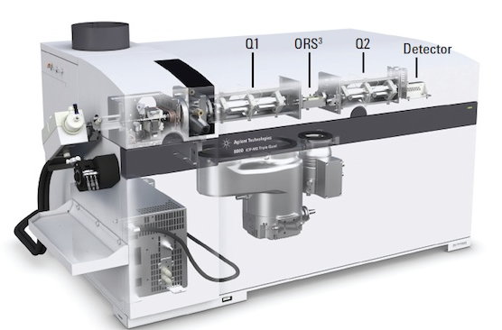
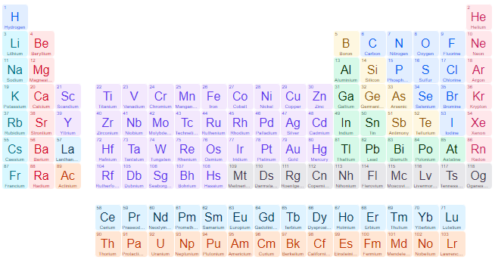
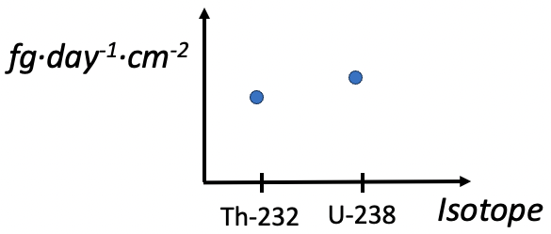
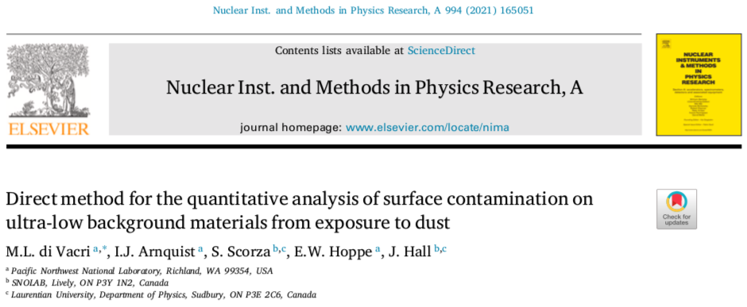
Direct, ICP-MS based method
3. Determination of stable elements and long-lived radionuclides
1. Dust sample collection on low-background vials
2. Dissolution and analysis on a triple quadrupole inductively coupled plasma mass spectrometer (ICP-MS, Agilent Technologies)
4. Determination of fallout rates contaminant/surface/time
Sensitivity on ²³²Th and ²³⁸U (30-day collection, class ≈1000 cleanroom)
10⁻³ fg·day⁻¹·cm⁻², or 10⁻⁸ μBq·day⁻¹·cm⁻²

Slide 6
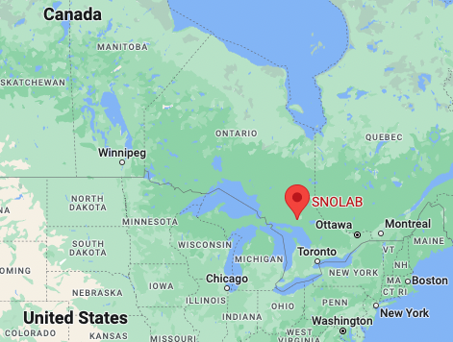
The SNOLAB facility
A ≈ 5000 m² class-2000 cleanroom
2 km underground, in the working Creighton nickel mine (operated by Vale Ltd.)
Hosting neutrino and dark matter experiments
Dust control is crucial

Slide 7
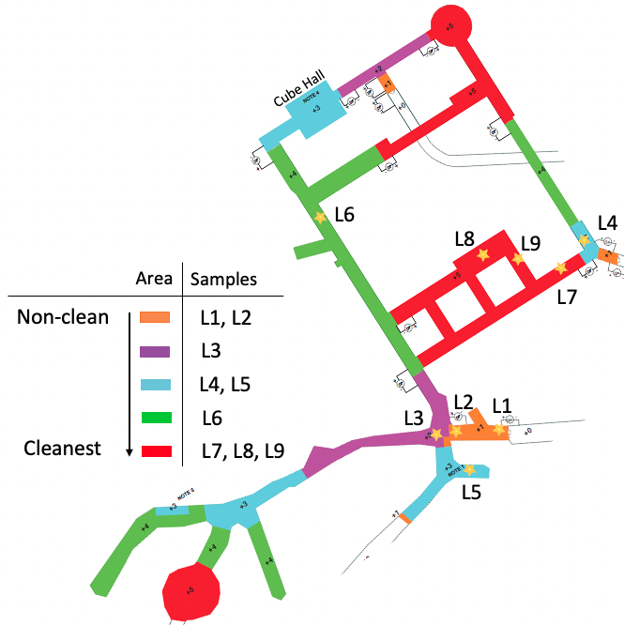
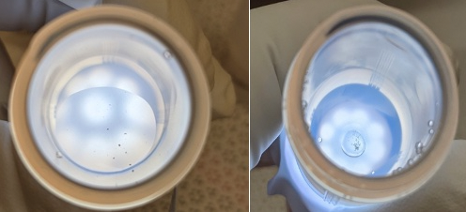
Evaluation of SNOLAB mitigation procedures
Tracers for dust from mine and local rock*
Relevant to low-background detectors
2-4 replicates per location
Visible particulate found in some of the replicates
*I. Lawson, Analysis of rock samples from the new laboratory, STR-2007-003 SNOLAB technical report (2007)
L9
L2

Slide 8
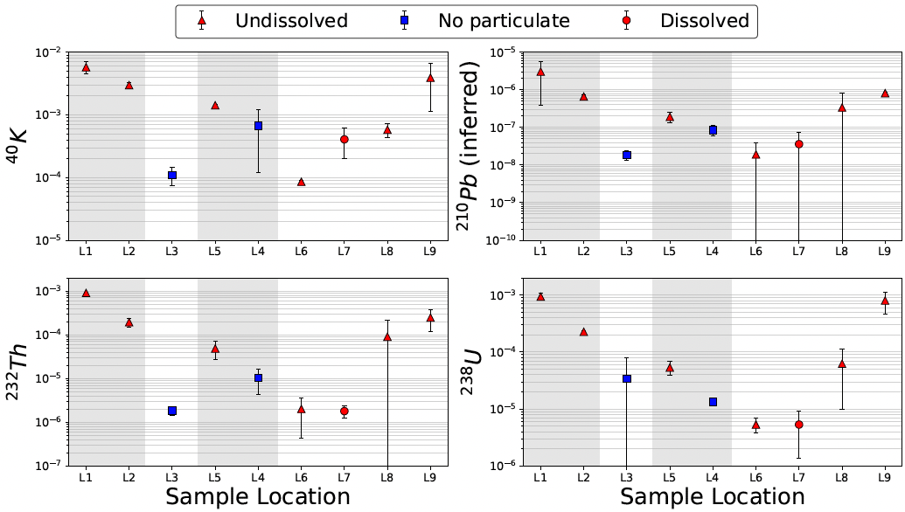
Results
Radionuclides of concern [μBq•day⁻¹•cm⁻²]
A reference value for Pb specific activity from ²¹⁰Pb (200 Bq·kg⁻¹*) was used to infer ²¹⁰Pb fallout rate
Shaded areas refer to locations that are not maintained at cleanroom levels
*Alessandrello, A., et al. Nuclear Instruments and Methods in Physics Research Section B: Beam Interactions with Materials and Atoms 142.1-2 (1998): 163-172.

Slide 9
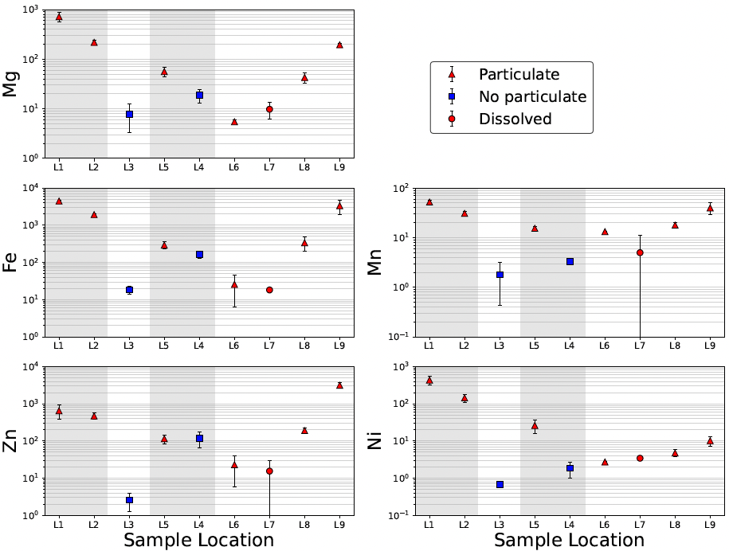
Results
Tracers for rock and mine dust [pg•day⁻¹•cm⁻²]
Mine dust tracer
Shaded areas refer to locations that are not maintained at cleanroom levels

Slide 10
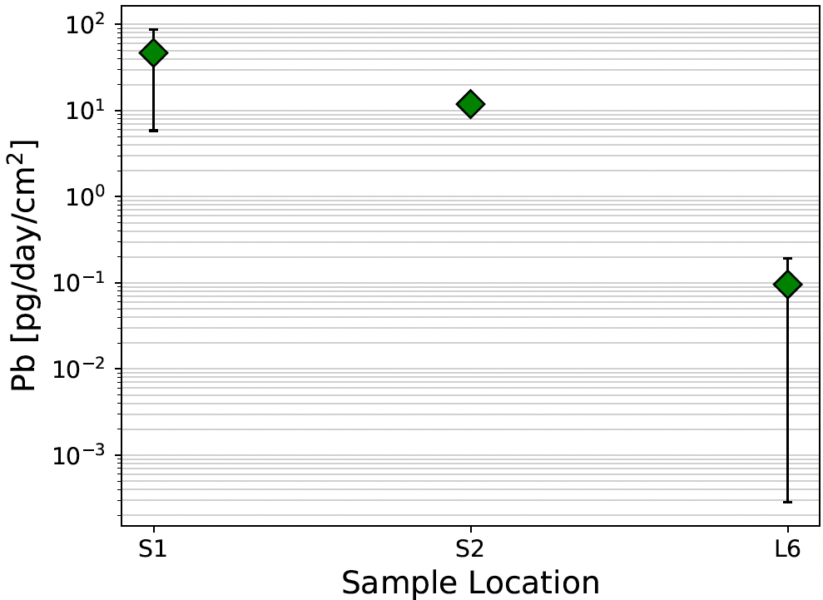
Results
Monitoring location L6 during construction of a Pb shield
S1, S2 → Two locations around the Pb shield assembly area
L6 → Data collected while no Pb was being handled
Fallout rate increased by two to three orders of magnitude
HPGe measured ²¹⁰Pb in the material: (4.2 ± 1.0) Bq·kg⁻¹*
²¹⁰Pb fallout rate from the handled material [μBq·day⁻¹·cm⁻²]:
S1: (2.0 ± 1.8)x10⁻¹⁰
S2: (5.0 ± 1.3)x10⁻¹¹
Error bar hidden by marker in S2
* p-type Canberra Well Detector, 46 keV line, ≈50g sample

Slide 11
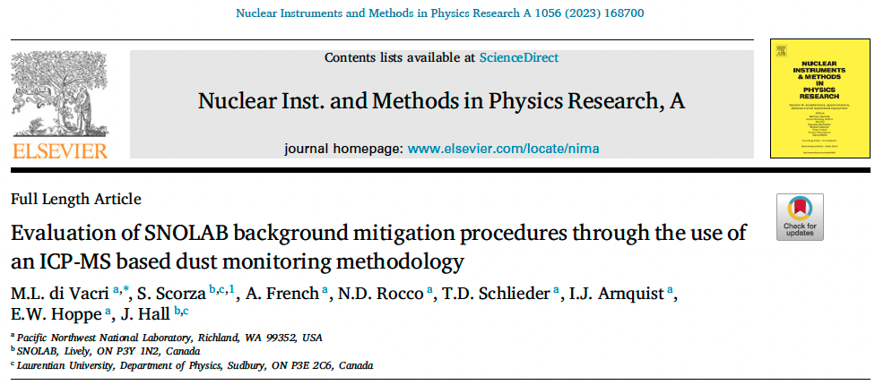
Conclusions
This study demonstrated:
The ICP-MS based method as an effective tool to inform dust backgrounds and evaluate mitigation procedures
The efficacy of mitigation procedures in place at SNOLAB
Dust backgrounds in clean laboratories are strongly affected by ongoing activities and handled materials
Note:
The method is being used within the SuperCDMS collaboration to monitor backgrounds from dust fallout during installation activities.
Next steps
Leverage the method to develop quantitative material cleaning procedures
Develop methods to directly determine contribution to dust backgrounds from ²³⁸U progeny (e.g., ²¹⁰Pb)

Slide 12
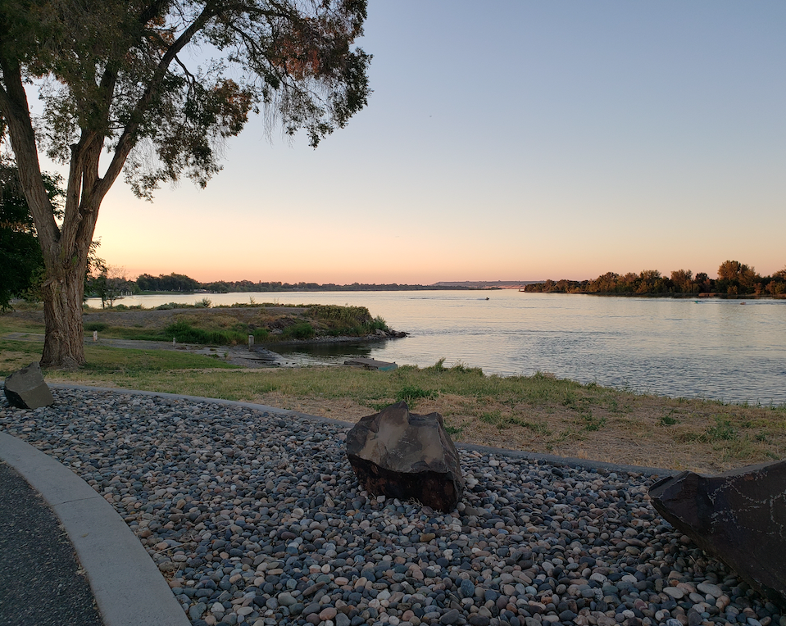
DOE, USA Office of High Energy Physics Advanced Technology R&D subprogram (KA-25)
Canada Foundation for Innovation
Province of Ontario Ministry of Research and Innovation

Slide 13
Backup slides

Slide 14
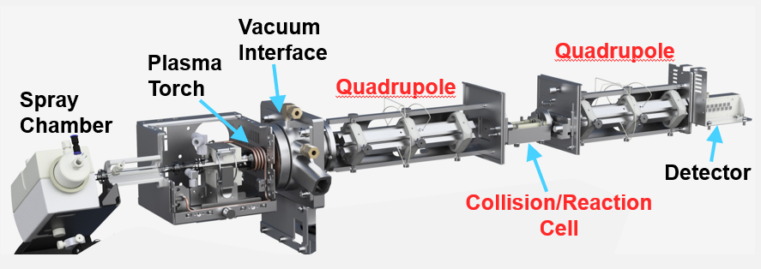
Triple quadrupole ICP-MS (ICP-QQQ-MS), or tandem ICP-MS (ICP-MS/MS)

Slide 15
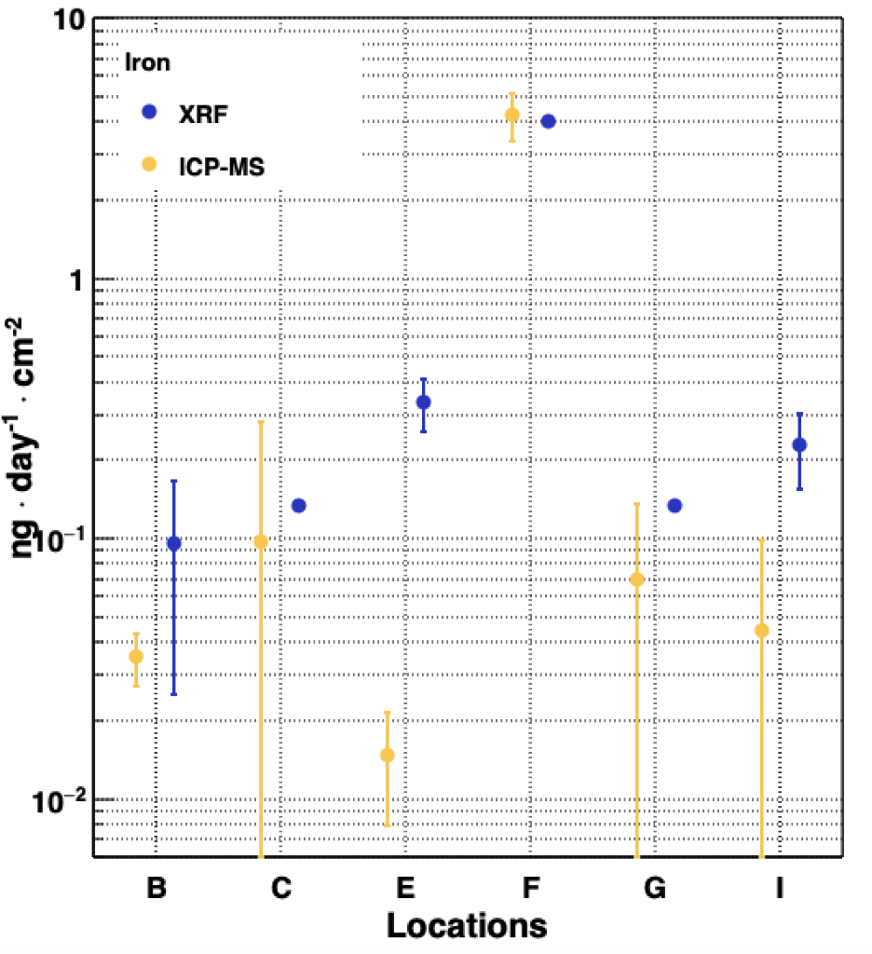
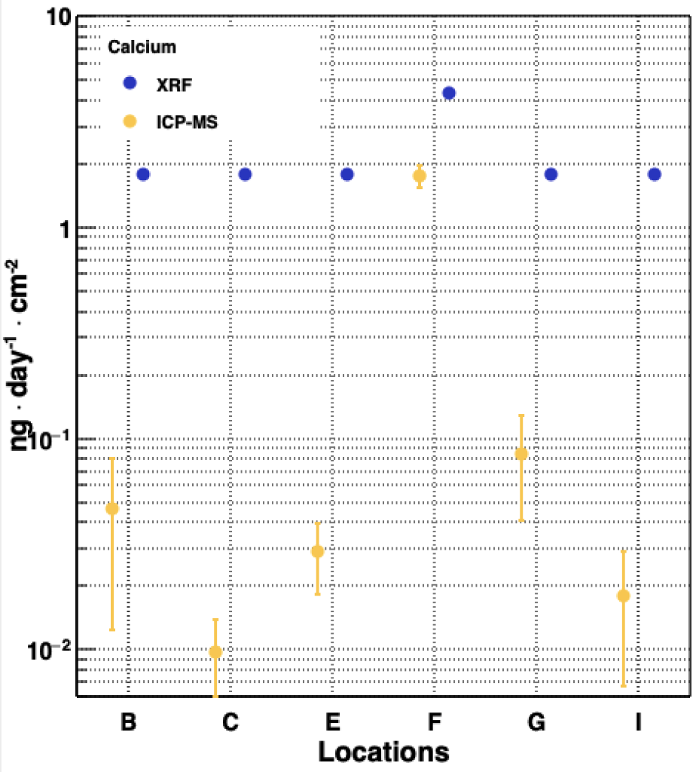
Method validation
ICP-MS vs XRF measurement of Ca and Fe fallout rate (2018 sample collection)
Same locations
Same exposure time
*Upper limits
*
*
*
*
*
*
*

