Slide 1
Data analysis notes
Santiago Cané

Slide 2
NTuple information
Run349327.root
Run348885.root
LHC Run 2 Data, year 2018
Run number: 349327
<μ> = 53.6
≈ 150000 events
DAOD_PHYS sample
LHC Run 2 data, year 2018
Run number: 348885
<μ> =54.4
≈ 60000 events
DAOD_PHYS sample

Slide 3
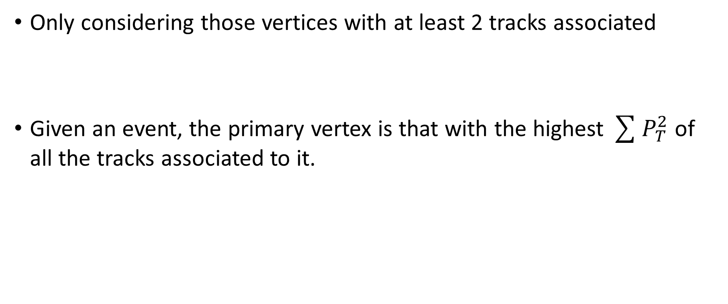
Initial vertex selection criteria
Only considering those vertices with at least 2 tracks associated
Given an event, the primary vertex is that with the highest $\sum{P_{T}^{2}}$ of all the tracks associated to it.

Slide 4
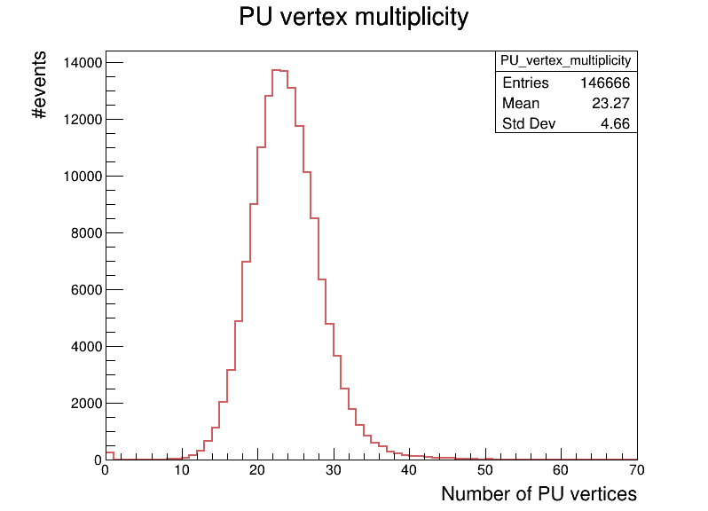
<μ>=53.6
<μ> = 53.6

Slide 5
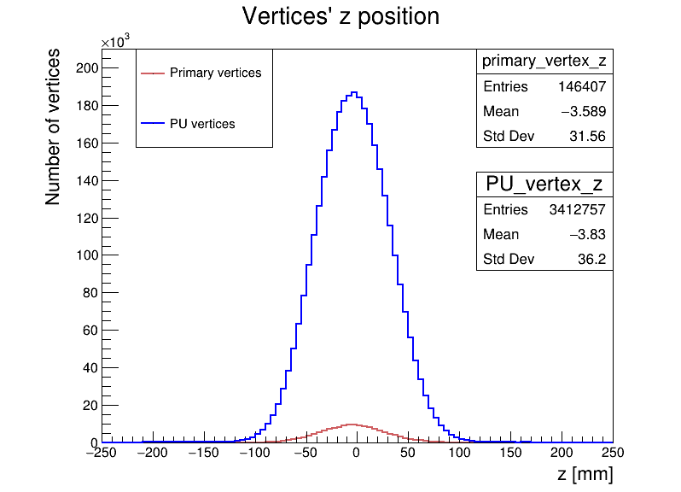
<μ>=53.6
<μ> = 53.6

Slide 6
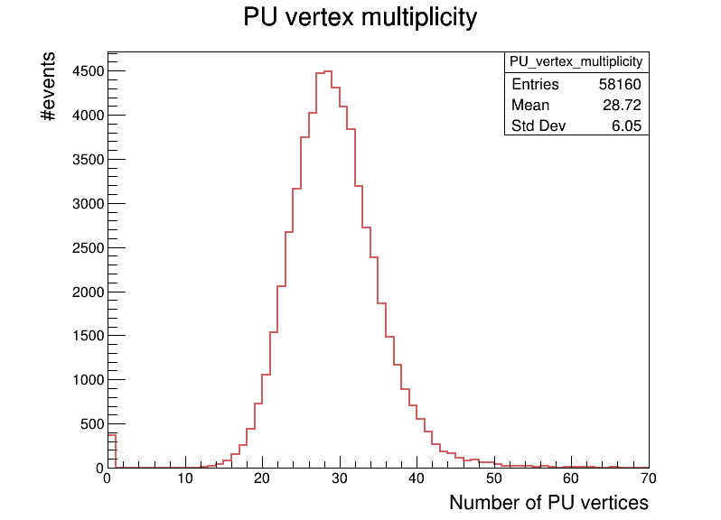
<μ>=54.4
<μ> = 54.4

Slide 7
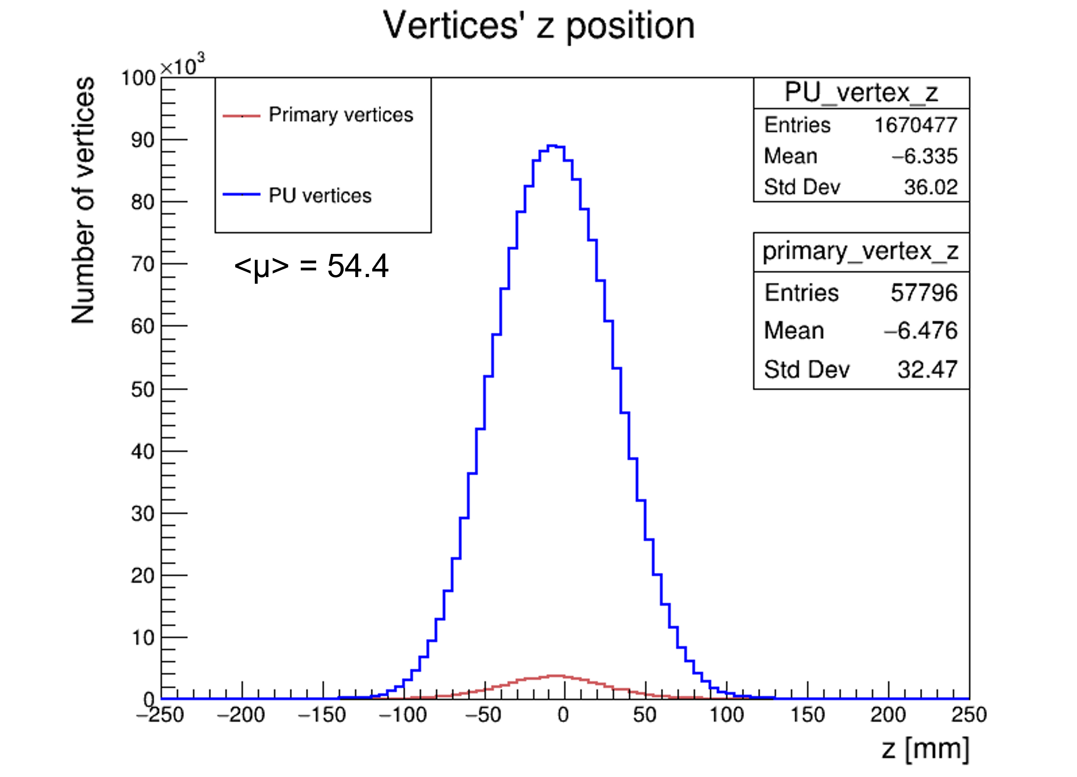
<μ>=54.4

