Slide 1
HITMAN: Machine Learning Likelihoods for Arbitrary Optical Neutrino Detectors
Garrett Wendel (gmw5164@psu.edu), Penn State University
August 24th, 2023

Slide 2
HITMAN: Event Reconstruction Software
Flipping the ML paradigm:
ML methods typically focus on innovative network structures to handle high dimensional input data
  Perform a regression on input data to produce a prediction
HITMAN focuses on analytic decomposition of inputs to reduce dimensionality and produces a scalar likelihood values for predictions

Slide 3
HITMAN: Event Reconstruction Software
Highly-parallelizable Inference Technique for Monitoring Anti-Neutrinos
(Based on work originally performed for WATCHMAN collaboration)
Reduce network input to ~10 dimensions using Neural Ratio Estimators and likelihood decomposition
  Incorporates non-standard detector designs
  Independent of detector layout
  Avoids “hand-tuning” of algorithms
Detailed methodology by Eller, et al. [1]
Ethos: “If you can simulate it, we can reconstruct it”
[1] 10.1016/j.nima.2023.168011

Slide 4
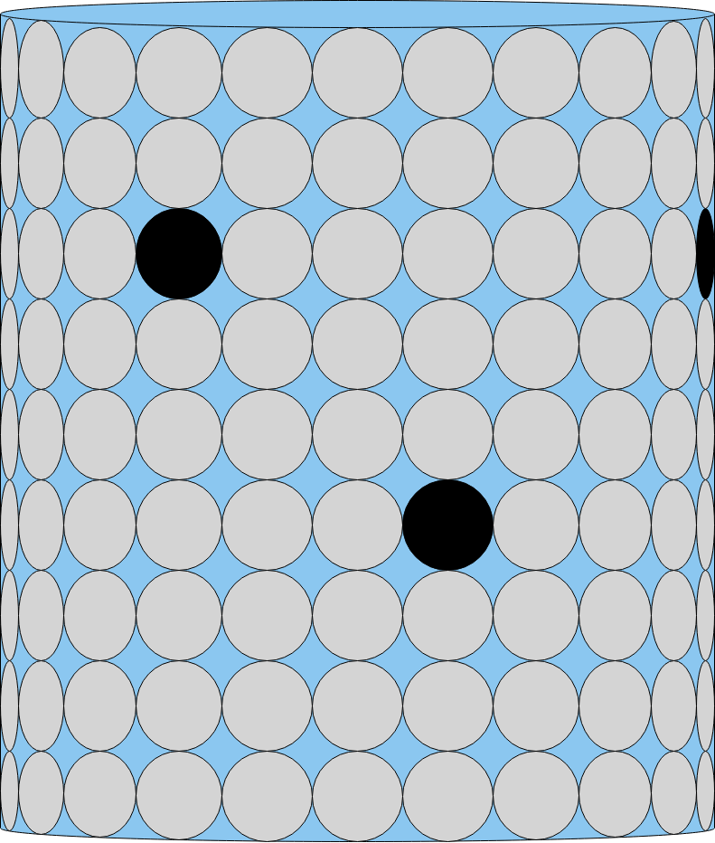
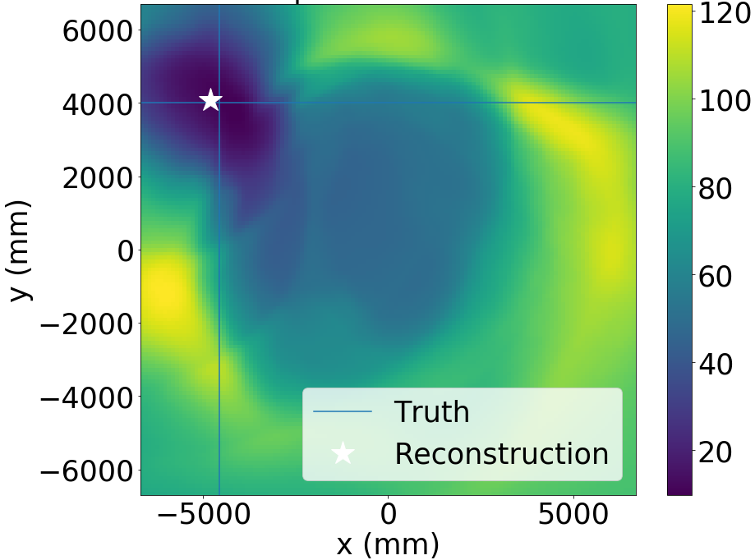

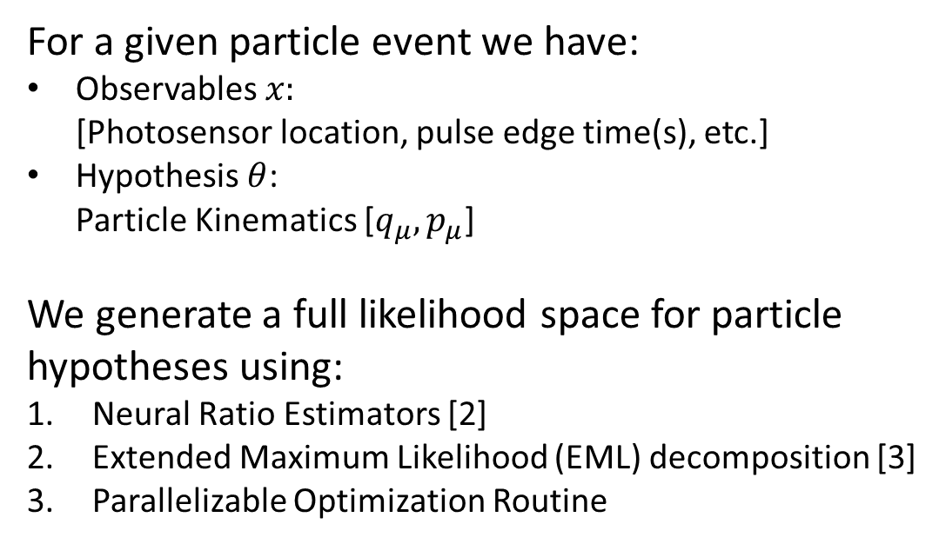



The Inference Problem
Detector Response: $x$
Particle Hypothesis :$θ$
$$\text{[}q_{μ},p_{μ}\text{]}$$
For a given particle event we have:
Observables $x:$
[Photosensor location, pulse edge time(s), etc.]
Hypothesis $θ$:
Particle Kinematics [$q_{μ},p_{μ}$]
We generate a full likelihood space for particle hypotheses using:
Neural Ratio Estimators [2]
Extended Maximum Likelihood (EML) decomposition [3]
Parallelizable Optimization Routine
$$−ln⁡(f\left(θ|x\right))$$
Example Negative Log Likelihood produced by HITMAN
[2] arXiv:1903.04057, [3] doi:10.1016/0168-9002(90)91334-8

Slide 5












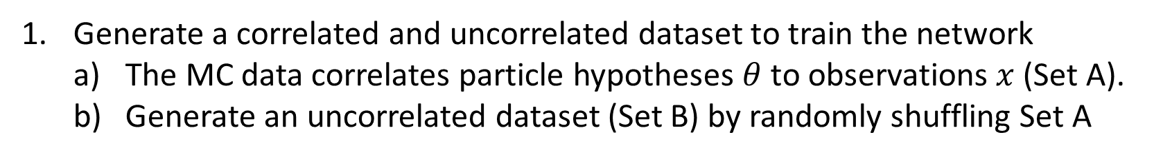
Neural Ratio Estimator
Generate a correlated and uncorrelated dataset to train the network
  The MC data correlates particle hypotheses $θ$to observations $x$ (Set A).
  Generate an uncorrelated dataset (Set B) by randomly shuffling Set A
Set A:
Set B:
$$θ_{1}$$
$$x_{1}$$
$$θ_{1}$$
$$x_{1}$$
$$θ_{2}$$
$$x_{2}$$
$$θ_{2}$$
$$x_{2}$$
$$θ_{3}$$
$$x_{3}$$
$$θ_{3}$$
$$x_{3}$$
… …
… …

Slide 6
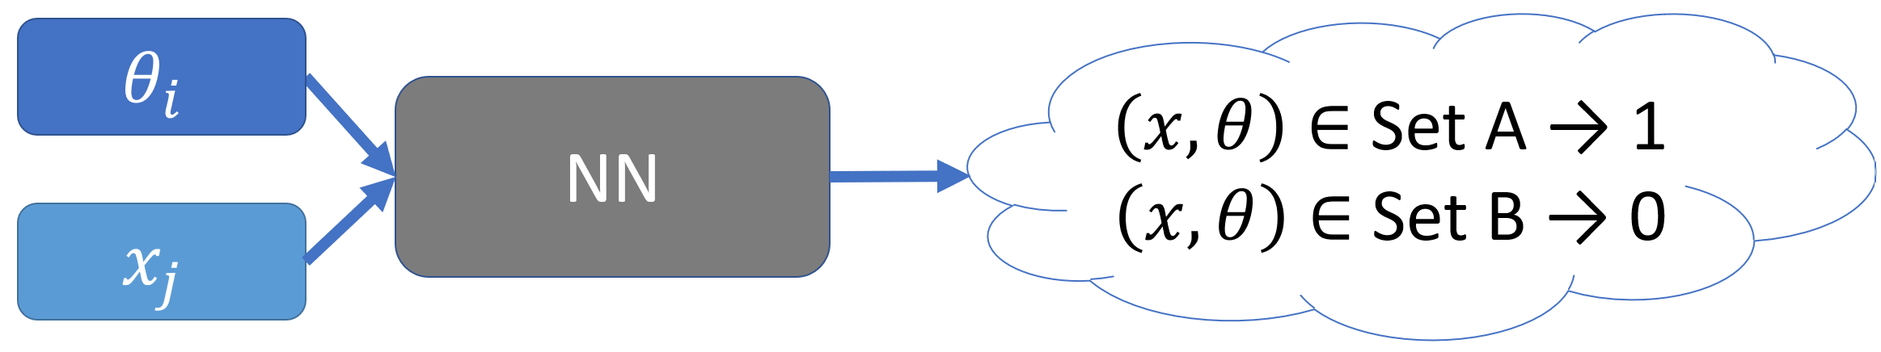
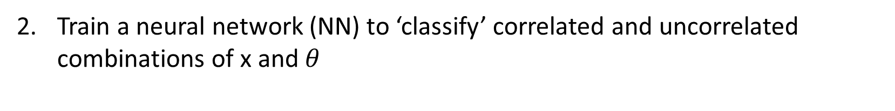
Neural Ratio Estimator
Train a neural network (NN) to ‘classify’ correlated and uncorrelated combinations of x and $θ$

Slide 7
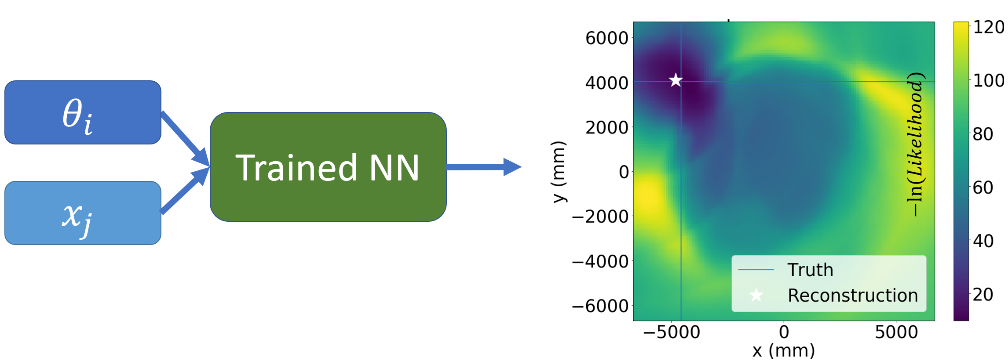

Neural Ratio Estimator
After slight manipulation network generates the likelihood to evidence ratio, producing contours for each particle event
$$−ln⁡(f\left(θ|x\right))$$

Slide 8
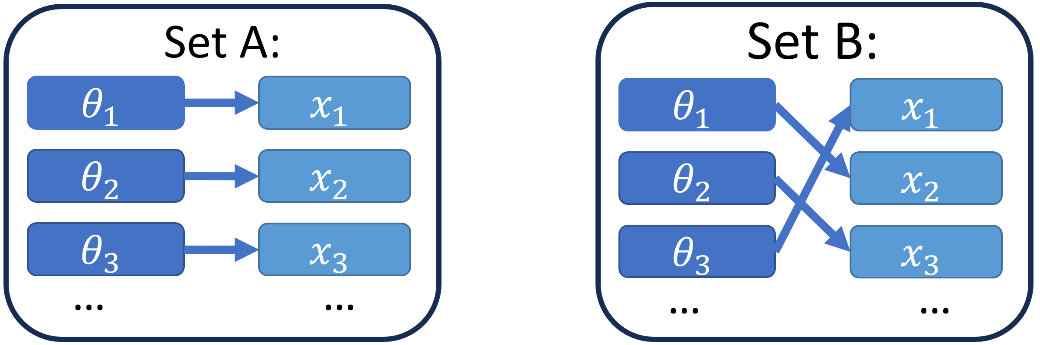
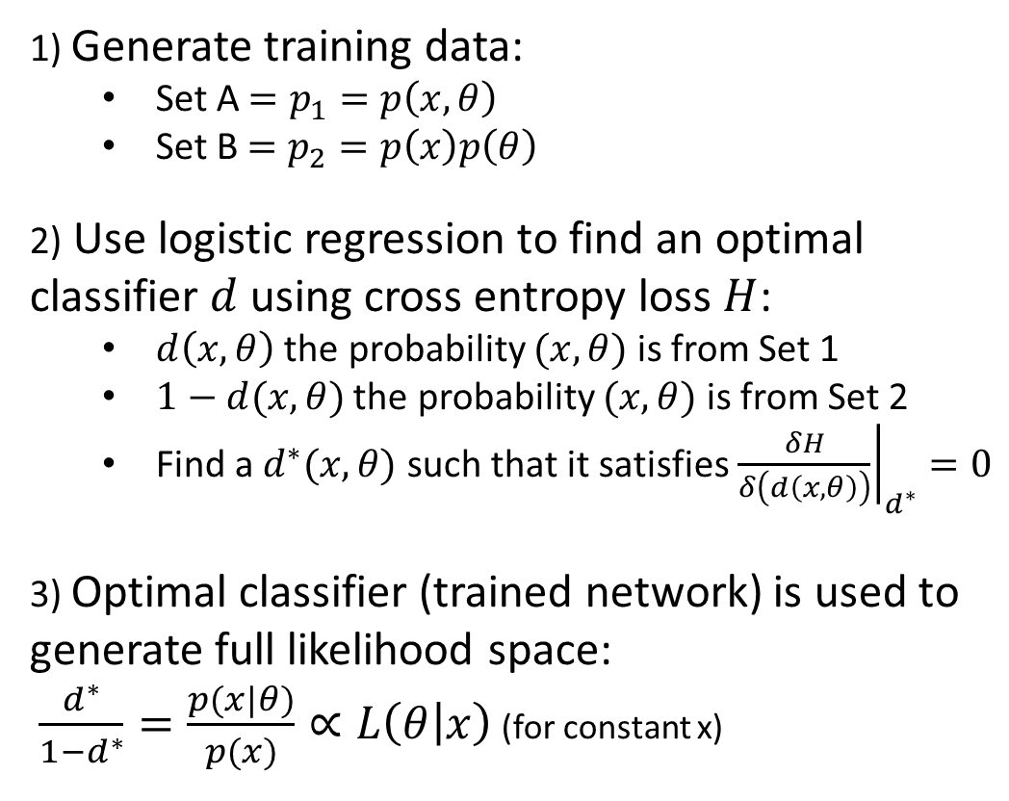
Neural Ratio Estimator; Theory
See Likelihood-free MCMC with Amortized Approximate Ratio Estimators (arxiv.org) for more information
1) Generate training data:
  Set A$=p_{1}=p\left(x,θ\right)$
  Set B $=p_{2}=p\left(x\right)p\left(θ\right)$
2) Use logistic regression to find an optimal classifier $d$ using cross entropy loss $H$:
  $d\left(x,θ\right)$ the probability $(x,θ)$ is from Set 1
  $1−d(x,θ)$ the probability $(x,θ)$ is from Set 2
  Find a $d^{∗}(x,θ)$ such that it satisfies ${\left.\frac{δH}{δ\left(d\left(x,θ\right)\right)}\right|}_{d^{∗}}=0$
  3) Optimal classifier (trained network) is used to generate full likelihood space:
$\frac{d^{∗}}{1−d^{∗}}=\frac{p(x|θ)}{p(x)}∝L\left(θ | x\right)$ (for constant x)

Slide 9
Extended Maximum Likelihood (EML)
Typical detector response can vary over many orders of magnitude
Complicated network structures and large datasets required to ‘learn’ how to appropriately reduce input
Solution: decompose likelihood into a constant length terms encoding (EML)
With access to full likelihood from the neural ratio estimator, we can decompose the detector response into independent components

Slide 10
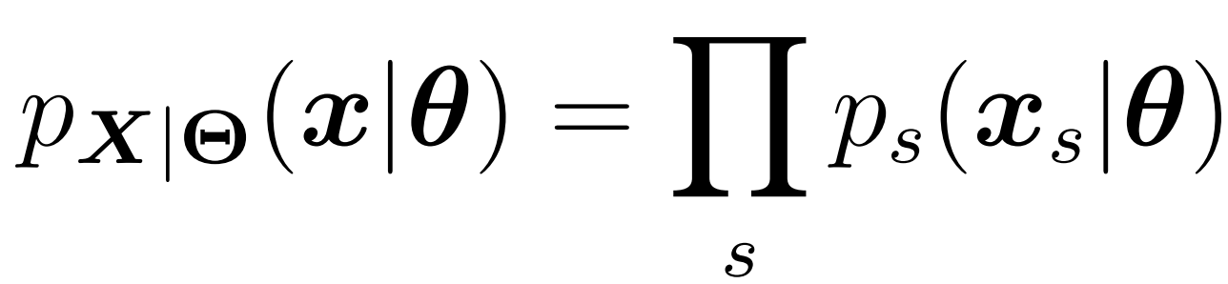
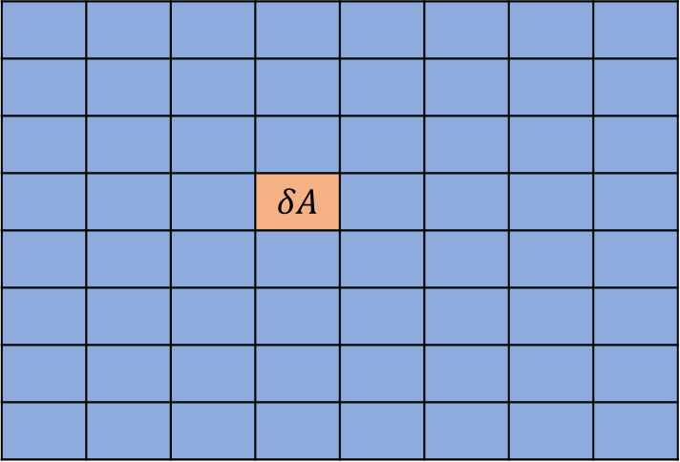
Extended Maximum Likelihood
Assume each detector is comprised of infinitesimally small tiles ($δA$) such that it only sees one photon per event.
 |  |  | $$δA$$
~
Full Detector
Likelihood per infinitesimal sensor

Slide 11
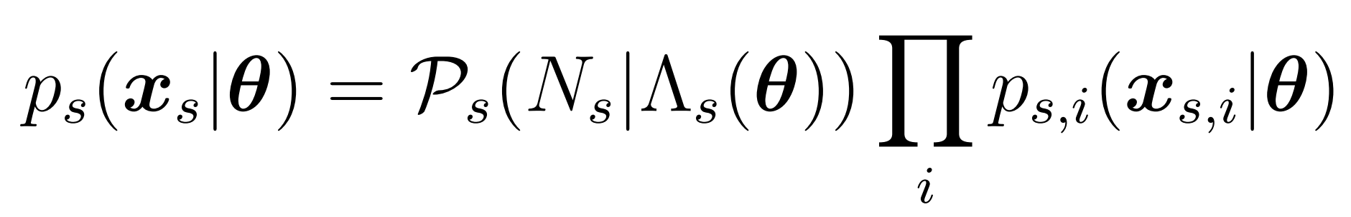
Extended Maximum Likelihood
To account for finite size photosensors, integrate over area generating an additional Poisson-like term
 | A
Finite Sensor Likelihood
Poisson-Like term
Likelihood per photon

Slide 12
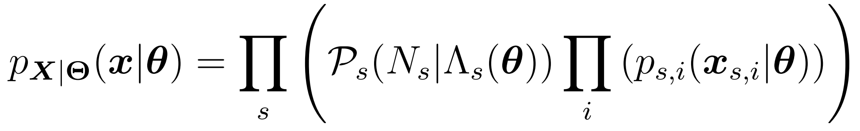
Extended Maximum Likelihood
Combine finite size sensors likelihoods by multiplying them together
Full Likelihood
Finite Sensor Likelihood

Slide 13
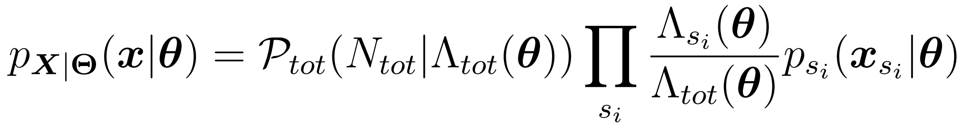
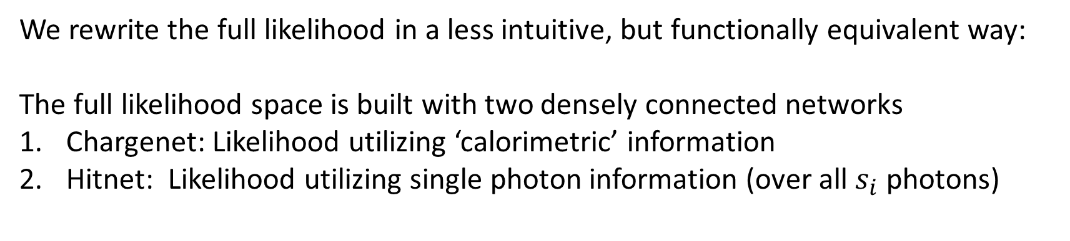
The Extended Maximum Likelihood
We rewrite the full likelihood in a less intuitive, but functionally equivalent way:
The full likelihood space is built with two densely connected networks
Chargenet: Likelihood utilizing ‘calorimetric’ information
Hitnet: Likelihood utilizing single photon information (over all $s_{i}$ photons)
Full Likelihood
Multi-sensor Info
(Chargenet)
Information per photon (Hitnet)

Slide 14



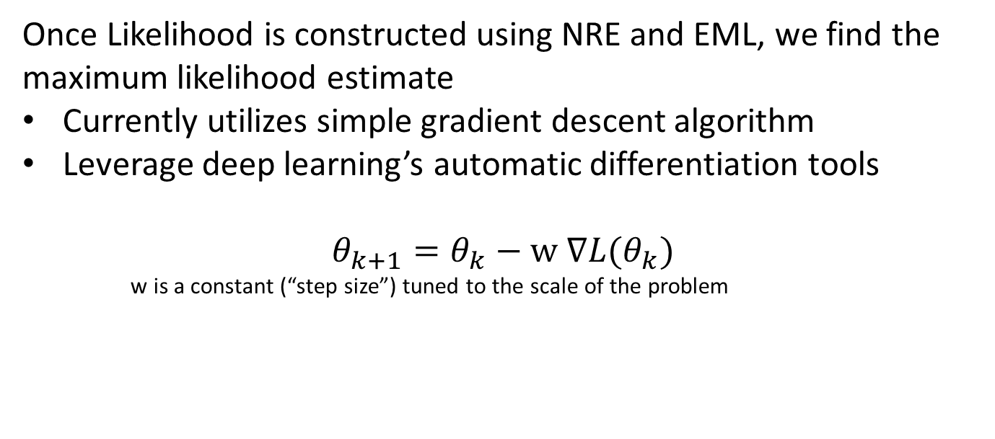

Optimization Routine
Once Likelihood is constructed using NRE and EML, we find the maximum likelihood estimate
Currently utilizes simple gradient descent algorithm
Leverage deep learning’s automatic differentiation tools
$$θ_{k+1}=θ_{k}−w ∇L(θ_{k})$$
w is a constant (“step size”) tuned to the scale of the problem
$$θ$$
$$x$$
Neural Network (Trained)
$$L(θ|x)$$
Optimizer
Most Likely $θ$ Value
14

Slide 15
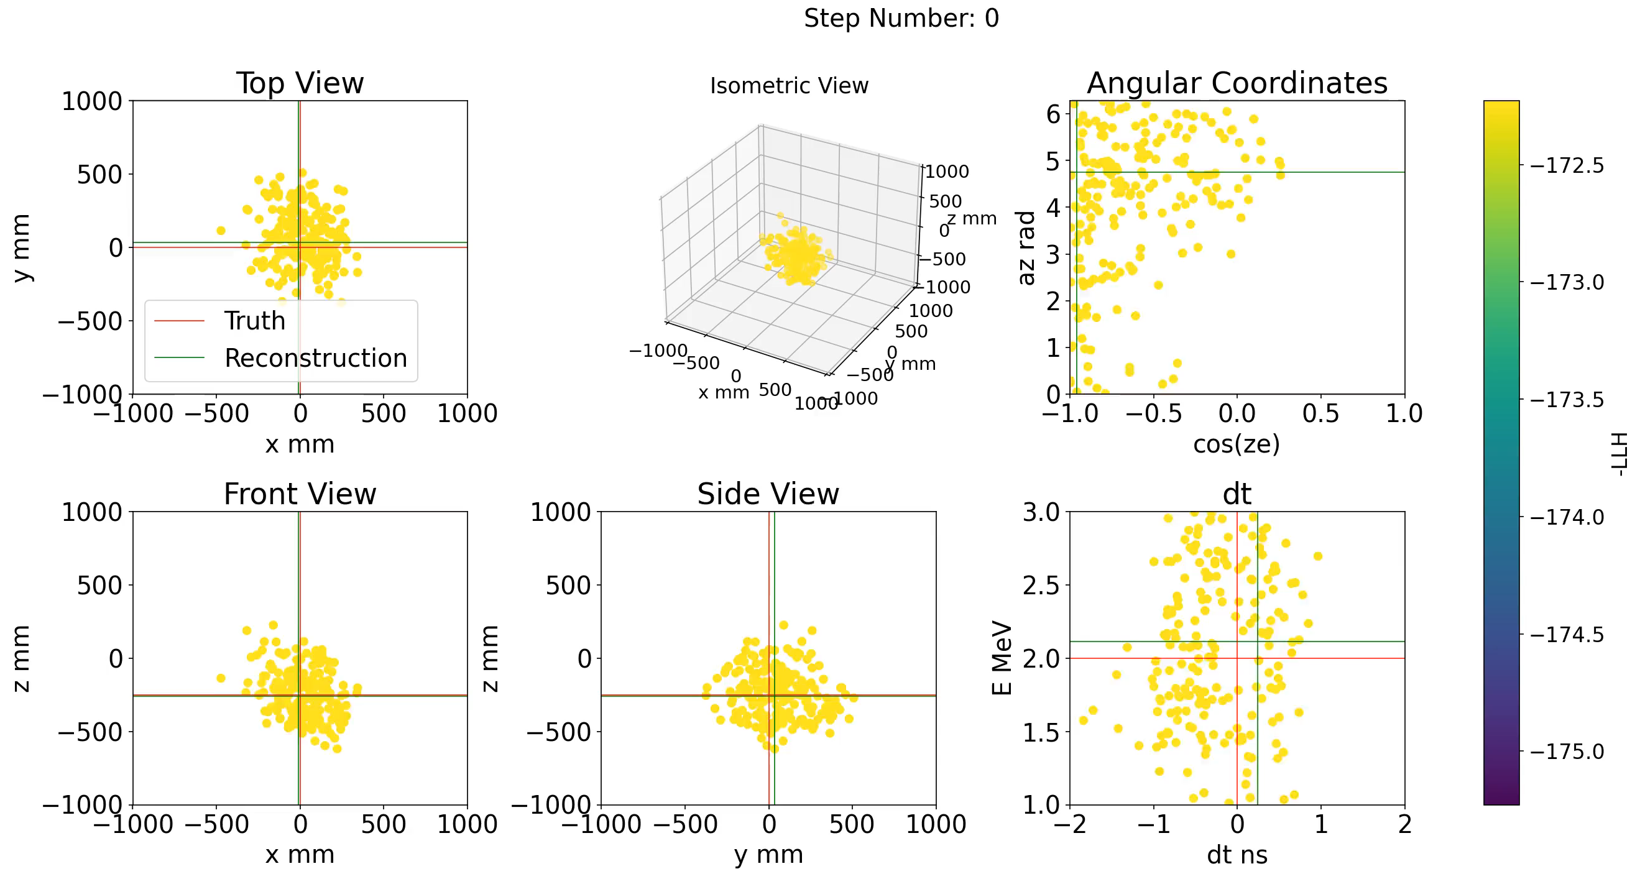
Optimization Routine: Example Detection Event
15

Slide 16
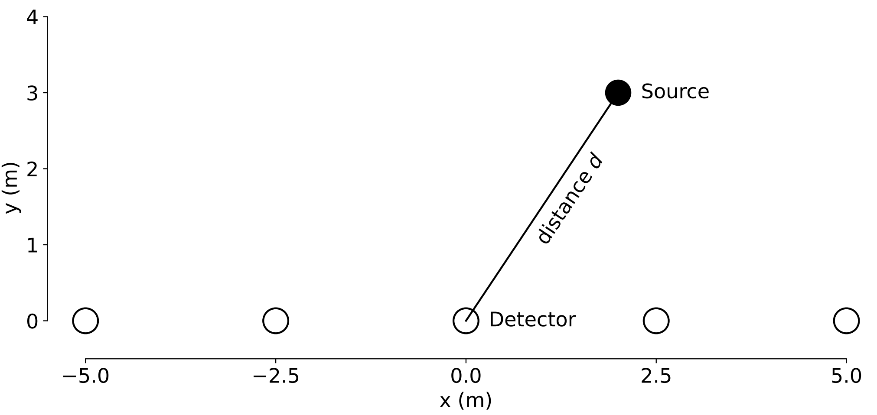
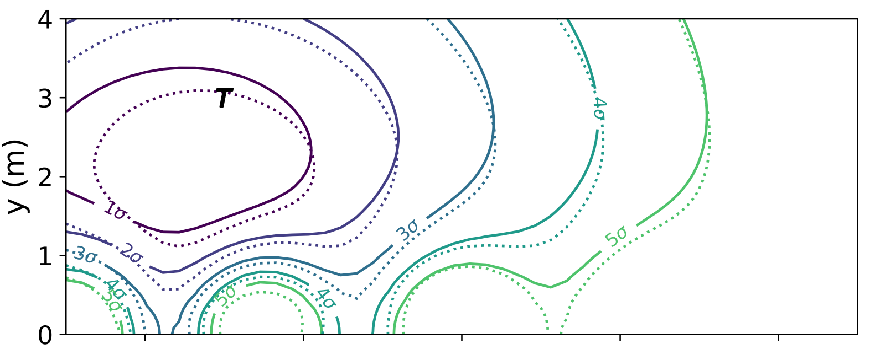
Model Verification
T Source position
Analytic LLH
Network LLH
Comparing log-likelihood (LLH) contours from a single event from the toy model, comparing the analytic solution with a neural network created akin to HITMAN for a single event.
  A toy experiment with an analytic solution: Determining the position of a light source located on a 2D plane with 5 photosensors along the x axis

Slide 17
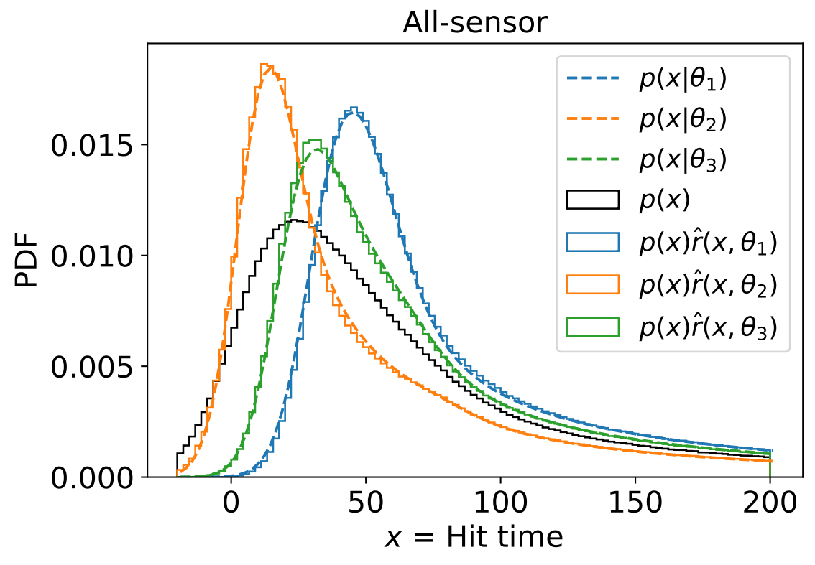
Model Verification
  In addition to event-by-event comparisons shown on the previous slide, we can look at the forward posterior distributions to check the network’s performance

Slide 18
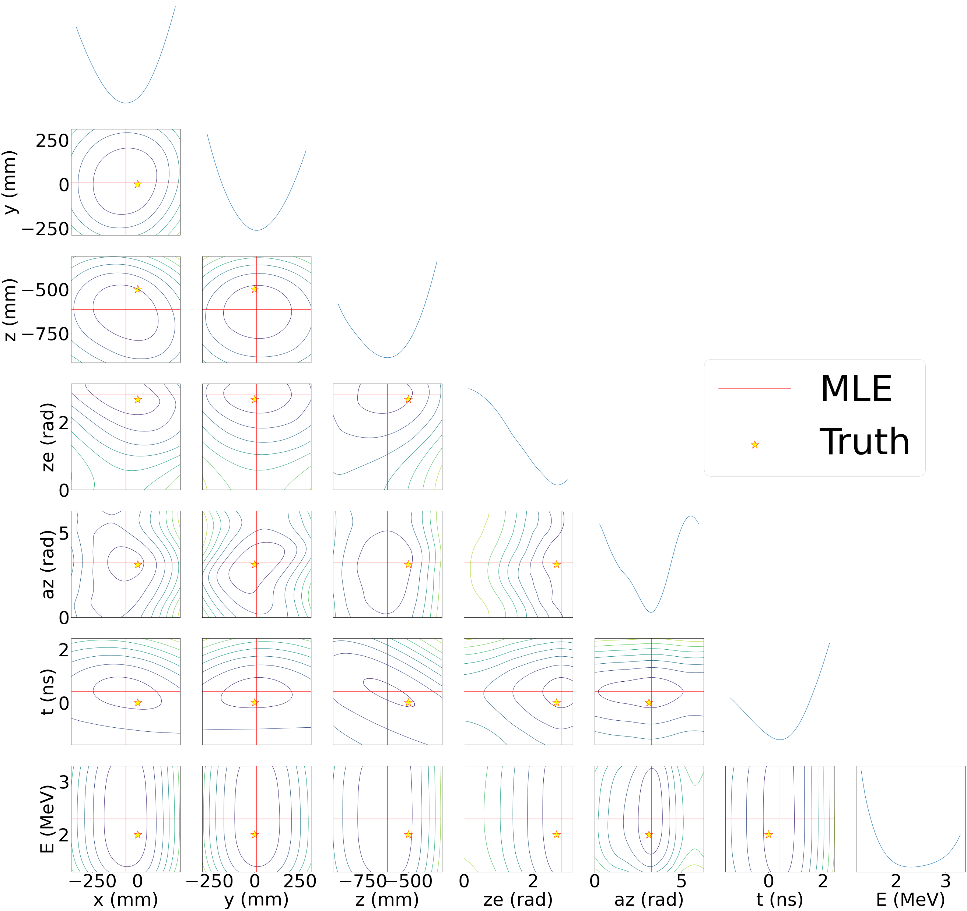
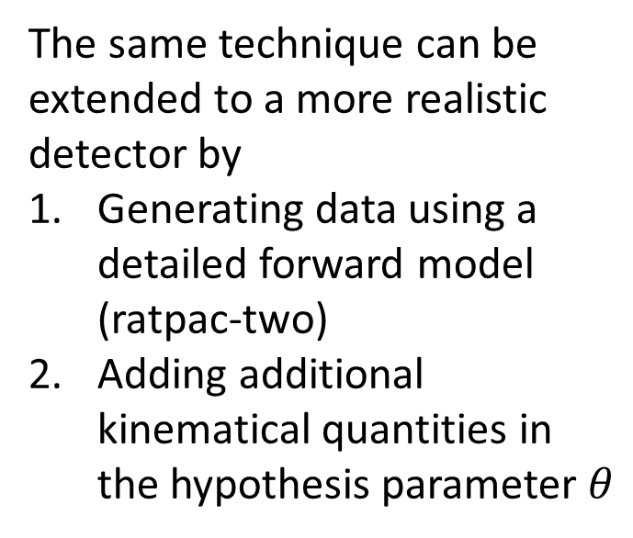
Extending the Model
The same technique can be extended to a more realistic detector by
Generating data using a detailed forward model (ratpac-two)
Adding additional kinematical quantities in the hypothesis parameter $θ$

Slide 19
HITMAN Workflow
Produce a correlated dataset from Monte Carlo simulation
Generate Network using HITMAN
Produce predictions from trained network (find MLE, perform scans of likelihood space, etc.)

Slide 20
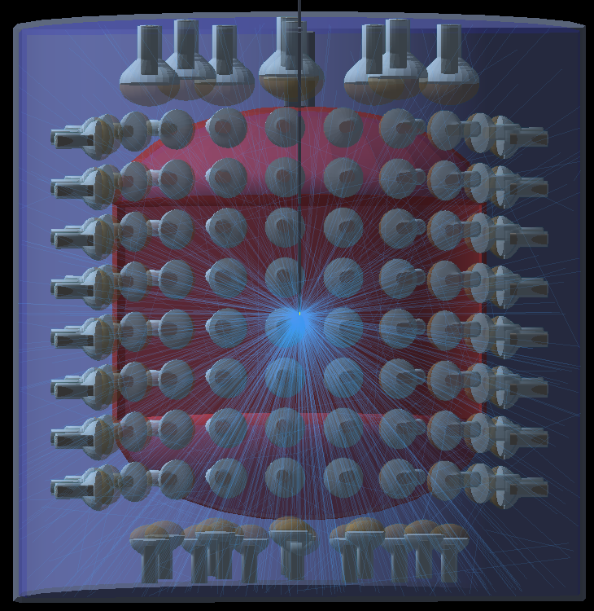
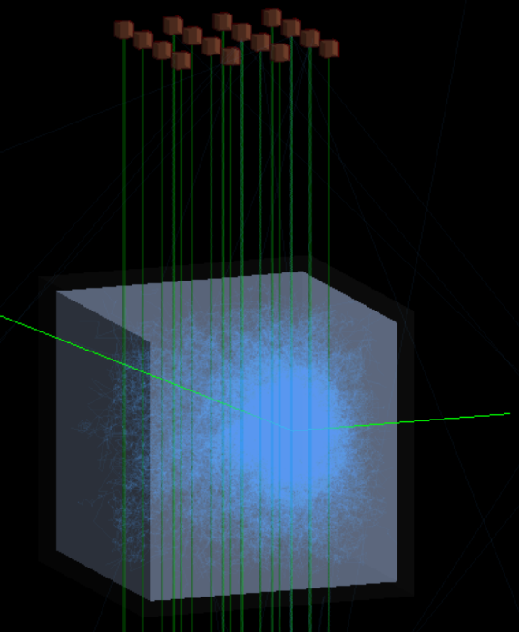
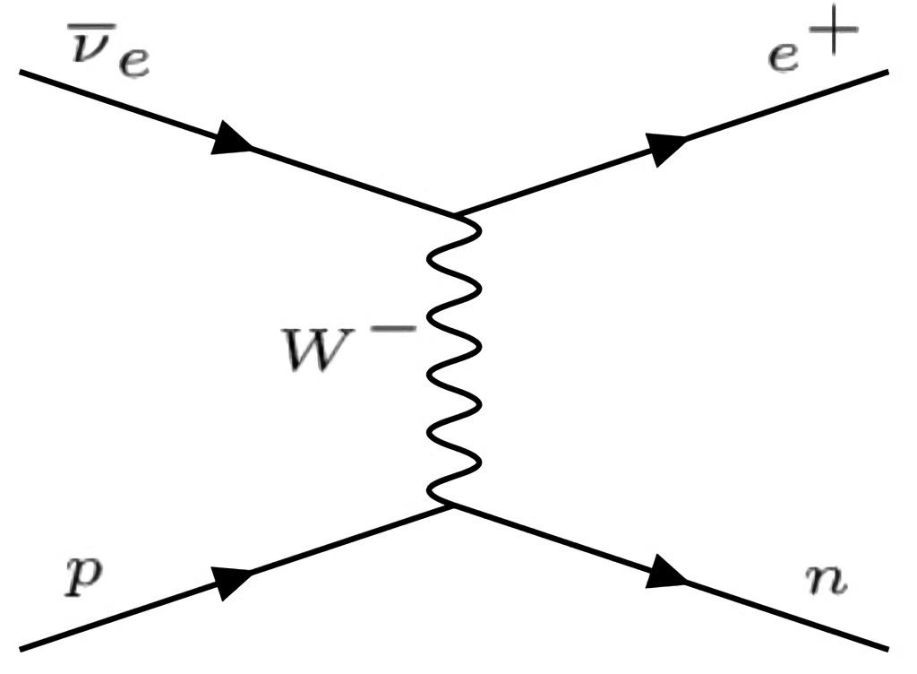
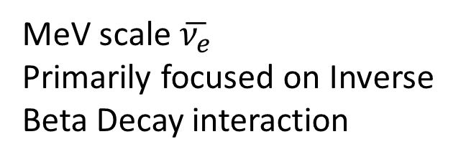
Applications
MeV scale $\overline{ν_{e}}$
Primarily focused on Inverse Beta Decay interaction
Eos: Mixed Water-Cherenkov Scintillator medium lined with Photosensors [4]
LiquidO: Highly scattering scintillator with wavelength shifting fibers to capture photons [5]
[4] doi:10.1088/1748-0221/18/02/P02009, [5] doi:10.1038/s42005-021-00763-5

Slide 21
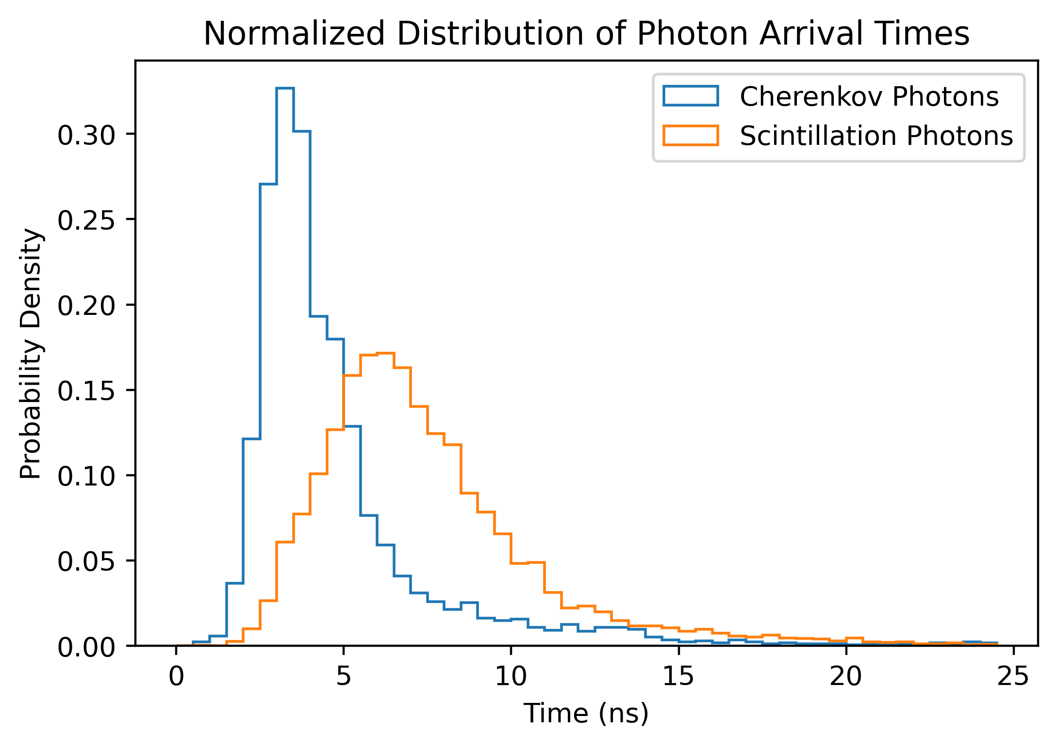
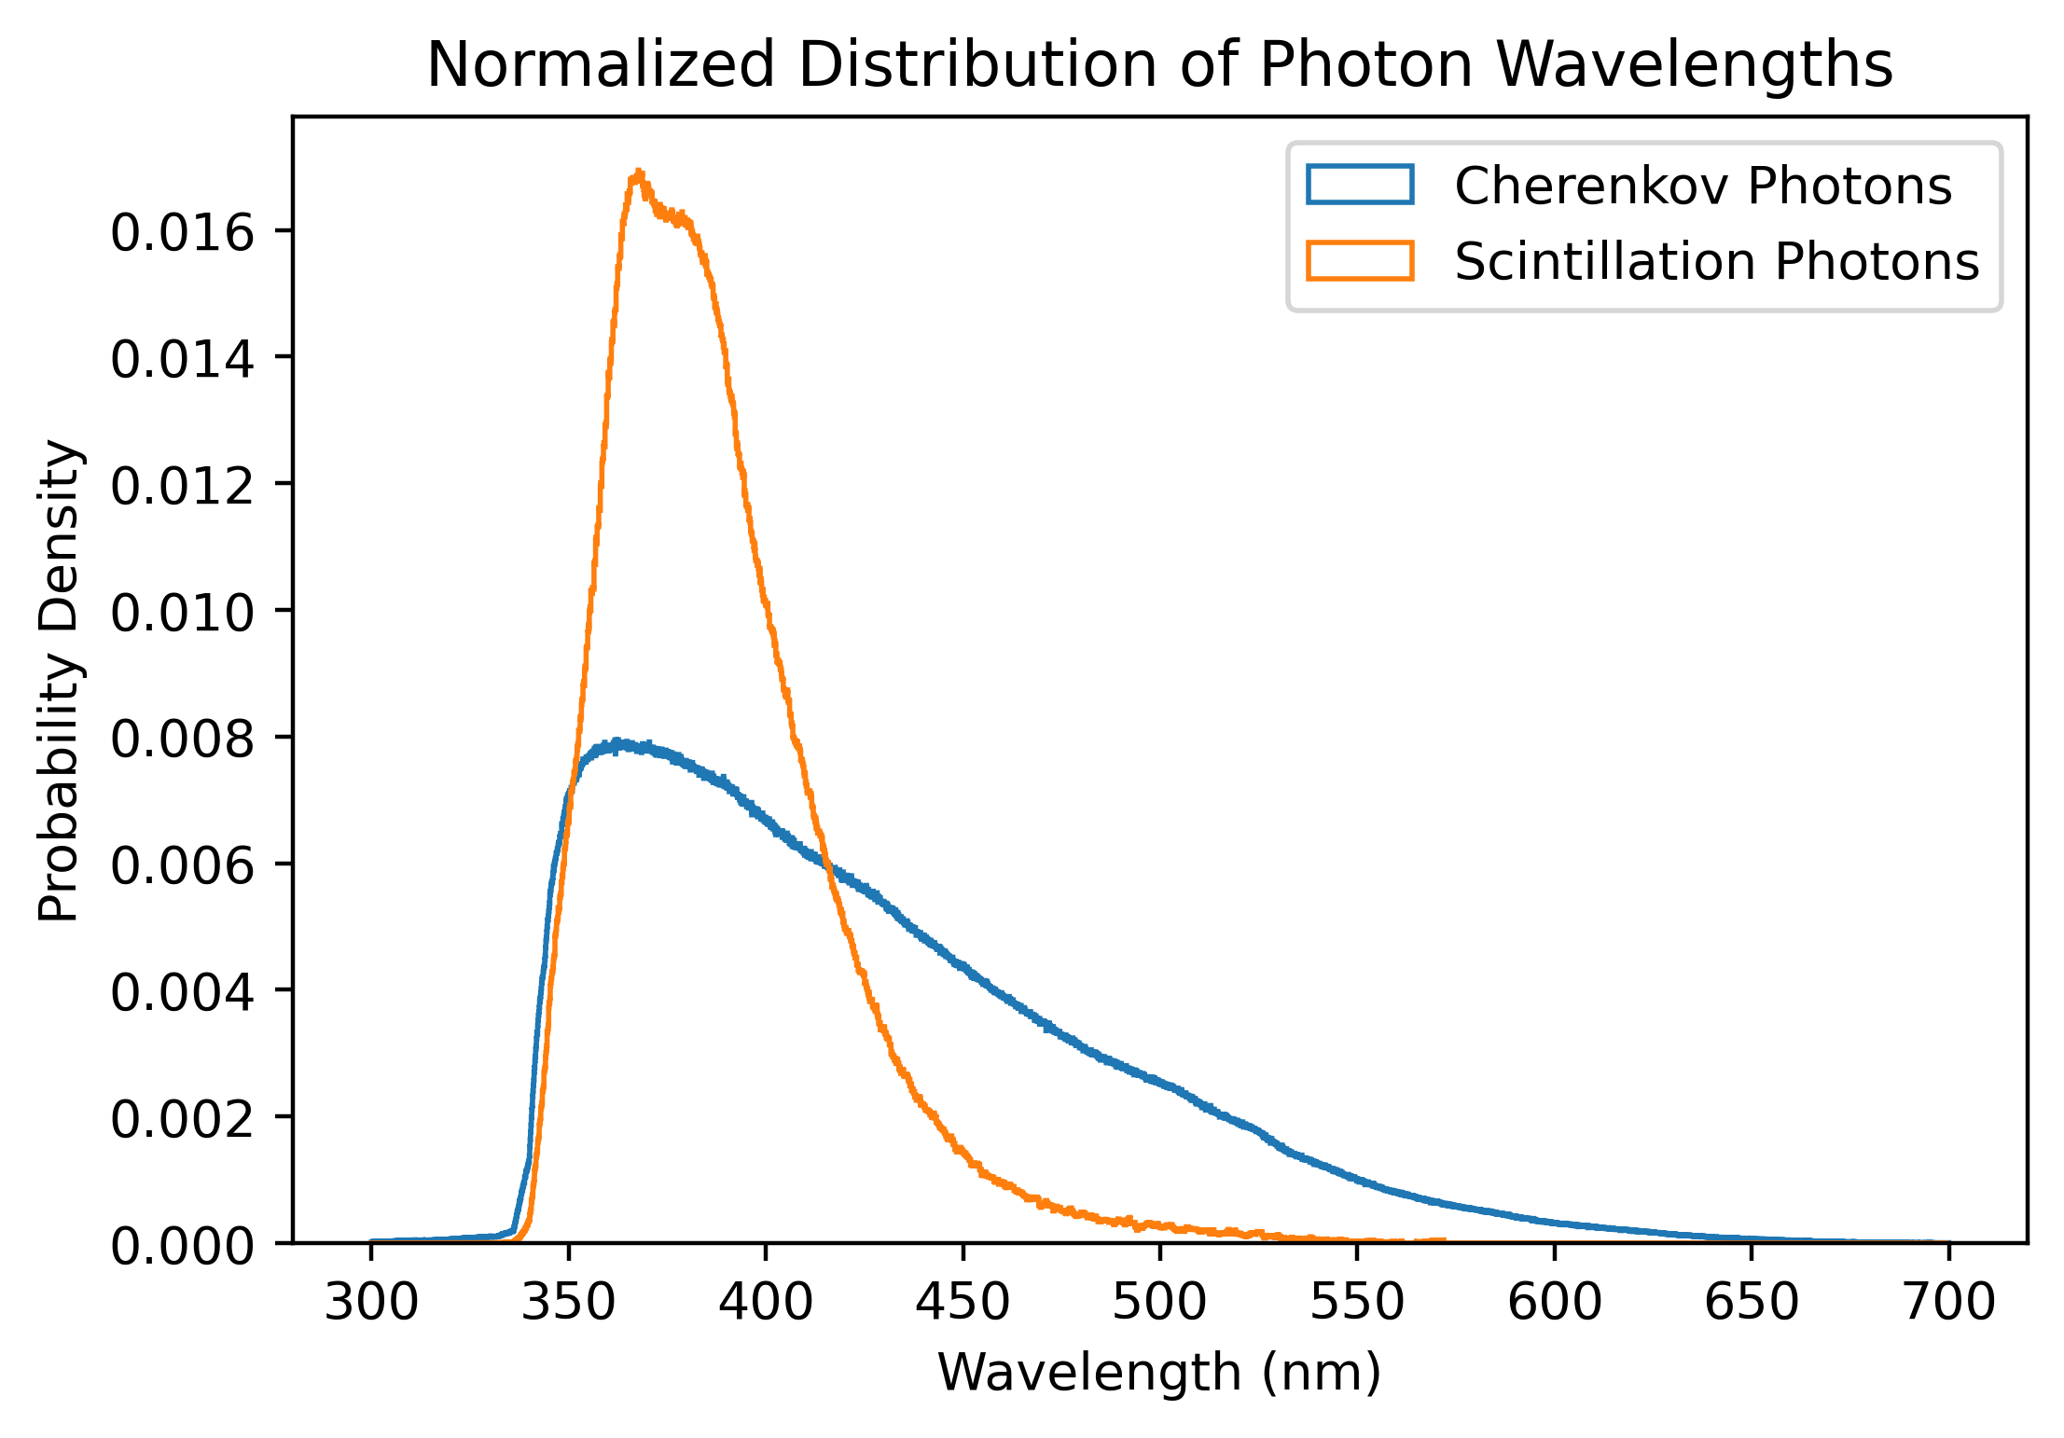
EOS
Reconstruction Goal: Use mixed Cherenkov and Scintillation light signal from particle interactions to obtain benefits from both sources of light
Cherenkov Light
  Informs on particle direction
  Low light yield
Scintillation Light
  Isotropic; no information on direction
  High light yield; improve energy and vertex resolution
Note: Actual distributions depend on detector configuration

Slide 22
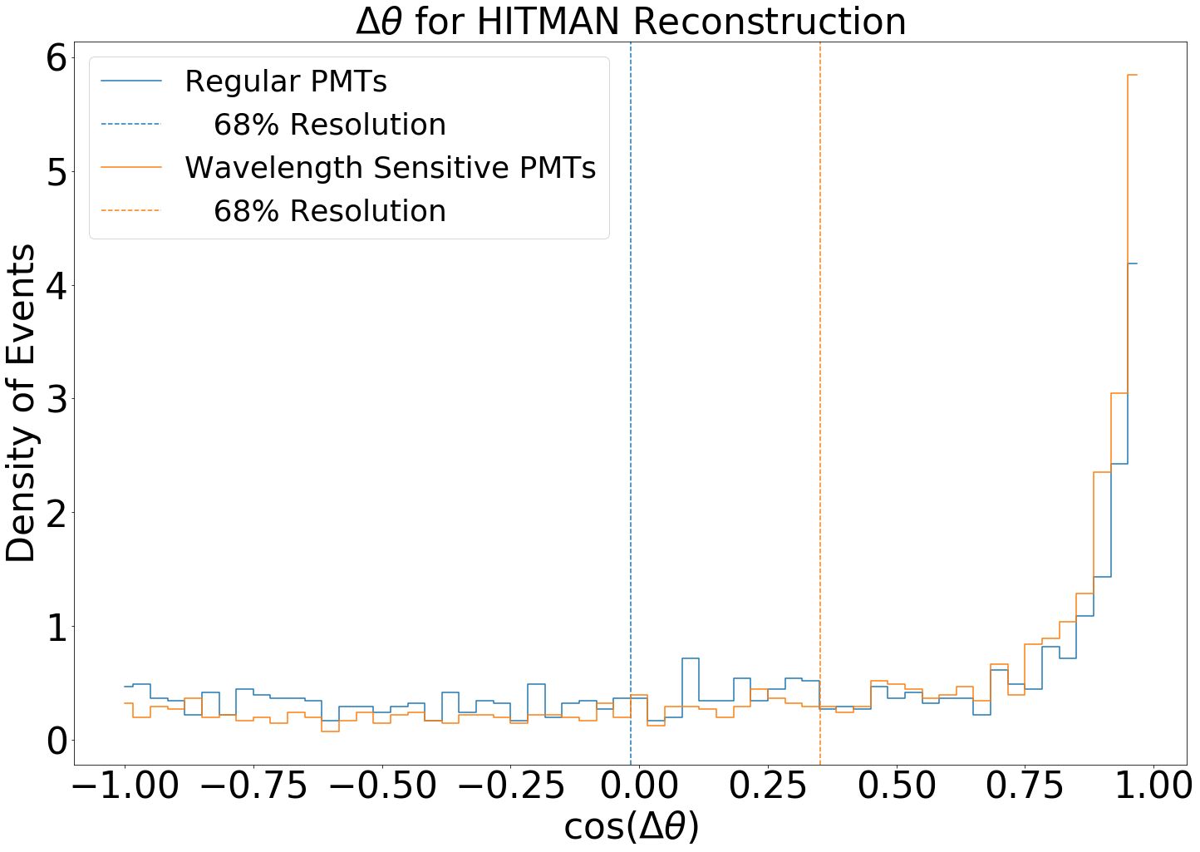
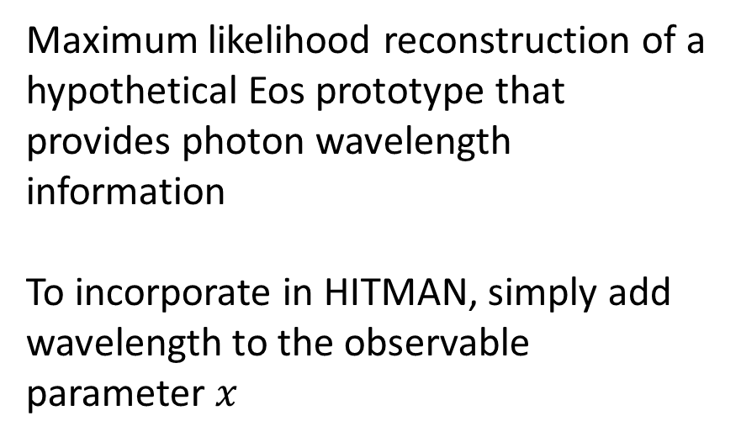
EOS: Reconstructing New Photosensor Tech
Maximum likelihood reconstruction of a hypothetical Eos prototype that provides photon wavelength information
To incorporate in HITMAN, simply add wavelength to the observable parameter $x$
Work in progress
Predicted
improvement
Reconstruction performance with 'standard’ photosensor vs wavelength-sensitive photosensors (idealized dichroicons) [6]. The angle (Δ𝜃) between true and reconstructed directions serves as the figure of merit.
[6] doi:10.1103/PhysRevD.101.072002

Slide 23
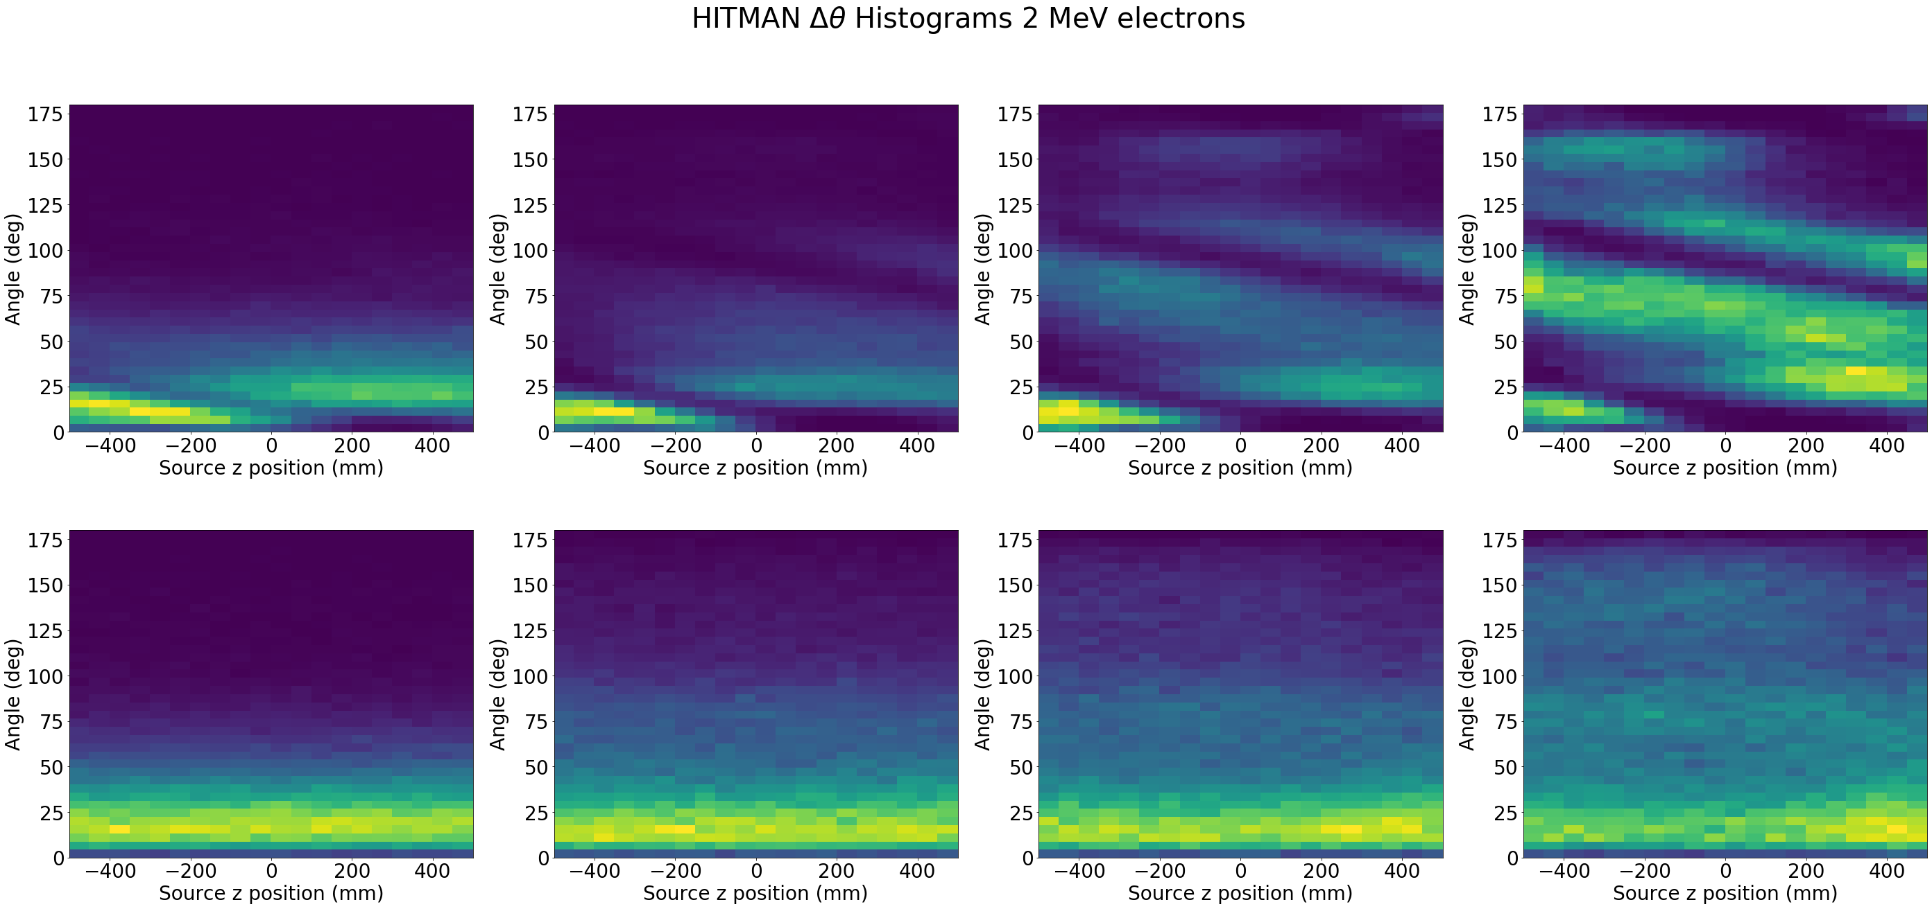
EOS: Prototype Development
Water
WbLS
An example study of directional resolutions of Eos prototypes varying geometries and target media
HITMAN’s small lightweight networks have quick turnaround time for training and reconstruction
Work in progress
Work in progress
Density of events
Δ𝜃 (deg)
Δ𝜃 (deg)
Example study of the angle between predicted and true angle (Δ𝜃) of electrons in various EOS prototypes varying the position of a calibration source and switching the target material from pure water to Water based Liquid Scintillator (WbLS)

Slide 24
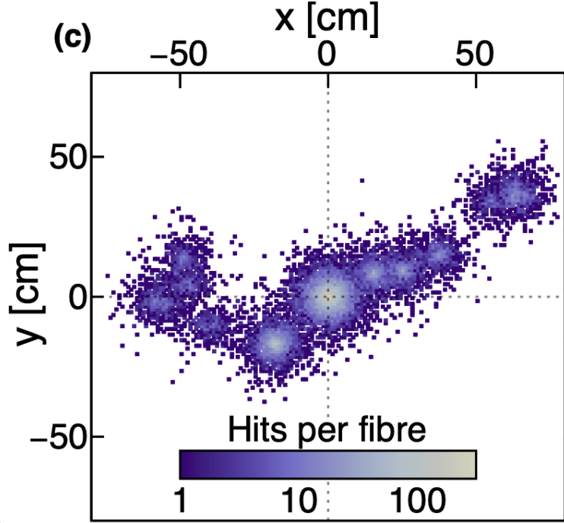
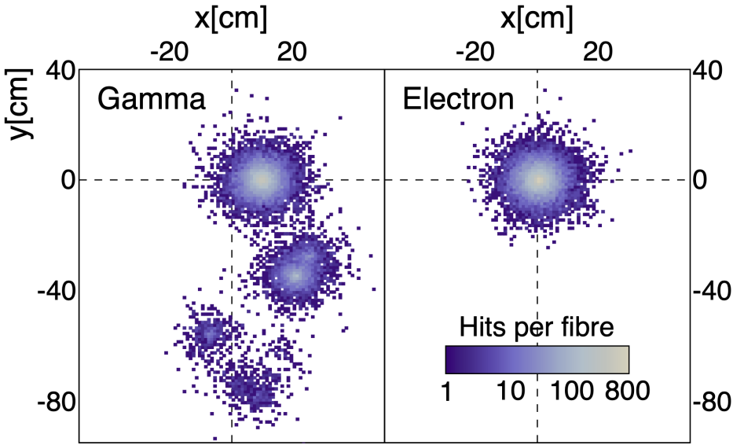
LiquidO
Positron
Paradigm: Localize light to preserve event topology
Improve Particle ID
  Reduce Shielding requirements
  Discriminate e⁻ from e⁺
Detailed Particle Track information for higher energy interactions
Example LiquidO photon topology of single event for various particles [5]

Slide 25
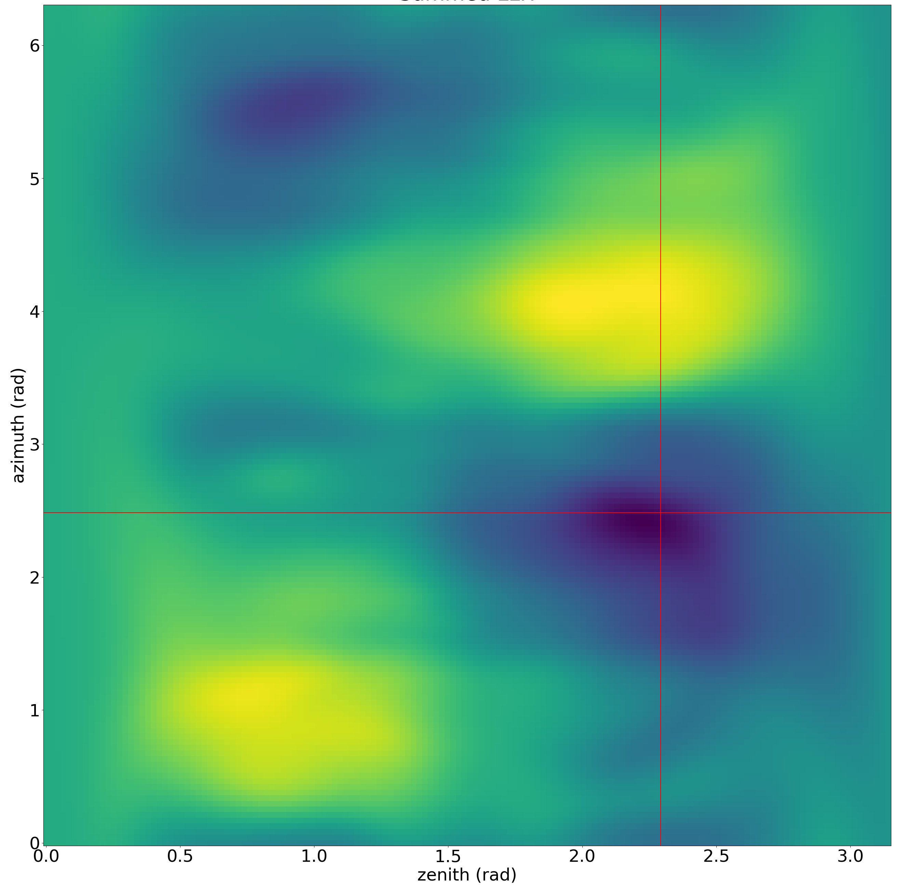
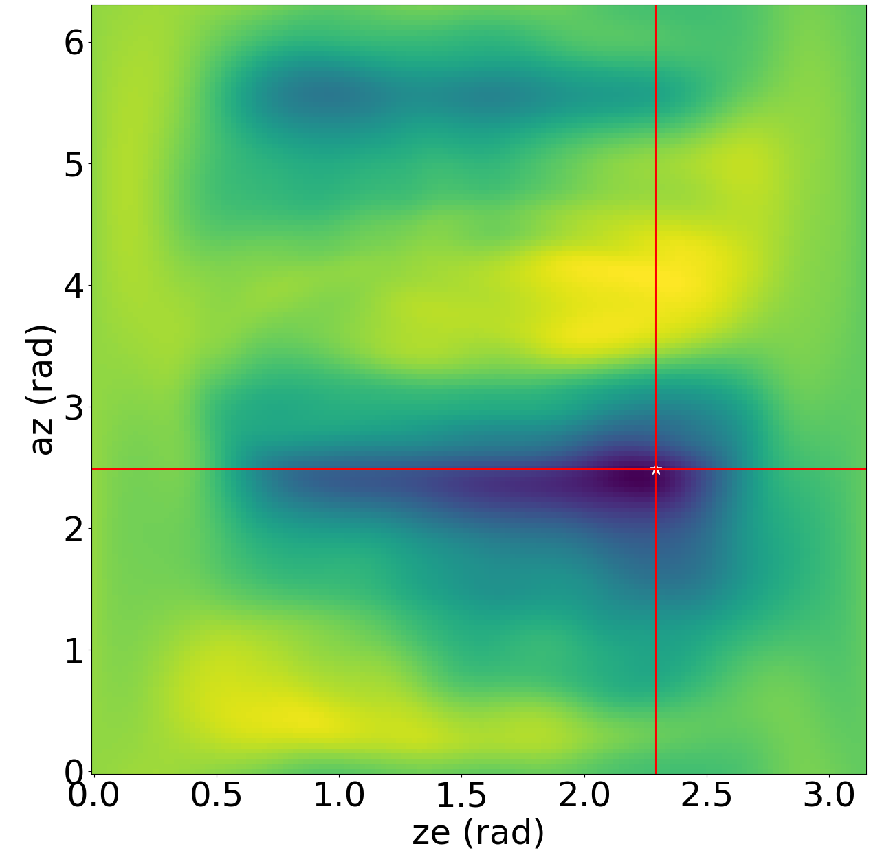
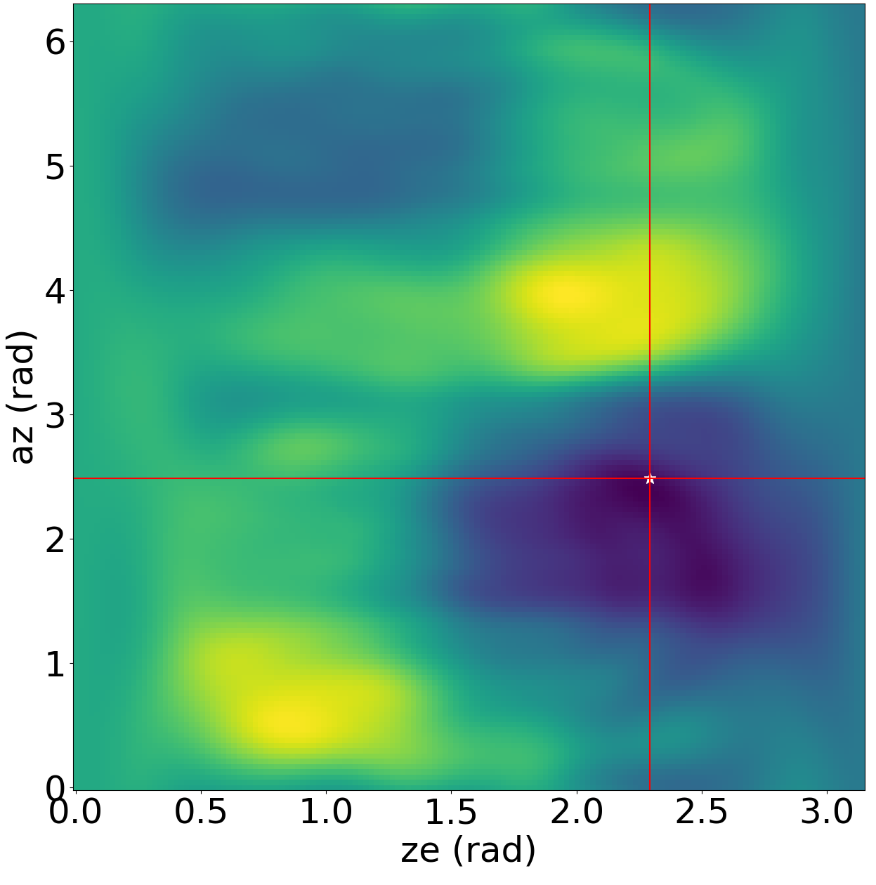
LiquidO: Fixed Source Multi-Event Reconstruction
Work in progress
Work in progress
Work in progress
…
HITMAN applied used to locate the direction of a fixed external gamma source with a LiquidO style detector
Multiple likelihoods from single gamma detections are multiplied together to constrain direction of a source
Application in addition to neutrino physics:
  PET scanners, Radiation Security & Nonproliferation, etc.

Slide 26
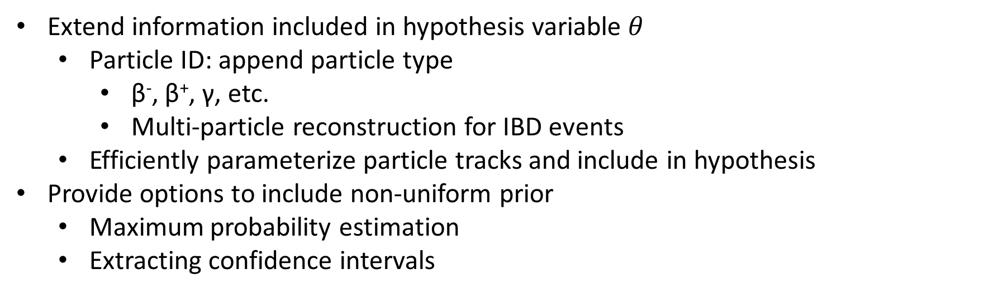
Future Work
Extend information included in hypothesis variable $θ$
  Particle ID: append particle type
    β⁻, β⁺, γ, etc.
    Multi-particle reconstruction for IBD events
  Efficiently parameterize particle tracks and include in hypothesis
Provide options to include non-uniform prior
  Maximum probability estimation
  Extracting confidence intervals

Slide 27
Conclusions
Combining NREs and EML provides a flexible event reconstruction for optical neutrino detectors
  Scalable to arbitrary numbers of photosensors with no architecture changes
  All additional detector details are implicitly encoded in dataset maps
Access to full likelihood space provides additional statistical information typically unavailable to other ML techniques
This work was funded in-part by the Consortium for Monitoring, Technology, and Verification under Department of Energy National Nuclear Security Administration award number DE-NA0003920

Slide 28
Backup Slides
…

Slide 29



Network Structure
$$x_{i}$$
$$θ_{j}$$
100k tunable parameters
  1 transformation layer to normalize inputs
  3 dense layers of width 256
  1 scalar output
Activations
  Mish activation between dense layers
    provides smooth gradients of likelihood space
  Sigmoid for output during training
    Changed to linear after training to ‘automatically’ produce log(likelihood)
Transformation Layer
Dense Layer
Dense Layer
Dense Layer
$$Output$$

Slide 30
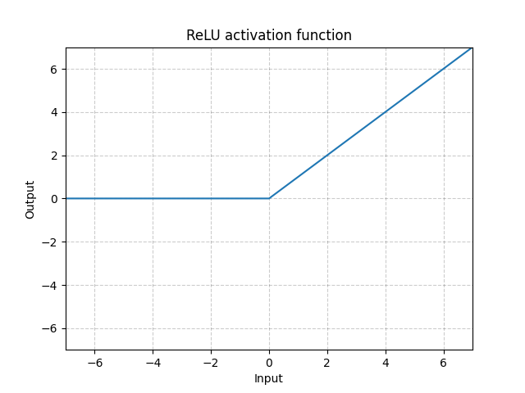
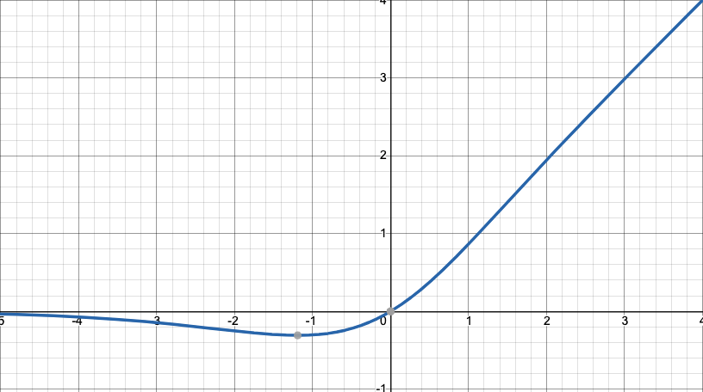
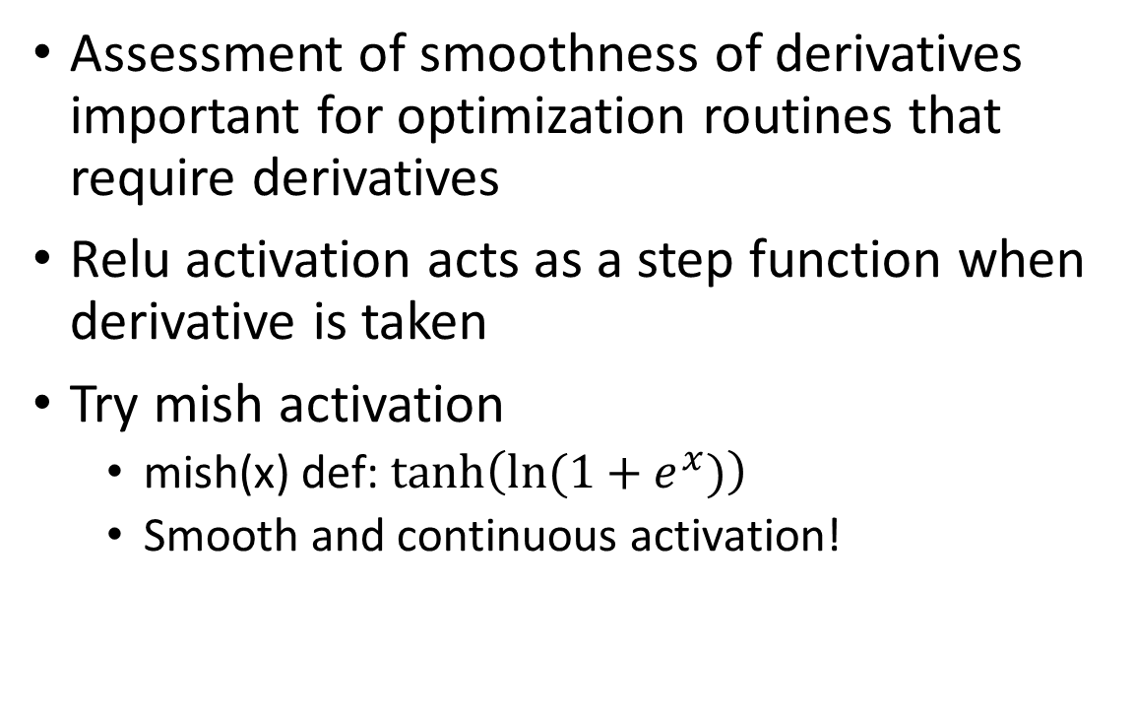
Smoothness of the network
ReLU(x)
Assessment of smoothness of derivatives important for optimization routines that require derivatives
Relu activation acts as a step function when derivative is taken
Try mish activation
  mish(x) def: $tanh\left(ln(1+e^{x})\right)$
  Smooth and continuous activation!
Mish(x)

Slide 31
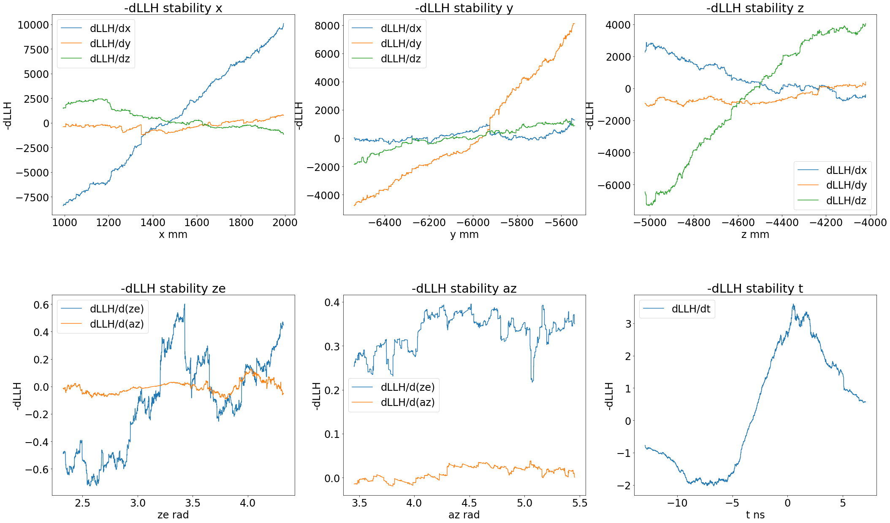
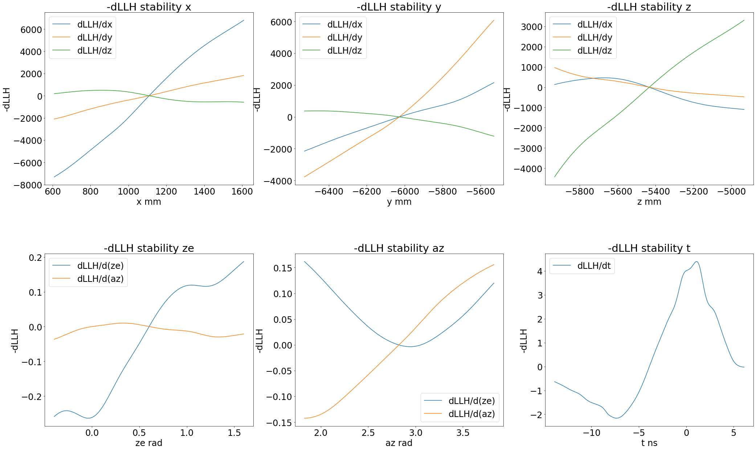
Recap: Smoothness of the network: ReLU vs Mish
ReLU gradient visibly noisy on large scales
ReLU Activation
Mish Activation

Slide 32
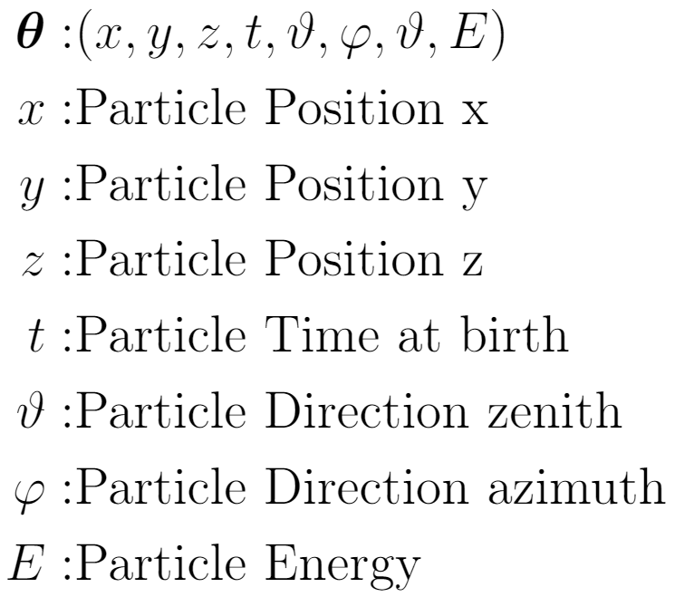
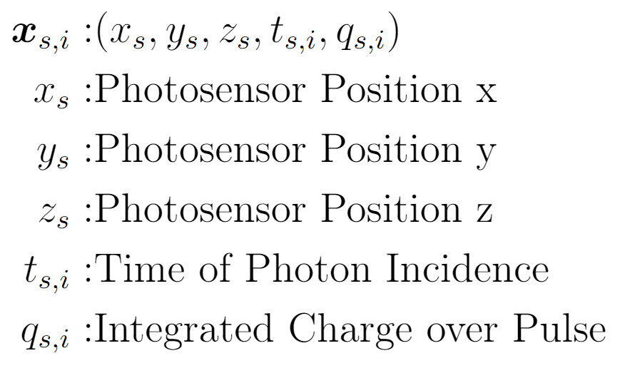
The Extended Maximum Likelihood
Include information about total charge collected and each photon’s arrival time
Likelihood
Multi-photon Info
(Chargenet)
Information per photon (Hitnet)

Slide 33
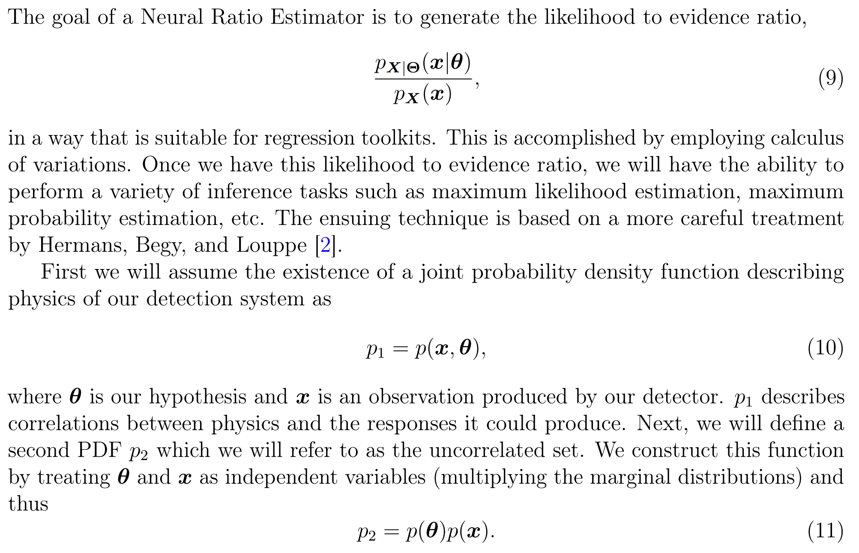
Neural Ratio Estimator Additional Theory
See Likelihood-free MCMC with Amortized Approximate Ratio Estimators (arxiv.org) for more information

Slide 34
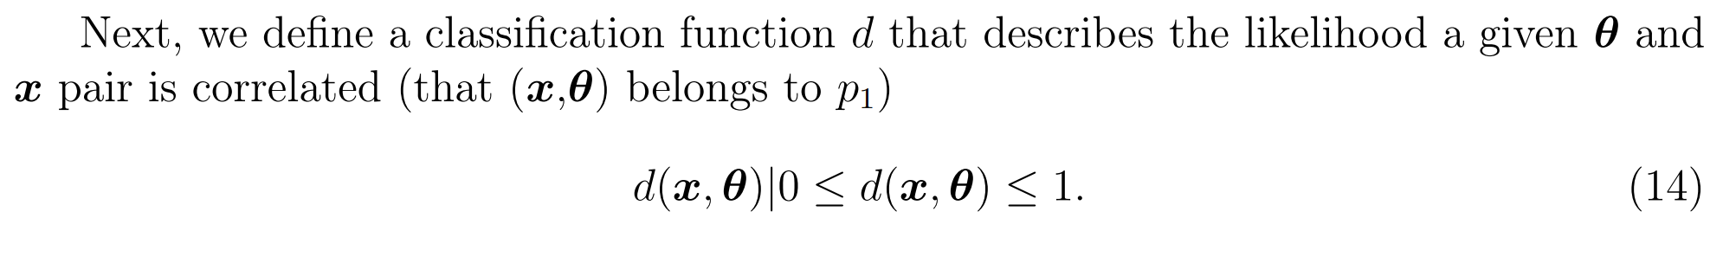
Neural Ratio Estimator Additional Theory
See Likelihood-free MCMC with Amortized Approximate Ratio Estimators (arxiv.org) for more information

Slide 35
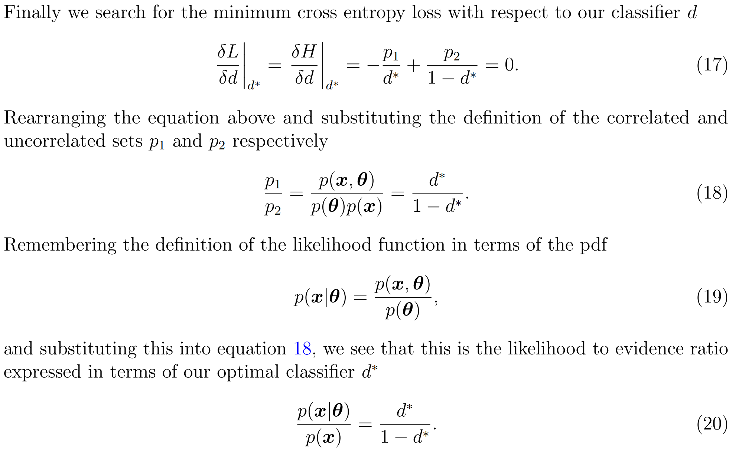
Neural Ratio Estimator Additional Theory
See Likelihood-free MCMC with Amortized Approximate Ratio Estimators (arxiv.org) for more information

