Slide 1
Solid Dreams: Advancing 0νββ and Dark Matter Detection with Crystalline Xenon TPCs
Qing (Shilo) Xia
On behalf of
Hao Chen, Ryan Gibbons, Scott Haselschwardt, Peter Sorensen
Lawrence Berkeley National Lab (LBNL)
Scott Kravitz
The University of Texas at Austin

Slide 2
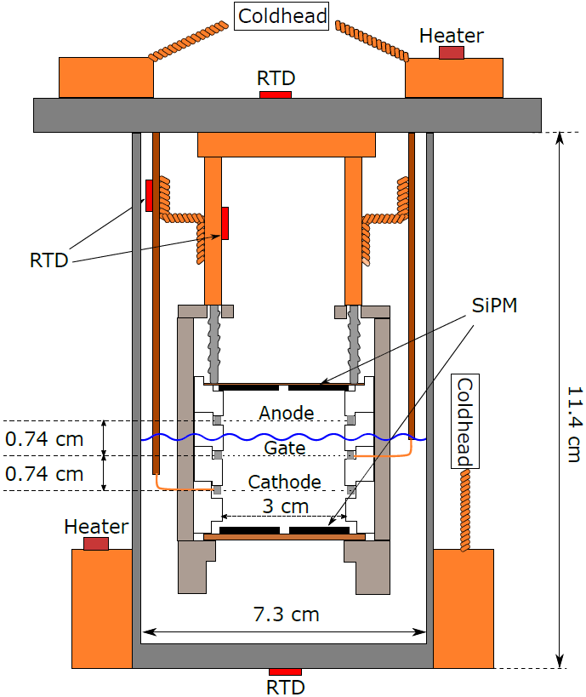
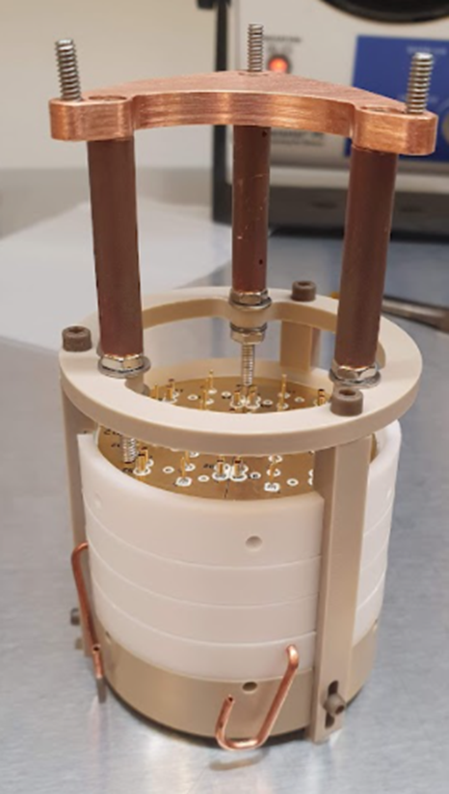
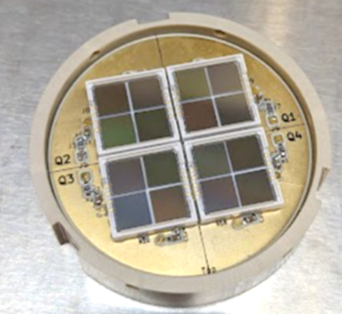
The CrystaLiZe Experiment at LBNL
Dual-phase mini-TPC
Liquid/Vapor or
Crystal/Vapor
Independent temperature control at two locations
~20-25g active xenon when full
32 SiPM readout (16 top, 16 bottom Hamamatsu S13371)

Slide 3
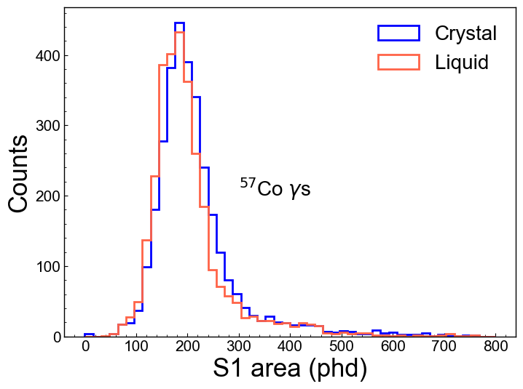
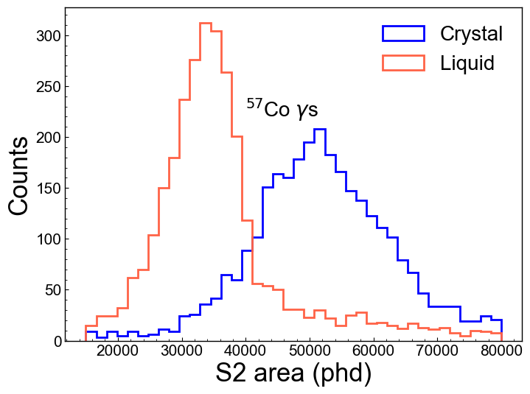
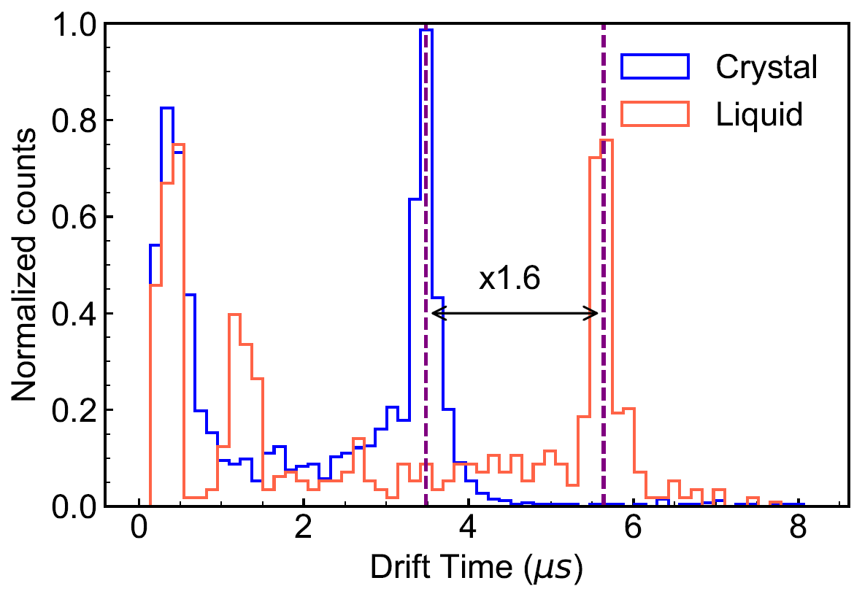
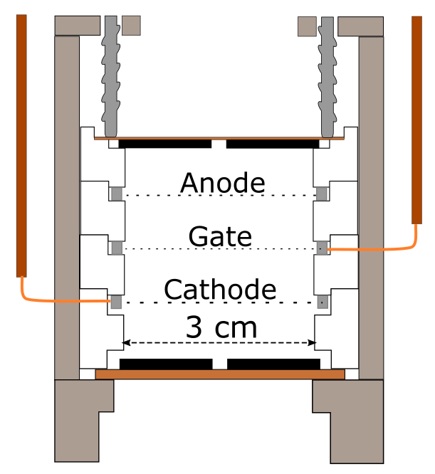
Performance Comparison of Crystal and Liquid Xe TPC
Similar yields from crystal and liquid Xe
~1.6x faster electron drift in crystal than liquid Xe
Potentially reduced charge signal diffusion enhanced SS/MS discrimination improved energy resolution
²¹⁰Po
2022 JINST 17 P04014
Notes:
The larger S2 size in crystal is likely due to different gas gap size, field, etc., which is under investigation

Slide 4
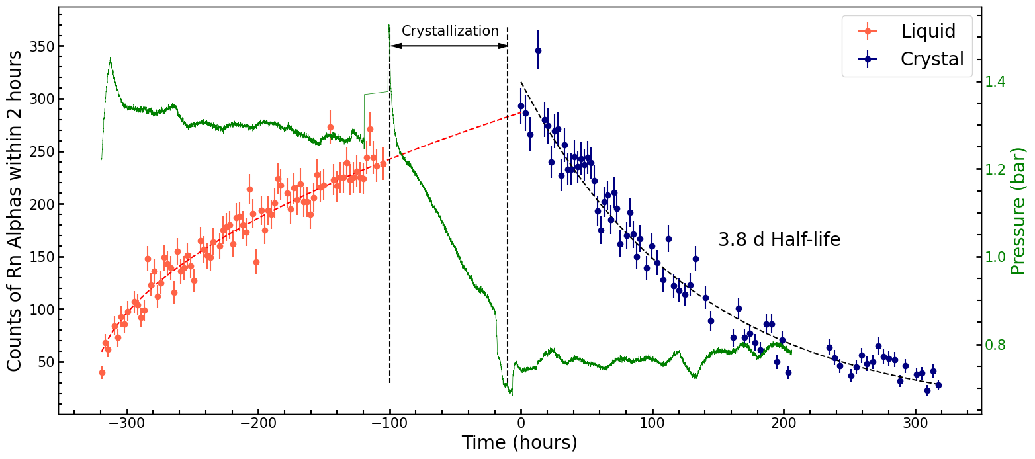
Powerful Radon Exclusion Capability of Crystal Xe
²²²Rn is a leading background in liquid Xe dark matter detectors and tonne-scale 0νββ experiments
Alpha rate with continuous ²²²Rn source flow:
The reduction of untagged radon daughters in crystal Xe allows a larger fiducial volume for 0νββ detection
Notes:
We continuously circulate gas xenon with a steady flow rate of 0.3 slpm.
In liquid/vapor mode, the Rn rate increase overtime, indicating Radon is added to the liquid bulk.
In crystal/vapor mode, the Rn rate drops with a half-life of ²²²Rn, indicating no or very few of Radon leaking into the crystal bulk.

Slide 5
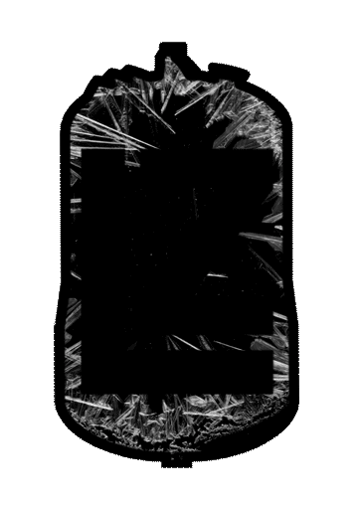
Opportunities of Crystalline Xenon TPCs
Proven ability for powerful radon reduction
Fast electron drift → potentially reduced diffusion → improved SS/MS discrimination and energy resolution
Realistic/scalable cryogenics for future experiments
Notes:
a leading background source in liquid xenon dark matter experiments (Pb214 betas) and tonne-scale 0vbb detectors (Bi214 gammas)

Slide 6
Backup slides

Slide 7
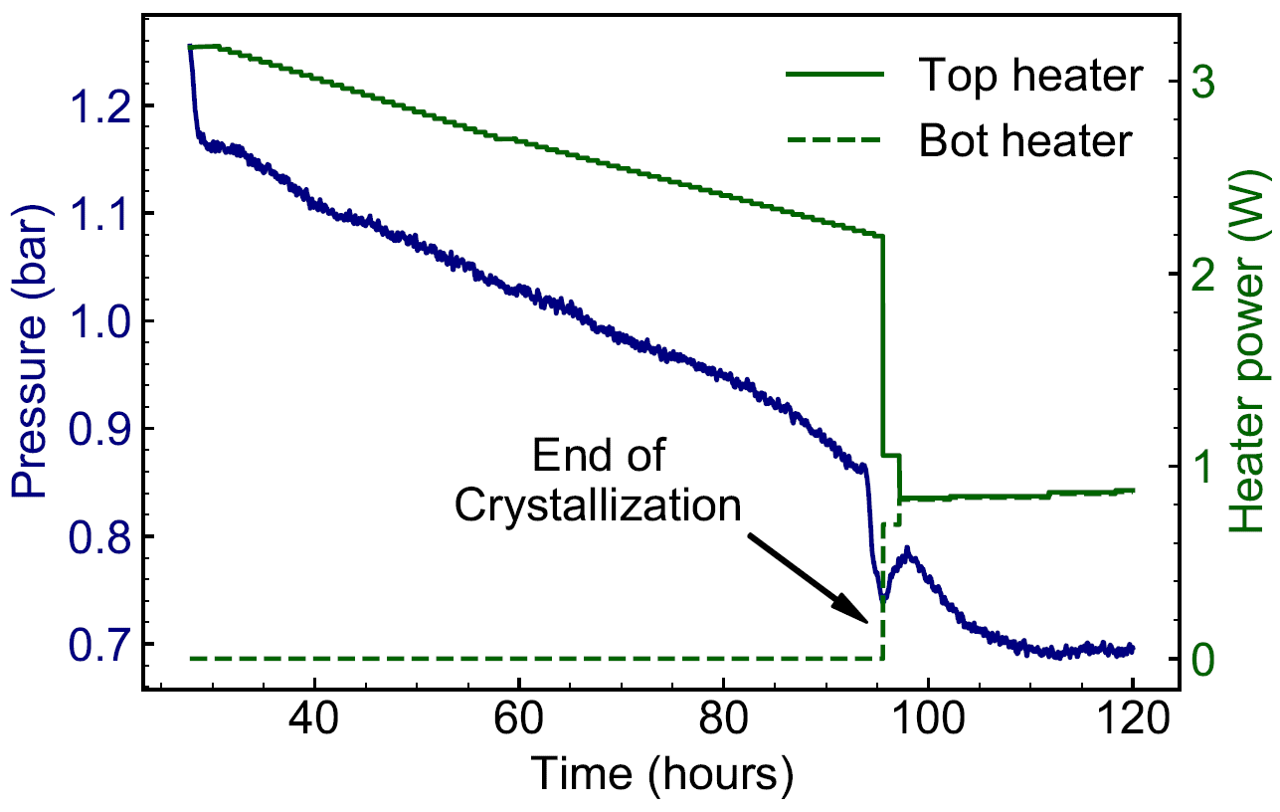
Faster Electron Drift in Crystal than Liquid Xe
Clear indications of freezing
Vapor pressure below triple point
Drift time reduced by ~1.6x
Faster drift speed in the crystal can potentially reduce charge signal diffusion potentially enhance SS/MS discrimination improve energy resolution
T = -117 C, p = 0.74 Bar
T = -111 C, p = 1.20 Bar
Note: triple point T = -111.8 C, p = 0.82 Bar
²¹⁰Po
2022 JINST 17 P04014
Notes:
Stable, repeatable crystallization procedure. Crystal grows from bottom to top (Bridgeman’s technique)
Realistic / scalable cryogenics for ton-scale experiment.
Clear indications of freezing:
Vapor pressure below triple point
Drift time reduced (~1.6x)

