Slide 1
Camera Readout in gaseous xenon tpcs
Leslie Rogers
Argonne national Laboratory
Corey Adams, Jonathon Asaadi, Jackie Baeza-Rubio, Kevin Bailey, Nick Byrnes, Eric Church, Diego Gonzalez-Diaz, Alex Higley, Ben Jones, Krishan Mistry, Ivana Moya, David Nygren, Philip Oyedele, Ilker Parmaksiz, Kara Stogsdill

Slide 2
Camera Readout And Barium tagging

Slide 3
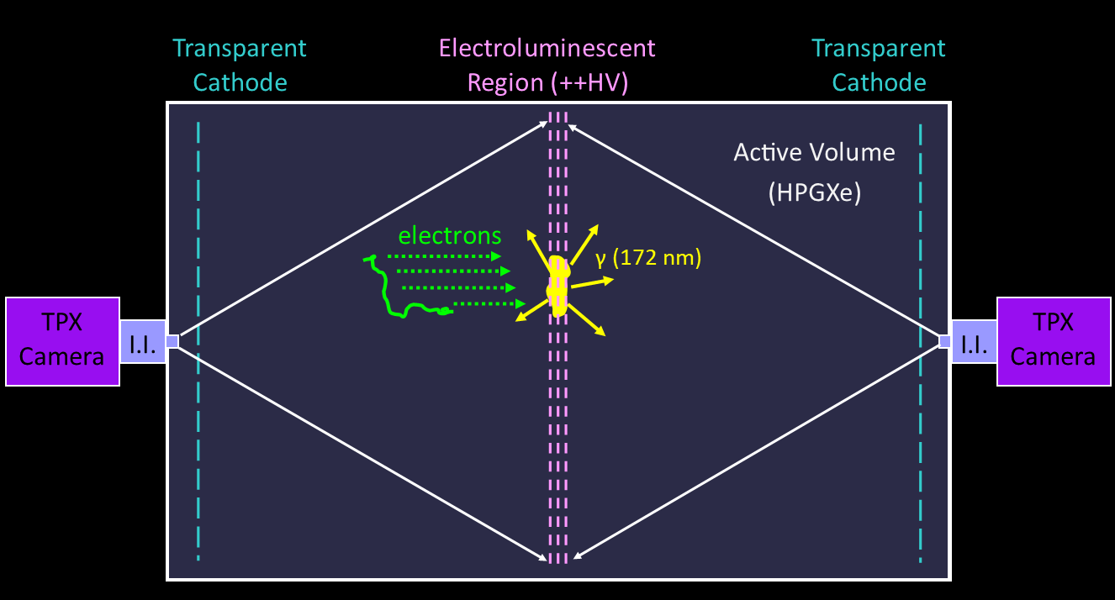
Motivation for using a Camera Readout in Place of a dense SiPM tracking plane for tonne scale
Entire readout system can be outside the vessel, improving radiopurity and heat
Simplifies electronics significantly
Cheaper, 130k per camera system vs >1 million in SiPMs
Each camera gives us 65k pixels
Can focus from a distance rather than up close
3

Slide 4
Motivation for using a Camera Readout in Place of a dense SiPM tracking plane for tonne scale
Entire readout system can be outside the vessel, improving radiopurity and heat
Simplifies electronics significantly
Cheaper, 130k per camera system vs >1 million in SiPMs
Each camera gives us 65k pixels
Can focus from a distance rather than up close
4

Slide 5
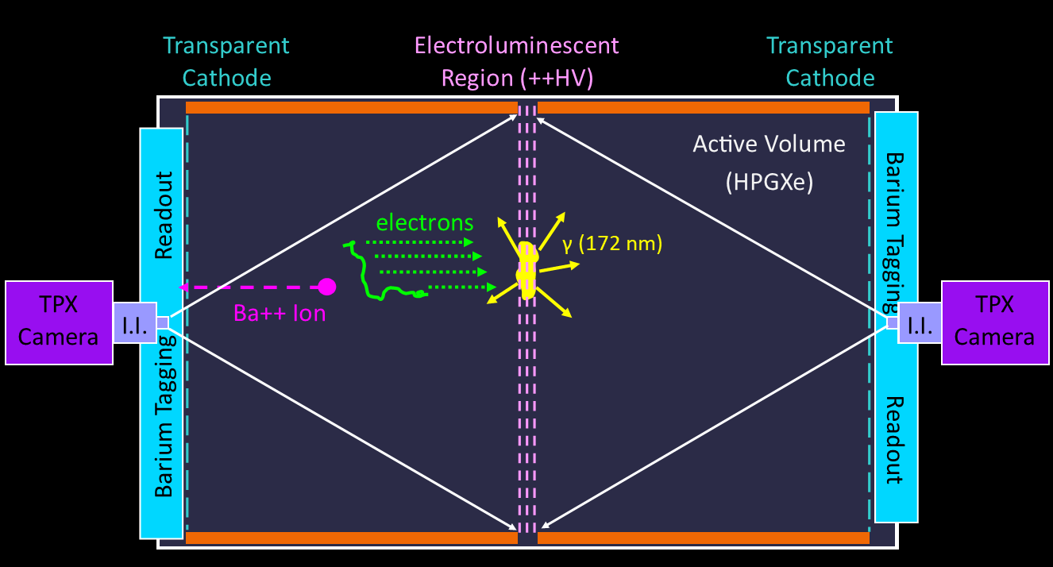
Opens up the Possibility of Barium Tagging
To get barium to the chemosensors we need the Cathode to be at ground
(For barium tagging itself refer to yesterday’s session)
5

Slide 6
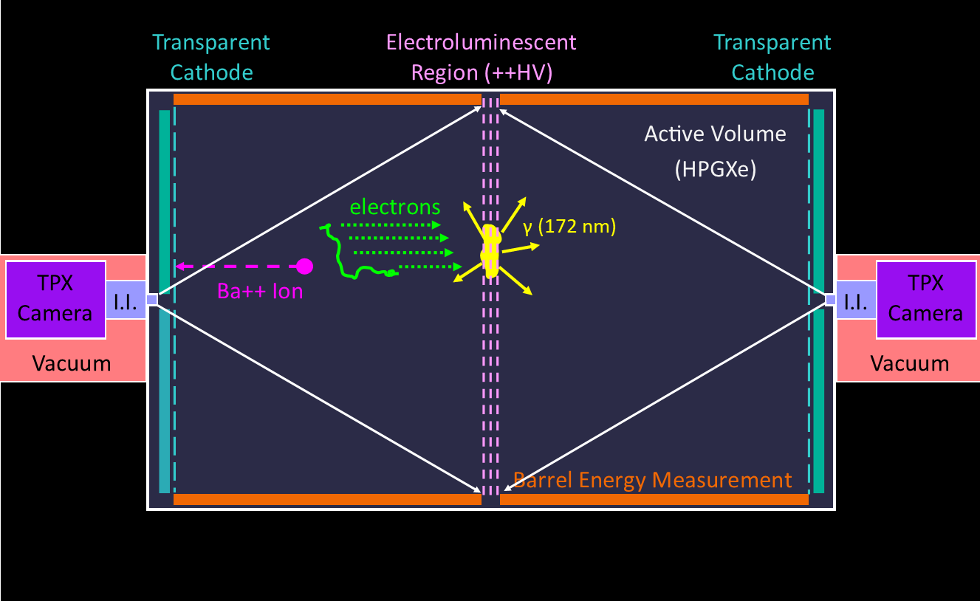
Camera readout system
The system includes a camera, an image intensifier, and optics to focus onto the region of interest
Attaching an image intensifier enables single VUV photon sensitivity, amplifying the light as well as converting into the visible region
6

Slide 7
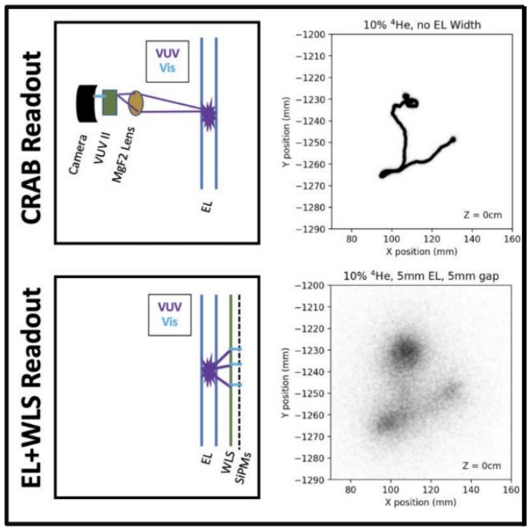
Replacing SiPMs + wavelength shifter with direct VUV camera tracking

Slide 8
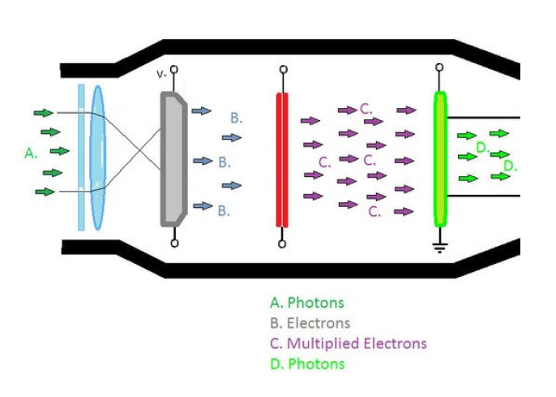
Image Intensifier
Photocathode
MCP
MCP
Phosphor plane
8

Slide 9
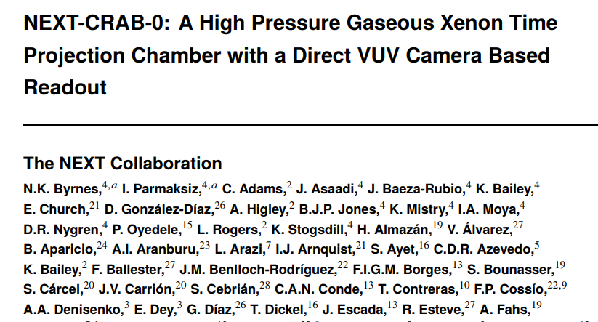
CRAB-0 Paper
https://arxiv.org/abs/2304.06091

Slide 10
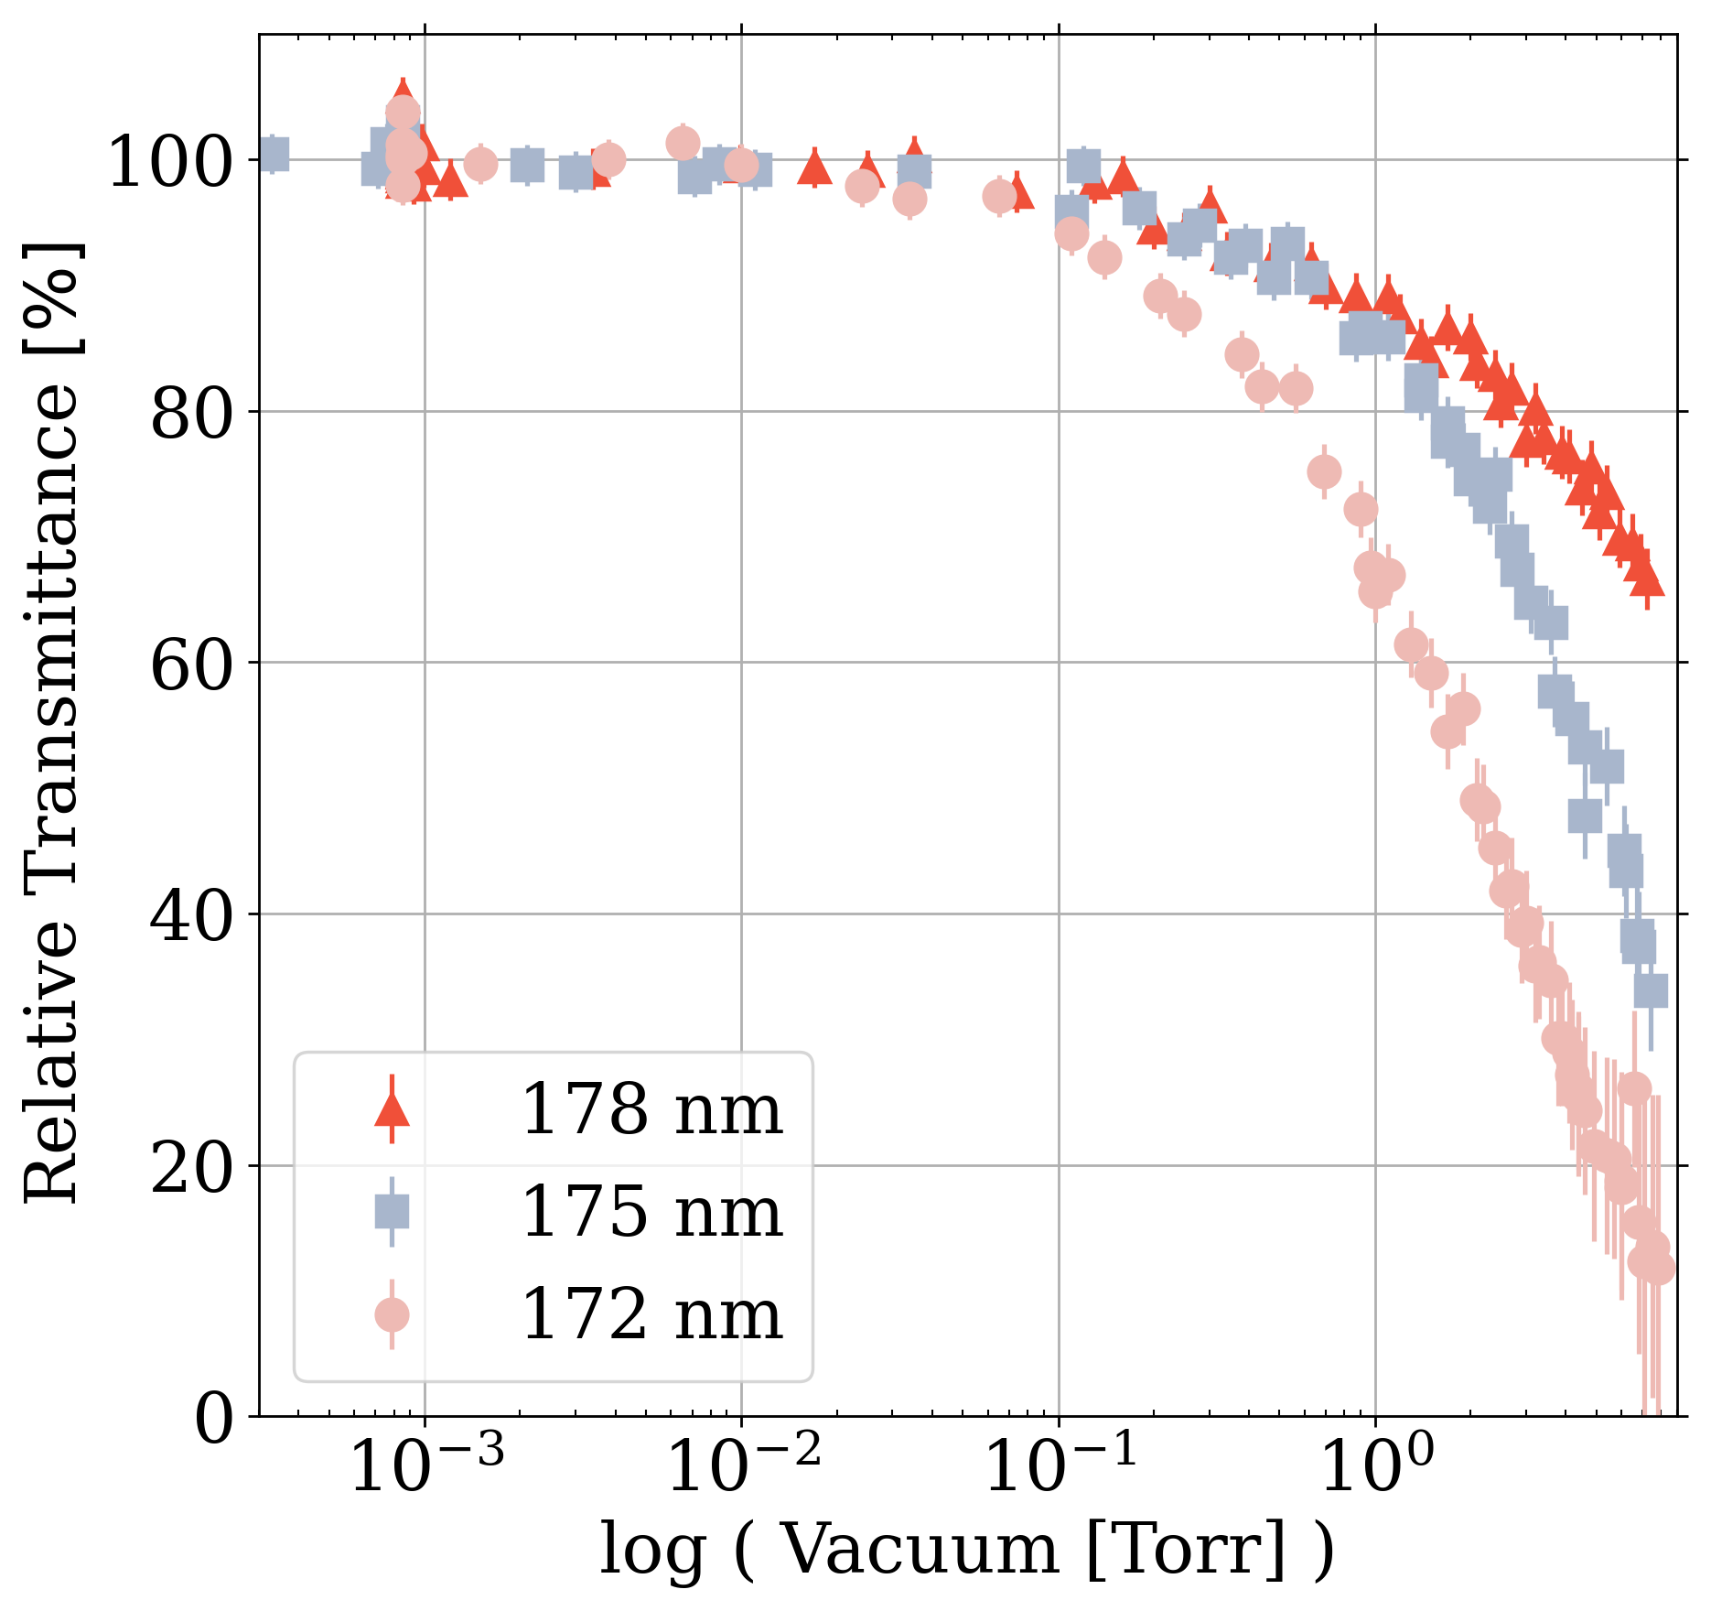
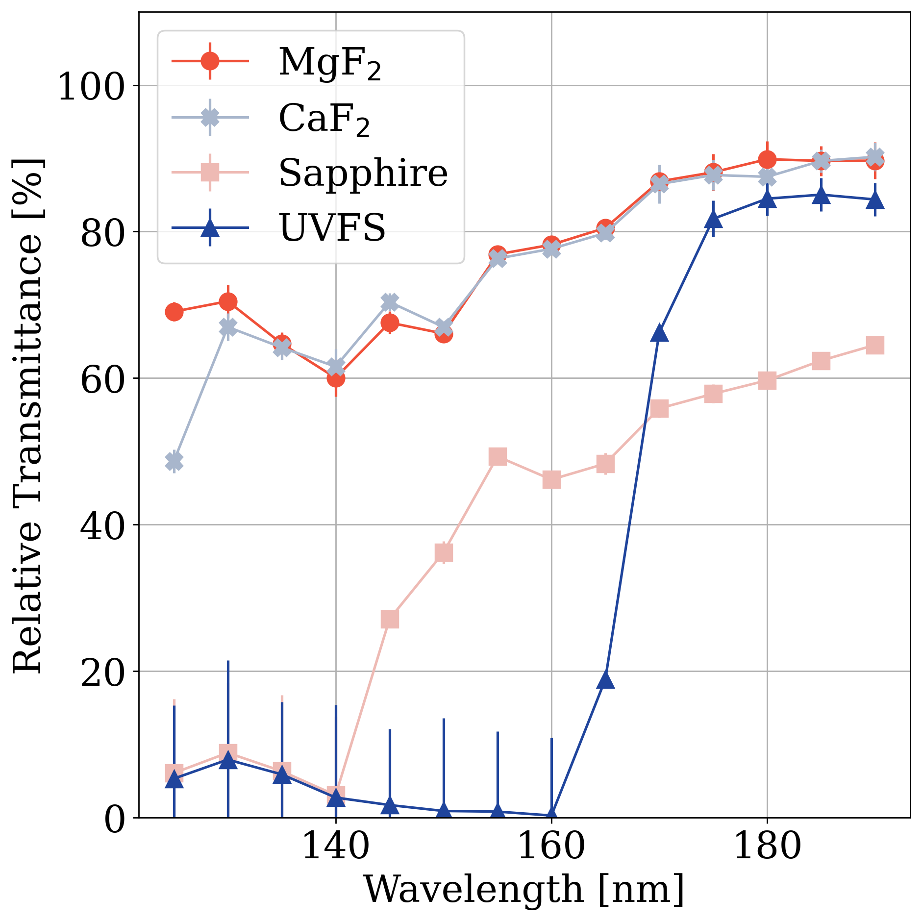
Transmissivities
We used a VUV monochromator to select appropriate lens material and establish necessary vacuum quality
Until the light exits the image intensifier everything must be a vacuum <.1 Torr or clean gas to avoid attenuation
All lenses and windows in the optics path should be made from MgF2 or CaF2
Once barium tagging is implemented we suspect the window should be MgF2 as Calcium is similar to Barium and may affect the chemosensors
This may affect how large lenses can be though we sourced a manufacturer capable of custom MgF2 lenses up to 6” diameter
10

Slide 11
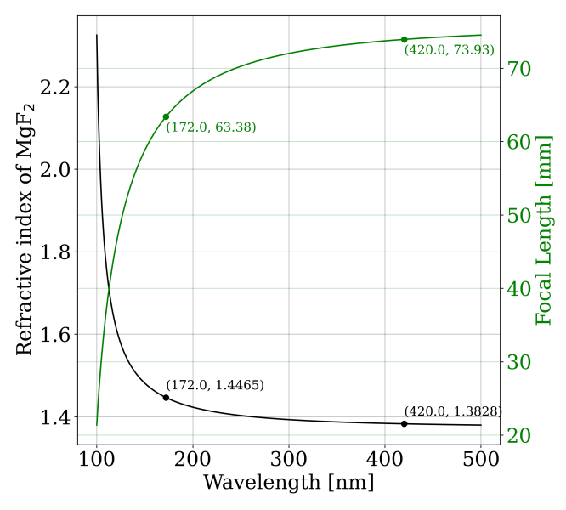
Focal Lengths
The refractive index changes with wavelength which in turn changes the focal length
Optics have to be focused using VUV light sources
11

Slide 12
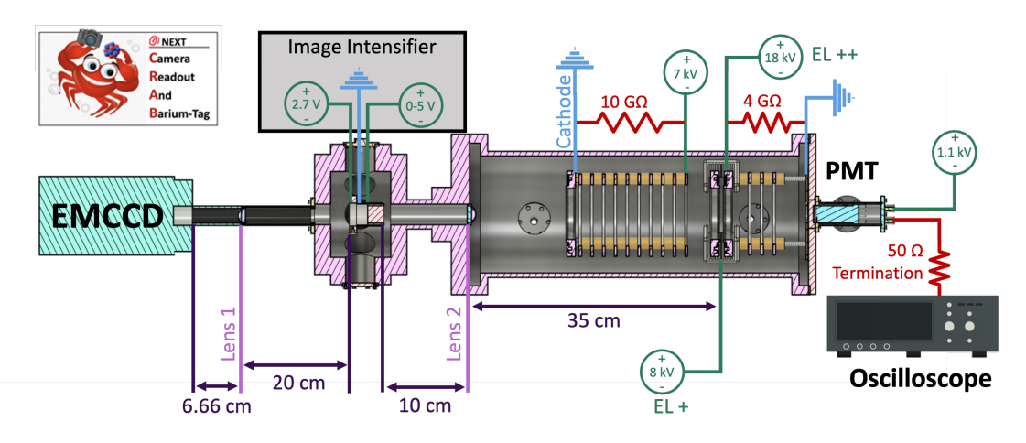
NEXT Optical TPC at UTA
Asymmetrical TPC but with Cathode still at ground
MgF2 lens used to focus the EL light onto a Photonis single MCP Image Intensifier which is then read out onto Hamamatsu imagEMX2 camera
PMT used on opposite side for energy reading
12

Slide 13
Running Configurations

Slide 14
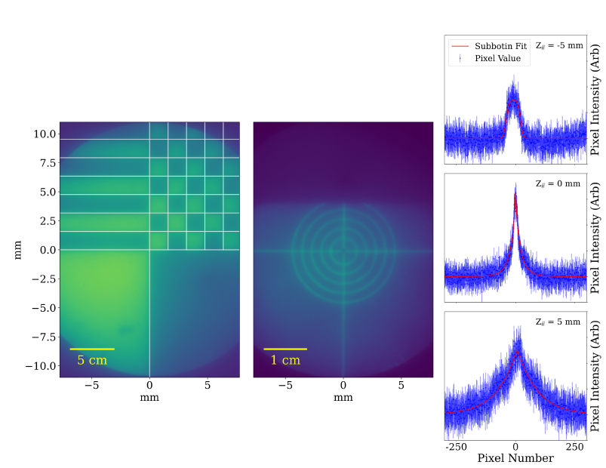
Imaging Characterization
For this test a higher resolution FLIR Firefly 1.6 Mpixel CMOS camera was used
Targets were illuminated with a low intensity 420 nm blue LED
14

Slide 15
Larger Scale
Left plot shows a larger scale target with clear distinctions between the white and black regions, indication there are not spherical distortions at larger scales that would be resolvable with the lower resolution hammamatsu camera
15

Slide 16
Quantifying Image Resolution
A target with .25mm thick lines was imaged
Each image was analyzed by measuring the intensities of 7 pixels along the horizontal and then averaged to assess the image point spread function.
16

Slide 17
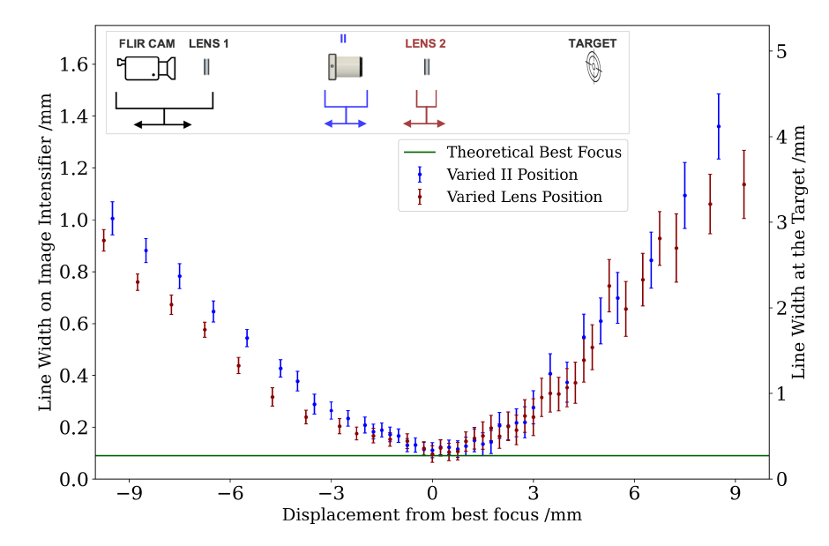
Quantifying Image Resolution
A Positioning precision of around 1 mm is good enough for optimal image focusing
17

Slide 18
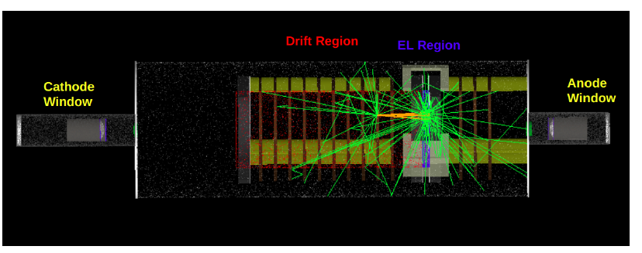
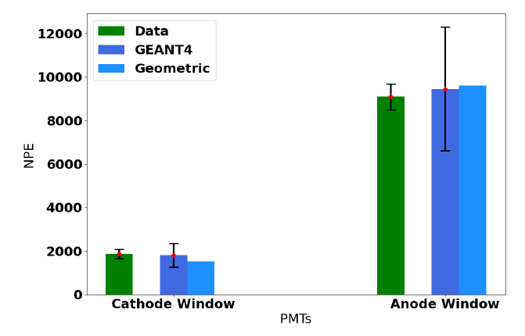
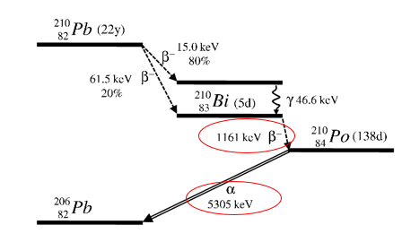
Light Yield Characterization
To characterize the light yield of the detector a 210Pb needle was inserted 5cm from the EL region with a PMT on either side of the detector
GEANT4 Geometry
18

Slide 19
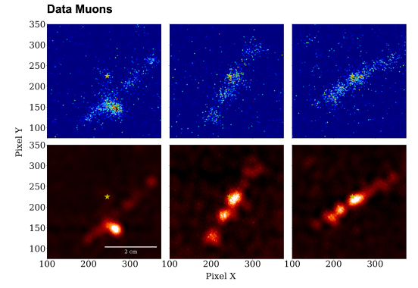
Full Configuration
Having the optics system on one end and the PMT on the other we could then obtain relatively clear data (top) which could then have a filter applied for cleaner tracks (bottom)
19

Slide 20
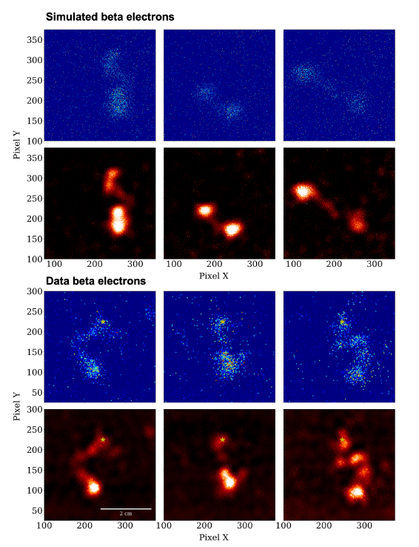
20

Slide 21
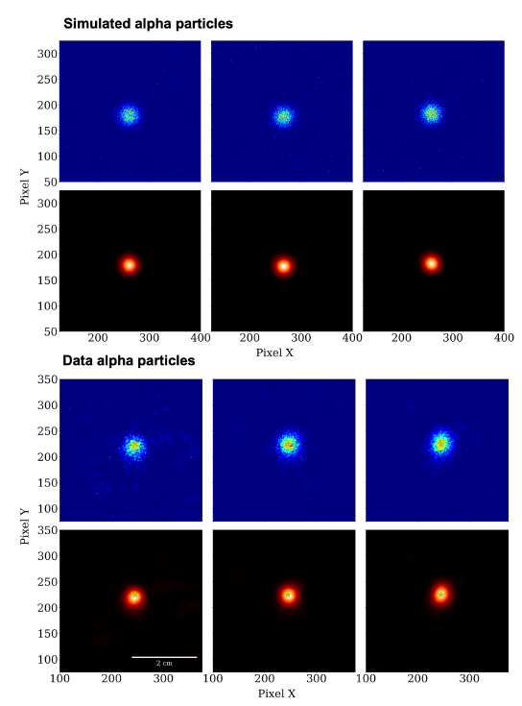
21

Slide 22
Conclusions of NEXT-CRAB-0 Paper
NEXT-CRAB-0 imaged directly in the VUV, achieving high-resolution camera readout images of particle tracks.
The detector performance has been tested and verified against simulations, showing good agreement in light-yield comparisons.

Slide 23
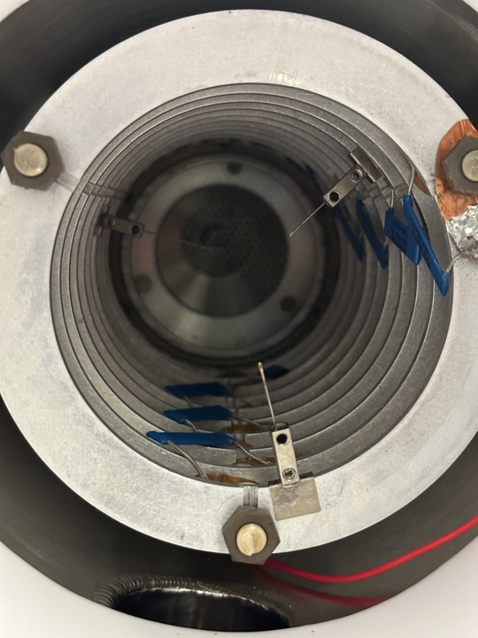
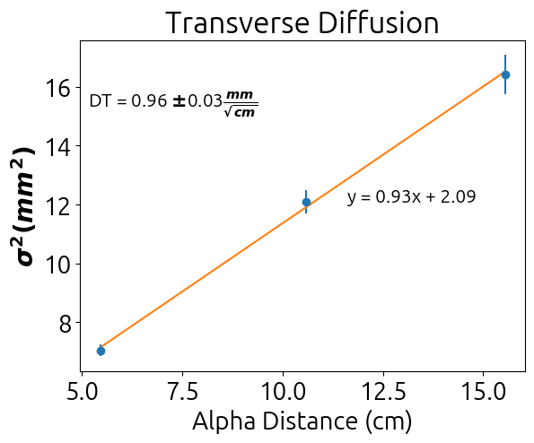
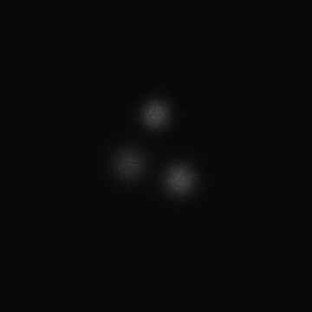
Measuring Transverse Diffusion with CRAB-0
3 Pb-210 sources placed in the field cage at 5, 10, and 15 cm from the EL
Collect pictures at various EL-Fields and Drift Fields
Mean spread of averaged images for each location then determines how much transverse diffusion occurs
Field of 440 V/cm, EL Field at 10k/cm
23

Slide 24
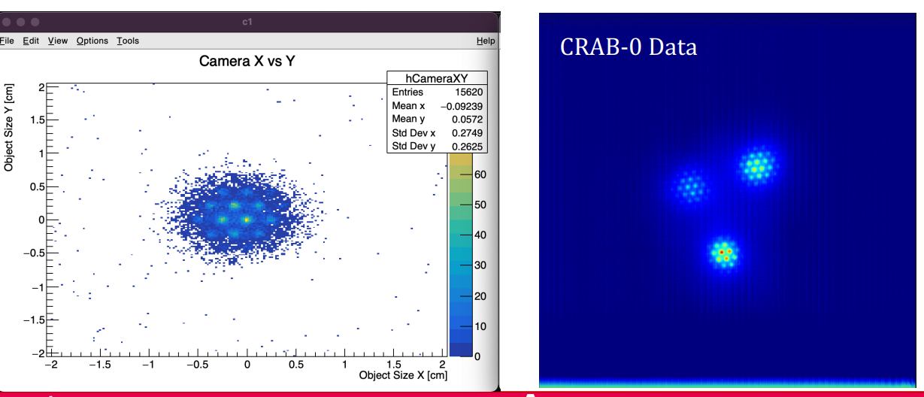
Fun Extra

Slide 25
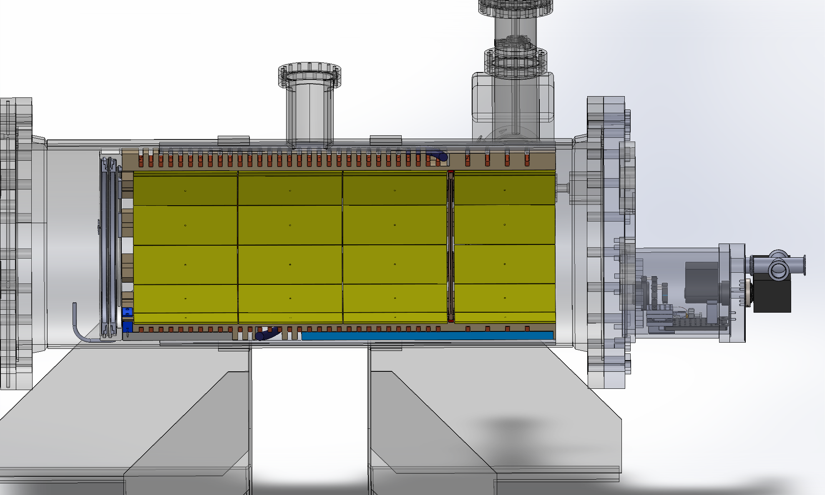
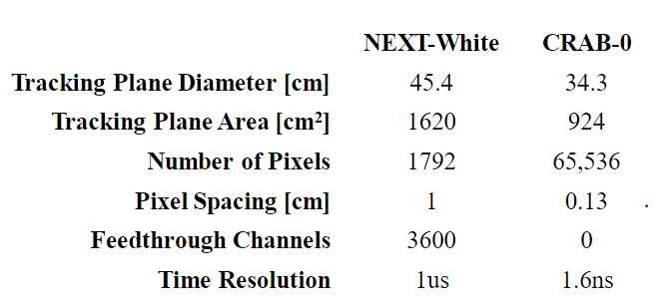
NEXT Optical TPC at Argonne
We turned the NEXT-100 prototype into an optical TPC capable of 3D imaging
Gate+Anode
Cathode
Optical setup
Drift Region
Buffer Region
25

Slide 26
NEXT Optical TPC at Argonne
While this is asymmetrical and does not have cathode at ground, the camera cannot tell the difference and is still modeling looking at the EL from a distance
Optical setup
26

Slide 27
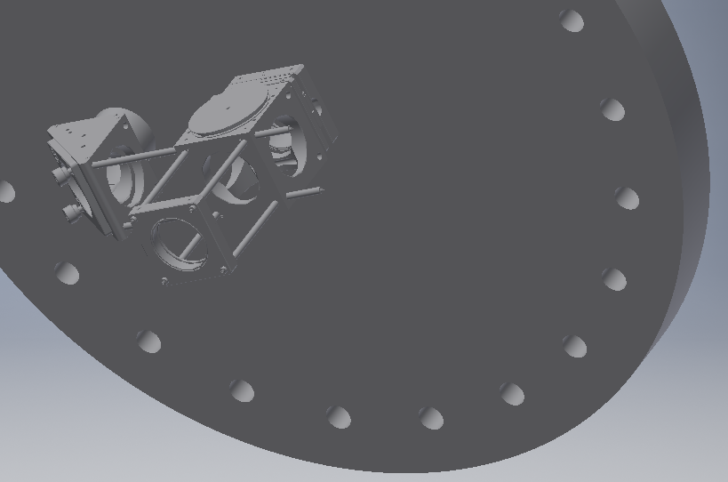
Focusing the Image Intensifier and Camera
The end cap has the windows at different radii that are not centered
Rather than just focusing a single convex lens directly on the EL plane we use a system of mirrors and lenses
I.I.
Camera

Slide 28
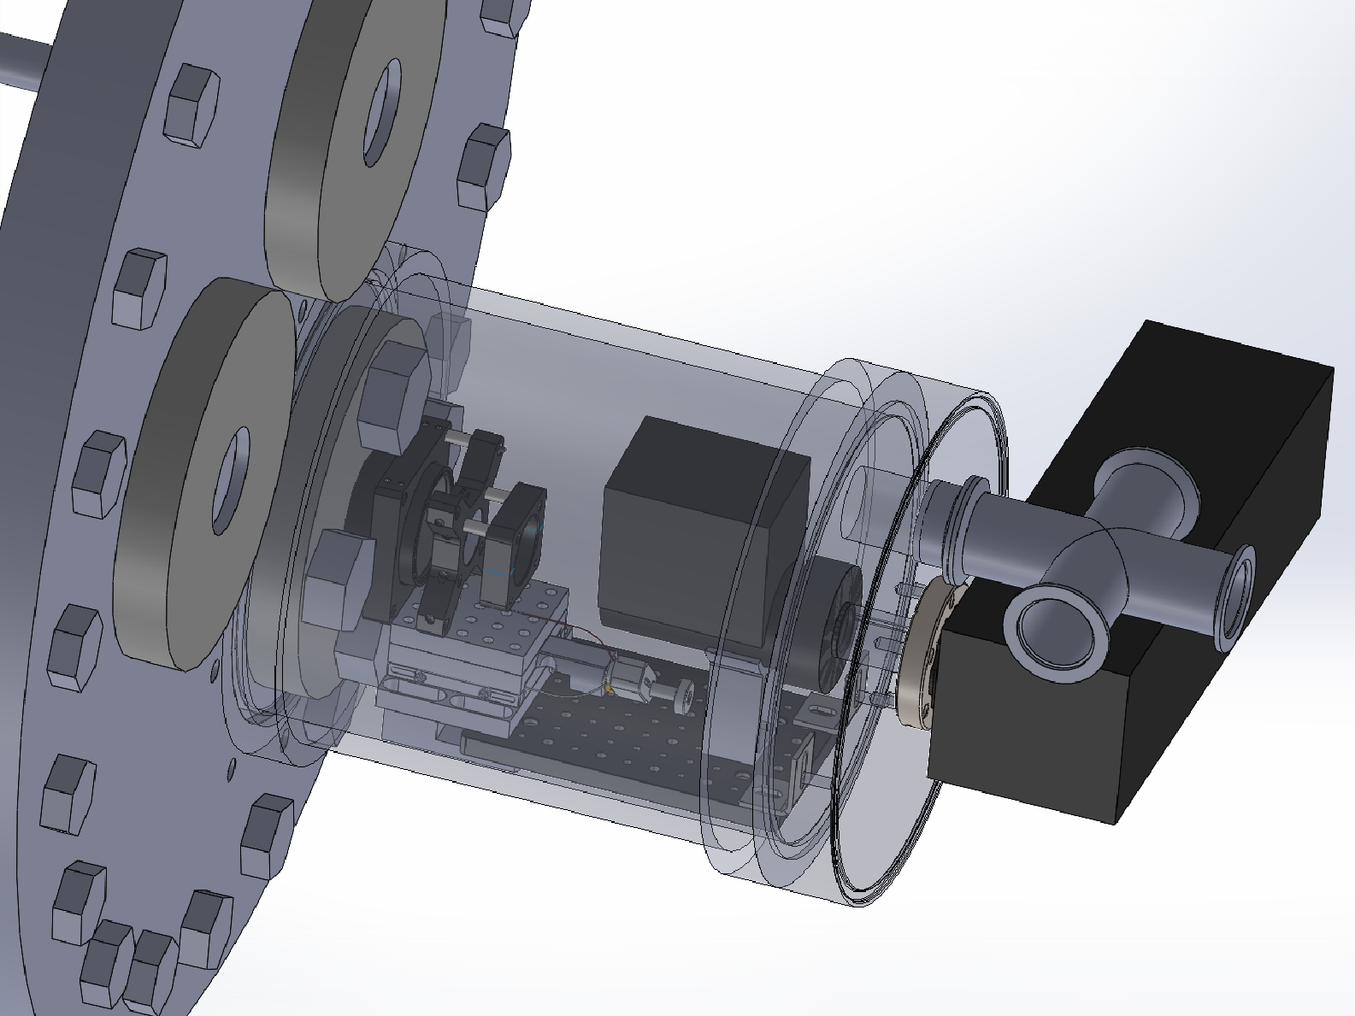
Attaching the TimePix Camera
Vacuum
Once the light leaves the image intensifier it is in the visible range
The camera has a cooling fan and therefore must be outside the vacuum chamber
We use a lens between the image intensifier and camera to focus the virtual image onto the camera readout due to the compact space we are working in
air
Window
Lens
28

Slide 29
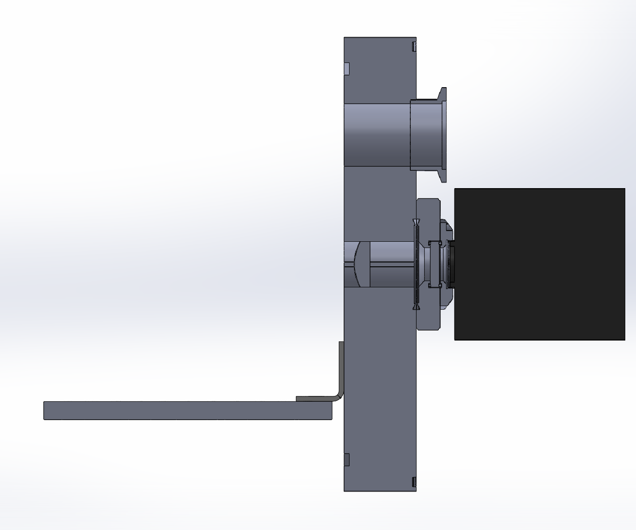
Attaching the TimePix Camera
air
By putting a reticle where the image intensifier’s virtual image will be we were able to adjust the lens position within the end cap
Lens
Recticle
Camera
Window
29

Slide 30
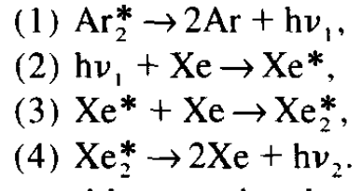
Focusing the optical system in VUV
We have a small amount of xenon in hand but not enough to fill the vessel at a suitable pressure
We run using a mixture of 3% Xe, 97% Ar which turns all excitations into 175nm
30

Slide 31
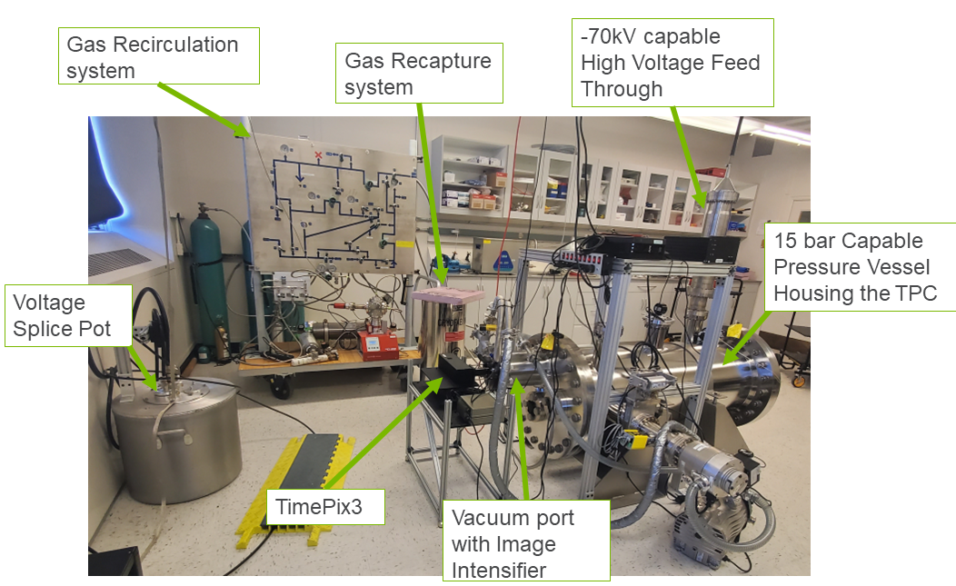
CRAB lab at Argonne

Slide 32
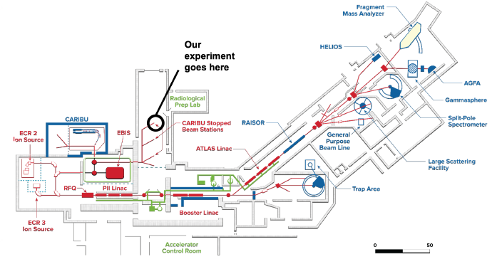
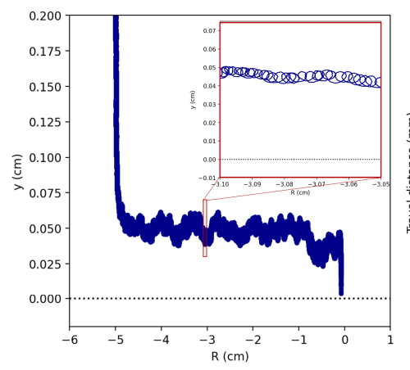
Measuring Efficiencies of Components
Use CARIBU to extract Ba¹⁴⁴ and get key insight into barium tagging R&D
32

Slide 33
Measuring Efficiencies of Components
First stages of testing can be done in low pressures up to 500 mbar
Only need this portion of ATLAS for a 200keV acceleration energy
Need to find a reliable way to get the barium from vacuum into gas
33

Slide 34
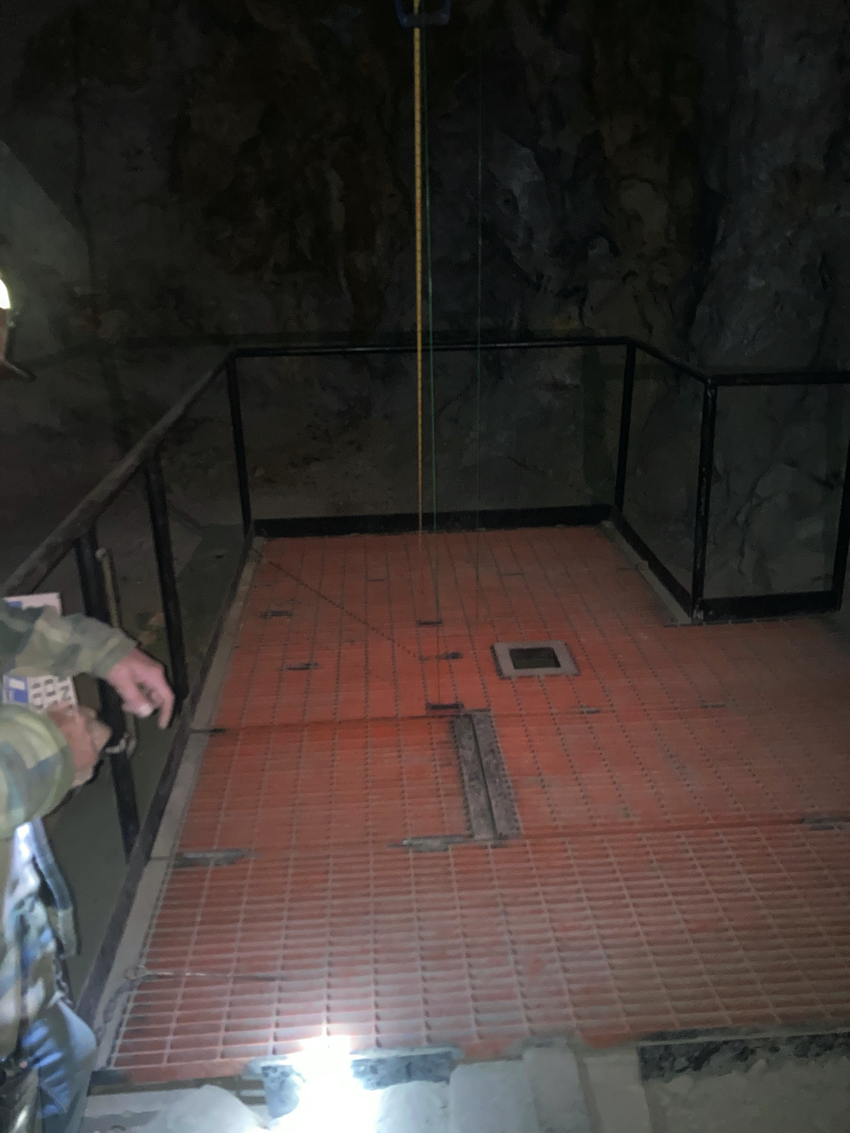
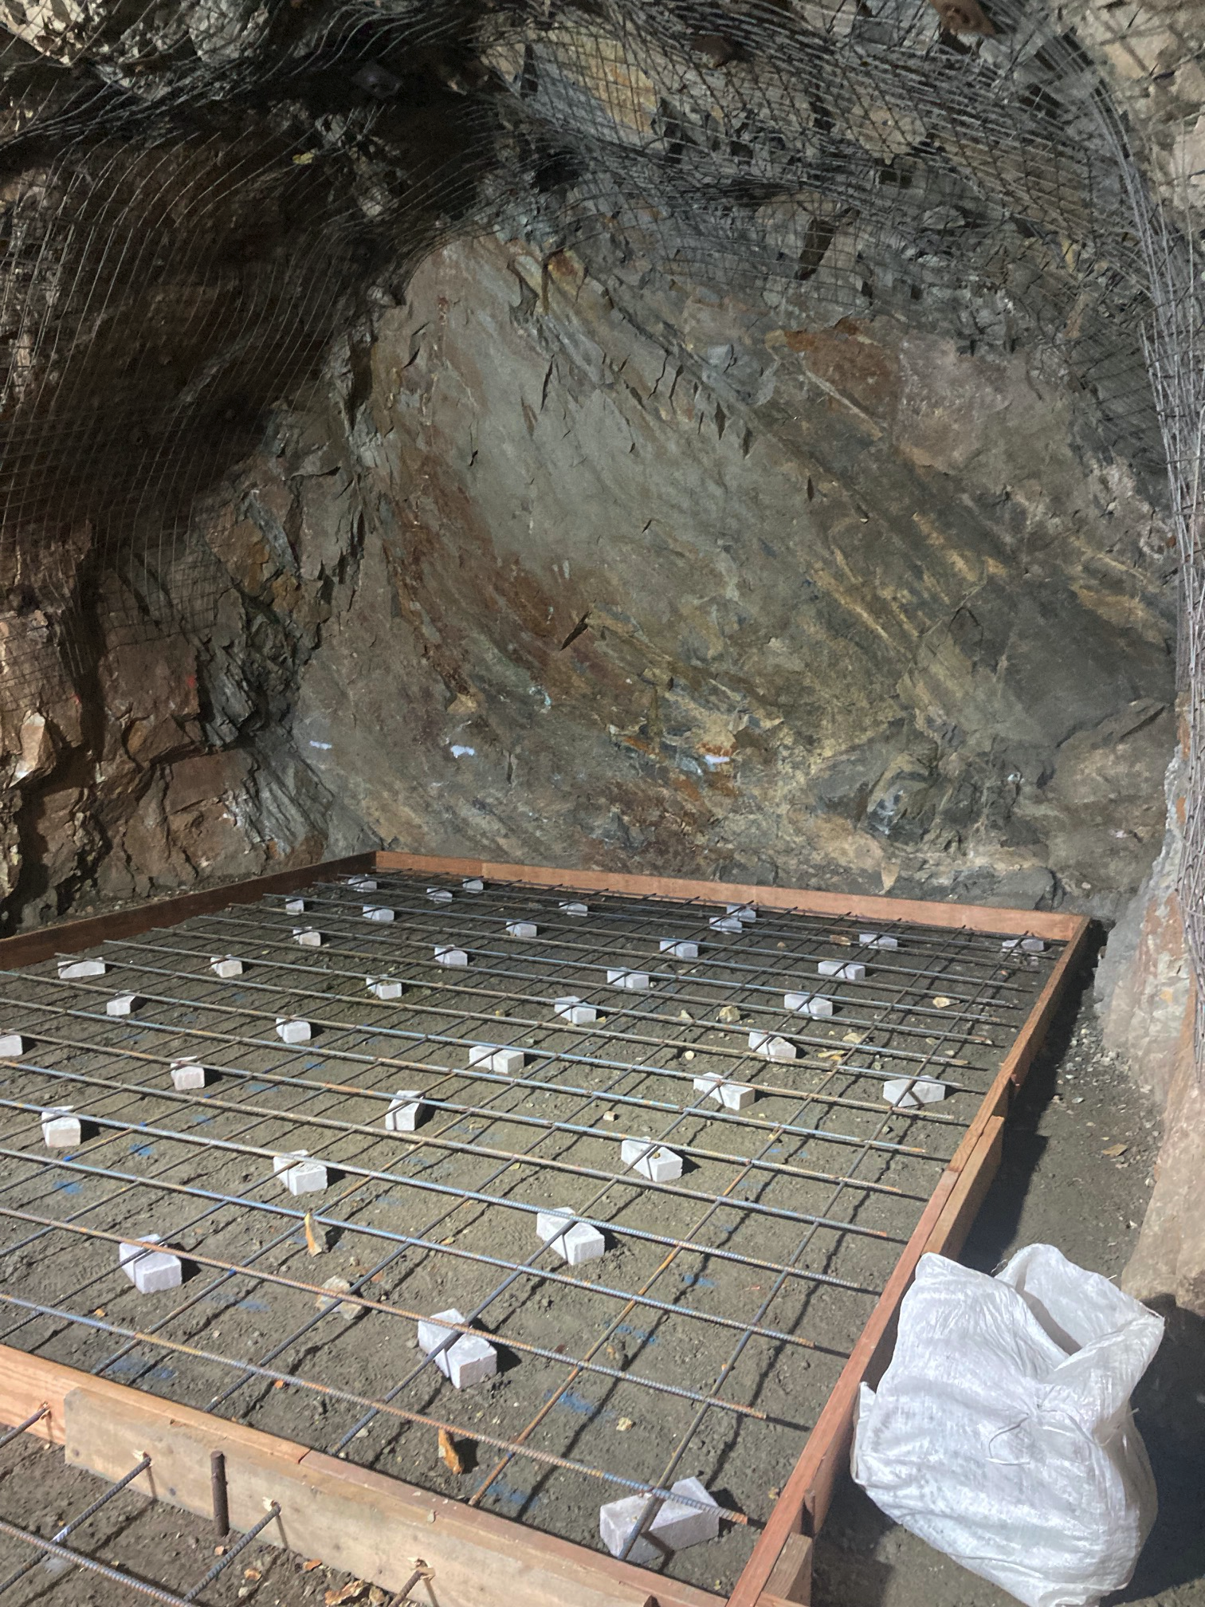
Lower Background Run?

Slide 35
Conclusions
A TimePix Camera plus Image Intensifier could provide a more radiopure option for tracking than SiPMs
Argonne will demonstrate 3d tracks with a fast optical camera
Argonne has the ability to provide a barium beam to test barium tagging components in situ
Colorado School of Mines has just joined the CRAB effort!
35

